Slide 1
How Lean Is Your Machine? Preliminary Findings from Recent State and EPA Business Process Improvement (BPI) Efforts
John Mitchell, Moderator
April 12, 2016

Slide 2
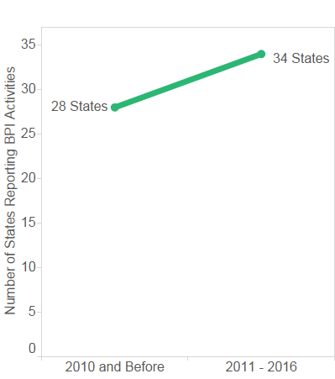
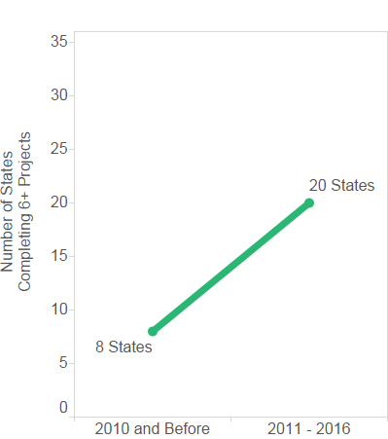
Impressive Gains in State BPI Activity
States Reporting BPI Activities
States Completing 6+ Projects
The number of states with 6+ projects has more than doubled between 2010 and 2016.
Since 2010, 21% more states have reported participating in Business Process Improvement (BPI) projects.
Notes:
Note:
– Data does not contain level of detail in order to report year to year trends.
– A state is counted in the reporting timeframe (e.g., 2011-2016) if it reported any BPI projects or events occurring in that timeframe. Not all data may be reported.
– Displaying increases of counts of projects is not recommended as projects are defined differently by different states.
Data sources: ECOS Final 2016 State Inventory.xlsx & StateLeanProjects_011916.xlsx
– Findings are based on ECO’s survey of state BPI activities in 2010 and in 2016.

Slide 3
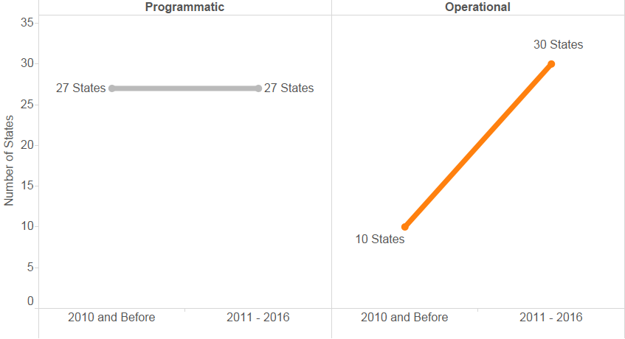
Continued Investments Across BPI Activities
Number of states with operational BPI activities has increased 200%.
Number of states with programmatic BPI activities has remained strong.
Notes:
Top programmatic activities by subcategory:
– Water (23 projects between 2011-2016)
– Air & Radiation (21 projects between 2011-2016)
Top operational activities by subcategory:
– IT (19 projects between 2011-2016)
– Planning (16 projects between 2011-2016)
Note:
– Data does not contain level of detail in order to report year to year trends.
– A state is counted in the reporting timeframe (e.g., 2011-2016) if it reported any BPI projects or events occurring in that timeframe. Not all data may be reported.
– Displaying increases of counts of projects is not recommended as projects are defined differently by different states.
Data sources: ECOS Final 2016 State Inventory.xlsx & StateLeanProjects_011916.xlsx

