Slide 1




Implementation of a Modernized, Online, Shared, Cloud Service for Improved Tribal Data Management, Access, and WQX Flow
Notes:
NAEPC's Online Implementation of AWQMS as a Modernized, Shared Service for Improved Tribal Data Management, Access, and WQX Flow
Successes and Challenges.
The presentation will discuss both project successes and various types of technical, political, and communication challenges encountered both in system implementation and setting up the peer trainer program. Attendees will learn about the benefits of using shared cloud-based services as well as potential polical/perception challenges that might be encountered with such an implementation.

Slide 2


NAEPC Overview
Mission:
With respect for tribal sovereignty, NAEPC is dedicated to providing technical assistance, environmental education, professional training, information networking and intertribal coordination as directed by the member tribes.
Notes:
Jill
30 seconds or less

Slide 3


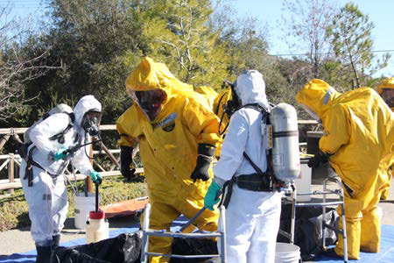
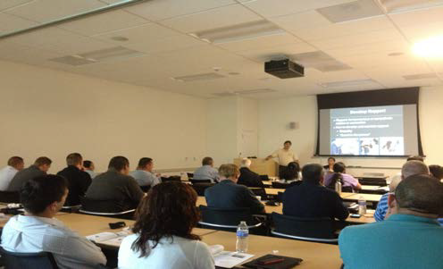
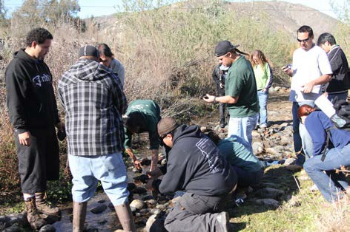
NAEPC Overview
Environmental Education for all Ages
Professional Training for Staff
Information Networking between tribes
Advocate for environmental justice
Partnerships/Collaborations
Disseminate information to Member Tribes
US Mexico Border Issues
Website
Underground Storage Tank (UST)Inspector
Hazwoper
Earth Day
Classroom
In-the-field
Notes:
Jill
1 Minute or less

Slide 4


WQX Data Flow Implementation,
Training, and Outreach Project
Notes:
Jill
One minute or less
Realized that many tribal water quality programs are busy doing their work and are not necessarily technically skilled at implementing Exchange Network data flows or cloud based data management systems.
Worked on an Exchange Network grant.
Obtained input/advice from Gold Systems personnel; whom we had met at an EPA Regional conference.

Slide 5

9 Tribal Project Partners!
Cahuilla Band of Indians | Campo Band of Kumeyaay Indians
Chemehuevi Indian Tribe | Iipay Nation of Santa Ysabel
Jamul Indian Village | La Jolla Band of Luiseno Indians
La Posta Band of Mission Indians | Bear River Rohnerville Rancheria
Los Coyotes Band of Cahuilla Indians | Manzanita Band of the Kumeyaay Nation
Moapa Band of Paiutes | Morongo Band of Mission Indians
Pala Band of Mission Indians | Pauma Band of Luiseno Indians
Pechanga Band of Luiseno Indians | Ramona Band of Cahuilla
Rincon Luiseno Band of Mission Indians | San Pasqual Band of Mission Indians
Santa Clara Pueblo | Santa Rosa Band of Cahuilla Indians
Santa Ynez Band of Chumash Indians | Soboba Band of Luiseno Indians
Sycuan Band of the Kumeyaay Nation | Viejas Band of Kumeyaay Indians
Hoopa Valley Tribe | Robinson Rancheria?
= Implemented
Notes:
Jill
30 seconds or less.
The project has provided advanced data access, data management, and data analysis capabilities for 9 or our NAEPC member tribes! Through this project, NAEPC is providing a valuable service to these tribes that they probably would still not have implemented at this point in time.

Slide 6
Project Overview
Provide participants improved exchange of and access to high quality water quality data.
Notes:
Jill – 5 seconds
The main goal of the project was to provide participants improved exchange of and access to high quality water quality data.

Slide 7
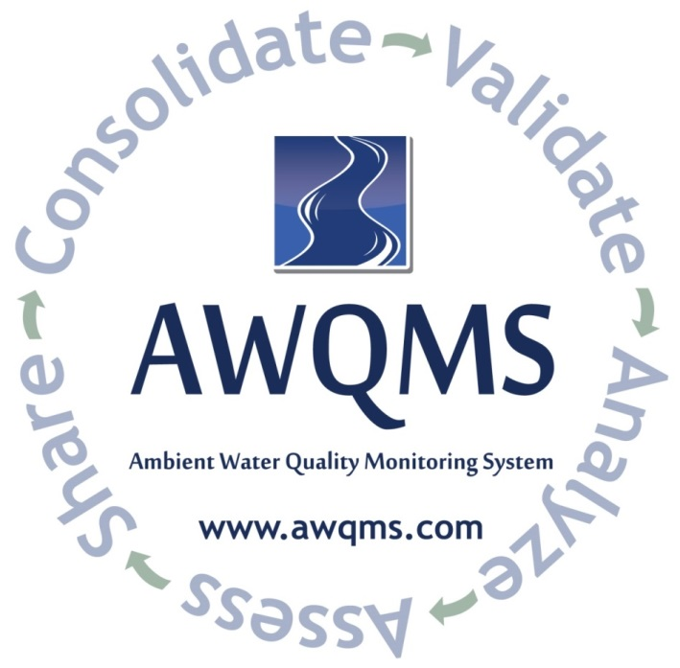
Project Overview
Adopt and enhance the Ambient Water Quality Monitoring System (AWQMS)
Provide proper training
  WQX exchange network flow
      Use of AWQMS
Notes:
Jill – 1 minute or less
We have achieved our main goal through partnering with Gold Systems to re-use the Ambient Water Quality Monitoring System and to provide training to tribal personnel.
AWQMS’s innovative, shared, cloud based Exchange Network data management system and built-in node client has enhanced productivity and streamlined tribal program processes by providing the ability to submit data to WQX without the need to host nor maintain a node.
Public tribal data, (managed and approved by tribal personnel), is also published from AWQMS-Cloud on the EN via virtual exchange services.
We have held 4 on-site training sessions for tribal personnel.

Slide 8
Project Overview
Assist tribes to:
  Import & Enter Data into AWQMS
      Flow data to WQX via the Exchange Network
      Configure and use AWQMS QC Thresholds
Notes:
Jill 1 minute or less
The project also provides one-on-one remote assistance and webinars to tribal personnel.

Slide 9




Project Overview
System Improvements
  Improve Data QA/QC Tools
      Publish Data Via EPA Virtual Node
      Improve Data Analysis Tools
      Share Enhancements with AWQMS Community
Notes:
Jill – 30 seconds or less
The project has made and is also making some modifications to the software that will benefit, not only the nine participating NAEPC member tribes, but also approximately 90 other tribes and seven states also using AWQMS. These changes are shared with those AWQMS community members at no additional cost beyond their normal maintenance or cloud service fee.

Slide 10

Challenges
Resistance to Change
Trusting Others with Data
Trusting “the Cloud”
Obtaining Local Approval
Getting Volunteers as Peer Trainers
Notes:
Jill
30 seconds or less

Slide 11
Successes
Setting up participants in AWQMS-Cloud
On-Site Trainings
One-on-one Remote Assistance
NAEPC / Gold Systems Partnership
Extensive Software ‘Re-use’
Notes:
Jill
30 seconds or less

Slide 12
Peer Trainer Program
Spreading the Word
Sharing Experiences
A Listening Ear
A Source of Ideas
Notes:
Jill
30 seconds or less

Slide 13

What is AWQMS?
A web-based water quality sample and observations information system.
Cloud Service
Local Deployment
Consolidate
Validate
Analyze
Assess
Share
Notes:
Mark

Slide 14
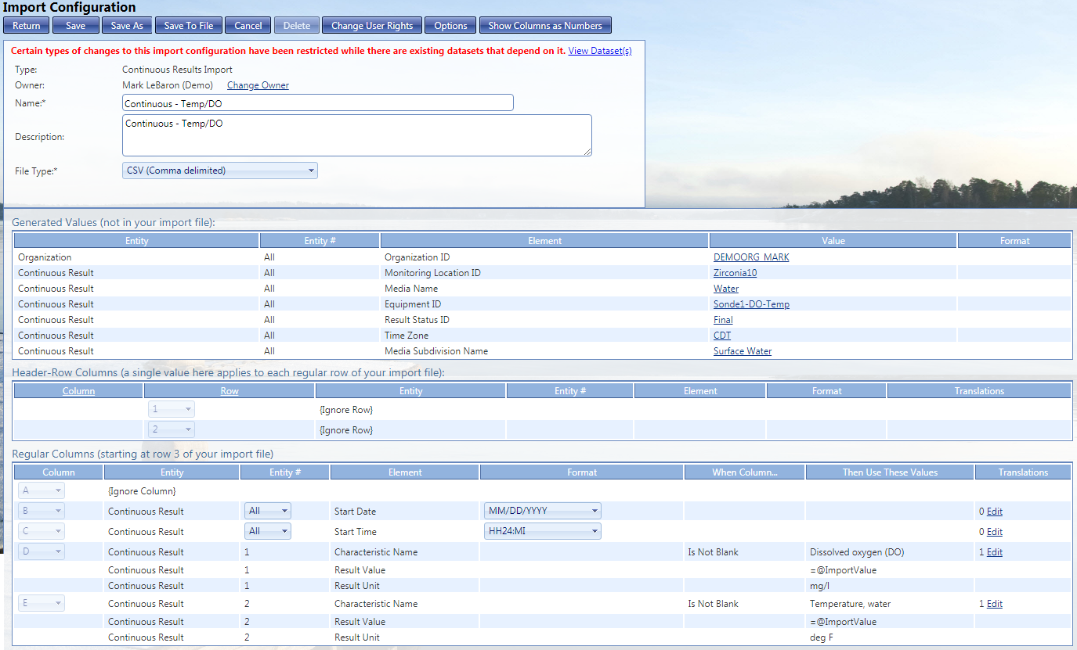
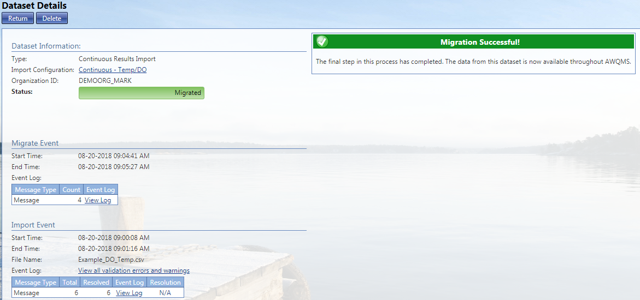

Major AWQMS Capabilities
Data Consolidation
  All Discrete WQX sample/observation types
  Continuous/Time Series Data
  Configurable Batch Import
  Configurable Rapid Entry Forms
  Data Management / Editing Tools
Notes:
Mark
30 seconds
Data Consolidation
All Discrete WQX sample/observation types
Continuous Data
Configurable Batch Import
Configurable Rapid Entry Forms
Data Management / Editing Tools

Slide 15
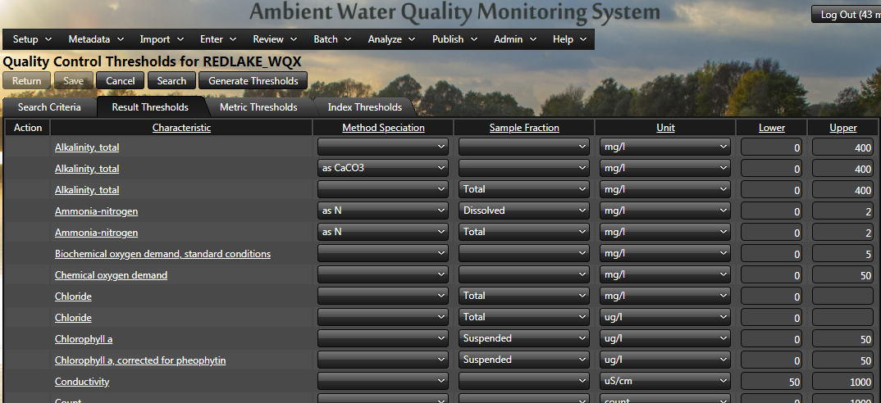
Major AWQMS Capabilities
Data Validation and Quality Controls
  All WQX Business Rules
  Parameter Consistency Checking (e.g. Units)
  Parameter Value Range Checking
Warning: The value for Turbidity was higher than your upper QC bound.
Value: 12.35 NTU
Upper QC Bound: 11 NTU
Location: SW4
Notes:
Mark
Data Validation and Quality Controls
All WQX Business Rules
Parameter Consistency Checking (e.g. Units)
Parameter Value Range Checking

Slide 16
Major AWQMS Capabilities
Data Validation and Quality Controls
  WQX Domain Value Lists w/Auto-Sync
  Batch updates for Activities data
  Batch updates for Results data
  Redundant Data Entry for QC purposes
Notes:
Mark

Slide 17
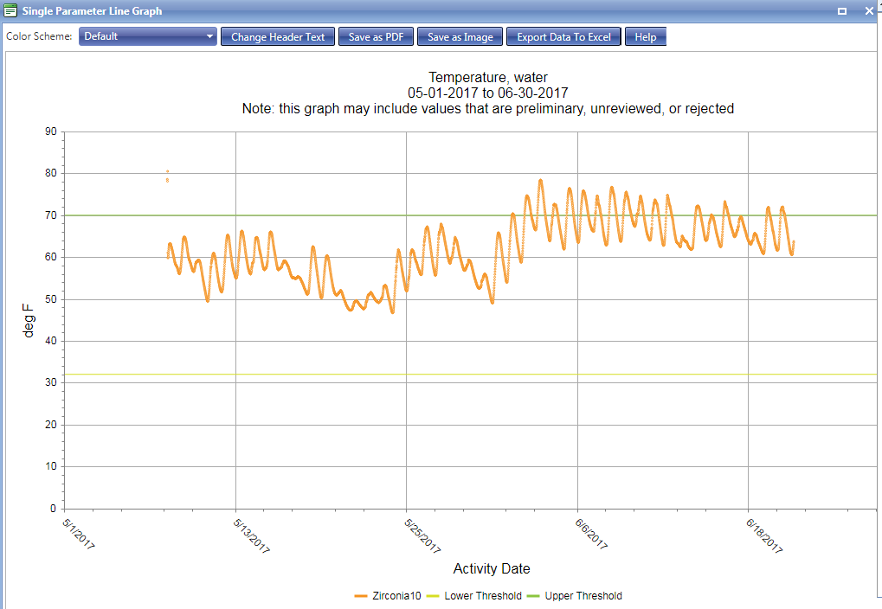
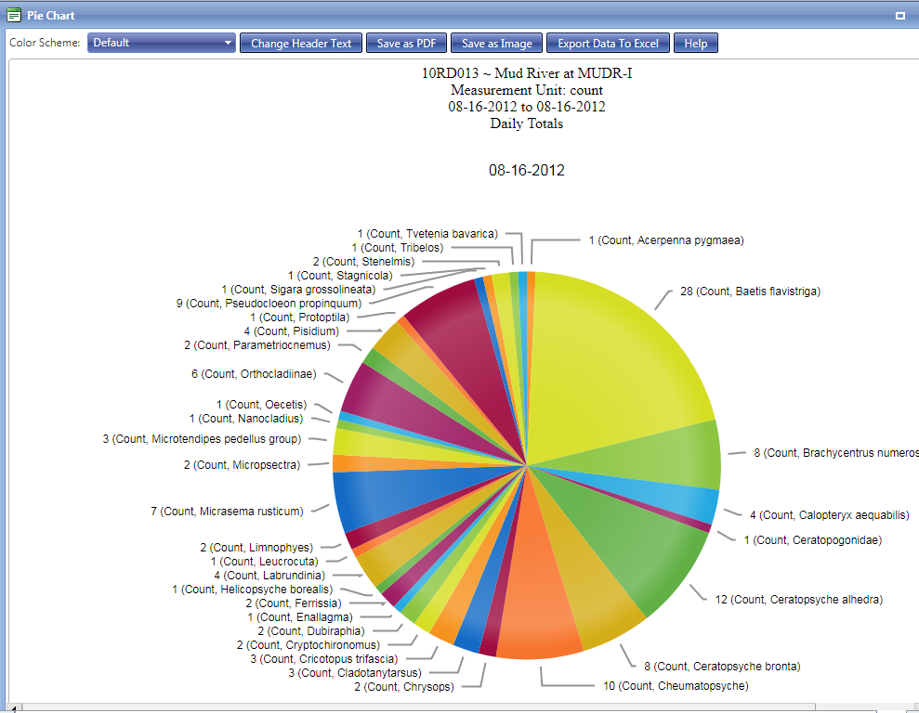
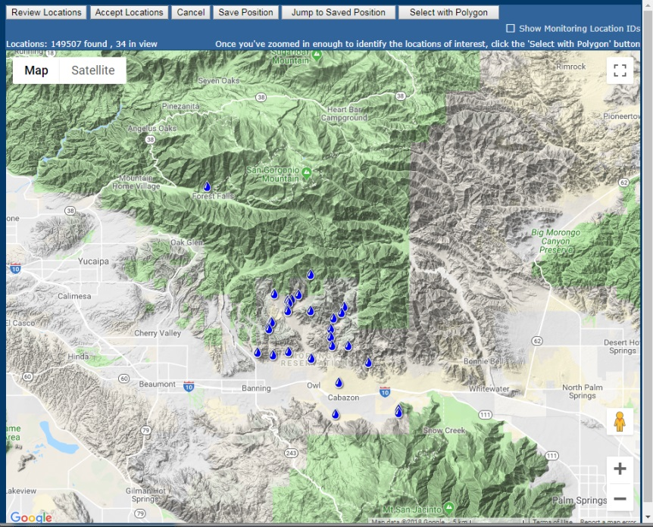

Major AWQMS Capabilities
Data Analysis
  Reports
  Graphs/Charts/Plots
  Built in Google Mapping Tools
Notes:
Mark
Data Analysis
Reports
Graphs/Charts/Plots
Built in Google Mapping Tools

Slide 18
Demo Video
Quality Control Enhancement Demo
  Identification of metadata inconsistencies
  Batch update of Activity and Result Metadata
  If changing Result Unit – Converts values
  (Play the video)
Notes:
Mark

Slide 19
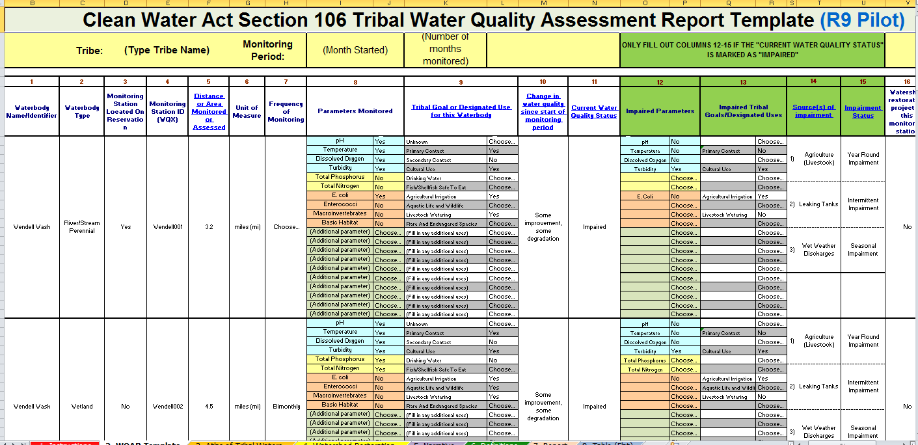
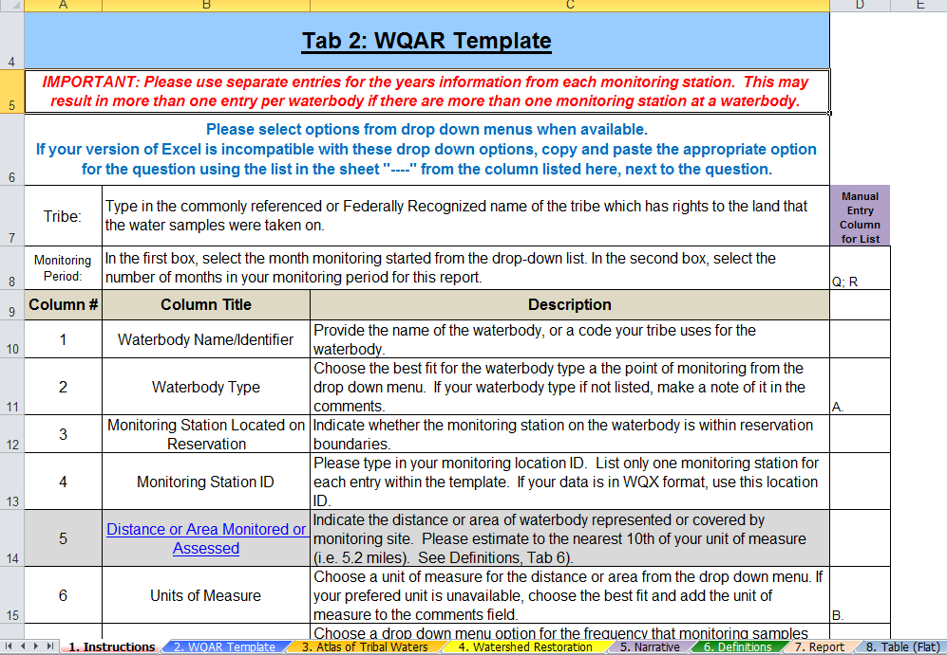
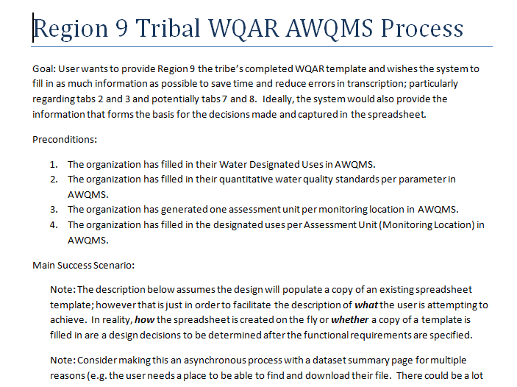
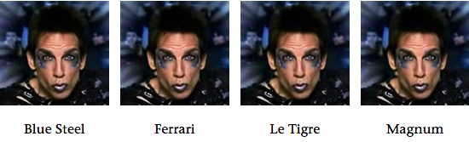
Project Next Steps
Data Analysis Improvements
    Release Version 7.0
      Code named “Magnum”
    Region 9 WQAR
    Flexible Export Configurations
Magnum
Notes:
Mark

Slide 20


Jill Sherman-Warne, Executive Director
Native American Environmental Protection Coalition
951-296-5595 jill@naepc.com
Mark LeBaron
Project Manager / Sr. Systems Analyst
Gold Systems, Inc.
801-456-6145 markl@goldsystems.com

Slide 21


Thank you!

Slide 22
Additional Slides if time permits or if applicable to questions
More features of our system and new features under development.

Slide 23
Major AWQMS Capabilities
Data Analysis
  Data Exports
  Ability to save named query criteria
  Leverage EPA Water Quality Portal for combined data analysis
Notes:
Mark

Slide 24
Major AWQMS Capabilities
Assessment Support
  Static Water Quality Criteria
  Calculated Hardness Based Metals Criteria
  Relate Monitoring Locations to Assessment Units; Assessment Units to Designated Uses; Designated Uses to Criteria
  Exceedance Analysis Reports, Exports, Map
Notes:
Mark

Slide 25
Major AWQMS Capabilities
Data Sharing
  Format and submit data as XML to WQX and PRAWN
  RESTful Web Services
  Virtual Exchange Services (Discrete data only)
Notes:
Mark

Slide 26
Major AWQMS Capabilities
Data Sharing
  Interoperable Watersheds Network SOS “Data Appliance” (Continuous monitoring data only)
  Mobile app API
  OGC Compliant Web Feature Service (WFS)
Notes:
Mark

Slide 27
Other Features Worth Mentioning
Monitoring Trip Planning Tool
BEACH Notifications and PRAWN EN Flow Submission
Program Document Management Tool “knowledge repository”
Notes:
Mark

Slide 28
More great features under construction
Better decision support for assessments
Capture and submit assessments to ATTAINS via EN
Integrated Continuous Monitoring Data Review and QC
  Review data / compare to standards & update result status accordingly
Notes:
Mark

Slide 29
More great features under construction
Improved Groundwater Tracking
Improved Taxa Profile Definition per organization
Auto-generation of bug abundance metrics per index based on taxa profiles
Notes:
Mark

Slide 30
On the Horizon
Project Dashboard
Open dumps integration with IHS WSTARS - Open Dumps
Improved Habitat Assessment Data Support
Event Analysis
More CMD QC improvements
Habitat Assessment Improvements
Notes:
Mark

Slide 31

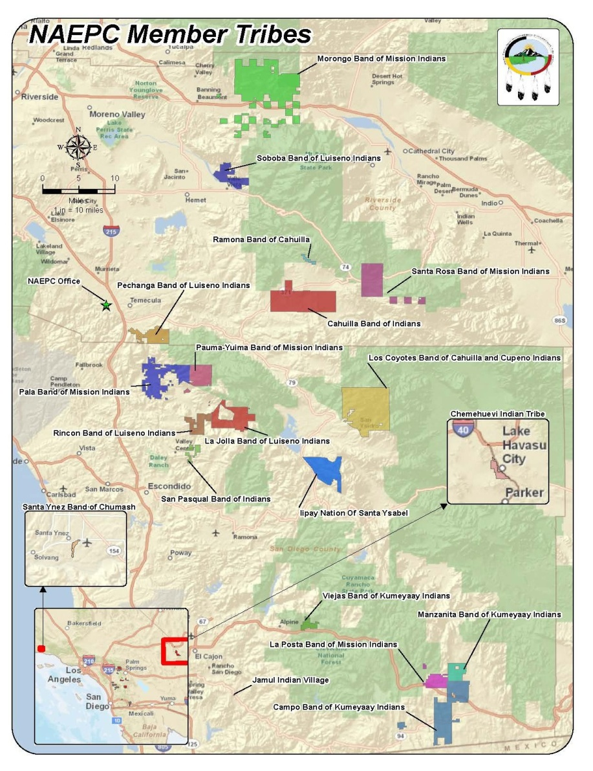

NAEPC Overview
NAEPC Tribes
NAEPC provides services to an area of over 1000 miles.
The Bear River Rancheria is the most northern in California
Campo is the most southern in California
Moapa is our first Nevada Tribe and
Santa Clara is our first New Mexico tribe
Notes:
Jill
30 seconds or less

Slide 32


NAEPC Overview
History:
Founded in 1996 by leaders of four tribes: La Jolla, Pauma, Pechanga & San Pasqual to assist with building programmatic capacity
Notes:
Jill – Briefly describe NAEP’s history
30 seconds or less

Slide 33
NAEPC Overview
Vision:
To become a recognized leader for environmental stewardship by creating and promoting resilient partnerships while embracing tribal traditions and culture for present and future generations
Notes:
Jill
30 seconds or less

Slide 34
NAEPC Overview
Goals:
Offer environmental education resources to people of all ages; advocate for environmental justice; strengthen intertribal partnerships and resources by sharing knowledge to promote environmental stewardship; provide technical training and support; and gather and disseminate information to member tribes.
Notes:
Jill
30 seconds or less

Slide 35
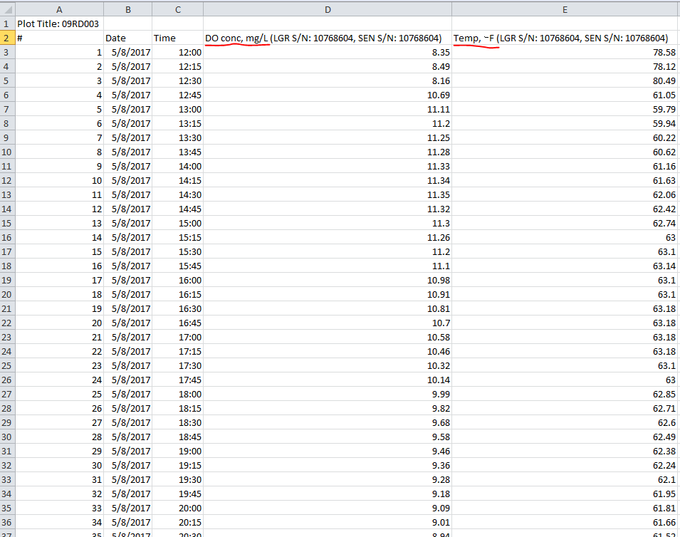
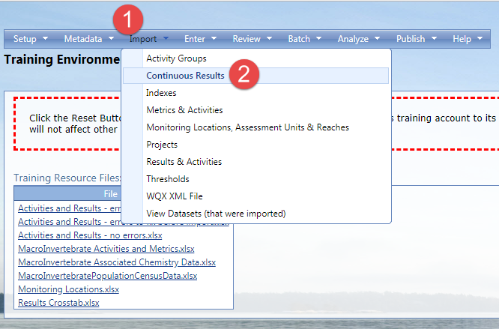
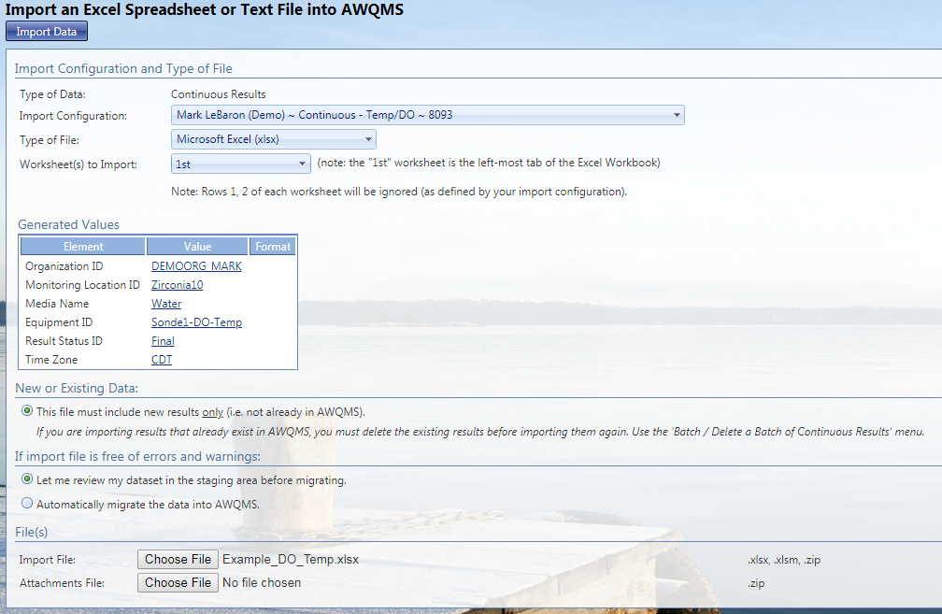
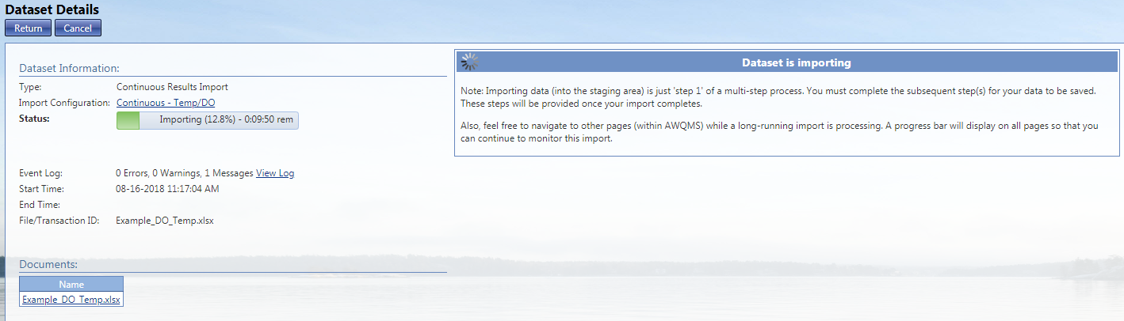
Major AWQMS Capabilities
Data Consolidation
  All Discrete WQX sample/observation types
  Continuous/Time Series Data
  Configurable Batch Import
  Configurable Rapid Entry Forms
  Data Management / Editing Tools
Notes:
Mark
30 seconds
Data Consolidation
All Discrete WQX sample/observation types
Continuous Data
Configurable Batch Import
Configurable Rapid Entry Forms
Data Management / Editing Tools

