Slide 1
Tribal Support for the NEIEN (Exchange Network)

Slide 2
NEIEN/Exchange Network
The goal of the Exchange Network is to improve decision making by providing timely access to consistent, accurate environmental data
Exchange Network is governed by joint collaboration of US EPA, States, Territories, and Tribes
Direct involvement by tribes has been limited despite dedicated funding to support tribal projects
Capacity development for environmental data collection, management and reporting

Slide 3
ITEP-EPA Cooperative Agreement
Coordinate and support the work of the Tribal Governance Group (TGG)
Host Annual Tribal EN Conference
Outreach to tribes on the EN (website, email list/newsletter, resources, etc.)
Mentorship, collaboration and training opportunities for tribes

Slide 4
Outreach to Tribes
Annual Tribal EN Conference
Approximately 100 attendees from tribes, EPA, states, and other agencies/organizations
Networking, information sharing, training and collaboration
Newsletter and email announcements
Website: www.tribalexchangenetwork.org
Mentorship requests
Resources
Conference materials

Slide 5
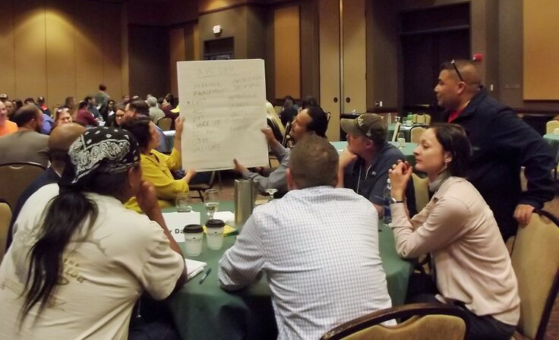
2018 Tribal EN Conference

Slide 6
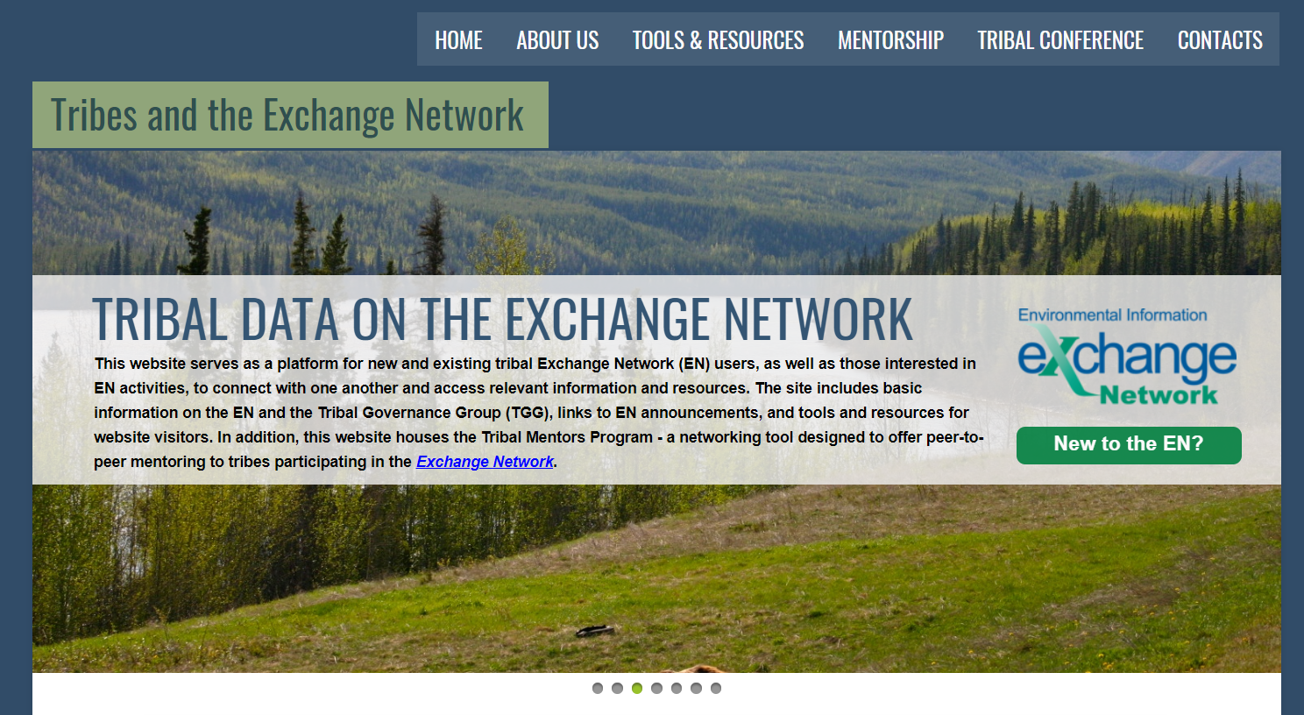
Website: www.tribalexchangenetwork.org

Slide 7
Mentorship & Collaboration
Tribe-to-tribe training and mentoring
Remote technical assistance
Webinars
Small-group workshops on a common topic
Tribal profiles of Exchange Network projects

Slide 8
Contact us!
ITEP Point-of-Contact:
Lydia.Scheer@nau.edu
TGG: tgg@tribalexchangenetwork.org

