Slide 1
Mission Shared Services Program
Future of Epa’s shared services technology platform
October 25, 2018

Slide 2
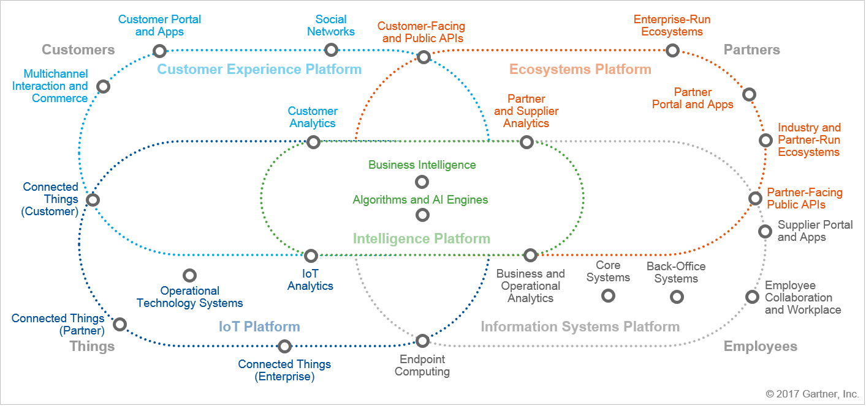
OMG !?!
Landscape
Digital Business Platform

Slide 3
IT’S ALL ABOUT THE CUSTOMER . . .
Customer Experience
Ecosystems Platform
A satisfied customer is the best business strategy of all
Intelligence Platform
IoT Platform
Information Systems Platform
. . . AND BUSINESS VALUE!

Slide 4
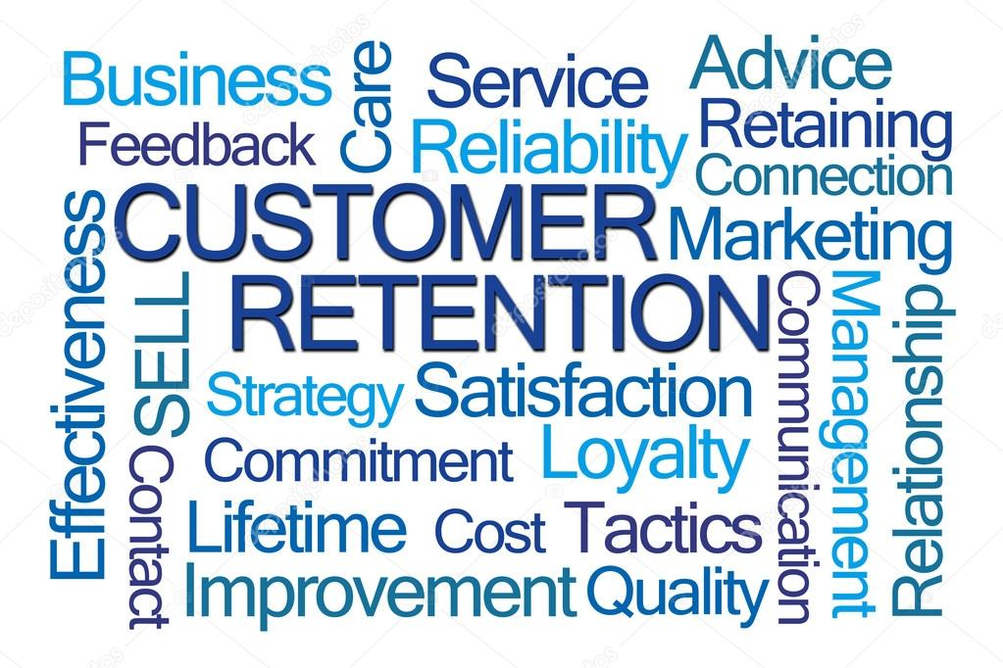
Who is the customer? – Everyone!
What do they want? – Everything!
When do they want it? – Now!
Where do they want to get it? – Their devices!

Slide 5
What’s a body to do?
Evaluate
Transform
Develop
Deliver
Disrupt?
Evaluate
Transform
Develop
Deliver

Slide 6
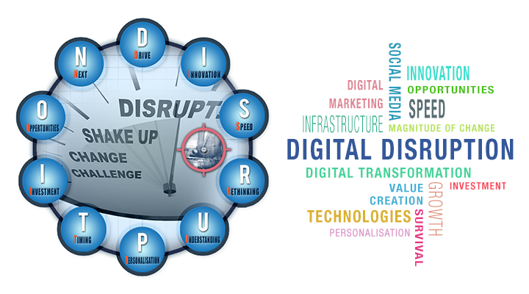
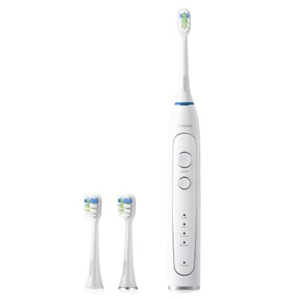
Disruption is Inevitable
Embrace, plan and do it
Key Things to Keep in Mind
Understand the customer journey and life cycles
Set objectives to achieve customer and organizational benefits
Do products – not projects

Slide 7
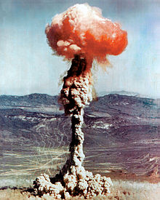
What and how do we change things?
Answer – Controlled Disruption
+
+
=
… actually Sensible Digital Transformation

Slide 8
EPA: Mission Shared Services Program (MSSP)
“The MSSP develops and promotes the business processes and technology framework to deliver shared services that optimize the collection and use of environmental data.”
… by Everyone

Slide 9
It’s not about technology alone
MSSP
Governance
Funding
Adoption
Technology
Comms
. . .
Culture
. . . we will talk about it soon

Slide 10
Mission Shared Services Workgroup (MSSwg)
MSSP
Governance
Funding
Adoption
Technology
Comms
. . .
Service delivery and standards
Communication and collaboration channels
All partners, internal and external
Harmonize strategies (digital, API, SS)
Focused “Topic Groups”
Use cases and technology pilots

Slide 11
OK, Now the Technology - shared Services Platform (SSP)
It’s a journey – not one and done
Incorporate legacy, emergent and emerging technologies
Minimum requirements:
Underpinnings for service delivery
Agnostic (environment and usage)
Available to and interoperable with all partners
Must support hybrid environments
Comprehensive management and orchestration

Slide 12
shared Services Platform (SSP)
Cloud deployments are essential
There are some components that must be included
Service Catalog and Registry
API Mediation (Gateway)
Event Broker
Integration Platform
Data Integration and Virtualization
There will be others

Slide 13
shared Services Platform (SSP)
Service Catalog
Component to manually or digitally obtain information (meta data) about a service
Service Registry
Component to determine where/when a service is available (running)
API Mediation (Gateway)
Component to mediate user API calls (possibly massaging in/outbound payloads)

Slide 14
shared Services Platform (SSP)
Event Broker
Component to receive notification of events and forward to event handlers (pub/sub)
Integration Platform
Component to integrate, manage and orchestrate services
Data Aggregation and Virtualization
Component to aggregate, organize and expose data in ways not explicitly defined in either physical or virtual data stores

Slide 15
shared Services Platform (SSP)
Will inevitably be implemented as “meshes”
Distributed, interoperable component categories
catalogs, gateways, event brokers
and yes, application components (MASA)
Integration is paramount – otherwise chaos ensues

Slide 16
shared Services Platform (notional)
Application / Analytics Layer
May be implemented in lower layers
Service Catalog
Aggregator
Logical Gateway:
Central Policy Definition and Policy Enforcement
Public Consumers
Private Consumers
Internal Consumers
Can be Stand-Alone
Gateway Deployments (Cloud, SW, VM, HW, Hybrid)
API Gateway Runtime
API Gateway Runtime
Service
Catalog
Service
Catalog
API
API
API
Policy Defined Interfaces
One or more gateway instances
Client/Server-Side Binding
Service Registries
iPaaS/ESB (Advanced Orchestration)
Cloud Services
Light-weight
Service Containers
Other
Containers
May extend downward and upward
Service
Implementations
Service
Implementations
Service
Implementations
Service
Implementations
Service
Implementations
Service
Implementations
Event Broker
(Pub/Sub)
Messaging
Public Consumers
Create
Fit-for-Purpose Data
Actionable Date Layer
(VDB /PDB )
Public Consumers
Data
Layer
Data Integration Layer
(Fit-for-Purpose Data Orchestration)
16
Data Collection Layer
(Raw Data – Structured/Unstructured)

Slide 17
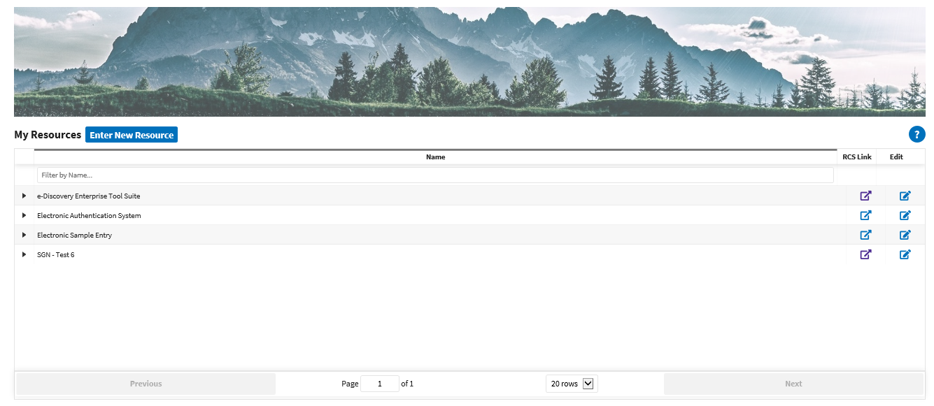
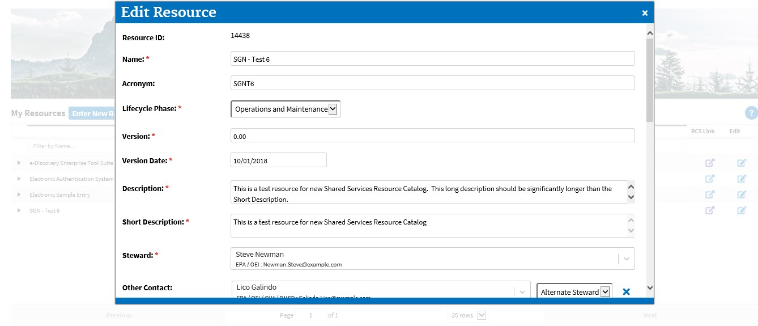
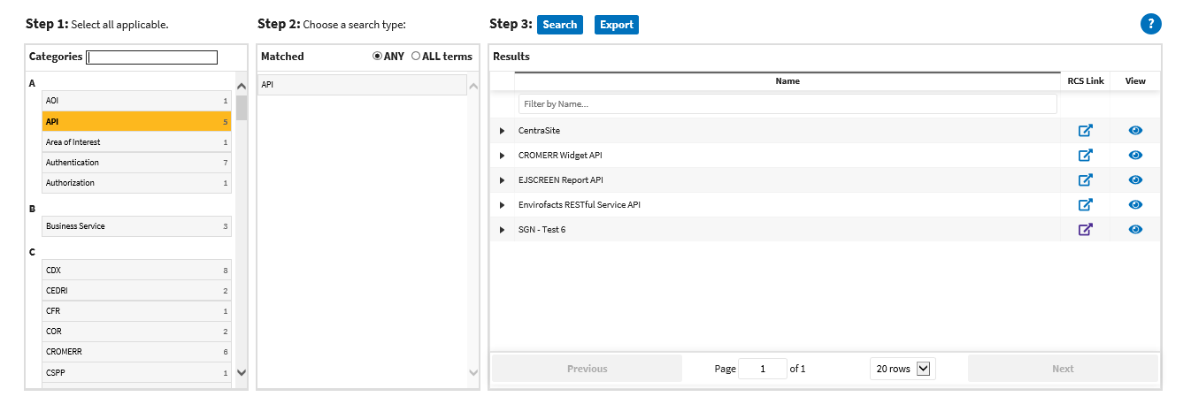
Service Catalog

Slide 18
API Mediation Layer (GATEWAY)
Outer API (Consumer)
API Mediation Layer
Do Something*
Auth Svc
Help Svc
Svc
GIS Svc
Air Svc
Inner API (Provider)
Svc
Data
Svc
Map Svc
Svc
Svc
* pass through, authentication, authorization, protocol translation, format translation, security, monitoring, rate limit, composition, . . .

Slide 19
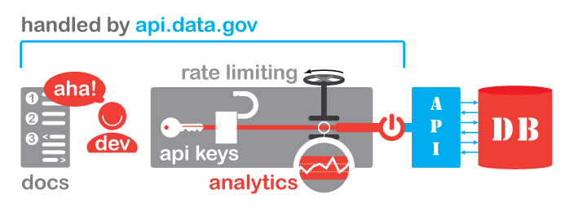
API Mediation Layer (GATEWAY)
“Light-weight” gateway – api.epa.gov
Implemented on cloud.gov’s API gateway (api.data.gov) – Feds only (for now)
Offers
Develop Keys
Monitoring
Traffic control
Caching
Analytics
In use by several EPA offices
OAR – Field Auditing Checklist Tool (FACT)
OIM – Substance Registry Service (SRS), Location Validation Service (LVS – provisional title)
OW

Slide 20
A Shared service Vertical – LVS Code set
LVS - Location Validation Service (provisional title)
API enabled City, County, State, Zip Code services
True micro-service
Will Expose APIs on api.epa.gov
Azure or AWS eventually
Will migrate backend to cloud-ready PostgreS(QL)
Will lift and shift to cloud environments
Will expose to iPaas and event broker

Slide 21
Building Up Shared Services
(hypothetical example)
Permits
Map Service
Location Service
Macro
Mini
Micro
Program Office Service
Micro
LVS Service
Program Office Contact Service
EPA Personnel Lookup Service
Chemical Meta-Data Service
Facility Service
Chemical Synonym Service
Chemical Compound Service
FRS Query Service
Chemical Formula Service
Advantages
Discrete, fit for purpose, loosely coupled services are:
Developed once, reused many times
Easily maintained
Replaceable with no (or minimal) impact
Entire applications and services can be assembled wholly or in large part with micro-, mini- and/or macro-shared services
21

Slide 22
for you Looney Tunes fans
That’s All Folks!

Slide 23
Questions
Todd Holderman
holderman.todda@epa.gov
202-566-2076
Steve Newman
newman.steve@epa.gov
202-566-2134
Phil Paparodis
paparodis.phil@epa.gov
202-566-0324

