Slide 1
Bishop Paiute Tribe’s Digital Transformation of Environmental Data Management
BryAnna Vaughan – Water Quality Program Coordinator
Mark LeBaron – Senior Business Analyst

Slide 2
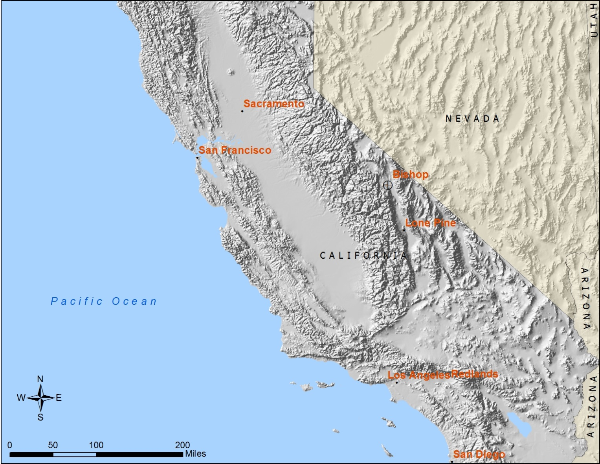
Bishop Paiute Tribe
Notes:
Fifth largest tribe in CA with approximately 2,000 members. Located along the eastern slope of the Sierra Nevada. The Reservation is 875 acres.

Slide 3
Notes:
Two forks of Bishop Creek run through the Reservation. BC is the largest tributary to the Owens River, which is a significant source for Los Angeles’ water demands (more than 50% in a typical year).

Slide 4
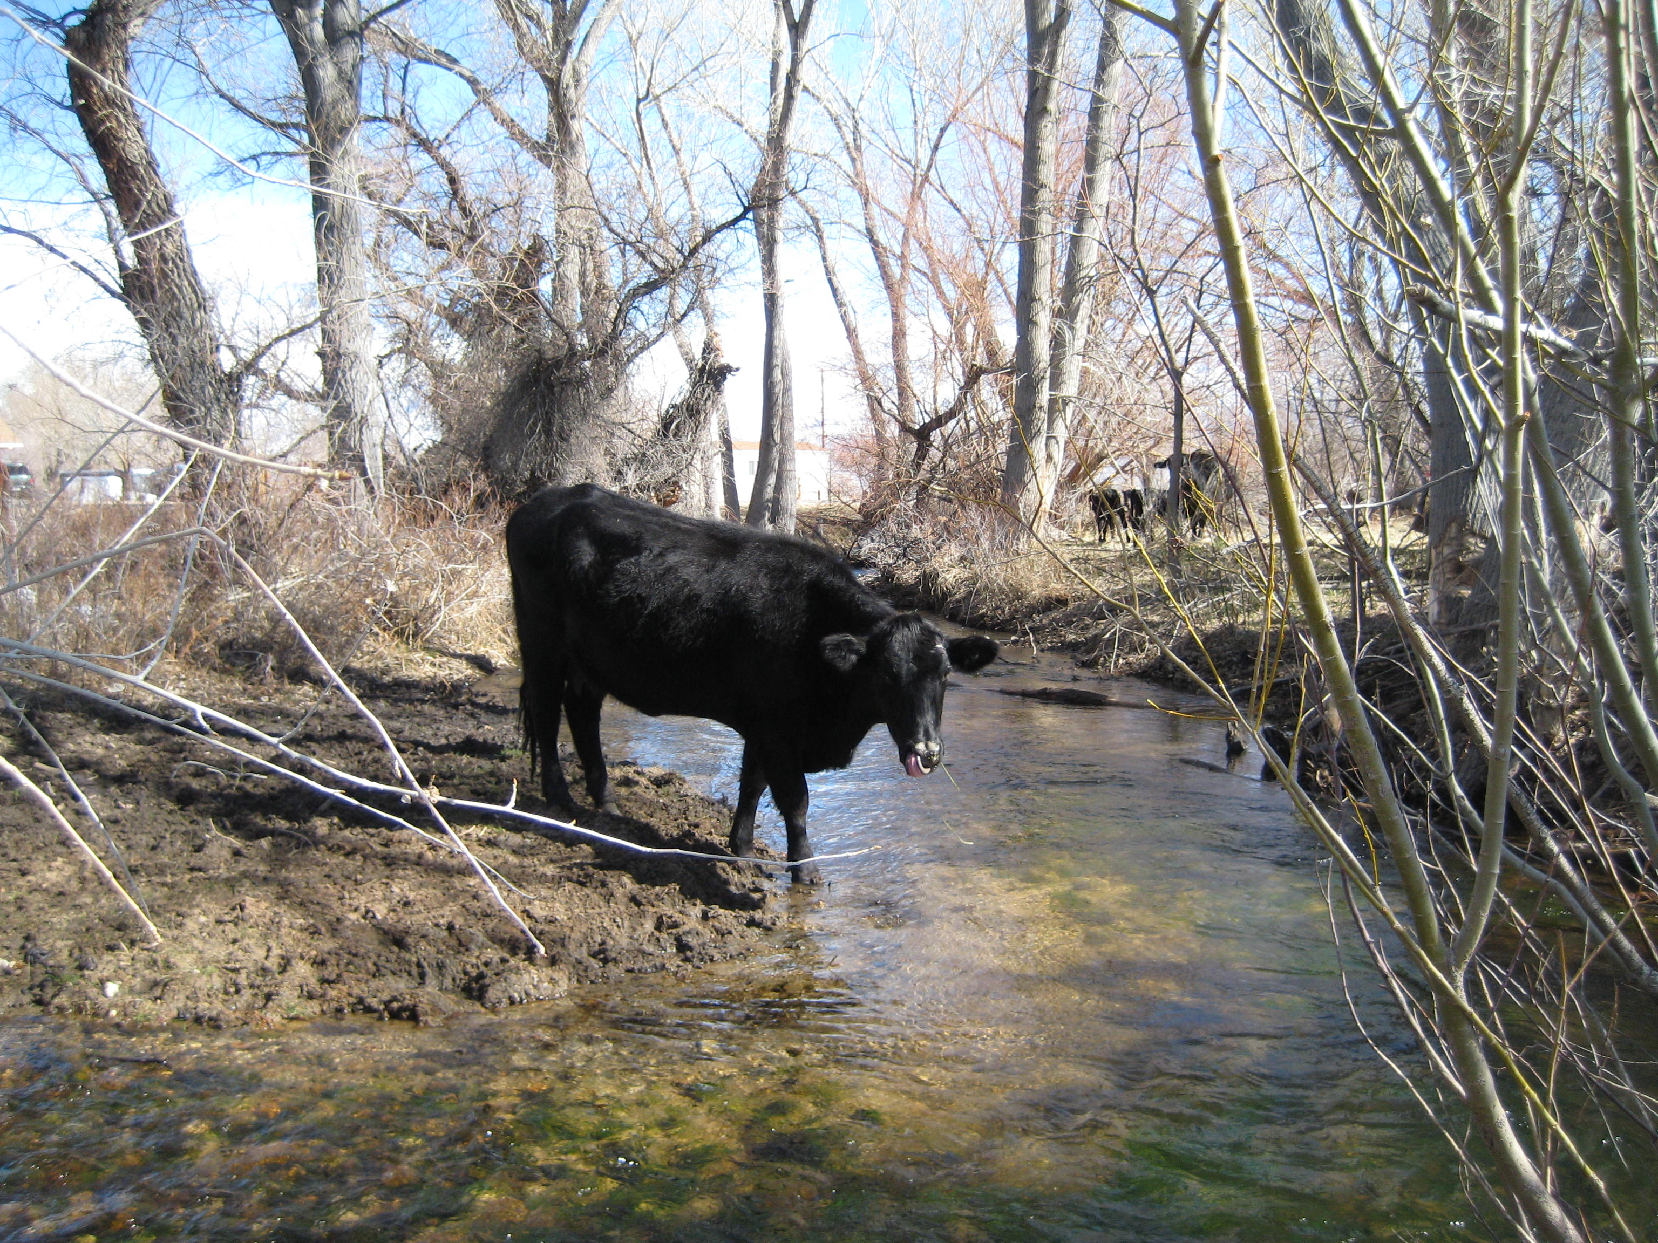
Water Quality Monitoring Program
Continuous Monitoring
5 Physical parameters monitored
Grab Samples
Bacteria (creeks, ponds, irrigation ditches)
Nutrients (creeks, ponds, irrigation ditches)
And…
Benthic Macroinvertebrate Sampling
Habitat Monitoring
Chemical Sampling

Slide 5
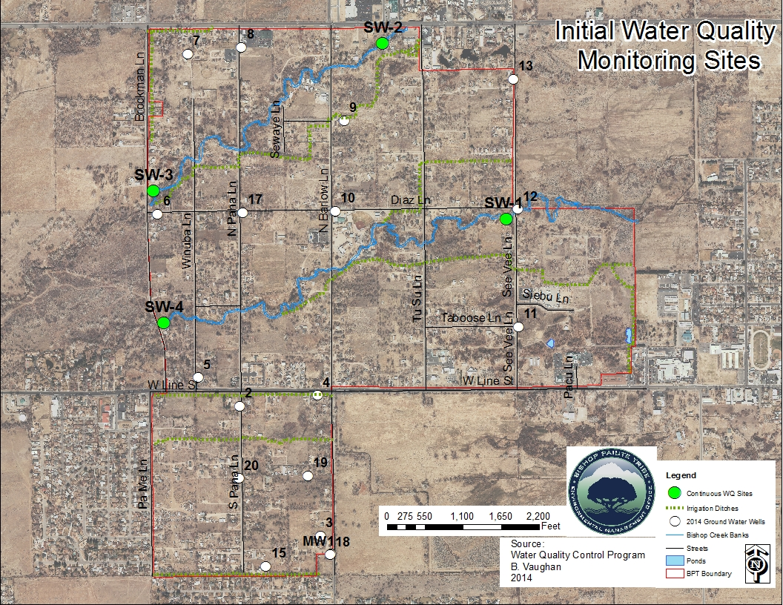
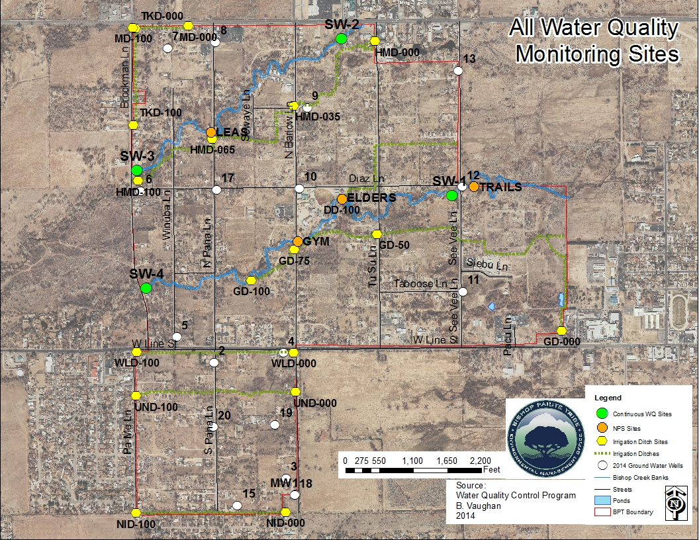
Notes:
We used to collect five physical parameters and one bacteria grab sample at each SW site weekly during irrigation season and monthly during non-irrigation season. Totals (480+100=580) physical parameter data points per year, (96+30=126) bacteria data points per year. Groundwater levels are recorded once a month (192 data points per year). All together, under 1000 data points throughout the year.

Slide 6
WQ Database Evolution
In the beginning….

Slide 7
WQ Database Evolution
We made some advances….
Notes:
We were backing the data up into Excel files

Slide 8
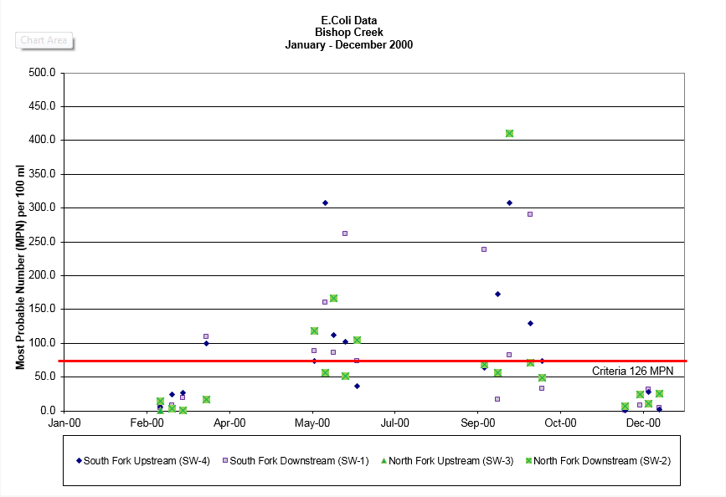
WQ Database Evolution

Slide 9
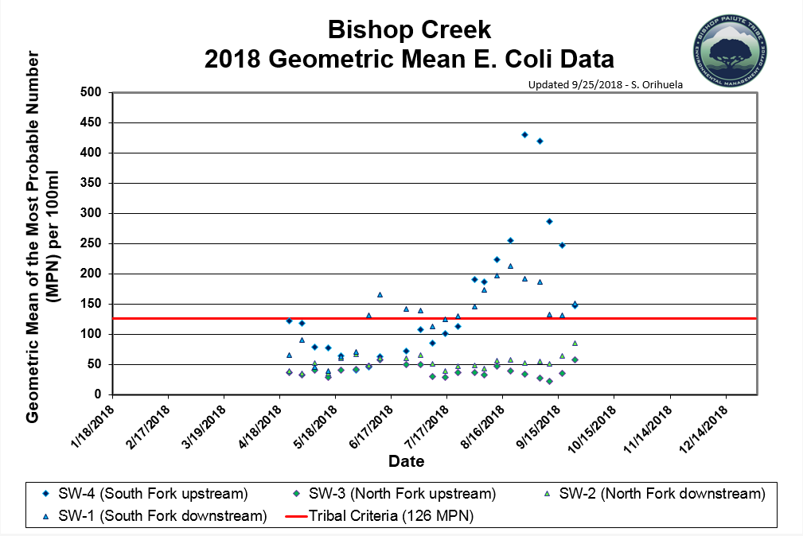
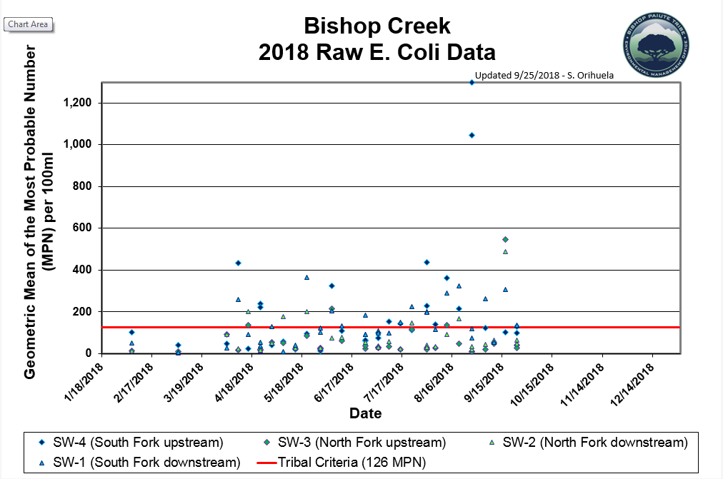
WQ Database Evolution

Slide 10
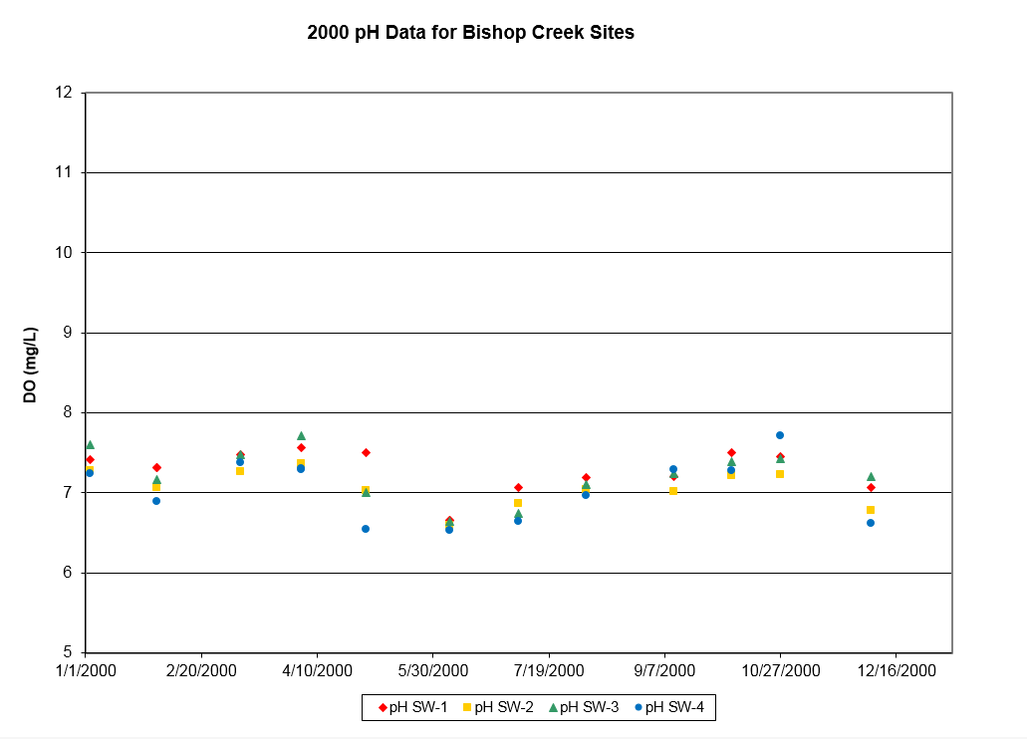
WQ Database Evolution

Slide 11
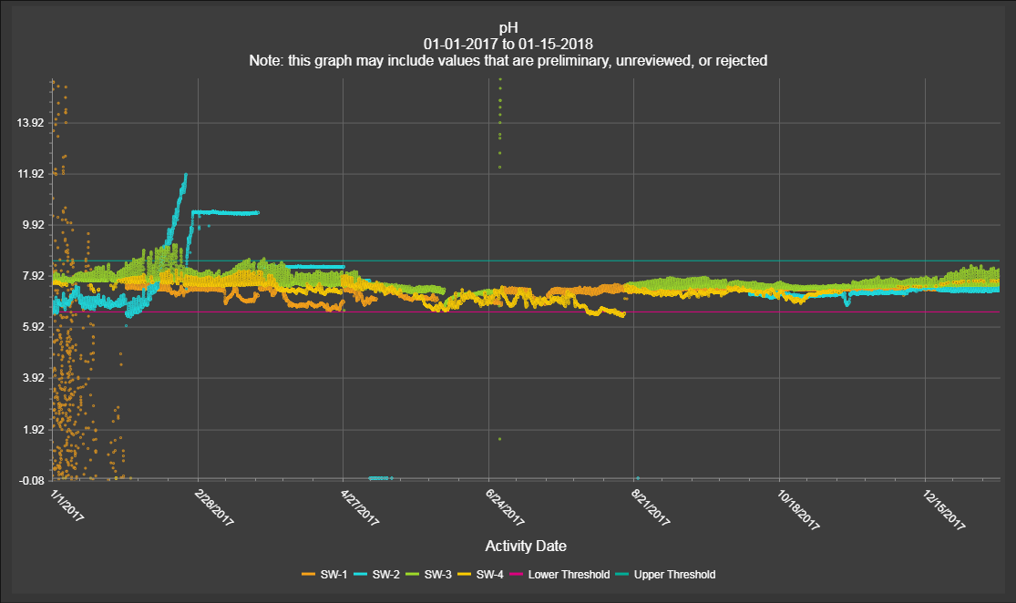
WQ Database Evolution
Notes:
Need graph of all sites with one year of pH data – Today we collect 17,520 data points for each parameter at each site per year (70,080 for each parameter at all 4 sites). With 5 parameters and 4 sites, this is 350,400 data points per year.

Slide 12
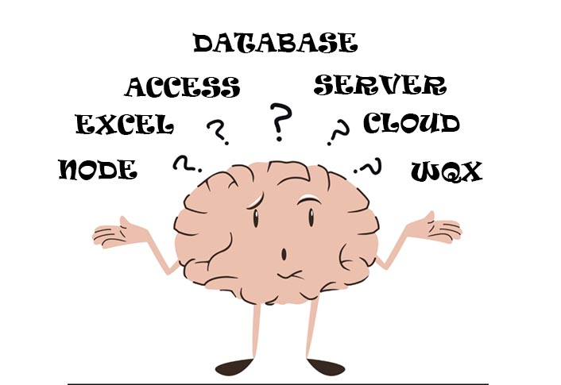

Slide 13
Ambient Water Quality Monitoring System
Why the Bishop Paiute Tribe chose AWQMS:
Secure, located in the US, deployment options
Reduces IT requirements / Web based
Built-in WQX Exchange Network connectivity
Useful analytical tools built-in
User friendly, AWQMS community support, large database development and training support team
Basically a shared services platform for water resource managers
Notes:
Mark – Bry changed AWQMS logo size and location

Slide 14
AWQMS Enhancements
MPN Calculator for total coliforms and E. coli using the Colilert® method
Geometric Mean Calculator for bacteria using the Colilert® method
Double Data Entry Tool for Quality Assurance
Auto-Poll, Auto-QC with Alerts for real-time continuous data
Integrated Review and Validation Tool for continuous data quality and adjustment
Public Portal for information dissemination
Sensor Observation Service “Data Appliance”
Notes:
Mark – Consolidate this into one slide

Slide 15
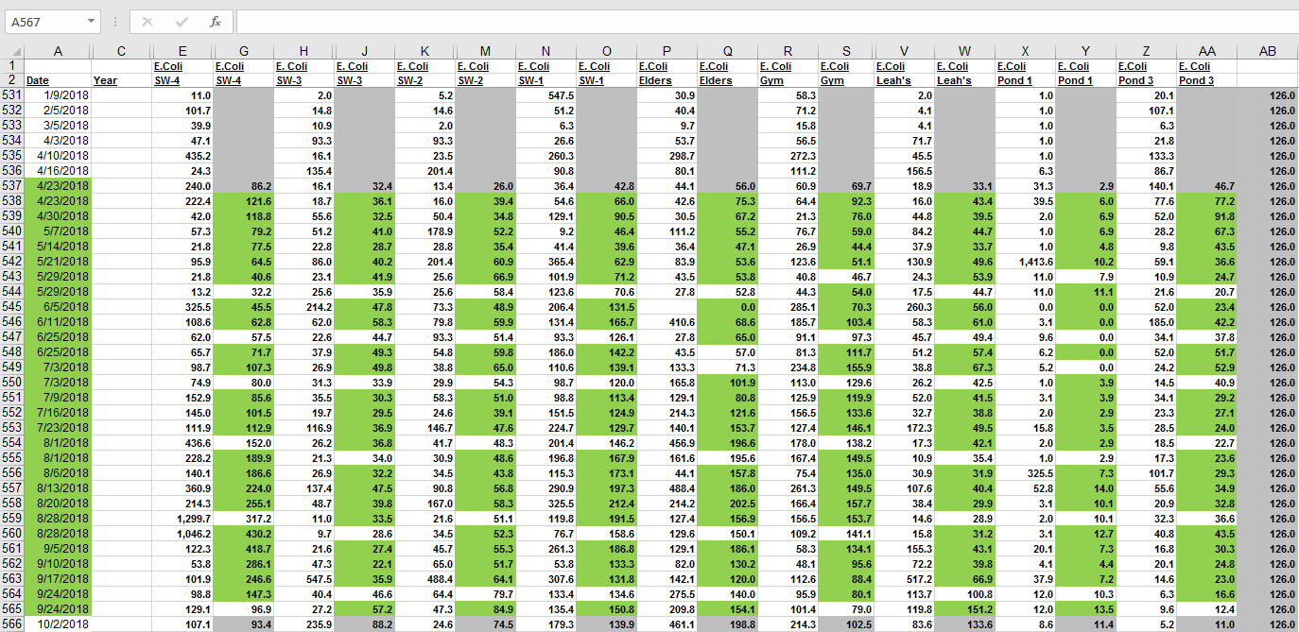
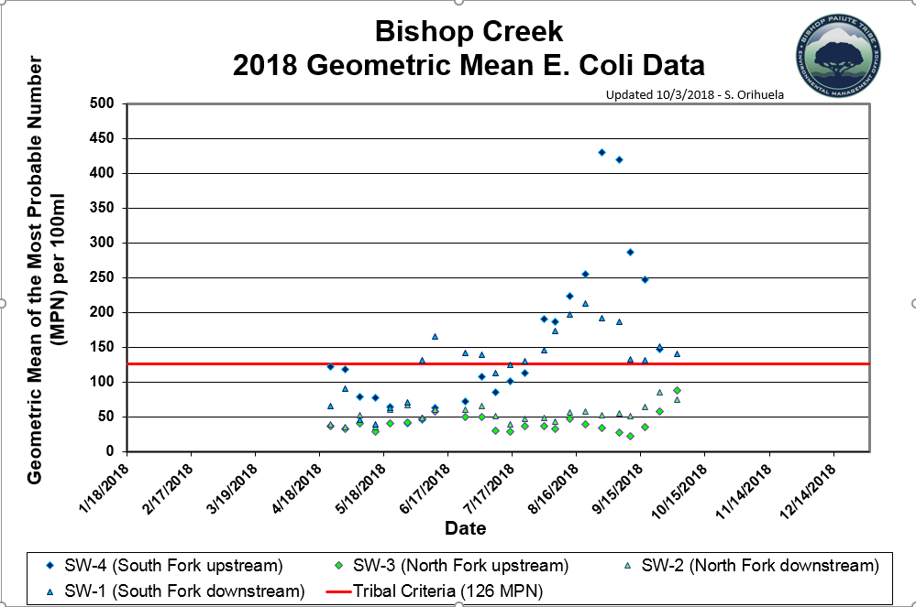
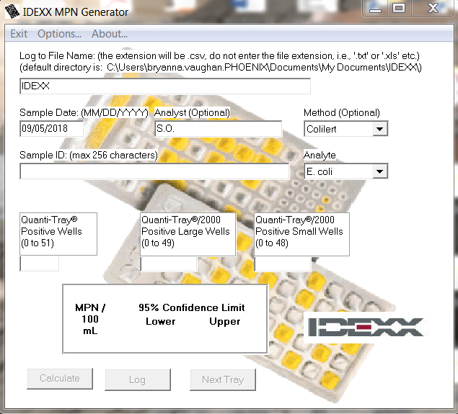
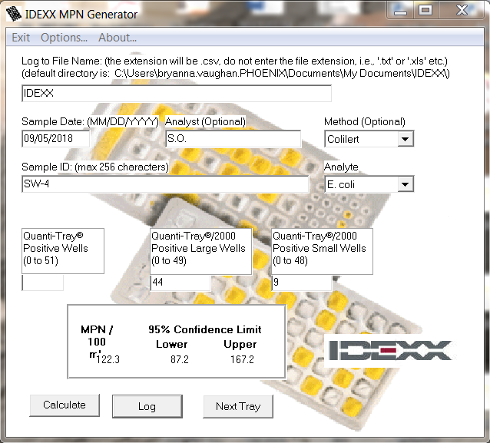
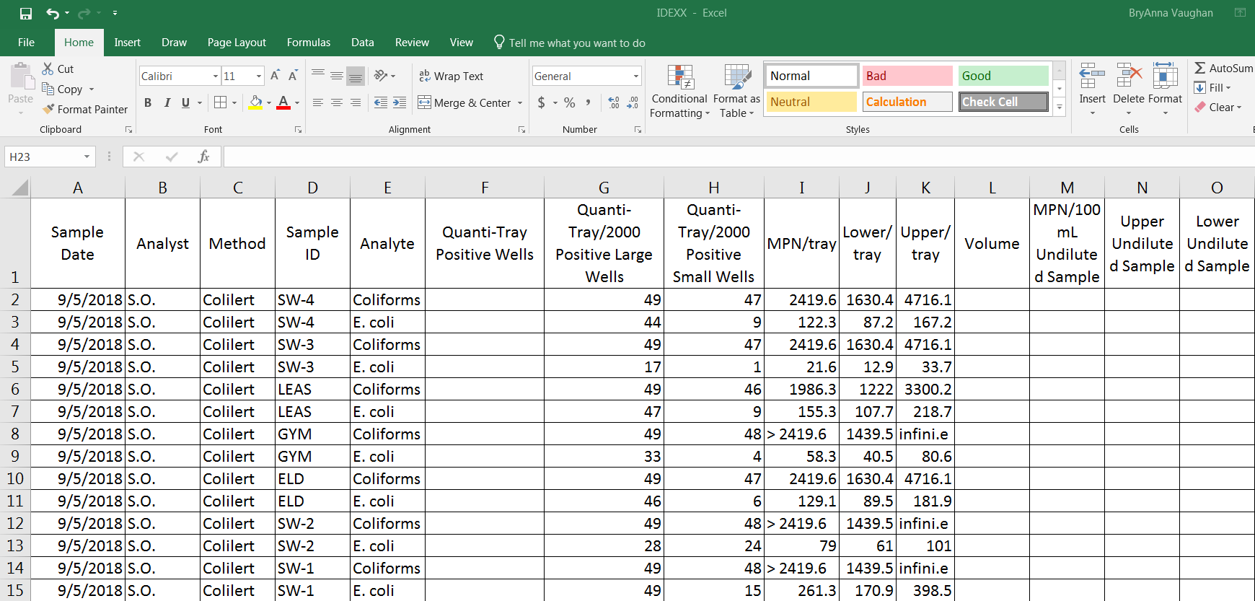
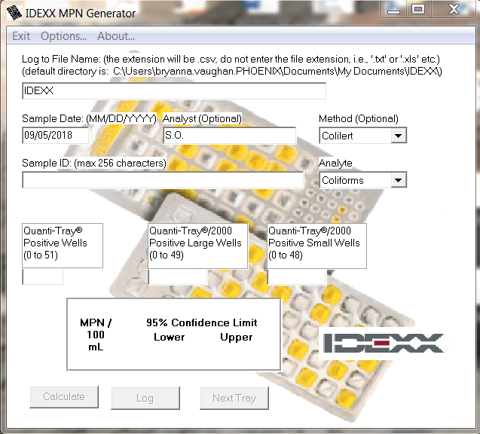
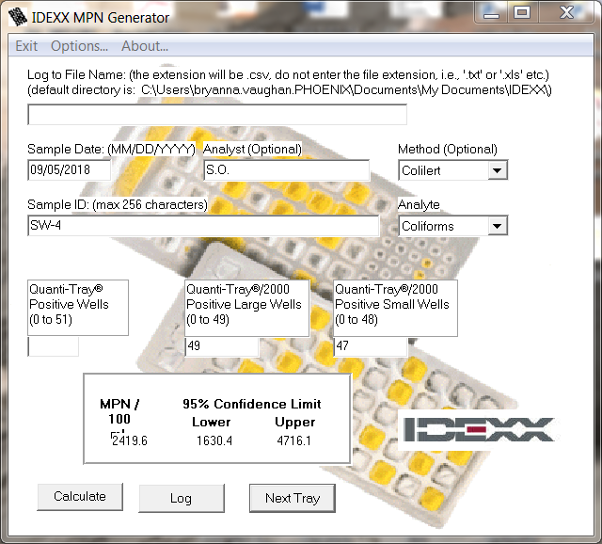
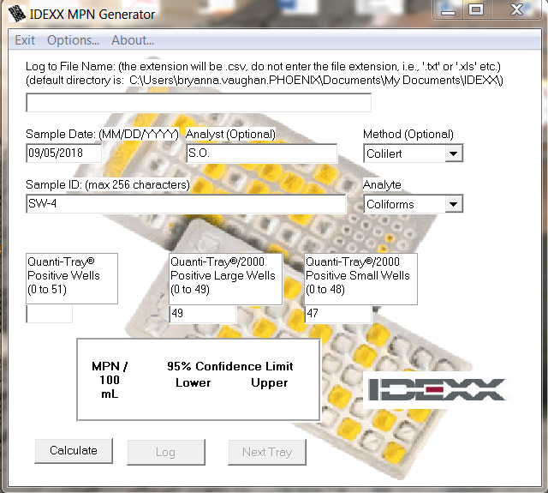
Pre-AWQMS Method for Calculating MPN & GM
Notes:
BryAnna

Slide 16
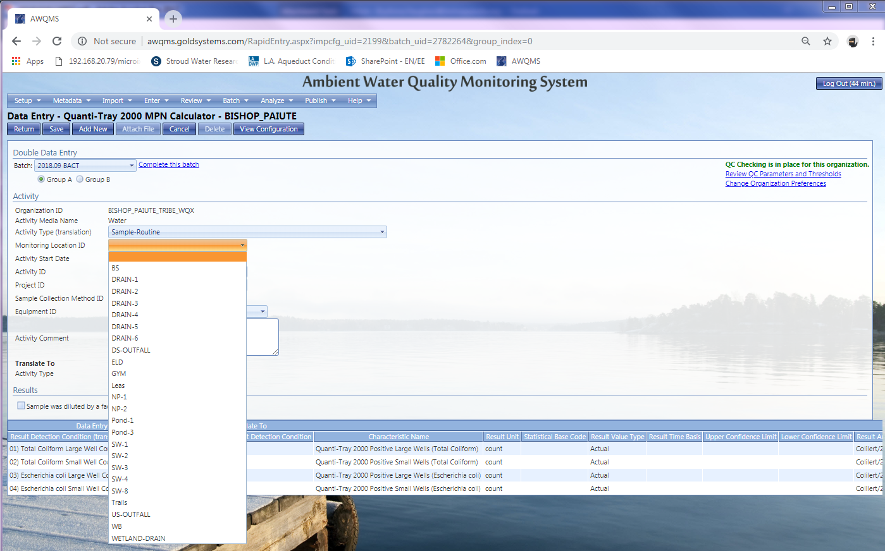
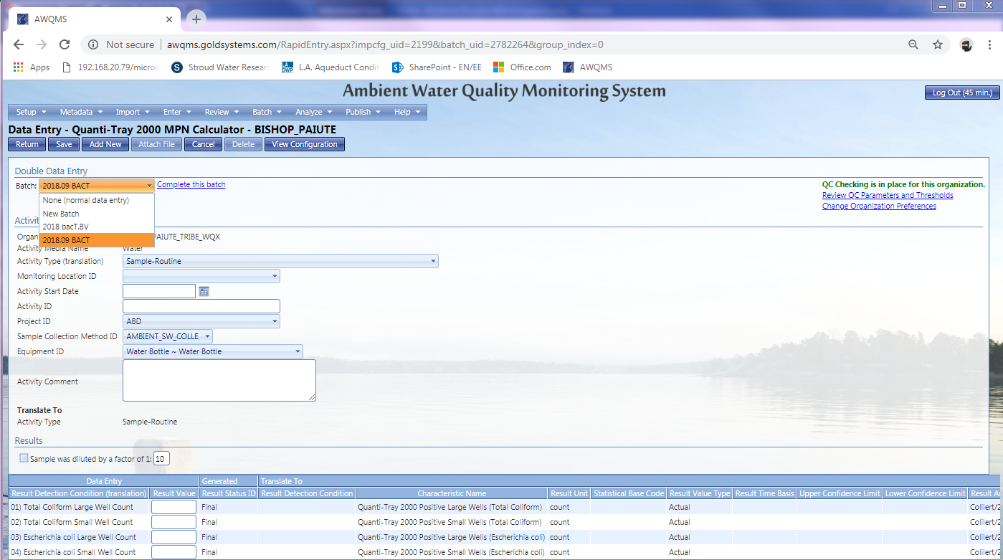
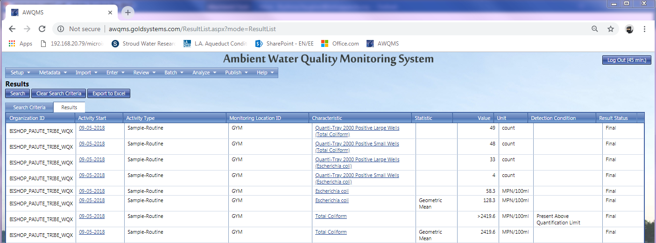
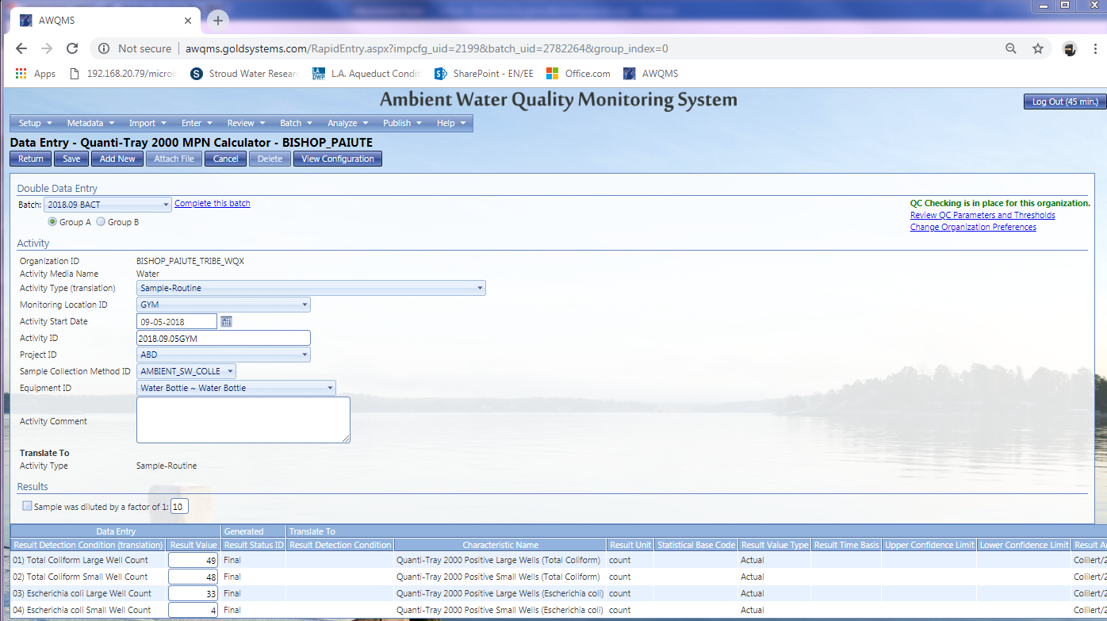
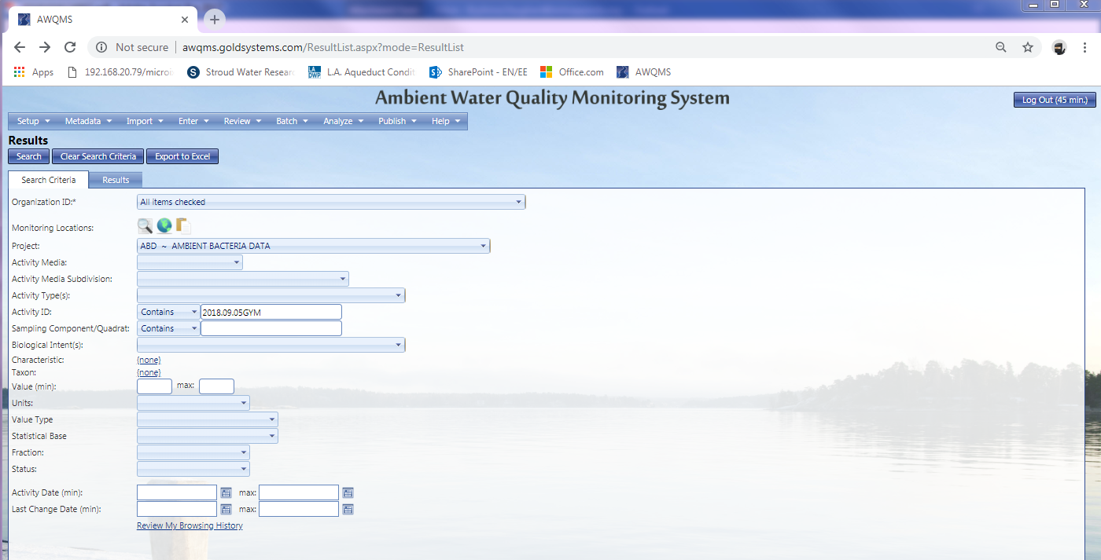
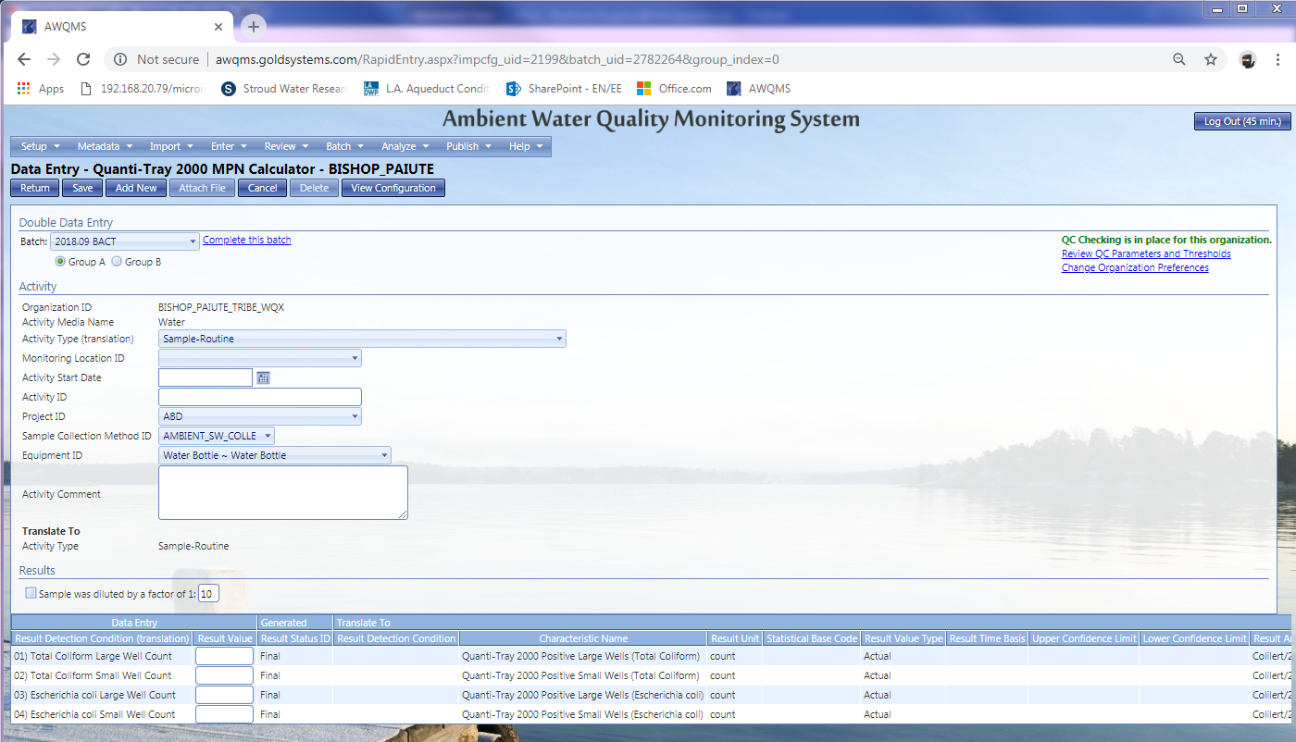
Calculating MPN and Geometric Mean
with AWQMS
Notes:
BryAnna

Slide 17
Sharing Real-Time Continuous Data
Pre-AWQMS method
Radio telemetry at continuous sites
Real-time, raw data transferred to Tribe’s domain and then pushed to TREX website for public availability
No validation tools, no analytical capability, no alerts
Dependable, cost-effective, very limited results
Notes:
BryAnna – Maybe diagram or image?

Slide 18
Auto-Poll, Auto-QC with Alerts
for real-time continuous data
Polls real-time continuous data over the Internet
Retrieves files from the loggers to the AWQMS server
Imports the data into AWQMS automatically
Checks whether imported parameters are the “expected” ones
Checks whether parameter values are within organization-provided QC bounds
Automatically sends alarms if either check is negative
Notes:
Mark

Slide 19
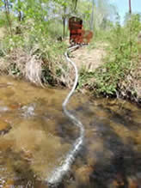
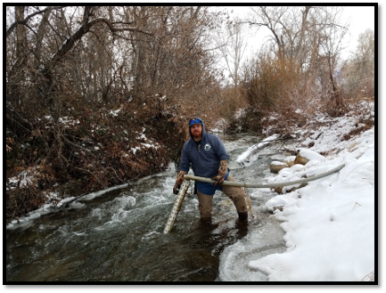
Auto-Poll, Auto-QC with Alerts
for real-time continuous data
Notes:
Bry - add photo of the data logger and screenshot of real-time data

Slide 20
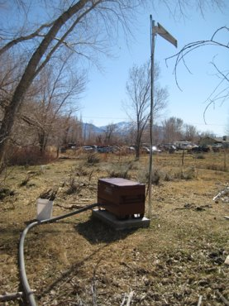
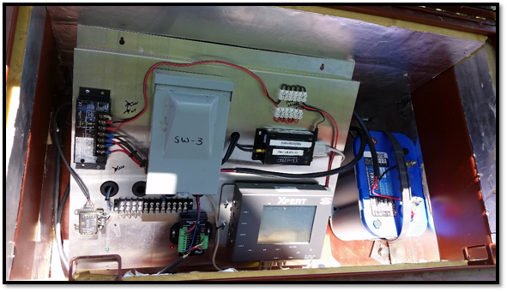
Auto-Poll, Auto-QC with Alerts
for real-time continuous data
Polls the data over
the Internet
AWQMs Polling Service
AWQMS database

Slide 21
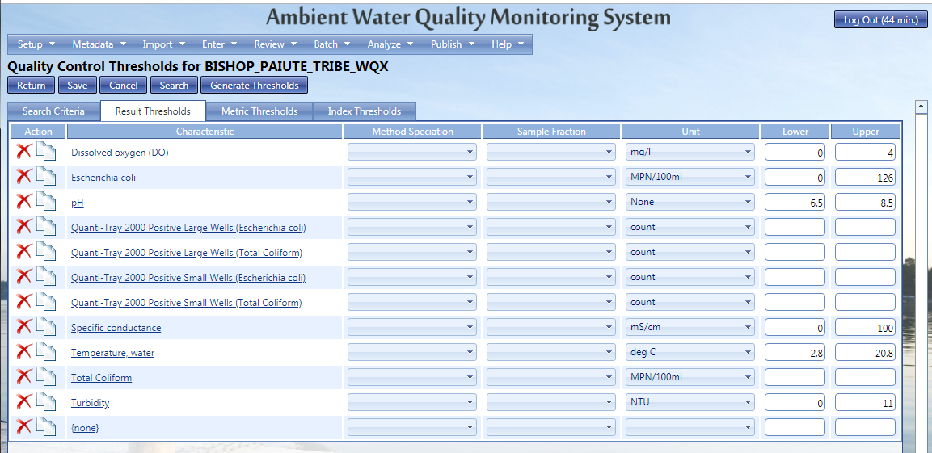
Auto-Poll, Auto-QC with Alerts
for real-time continuous data
Files are auto-imported into AWQMS
Values are evaluated against thresholds
Exceedances trigger Alerts
Notes:
This screen shot should reference valid parameters collected at our continuous sites.

Slide 22
Auto-Poll, Auto-QC with Alerts
for real-time continuous data
AWQMS sends email notification
Alert!
Warning: The value for Turbidity was higher than your upper QC bound.
Value: 12.35 NTU
Upper QC Bound: 11 NTU
Location: SW4
Notes:
Unreviewed data can be reviewed in AWQMS using graphs, reports and visual inspection
The review can consist of comparing the data against standards or other thresholds as desired by the tribal program.

Slide 23
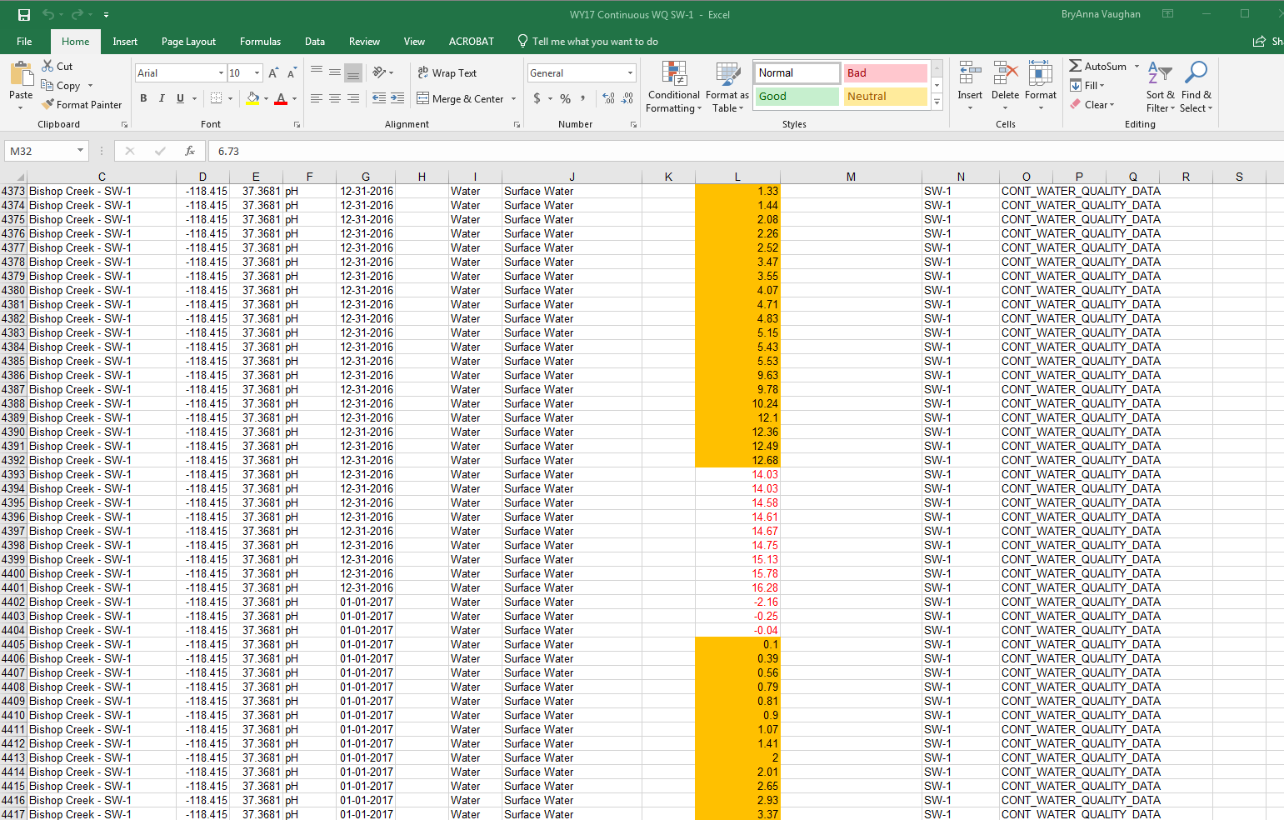
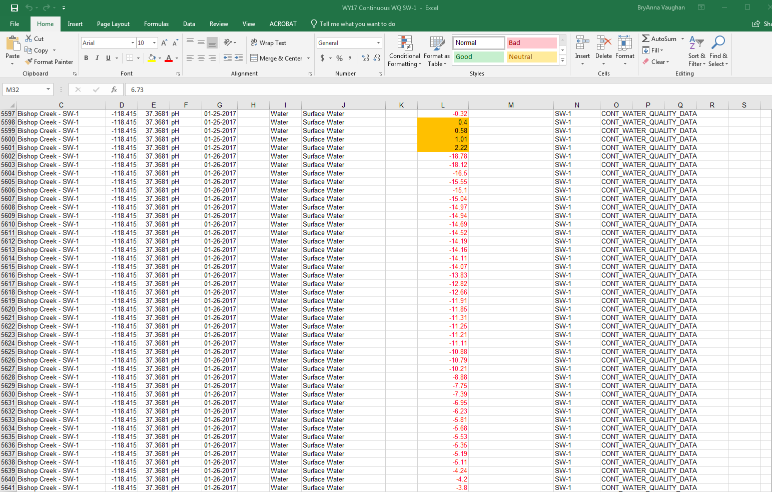
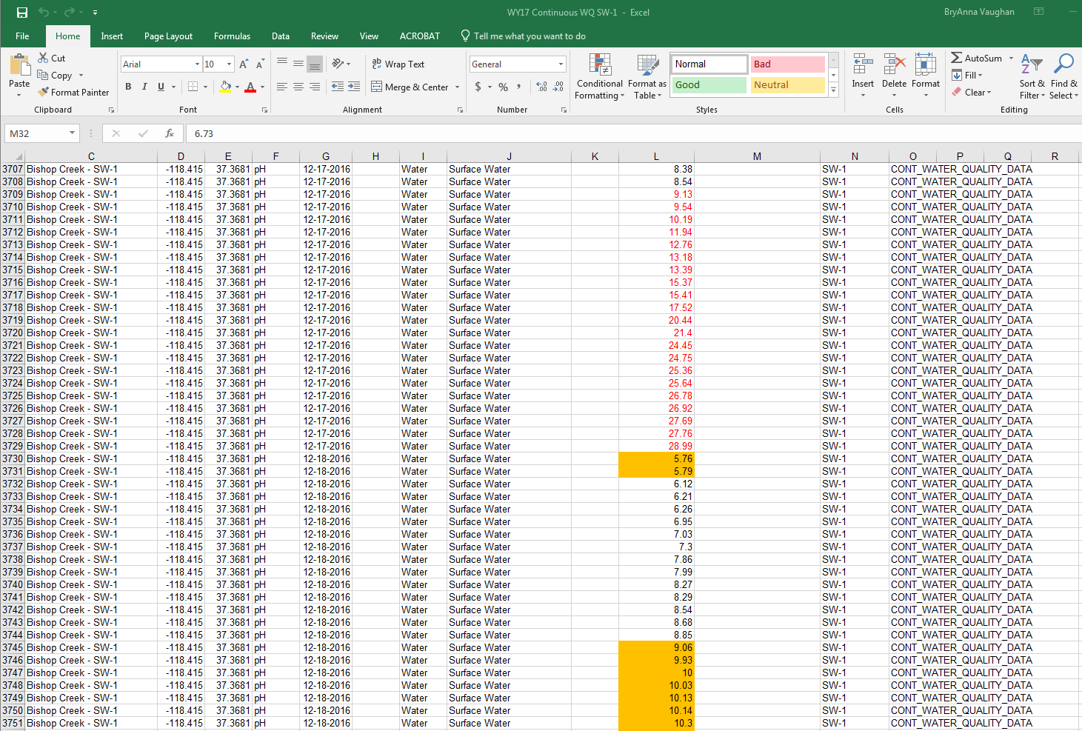
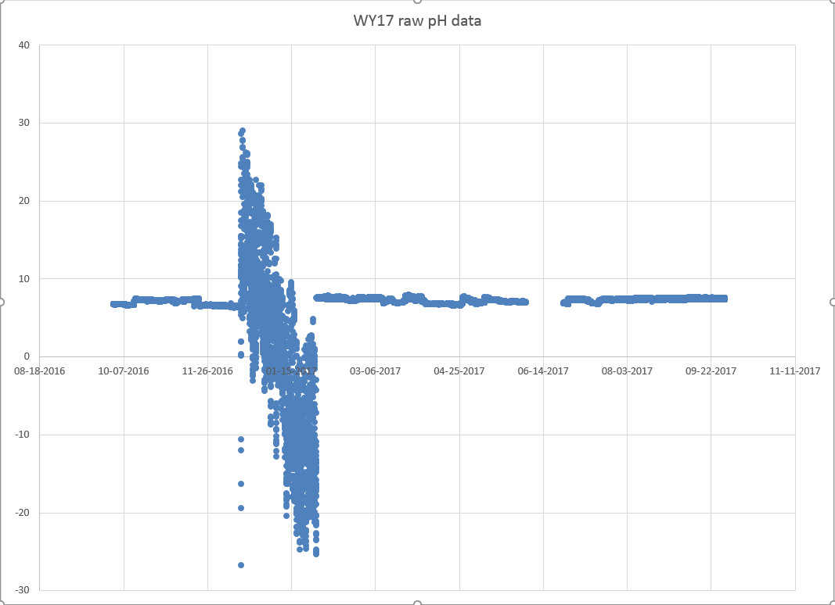
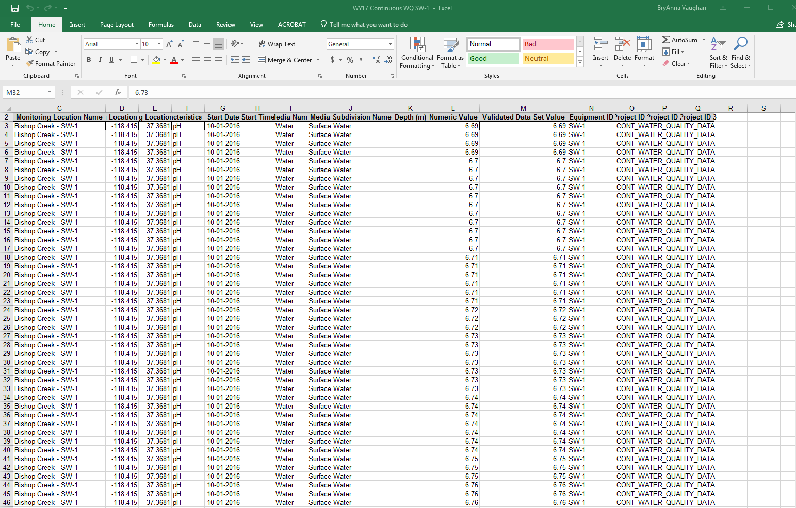
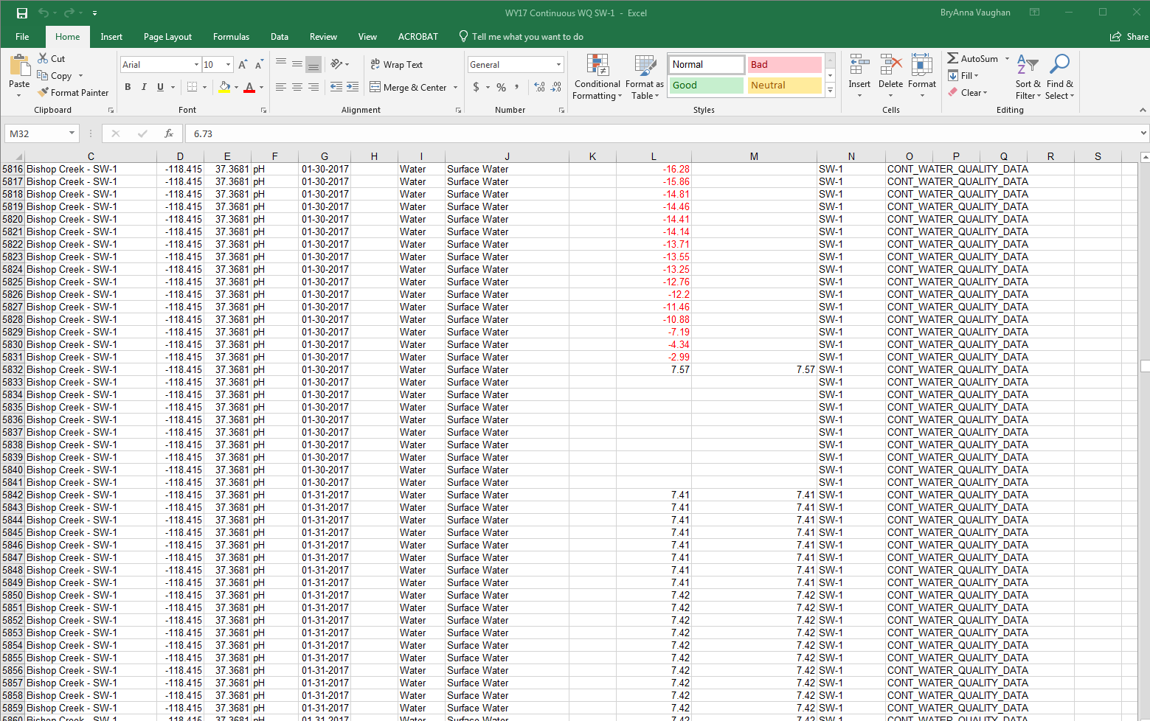
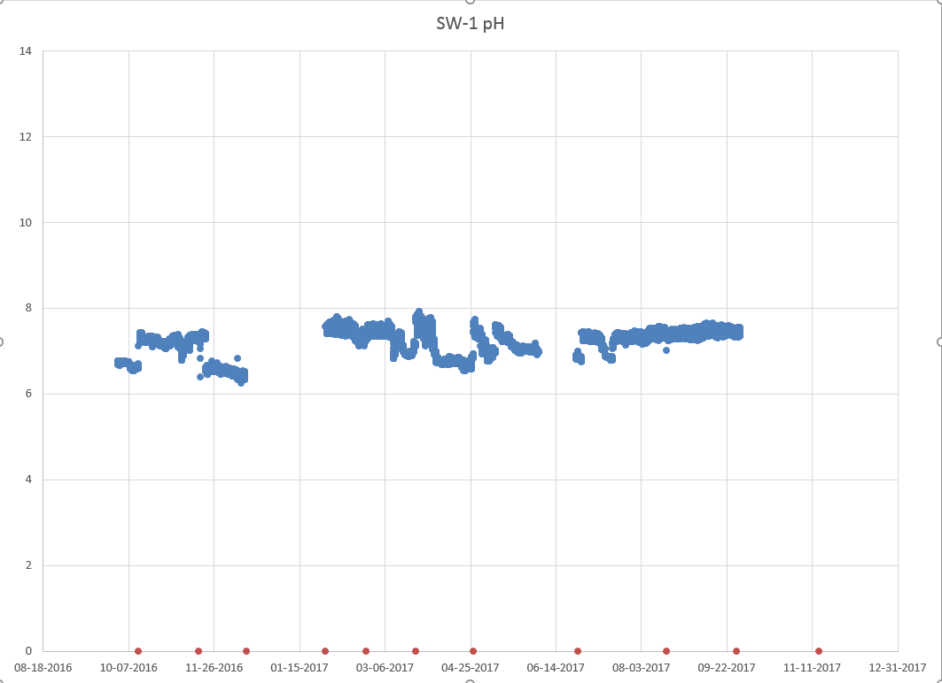
Continuous WQ Data Review & Validation
The “old” way
View raw data
Validate data based on
Sensor capability
Parameter range
Personal knowledge
Gut feeling
Notes:
Mark

Slide 24
AWQMS Integrated Review and Validation Tool
For Continuous WQ Data
Visualize data in a graph and view values in a grid simultaneously
Visually compare data in the graph against either QC bounds or water quality criteria
Click/Drag to zoom in on values
Add the same comment to zoomed values
Update the status and add a comment for zoomed values (e.g. flip from “Preliminary” to “Final”)
Adjust the values and add a comment for zoomed values (e.g. drift adjustment)
Notes:
Mark

Slide 25
AWQMS Integrated Review and Validation Tool
For Continuous WQ Data
Short clip
defining data set
showing data set in graph
showing the update tools (a work in progress)
EE2018Integrated CMD Review and Adustment_cut.mp4
Notes:
Mark

Slide 26
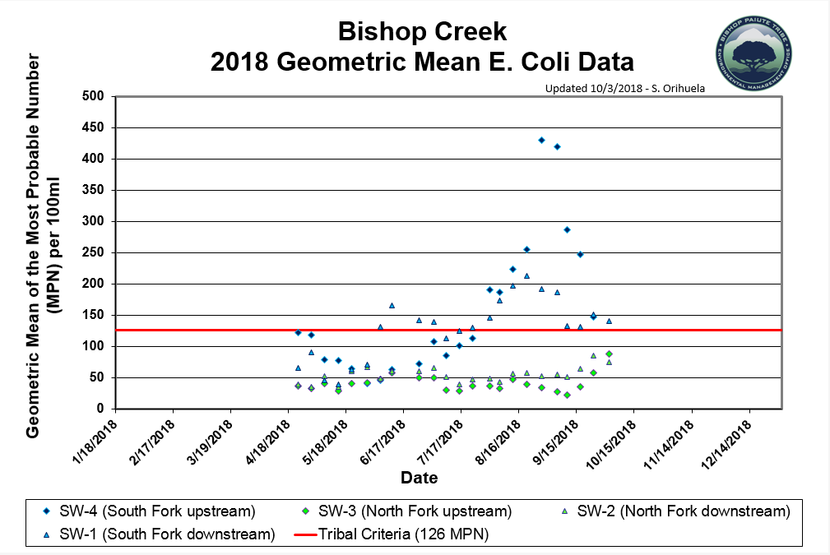
Bishop Paiute Tribe WQCP Data Sharing
Current method for sharing bacteria data on the Tribe’s Water Quality Control Program website
Notes:
Mark

Slide 27
AWQMS Public Portal
for Data Sharing
Two Modes: Exploration & Administered
Modes are not mutually exclusive
Public Portal information only shows data the organization wishes to be public
Public Portal access is “read-only”
Notes:
Mark

Slide 28
Public Portal
for information dissemination
Exploration Mode
User can use any of the built-in AWQMS data analysis graphs, plots, reports, exports, and maps
User defines the data set and sets the options
User works from scratch with each session
Administered Mode
Administrator pre-configures data set definitions
Administrator pre-configures which analysis tools
Administrator pre-determines the entry point
Links to preconfigured tools from external site
Notes:
Mark

Slide 29
Public Portal
for Data Sharing
Show the new method
Explorer Mode
Administered Mode (Linked from web site)
BPT show more efficient “new” method of updating bacteria data onto the BPT WQCP website using the AWQMS Public Portal
Notes:
Mark

Slide 30
AWQMS Data Appliance
Continuous Data Submission Old Way
Data User
Sensor
WQ Portal
metaata
Summary
data
data
Organization
Metadata
WQX
Summary Data
Metadata
STORET
Raw data file
attachment
Summary Data
Notes:
Mark

Slide 31
Sensor Observation Service
“Data Appliance”
AWQMS is optimized to handle continuous monitoring data
Only data summaries for CMD are sent to WQX
User can specify the summary period
AWQMS is now a SOS “Data Appliance”
AWQMS SOS web services will be added to the IWN catalog and discovery tool
Notes:
Mark

Slide 32
AWQMS Data Appliance
EPA Guidance:
“Sensor Data Appliance”
Data User
Raw Data
“Data Appliance”
Discovery Tool (AKA: “Sensor Catalog”
Sensor
Raw Data
Raw Data
Organization
Metadata (Monitoring Locations, etc.)
Notes:
Mark

Slide 33
AWQMS Data Appliance
AWQMS is now a
data appliance
Data User
Raw Data
“Data Appliance”
Discovery Tool (AKA: “Sensor Catalog”
Sensor
Raw Data
Raw Data
Organization
Metadata (Monitoring Locations, etc.)
Notes:
Mark

Slide 34
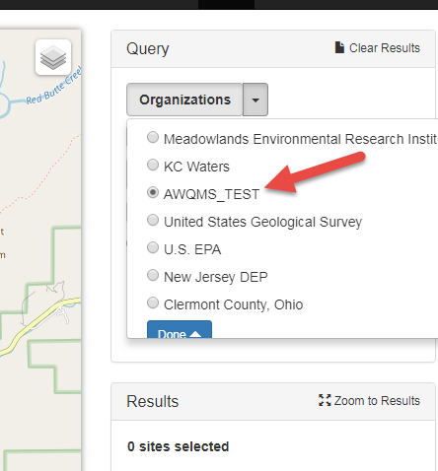
AWQMS Data Appliance
Notes:
Mark

Slide 35
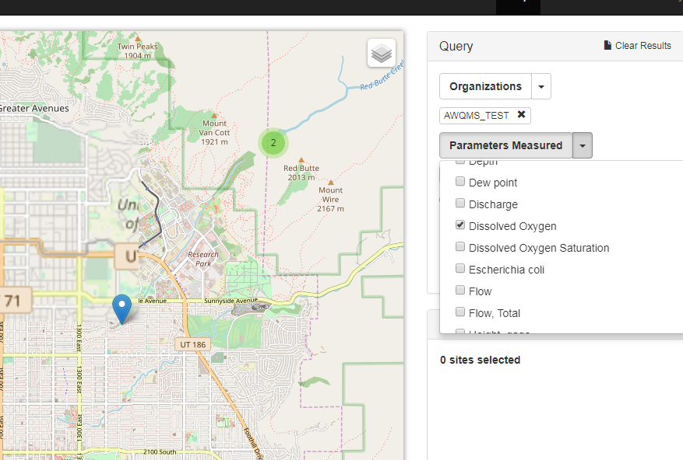
AWQMS Data Appliance
Show new method
Notes:
Mark

Slide 36
Questions?
BryAnna – BryAnna.Vaughan@BishopPaiute.org
Mark – Mark.Lebaron@GoldSystems.com

