Slide 1

Streamlining Field to Desk: Port Gamble S’Klallam Tribe’s Strong Water Mobile Application
Abigail Welch
Finfish Management Biologist
E-Enterprise for the Environment 2018

Slide 2
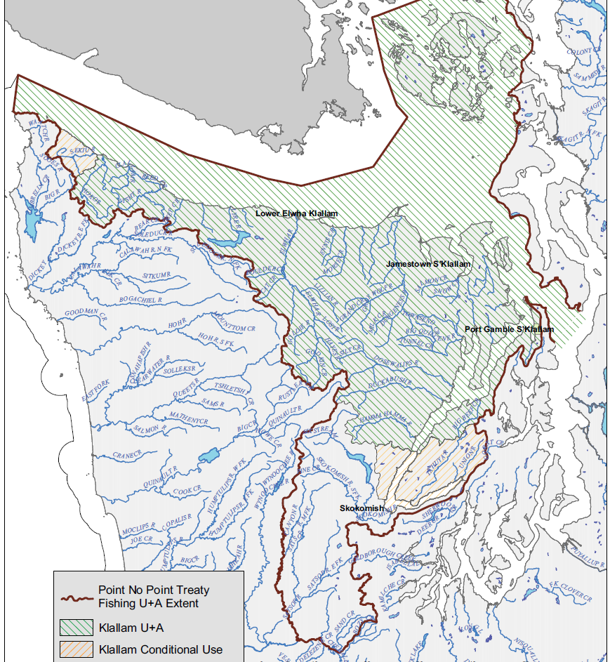
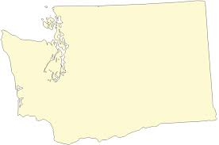
About Us
Located in the northwest corner of Washington state. One of 29 federally recognized tribes in WA state.
Reservation consists of 1,700 acres
1,300 enrolled members
Treaty rights to harvest fish, wildlife, and other natural resources under a co-management process
Usual and Accustomed areas includes 1250 river miles and 2250 square miles of marine areas.

Slide 3
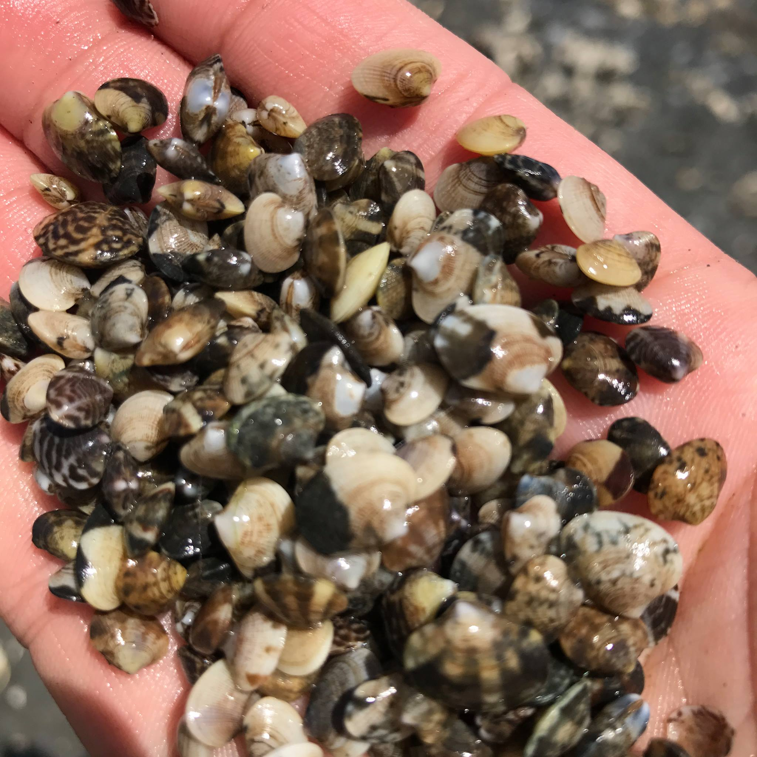
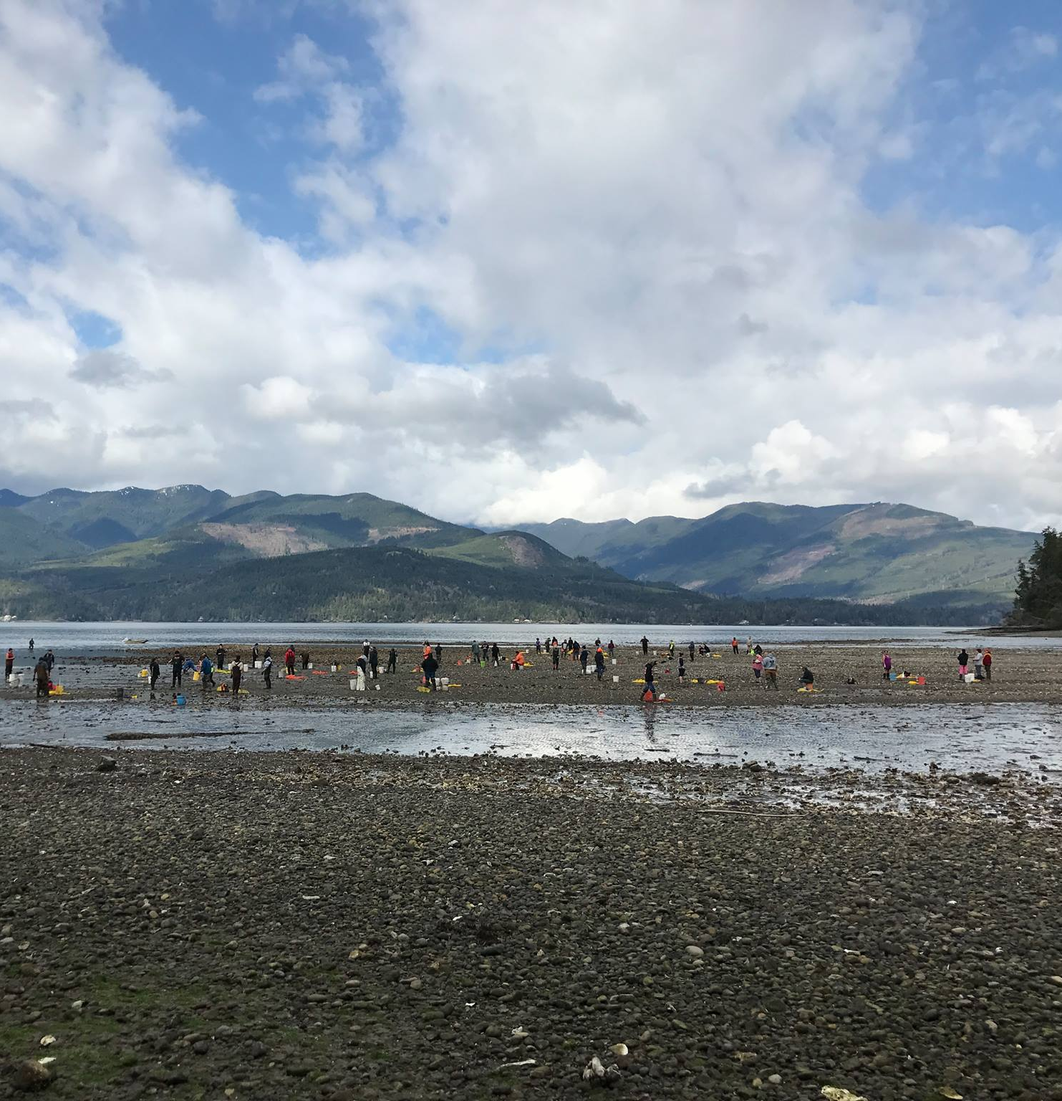
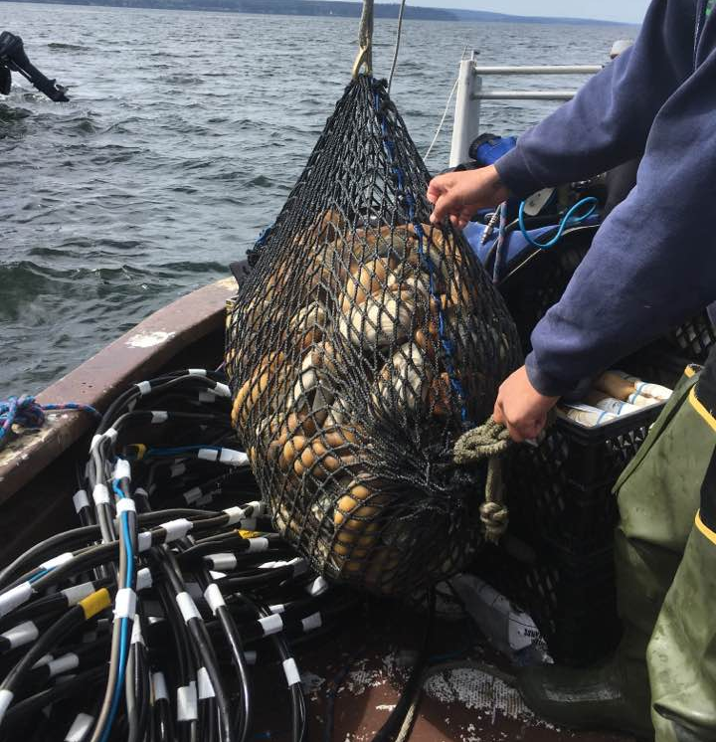
Natural Resources

Slide 4
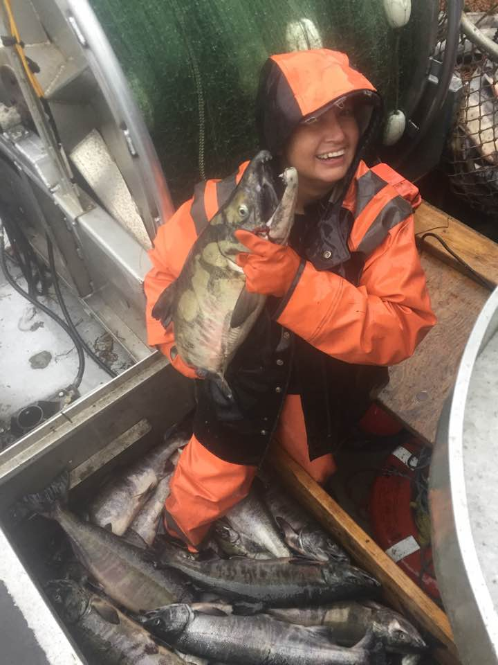
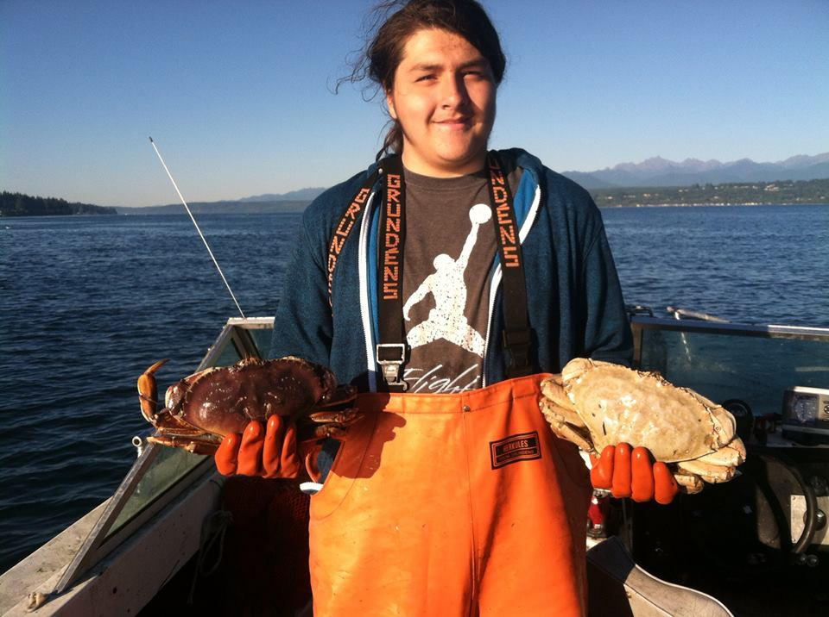
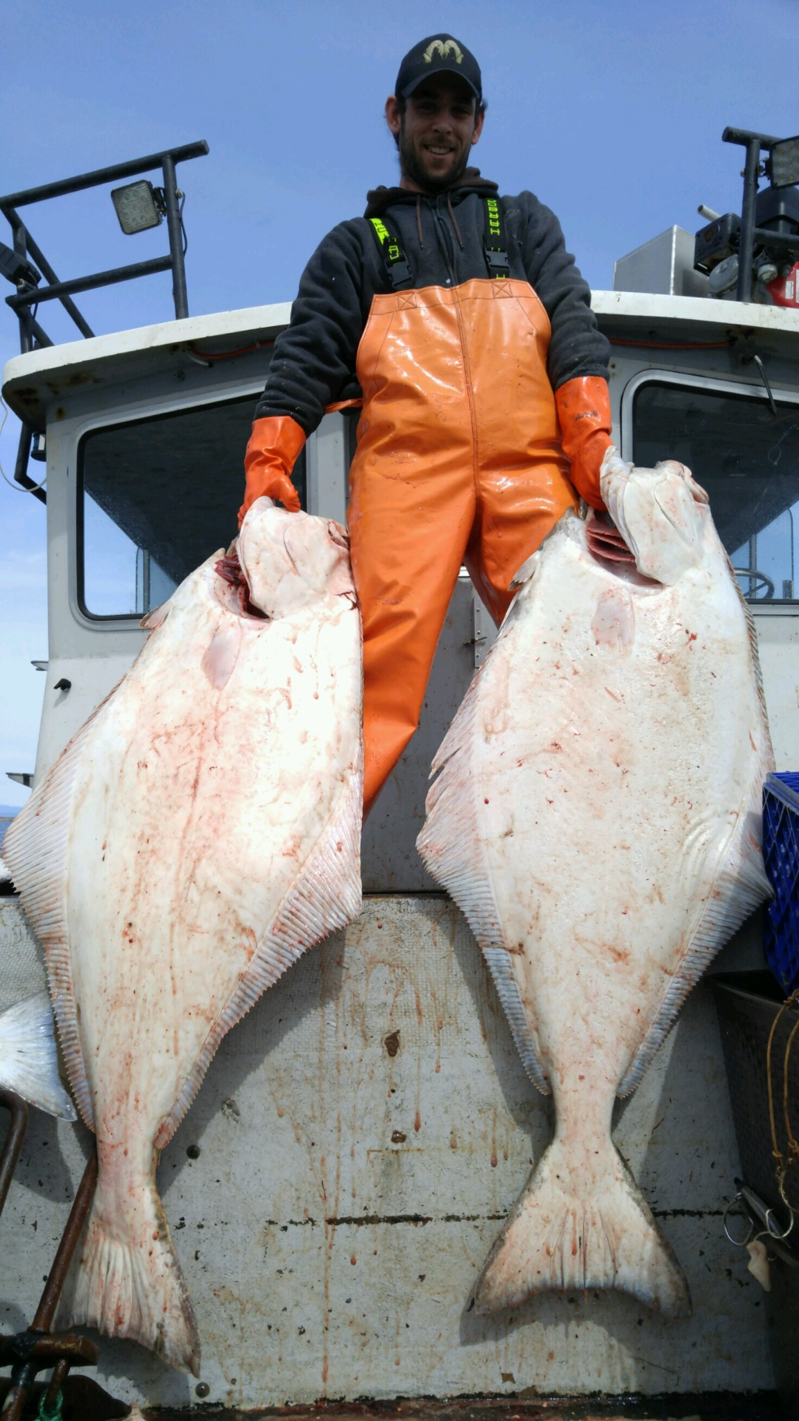
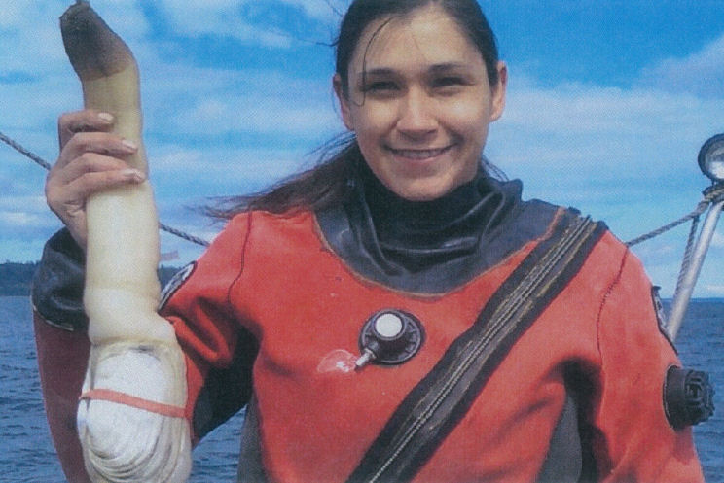
    Fisheries Management
    • Finfish
    Hatchery & Net Pen program
    Harvest
    Commercial sampling
    • Shellfish
    Harvest
    Beach Surveys
    Flupsy-Floating Upweller System

Slide 5
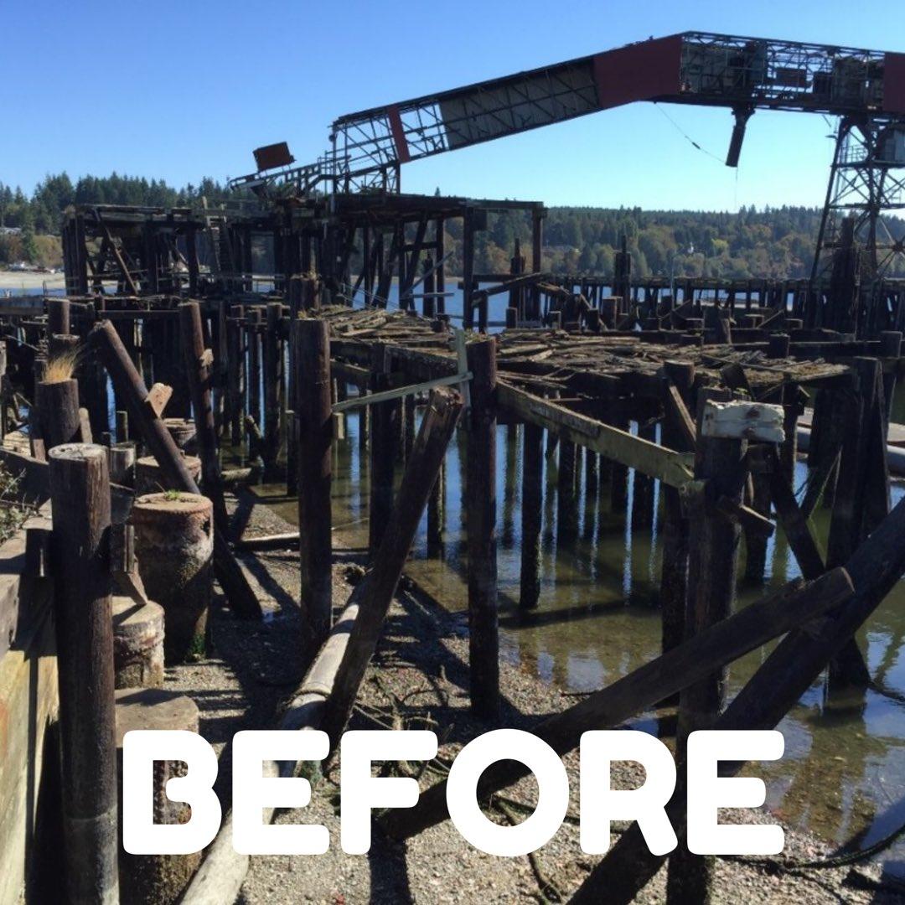
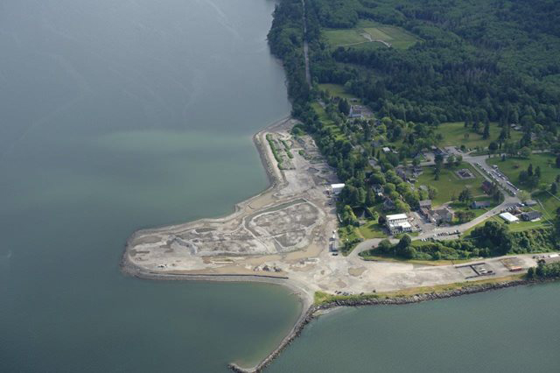
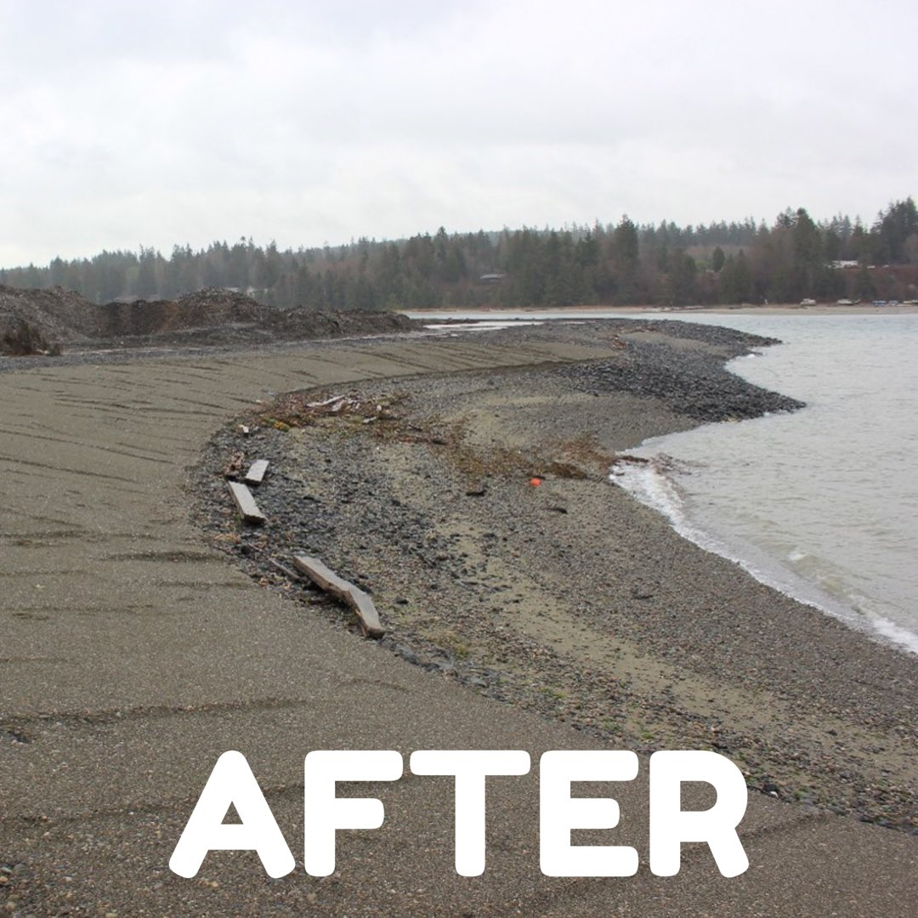
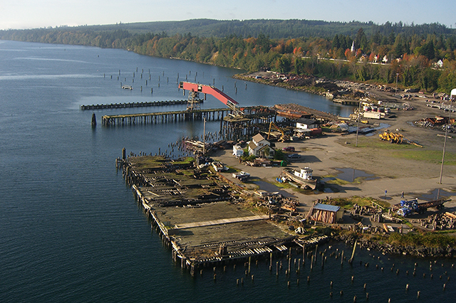
Environmental Programs
  Brownfields
  Climate Change
  Protection/Restoration
  Shoreline Management
  Water Resources

Slide 6
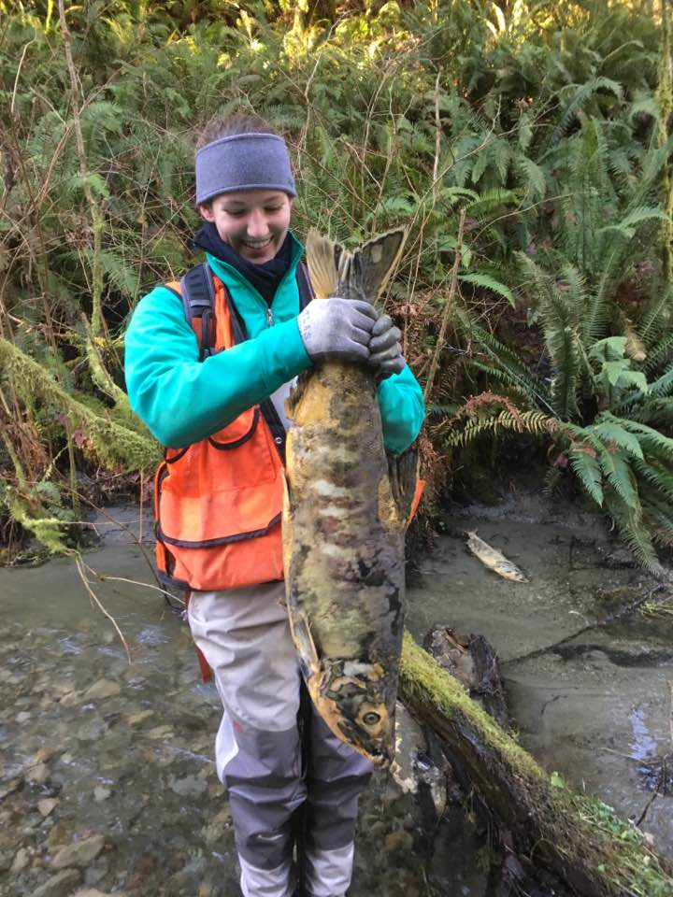
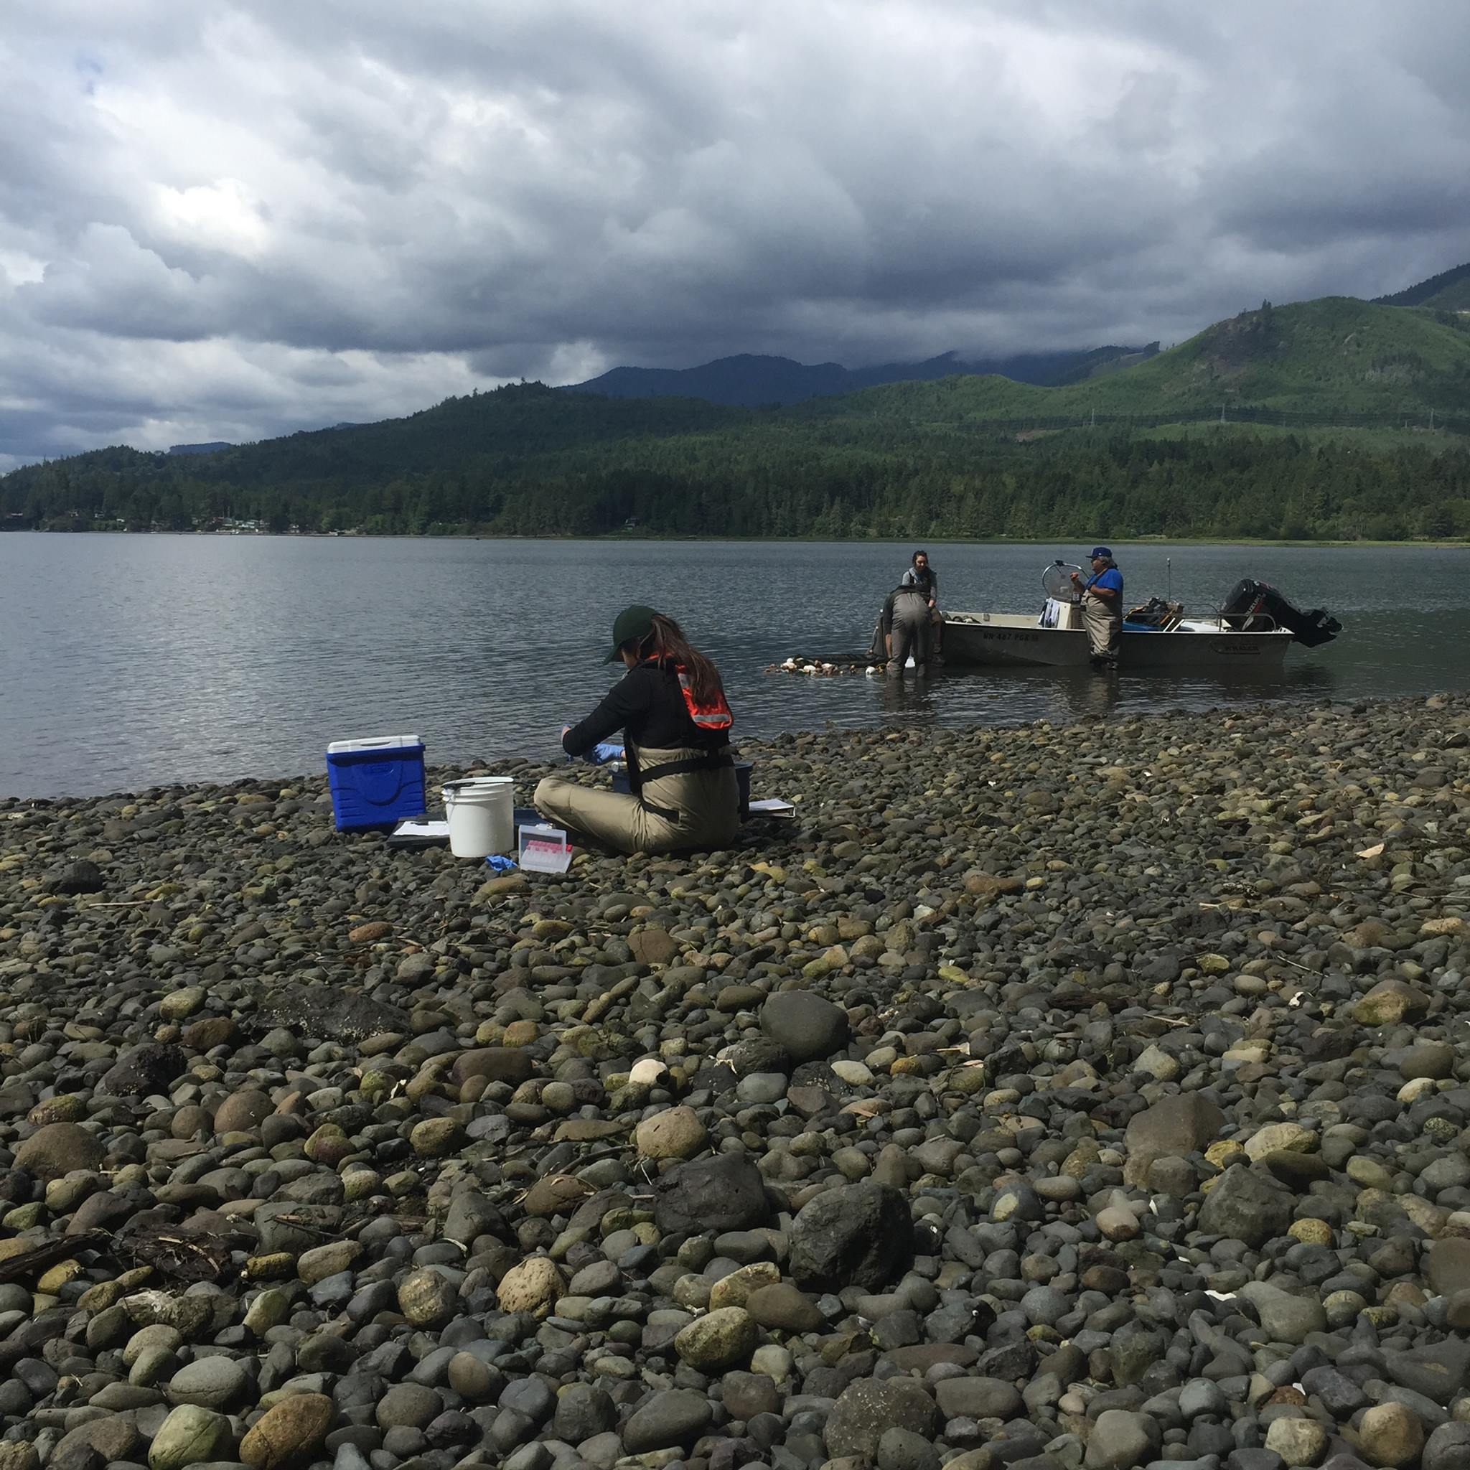
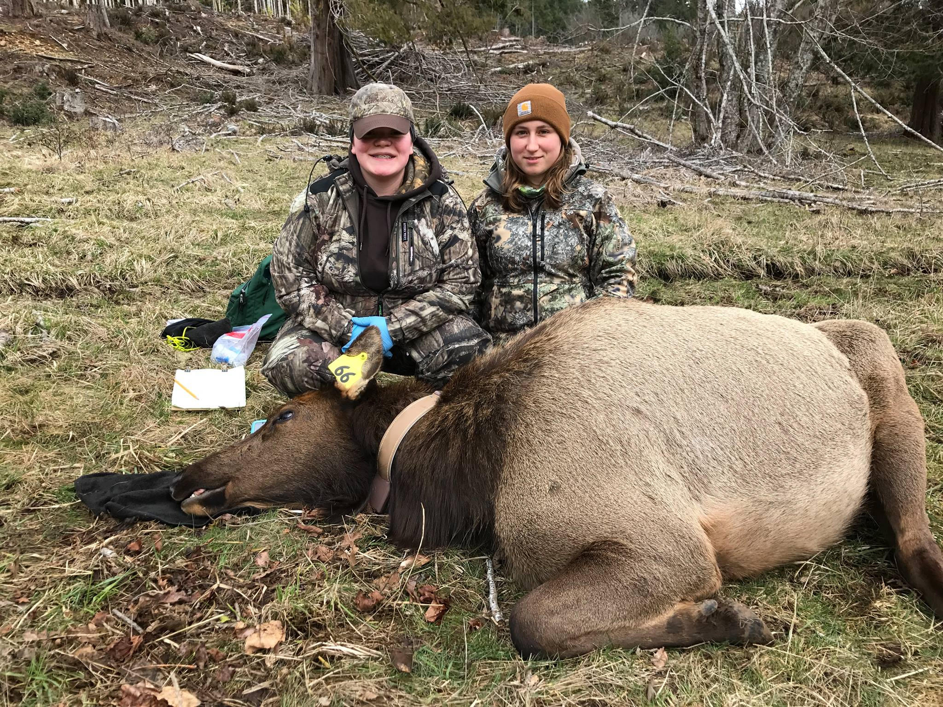
Habitat Research & Monitoring
Salmon Recovery
Forestry
Wildlife/Hunting
Elk surveys

Slide 7
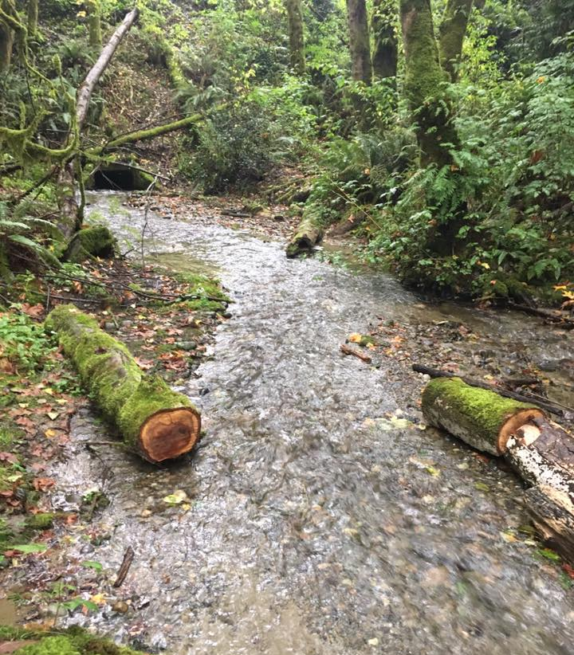
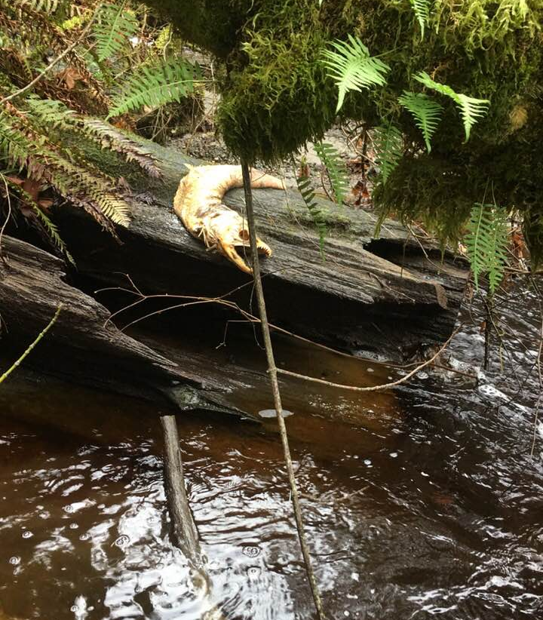
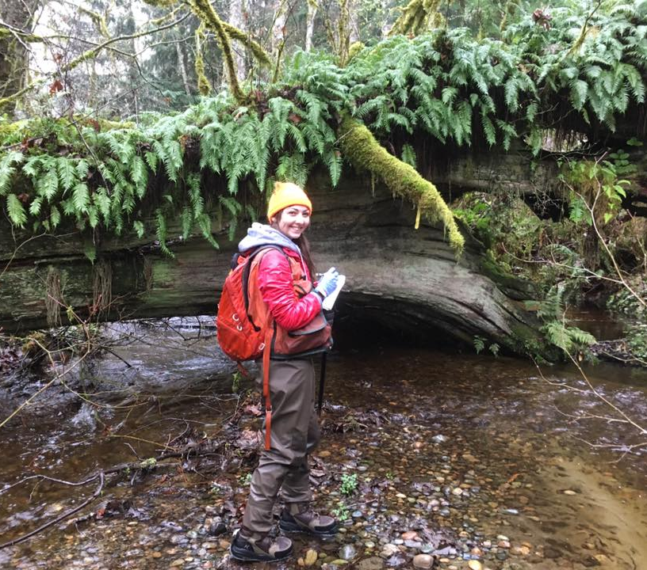
WQX Data Flow
First successful data flow to EPA
Monthly sampling on 13 different creeks and streams throughout the reservation.
Quarterly submittals to EPA-106 grant requirements.
Needed to streamline data entry into STORET
Utilizes the NWIFC front end but uses PGST’s own network node (2009 Readiness grant).
Paper to database data entry time consuming
Mobile App that can sync to our database
Notes:
Help streamline ability to get data into EPA’s database-elaborate on this, describe the “front end”, challenges of STORET database

Slide 8
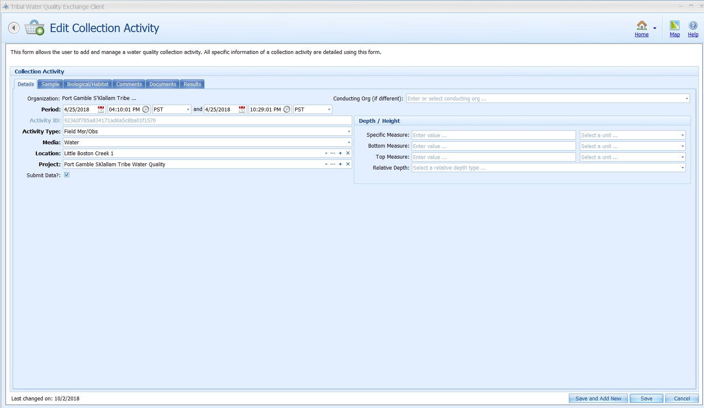
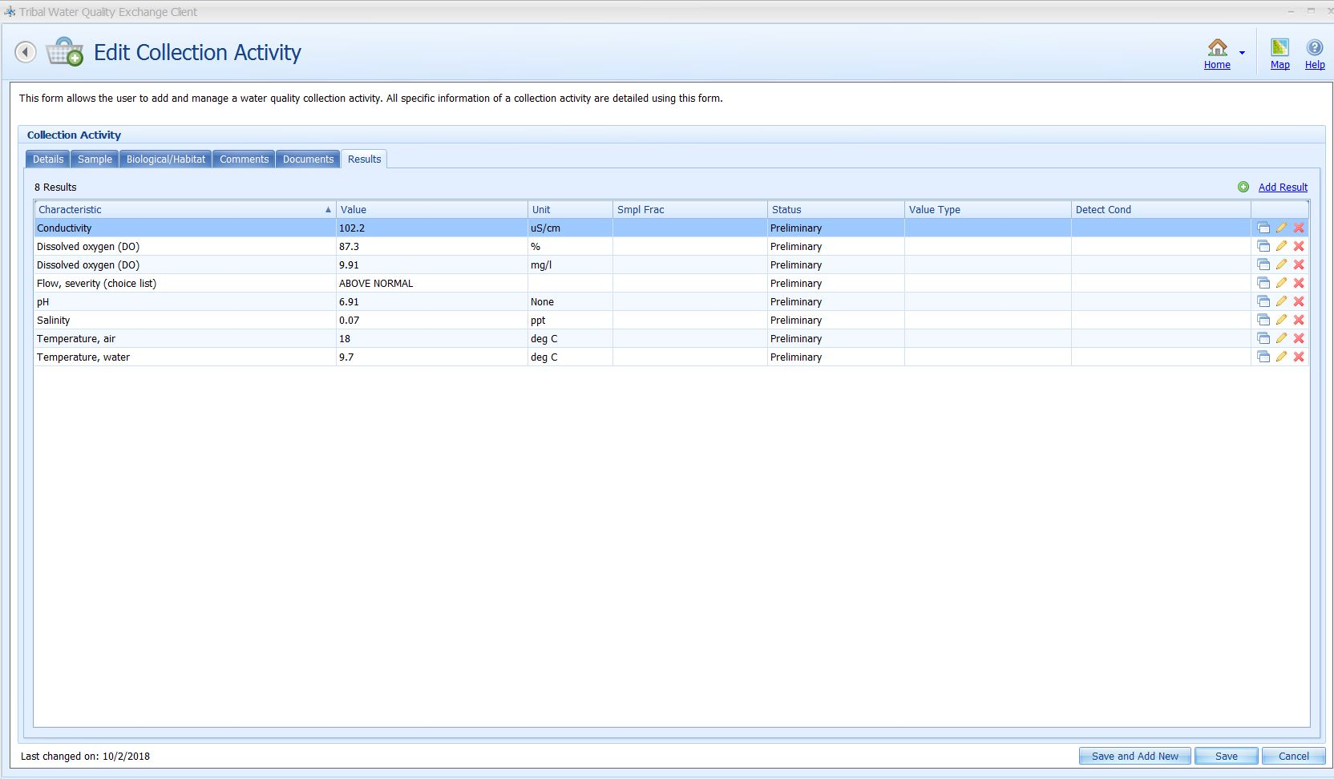
NWIFC TWQD User Interface
Desktop application for entering, querying and submitting data to EPA
User friendly interface to aid in submitting data to EPA
Time consuming for larger datasets
Notes:
60 clicks of the mouse for 1 site, average of 13 sites a month. Includes all water quality characteristics and measurable units.

Slide 9
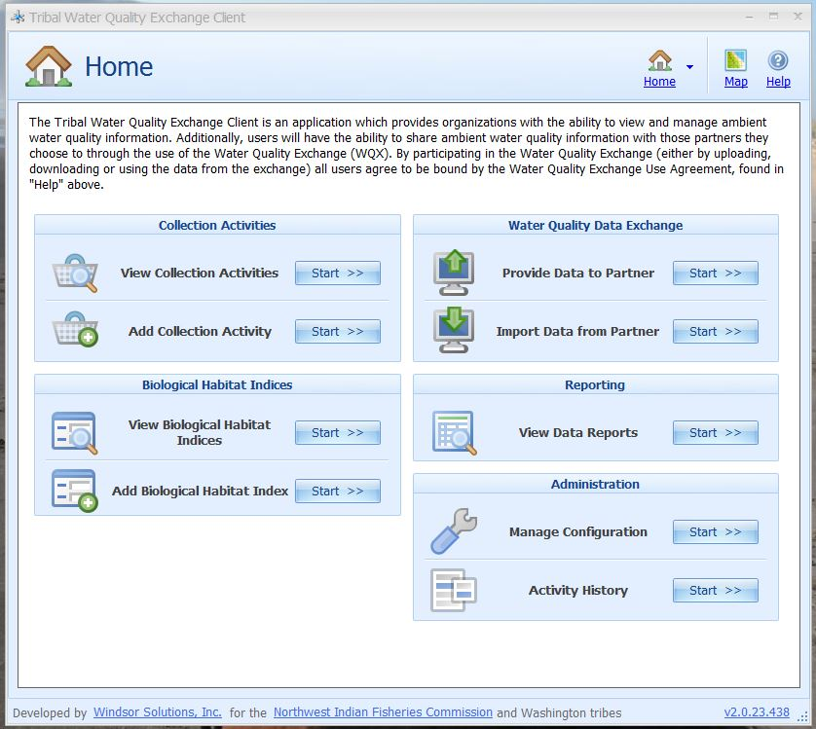
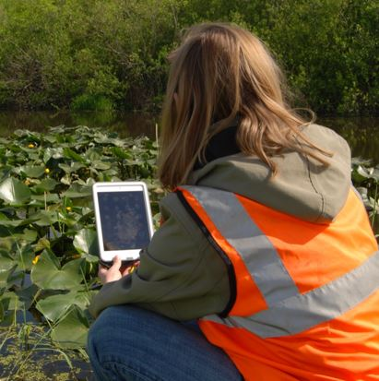

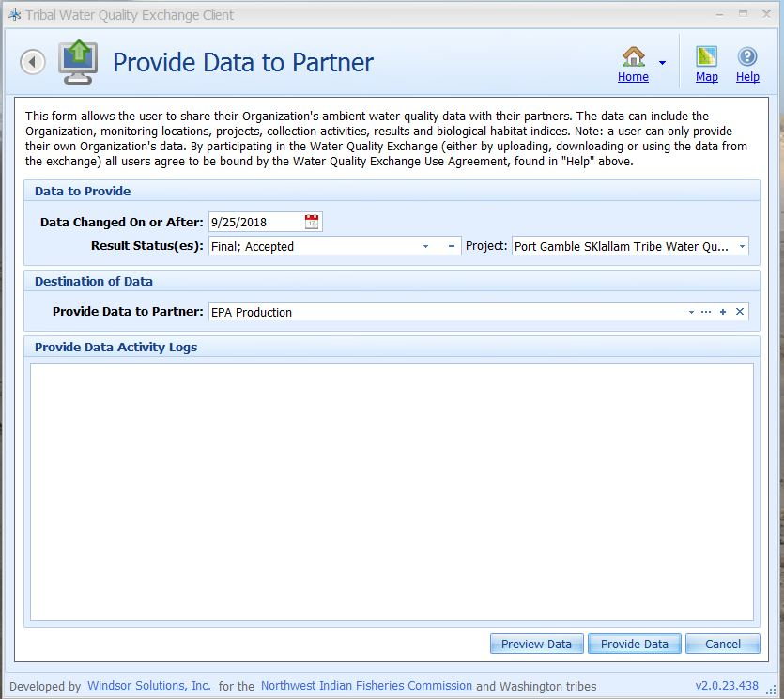
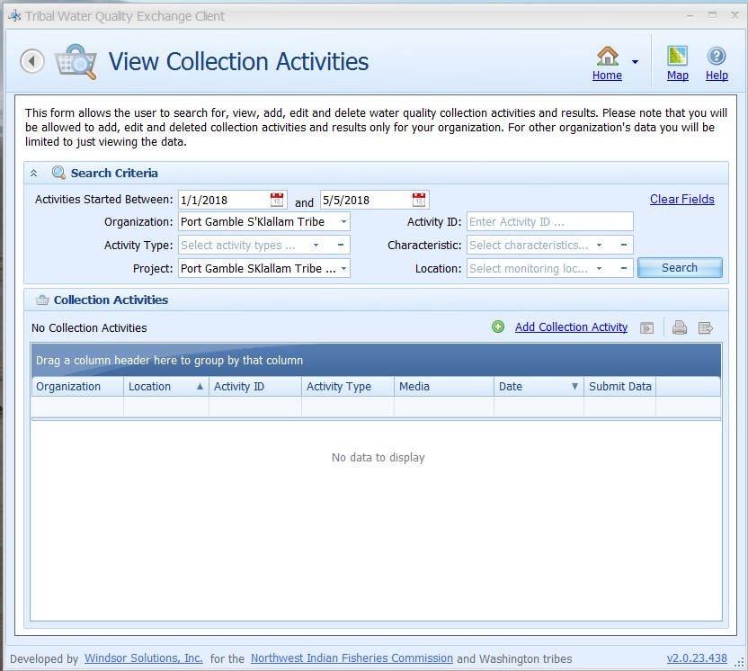
From the Field to EPA
TWQD
PGST network
Sync data

Slide 10
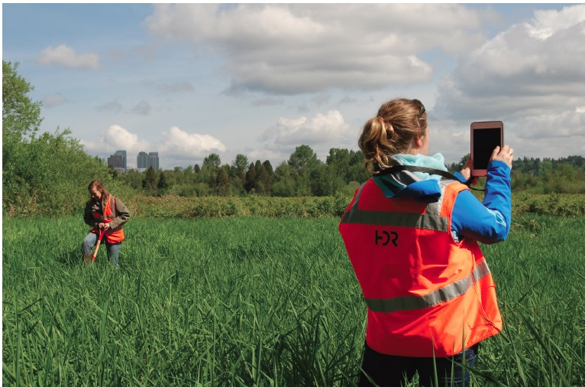
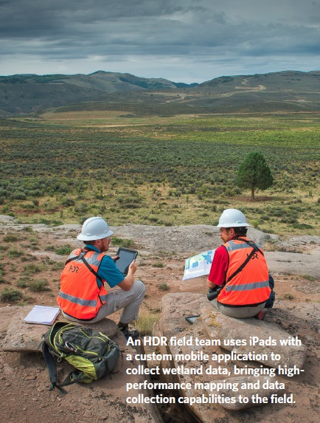
WQX Mobile Application
2017 Grant awarded
Goals
  Paperless in the field
  Ability to function offline, data transfers can resume when connection is restored.
  Rapid Collection
  Increased availability of timely, high quality data to improve decision making
  Affordable maintenance fees
Notes:
Elaborate how much time we are saving, compare to NWIFC front end and how many clicks/time for entering it in.

Slide 11
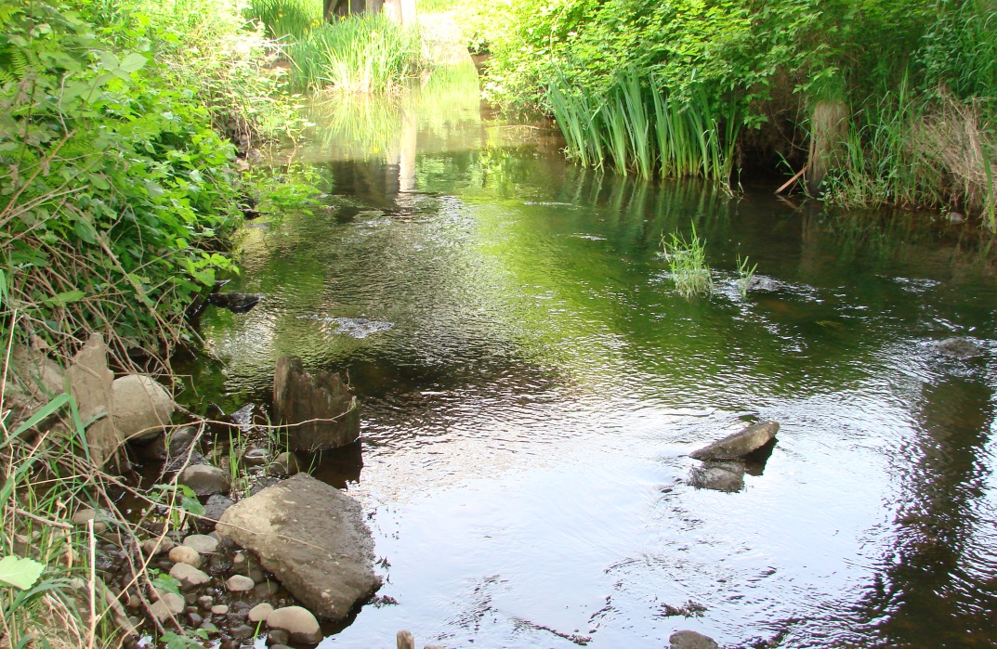
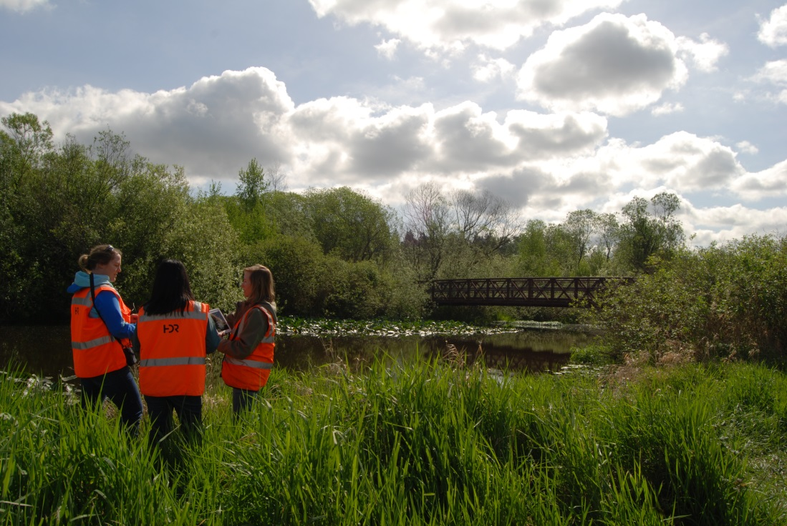
WQX Mobile Application
Platform: iOS
Mobile Framework: Xamarin
Data Connection: ASP.NET core, web API
Works offline
One-way sync
Installs and updates are distributed via custom app store or iTunes
Notes:
Xamarin is a cross platform mobile framework owned by Microsoft.
Xamarin can support iOS, android, or window apps. So we can reuse the same code if we want to extend into another platform
The app works offline by storing data on a device using SQLite, which is a database that lives on the device. SQLite connects to the SQL database via ASP.NET core, web API.
All of these programs are open source and don’t require fees.

Slide 12
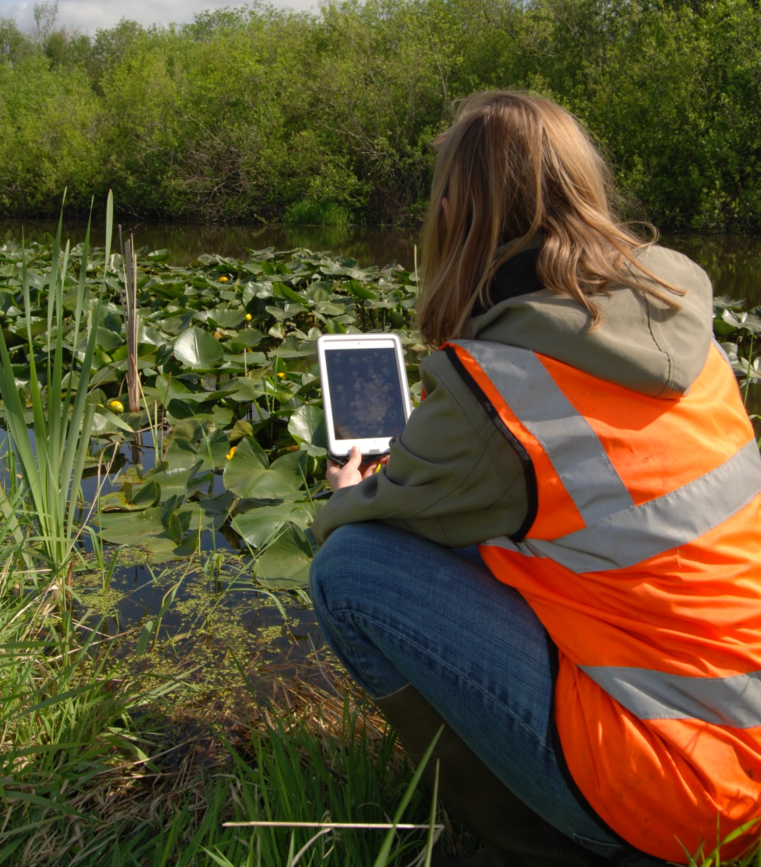
WQX Mobile Application
Challenges
Complex database to understand
Validation of tables

Slide 13
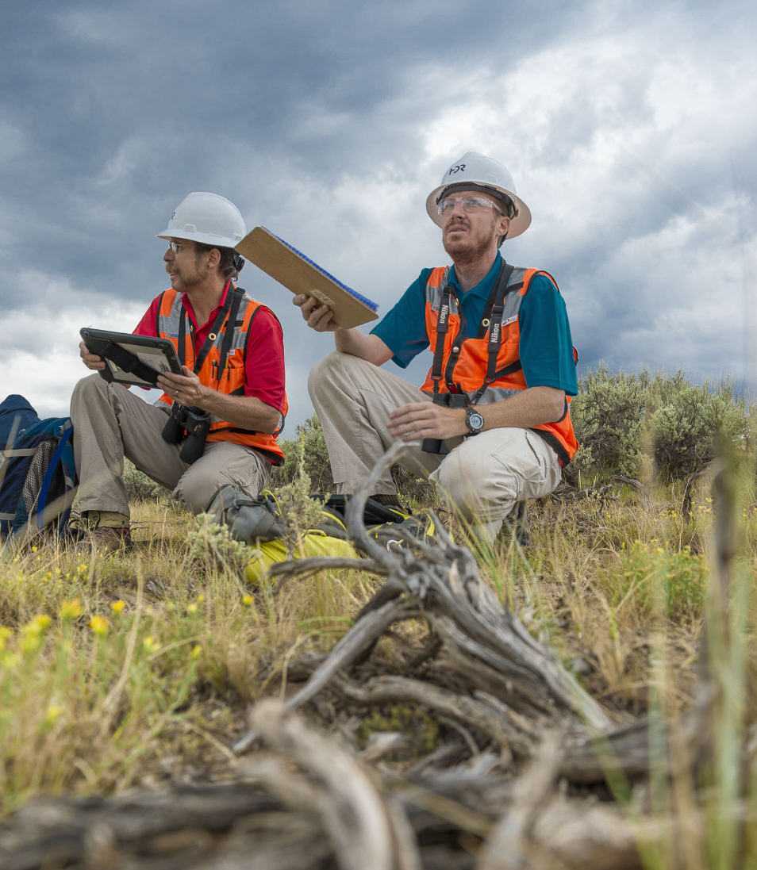
Benefits
Simplified flow having to select 8 of 3,028 characteristics
Minimize errors in the field having uniform data entry requirement and acceptable ranges for units

Slide 14
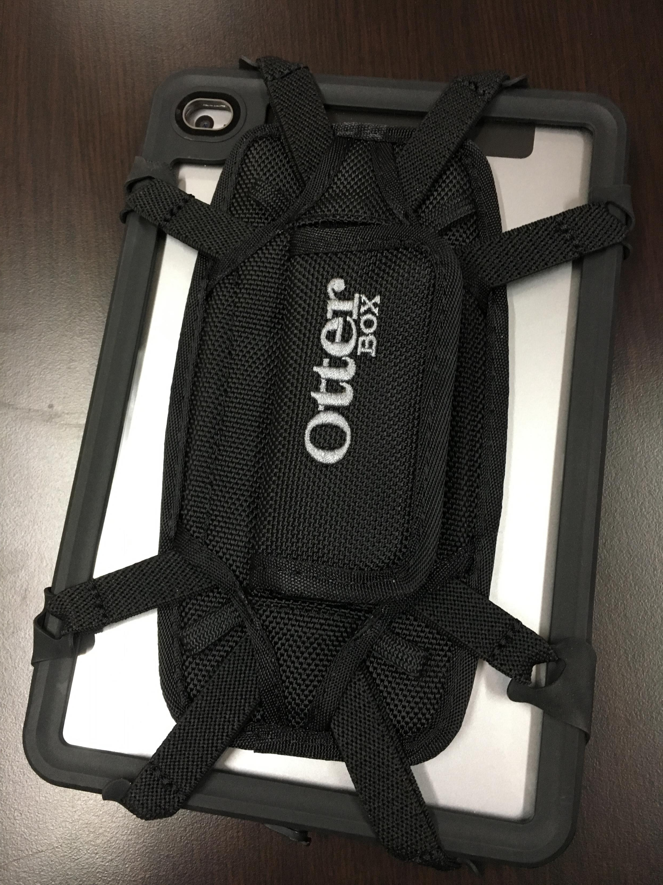
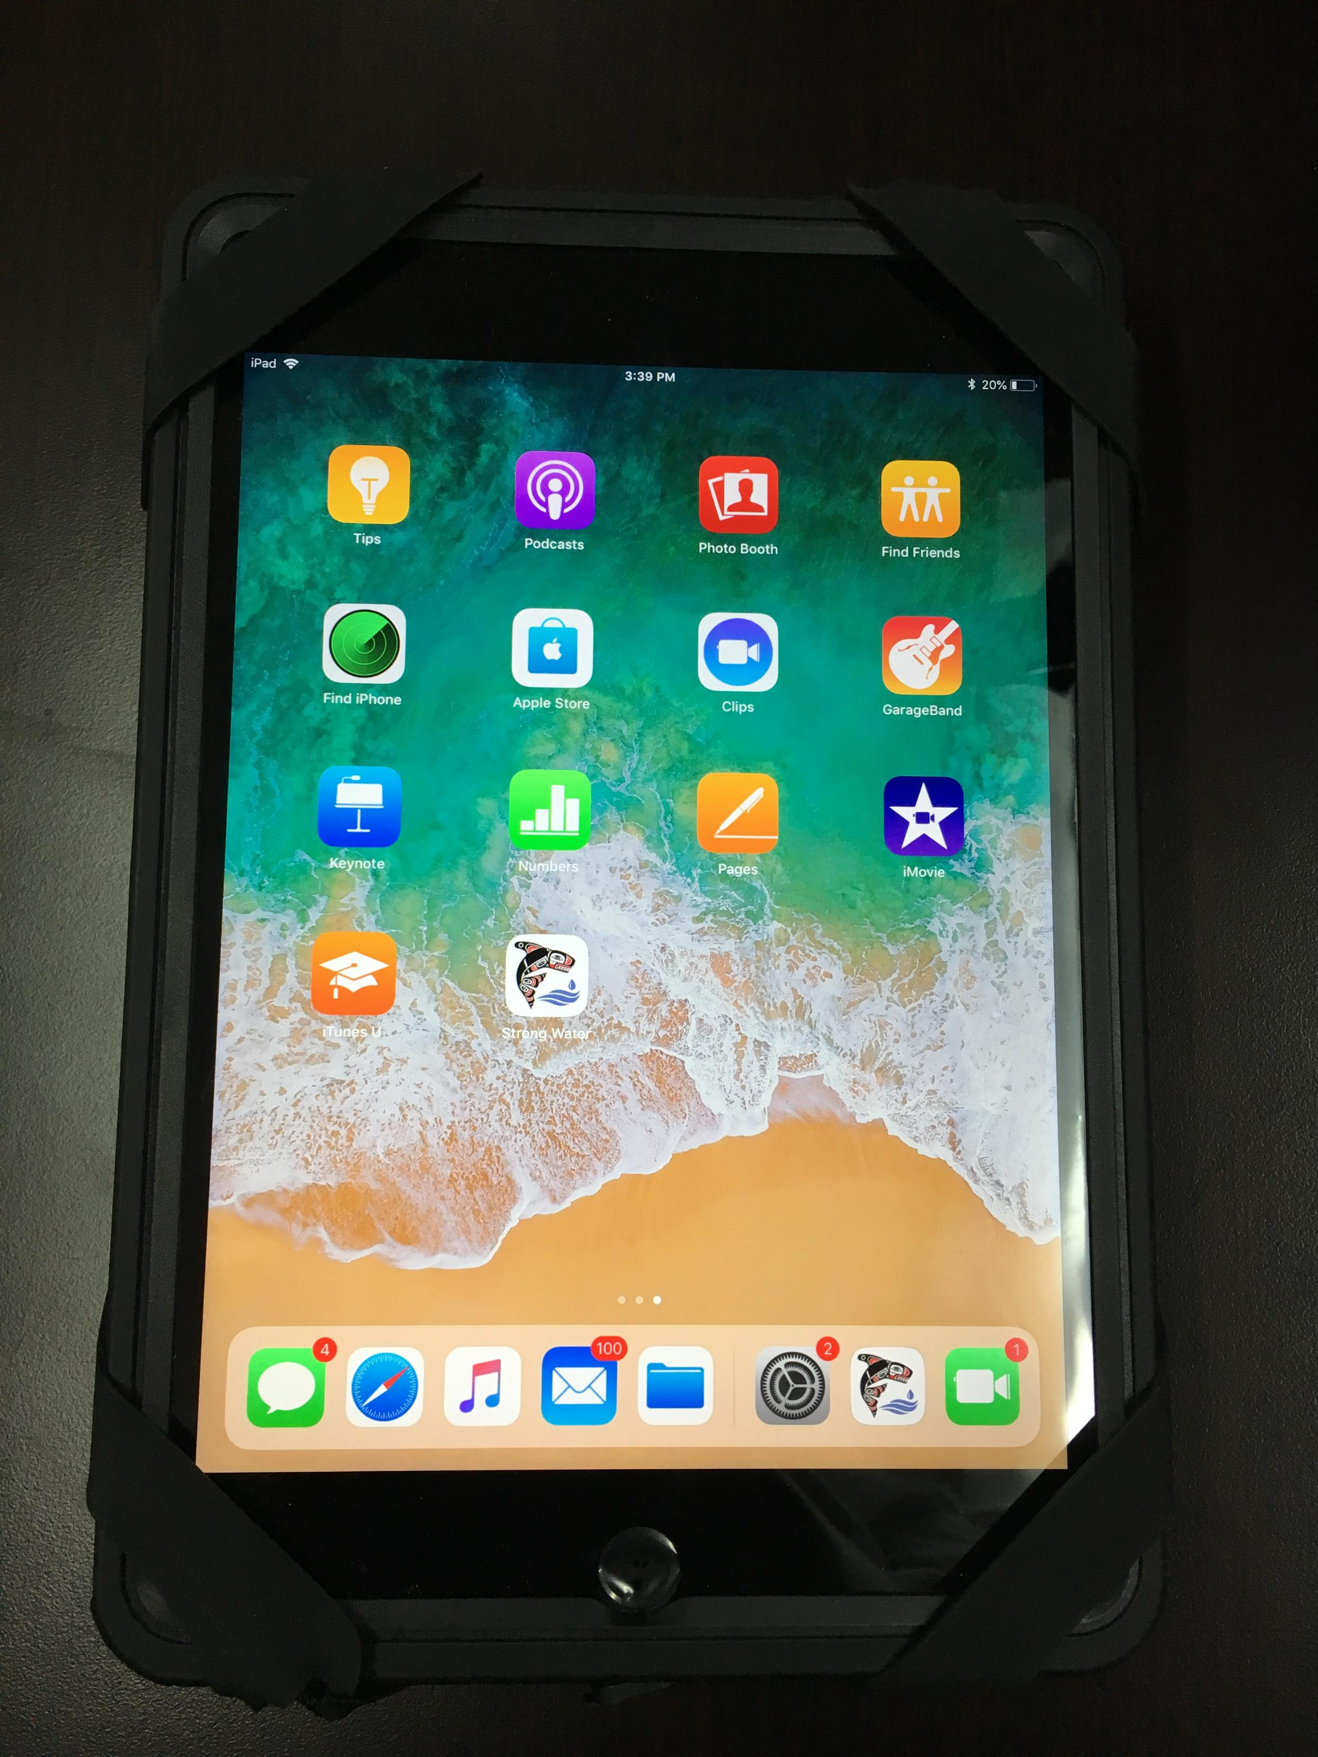
Ipad Mini with waterproof case and holder

Slide 15
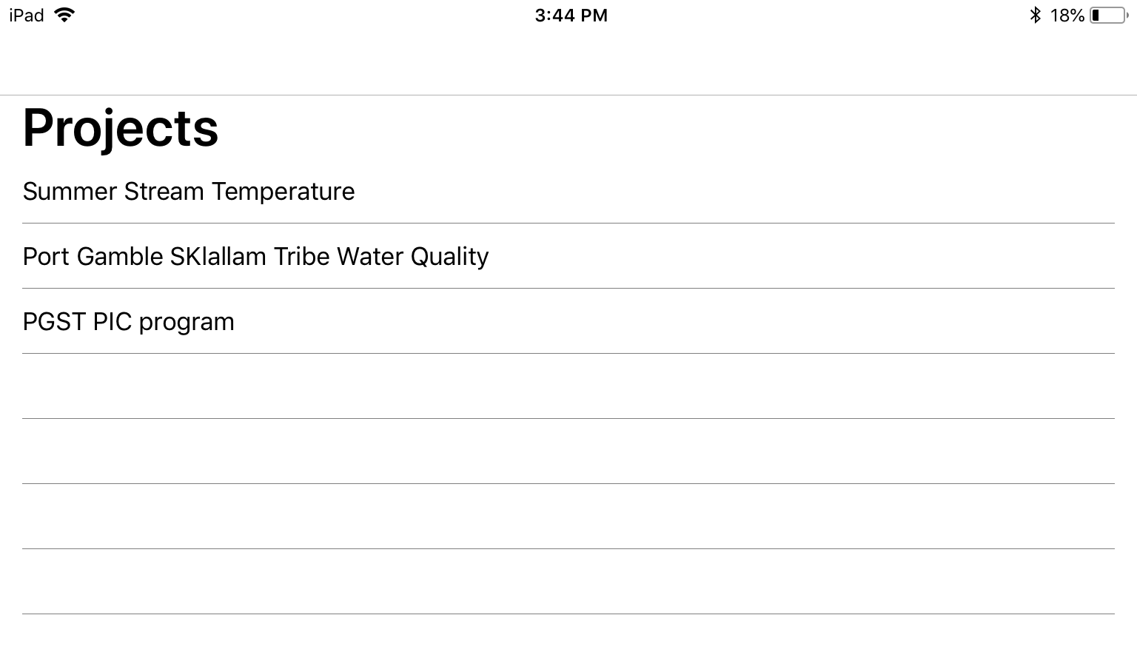
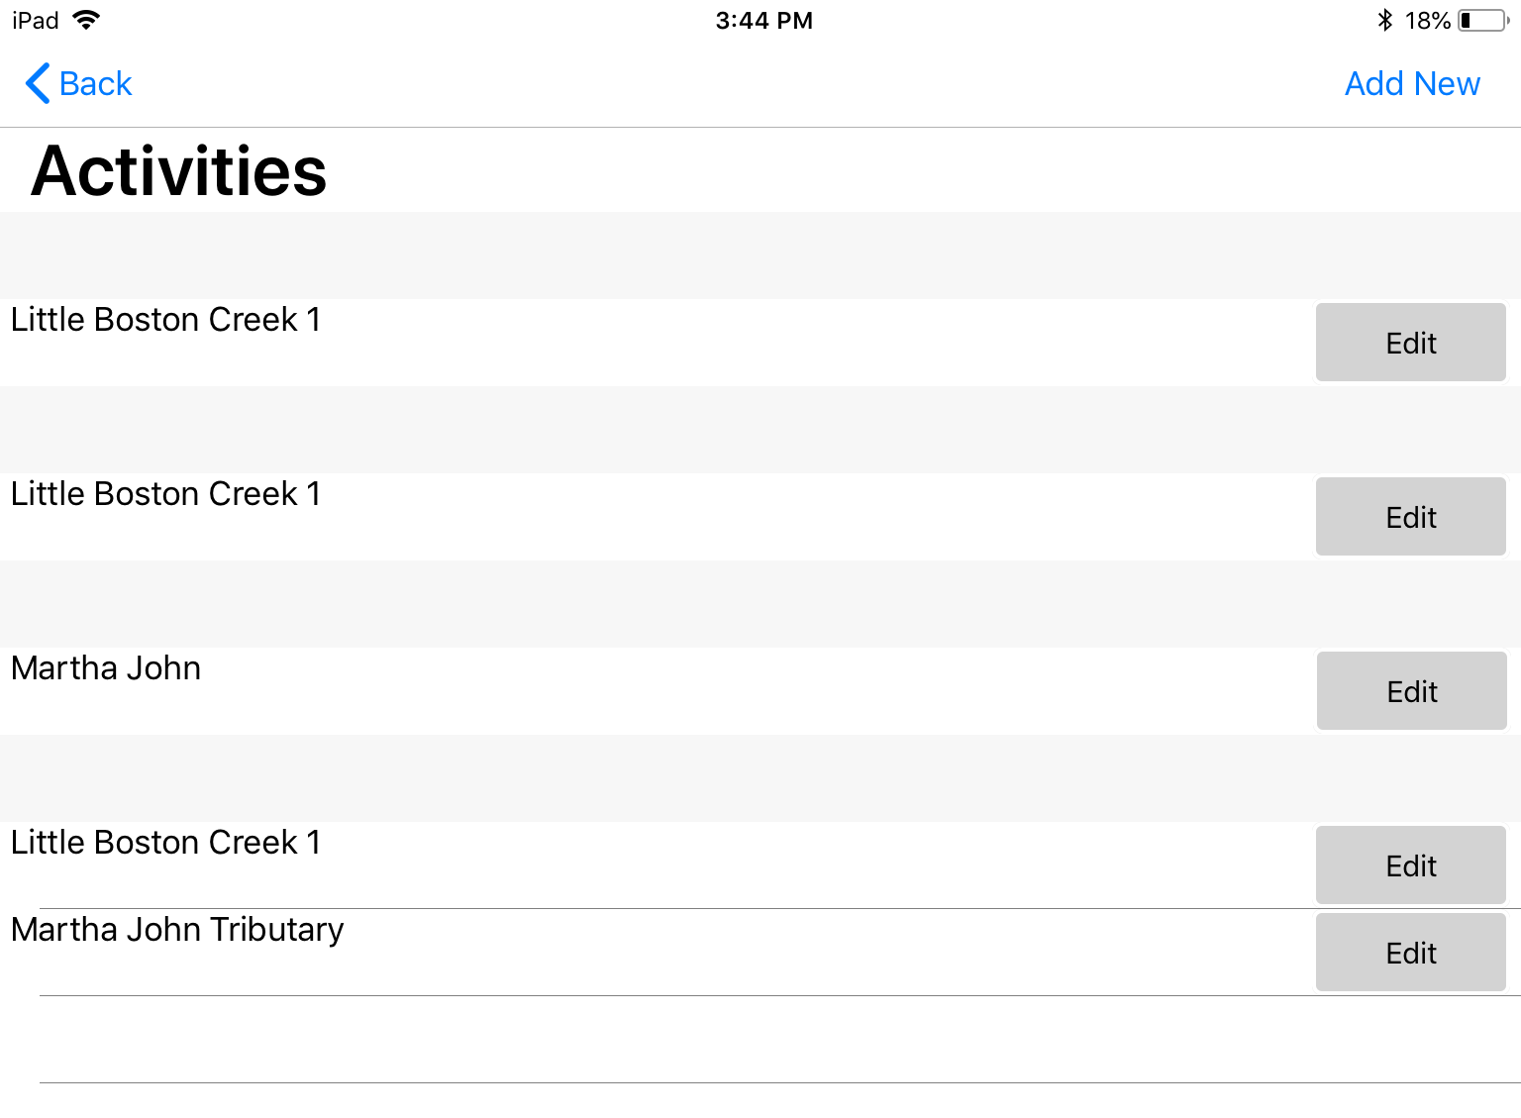
Notes:
Crop, make larger or do a video clip of data collection.

Slide 16
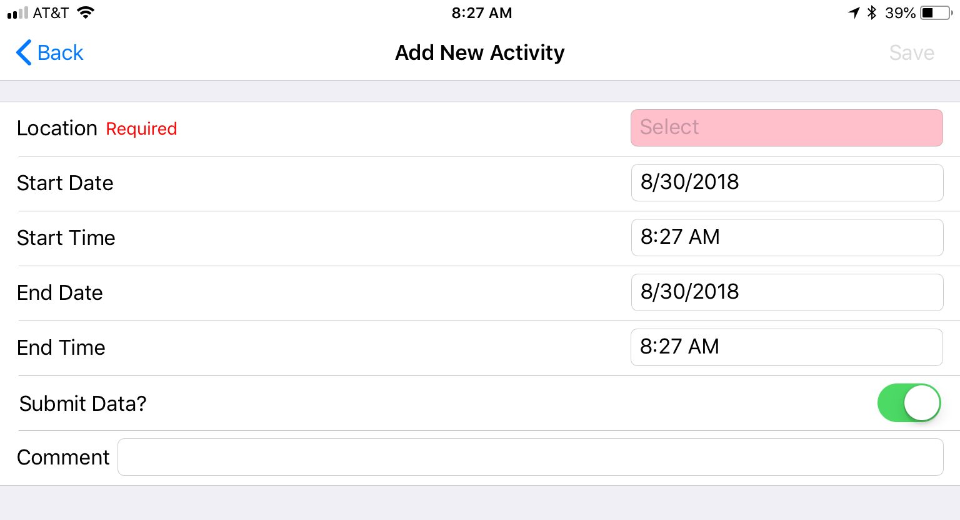

Slide 17
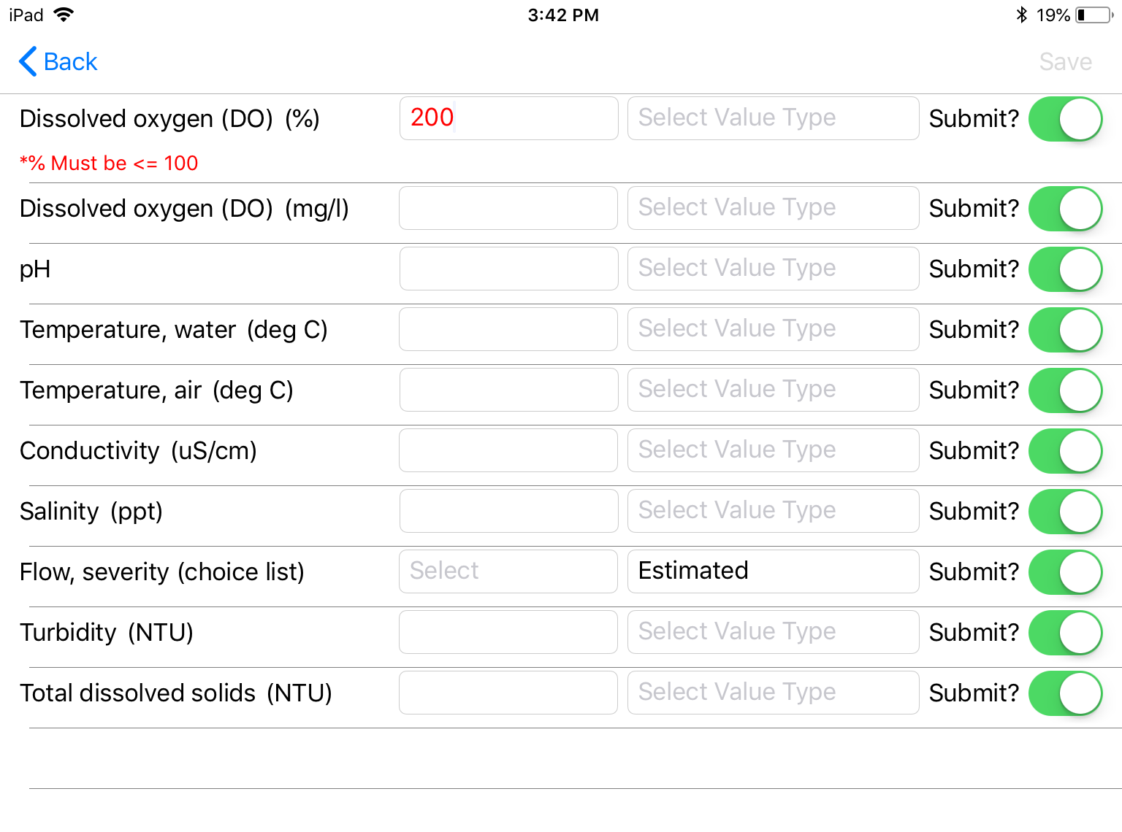
Notes:
Talk about QA/QC

Slide 18
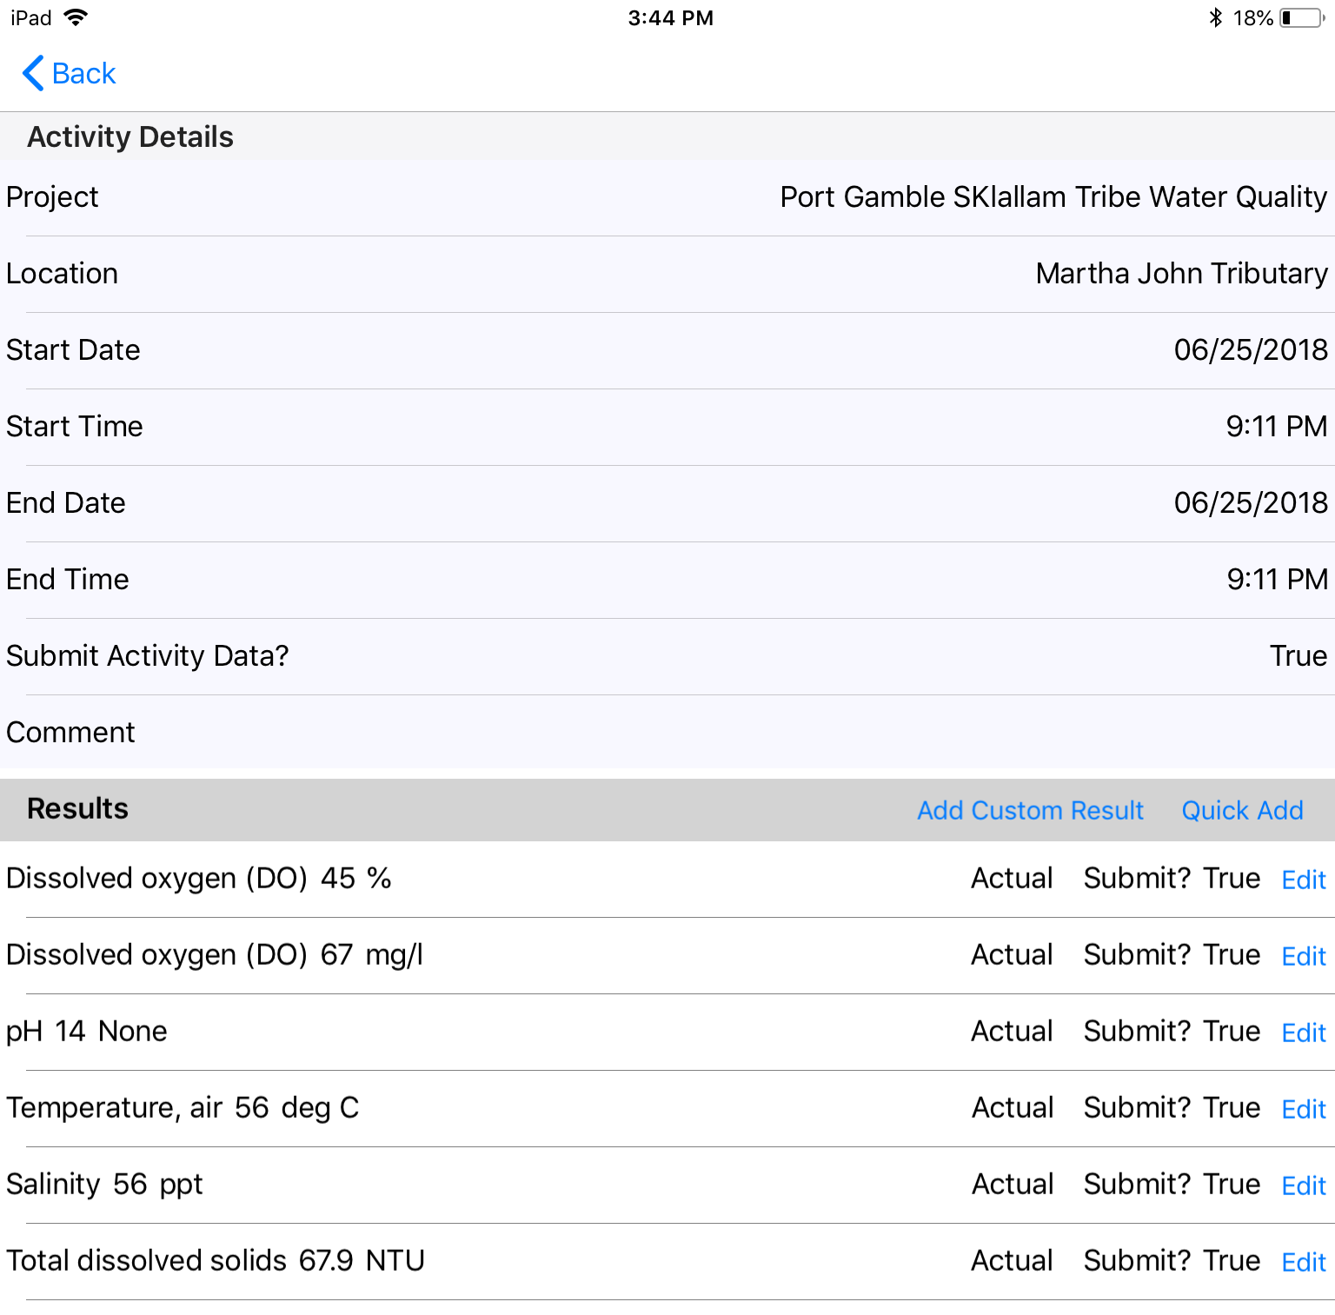

Slide 19
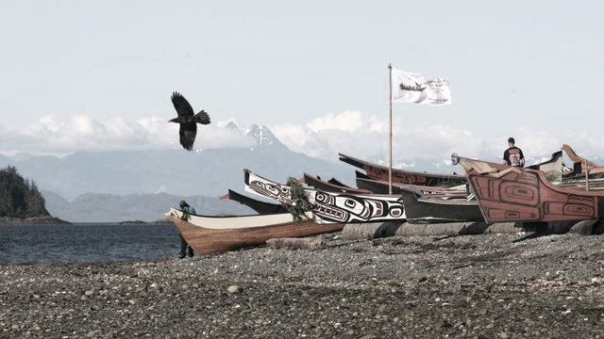
Questions?
PGST Resources:
Northwest Indian Fisheries Commission/ SSHIAP https://nwifc.org
HDR Inc: www.hdrinc.com
Windsor Solutions: www.windsorsolutions.com

