Slide 1

Shared
CROMERR Services
Workshop
Presented by
Greg Mitchell
10/23/2018

Slide 2
Agenda
What is Shared CROMERR Service?
How do I CROMERR in an hour?
What Do I Get CROMERR in an hour?
Demo the process
:
Results - process request by the end of workshop

Slide 3
What is Shared CROMERR Services?
  CROss Media Electronic Reporting Rule (CROMERR)
  Sets standards for electronic report receiving systems for regulated 40 CFR information collected by states, tribes, and local governments and U.S. EPA through authorized programs.
  Shared CROMERR Services
  Advanced Websites AND Core web services
  Procedures AND documentation (approved by the CROMERR Committee)
  Contract templates and Open Source Software
  Demo applications and Tools
https://encromerrdev.epacdxnode.net/about
  Greg Mitchell
  U.S. Environmental Protection Agency
  919-541-4823
  Mitchell.greg@epa.gov
  CDX Help for Desk Shared Services
  888-890-1995 Option 2
  sharedcromerrservices@epacdx.net

Slide 4
How Do I Get CROMERR in an Hour?
Https://encromerrdev.epacdxnode.net/about
Email Request link
Get Form link
Email Link to
Submit Form
Meeting Instructions
Email Notification
Your New App.
Is Built
Receive Email
Back w/Account,
Rules Documentation
Additional Links
to Information
1 HOUR

Slide 5
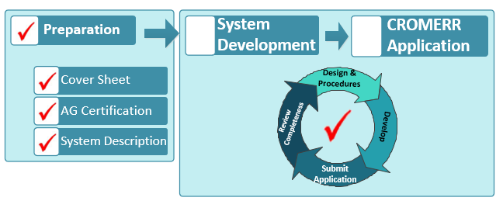
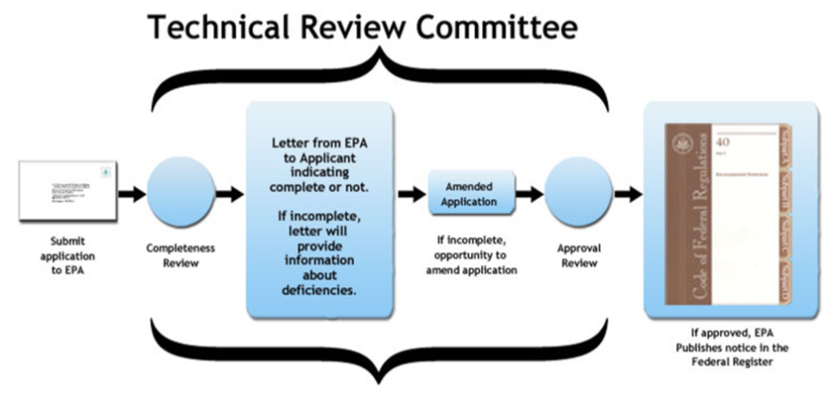
What Do I Get CROMERR in an hour?
Shared Process:
Custom Configured Application
Pre-approved Implementation
Contract Forms for 3rd Party Id-Proofing

Slide 6
What Do I Get CROMERR in an hour?
Customized Software:
Registration and Id-Proofing
Role Based Access and Approval Methods
Help Desk Admin and Communication Tools
Identity Proofing Statistical Reports
End User e-Signature Document Certification
Search, Review & Single/bulk Download Records
Registration Shortcuts w/Color and Logo Themes

Slide 7
DEMO SHARED CROMERR REQUEST

Slide 8
CONTINGENCY SLIDES
WHAT IS BUILT IN AN HOUR
OFF-LINE DEMO
https://encromerrdev.epacdxnode.net/Newabout/HostedSolution
Go to Webpage Step 4 - Dataflow Setup
Download Form Request
Fill it out and Submit

Slide 9
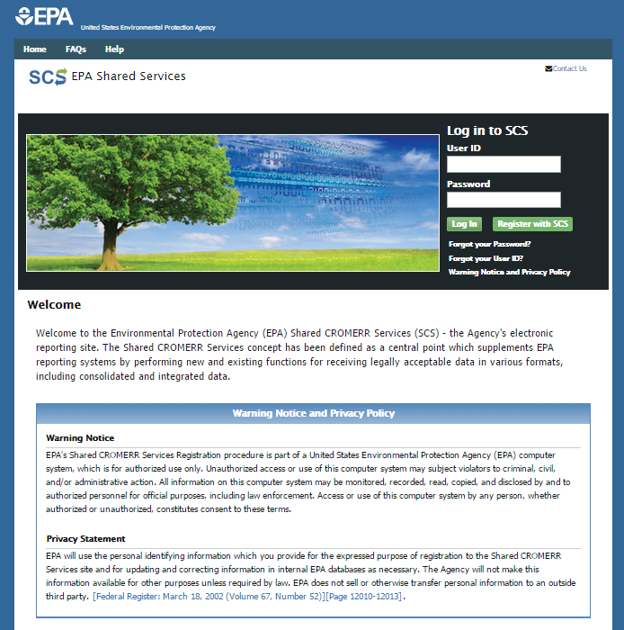
SCS Home
OneEPA Template
Central Data Exchange (reuse)
Mobile/Responsive Design
Login Or Register
Supports Dedicated Home Pages
  Provider
  Provider Partner (EN Partner)
  Program
  Program & Limited Partners

Slide 10
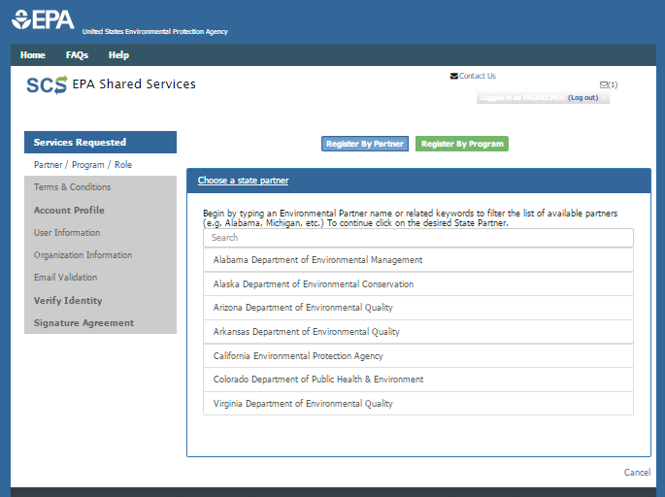
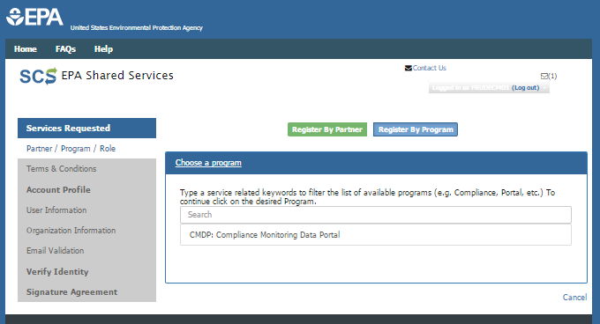
Program and/or Partner selection
Option to select Partner or Program, first, then choose other.
Add Custom Home Pages for Program, Partner, or Program and Partners.

Slide 11
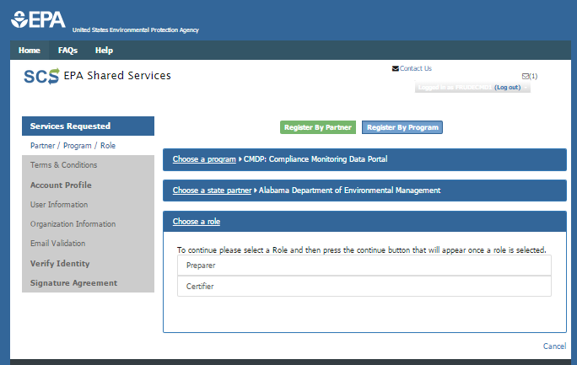
Partner Program Role Selection
Provision Roles based by Partner/Program

Slide 12
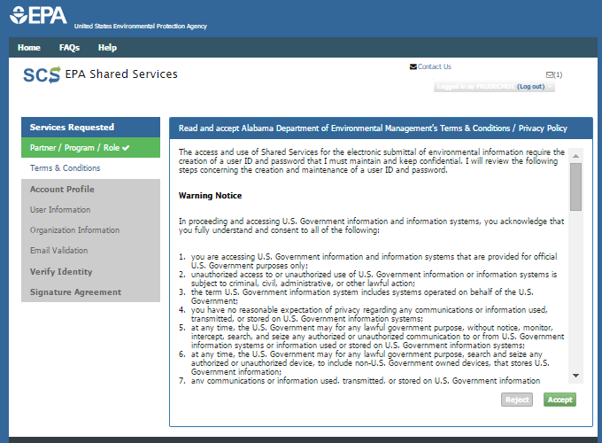
Privacy (dynamic) by Partner
Every Provider/Partner/ Program Service may have its own Custom Warning Statements, Privacy Statements by role.

Slide 13
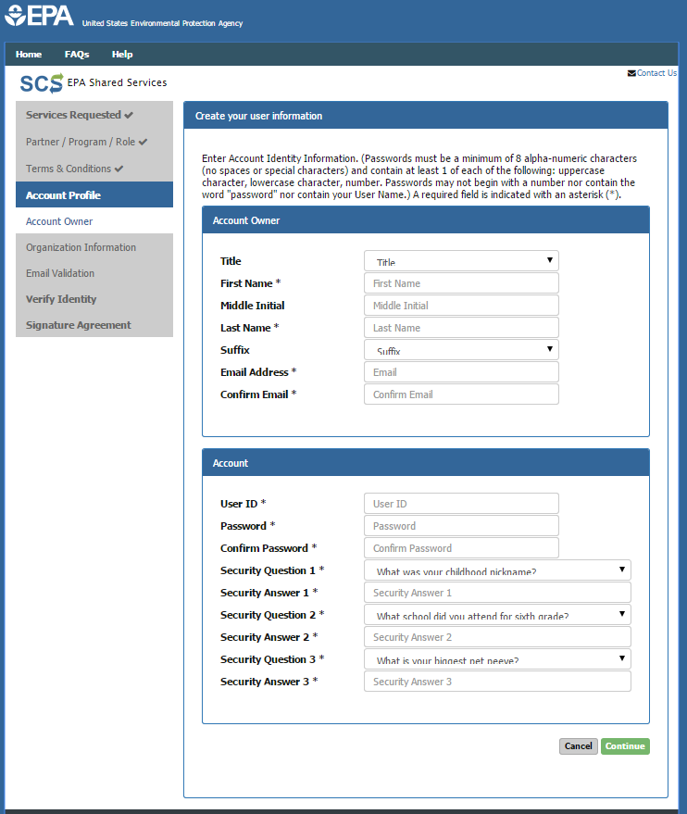
Account Profile
Provision what is required/optional/ omitted
Provider Pre-Registration
Duplicate Email Account Actions
If email address is already in use ask if they wish to add the role to existing account or create new account.

Slide 14
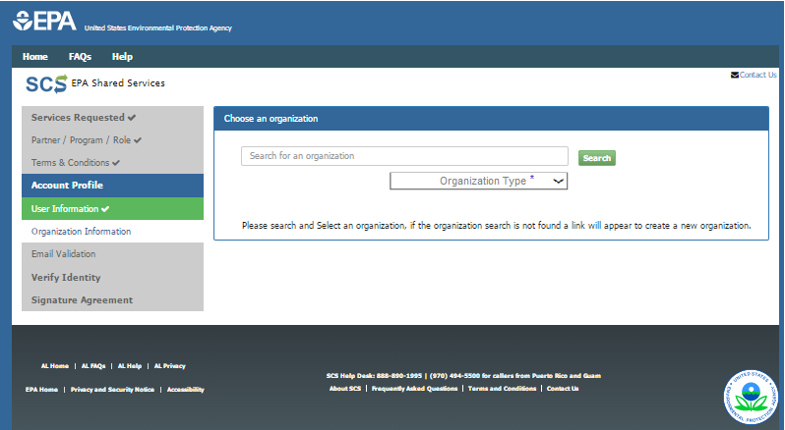
Custom Organizations
Provisioning controls Organization Search/Selection menu.
Flexibly Supports Program/Partner Ownership
Search by Org/Advanced
Search by Org (only)
Search by Org and Require Org Type
Allow/Disallow create new Org

Slide 15
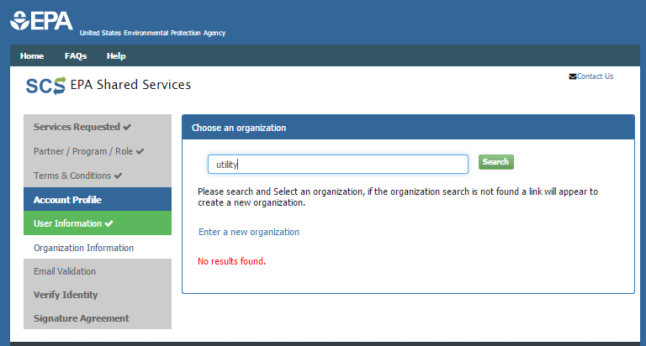
Select or Create New Orgs
Org Options
  Search and optionally Create new Organizations
  Or Force user to go to Provider for Partner-managed Organizations

Slide 16
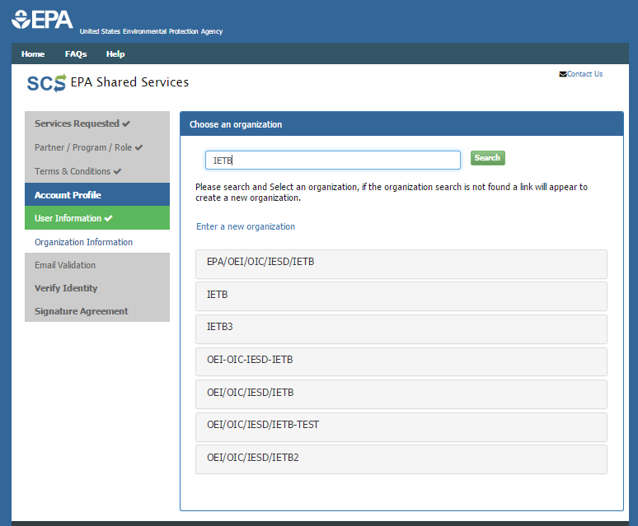
Organization Name “Drill Down”
When Organization keyword is found, Names are listed.
May restrict Role to Org Owner
Allows Expansion “Drill Down” on:
  Name
    Org Type
      Address Detail
Different Organizations Same Name
Same Organizations Different Partner
Same or Different Orgs multiple address locations.

Slide 17
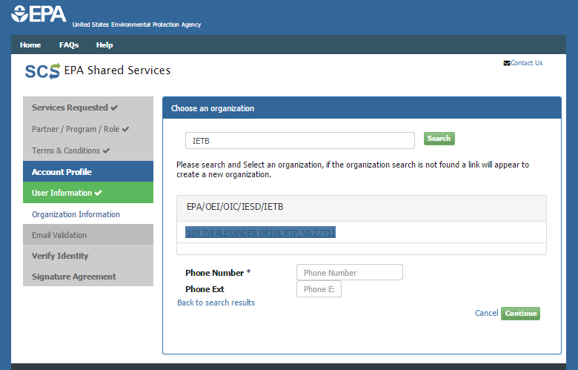
Organization Selected
Personal contact info Linked to User-Role-Org not user

Slide 18
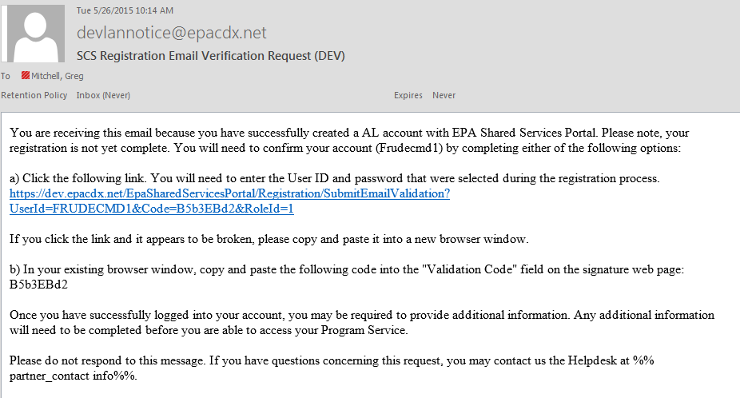
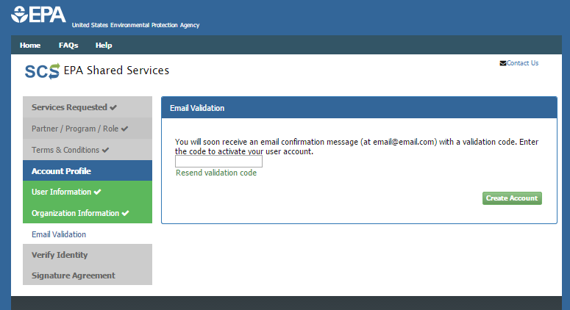
Out-of-Band (Email) Confirmation
Email account is sent hyperlink to confirm email is reachable.

Slide 19
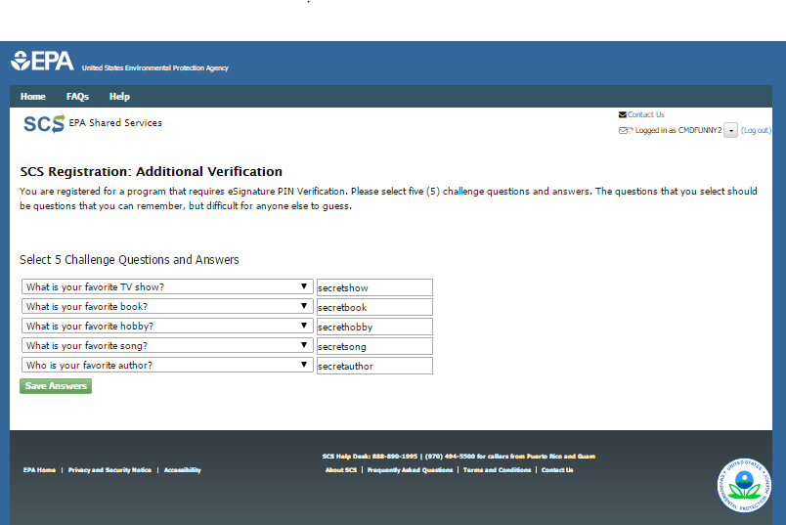
CROMERR Approved Questions
Use to (Optionally) perform e-Signature

Slide 20
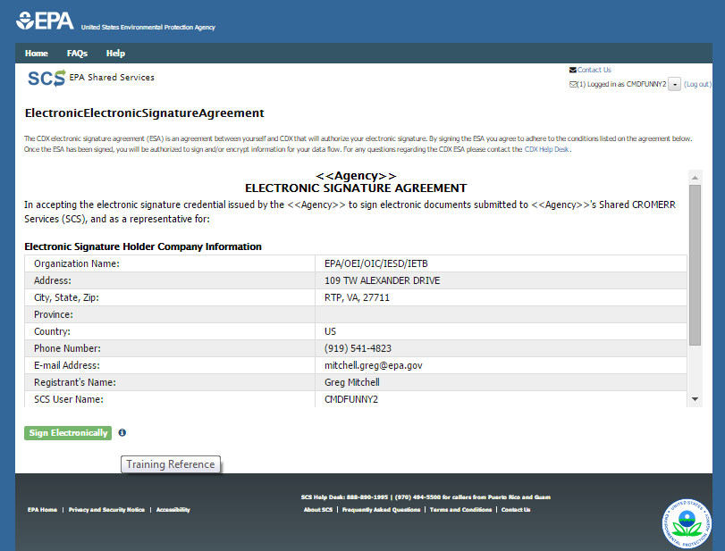
Approved Electronic Signature Agreement
Supports Default ESA
Offers ESA’s Unique by Partner/Program/ Service and Role

Slide 21
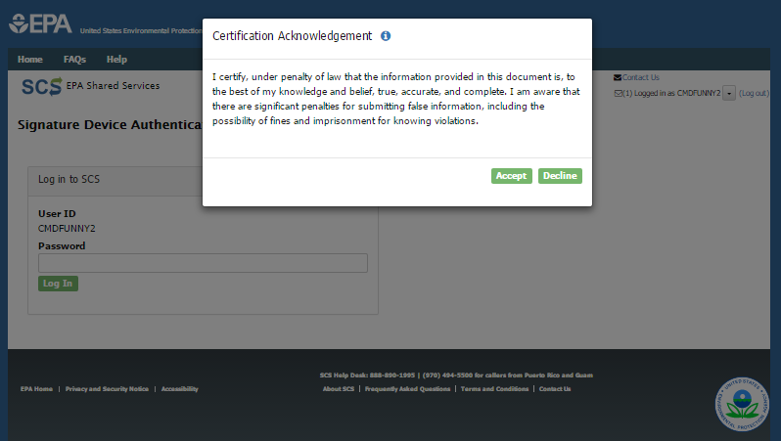
CROMERR Attestation for ESA
Supports Default and Custom Attestations
Custom ESA’s by Program/Partner Service and Role

Slide 22
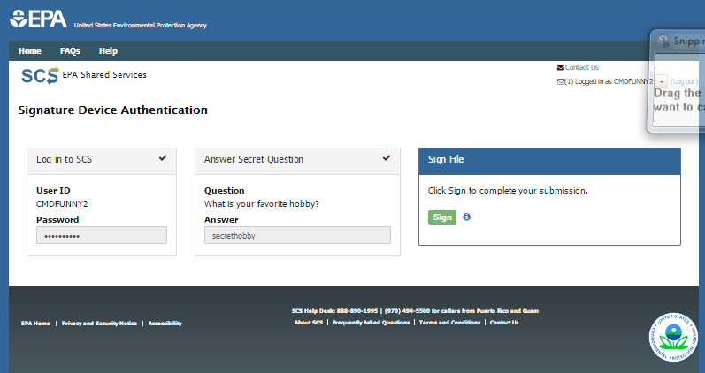
CROMERR Standard Signature Ceremony
Supports Standard Electronic
Registered Knowledge-Based Questions

Slide 23
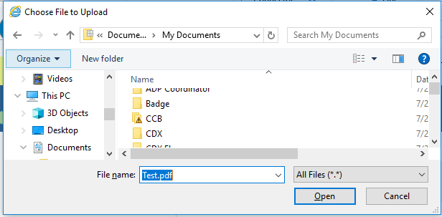
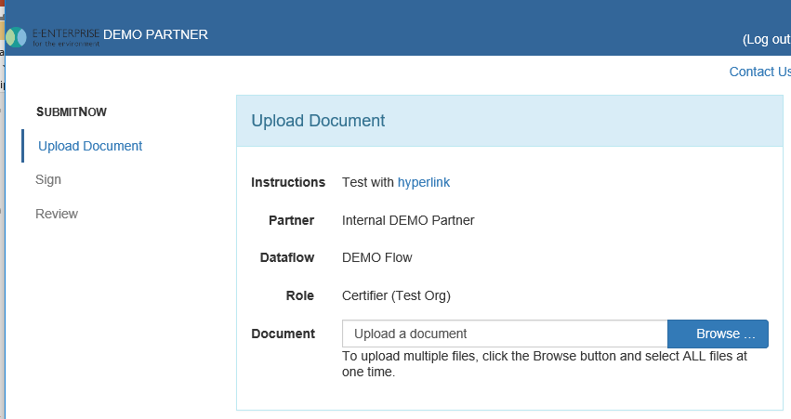
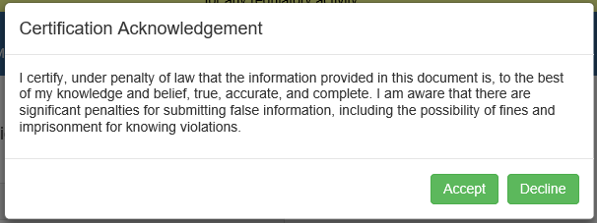
Upload/Certify Documents

Slide 24
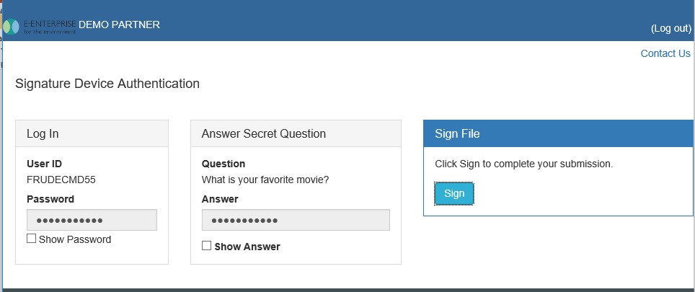
CROMERR E-Signature Ceremony

Slide 25
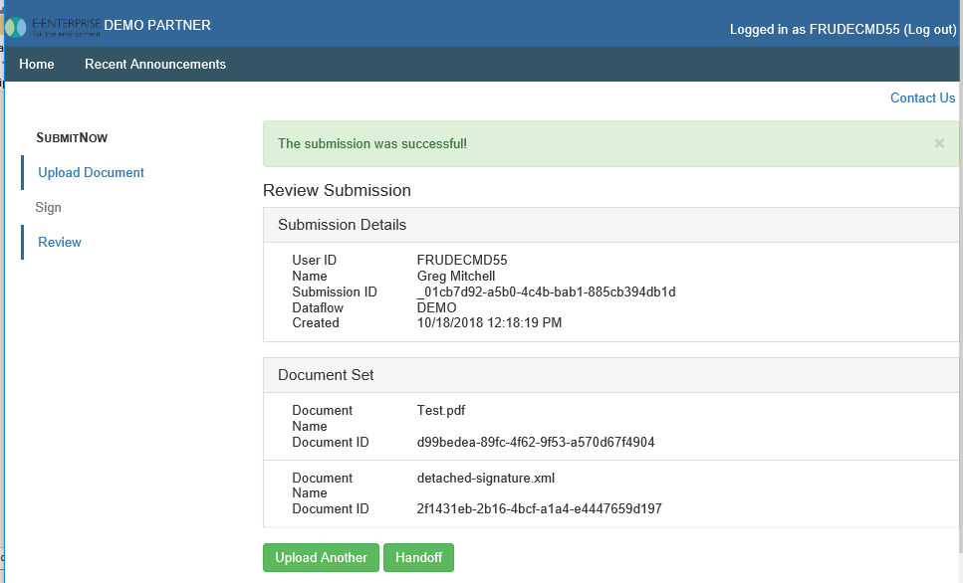
CROMERR Record Upload Review

