Slide 1

Virtual Exchange Services (VES)
Presented by
Greg Mitchell

Slide 2
Background
VES exchanges data from point to point securely
Automates scheduling for machine-to-machine
Cloud-based alternative to Local Node Systems
Replaces software installation w/configuration in minutes
Partners map their data to staging tables without complexities of XML and data exchange software logistics.

Slide 3
Why VES?
Low cost data Node Exchange
Limit skills required for database and staging table setup
Eliminates infrastructure and software maintenance costs
Configure rather than develop program exchanges
Supplement state nodes or create new nodes
Common Extensible Architecture for sharing data
VES supports reusable components
Automatically catalogs node services

Slide 4


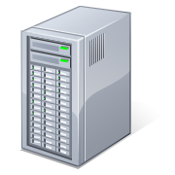
How It Works
Partner
Environment
Cloud
REST or
SOAP
Exchange Network &
CDX
Admin
VES
Submissions
Configures Services
Staging Tables
Internet Service Bus
Or VPN
Reports
Staging data either
Local or the cloud
Notifications
Production Database
Staging Tables

Slide 5
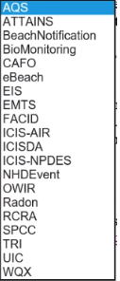
Partners Systems and Dataflows
Hualapai Tribe: WQX production flow
San Joaquin Valley Air District: ICIS AIR
Jefferson County Health Dept – ICIS Air
Klamath Tribe - WQX
Alabama: ICIS-AIR
Georgia: ICIS AIR dataflows for data families , EIS
Region 1 Storm 3 Buoy Flow, SPCC Tanks
South Dakota: TRI-OUT , ICIS-AIR, EIS
Tennessee – ICIS-AIR, ICIS NPDES
Texas – AQS, Facility FRS
Maine: ICIS Export
Gold Systems: WQX, ICIS AIR, AQWMS
Potential New States/Organizations
TX,CT,VT,Chesapeake Bay Program
59 Partner Systems
20 Pre-built Programs

Slide 6
What you do What VES does for you
Division of Labor for VES
Call Node Help Desk
  Get a Node administrator account
  Set up a “Getting Started” meeting with VES Team
Set up VES SSL Trust Certificate
Log into VES
Generate and Import your Exchange
Map your data to a Staging Database
Schedule Data Exchanges
Creates SOAP and REST Services
Executes Exchange Schedules
Authenticates
Point-to-point data pulls from staging
Formats data to Program XML Specs
Sends submission to Destination Nodes
Logs activities
Checks Status
Collects processing reports
Sends Notifications to you

Slide 7
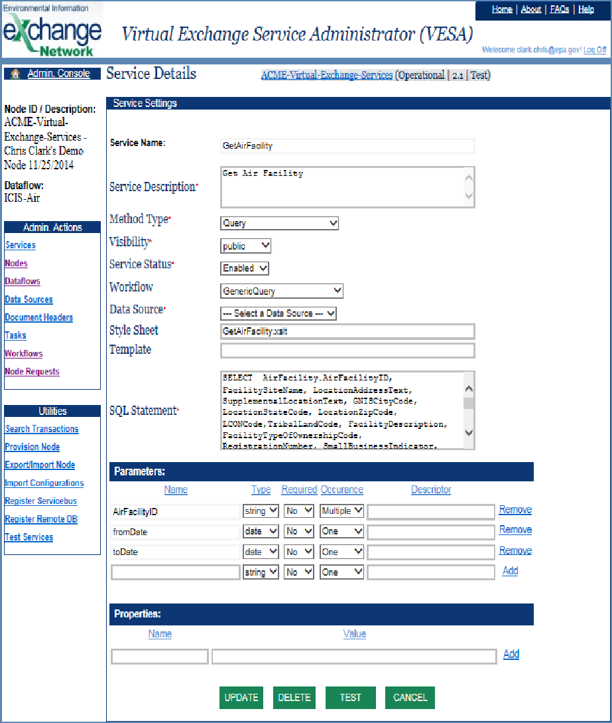
VES Admininistration & Utilities

Slide 8
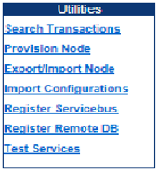
VES Utilities
Name & Provision Nodes
Generate Schema scripted by Program Ref. Packages
(Oracle, SQL Server, SQL Express)
OR Export/Import a Node
Provision staging location
Set up VES Connectors to convert Staging DB to XML automatically
Test your services

Slide 9
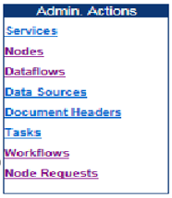
VES Administration
List/Maintain your Nodes & Program Exchanges
List/Maintain your Staging Databases by Program
Configure Additional Headers for XML content
List/Maintain Scheduled Tasks by Program, Service, Selection Criteria and time/frequency
Manage sequences of tasks
Query/test VES Node Functions

Slide 10
REST Services
No Additional configuration for REST Query Services
GetCountyCode – Query Method Example on “PartnerNodeName” VES Node
This is what the REST service URLs look like for my VES REST services
JSON format:
https://virtualnode.cloudapp.net/nodedataservice?node=PartnerNodeName&Dataflow=RESTServices&request=GetCustomerList&CustomerId=B&format=json
XML format:
https://virtualnode.cloudapp.net/nodedataservice?node=PartnerNodeName&Dataflow=RESTServices&request=GetCustomerList&CustomerId=B&format=XML

