Slide 1
Creating a Culture That Is Ready for Anything
E-Enterprise National Meeting
October 23, 2018
Leigh McMullen

Slide 2
The pace of business requires frequent, rapid transformation
Yet, process or organization-focused
transformation is like a Hype Cycle
Very few make it
out alive …
We must find a way to flatten the curve …
Notes:
REVIEWER NOTE: Yes this slide has essentially the same message as #3. Intentionally repeating it to make sure it sticks.

Slide 3

Where do we start?
Notes:
https://www.istockphoto.com/in/photo/businessman-giving-presentation-to-his-colleagues-gm469875502-61813106

Slide 4
What Is a Culture That Is Ready for Anything?

Slide 5
Cross-
Functional
Pollinating
Focused
Curiosity
Powered
by
Rigorous
Honesty
Values
Minimal Management
Hands-On
Every
One Is
Creative
Individual
Autonomy

Slide 6

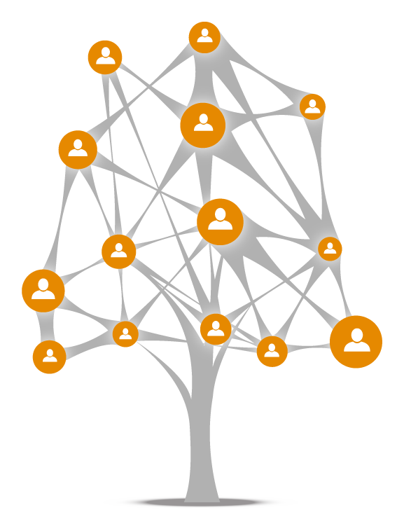




They Look Cellular and Feel More Dynamic
What if we could replace this
With this
Team Leader
I see Numbers!
Subject Matter Experts
Practitioners
Practitioners
Subject Matter Experts
Interns
Interns
Interns
Notes:
Time to Get Crazy.
Hierarchal Management is an artifact of assembly line manufacturing
It’s designed to pass the boredom up a level
Not suitable for creative or fast moving teams

Slide 7
They 360 Review Everything
Constructive, moves the ball forward, targeted toward the idea or solution and not the person.
Especially important upward to avoid “Bubble” leadership.
A challenge based on values must always be okay
Notes:
Consider:
Before Action, Checkpoint and After Action Reviews.
The leader must make this a safe space.
Leaders must be mindful of the power of their own critiques (Go last).
NOT YEAR END PERFORMANCE REVIEWS but NEAR REAL TIME.

Slide 8
They Are Explicitly Designed
How we make decisions
There are really only
four dials to turn to
change culture.
But you can turn them in many different combinations!
Tempo
Culture
How we create
How we engage
Value
Collaboration
Direction
How we measure

Slide 9
Understanding How Cultures Change

Slide 10
“Culture” Is Those Automatic Behaviors That Let Members of a Society Work Together With
Minimal Friction
Most of what you think of as your culture is really just a bunch of habits!

Slide 11
Which is why simply explaining “what’s in it for them” doesn’t drive people to change.
Using persuasion on a habit is like trying to hammer a nail with a duck …

Slide 12

>
The Good News:
You don't need to persuade people much at all.
You just need to show them.
Most people readily adapt their formal work and casual social behaviors based
on context.
Formal/Work behaviors
Casual social behavior
Situational/
Superficial
Intimate personal behavior
Core identity
Survival reactions
Beware the Dark Side
It is immoral and dangerous to attempt any deeper levels of change than this, or to attempt to drive change too quickly.

Slide 13
Your Brain Loves Making Habits; Don’t Fight It, Use It!
Trigger — A situation or an event that provokes the execution of a routine, e.g., if you smoke after your eat, feeling full is the trigger
Routine — A behavior that is executed
quasi automatically as a result of the trigger. “Smoking after eating”
Reward — A physical, chemical or emotional reward used by our brain to reinforce the habit. “Nicotine Rush.”
Notes:
Create business example.

Slide 14
Triggers
It Is Nearly Impossible to Eliminate Old Triggers.
But you can reframe them
Conflict is where “awesome” comes from
Lets go
find the awesome!
Changing the narrative for how one interprets commonly occurring triggers can reframe the situation and make it easier for the brain to accept a new routine
I’m feeling triggered
That still doesn’t make you a snowflake
Notes:
.

Slide 15

Routines
It’s Easier to Change an Existing Routine Into an Adjacent Routine.
(Just like replacing cigarettes with lollypops)
Ritualizing certain routines, such as resolving conflict
or overcoming resistance can reduce the amount
of negativity these
situations create.
Just work the program
Until the program works you
Notes:
.
Story telling. Telling each other stories. OTHER EXAMPLES OF ADJACENT ROUTINES>

Slide 16

Rewards
It is actually the anticipation of the reward which reinforces and strengthens the trigger and drives automatic execution of the routine. Not the reward itself.
The best rewards in a business context are positive social reinforcement.
Don’t get too hung up on rewards. Your brain already rewards you with a small hit of dopamine when you successfully complete a routine.
Notes:
ELIMINATE CARROTS AND STICKS. MAKE INTRINSIC

Slide 17
Making Habits Stick
1
2
3
Build new habits on top of previously existing ones
Transfer habits from narrow contexts to wide contexts
Make the community responsible for establishment and enforcement
Notes:
Scott Adams story? LITTLE STEPS. Weights next to toilette not in weight room.

Slide 18
Example Implementing a Habit
CIO, decides “Incident Management” moment of truth is a strategic focus area for new culture, publishes a POV on what this means and pushes that POV to the help desk asking to rethink their processes
Help desk team managers distill these, synthesize and publish as new policy
Help desk team members rewrite processes to drive better customer experience during incidents, they forward them to their managers

Slide 19
Picking Which Habits to attack.
Don’t denigrate what got you here. (current behavior)
How to access which
Notes:
Don’t

Slide 20

Start With Engagement Styles
Fixing engagement will change how your culture feels making the most apparent impact first.
Notes:
The language and behavior of engagement is critical to fostering collaboration and ultimately value.
Establish different engagement rituals to foster engagement styles.
Establish Rules of the Road for engagement

Slide 21
Engagement Can Bridge Culture “Gaps”…
Power
Conflict
MIND THE GAP
Feedback
Notes:
Pay attention to “power flows” in dialogue
Most ‘resistance’ is really just habits
Encourage continuous feedback

Slide 22

The Language of Engagement Is Critical
Change the words
Change their minds
We say
We don’t say
Yes,
I wish I knew,
I’d like to understand,
How do we?
…
No,
We can’t
The problem with that is...
My Issue…
…
Remember the most telling language, is Body Language
Notes:
Gamify; TIP JAR.

Slide 23
Mindfulness of power flows in interactions is a secret to great engagement.
MIND THE GAP
Power
Want to get fish later?
No, not really
(People with positional power need to figure out how to create situational power for others.)
Notes:
Positional power / Situational Power - Hard to take off your hat – Use LOW power language – give power away – use 3rd party facilitators, etc.

Slide 24
Having the right answer is not the secret to resolving conflict
MIND THE GAP
Conflict
I know what your problem is
1. Listen
2. Determine if resistance is occurring
3. Acknowledge the resistance
4. Resolve the conflict
You’re not listening, and that’s also a problem
Notes:
Insult the condition or the enviornment --- The prest one is too weird. --- EXPAND HOW WE OVERCOME RESISTANCE. ---

Slide 25
There are many different ways to give feedback but only one secret — make the person feel valued
MIND THE GAP
Am I interrupting you?
Feedback
What? I’m totally paying affection
(Leaders often offer implicit permission by not stopping things — they’re encouraging it!)
attenuation
dang it!
Attention!

Slide 26
Focus on the “moments of truth” of customer experience
Problems
Collaboration
Interactions
Communication
Incident Management
Strategic Planning
Meeting Management
Verbal and Written
Conflict Resolution
Innovation Management
Achieving Consensus
Nonverbal
Outages
Solution Development
Information Gathering
Attire
There are of course many other possible moments.
Evaluate which most impact your customer experience.
Notes:
You must still address the danger zone, but it must be handled with sensitivity.
EVERYONE IS A CUSTOMER INCLUDING EMPLOYEES

Slide 27
Rituals
Make It Real …

Slide 28
Meetings give us a place to “practice our culture”
Social and Interpersonal Skills
Problem Solving and Creativity
Executive Presence and Leadership
Power
Time and Agenda Management
Conflict
MIND THE GAP
Feedback

Slide 29
It Is Essential to Turn the Process Over to the
People Quickly
We need the tools, time and autonomy, to make it happen
We need to be shown how that’s possible
And how the organization’s values align to our own
We all want to be successful
With the power in our hands, it will be self-sustaining
Notes:
Distribute decision making. Having people collaborate on all the little steps.

