Slide 1
E-Enterprise Community Inventory Platform
The E-Enterprise Community Inventory Platform is an online community and living project inventory for State, Local, Tribal, and Federal environmental agencies and their employees across the US.

Slide 2
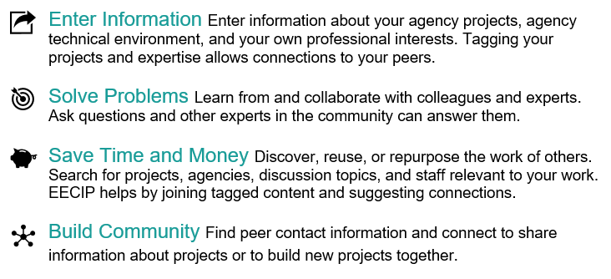

Slide 3
EECIP Steering Group Members
Name | Organization
Chris Simmers, Chair | New Hampshire DOIT
Letty Hardee | Arkansas DEQ
April Hathcoat | Cherokee Nation
Andy Putnam | Colorado DPHE
Lydia Scheer | Institute for Tribal Environmental Professionals
Ted Saad | Massachusetts DEP
Mary Montoya | New Mexico ED
Vicky Hutchings | Tennessee DEC
Steve Girt | Wyoming DEQ

Slide 4
