Slide 1

How the Facility Registry Service Supports E-Enterprise
Susan Joan smiley baker, U.S. EPA office of environmental information
Kimberly Hoke, CGI federal
EE 2018
October 23, 2018

Slide 2
What is the Facility Registry Service?

Slide 3
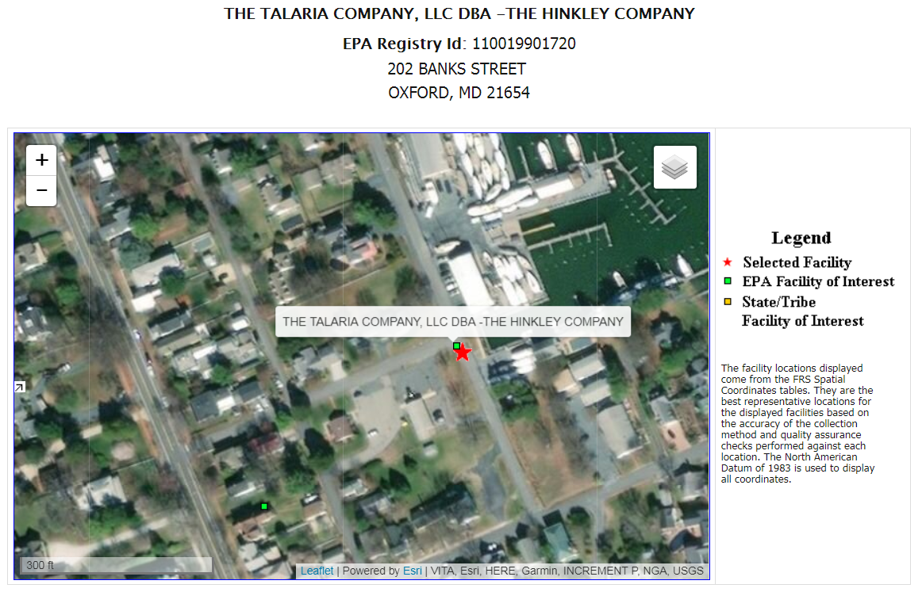
Facility Information is Key
  Facility data is at the core of federal and SLT regulatory processes.
  Knowing a facility’s name, ownership, location, and characteristics are key to a comprehensive picture of past, current, future, and potential environmental impacts.

Slide 4
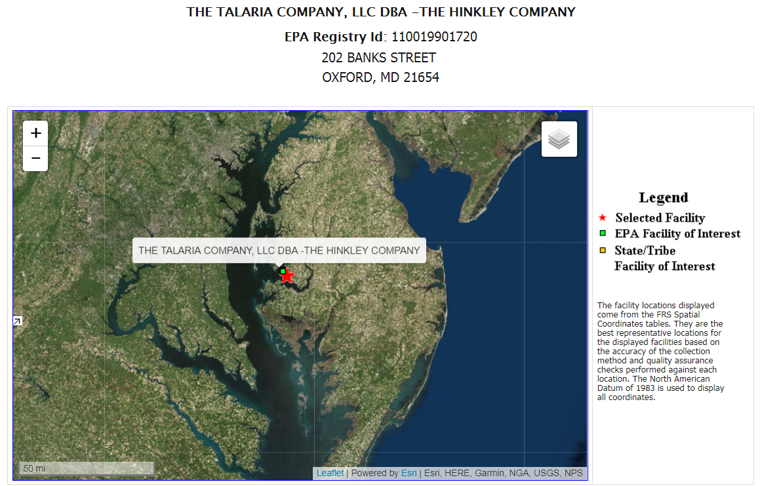
Facility Information is Key
Facility data has the capacity to provide a comprehensive picture that enables co-regulators to better protect human health and the environment when linked to critical environmental data such as ambient air and water quality data, or distances to protected water bodies.
Notes:
This is a zoomed out view of the previous facility location. Now we can see it is adjacent to the Chesapeake Bay.

Slide 5
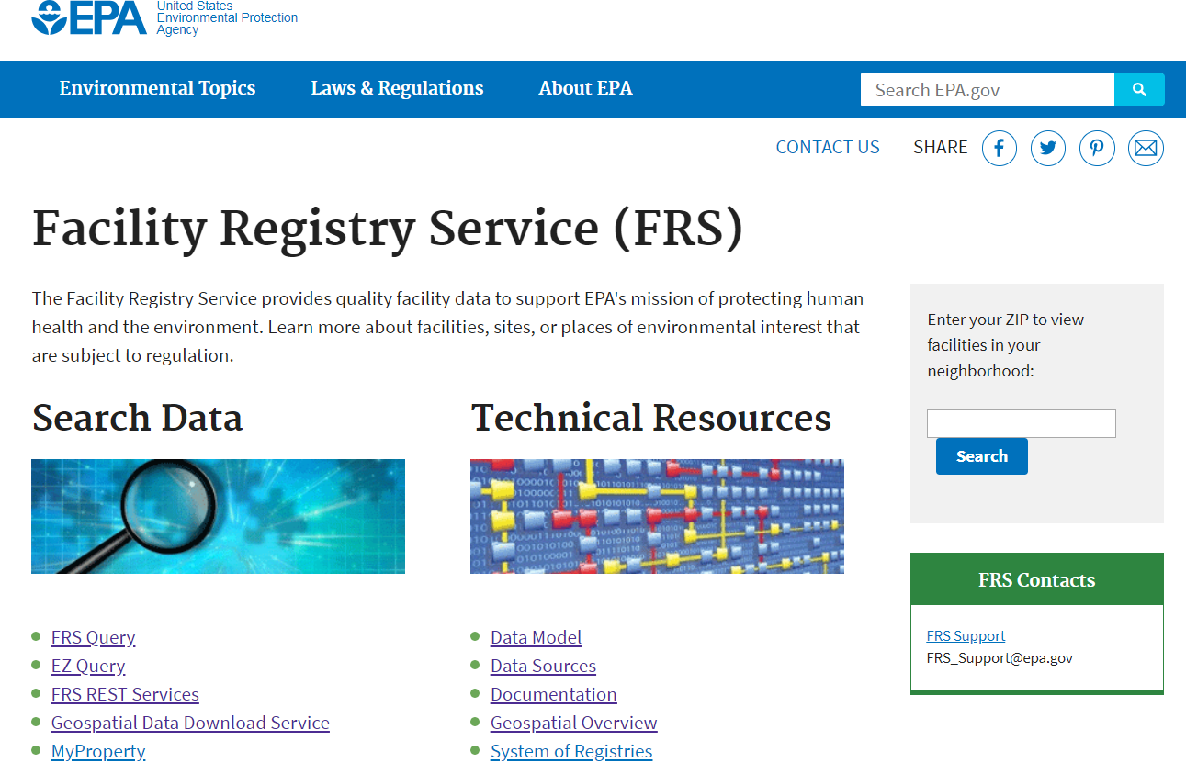
What is the Facility Registry Service?
Facility Registry Service (www.epa.gov/frs)
FRS integrates facility data from dozens of data sources including:
  EPA program systems
  State and Tribal data systems
  Other Federal datasets
  Reference datasets
Integrated information for over 4.5 million facilities is provided for public viewing via queries and in other EPA platforms such as Envirofacts and ECHO.

Slide 6
What Does FRS DO?
FRS integrates facility data from disparate data sources.
FRS improves facility data by applying standardization, business logic, geocoding and data validation tools to incoming data.
FRS provides this integrated, improved facility data set to partners and the public through a variety of mechanisms.

Slide 7
A FRS Registry Record is Composed of
EPA Program Facility Records
Partner Facility Records
Other Federal Data Set Records
FRS Registry Record
EPA program facility records and partner program facility records are stored in the FRS Program Facility tables.
FRS business logic populates the FRS Registry record
Data Steward Edits in
Facility Linkage Application (FLA)
FRS registry records are stored in the FRS Registry tables.
Notes:
FRS receives data from many other sources including:
EPA Program Systems
States and Tribal Partners
Industry Reporters via the Facility Widget and CDX Programs
Other Federal Data Sets
This diagram represents a schematic of what a registry record is composed of and what can change it.

Slide 8
FRS Registry Record Structure
FRS Registry Record
EPA Program System Record
ETL Process
Partner System Record
FACID
EPA Program System Record
Facility Widget
Other Federal Dataset Record
ETL Process
Source of the Record
Method Record Provided to FRS

Slide 9
What Information is in the FRS Registry Record?
The FRS Registry Record refers to the entire top-level facility record in FRS.
It includes the Registry table as well as tables that contain additional data such as SIC and NAICS codes, organization, contact, and others.

Slide 10
Expanded EPA FRS Data Model Reflects
Programs’ Reporting Requirements
Old Model:
This is one facility
Expanded Model:
More detailed view of facilities, including sub-components and relationships between components
9
Notes:
In late 2016, EPA expanded the FRS data model to enable sub-facility data management. This allowed us to capture more granularity at a facility.
Current sub-facility data is focused on supporting the Clean Air Act, but this will be further expanded to manage data for other media.

Slide 11
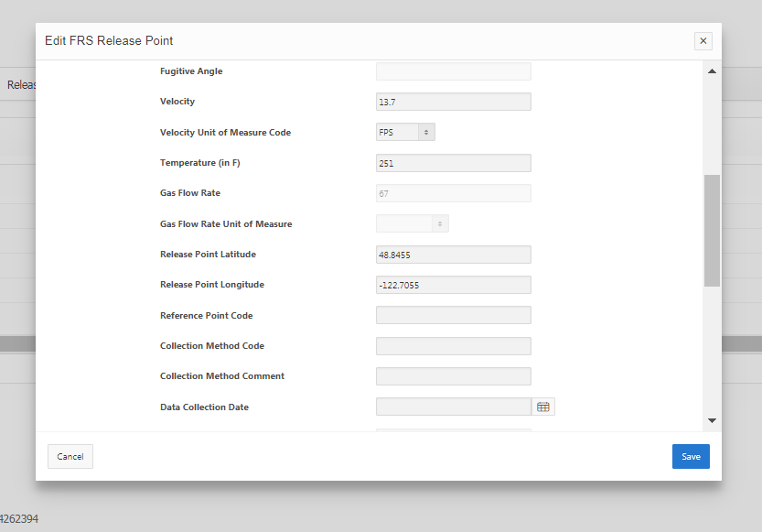
FRS Sub-Facility Data
Registry records can have sub-facility data for multiple programs.
Each EPA program or partner record can contain program-specific sub-facility data.
The FRS data quality tool, FLA, has functionality to edit registry-level sub-facility data and associations and view program-level sub-facility data.

Slide 12
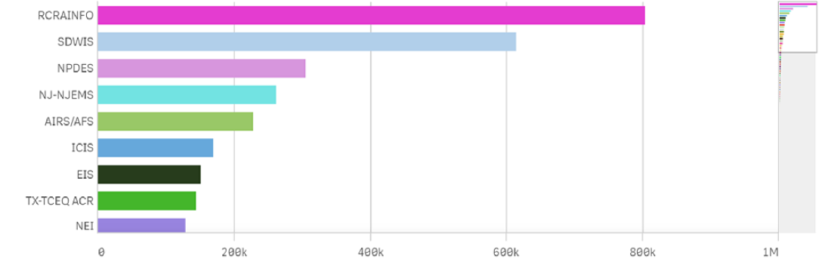
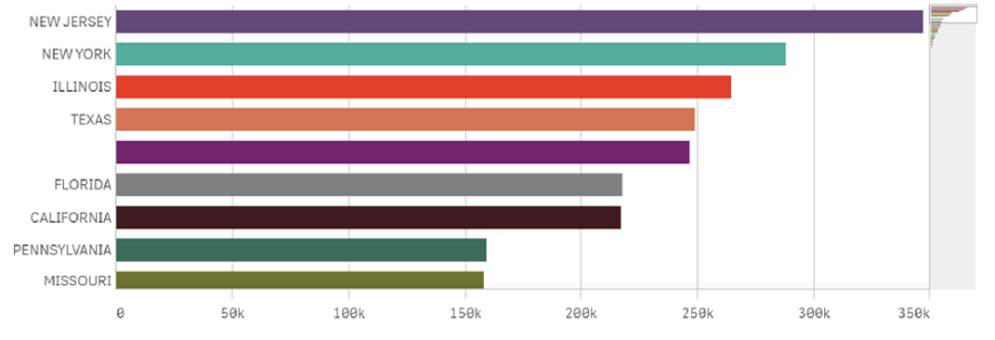
FRS by the Numbers
Records by program data source
Records by State
6.4 million program records
4.5 million registry records

Slide 13
How is the FRS Registry Record Populated?
EPA Program Facility Records
Partner Facility Records
Other Federal Data Set Records
FRS Registry Record
EPA program facility records and partner program facility records are stored in the FRS Program Facility tables.
FRS business logic populates the FRS Registry record
Data Steward Edits in
Facility Linkage Application (FLA)
FRS registry records are stored in the FRS Registry tables.
Notes:
The next series of slides describe how the FRS registry record is populated.

Slide 14
Registry Record Population Overview
Notes:
There are a number of processes at work to populate the FRS registry record

Slide 15
Registry Record Population Overview
Notes:
We will first discuss geocoding

Slide 16
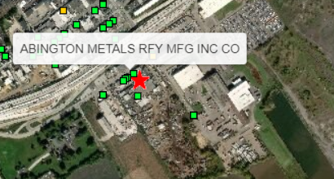
FRS Geocoding
Facility Address, City, State, Zip
Derive latitude, longitude
Plot facility on the map
Provide latitude, longitude and metadata
Derive geocoded, standardized address
Use to integrate with other facility records
7345 Milnor St.
Philadelphia, PA 19136

Slide 17
Registry Record Population Overview

Slide 18
Standardization and Validation
Incoming data can be in a variety of formats and of varying quality.
  Standardization processes divide, standardize, and evaluate the data. Missing data elements are added when possible.
  Validation is the process FRS uses to evaluate data quality and results in a data quality code.
These processes create uniformity so data can be accurately compared to other FRS records.
Notes:
The standardization and validation processes are important when handling such a large number of incoming data records, which may use different naming conventions. In order for records to be merged, the standardization process is integral.

Slide 19
Data Standardization Example
A new program record is inserted into FRS with the following information for name and address:
  MXI Environmental Services, LLC
  26319 Old Trail Road, Abingdon, VA
  (no ZIP code or county name provided)
Standardization process breaks out address into pieces (street number, street name, etc.)
Standardization process completes null values for county and ZIP code based on reference information
Standardizes facility name and address
Input Name and Address: MXI Environmental Services, LLC; 29319 Old Trail Road, Abingdon, VA
Standardized Name and Address: MXI Environmental Services LLC; 29319 Old Trail Rd, Abingdon, Washington County, VA, 24210
Note: Standardized values do not overwrite the values provided in the program record. They are stored in separate fields within the program facility tables.
Notes:
Portions in red are what changed from initial record.
More information about the this is available on the web under FRS Technical Documentation in a file called ‘FRS-parser and standardization’. It describes the process in detail.
The standardization process is summarized in the following three steps:
FRS attempts to geocode the address. If it passes geocoding (does not flunk), FRS populates the geocoded address data in the standardized fields in FRS and continues with the integration process.
If the record does not pass geocoding (flunks), FRS uses the old FRS address standardization routines to standardize the provided data and populates the standardized address fields in FRS with those values.
The standardized address fields (either populated by the geocoder or the “old” standardization routine) are used to evaluate potential linkages.

Slide 20
Data Validation
  FRS data validation process evaluates data and determines a data quality code (DQ) for registry facility data and program facility data.
  The DQ code is visible in FLA and in the public website.
  The validation logic is exposed in a web service.
  The DQ code is not used in other parts of FRS processing (i.e., it is not used in best pick or other logic).

Slide 21
DQ Code Values
V – Indicates the data quality is valid for the record.
Non-valid records receive a DQ code that is one of, or a combination of the following 13 codes.
  mN – missing facility name
  eN – erroneous facility name
  mA – missing street address
  eA – erroneous street address
  mC – missing city name
  iC – invalid city name
  mO – missing county name
  iO – invalid county name
  mS – missing state code
  iS – invalid state code
  mZ – missing ZIP code
  iZ – invalid ZIP code
  iM – invalid county and city name combination
A record’s DQ code can be a combination of the codes listed.
  mNmA – missing facility name and missing facility address
  eAiC – erroneous street address and invalid city
There are hundreds of possible DQ code combinations
Notes:
Do not go into details but illustrate the number and potential complexity of codes.

Slide 22
Registry Record Population Overview

Slide 23
FRS Linking
Uses incoming standardized program record data.
Compares against existing standardized registry record data.
Calculates a score based on how well fields match.
Determines whether or not incoming record may be related to an existing registry record.
Possible results:
  Automatically linked to existing registry record.
  Not linked to an existing record, but flagged as a potential match
  Not linked to an existing record and not flagged as a potential match.

Slide 24
Registry Record Population Overview
Notes:
Registry records are updated when FRS receives a new program facility record that is not linked to an existing record.
Registry records are updated when an FRS data steward updates data in FLA, when FRS receives an updated program record, a new program record (newly linked), or as part of weekly GIS processing.

Slide 25
Registry Table Updates
Notes:
The is the overall process to update information in the registry table. We won’t cover in detail, but a summary is presented in the next slide.

Slide 26
Updates to the Registry Record
  Is the incoming program record is the only program record linked to the registry record?
          If yes, the registry record is updated with new program record information.
  Has the registry been previously edited by an FRS data steward?
        If yes, then null data in the registry record may be replaced by new program record information.
  The DQ code on the existing registry record and the incoming program record.
  Is one of the program records linked to the registry record is one of: TRI, RMP, State Data, ICIS?
        If yes, then facility name updates follow the following hierarchy: (TRI→ RMP→ State Data → ICIS)

Slide 27
Managing FRS Data with FLA
EPA Program Facility Records
Partner Facility Records
Other Federal Data Set Records
FRS Registry Record
EPA program facility records and partner program facility records are stored in the FRS Program Facility tables.
Data Steward Edits in
Facility Linkage Application (FLA)
FRS business logic populates the FRS Registry record
FRS registry records are stored in the FRS Registry tables.

Slide 28
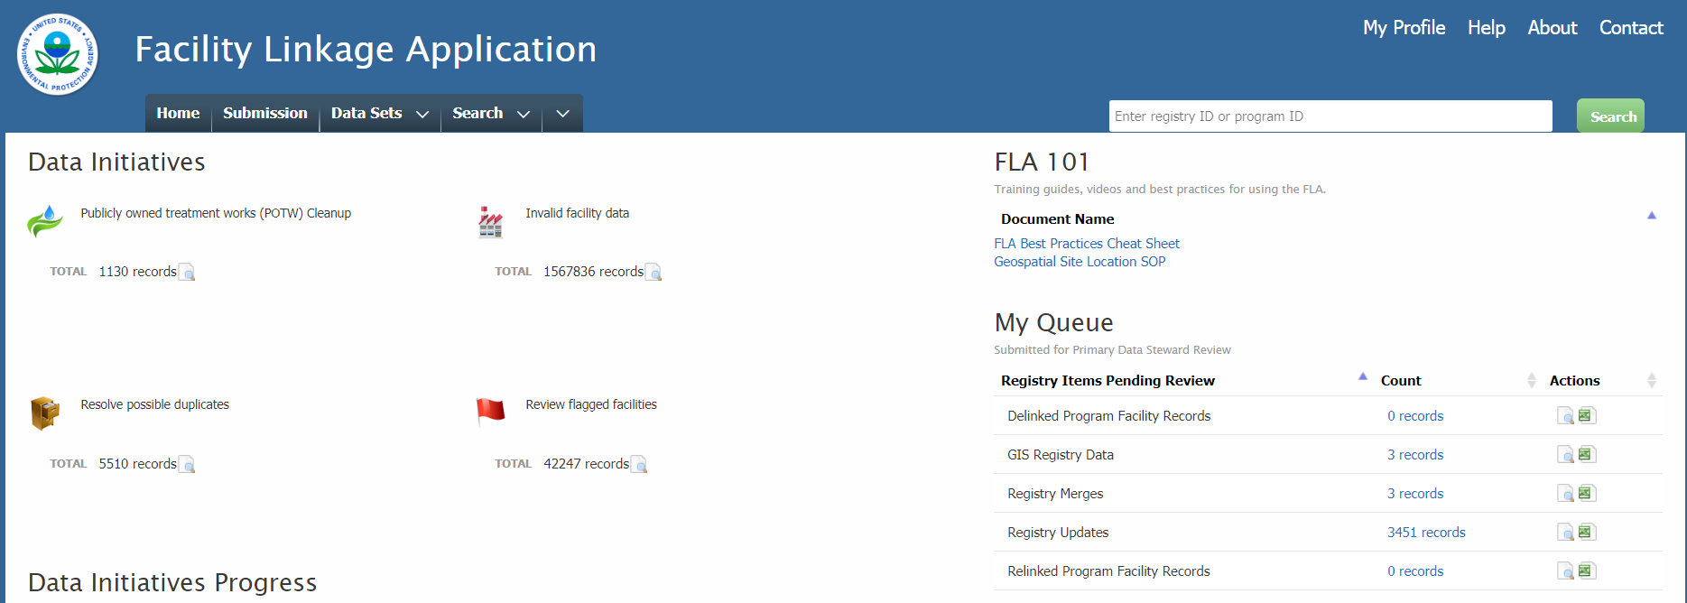
Facility Linkage Application (FLA)
FLA is the data quality tool for FRS.

Slide 29
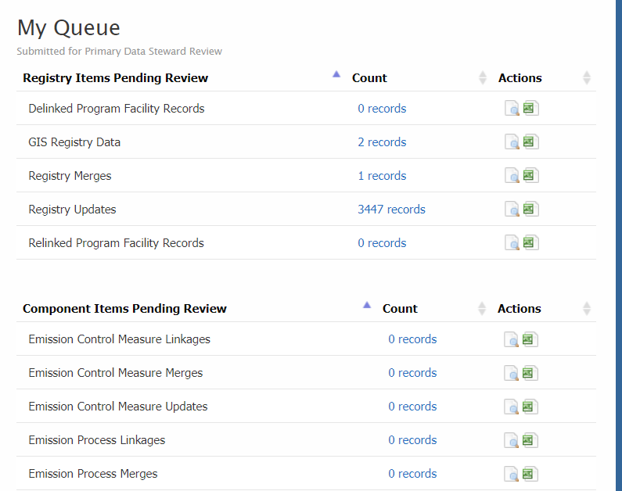
FLA Roles
Primary data stewards can make changes to registry-level facility data in FRS; Secondary data stewards can recommend changes.
FRS data stewards do not update program-level facility data (data provided by source systems).

Slide 30
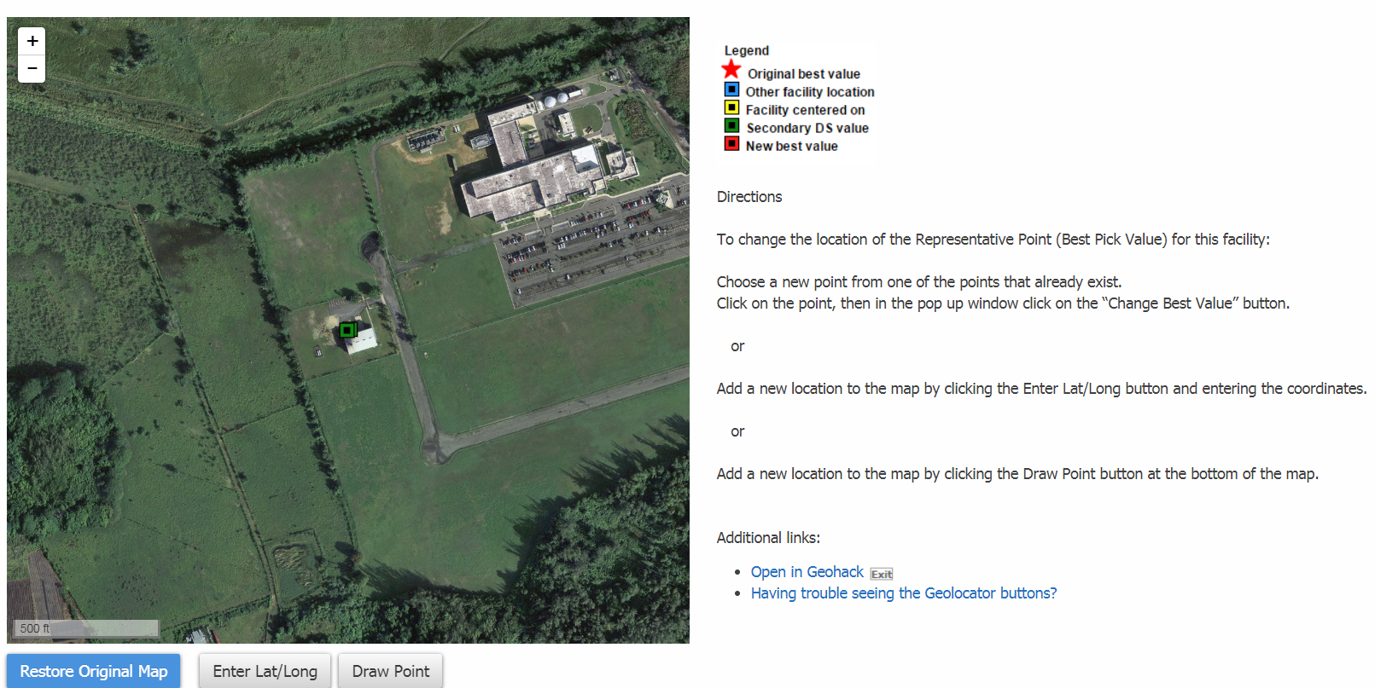
FLA Capabilities
Update location data via interactive map
Merge registry-level records to resolve duplicates
Link and de-link program records to registry records to improve data integration
Manage registry-level sub-facility data
Generate and view reports on a variety of facility data information

Slide 31
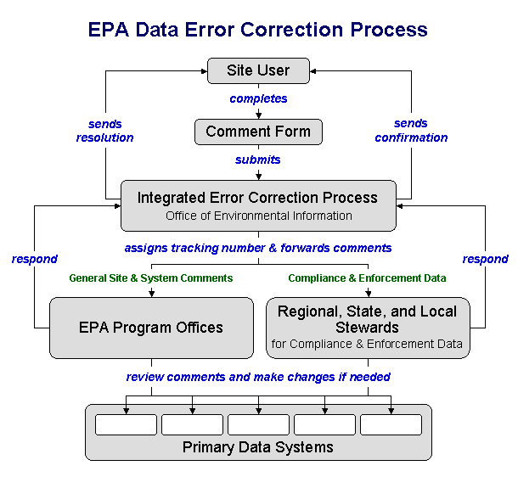
FLA Used as Part of Error Correction Process
Error Correction Process is used by EPA and state staff to address errors reported by users of EPA’s public websites like FRS, Envirofacts, and ECHO.
Data Steward network includes FRS data stewards who address facility errors.
EPA Regional and State Data Stewards address other types of errors.
The Error Correction Process helps improve data quality in EPA data systems and across the Enterprise.

Slide 32
How does FRS Support E-Enterprise?

Slide 33
FRS and E-Enterprise
FRS is EPA’s integrated facility management tool and represents EPA’s contribution to integrated facility management across the Enterprise.
Facility Team FRS program manager is one of the Integrated Facility co-chairs.
Integrated facility information is crucial to many E-Enterprise projects.

Slide 34




Facility Team: Component of E-Enterprise
E-Enterprise Teams
Facility Team
SPeCS for SIPS: State Plan Electronic Collection System for State Plan Submissions
E-Manifest for Hazardous Waste
Smart Mobile Tools for Field Inspectors
Advanced Monitoring Strategy and Implementation
E-Enterprise Community Inventory Platform
E-Enterprise Respectful Use of Data: ECHO
Shared Services
E-Enterprise Portal Governance & Maintenance
Assistance Gateway
Shared CROMERR Services (SCS) Implementation
Virtual Exchange Service Implementation
Combined Air Emissions Reporting (CAER)
Safe Drinking Water Information System Prime (SDWIS) Modernization
Identity Management Solution Project
The Interoperable Watersheds Networks
Shared Identity Management

Slide 35
2017 Integrated Facility Pilot
  Partnership with Rhode Island Department of Environmental Management (RIDEM).
  Developed APIs to exchange data in real-time between FRS and RIDEM’s integrated facility system.
  Updated FRS business logic to incorporate RIDEM data at the registry level, promoting state facility data as the facility data of record at EPA.
  Enabled FRS and RIDEM to benefit from more timely and accurate facility information.

Slide 36
Implementing Pilot Services Changes: How FRS Facility Attributes are Populated
FRS Facility Record
ID: 1234567
Name: ABC Company
Address: 123 Main St., Anytown, RI 02863
Program Facility Record
Program ID: TRI 0001234
Program Facility Name: ABC Co
Program Facility Address: 123 Main Street, Anytown, RI 02863
Program Facility Record
Program ID: NPDES RIG0009876
Program Facility Name: ABC Company
Program Facility Address: Main St., Anytown, RI
Partner Facility Record
ID: PLOVER 567
Facility Name: ABC Materials Company
Facility Address: 123 West Main Street., Anytown, RI 02809
FRS Facility Record
ID: 1234567
Name: ABC Materials Company
Address: 123 West Main St., Anytown, RI 02809
Program Facility Record
Program ID: TRI 0001234
Program Facility Name: ABC Co
Program Facility Address: 123 Main Street, Anytown, RI 02863
Program Facility Record
Program ID: NPDES RIG0009876
Program Facility Name: ABC Company
Program Facility Address: Main St., Anytown, RI
Partner Facility Record
ID: PLOVER 567
Facility Name: ABC Materials Company
Facility Address: 123 West Main Street., Anytown, RI 02809
Pre-Pilot Approach
Pilot API
Partner Record attached to FRS Record but not used to populate attributes in FRS Facility Record
Partner Record attached to FRS AND used to populate attributes in FRS Facility Record
Notes:
Highlight differences in what is being shown.

Slide 37
Applying Partner Data to FRS Facility Records
Applying partner MDM data to the FRS Facility Record represents a paradigm shift for EPA.
  This means that the FRS Facility Record will represent the Partner’s Facility Record, rather than a combination of Facility data from EPA partner systems.
The foundational (pre-development) phase of the State MDM Pilot included significant time understanding what it means to use partner data to populate FRS Facility Records. This included:
  Multiple, detailed discussions of EPA’s FRS system including architecture, business logic and data stewardship processes.
  Multiple, detailed discussions of Rhode Island’s PLOVER system, including demonstrations, an overview of business logic and a thorough discussion of the data stewardship process.

Slide 38
Applying Partner Data to FRS Facility Records
The conclusion was that if a state has an MDM system with a data governance process in place and data stewards engaged with the MDM system on a daily basis, this is sufficient to “promote” data from the partner system to the FRS Facility Record.
  For the purposes of the pilot, where services were implemented in non-production environments, this allowed us to change FRS business logic and conduct evaluation of impacts to logic changes.
  The Facility Team anticipates that there will be future discussions and a more comprehensive process established in order to more fully describe and document criteria that should be used when determining whether partner records could/should be used to populate the FRS Facility Record.

Slide 39
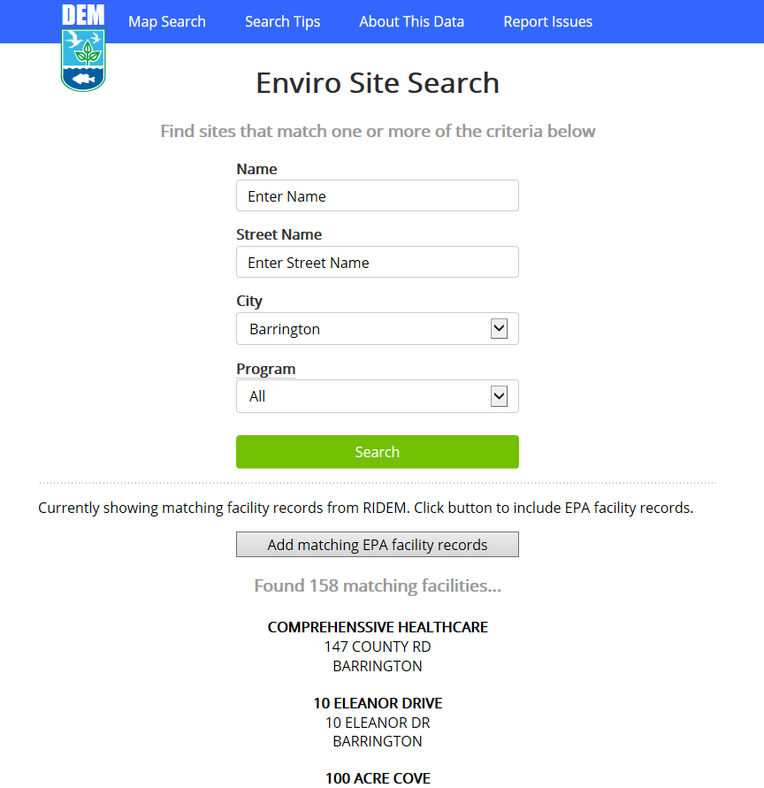
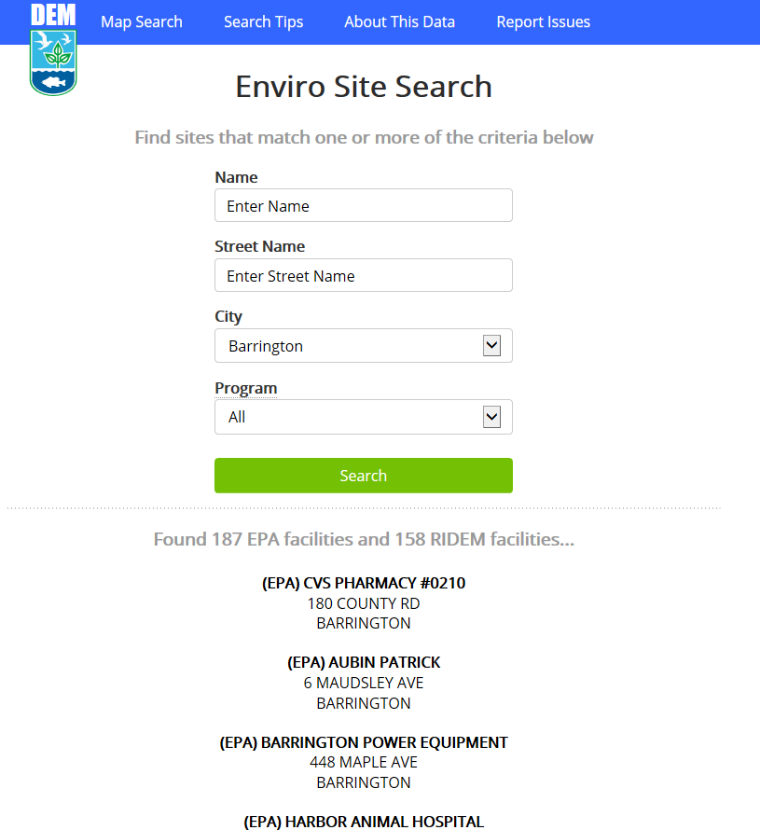
RIDEM Incorporated FRS Data Into Publicly-Available Site Search
Users given the option to add matching EPA facility records.
If selected, results are displayed with “(EPA)” appended to the front of the name.
Note: This example was used in the pilot to demonstrate how state and EPA data may be displayed

Slide 40
How Do I Get Involved?

Slide 41
Use FRS
FRS provides a comprehensive view of environmental activity at a facility or within a region or a specific geographic area.
The more data in FRS, the more accurate information is available to everyone.
New APIs will soon enable you to query FRS data in real time to augment your data, providing a more comprehensive picture to your stakeholders and customers.

Slide 42

Provide Your Data to FRS
    Improve the quality of data in FRS by providing your facility data to us.
    How?
      Implement FACID through the Exchange Network
      Through services (when available)
      Other methods may also be available
    Contact us for more information
      Let’s discuss the best scenario for your facility’s data

Slide 43
Use the FRS API
Use the FRS Query Service to augment your data with real-time data from FRS.
  Enable access to FRS integrated facility records to augment your organization’s data.
  FRS Query Service is expected to be available in production in the coming months.
Use the FRS Submit Service to exchange real-time data with FRS when it is available in production.

Slide 44
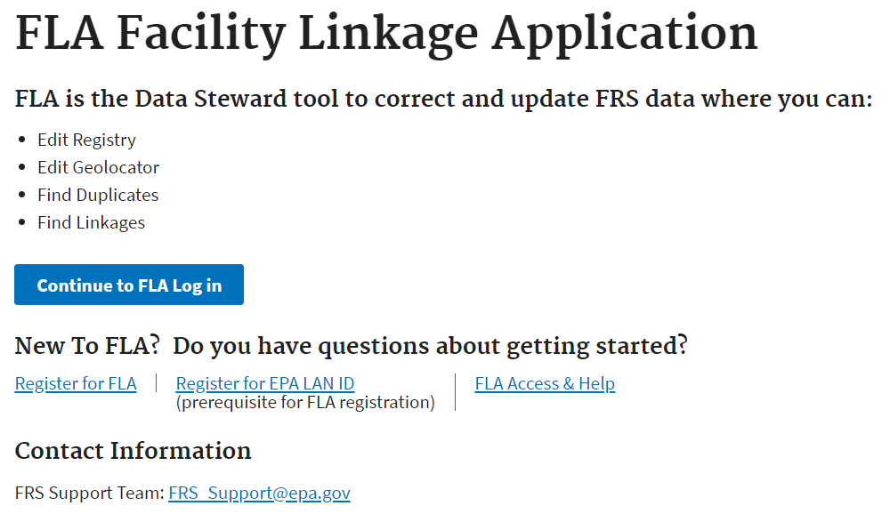
Register as an FRS Data Steward
Use FLA to correct and help manage facility data.
Contact us to learn more about FLA and to register to be an FRS data steward.
Attend data steward training, available quarterly.

Slide 45
Participate in E-Enterprise Integrated Facility Team
Help to further the vision for integrated facility across E-Enterprise.
Integrated facility information will:
  Increase efficiencies for the regulated community.
  Provide all stakeholders more accurate and timely facility data.
  Facilitate broader understanding of facilities across agencies, programs, and the general public.

Slide 46
Participate In a Pilot
E-Enterprise Integrated Facility is seeking pilot partners to continue API development and testing.
The pilot will build upon earlier pilot efforts implement bi-directional services to update facility data in real time (in a non-production environment) between a partner system and FRS.
This pilot will use expanded services and test additional FRS business logic changes.
  Services being expanded to enable exchange with full FRS data model including:
    Locational data and metadata
    Sub-facility data
    Organization and Contact data

Slide 47
Participate In a Pilot
What will partners need to do?
  Use the expanded FRS submit service to submit data to FRS in real-time.
  Build a service to allow updates made in FRS to be submitted to your system in real-time.
  Work with EPA and the Facility team to scope and perform testing of the services.
  Review materials and outputs produced from the pilot. This may include summary presentation material and updates to the Implementation Guide.
What is the time commitment?
  The previous pilot development was developed, tested, and deployed within a 12 week period.
  However, the pace will be dependent upon partner availability. We’re flexible!

Slide 48
What Does Pilot Participation Entail?
Sharing Facility Services Implementation Guide on the Integrated Facility website at: https://e-enterprisefortheenvironment.net/wp-content/uploads/2018/06/Implementation-Guide_Facility-Shared-Services-0.4.pdf.
Guide describes the steps for partners to implement and test the pilot services.
Contains technical and business process questions to aid partners in determining the best way to implement to meet their needs.

Slide 49
Participate in an Integrated Facility Team Work Stream
Facility status micro-service
Facility governance
Significant differences in what ‘facility status’ means.
Several types of status that apply to ‘facility’ are conflated
Identified types include:
  Environmental Program Interest
  Operational Status
  Compliance Status
  Permitted Status
  Reported Requirements and/or Status
The Work Stream will attempt to define “status” requirements
Facility web service specifications require change management
Work Stream will create a governance framework that will include:
  Over-arching policy component
  Revised facility data standards

Slide 50
Contact the Integrated Facility Co-Chairs
Susan Joan Smiley Baker
EPA Office of Environmental Information
smiley.susan@epa.gov
Joshua Kalfas
Oklahoma Department of Environmental Quality
joshua.kalfas@deq.ok.gov
Ron Evans
EPA Office of Air and Radiation
evans.ron@epa.gov
Ben Way
Wyoming Department of Environmental Quality
ben.way@wyo.gov

Slide 51
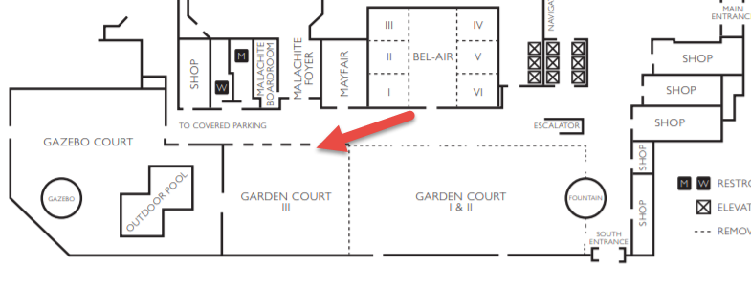
Find Us in the Exhibit Space
Connect with us and the other Integrated Facility Co-chairs.
Learn more about FRS and how it can benefit your organization.
Across the hall in Garden Court III

Slide 52
Attend the Shared Services Concurrent Session
Learn more about E-Enterprise Facility Integration and how it supports the Combined Air Emissions Reporting (CAER) project.
The session covers recent accomplishments and highlights future work.
A focus on how the CAER project will leverage integrated facility information to streamline emissions reporting, saving time and resources for industry, state, and EPA staff.
Wednesday afternoon 1:45, Bel-Air.

Slide 53
Questions?
Thank You!
Susan Joan Smiley Baker
Office of Environmental Information, EPA
smiley.susan@epa.gov
Kimberly Hoke
CGI Federal
kimberly.hoke@cgifederal.com

