Slide 1
LEAN
    E-Enterprise
    National Meeting
    Bert Kovacs
    Kelton Kosik
      October 22, 2018
  Training
Notes:
BERT

Slide 2
Course Agenda
Welcome and Introductions
Lean 101 Basics
Lean Assessment of Operations
Developing Implementation Roadmaps (after Assessment)
Using Workshops to Transform Processes
Course Wrap-up
Notes:
BERT

Slide 3


Meet your instructors
BOTH INSTRUCTORS HAVE DEEP, REAL-LIFE EXPERIENCE IN LEAN OPERATIONS ASSESSMENT AND PROCESS TRANSFORMATION
BERT KOVACS
Certified Master Black Belt in Lean Six Sigma
Led process workshops and training activities for Government and Corporate Clients
30 years’ experience facilitating process improvement workshops and projects for clients in nearly every industry
30 years’ experience working on more than 300 Rapid Process Improvement Events
Deep experience in BPR training across a number of methodologies, including seven management and planning tools
KELTON KOSIK
Currently working on Green Belt Certification in Lean Six Sigma
Led process workshops with multiple governmental organizations
Extensive industry expertise in systems operations, database management, and process improvement, especially as it relates to CRM systems
Heavy background in transforming complex paper-based workflows into streamlined and digitalized processes
Notes:
BERT / KELTON

Slide 4
Lean baseline SURVEY
WHERE ARE WE AS A CLASS?
  1 – I have never used lean tools/techniques
  3 – I use lean tools sometimes
  5 – I use lean tools a lot
  7 – I always use lean, regardless of process or environment
  9 – I should be teaching this stuff
Notes:
BERT
This is where we will do the electronic poll

Slide 5
Introductions
Your Name
Your Organization and your Role
Your Previous Lean Experience?
Where on the Lean Journey is your Organization?
Notes:
BERT

Slide 6
CLASSROOM LOGISTICS
Class Hours
  8:00 AM – 12:00 PM (CT)
Safety
  Fire Exits
  Trips and Other Hazards
Restroom Locations
Breaks
Other Items - Benefits and Concerns
Notes:
BERT
Talk about benefits and concerns and putting them up on the board.

Slide 7
Evolution Of Lean
(Lean 101)
Notes:
BERT

Slide 8
WHAT IS THIS REALLY ALL ABOUT?
WHY IS EVERY ORGANIZATION DRIVEN TO QUALITY, COST AND CYCLE TIME REDUCTION GOALS?
Improved Citizen Experience
Shorter Time to Complete Core Processes
Downward Price Pressure: Lower Costs
Higher Citizen Satisfaction
Reduce Errors and Rework
Do More with Less
This can be achieved through a culture of continuous improvement
Notes:
BERT
Ask the audience how we can make these parallels through government work

Slide 9
WHY 99% is not good enough
THE “GOODNESS” LEVEL OF 99% EQUATES TO:
20,000 lost articles of mail per hour
Unsafe drinking water almost 15 minutes each day
5,000 incorrect surgical operations per week
2 short or long landings at most major airports each day
200,000 wrong drug prescriptions each year
No electricity for almost 7 hours per month
Notes:
BERT

Slide 10
Lean Can Be Applied to All types of Processes, Not Just Manufacturing
Lean tools/methodologies have shown success in government processes and even software development.
CITIZEN FACING PROCESSES
Permit Applications
Application/Request Management
Citizen Service Calls
Opening New Accounts
INTERNAL GOVERNEMENT PROCESSES
Payment Processing
Citizen Statement Production
Budget Processes
Requisition Approvals
All processes can and should be improved using Lean Quality and Cycle Time Tools !
Notes:
BERT
Lean was a precursor to agile software development

Slide 11
“OUR PRODUCTION CYCLE IS 33 HOURS FROM IRON ORE TO AN AUTOMOBILE, COMPARED TO 12 DAYS WHICH WE THOUGHT WAS RECORD BREAKING.”
      – Henry ford
Copyright 2018 Accenture. All rights reserved.
Notes:
BERT

Slide 12
LEAN’S Roots in Manufacturing
MODERN LEAN METHODOLOGIES ORIGINATED IN POST-WWII JAPAN BASED ON “DOING MORE WITH LESS”
Ford Motor Company
General Motors
Toyota
Notes:
BERT
FORD MOTOR COMPANY – DRIVEN BY CAPITAL TURNOVER AND LOW COST (ROIC)
“The time element in manufacturing stretches from the moment raw material is separated from the earth to the moment when finished product is delivered to the ultimate consumer.”
“Ordinarily, money put into inventory is thought of as live money,...but it is waste – which like every other form of waste, turns up in high prices. We do not own or use a single warehouse!”
“Time waste differs from material waste because there can be no salvage.”
GENERAL MOTORS (1920-1964) Alfred P. Sloan
Supplanted Ford via EBIT margin (effectiveness) as opposed to capital turnover (efficiency)
First use of strategy and marketing in industry
Focused on meeting customer demand for product variety – which was a precursor to “Just in Time” Methods
TOYOTA (1960-1990) Kiichiro Toyoda, Shigeo Shingo, Taiichi Ohno
Focused on link between cycle time, inventory, batch size, and setup time
Tied Ford’s efficiency concept and Sloan’s effectiveness concept together for repetitive manufacturing environments with many part numbers
Focus on both profit margin and capital turnover components of Return On Invested Capital calculation
Created Toyota Production System (TPS): foundation of Just-In-Time and Lean Production movements in U.S. and the world

Slide 13
TYPES OF MUDA (WASTE)
T.I.M.W.O.O.D
  Transportation (moving material/product from one place to another)
  Inventory (material/product/information waiting to be processed)
  Motion (excess movement and/or poor ergonomics)
  Waiting (delays caused by shortages, approvals, downtime)
  Overproduction (producing more than is needed)
  Over processing (adding more value than the customer is paying for)
  Defects/Rework (doing the same job/task more than once)
Benefits & Expectations of Reducing Muda (Waste)
Less Labor Requirements
Less Space Requirements
Increased Flexibility
Decreased Costs
Improved Quality
Improved Responsiveness
Increased Innovation
Increased Employee Enthusiasm
Notes:
KELTON
“Show me the Muda!” - “Muda is Waste”
Another waste is: People and their talents (untapped and/or misused resources)
We have a handout on Waste in the Office
Important to look at waste – More bang for the buck in improvement vs. Value Added activities

Slide 14
“There is nothing so useless as doing efficiently that which should not be done at all.”
      – Peter Drucker
Copyright 2018 Accenture. All rights reserved.
Notes:
KELTON

Slide 15
BREAKOUT
Where is the waste in your organization?
Identify waste as a table team and list examples
Note…..Could be a common process (e.g.: Air Quality) or large area of macro waste.
Notes:
KELTON
A few good examples to stimulate conversation before the breakout – maybe get ideas from lean practitioners in audience.
i.e. Waiting – incomplete submittals.
Complex, multiple levels of approval and steps for processes like procurement, all occurring sequentially – is that over-processing or Motion? But maybe a good gov’t example

Slide 16
Lean Methods of Improvement
LEAN MEANS SPEED, LOW COST, FLEXIBILITY AND IS APPLIED THROUGH A VARIETY OF TOOLS AND TECHNIQUES
Kaizen Events (Process Workshops)
Value Stream Mapping
5S for Cleanliness and Organization
Kanban
Setup Reduction
Queue Reduction
Value-Add Analysis
Work Flow/Layout Improvement
Process Balancing
Mistake-Proofing
Complexity Reduction
Notes:
BERT
Kaizen events to effect rapid impact/changes
Value stream mapping for opportunity identification
5S for cleanliness and organization
Kanban for “pull” from the customer
Setup reduction for flexibility
Queue Reduction for productivity improvement
Value-Add Analysis
Work flow/layout improvement to reduce non-value add transportation
Process Balancing to identify time traps, balance workloads, and increase throughput
Mistake-Proofing to eliminate rework through mistake-proofing (defect prevention)
Complexity analysis for procurement activities

Slide 17
The Foundations of Lean
Specify Value
2. Identify the Value Stream
3. Pull
4. Flow
5. Perfection
Notes:
BERT
1. Specify Value – Value addition is judged by the customer through:
Specific products
With specific capabilities
Through dialogue with specific customers
2. Identify the Value Stream – The value stream is all of the activities that are necessary to bring a specific product through three critical business tasks:
Problem solving
Information management
Physical transformation
3. Pull – Real customer demand pulls products and information through the system:
Inventory is waste: Producing/working on items/information that are not used is waste
Remove excess capacity or increase the rate of customer pull
4. Flow – The distance that product/information must travel and the time it takes:
Reduce non-value add time by reducing time and/or distance between resources
5. Perfection – Opportunities for improvement are identified and implemented
Reduction of effort, time, space, cost, mistakes
Increasing customer satisfaction

Slide 18
BREAKOUT
‘Why does “Leadership Buy-in” have Critical Importance for Deploying Lean Methods?’
Brainstorm Answers with your Table Team
Notes:
BERT

Slide 19
Executing Operations Assessments
Notes:
KELTON

Slide 20
Which Process to Focus on?
A PROCESS CAN BE SELECTED TO UNDERGO A LEAN TRANSFORMATION FOR A NUMBER OF REASONS
Process prioritized during Operations Assessment
Process area that has been previously neglected in terms of resources and improvement efforts
Highly visible process that is or may be receiving negative scrutiny from it’s stakeholders
High volume and variability
Outdated technology. lack of automation, and lack of visibility into process
Complicated requirements and frequent handoffs causing lengthy and inefficient processing
Notes:
KELTON
Critical to have sponsorship from the leadership of your organization.
Communication is critical – You can’t over communicate the effort.
We can all name an area that we know needs to be improved.
High Volume – Seasonal vs. Unpredictable
\
Highly Visible – We have done a process transformation workshop – Governor was receiving a huge amount of phone traffic on a permitting process that was taking too long.

Slide 21
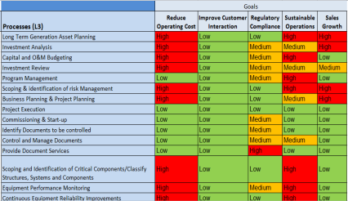
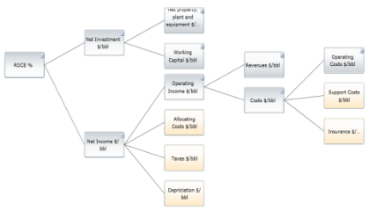
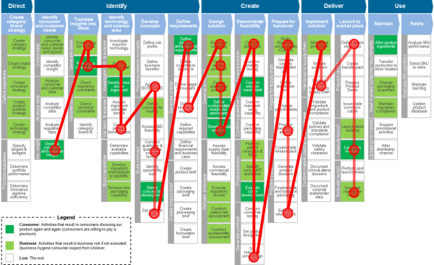
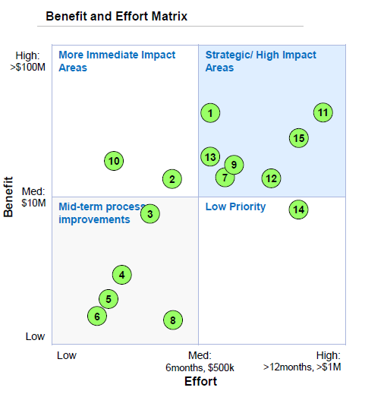
Operations Assessment
THIS APPROACH IS UTILIZED WHEN THERE IS UNCERTAINTY ON HOW AND WHERE TO EMPLOY PROCESS IMPROVEMENT EFFORTS IN A GIVEN FUNCTIONAL AREA WITHIN AN OPERATION.
A Process Inventory builds a listing of process considered to be in the scope of the process Universe.
  The Operating Model shows process interactions, data, issues and technology enablers.
Prioritization of processes is determined based on their relative benefit and effort, which will help determine which processes will be the best candidates for additional transformation efforts.
  The “World on a Page” illustrates the interactions between all processes in the Universe.
Notes:
KELTON
NOTE: Critical to have the right people in the room
MORE NOTES ABOUT PROCESS INVENTORY – Performance score card – How are you performing around errors, how many people are involved in the process, what are the downstream implications?
LIST OF THINGS THAT SHOW UP ON THE OPERATING MODEL
Technology Enablers
Rework Loops
Owners of process steps
Inputs/Outputs
Macro areas of activity
All of these processes build off of one another
WOP – Value Added vs. Non Value Added, Rework hotspots, FTE Counts, Budget Costs in certain areas, Overtime
Green marker stays in facilitators hands
Maybe draw out a quick example of a prioritization matrix

Slide 22
Overview of Operations Assessment Method
Phase
Process Inventory
and/or
Operating Model
Prioritize Processes
and Opportunities
Evaluate Processes
And Opportunities
Identify Quick Wins
and Roadmap to
Outcomes
Activities
List of Owned Processes
Resource Assignment to Processes
Operating Model
List of Processes with Opportunities for Improving Efficiency and Effectiveness
Create and Validate Current State Process
Evaluate Process Measurement Approach
Create Solution Implementation Plan
Create Future State Process Map
Identify High Value Cost Savings and Capacity Building Opportunities
Deliver Execution Plan for Quick Wins
Deliver Long Range Roadmap for Long Term Process Improvement
Work Products
Inventory List of Owned Processes with Assigned Resources
“World on a Page” View of Process Interactions
Operating Model
Prioritized List of Processes to Execute Process Improvement Methodology (Benefit/ Effort Matrix)
Executive Presentation Summarizing Assessment Findings
Process Charter
Current State Process Map
Metrics Driver Tree
Solution Implementation Plans
Future State Process Map
Business Case for Savings/Value
Roadmap for Short Term and Long Term Improvement
Actionable Statements of Work for Execution
Notes:
KELTON
Get into current state here
Quick Wins is where you can gain rapid support

Slide 23
Lean Roadmap
(After Operations assessment)
Notes:
KELTON

Slide 24
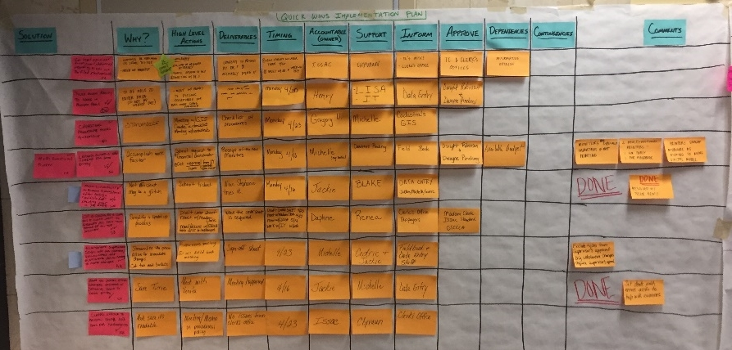
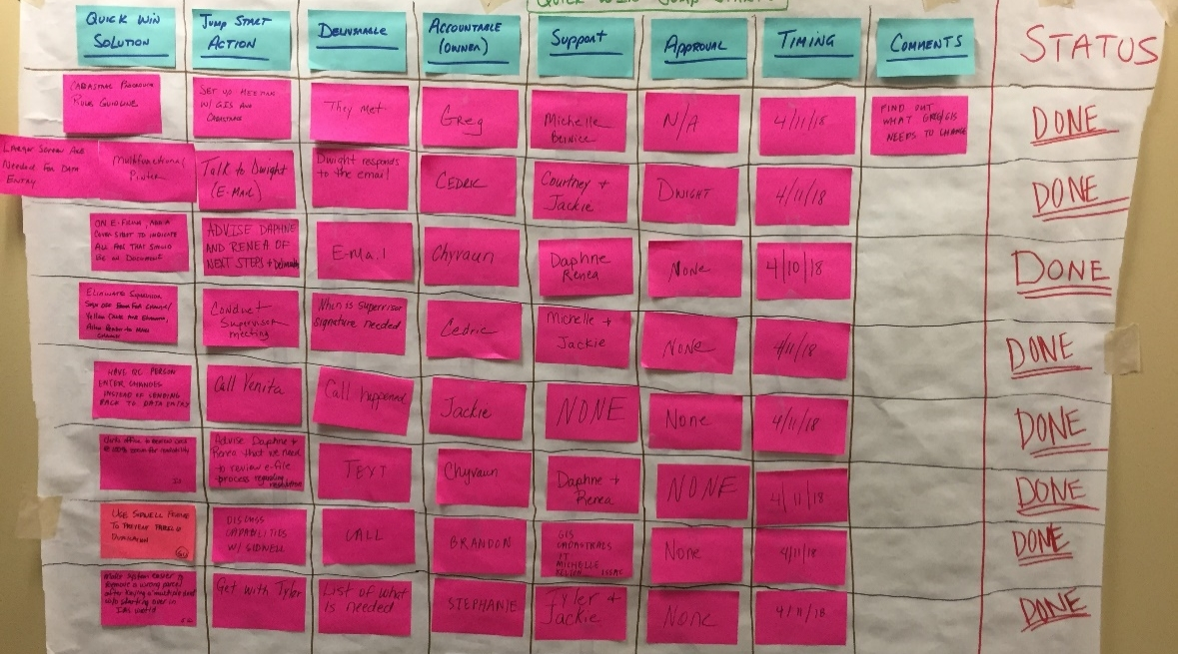
Implementation Plans
QUICK WINS IMPLEMENTATION PLAN
Collect from the marriage of issues and solutions identified on the Operating Model
Identify solutions that can be implemented in 45 days or less
  Inform, approve, and support entities identified
  Deliverables identified and described
Implementation of quick wins is critical to continuing momentum
JUMP STARTS
Take the Quick Win solutions and begin action immediately
  Initial actions for each solution, known as “jump starts”, are usually completed during workshops
  Some solutions are even fully completed before the end of the workshop
Creates additional ownership and buzz around the solutions
Notes:
KELTON
NEED TO TALK ABOUT WHERE THE SOLUTIONS CAME FROM – Solutions come during an identified brainstorming session or are grabbed during conversations regarding the process
Talk about Fulton Examples

Slide 25
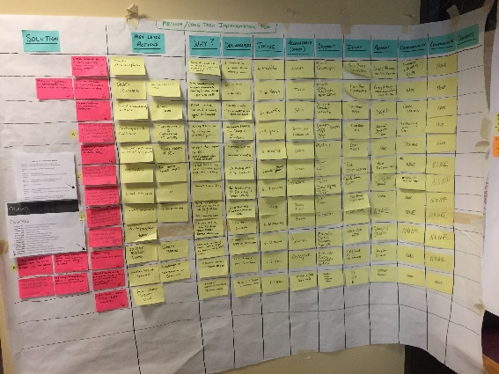
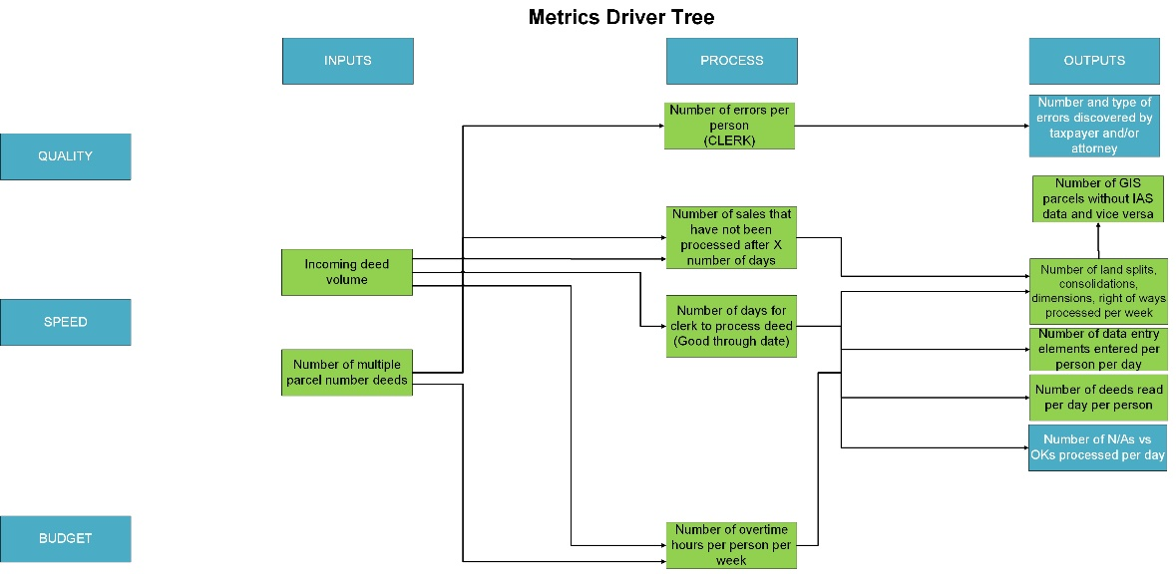
Implementation Plans
MEDIUM/LONG TERM IMPLEMENTATION PLAN
High level approach to long term solution planning
  Inform, approve and support entities identified
  Solution deliverables identified and described
  Dependencies and contingencies were examined and identified
Further detail, including additional actions and estimated completion dates, are revisited after launch by accountable teams
METRICS IMPLEMENTATION PLAN
Detailed plan to implement metrics (such as KPI’s) based on Metrics Driver Tree
  Identifies important details such as metric formula, data source, frequency of measurement, and the type of chart to display
Metrics used to manage and monitor the process being transformed
Notes:
KELTON – TAKE A BREAK AFTER THIS ONE – SHOULD BE ABOUT 10:10AM
Talk about both Metrics Driver Tree and the Imp Plan in getting those in place

Slide 26
Lean Workshops
(Kaizen Events)
Notes:
BERT

Slide 27
What Is Kaizen?
Kaizen is the organized use of common sense to improve cost, quality, delivery, and responsiveness to customer needs.
Kaizen assembles cross-functional teams aimed at improving a process or problem identified within a specific area
Kaizen is the continuous improvement vehicle utilized by the Toyota Production System
Notes:
BERT

Slide 28
Steps to a Successful Kaizen Event
EVENT PREPARATION
1. Select an area that must be addressed based upon the voice of the business or voice of the customer
2. Select an event sponsor that has been trained in Lean leadership
3. Select the team members based SIPOC diagram
4. Communicate and schedule the event in a room conducive to audience size and process scope
5. Perform the Pre-Kaizen Checklist
6. Gather necessary data/information
7. Create a RACI CHART showing roles and responsibilities (setting expectations)
8. Understand the current/baseline conditions
9. Define the goals/objectives of the event
10. Create a Project Charter
11. Perform a Project Risk Assessment
12. Determine the emergency and safety rules within the Kaizen area
CRITICAL TO HAVE A TRAINED KAIZEN LEADER (IN HOUSE OR OUTSOURCED)
Notes:
BERT
Talk about sponsors’ responsibility for follow through and support
Make reference to handout checklists for pre workshop and shopping list

Slide 29
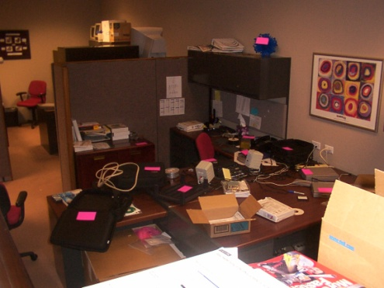
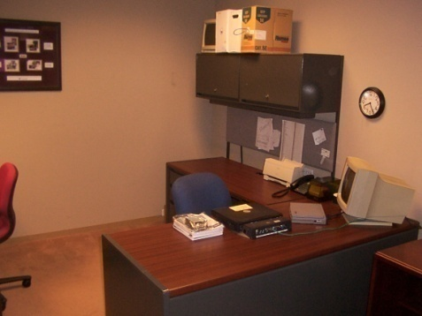
Steps to a Successful Kaizen Event
EVENT EXECUTION
13. Train the team members
14. Take ‘before’ pictures of the area
15. Map the process (Value Stream Map)
16. Create a set of performance measures
17. Conduct the Kaizen – follow the mini DMAIC schedule
18. Implement the new improvement
Notes:
BERT

Slide 30
Steps to a Successful Kaizen Event
EVENT CONCLUSION AND FOLLOW THROUGH
19. Take ‘after’ pictures of the improved area
20. Rehearse the team presentation to management
21. Team presents the results to management
22. Celebrate the results!
23. Conduct follow-up meetings to execute action plans and opportunity maps
Notes:
BERT

Slide 31
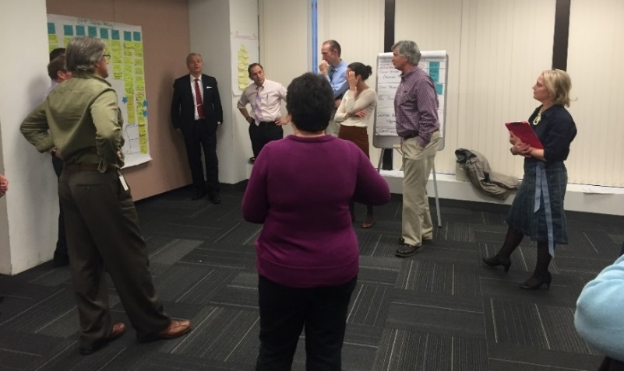
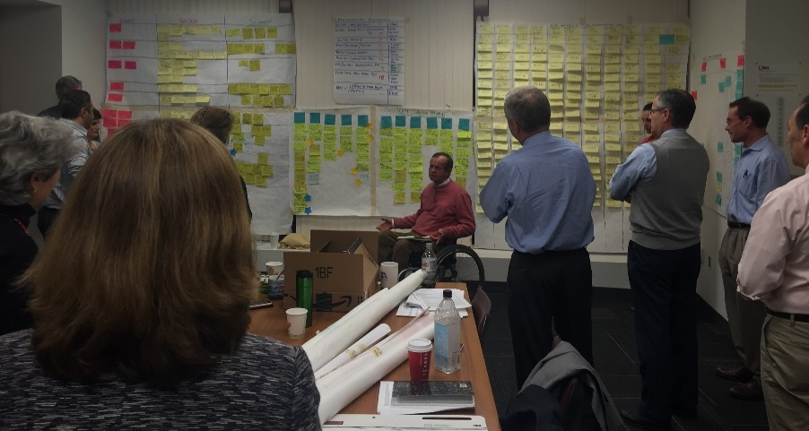
BPR Workshop Methodology
THE TEAM WORKS TOGETHER TO IDENTIFY ROOT CAUSE ISSUES, DEVELOP QUICK WIN AND LONG TERM SOLUTIONS AND TRANSFORM THE ENTIRE BUSINESS PROCESS.
Current State Maps
Identify
Issues/
Opportunities
Develop Solutions
Future State Map
Development of Scope
Action Plans
Charter
Macro-level scoping document
Process mapped out “as-is” to create a baseline
Rework loops identified
Issues identified during mapping of current state
Issues prioritized for further analysis
Solutions Identified in brainstorming sessions
Linked to issues and root causes
Solutions prioritized into quick hits and longer term
Development of quick hit action plan
Development of medium to long term action plan
Process mapped out as it will be once all quick hits and longer term solutions are implemented
Notes:
BERT

Slide 32
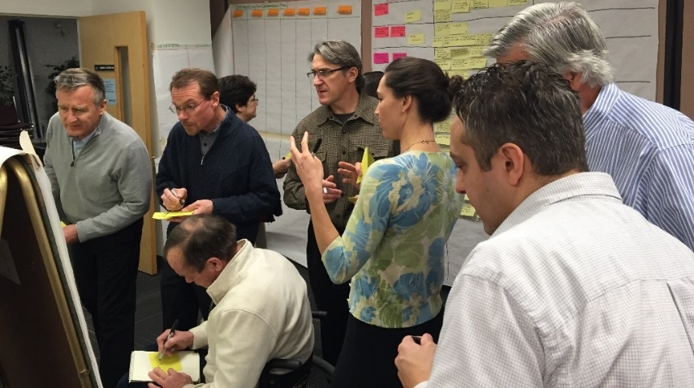
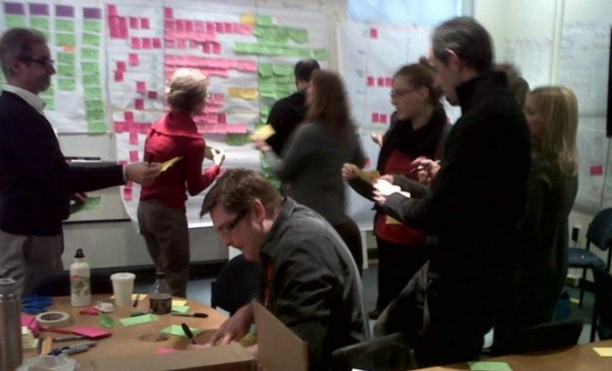
The process is engaging, highly visual and participative
Notes:
BERT

Slide 33
Value-Stream Mapping
VALUE ADDED TIME – A CUSTOMER PERSPECTIVE
CUSTOMER VALUE ADD (CVA) QUESTIONS
Does the task add form, feature, or function to the product or service?
Does the task enable a competitive advantage (reduced price, faster delivery, etc.)?
Would the customer be willing to pay extra or prefer us over the competition if he or she knew we were doing this task?
BUSINESS VALUE ADD (BVA) QUESTIONS
Does this task reduce owner financial risk?
Does this task support financial reporting requirements?
Would the process of producing/selling the product break down if this task were removed?
Is this task required by law or regulation?
NON-VALUE ADD (NVA) QUESTIONS
If the customer knew we were doing this, would they request that we eliminate the activity so we could lower our prices?
Does the task fit into either of the other two categories?
Can I eliminate or reduce this activity?
Notes:
BERT
Typical CVA Activities:
Opening a customer account
Applying payments correctly
Answering customer questions quickly and correctly
Sending customer statements on-time
Reviewing new products that the customer needs or wants
Typical BVA Activities:
Order Entry/Processing
Purchasing
Product Sustaining/ Development
Sales/Marketing
Sarbanes Oxeley reporting
Internal Financial Reporting
Customer Required Inspection
Filing Corporate Income taxes
Typical NVA Activities:
Counting
Handling
Reviewing
Transporting/Moving
Stocking/Storing excess office supplies
All Rework Loops
Excessive Signoffs/Approvals

Slide 34
Feedback Plan – Kaizen event
MIDPOINT REVIEW (1 HOUR)
Purpose of review is to update sponsor on team findings & proposed kaizen activity for implementation (“new” solution).
Sponsor support will be needed to address any obstacles the team has identified.
FINAL REVIEW (2 HOURS)
Kaizen team will inform the process owners & sponsors on findings, progress and results obtained (proposed new “solution”).
Sponsor will use this time for team recognition.
Notes:
BERT

Slide 35
Benefits of Culture Change
THROUGH PROCESS IMPROVEMENT
Not paving the cow paths
Every process that will be integrated in a new technology solution should first go through BPR to align and optimize underlying business activities before automation
Building internal capacity – Establishing a Culture
A “center of excellence” with trained Lean workshop facilitators to support the effort; capacity augmented by 3rd party support
Empowering staff to own the process
The people working in the process are very familiar with the pain points and often have the best ideas for eliminating that pain, which promotes the team to take ownership of the enhancements
Striving for continuous improvement
The ultimate goal is to have every employee come to work each day trying to identify and implement changes in the processes they work in to enhance quality, cost and speed
Notes:
BERT

Slide 36
When to Bring in BPR/Kaizen?
Preparation for a technology implementation
Reaction to limited process capacity
Developing understanding of current state process
Developing understanding of how the agency’s business processes interact within their operations universe
Developing a culture of continuous improvement
Strategic and Tactical IT Transformation
Notes:
BERT – SHOULD BE AROUND 11:10AM
Preparation for a technology implementation
Requiring that every process that will be automated in a new system must first go through BPR to ensure that underlying business activities are aligned and optimized
Reaction to limited process capacity
Optimizing the current process in order to handle the same workload with limited resource levels, due to workforce reductions, high volumes, etc.
Developing understanding of current state process
A baseline, used to understand how an agency is currently performing
Can also be used to document processes as a training tool
Assessment and potential redesign of current measurement system
Developing understanding of how the agency’s business processes interact within their operations universe
A starting point for improving processes across an entire agency
Developing a culture of continuous improvement
Every employee comes to work each day trying to identify and implement changes in the processes they work in to enhance quality, cost and speed
Strategic and Tactical IT Transformation
Fundamentally transform your IT function to drive business value

Slide 37
BPR Workshop Menu
Process Optimization involves changing various aspects of the process (people, process, technology, policy) to affect improved efficiency and effectiveness in the Future State.
Process Standardization involves changing various parts of the process (that are being executed inconsistently) so there is a uniform, consistent way of executing the process across locations, functions, departments,
Current State Validation involves documenting a business process “as-is” to create a baseline and understand how different scenarios are handled based on the current rules and policies.
Innovation is employed when the current process is so dysfunctional, that it is scrapped entirely and a new process is developed on a clean sheet of paper.
Elimination is employed when it is determined that the process or sub-process is no longer necessary to perform in the agency’s universe.
Replication candidates are similar to a process that has already been through a workshop, so that opportunities may be able to be translated to benefits in several other processes.
Notes:
KELTON
This is the menu – Each will be discussed in more detail in the subsequent slides

Slide 38
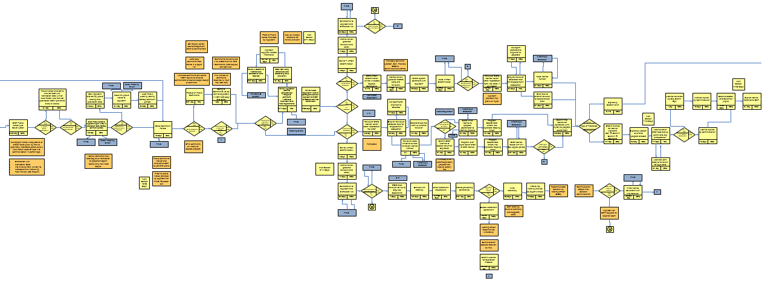
Current State Validation & Mapping
BUSINESS PROCESS IS MAPPED OUT “AS-IS” TO CREATE A BASELINE AND UNDERSTANDING OF HOW DIFFERENT SCENARIOS ARE HANDLED BASED ON CURRENT RULES AND POLICIES
Current State Validation is one of the first steps in any BPR effort, but can also be performed on a standalone basis.
Example of Current State Process Map
Week 1 | Week 2 | Week 3
Kickoff
Define and Develop Current State
Finalize Documentation
Executive Presentation
An example of a valuable use of this practice would be a risk assessment of processes and policies. The goal is to understand the risk that comes with various scenarios that may effect the process and it’s stakeholders.
Notes:
KELTON
Getting it visual is critical
Quote from Fulton County

Slide 39
Process Standardization
CHANGING VARIOUS PARTS OF THE PROCESS (THAT ARE BEING EXECUTED INCONSISTENTLY) SO THERE IS A UNIFORM, CONSISTENT WAY OF EXECUTING THE PROCESS ACROSS LOCATIONS, FUNCTIONS, DEPARTMENTS, ETC
Week 1 | Week 2 | Week 3 | Week 4
Process being performed in multiple ways
Single, standardized process
Kickoff
Process Standardization may require visits to other sites or regions in order to document the multiple ways in which the current process is performed.
Define and Develop Current State
Prepare for Event
4 Day Process Workshop
Finalize Documentation
Executive Presentation
Notes:
KELTON
WOULD YOU FIND THIS OUT DURING THE CURRENT STATE MAPPING – Yes
Makes it easier to leverage technology

Slide 40
Process Optimization
CHANGING VARIOUS ASPECTS OF THE PROCESS (PEOPLE, PROCESS, TECHNOLOGY, POLICY) TO AFFECT IMPROVED EFFICIENCY AND EFFECTIVENESS IN THE FUTURE STATE
Process is highly variable and out of specification
Optimized process fits more precisely within process specifications
Week 1 | Week 2 | Week 3 | Week 4
Kickoff
Process Optimization requires more effort than simply implementing new software. It requires an analytical look at a group’s operations to eliminate the waste in the process that is preventing the resources
from working efficiently and effectively.
Define and Develop Current State
Prepare for Event
4 Day Process Workshop
Finalize Documentation
Executive Presentation
Notes:
KELTON
Optimization is getting in there and taking out waste, at the most basic level
Through mistake proofing, streamlining forms, taking to another office, etc.
Can also look at analytics here – Triage to make the process simplier

Slide 41
Opportunities for Replication
SIMILAR PROCESSES IDENTIFIED IN A WORKSHOP HAVE THE OPPORTUNITY TO BE TRANSLATED INTO BENEFITS IN SEVERAL OTHER PROCESSES.
Replication candidates will be compared to a benchmark to determine opportunities for standardization and optimization.
Pre-Replication
Replication
Key Tasks | Identify and confirm Replication Participants Schedule and conduct process walk-throughs to create SIPOC for candidate process Compare SIPOCs of candidate and benchmark processes Assess high level capability for replication | Review Future State Map of benchmark process and identify standardization and optimization issues/opportunities (i.e. areas where candidate process does not match benchmark’s Future State) Identify solutions from benchmark process, or create new solutions, that address issues/opportunities and align candidate process to benchmark’s Future State Map Develop high-level action plan and prioritize solutions on a Benefit/Effort Matrix Conduct sponsor/process owner review
Outputs | SIPOC Current State Map (if necessary) | Issues/opportunities Prioritized list of solutions Benefit/Effort Matrix
Week 1 | Week 2
Kickoff
Define and Develop Current State
Prepare for Event
2 Day Process Workshop
Finalize Documentation
The example timeline for this initiative reflects replication of 1 process in a 2 week period and assumes the baseline workshop is already complete.
Executive Presentation
Notes:
KELTON
If I do the initial workshop on one process, I can run the next workshop for a similar process much faster using the same processes

Slide 42
Elimination and Innovation
ELIMINATION IS USED IN ONLY A SMALL PERCENTAGE OF WORKSHOPS, WHERE THE PROCESS OR PART OF THE PROCESS IS OUTDATED, REDUNDANT, OR ADDS NO VALUE TO THE AGENCY’S UNIVERSE.
Process is highly variable and out of specification
Innovation is used in only a small percentage of workshops, where the process is so dysfunctional that it is scrapped entirely and a new process is developed on a clean sheet basis.
Process is highly variable and out of specification
Brand new process
Notes:
KELTON
Elimination – Go back to Peter Drucker statement
A lot of things can be eliminated because they were done in the past to CYA – Technology can eliminate a lot of this.
Innovation is clean sheet.

Slide 43
BPR Workshop Outcomes
IMPLEMENTATION OF SOLUTIONS STARTS IN THE WORKSHOP; FULL IMPLEMENTATION PROVIDES SEVERAL BENEFITS TO THE AGENCY, PROCESS STAKEHOLDERS, AND CITIZENS.
 | Faster processing for internal and external stakeholders. For example, a 61% reduction in overall time to process an application.
 | More manageable staff workloads for current staffing levels. Increased capacity due to elimination of defects and rework loops.
 | Improved simplicity / clarity / user-friendliness of public-facing materials.
 | Improved ability to use metrics to assess program performance and identify process pain points, bottlenecks, etc.
Deliverables:
Current state process map
Quick hits action plan that can be implemented within 45 days
Long term action plan
Future state process map
Executive presentation that can be used to share results with leadership
Notes:
KELTON
Flexibility in job positions – Goes back to eliminating the waste of sub optimized workforce

Slide 44
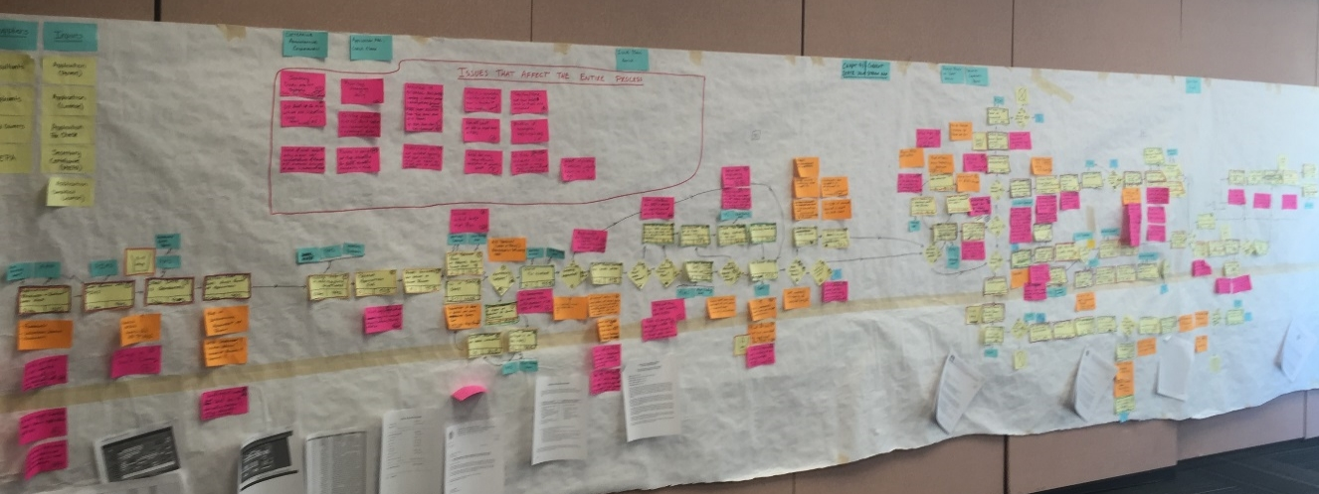
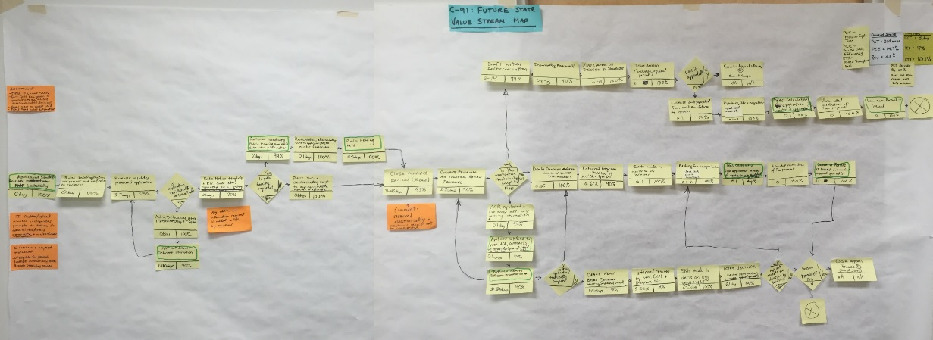
SUCCESS STORIES: IMPROVING THE BUSINESS PROCESS
PROGRAM STAFF REDUCED THE TIME REQUIRED TO COMPLETE THE PROCESS BY 128 DAYS - A 61% REDUCTION IN OVERALL CYCLE TIME.
Before: 209 days
After: 81 days
Process Yield Increased
0.5% → 65.1%
(Likelihood for an application to successfully complete the process without any errors or rework)
Notes:
11:35AM
KELTON
Chapter 91 process for Mass
Typically target 40-60% reduction
Process Yield – Probability one application would go through without an error. – Increased this big time.

Slide 45
Course Wrap up
Notes:
KELTON

Slide 46
BREAKOUT
WHEN YOU GET BACK TO THE OFFICE, WHAT WILL YOU DO NEXT WITH REGARD TO YOUR LEAN JOURNEY?
Notes:
KELTON

Slide 47
Real time feedback
Benefits and concerns
Use Post it notes to provide feedback on the course
Notes:
KELTON
POST ITS ON THE FLIP CHART

