Slide 1
Open Data Platforms at the Colorado Department of Public Health and Environment
Eric Brown, M.P.A.
Environmental Data Coordinator
Colorado Department of
Public Health & Environment

Slide 2
Colorado DPHE Platforms
Data Request System
Local Environmental Health Reporting Tool
Environmental Web Drawer
Colorado Information Marketplace

Slide 3
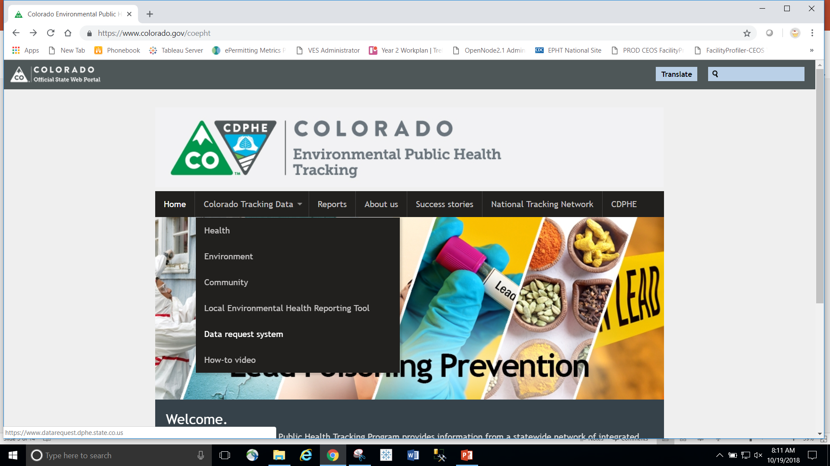

Slide 4
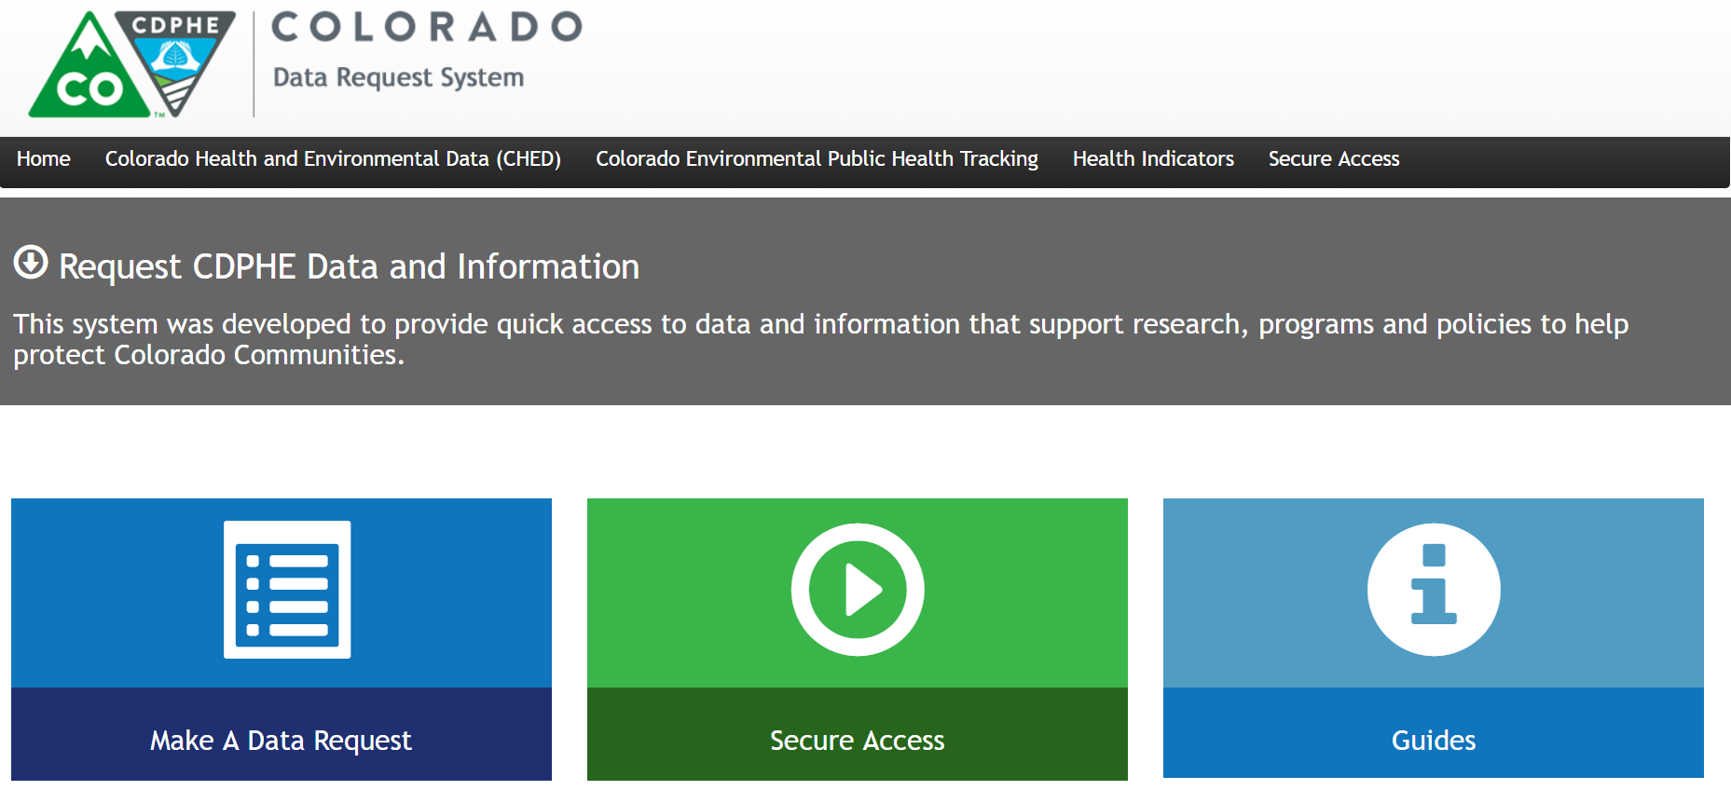
CDPHE Data Request System
Access to a variety of public and secure environmental or public health data and records

Slide 5
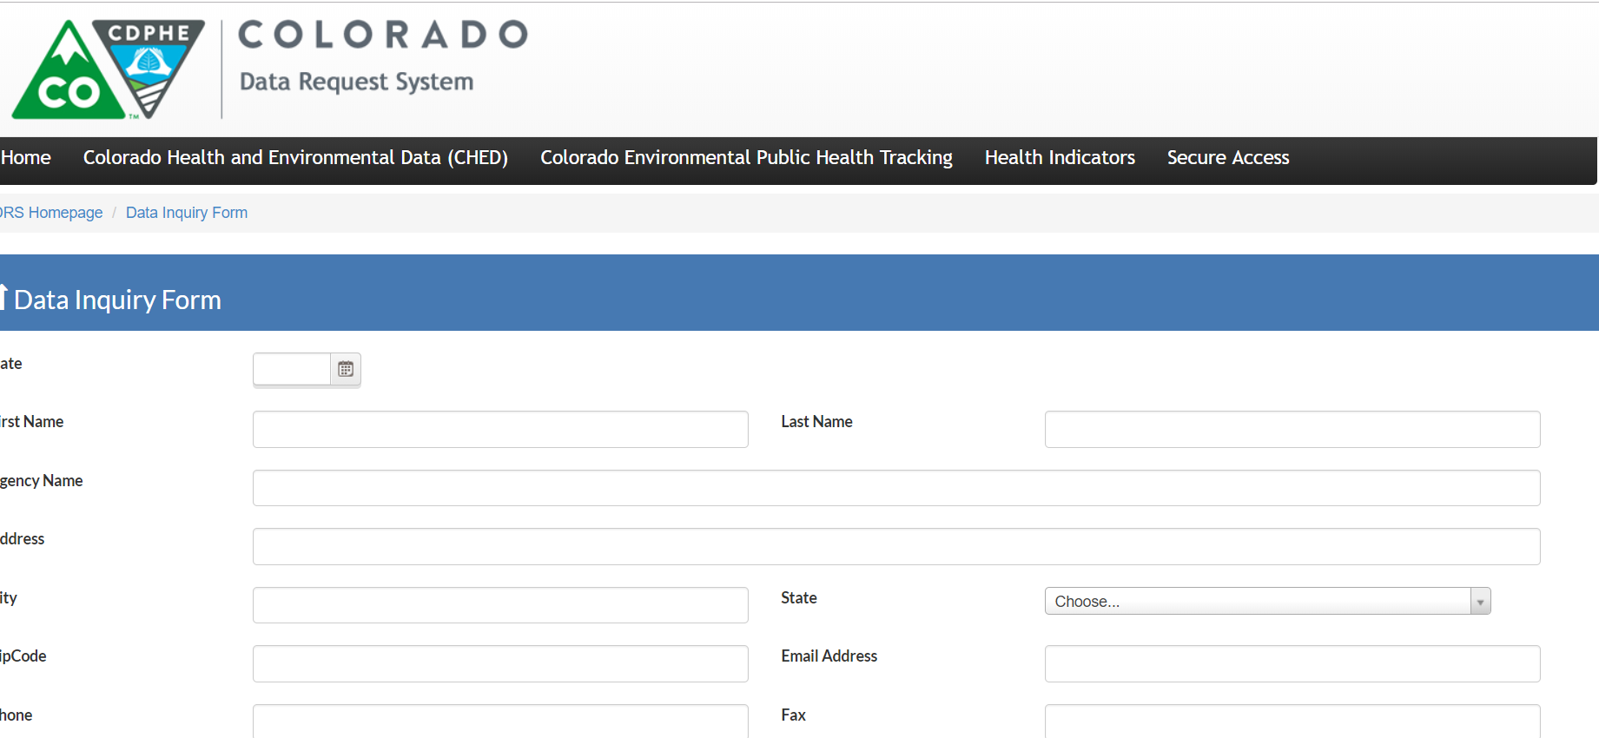
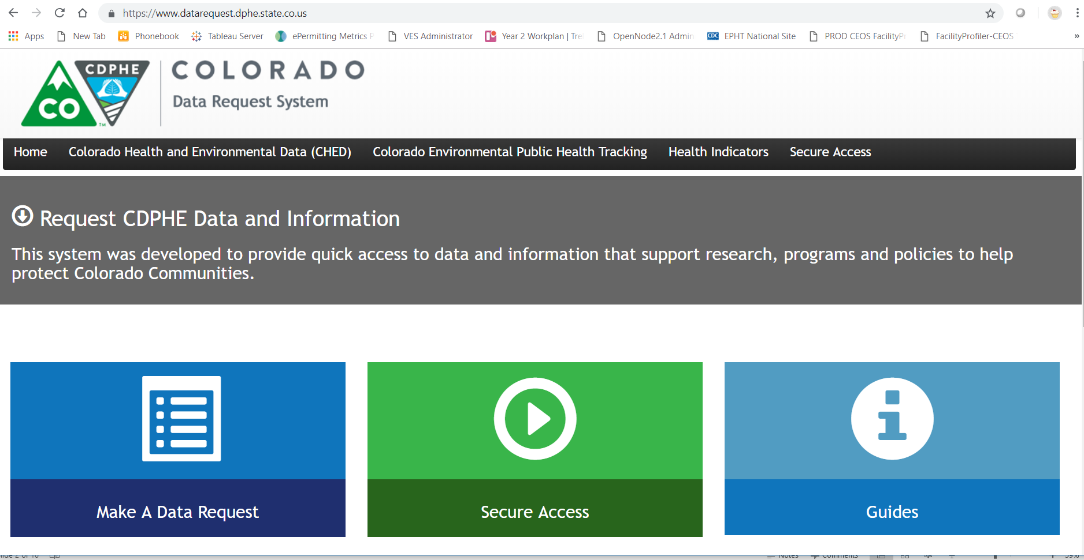
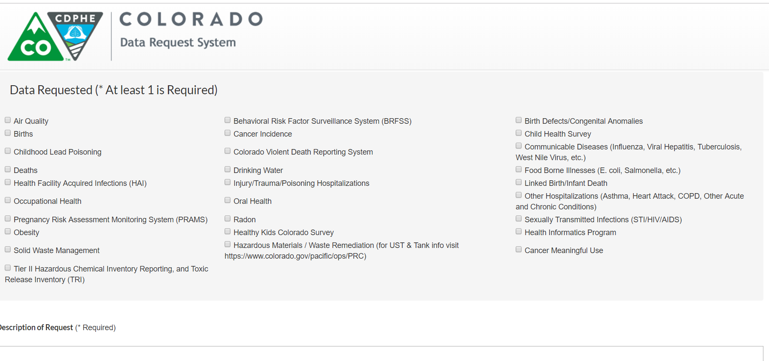
CDPHE Data Request System
Select from a range of environmental or public health topics

Slide 6
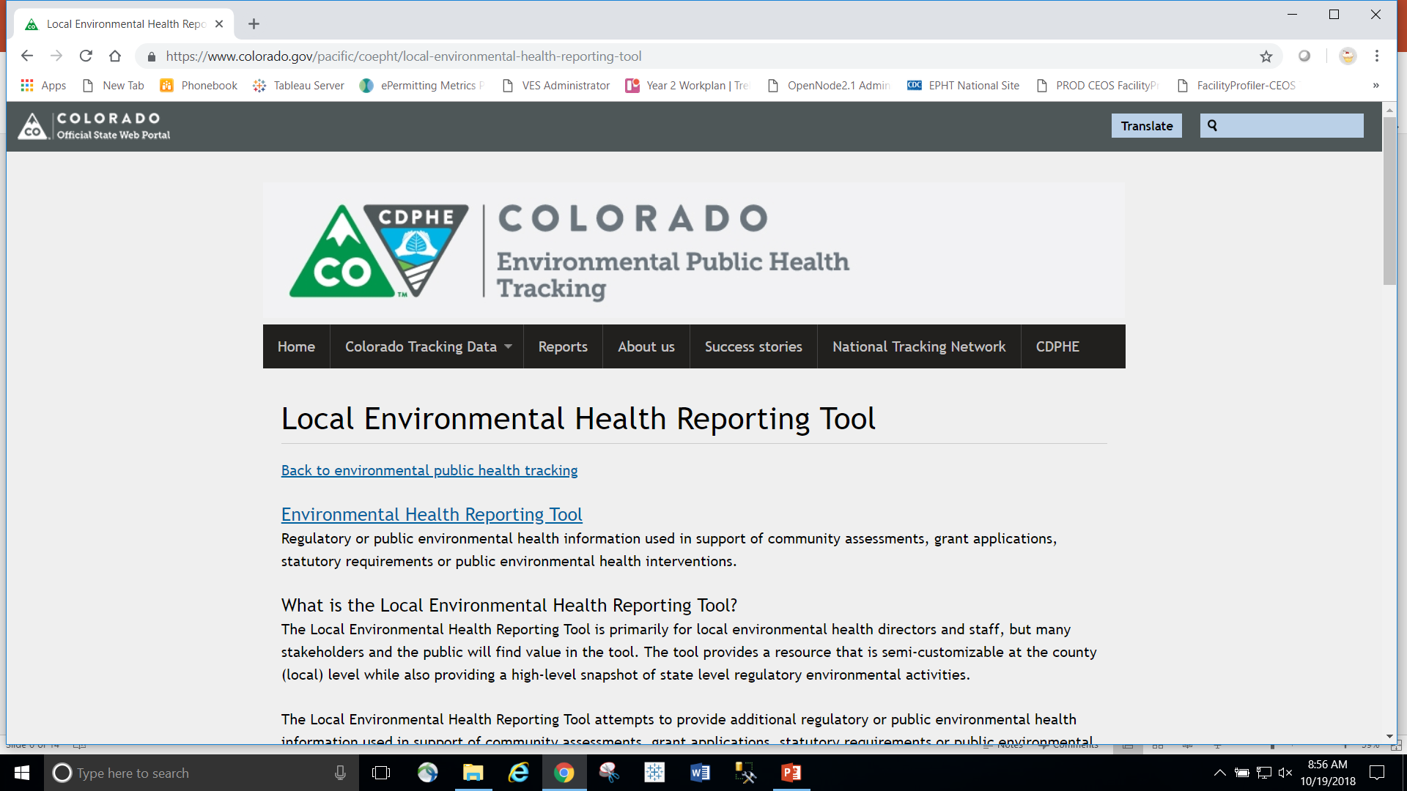
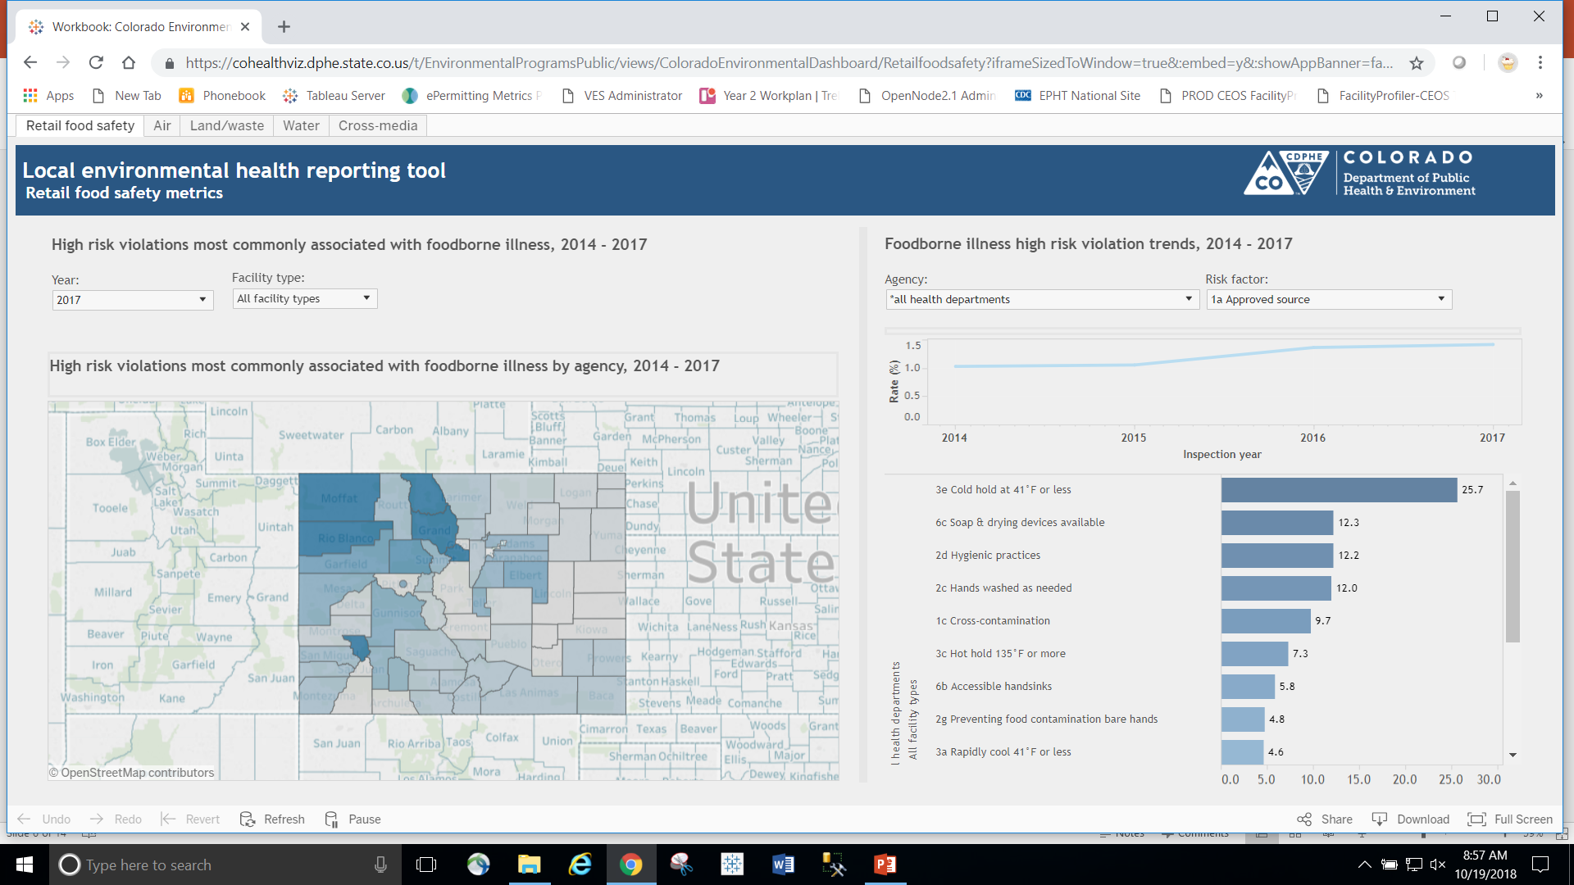
Local Environmental Health Reporting Tool

Slide 7
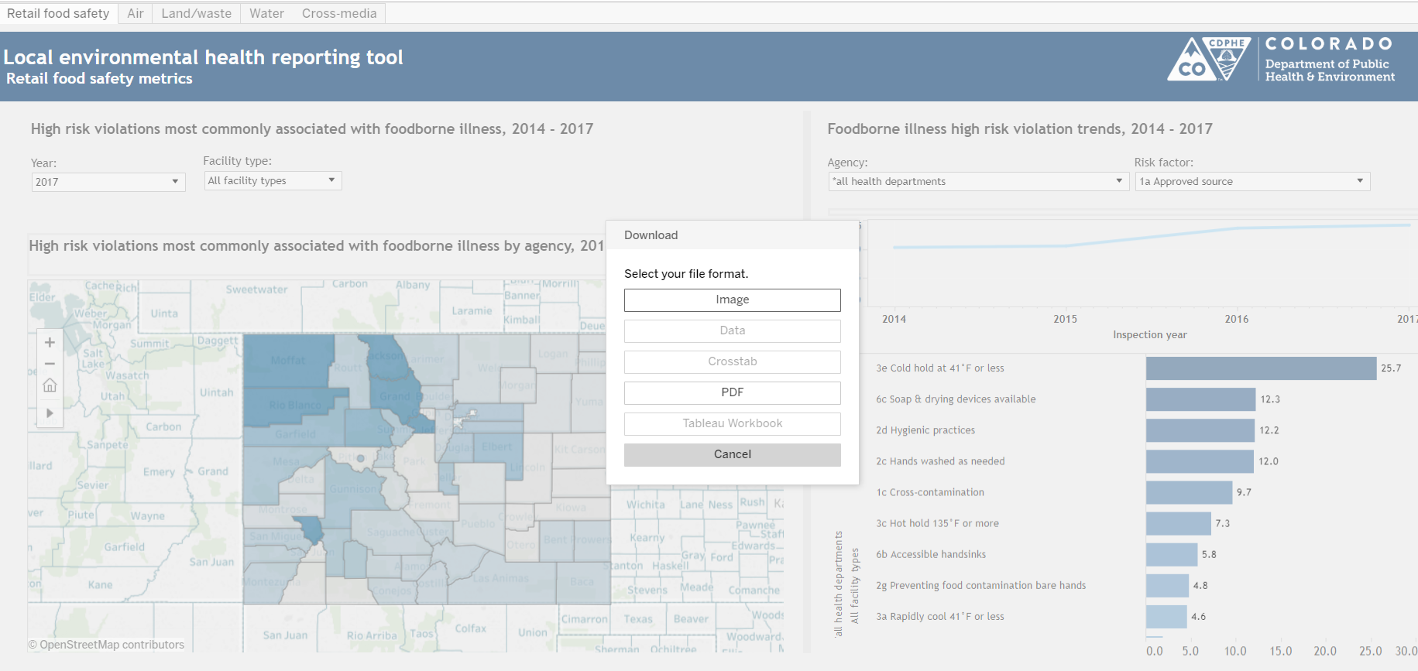
Local EH Reporting tool platform can be configured for raw or summary data download

Slide 8
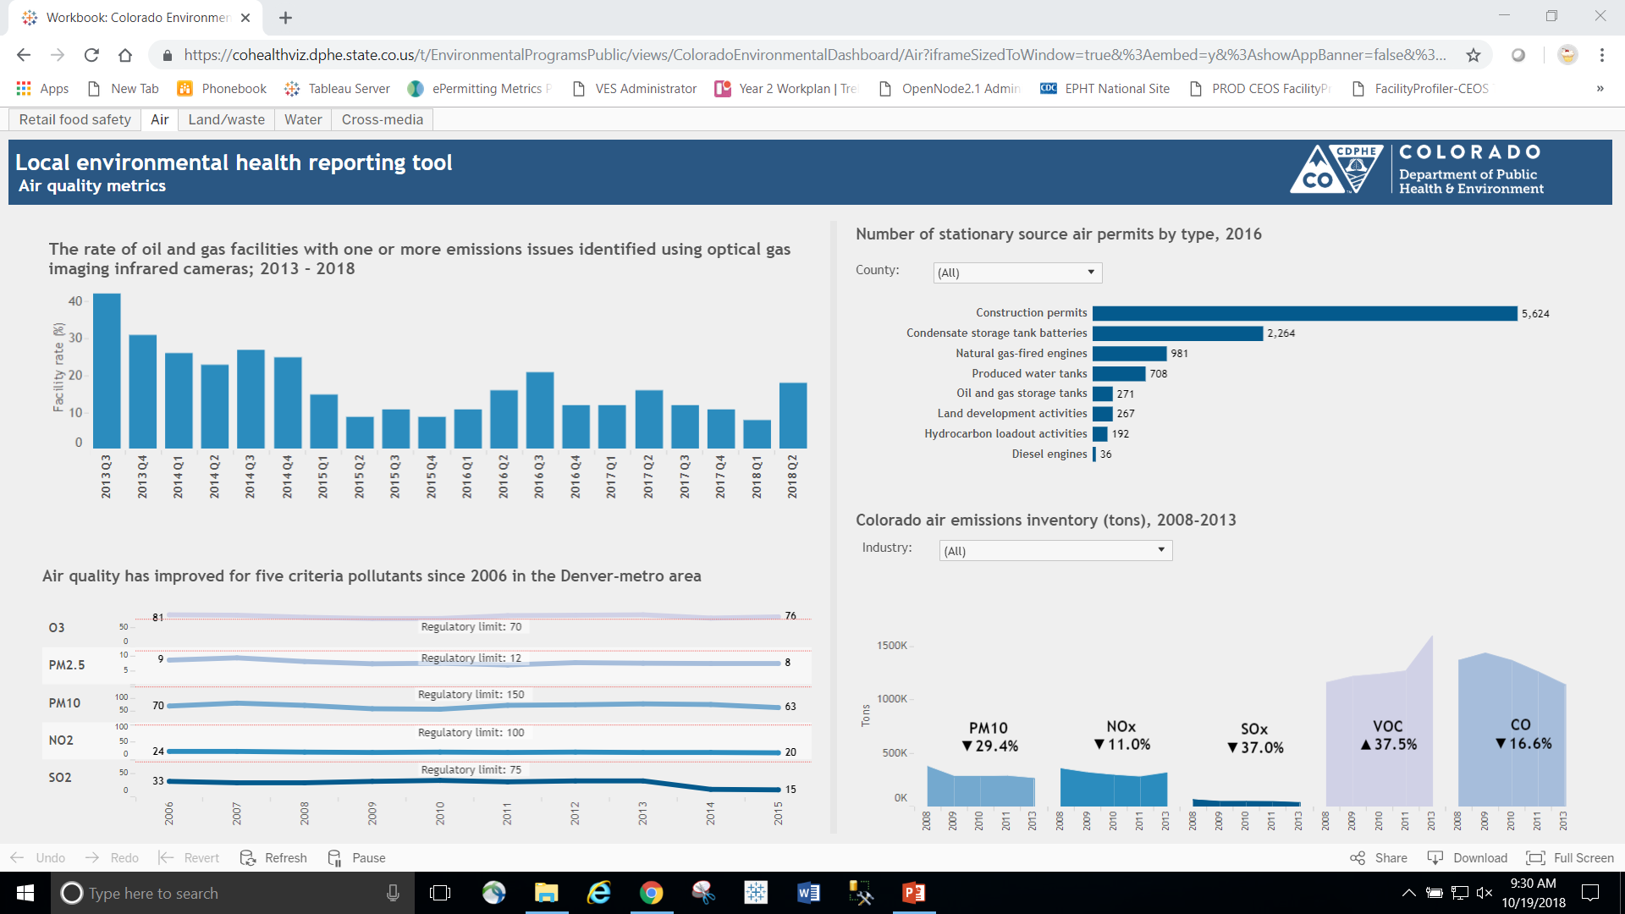
State level measurements and county level queries

Slide 9
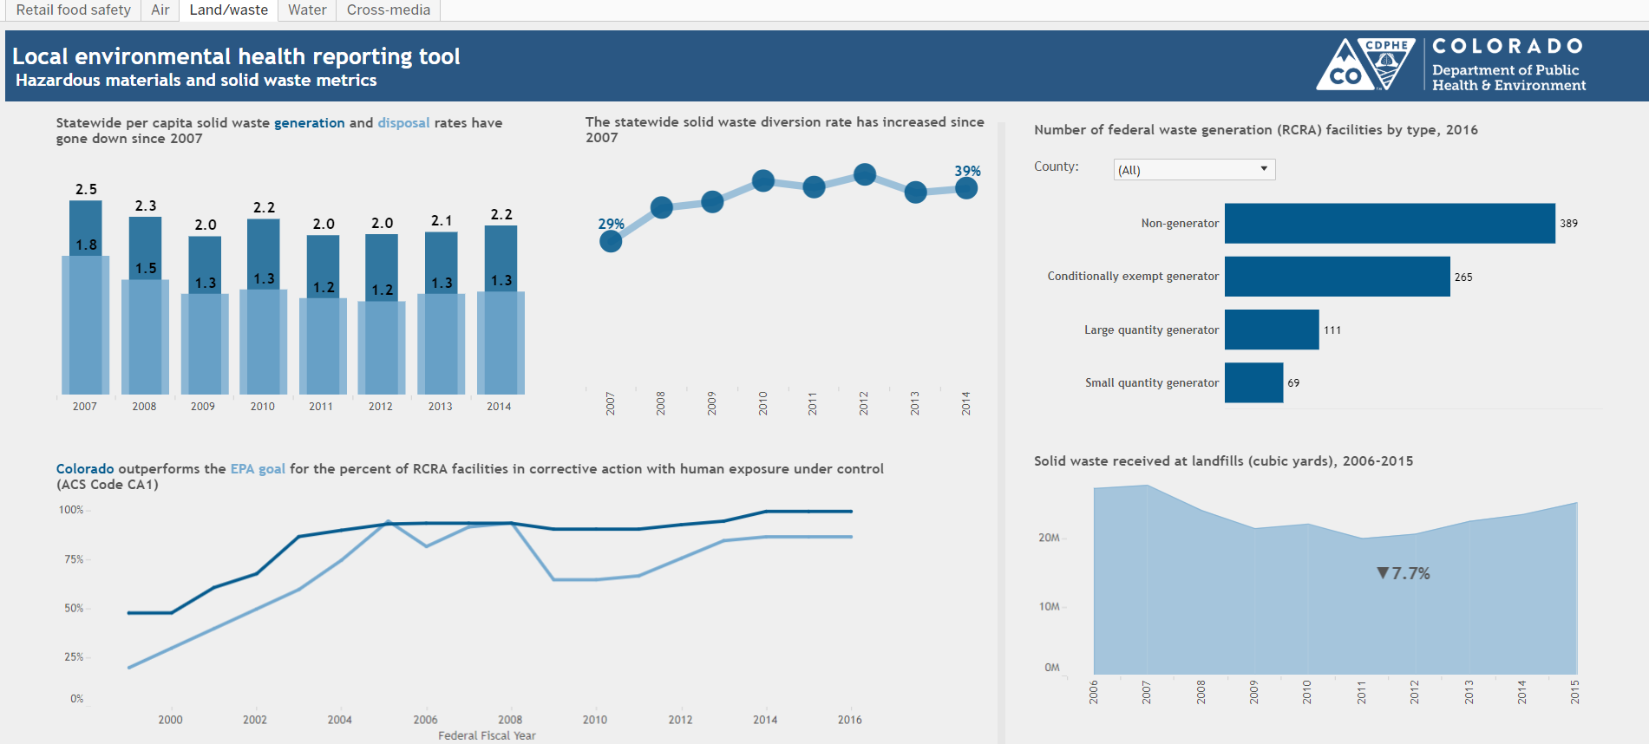
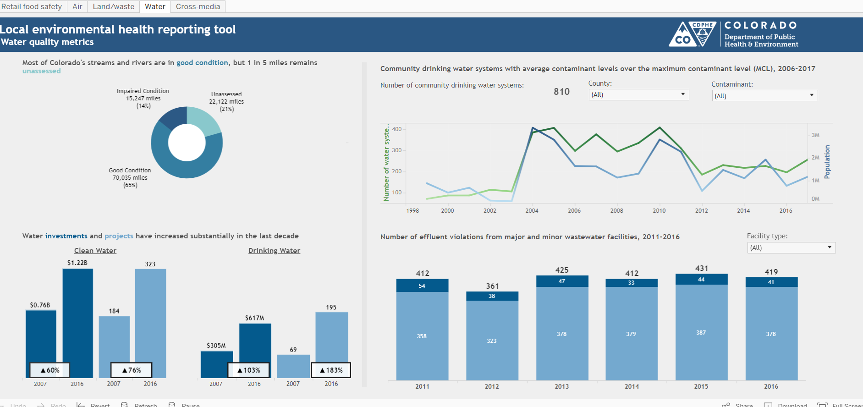
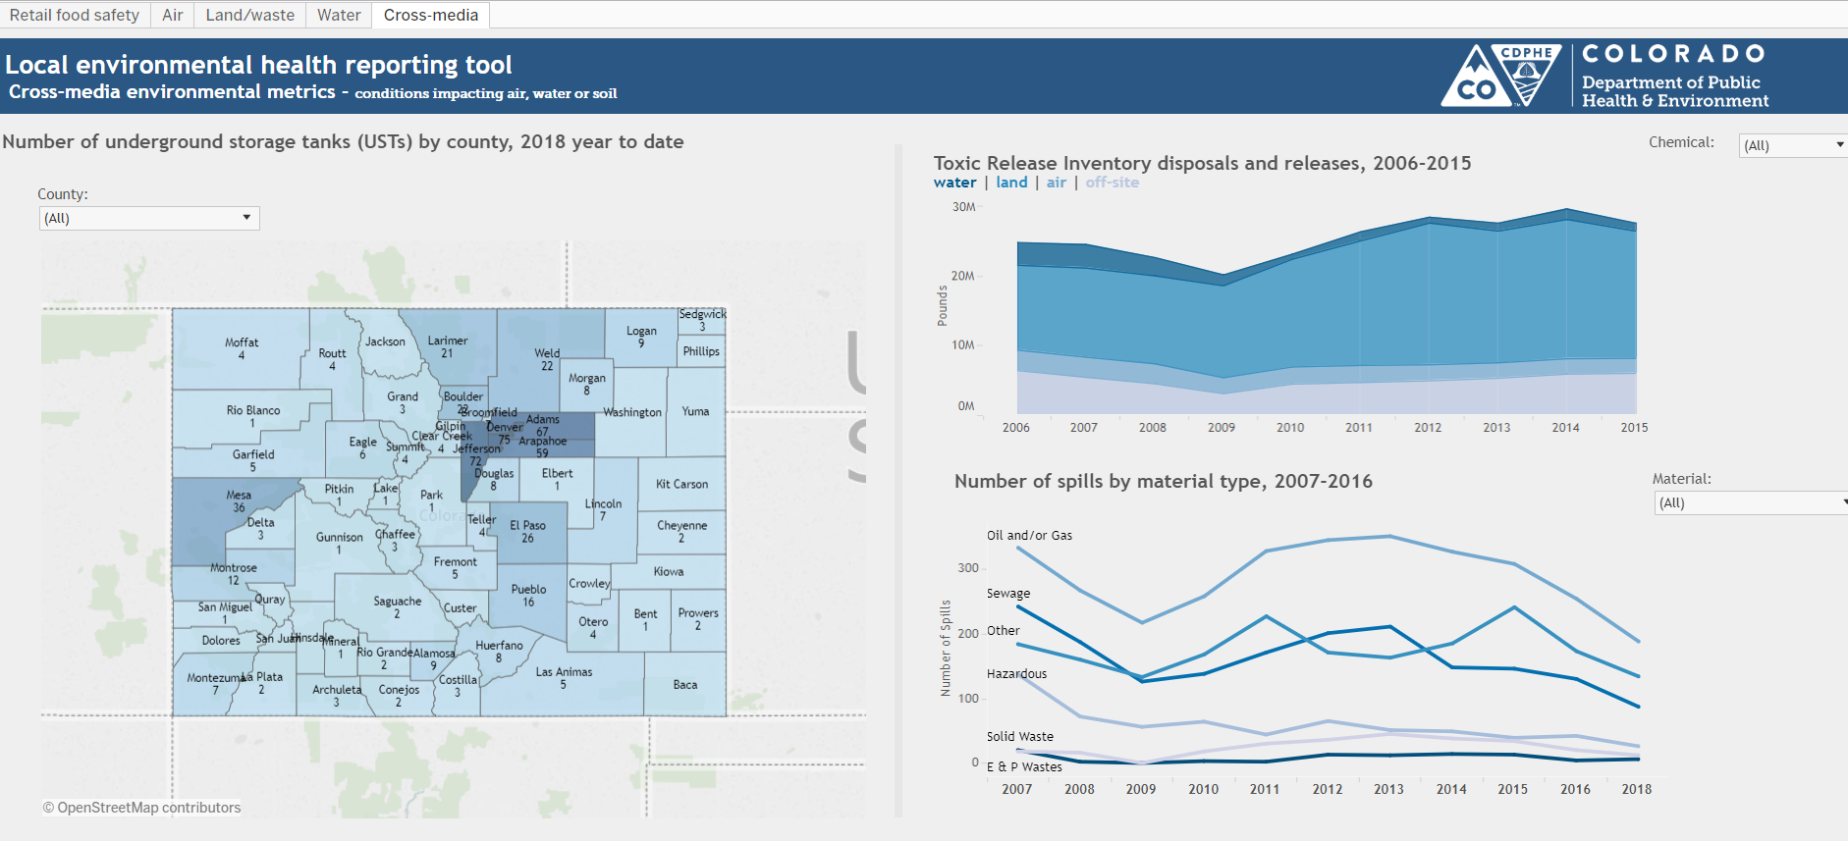
Depending on program data may be queried to industry, material or chemical

Slide 10
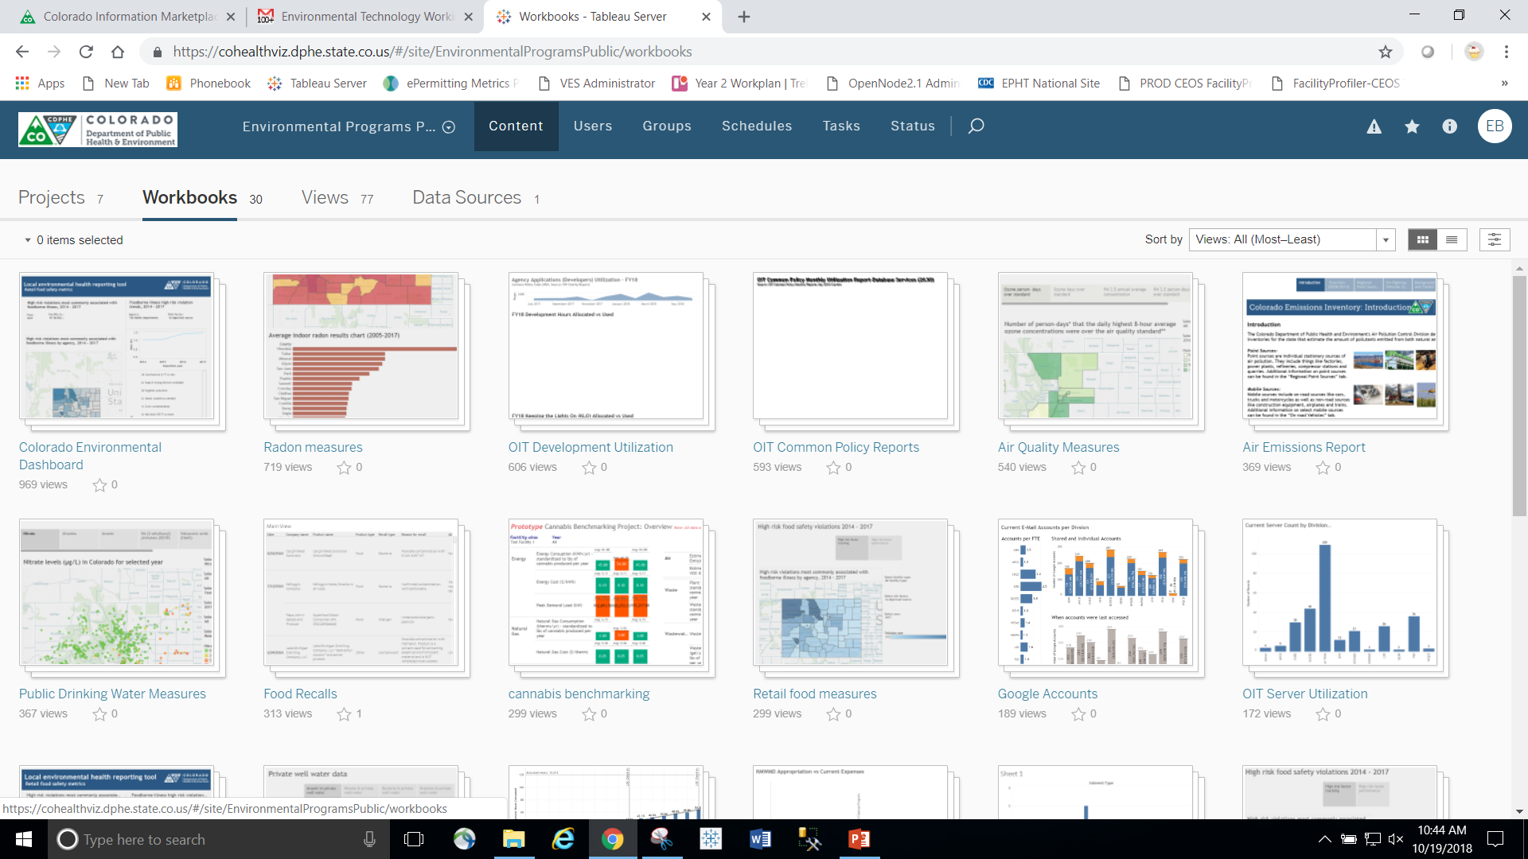
CDPHE Tableau Server provides the platform for internal data sharing and collaboration on program analytics and drives the open data culture shift we want

Slide 11
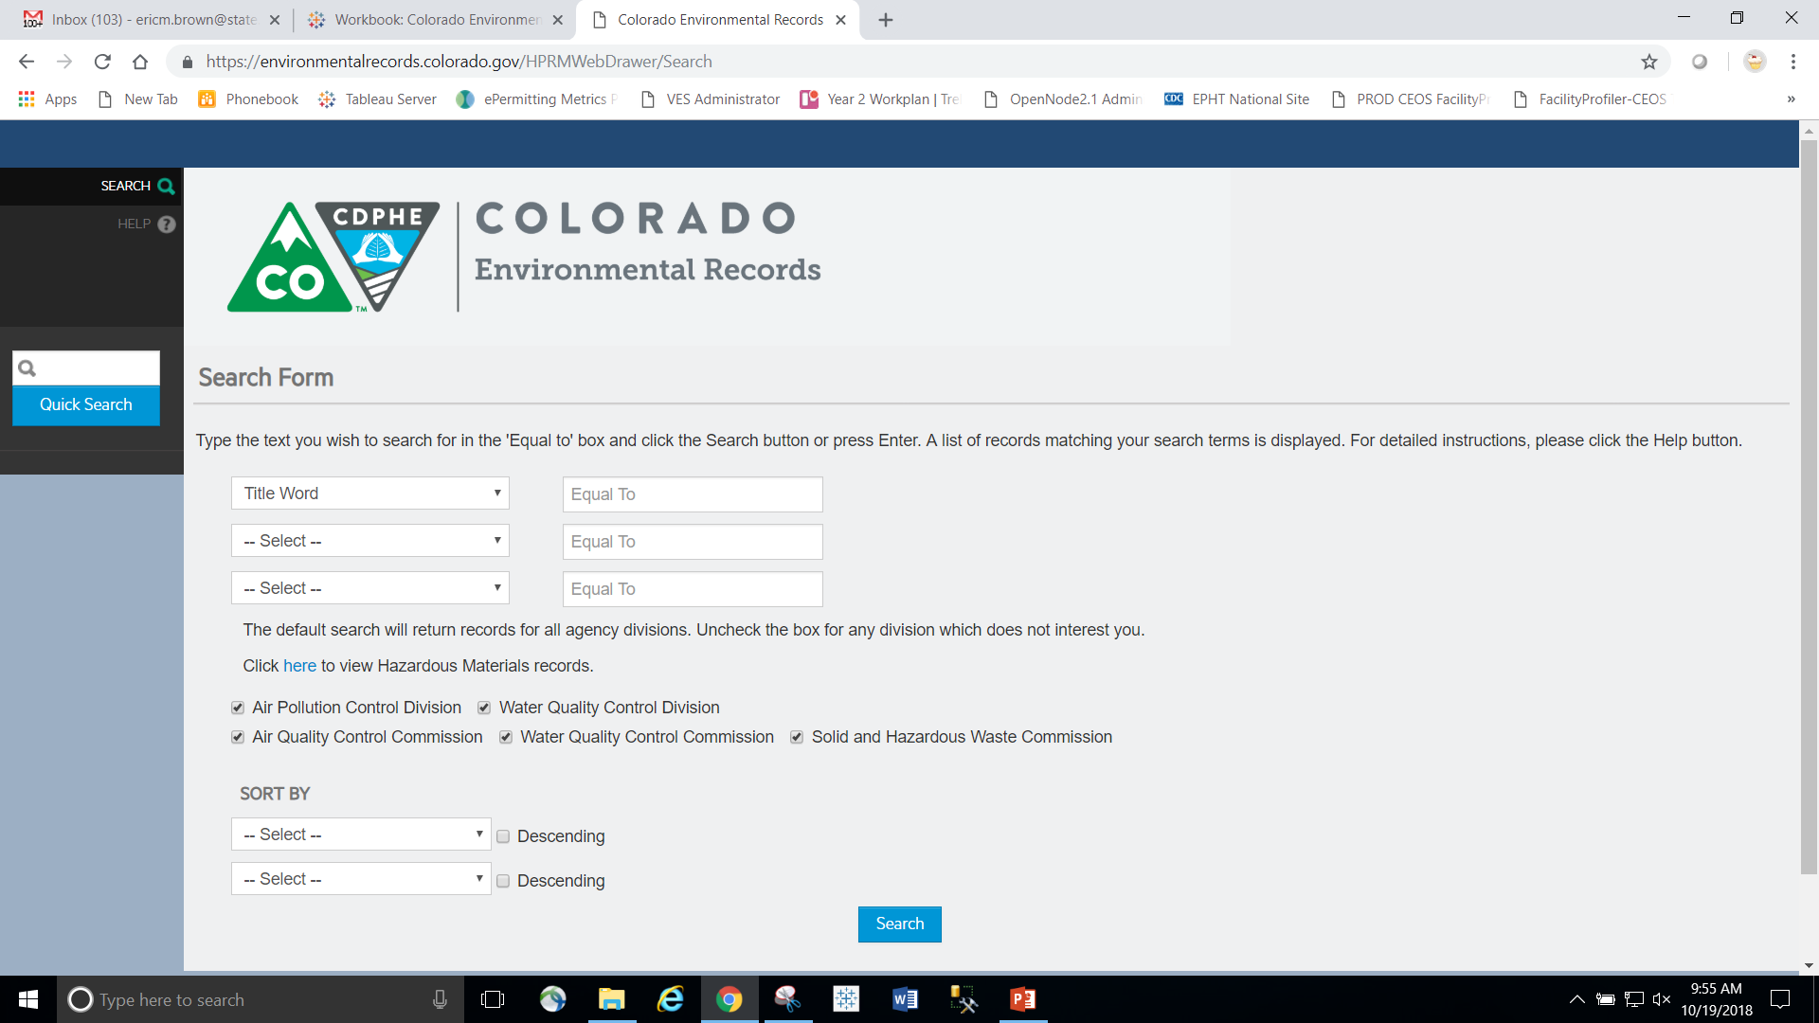
Colorado DPHE environmental programs web drawer provides online access to historical documents and records

Slide 12
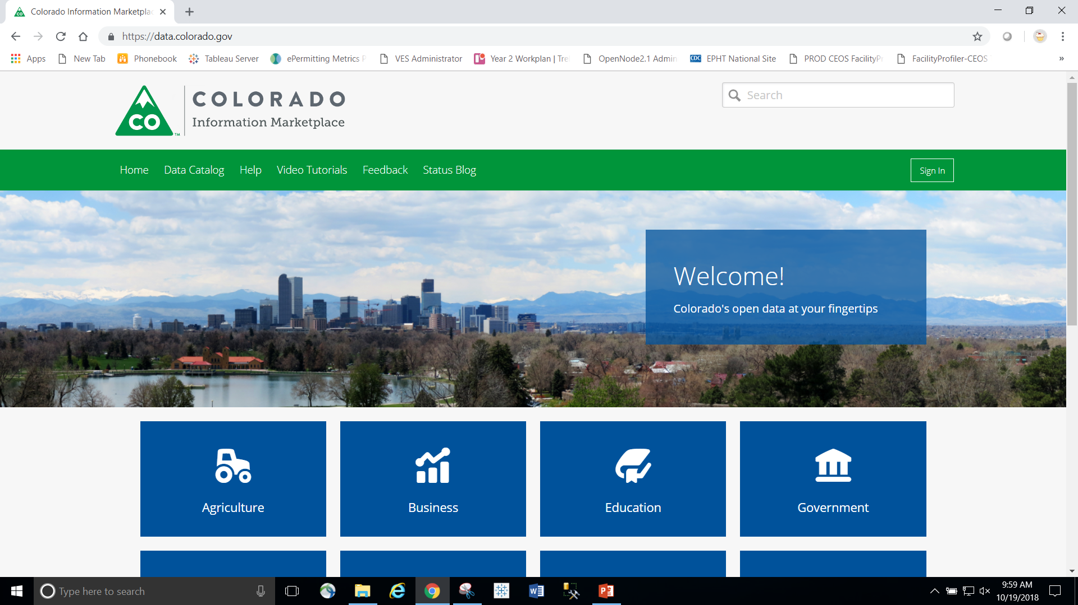
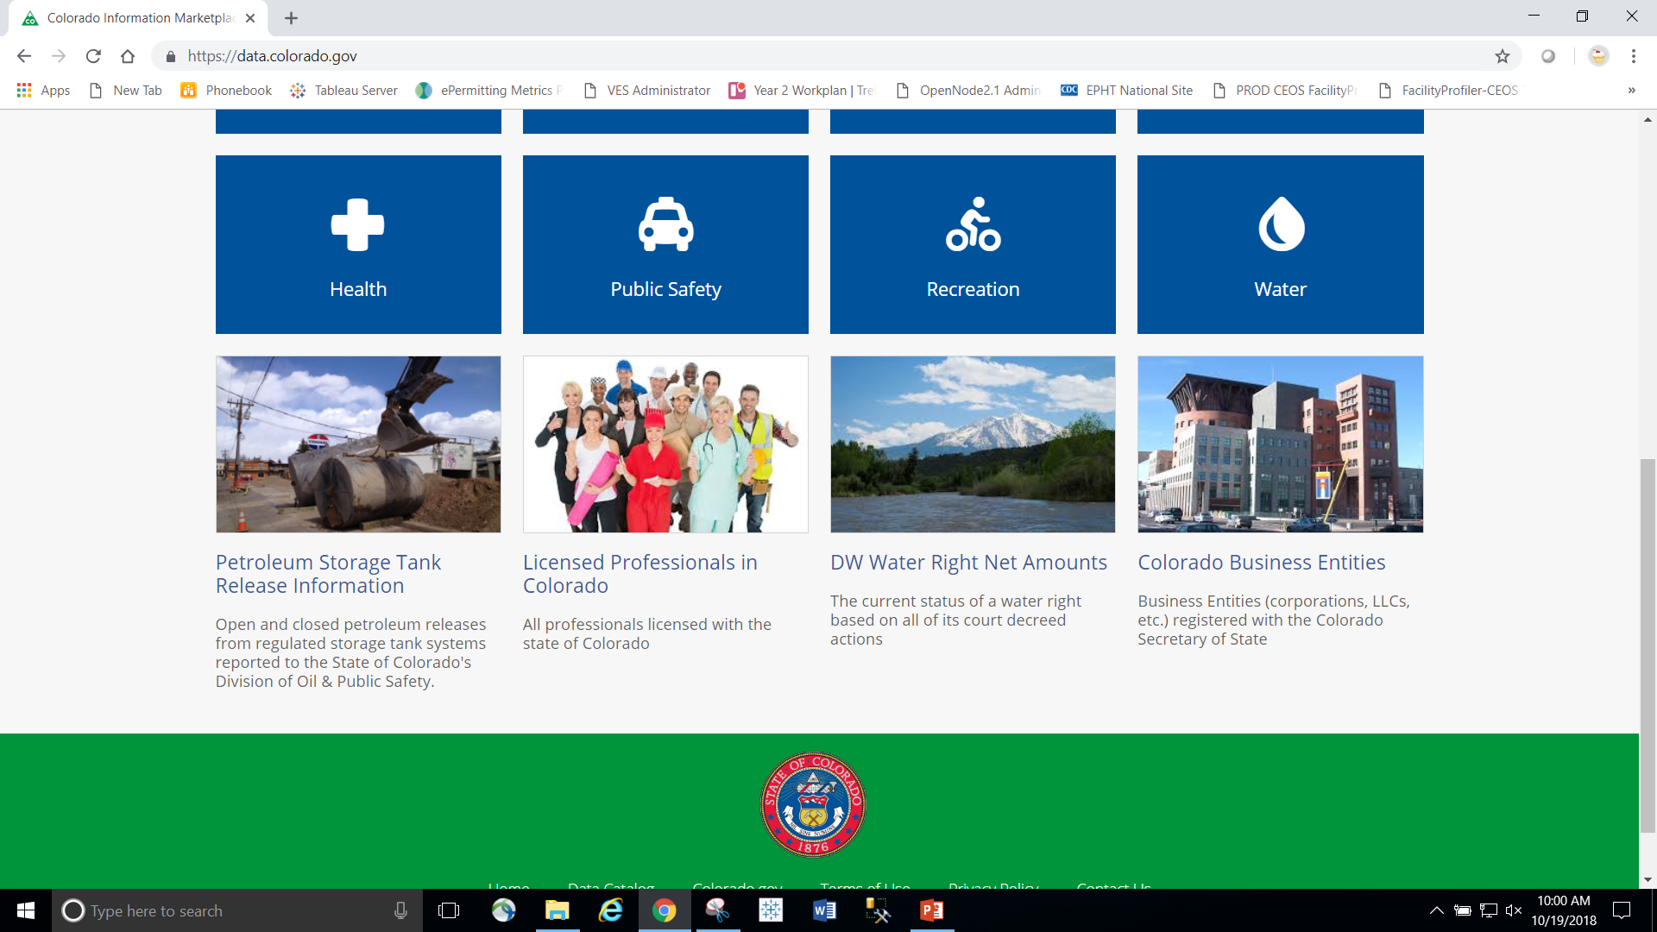
State enterprise level open data portal

Slide 13
Philosophical Can we provide open data and in what format? Scientific Can the user apply the same analysis methods that the agency does or that the statute requires? Cultural What liability might we be exposed to given misinterpretation of the data? Resources Costs of development, support & response to inquiry
Constraints on Open Data in the Public Sector

Slide 14
QUESTIONS?

Slide 15
Eric Brown M.P.A.
Environmental Data Coordinator
Colorado Department of Public Health & Environment
Email: ericm.brown@state.co.us
Phone: (303) 692-3630

