Slide 1

Adventures in Open Data
Mike Mahaffie
Web & Digital Media
Delaware Department of Natural Resources
and Environmental Control

Slide 2
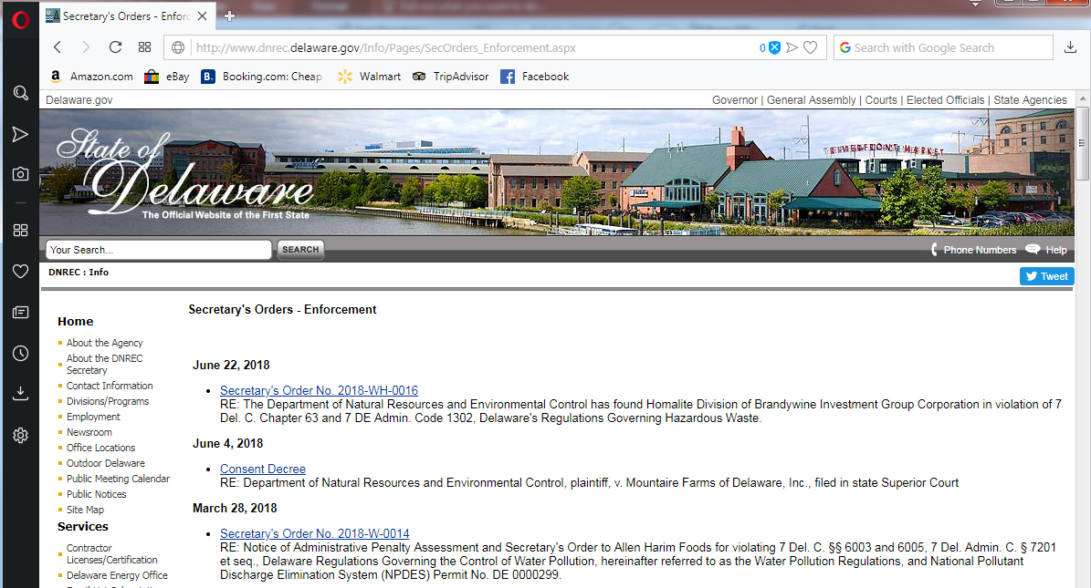
“Post Everything Online”
Notes:
As an agency made up of scientists and engineers, DNREC collects and keeps a lot of data
Those data are mostly public data
With obvious privacy and security exceptions
And we have a strong tradition of openness and transparency

Slide 3
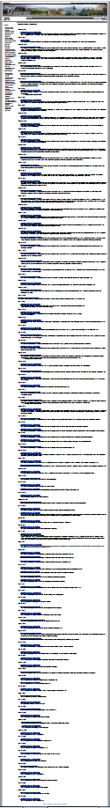
Notes:
But when do we stop?
And how can you find anything?

Slide 4
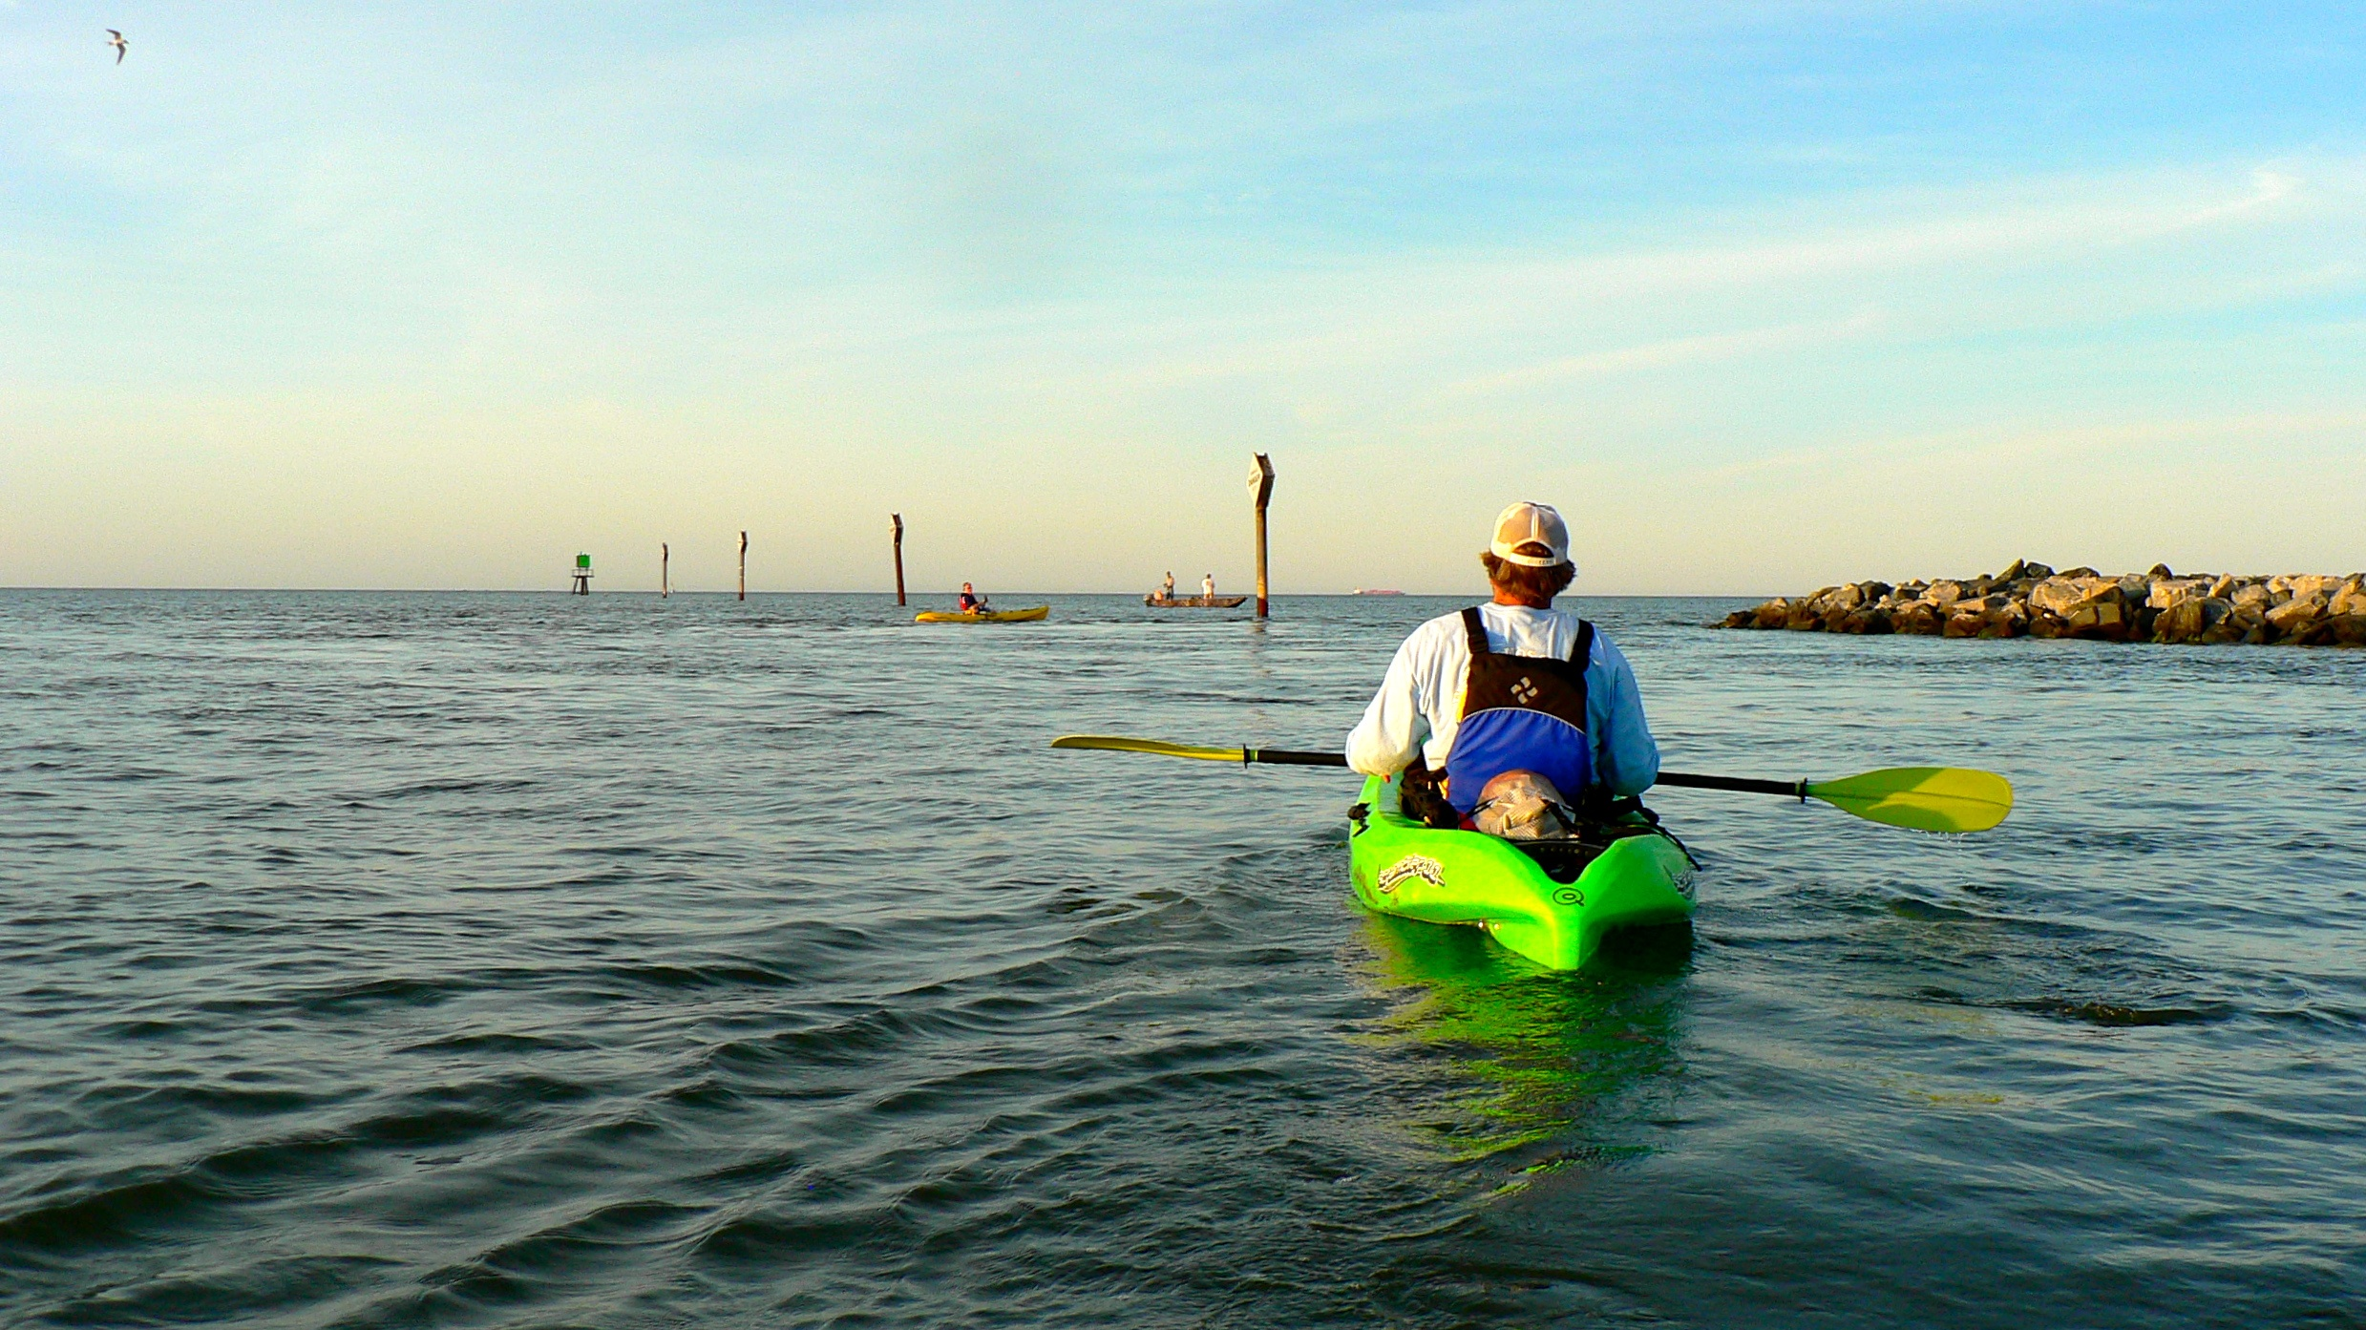
The Delaware Open Data Portal
Grew from agency responses to transparency scorecards
Established by Executive Order
Governed by an Open Data Council
Linked to state checkbook
and GIS data archive
Notes:
Established by Governor Markell in 2016 and expanded by Governor Carney in 2018
Started with a small group of agency members
Expanded by second EO
All agencies now required to develop a list of all data sets
Strategic plan on how to publish them all

Slide 5

data.delaware.gov
Launched October 2016
54 Datasets
38 Charts
42 Filtered views
44 Maps
19 Environmental datasets
50 more “on deck”
Filtered views integrated with web site
Data and charts used in published Environmental Perspectives stories

Slide 6
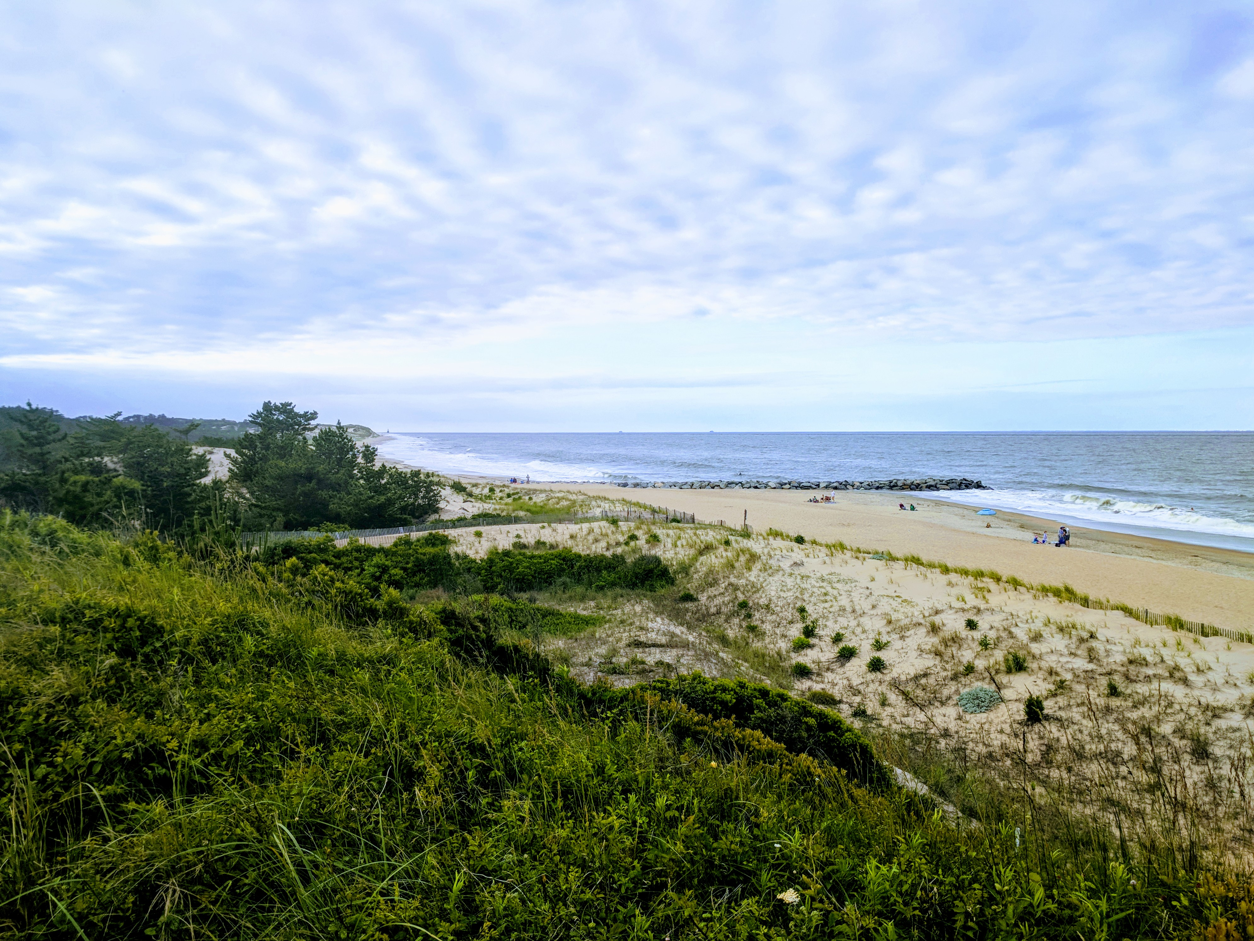
Environmental Data (so Far)
Freshwater Pond Fish Community Surveys
Horseshoe Crab Spawning Survey
Aerial Waterfowl Survey Data
Delaware Natural Areas
Open Space Program Land Inventory

Slide 7
Environmental Data (so Far)
Recreational Water Advisories
DNREC Events
State Park Programs
Grants for Weatherization Services
Green Energy Program Grants

Slide 8
Environmental Data (so Far)
Rebates for Alternative-Fuel Vehicles
Electric Vehicle Charging Equipment Rebates
Condition of Non-Tidal Wetlands
Storm Water Notices of Intent
Well Permits

Slide 9
Environmental Data (so Far)
Permitted Septic Systems
On-Site Wastewater Treatment and Disposal System Contractors
Toxics Release Inventory
Air Quality Monitoring Data

Slide 10
On Deck
Major permit program data
Professional licensing
Wildlife and fisheries data
Inspections and enforcement
Public inquiries (FOIA, Media Queries, etc.)

Slide 11
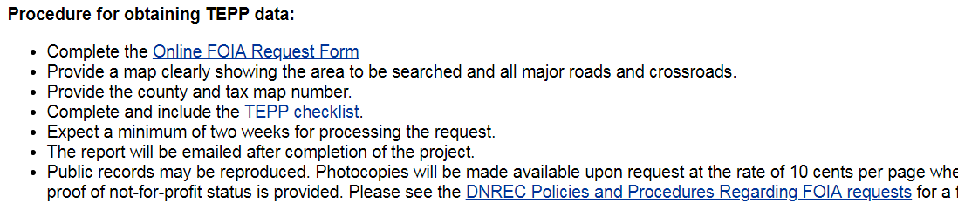
Self-Service FOIA
Notes:
We used to get regular FOIA requests for the full database of permitted wells
It took one professional stafaf person a full day to handle each

Slide 12
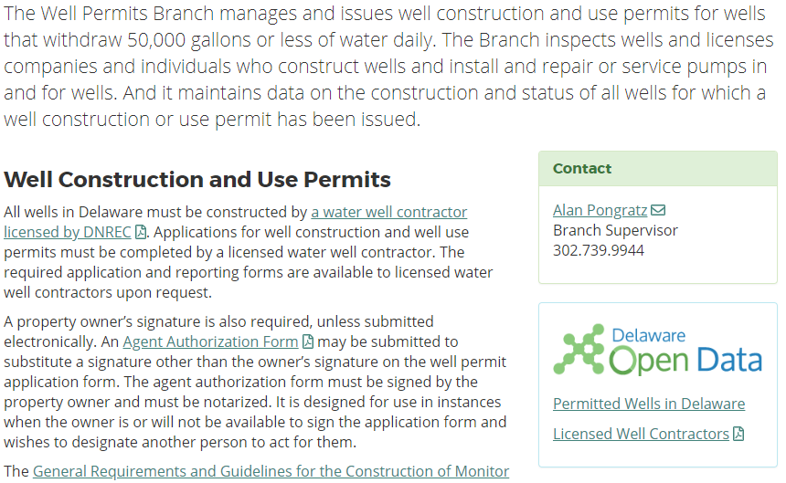
Self-Service FOIA
Notes:
Now we direct all to our Open data

Slide 13
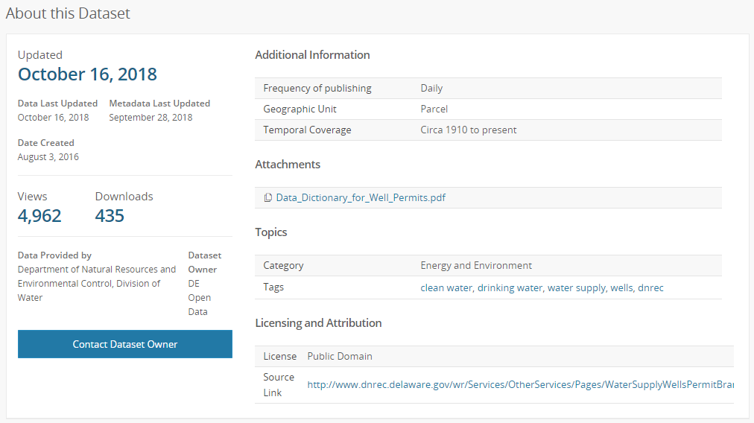
Self-Service FOIA
Notes:
And they handle it themselves

Slide 14
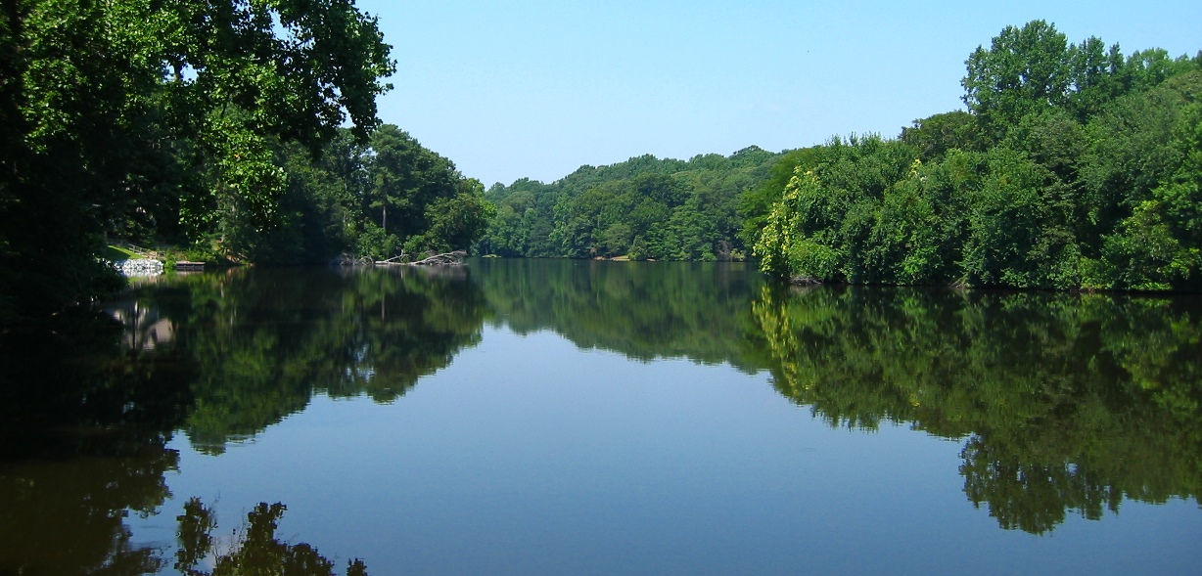
Telling Stories
Using data from the portal
Combining data visualization with photography and text
Using a story format to present data and information
in a less formal way

Slide 15
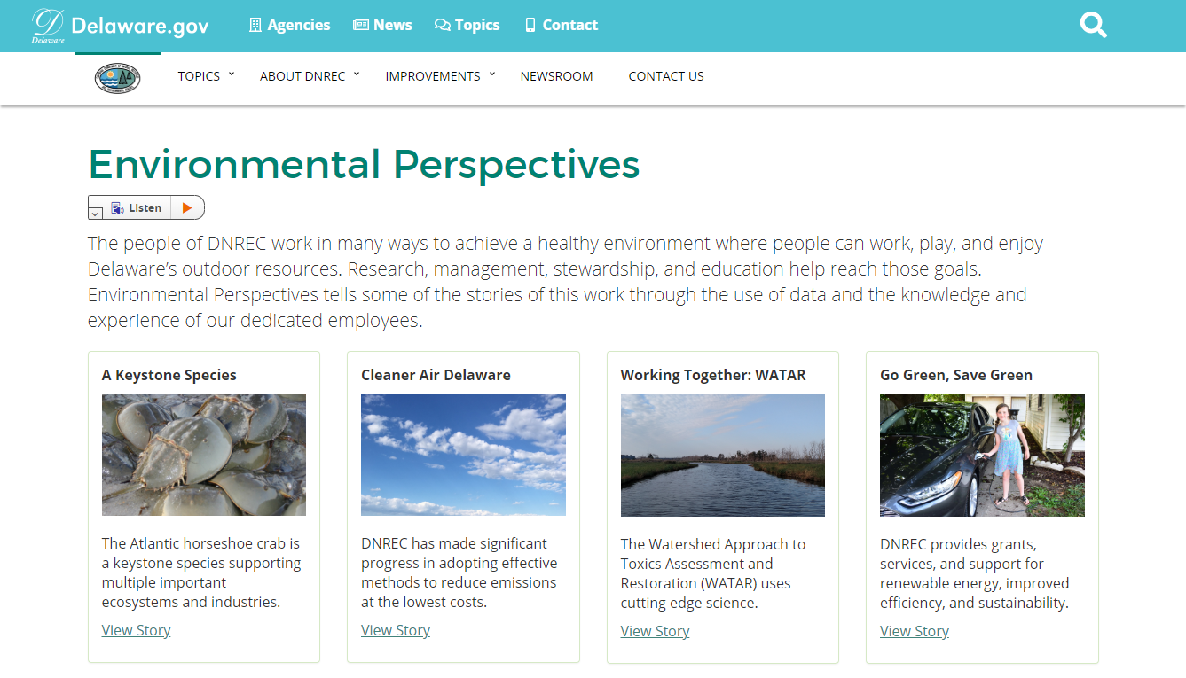

Slide 16
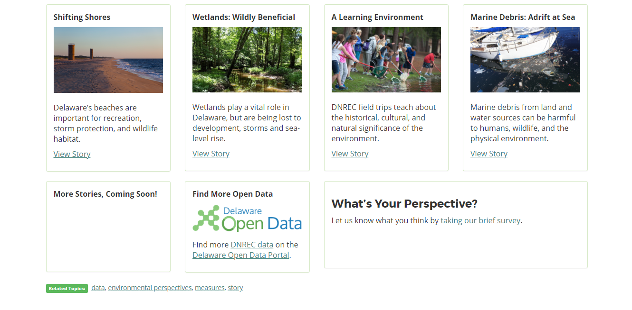

Slide 17
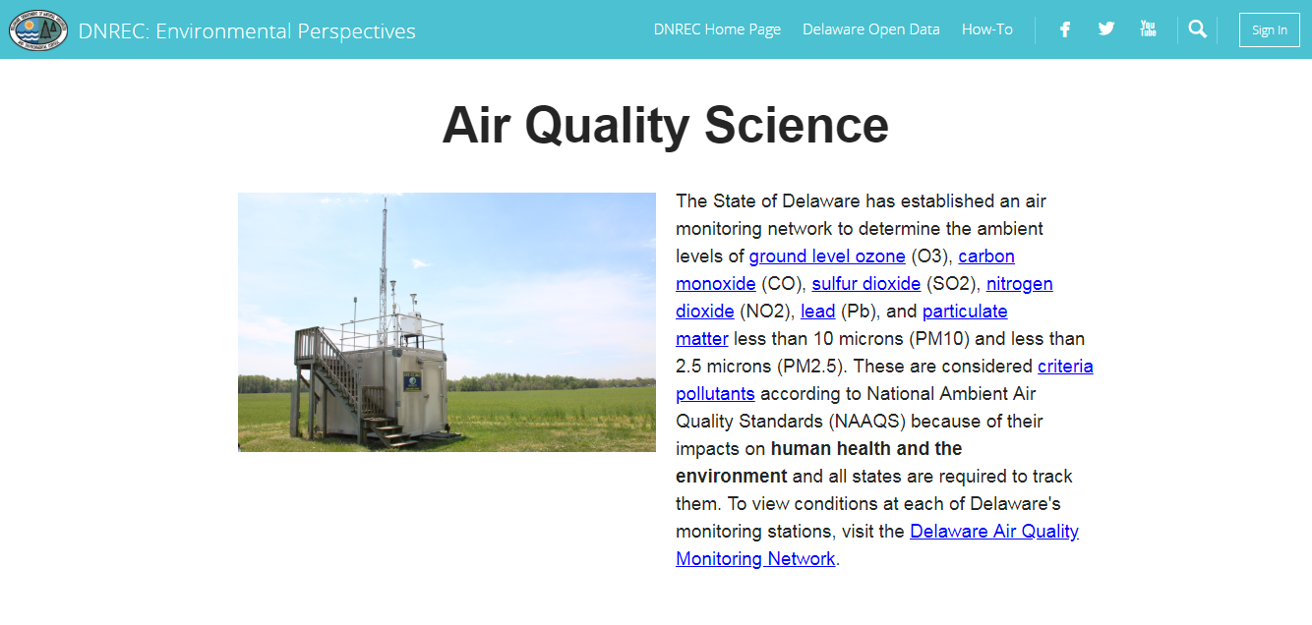

Slide 18
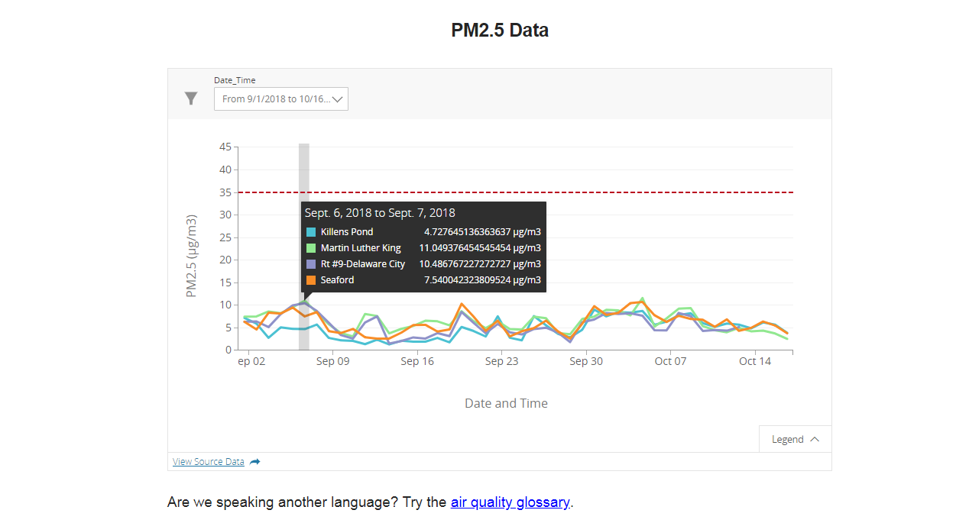

Slide 19

Get Others to Use the Data
The 2018 Delaware Open Data Challenge
Three state agencies
Open Data Delaware
Engage the “civic hacker” community
Up to $37,000 in prizes
Awards possible for products and ideas

Slide 20
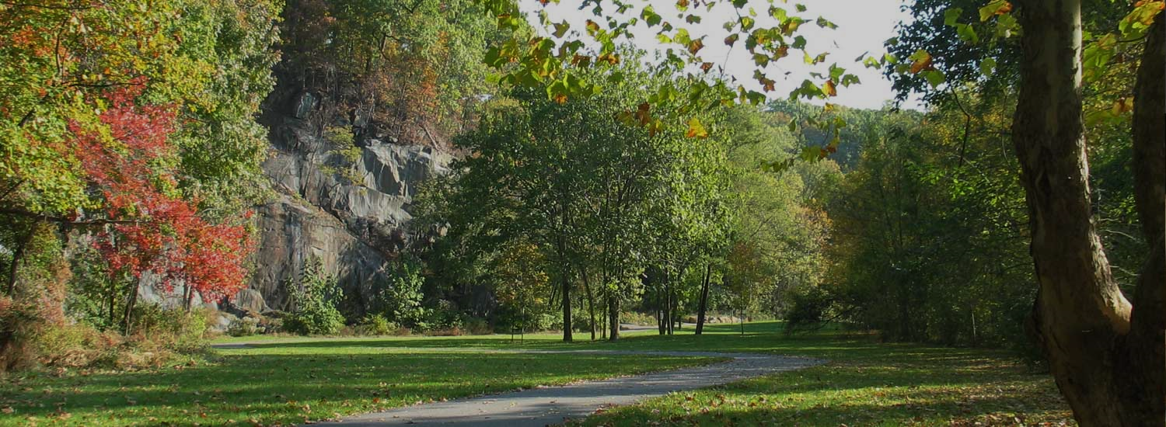
Set a Challenge
Delaware has natural beauty and great recreational opportunities. We have parks, forests, beaches, rivers, ponds, bays and an ocean to explore and enjoy. We have roads, trails, bike routes, buses and rail to get us there. But not everyone is always able to take advantage of these opportunities. There are different reasons for this, and different ways to solve these problems. DelDOT and DNREC have come to the Open Data Challenge for help finding solutions.
Notes:
A Month-Long Data Jam
A kick-off event to set the scene
An ideation session to explore the issues
Workshops on mapping, data access, visualizations, story-telling
A final event for presentations, judging and awards

Slide 21
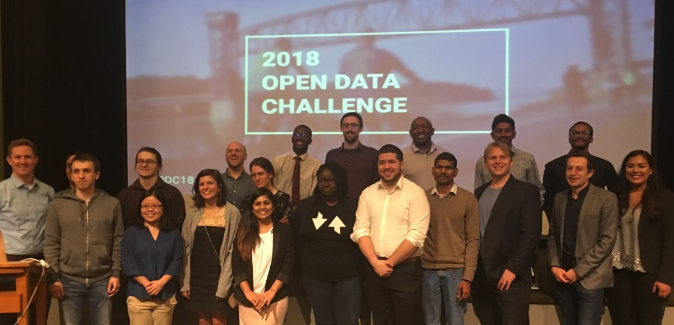
$32,000 Awarded
Notes:
Eight teams stayed in the challenge for the full month
They presented ideas for new websites and new apps
Focused on a single agency or data from both
There were tie-ins to external systems (Open Street Map, Yelp, Etc.) and crowd-sourcing ideas
Two $1000 idea awards, two $5000 awards and two $10,000 awards

Slide 22
Lessons Learned
Ideation session generated ideas for apps and ideas for program-specific updates
Outside perspectives showed us interesting alternatives:
  Commuting through state park trails
  Itinerary-building for tourists and visitors
Non-contracted users offer less deferential feedback
  They’re not trying to please us

Slide 23
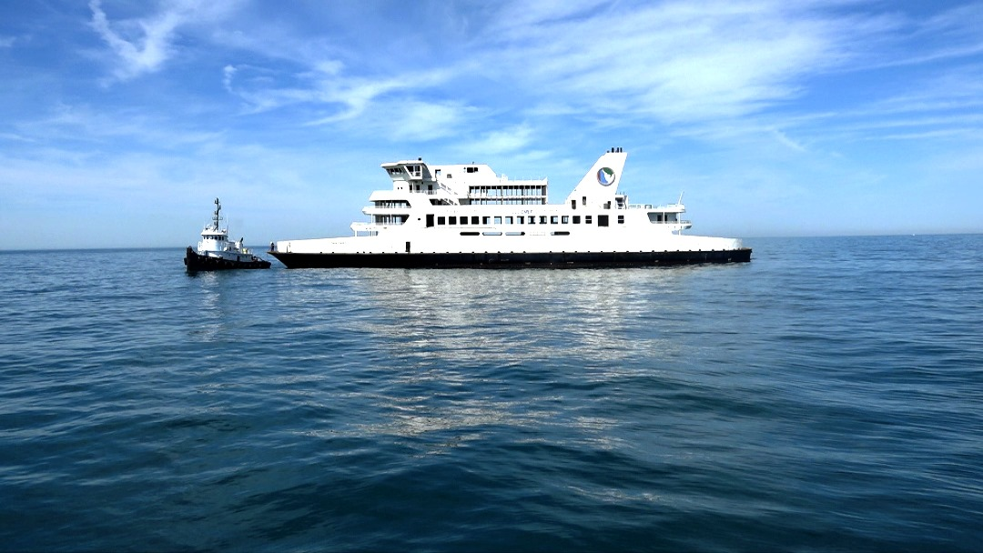
It’s easy to get some people excited about modern web sites and open data
It’s harder to get the rank and file and general staff on board
“Organizational Change Management” needs to be more than just a buzzword
“But we’ve always done it this way” can be more
powerful than you think
Notes:
Challenges

Slide 24
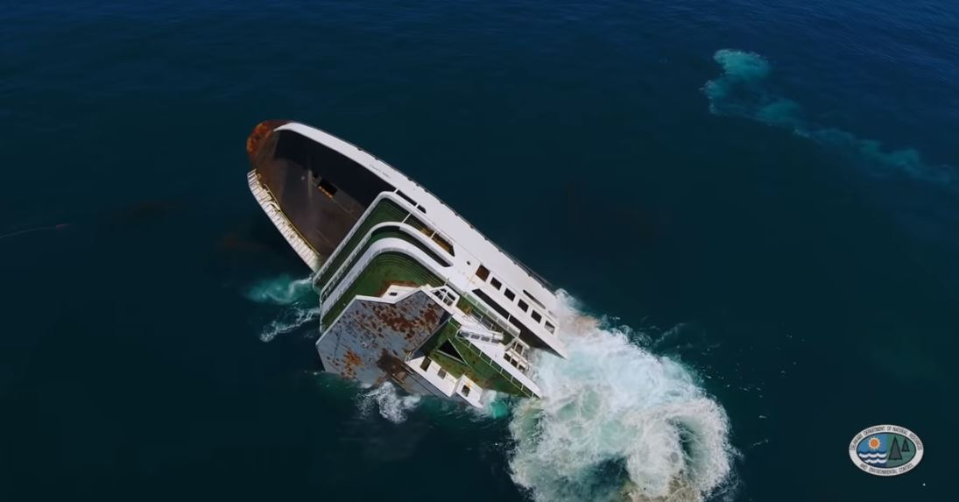
“I’m interested in somehow sharing our data but am hesitant to what extent we share it as we still like to have some control over what data we share. For instance we don’t necessarily want the raw data set out there for anyone to grab without our consent and/or knowledge.”

Slide 25
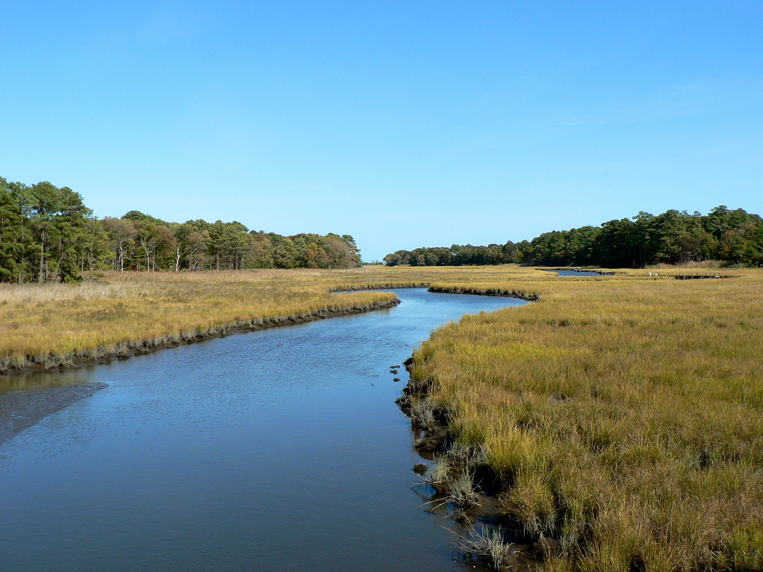
Open Data needs to be a fundamental part of our data infrastructure
Open Data needs to be a fundamental part of our organizational culture
We need to integrate data and information into our websites and applications
We can use the same data to help guide agency management

Slide 26
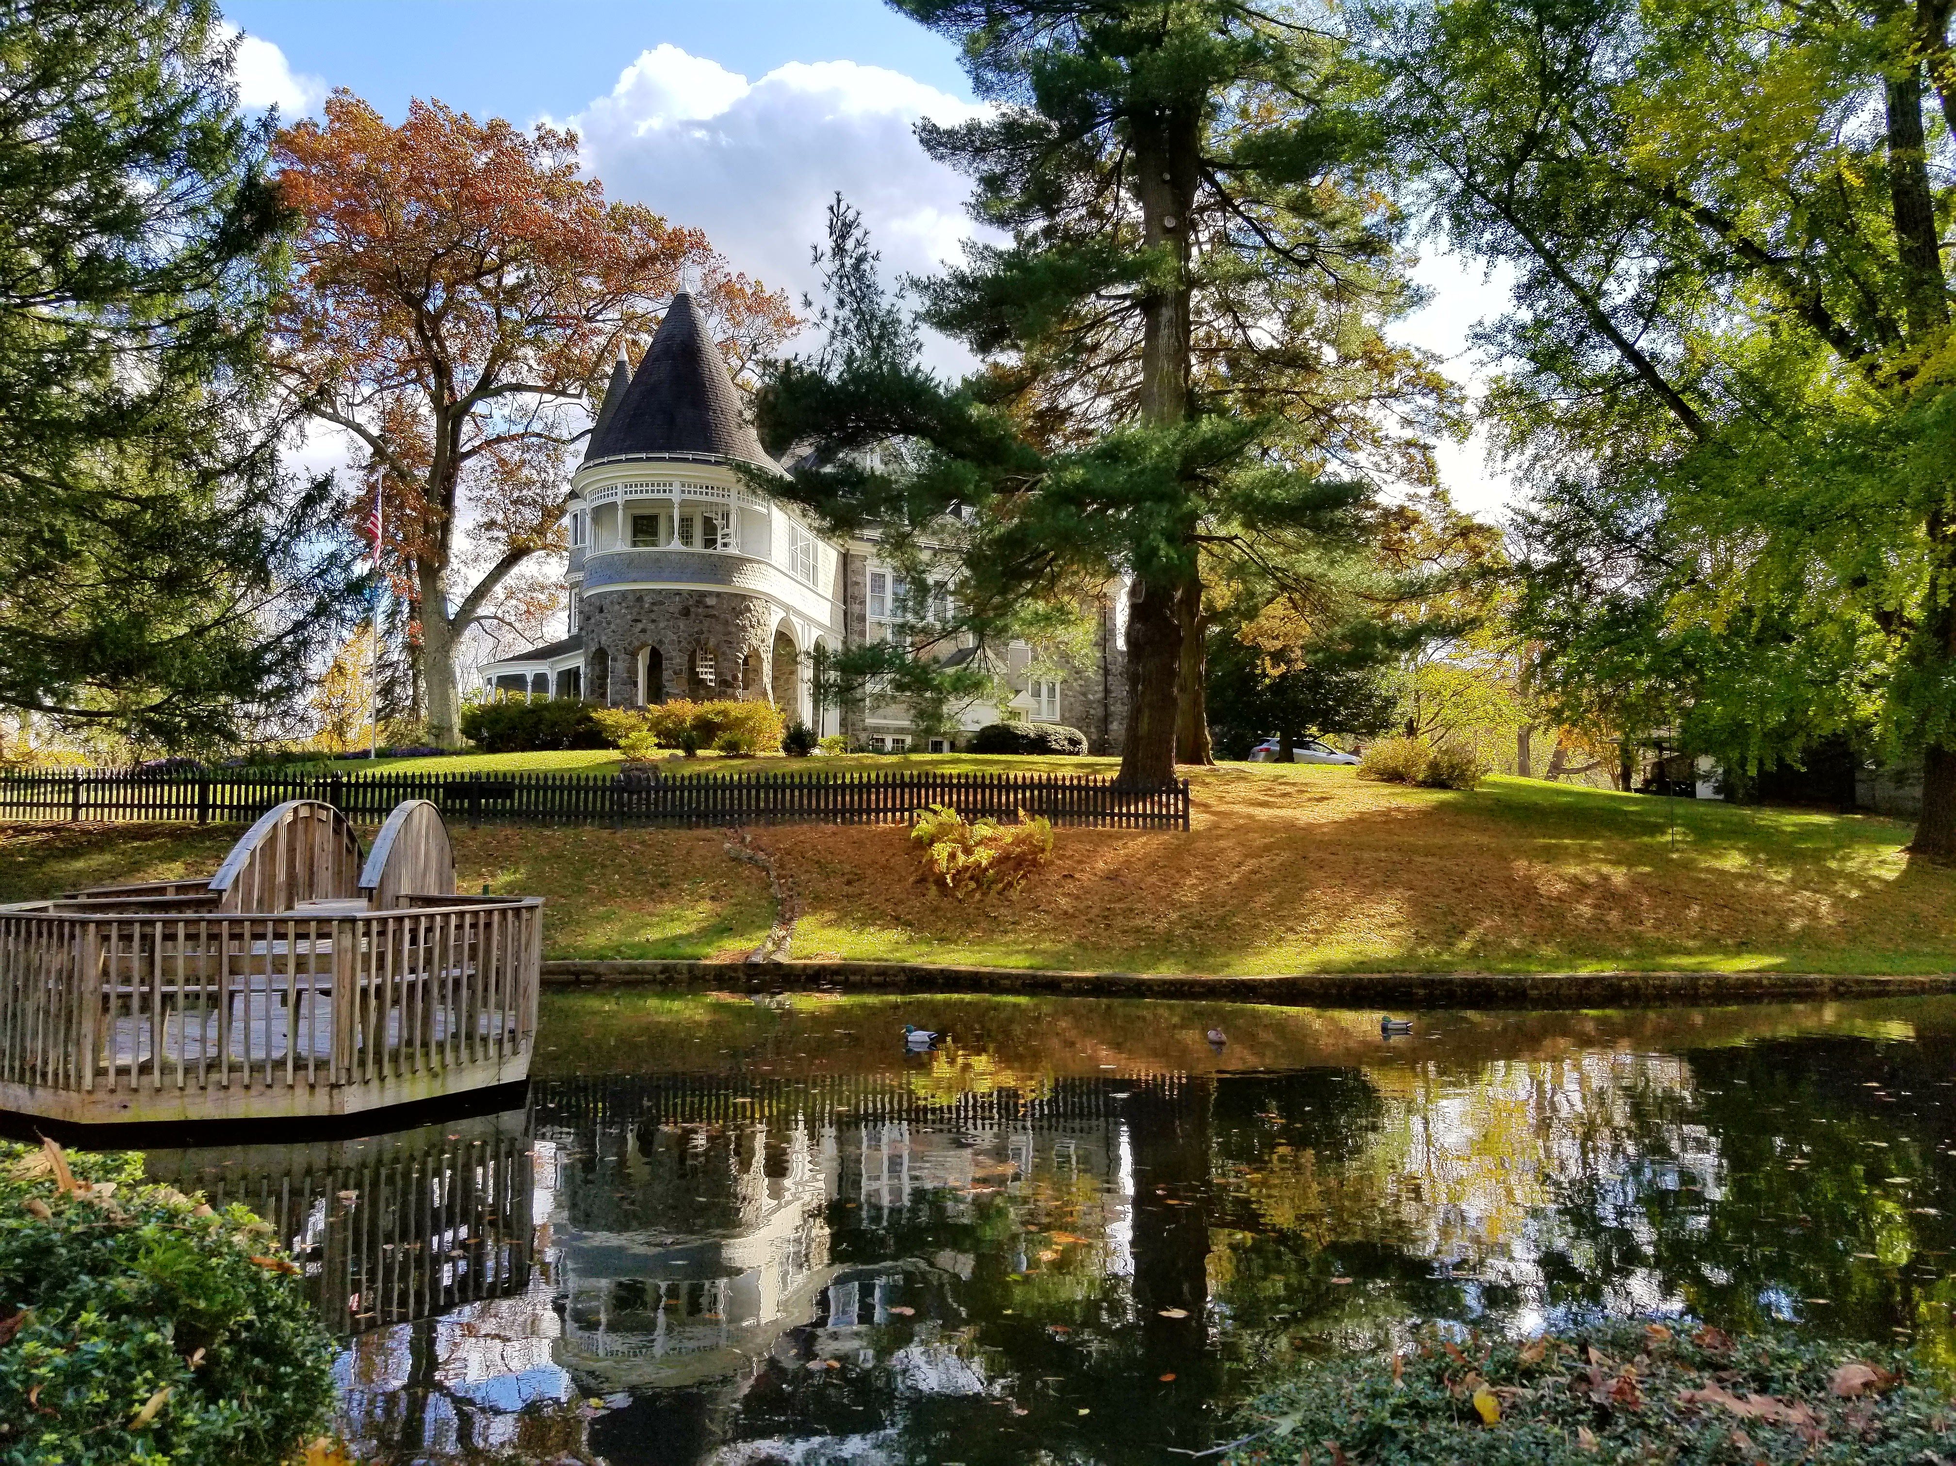
We’ll keep trying

