Slide 1
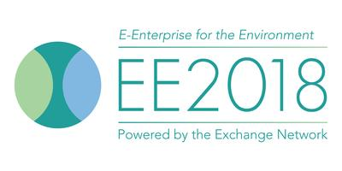
Alabama’s Experience with Electronic Inspections
Eric Cleckler
Program Development Section
Alabama Department of Environmental Management
ecleckler@adem.alabama.gov

Slide 2
Alabama’s Experience with Electronic Inspections - Overview
Origin of Project
History of Project
Lessons Learned
Questions
Notes:
Why did we do this?
How did we do this?
What did we learn?

Slide 3
Alabama’s Experience with Electronic Inspections – Origin of Project
Goal: Become more efficient
How: Electronic Inspections
Notes:
Budgets shrinking
Work growing
CLICK
Electronic processes, when done right, can be more efficient than paper.
Dept started journey to being paperless mid-to-late 90s.
CLICK
Next step in that journey is electronic inspections

Slide 4
Notes:
Having inspectors in the field recording what they see and moving to the next site would be more efficient than
CLICK

Slide 5
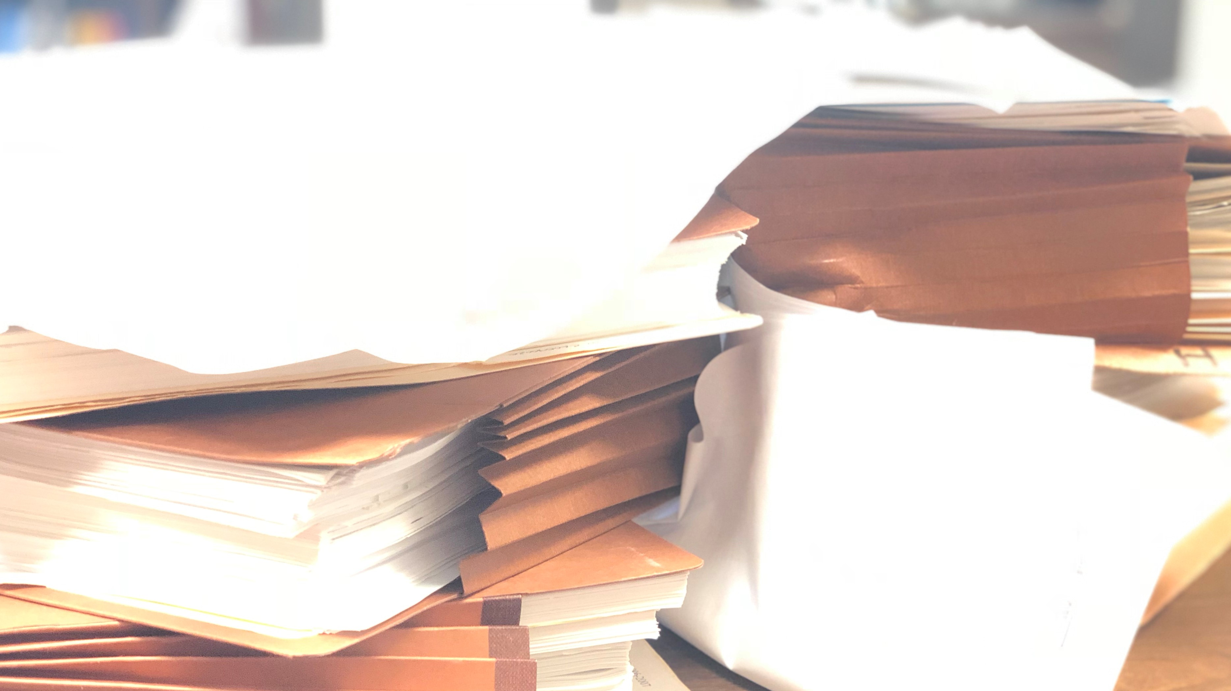
Notes:
Having inspectors write down what they see and then come back to the office to do paperwork describing what they saw.

Slide 6
Alabama’s Experience with Electronic Inspections – History of Project
Initiated Project 2014
COTS, Custom, or In-House?
Windsor Solutions: nSpect
Production: January 2016
30% Efficiency Gain
Notes:
2014 when decided to do electronic inspections
CLICK
Considered 3 methods of acquiring software
CLICK
Windsor
Spent a year researching, deciding, and purchasing
Spent a year implementing first program areas
CLICK
Prod
CLICK
Due to nSpect, field inspectors report 30% more inspections
2017 ECOS award

Slide 7
Alabama’s Experience with Electronic Inspections – Lessons Learned
Hardware Matters
User Buy-In
Testing
Constant Communication
Notes:
Office = ideal environment
Field = sun, hot, cold, hills, bushes, construction, mines, facilities, etc.
GPS? Camera? Weather proof? Glare? Weight? Too bulky? Too Large? Too Small?
Accessorize!
CLICK
All users, not just some
CLICK
Think you’re done testing? Ok, start over.
Mostly integration with other systems that we had issues with, kinda hard to test so nobody did
CLICK
While choosing project, while choosing method, while choosing product, while choosing hardware, while testing, while going to prod, after prod
Program areas are living, they change. Supporting systems have to change with them.
Hardware breaks, if not easy report users may put off until never.

Slide 8
Alabama’s Experience with Electronic Inspections
Eric Cleckler
Program Development Section
Alabama Department of Environmental Management
ecleckler@adem.alabama.gov

