Slide 1
REGION 5 APP DEVELOPMENT Mardi Klevs Scott Bessler Christina Saldivar U.S. Environmental Protection Agency – Region 5
E-Enterprise
National Meeting 2018
Notes:
This is the Title Slide for all EN2017 presentations. Please insert your presentation title (in ALL CAPS), your name (in plain text), and your organization affiliation (in italics). Organizational logos may be used starting with Slide 2. IMPORTANT: Format for 16x9 projection and monitors.

Slide 2
ABSTRACT
U.S. EPA Region 5 has successfully experimented with various platforms to build mobile electronic tools to facilitate the processes of inspections/site assessments, including the Pesticide Label Matcher (PLM) [an E-Enterprise Project], the Lead Renovation, Repair and Painting Rule Inspector Application (RRP Inspector App), and the USS Lead Superfund Site Electronic Surveys.
VISION
Mobile inspection/site assessment applications will contribute to greater efficiency and coordination between U.S. EPA, State/Local Agencies, and other stakeholders active in the field.

Slide 3
Table of Contents
Pesticide Label Matcher
USS Lead Superfund Site:
Electronic Surveys
RRP Inspector Application
Time and Cost

Slide 4
Pesticide Label Matcher State Co-Chair: David Scott, Office of Indiana State Chemist, scottde@purdue.edu EPA Co-Chair: Mardi Klevs, U.S. EPA Region 5 Project Manager: Alan Boutureira, U.S. EPA OCSPP EELC Liaison: Louise Wise, U.S. EPA OCSSP

Slide 5
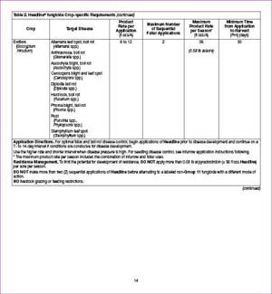
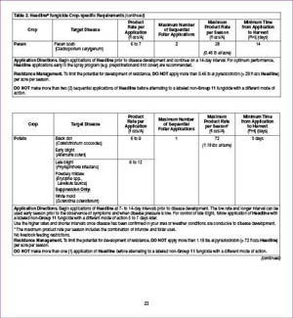
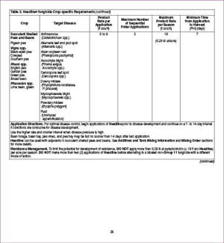
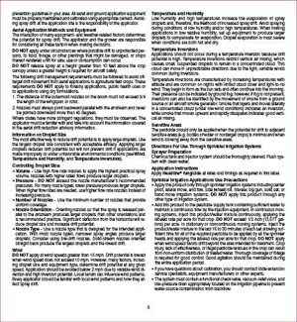
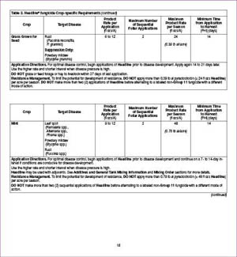
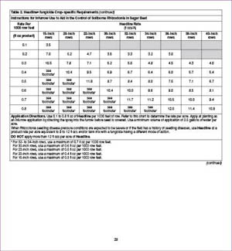
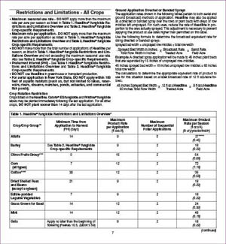
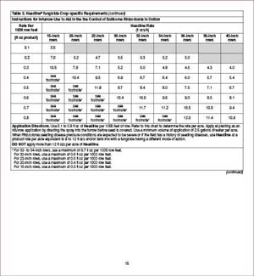
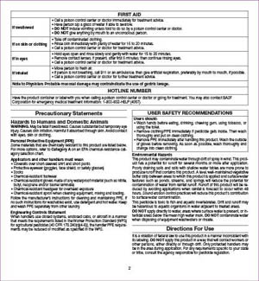
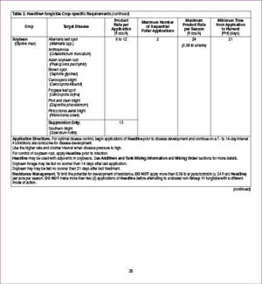
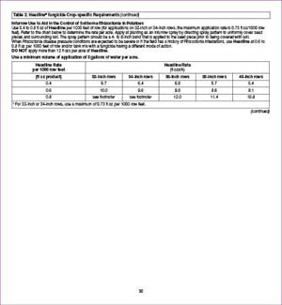
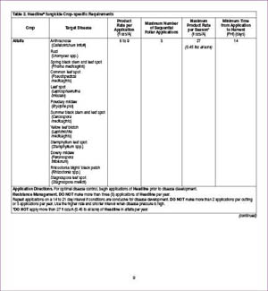
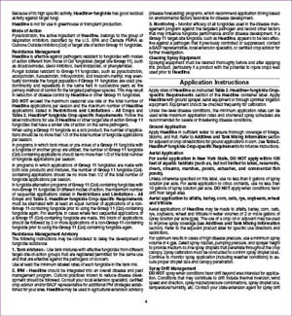
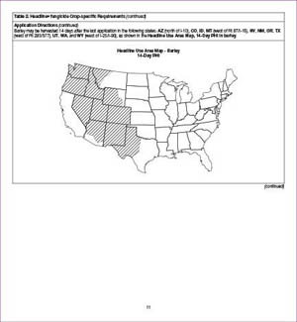
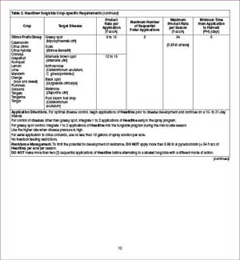
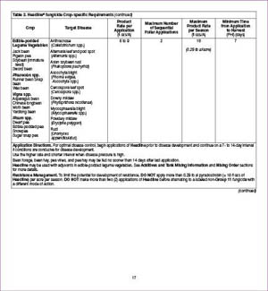
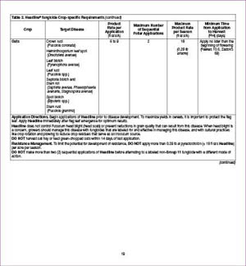
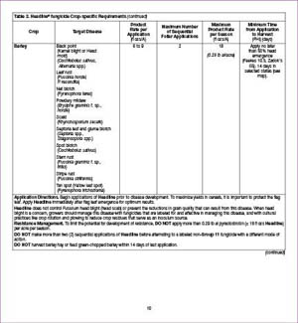
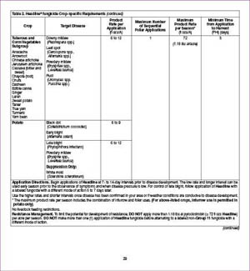
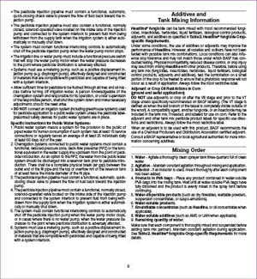
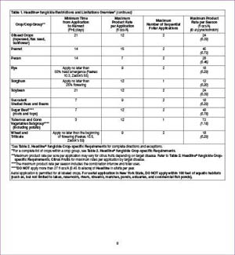
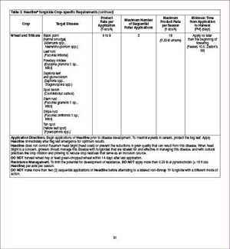
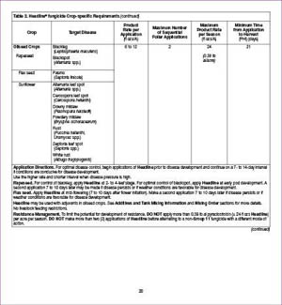
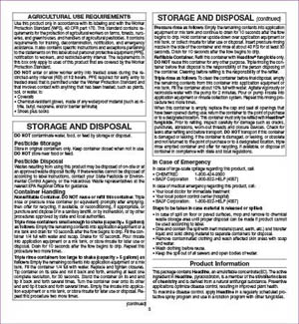
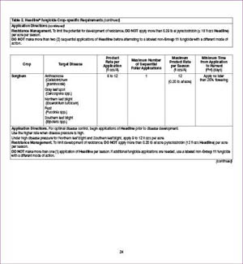
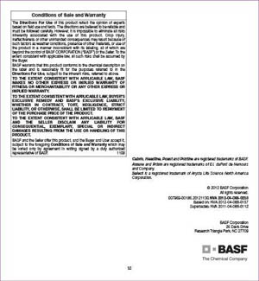
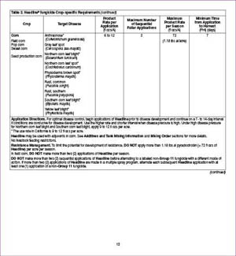
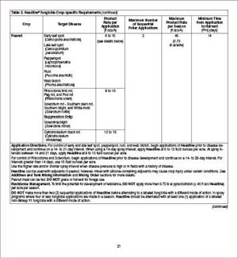
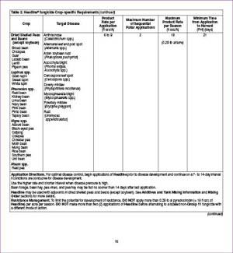
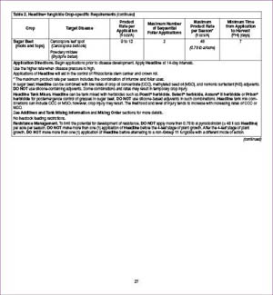

Slide 6
EPA’s Pesticide Data Availability and Label Matching Project
Major benefits this project provides include:
Reduce pesticide label inspection program complexity and cost.
Vastly improve efficiency and impact of inspections.
Promote greater and more proactive regulatory compliance.
Provide instant access to the critical data while in the field.
Allow greater public access to timely product registration data.
https://www.epa.gov/pesticide-labels/mobile-application-pesticide-label-matching

Slide 7
PLM: Need for Application
E-Enterprise Project
Used Agile method
Held State/EPA workshop with 18F to conceptualize project.
Allows for easy comparison of label to label requirements on a screening level
Screening Reports issued via email
Accesses Master Labels from EPA’s Pesticide Product Label Database (PPLS)
PLM Application Users
PLM Upgrades for 2019:
State and Federal Inspectors
Pesticide Registrants
Pesticide Users
Pesticide Consumers
Removal of OCR
Addition of New Information Available in PPLS
CDX User Accounts
Possible Creation of Database

Slide 8
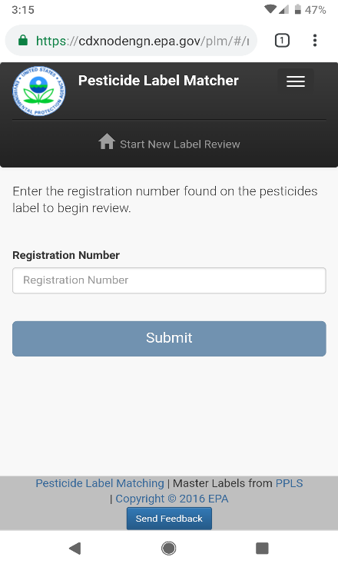
PLM: Information Collection Demo

Slide 9
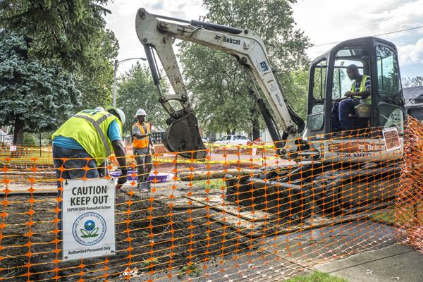
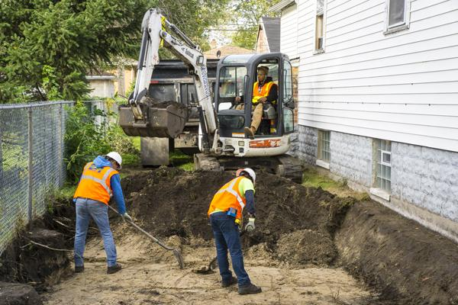
USS Lead Superfund Site:
Electronic Surveys
U.S. EPA Region 5 – Superfund Division
Photos: Removing lead and arsenic contaminated soil from the USS Lead Site in East Chicago, IN.

Slide 10
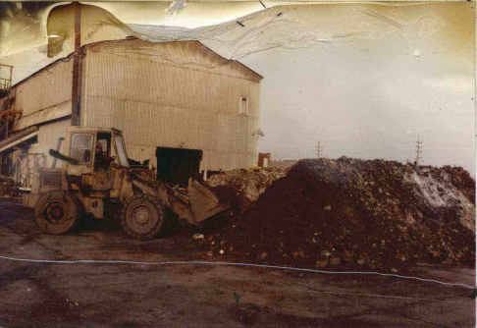
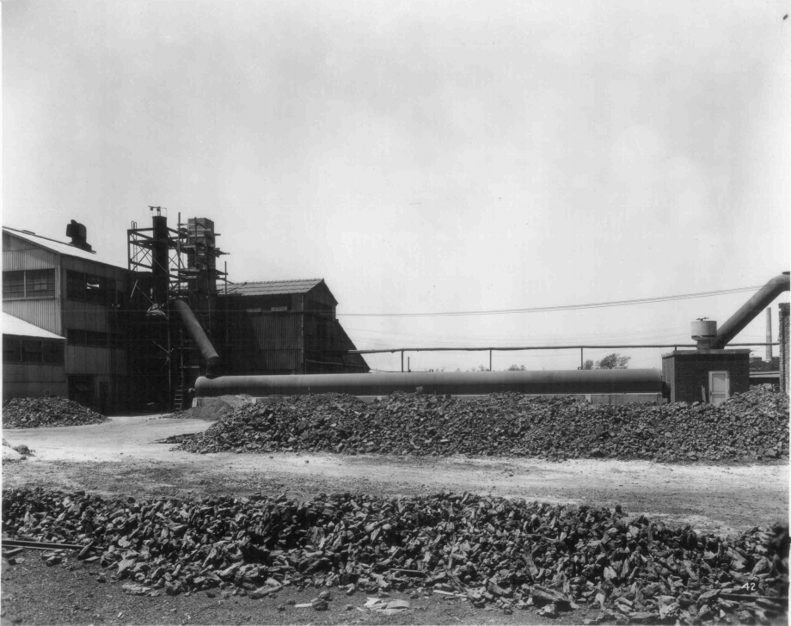
USS Lead Superfund Site: Background
East Chicago, Indiana
U.S. Smelter and Lead Refinery, Inc. (USS Lead)
Lead Refining Facility: 1920 – 1972
Secondary Lead Smelter: 1972 – 1973
Ceased Operations: 1985
Filed Bankruptcy: 1987
Waste Materials:
Blast-furnace slag
Baghouse lead-containing dust
Contaminates: Lead & Arsenic
Nearby Residential soils
Facility Site soils
Wetland
USS Lead Operation: Charge mix for the blast furnace.
USS Lead Operation

Slide 11
USS Lead Superfund Site: Background (Cont.)
ROD: November 2012
Excavation of soil.
Disposal of extracted soil at on off-site Subtitle D landfill. Chemical stabilization in soil exceeding TC threshold.
Establish visual barriers and implement institutional controls to prevent of exposure to contaminated soil over 24 inches bgs.
Excavated soil replaced with 6 inches of clean topsoil.
USS Lead Site - Operation Unit 1: Residential Zone 1, Zone 2 & Zone 3
https://www.epa.gov/uss-lead-superfund-site

Slide 12
USS Lead Site: Tools to Capture Data in the Field
Esri’s Electronic Smart Form System
Field Data Collection
Integrated with Geoplatform
Works on Multiple Platforms
Applications
Survey123 Connect (Developers)
Survey 123 for ArcGIS (Samplers)

Slide 13
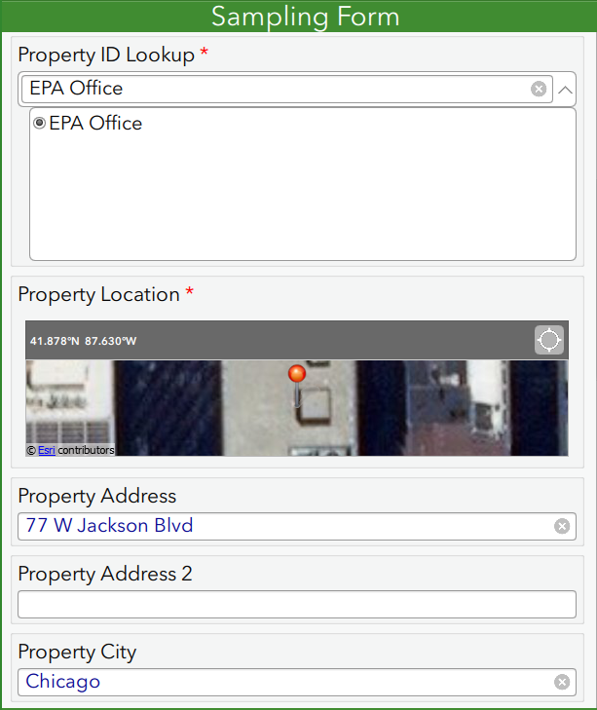
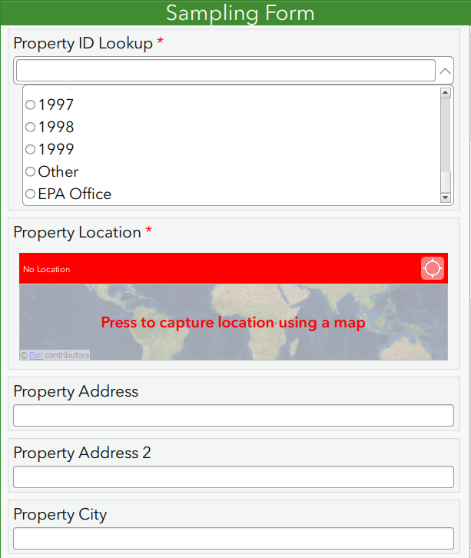
Look-Up Tables & Auto-Populating Fields

Slide 14
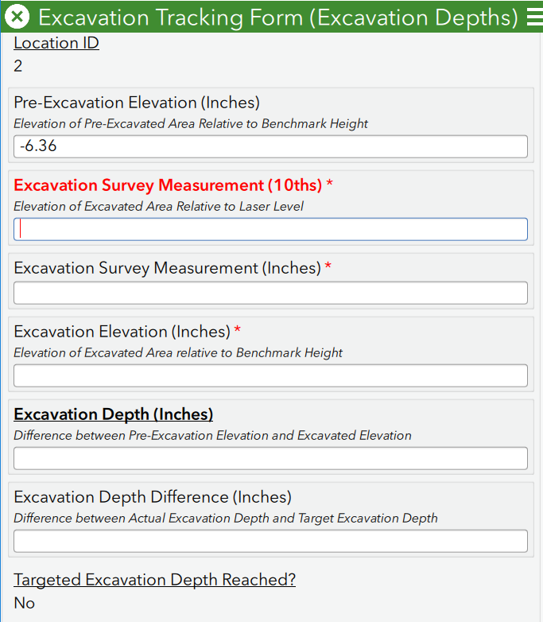
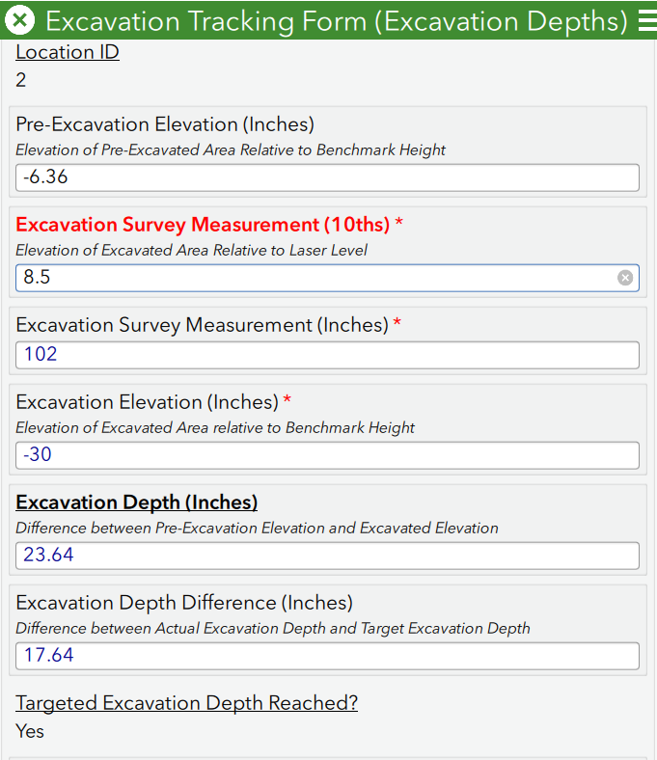
Real-Time Calculations
Ensures
appropriate
amount of soil
is excavated.

Slide 15
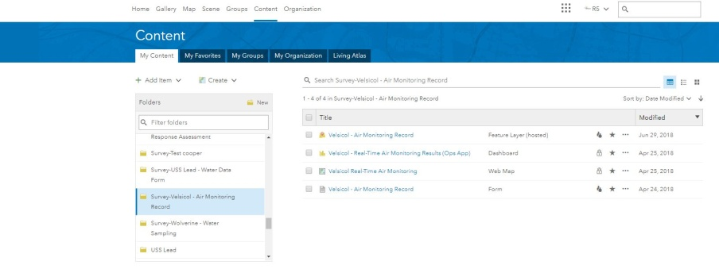
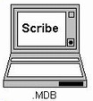
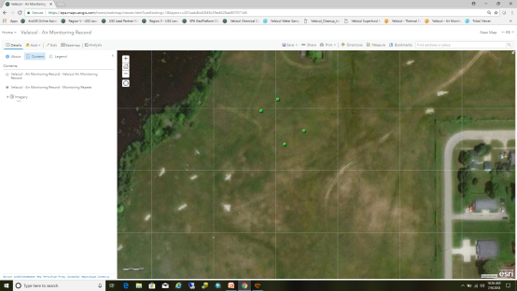
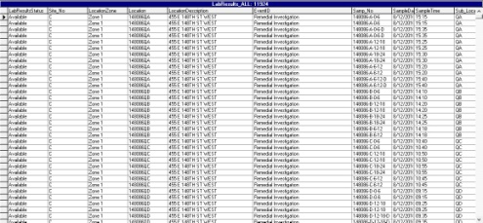
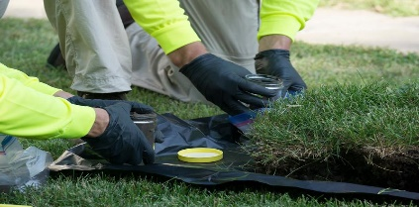
Electronic Survey Overview
Surveys
Exporting Data
EPA’s Database
Analytical Lab Result Data
Field Sampling Data

Slide 16
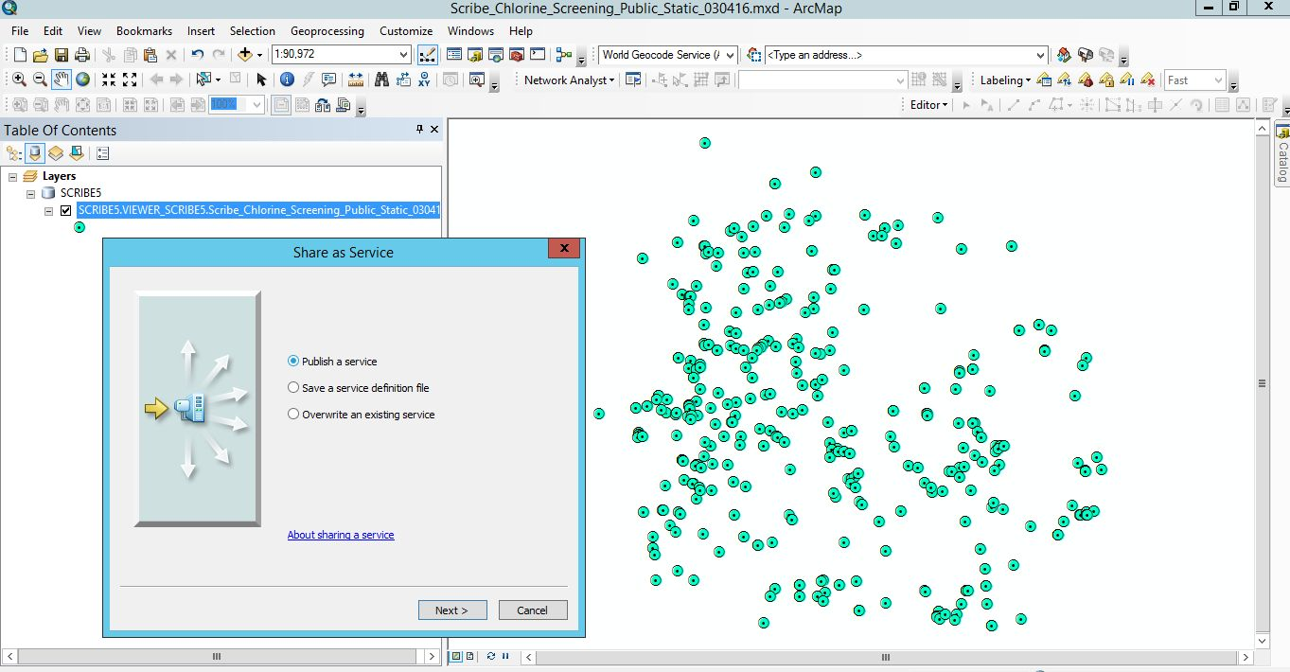
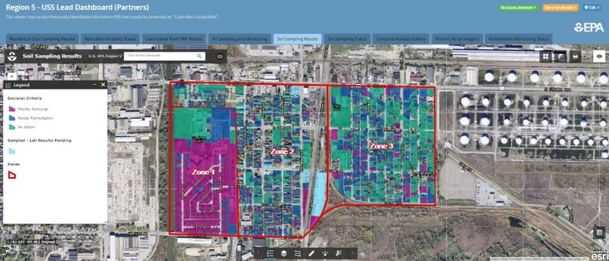
Electronic Survey Overview (cont.)
Database
Publish Scribe
GIS Services
Scribe.NET

Slide 17
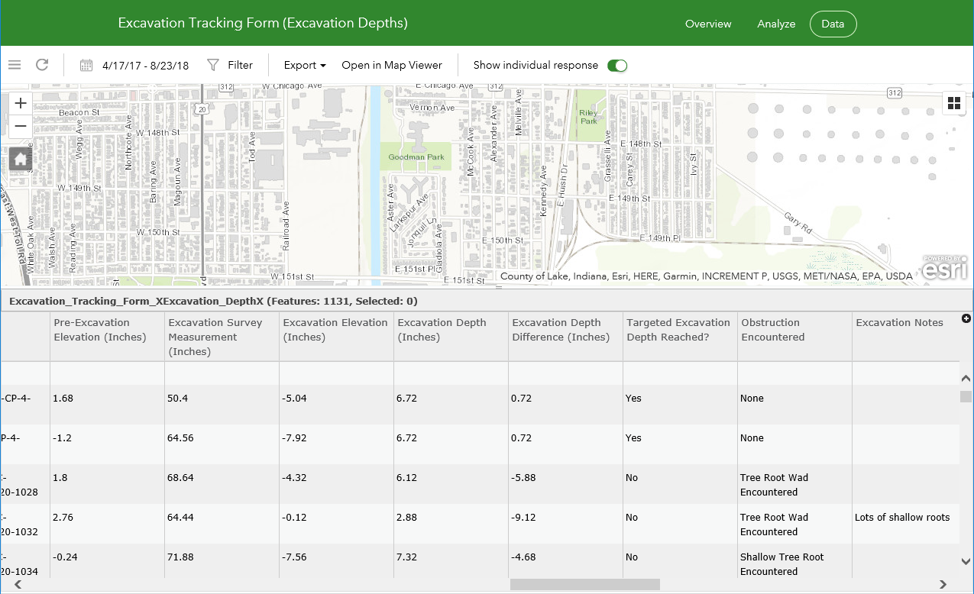
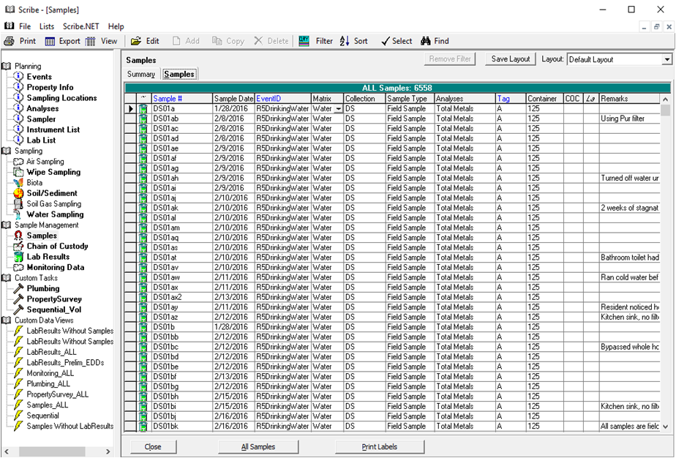
SCRIBE Database
Survey123
Data from electronic surveys on Survey123 can be viewed as tabulated data and map the location of the collection site.
Survey123 data uploaded and published into EPA’s Scribe Database (Microsoft Access).
Personnel QC of data
Permanent Data

Slide 18
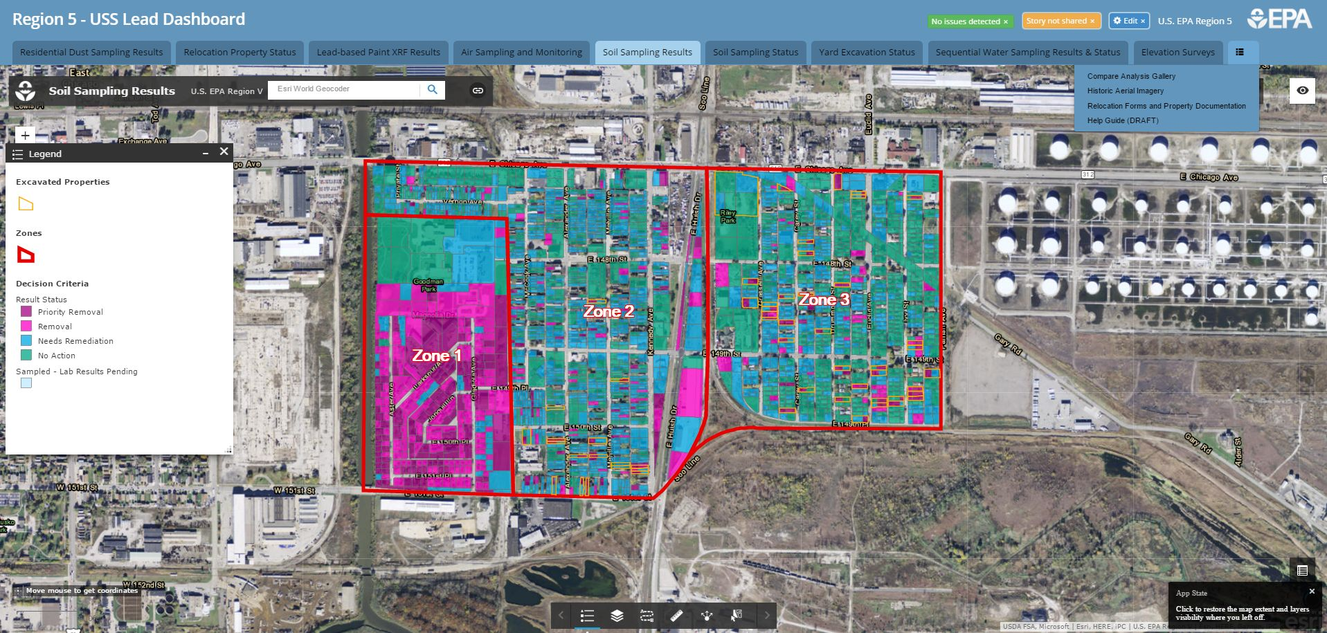
Geoportal Services For Internal/External Partners
USS Lead Dashboard: Soil Removal Sampling Results View for Internal/External Partners

Slide 19
RRP Inspector Application U.S. EPA Region 5 TSCA Lead Enforcement Team:
Scott Bessler, Christina Saldivar, Pamela Grace
U.S. EPA Region 5 LCD Project Managers:
Mardi Klevs and David Star
Technical: David Rebot, U.S. EPA ORISE; Mark Messersmith, U.S. EPA OECA

Slide 20
Lead Renovation, Repair and Painting Rule (RRP Rule)
RRP Rule Ensures:
RRP Rule Requirements:
Reducing exposure of lead-based paint hazards associated with renovations for compensation in pre-1978 residential housing and child-occupied facilities.
Household lead dust:
Home Renovations
Wear and tear of friction surfaces
Paint flaking
Emphasis on children under 6 years old.
Childhood Lead Poisoning
Firm Certification
Individual Renovator Certification
Information Distribution
Lead-Safety Work Practices
Recordkeeping & Reporting

Slide 21
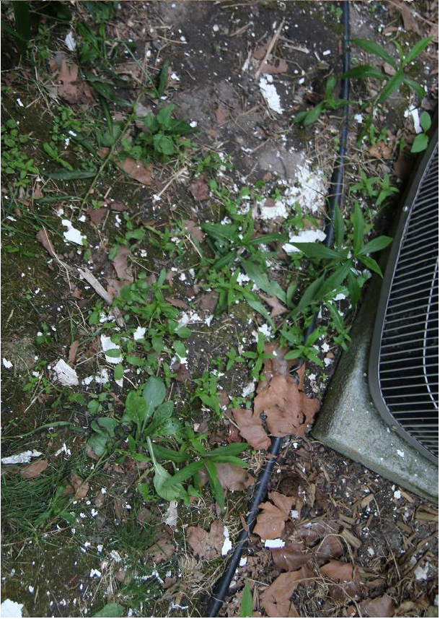
✓
RRP Violation Examples - Failure to Cover Ground in Exterior Renovation:
Proper RRP Lead-Safety
Work Practice Standards:
“[Contractor] and my landlord’s negligence exposed my daughter to lead and left us moving between five different living situation in the past few months.”
“When we came home, we were shocked to see the perimeter of house covered with hundreds and thousands of lead paint chips.”

Slide 22
RRP Inspector: Need for Application
EPA enforcement resources are quite limited.
Limited Enforcement Presence
HUGE Regulated Community:
General Contractors
Special Trade Contractors
Residential Rental Property Owners/Managers
Maintenance Personnel
Create Partnerships with State/Local Health Departments
RRP Inspector Application
RRP Inspector is in beta testing

Slide 23
RRP Inspector: Technical Specs
RRP Inspector is built on Survey123 for ArcGIS platform.
Available and Free in all major App Stores and accessible on all major platforms.
Available in EPA’s App Catalog for EPA personnel devices.
Information collected and submitted to EPA through a custom electronic survey.

Slide 24
RRP Inspector: Key Information Needed
Renovation Contractor’s Identity.
Renovation Property Address and GPS coordinates.
Description and Pictures of RRP violations.
Witness Statements.
Inspector submits key information into Survey123 and it is transmitted, stored and viewed in EPA’s GeoPlatform.

Slide 25
RRP Inspector: Information Collection Demo

Slide 26
RRP Inspector: Survey123 to GeoPlatform

Slide 27
Cost and Time for PLM & RRP Inspector
Pesticide Label Matcher
RRP Inspector Application
Milestones:
Return on Investment Analysis (May 2015)
Feasibility Study (December 2015; June 2016)
18F Design Workshop (April 2016)
Development of Minimal Viable Product (MVP) (April 2016)
User Testing (May 2016)
Beta Testing Release 1.1 (August 2016 )
Beta Testing Release 1.2 (March 2017)
Production FY17 (September 2017)
Implementing Upgrades (2019)
Cost:
Estimated several thousand dollars
Several projects in IT contract
In-process of establishing cost
Milestones:
Collaborating with CDPH and Region 5 OECA. (March-April 2018)
Developing Custom Electronic Surveys (May-June 2018)
Internal User Testing (July 2018)
Pilot Demo and Application Setup for External Partners. (August 2018)
Beta Testing Release with CDPH (August-November 2018)
Review Results and Troubleshoot (2019)
Cost:
Minimal Cost
Developed and managed internally

Slide 28
Acknowledgements
Pesticides Label Matcher
USERS:
CONTRACTOR:
TEAM MEMBERS:
State and Federal Pesticide Inspectors
Regulated Community
Public
CGI:
Kathy Logan
Ted Dacy
Xiangbo Li
Andrew Hebert
Joshua Martin
Michael Seavey
Aaron Zamecnik
Zack Connelly
Sue Dose
Cody Latiolais
David Scott
Mardi Klevs
Alan Boutureira
Patrick Dobak
Robert Schultz
Many Pesticide State/Federal Program Directors and Staff.

Slide 29
Acknowledgements
RRP Inspector Application
USERS:
DEVELOPERS:
TEAM MEMBERS:
Local and State Health Departments
Federal RRP Inspectors
David Rebot
GIS ADMINSTRATORS:
Paisly Kauth
Scott Bessler
Mark Messersmith
Christina Saldivar
David Star
Kathy Triantafillou
Jodi Wilson

