Slide 1
Smart Mobile Tools for Field Inspectors
October 24, 2018
SMART
TOOLS

Slide 2
What is Smart Tools?
A suite of digital tools (software / hardware) to fundamentally change the way environmental inspection programs are operated and managed
Smart Tools provides the following features to improve the quality and consistency of inspections and reports:
Inspection planning, assignment, tracking and management
Field data collection improving quality, consistency and efficiency
Robust and secure evidence management and retention
Seamless data flow with EPA programmatic databases (e.g.,RCRAInfo and ICIS)
Supports timely completion and release of Inspection Reports
Jointly governed by EPA, ECOS and other program associations

Slide 3
Why Smart Tools?
Current
Future

Slide 4
Evolution of Smart Tools
Concept
Pilot
Analyze
Procure
Govern
Commenced procurement for COTs
Completed LEAN process for Inspection Process requirement (EPA/state)
Launched pilot with a select group of inspectors in Region 4
Developed Lessons Learned
Conducted Alternative Analysis
Conducted RCRA requirements gathering
Three-tiers: Project Teams, Mid-level management with Senior Executive oversight
Jointly governed with ECOS, State Associations and States
Florida DEP Solid Waste Field System (SWIFT) benchmark
Partnered with EPA Region 4

Slide 5
State Participation
Representatives of State Associations (currently ASTSWMO) and ECOS participate in all levels of the Smart Tools Governance structure
In addition to ASTSWMO and ECOS staff, ten (10) states are currently actively participating
AR, CO, GA, MD, NH, OH, SC, TN, VA, VT

Slide 6
2018 Project Milestones

Slide 7
2019 Project Milestones

Slide 8
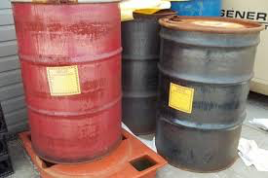
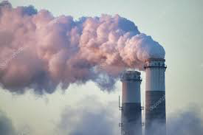
Phased Implementation
Phase 1: RCRA
Phase 2: CWA;
Phase 3: CAA;
Phase 4: TSCA, FIFRA, SDWA, EPCRA, and CERCLA
July 2019
RCRA
Late 2019 est.
Water
Mid 2020 est.
Air
Early 2021 est.
TSCA, FIFRA, SDWA, EPCRA and CERCLA

Slide 9
Smart Tools Software
Customizable Off-the-Shelf Software
Developed using Agile Process
Robust, built in features
Mobile friendly & offline capable
Supports process based inspections
Device & operating system agnostic
Interfaces with federal & stare regulatory citation registry
Interfaces with EPA source systems (ICIS, RCRAInfo & FRS)

Slide 10
Smart Tools Functionality

Slide 11
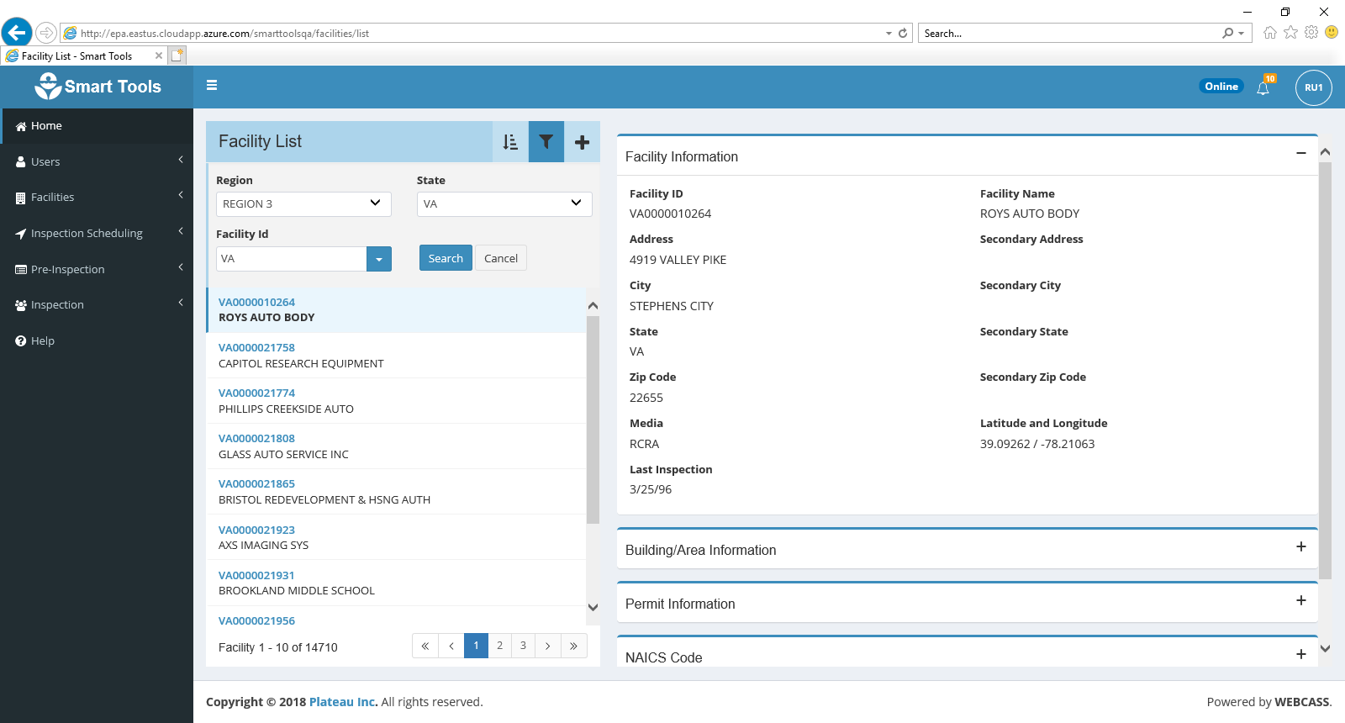
Facilities
Facility Details
Facility Personnel
Buildings & Areas
State Notifications
Updating facility details
Creating EPA ID’s
Building A

Slide 12
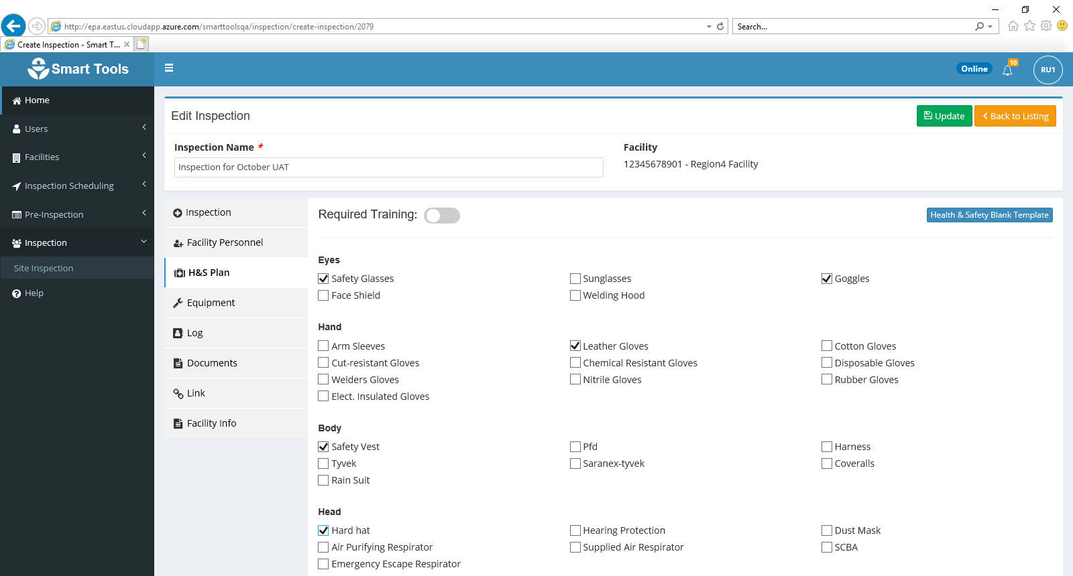
Pre-Inspection
Import Targets
Import Permits
Compliance History
Generate Health & Safety Plan
Company A

Slide 13
Site Inspection
Facility A
Field Observations
Electronic 40 CFR Federal Regulations
Corresponding State Citations
Inspection and Facility Linking
Document uploads
Multimedia & Multi-Inspector
Evidence Management

Slide 14
Post Inspection
Draft Inspection Report
Automated / Pre-populated
Supports inspection report timeliness of completion & dissemination
Inspection Conclusion Data Sheet
Data Translations to RCRAInfo / ICIS
Custom / Ad Hoc Reporting
Potential Data Exports to State Systems

Slide 15
Management Features
Inspection Assignments
Inspection Monitoring
Inspection Workflow Review
Dashboard Reporting

Slide 16
Key Features
Photo Log
Notes Highlighting
CBI redaction & Segregated, Secure Storage
Voice & Handwriting Recognition

Slide 17
Smart Tools Innovations (Coming Soon!)
Product Extension
Assistive tool software layer capable of supporting inspectors in the field
Automatically generates draft inspection plan based on inspector input
Guides inspectors as they encounter unique situations in the field
Jointly owned by EPA and Plateau
Facilitate equipment calibration and data collection

Slide 18
Questions and Discussion

