Slide 1

Integrating Facility Information Shared Services: Handle with CAER
Ben Way, Wyoming Department of Environmental Quality
Joshua kalfas, Oklahoma Department of environmental Quality
Ron Evans, US EpA, Office of Air and Radiation
Susan Joan Smiley Baker, US EPA, Office of Environmental Information
October 24, 2018

Slide 2
Topics for this Session
Why integrated facility information matters
Progress To-Date on facility information integration
What’s next for facility shared services
Combined Air Emissions Reporting (CAER) Background
Progress To-Date on CAER
What’s next for CAER common form
2

Slide 3




Facility Team: Component of E-Enterprise
E-Enterprise Teams
Facility Team
SPeCS for SIPS: State Plan Electronic Collection System for State Plan Submissions
E-Manifest for Hazardous Waste
Smart Mobile Tools for Field Inspectors
Advanced Monitoring Strategy and Implementation
E-Enterprise Community Inventory Platform
E-Enterprise Respectful Use of Data: ECHO
Shared Services
E-Enterprise Portal Governance & Maintenance
Assistance Gateway
Shared CROMERR Services (SCS) Implementation
Virtual Exchange Service Implementation
Combined Air Emissions Reporting (CAER)
Safe Drinking Water Information System Prime (SDWIS) Modernization
Identity Management Solution Project
The Interoperable Watersheds Networks
Shared Identity Management
3
Notes:
The big blue arrows are our teams but the little arrows show how the facility work is related to many other E-Enterprise work teams
Facility identity integrations supports many environmental management activities and E-Enterprise goals

Slide 4
E-Enterprise Facility Team
Purpose: To bridge disparate sources of facility data and develop a more comprehensive approach to:
  Allow regulated facilities to streamline data collection and reporting requirement
  Provide a shared facility ID approach to facilitate cross-program coordination and access to public information
Focus: collecting state, local, tribal, industry and EPA input into an approach for how these groups may:
  Share facility identifiers
  Correct facility data as it is being reported
  Facilitate many of the functions envisioned by E-Enterprise
4
Notes:
Allows users to identify…
Permits/regulations that pertain to a particular facility, and evaluate its compliance
Location of a particular facility
Regulated facilities within a particular sector
Used for enforcement, rulemaking, reporting, analysis and emergency response
Enables cross-program analysis and evaluation

Slide 5
Facility Team Timeline
Phase I - Discovery and Analysis
  Focused on a thorough analysis of the current state of facility data management
  2015 – April 2016
Phase II - Develop draft facility services
  Define requirements (user stories, business rules, data model) for development and testing of services
  July 2016 – May 2018
Phase III – Expand testing and use cases, draft governance
  Expand to other partners and CAER
  May 2018 – September 2019
5
Notes:
We are now in Phase III of a five phase plan for integrated facility information

Slide 6
Why Integrated Facility Information Matters
Provides comprehensive facility data through coordinated facility ID
Facilitates cross-program coordination
Supports reduction of regulatory reporting burden
Enhances program management
Improves data quality
Reduces workload associated with data reconciliation
Decreases costs associated with synchronizing EPA/partner system data
Reduces response time to public information requests
6

Slide 7
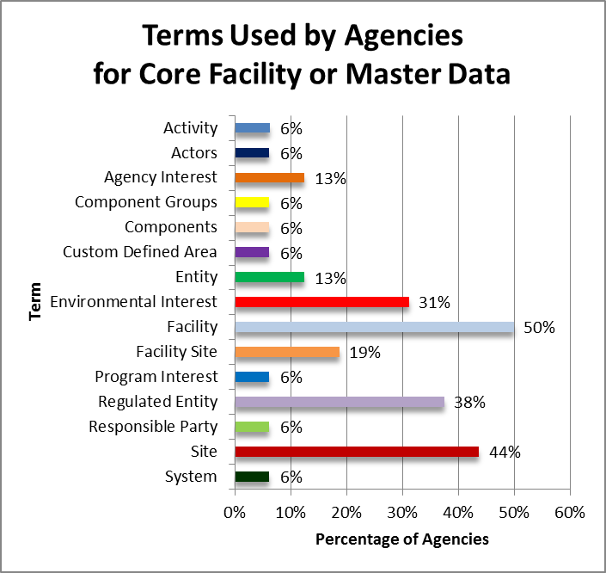
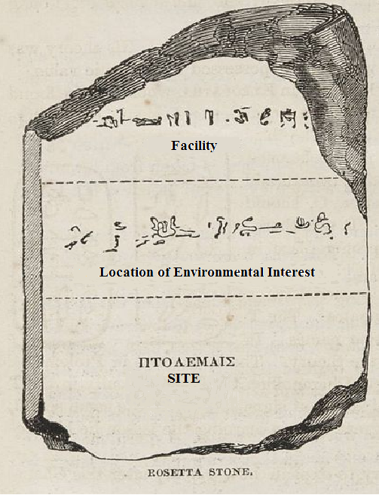
Developing a Common Understanding of Facility Information
From Phase 1 Discovery and Analysis
7
Notes:
We use the Rosetta Stone analogy to illustrate how we need to map various terms and facility definitions across programs and systems.
The chart here is from Phase I’s deliverable that shows various terms used for “facility.”

Slide 8
Starting With What We Have
Expanded version of EPA’s Facility Registry Service (FRS) data model which contains information from over 4 million facilities of environmental interest.
States, Tribes and Local (SLT) governments’ facility data in:
  Master Data Management systems (MDM)
  Separate program systems
  Some modern, some antiquated systems
  Varying degrees of cross-program integration
Begin integrating/synchronizing FRS and SLT facility data.
8
Notes:
n planning an E-Enterprise integrated facility resource, we started with the facility information resources that exist already

Slide 9
Expanded EPA FRS Data Model Reflects
Programs’ Reporting Requirements
Old Model:
This is one facility
Expanded Model:
More detailed view of facilities, including sub-components and relationships between components
9

Slide 10
A FRS Registry Record is Comprised of:
EPA Program Facility Records
Partner Facility Records
Other Federal Data Set Records
FRS Registry Record
EPA program facility records and partner program facility records are stored in the FRS Program Facility tables.
FRS business logic populates the FRS Registry record
Data Steward Edits in
Facility Linkage Application (FLA)
FRS registry records are stored in the FRS Registry tables.
10

Slide 11
Integrated Facility Phase II Pilot
  Partnership with Rhode Island Department of Environmental Management (RIDEM).
  Developed APIs to exchange facility data in real-time between FRS and RIDEM’s integrated facility system, PLOVER.
  Updated FRS business logic to incorporate RIDEM data, promoting PLOVER facility data to the registry level opposed to individual program level.
  Enabled FRS and RIDEM to benefit from more timely and accurate facility information.
  Developed a query service to add FRS facilities to the result of a search in a state system (if user requests EPA facilities to be included).
11
Notes:
The next three slides help explain what these services do

Slide 12
SLT Submit Service Promotes SLT Record to Registry Record
12
Notes:
This is a paradigm shift in how SLT records are managed in FRS

Slide 13
Implementing Pilot Services Changes: How FRS Facility Attributes are Populated
FRS Facility Record
ID: 1234567
Name: ABC Company
Address: 123 Main St., Anytown, RI 02863
Program Facility Record
Program ID: TRI 0001234
Program Facility Name: ABC Co
Program Facility Address: 123 Main Street, Anytown, RI 02863
Program Facility Record
Program ID: NPDES RIG0009876
Program Facility Name: ABC Company
Program Facility Address: Main St., Anytown, RI
Partner Facility Record
ID: PLOVER 567
Facility Name: ABC Materials Company
Facility Address: 123 West Main Street., Anytown, RI 02809
FRS Facility Record
ID: 1234567
Name: ABC Materials Company
Address: 123 West Main St., Anytown, RI 02809
Program Facility Record
Program ID: TRI 0001234
Program Facility Name: ABC Co
Program Facility Address: 123 Main Street, Anytown, RI 02863
Program Facility Record
Program ID: NPDES RIG0009876
Program Facility Name: ABC Company
Program Facility Address: Main St., Anytown, RI
Partner Facility Record
ID: PLOVER 567
Facility Name: ABC Materials Company
Facility Address: 123 West Main Street., Anytown, RI 02809
Pre-Pilot Approach
Pilot API
Partner Record attached to FRS Record but not used to populate attributes in FRS Facility Record
Partner Record attached to FRS AND used to populate attributes in FRS Facility Record
13
Notes:
Highlight differences in what is being shown.

Slide 14
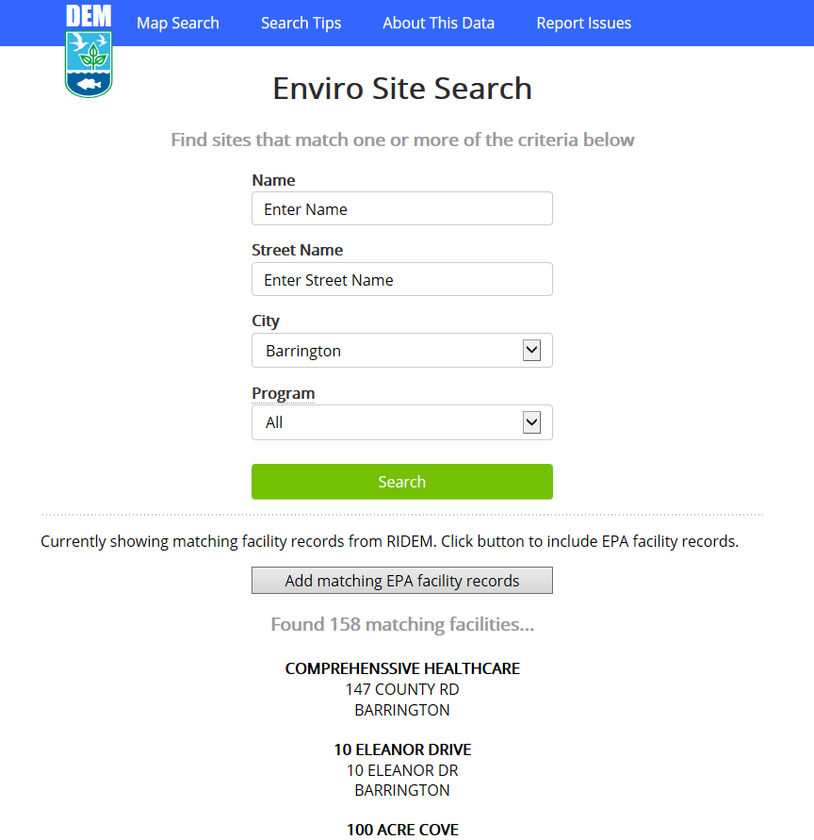
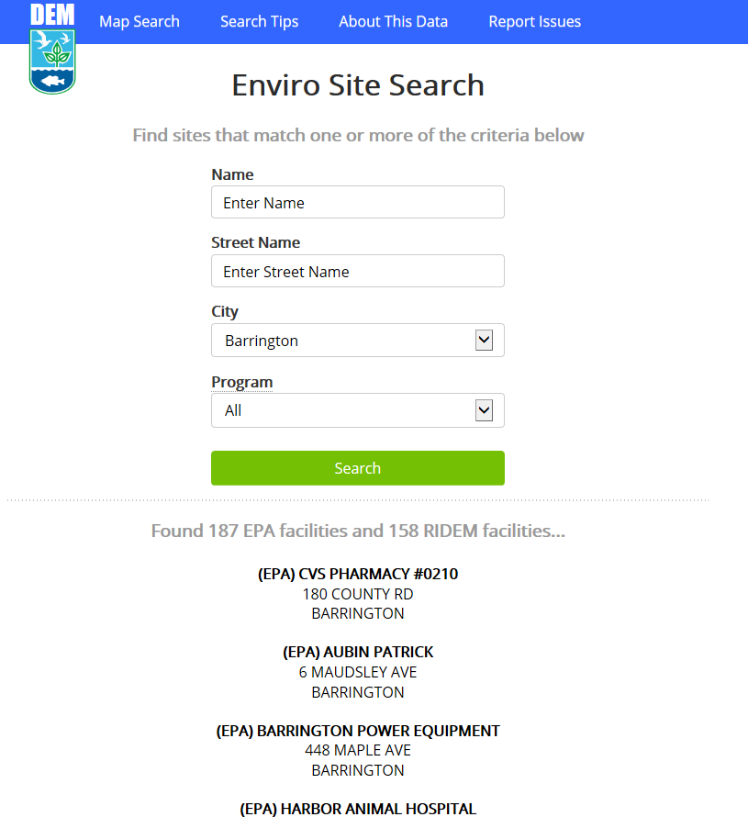


RIDEM Incorporated FRS Data Into Publicly-Available Site Search
Users given the option to add matching EPA facility records.
If selected, results are displayed with “(EPA)” appended to the front of the name.
14
Notes:
Adding EPA facilities from FRS query shows 29 additional facilities in Barrington, Rhode Island – a fuller picture of facilities of environmental interest with both state and federally regulated information.
This is a prototype of the presentation of the data – the specifics of the final user interface is a work in progress.

Slide 15
Facility Services MVP in Phase II
Services tested were based on basic facility profile fields in FRS registry record
  Fields documentation: https://ofmext.epa.gov/facilityiptwebservices/
Expanding more fields in Phase III
  Geospatial, organizational, sub-facility
Services need testing in other partner systems
  *****Recruiting Phase III testing partners now*****
15

Slide 16
Phase III Priorities
Additional testing of pilot services with other SLT partners
Combined Air Emissions Reporting (CAER) Gap Analysis
Facility Governance Framework
Unified Facility “status” micro-service
Move facility shared services to production (after additional testing)
Leverage FRS’ Facility Linkage Application (FLA) to support SLT facility management
16

Slide 17
Phase III Facility Services Objectives
Collaborate with an additional partner or partners to test expanded services in a non-production environment
Complete a comprehensive review of downstream user impacts
Move services to production for use and adoption by partners after sufficient testing and review is complete
Pilot the use of EPA’s Facility Registry Service (FRS) tools to support MDM with a partner that does not have that capability in-house
  Demonstrate that a partner that does not have a facility MDM system can take advantage of shared facility services
17

Slide 18
Getting Your Feedback
Raise Your Hand
Facility Governance Pop-Quiz
Micro-service Input Activity
18
Notes:
First interactive activity: Raise hands exercise
Raise hand if attending EE2018
Raise hand if from an SLT
Raise hand if interested in piloting facility web services

Slide 19
Facility Data Governance Framework
Building and using an integrated facility data construct has broad ramifications: 35 EPA systems; 58 SLTs; other federal agencies; public
A GOVERNANCE FRAMEWORK IS NEEDED
The facility governance body will work within the larger E-E governance structure
Governance body membership will comprise representatives from EPA, SLTs, IT, all media
Governance body charge (not exhaustive):
  ▪ Change Management ▪ Data Standards and Integrity
  ▪ Communications ▪ Coordination and Support
  ▪ Documentation Repository
19

Slide 20
Facility ‘Status’ Micro-Service
Team is actively scoping the requirements for supporting and employing a unified facility status micro-service
Immediate Observations:
  Significant divergence in what ‘facility status’ is interpreted to mean
  Several types of status that apply to ‘facility’ are frequently conflated:
      Environmental Program interest
      Operational status
      Compliance status
      Permitted status
      Reporting requirements and/or status
    Existing codesets insufficient for supporting envisioned needs
20
Notes:
Do interactive activity – sketch, needs, etc.

Slide 21
Next Steps in Facility Information Integration
Facility Governance work stream - develop governance framework
Facility micro-service work stream - define “status” requirements
Pilot expanded facility services with SLTs - demonstrate real-time facility information updates
Support CAER facility requirements - for common form
21

Slide 22
Moderator and Panelists
Charles Freeman
Office of Environmental Information, EPA
Freeman.charles@epa.gov
Tammy Manning
NC Department of Environmental Quality
tammy.manning@ncdnr.gov
Julia Gamas
Office of Air and Radiation, EPA
Gamas.julia@epa.gov
Mark Wert
MA Department of Environmental Protection
mark.wert@state.ma.us
Susan Joan Smiley
Office of Environmental Information, EPA
smiley.susan@epa.gov
Joshua Kalfas
Oklahoma Department of Environmental Quality
joshua.kalfas@deq.ok.gov
Ron Evans
Office of Air and Radiation, EPA
evans.ron@epa.gov
Ben Way
Wyoming Department of Environmental Quality
ben.way@wyo.gov
22

Slide 23
Combined Air Emissions Reporting
Project, the “Common Form”
Julia Gamas (U.S. EPA), Mark Wert (MA DEP) & Tammy Manning (NC DEQ)
E-Enterprise 2018 Meeting
Wednesday October 24, 2018

Slide 24

Air Emissions Reporting “As is” State
Attributes
and Emissions to SLTs
Attributes
and Emissions to EPA
Attributes
and Emissions to EPA
Attributes
and Emissions to EPA
Attributes and Source Test/
Compliance Data to EPA
Source Test Data to SLTs
Publish
WebFIRE
Publish
Publish
TRI GHGRP CEDRI, NEI
NSPS/NESHAP
Notes:
Here is a simplified version of the “Current State” diagram shown in the previous slide

Slide 25
What are we building and why?
What: “Common Form” system to streamline air emissions reporting.
Why: Emissions data is being reported separately, at different times for: Greenhouse Gas Reporting Program (GHGRP), National Emissions Inventory (NEI), Toxics Release Inventory (TRI), Sector/Industry specific via the Compliance and Emissions Data Reporting Interface (CEDRI), plus state/local/tribal (SLT) specific programs. This leads to:
  Duplication: Much of the data are shared and could be reported simultaneously, saving industry reporters time, for example:
    Data for the same facility (e.g., company name & address)
    Input data needed to estimate emissions, such as:
      activity data (e.g., BTU of coal);
      emission factors (pollutant generated per unit of activity): e.g., tons of VOC per BTU of coal.
    Similar pollutants reported to TRI and NEI.
  Inconsistent data: data from different programs for the same facility and same year don’t match up. Time spent by EPA and SLT staff reconciling these data after the fact could be reduced.

Slide 26
Proposed “Future State” Concept
A “Common Form” approach supports a single point of reporting for programs that participate.
Common Reporting
Separate entry points for SLTs, GHG,
TRI, and CEDRI are still retained,
sharing facility data and
emissions data where appropriate.
Shared
Common Form
Facility Attributes
SLT
EPA
Emission Data
FRS
Master Facility Database
Unique Program Reporting Requirements
CEDRI/WebFIRE
GHG
GHG
Other SLT Systems
TRI
Emissions Databases
NEI/EIS

Slide 27
Benefits of Streamlining
Through streamlined air emissions reporting we will:
  Reduce industry burden for air emissions reporting.
  Create consistent information across air emissions programs.
  Improve timeliness and transparency of data.
  Improve data quality.
  Make data more accessible and useable.
  Support more timely decision-making.

Slide 28
Common Form System
from the User’s
Perspective
Common Air Emissions Reporting
Web-based Tax Reporting
Login to Common Form
Login to Common Form
Common Form:
An electronic reporting tool that allows facilities to report their emissions data to more than one federal (NEI, TRI, GHGRP & CEDRI*) and state program at the same time.
Users are Facilities reporting and States who review data for one of the programs (NEI)
Show Dashboard for Facility (name, address, sub-facility data)
Show Dashboard for Profile (name, social security number,…)
Update Facility Information
Update Personal Information
View Last Year’s Emissions
View Last Year’s Taxes
Enter Input Data
(activity, emission factor, pollutant…)
Enter Input Data
(income, dependents,…)
Submit Data for Calculations
Submit Data for Calculations
QA Data for Errors
QA Data to avoid Audit
*CEDRI is a system that collects data from a number of sector specific air rules including: RTRs, NSPS: 60, 62, 63,
& MATS
Submit Data
Submit Data
Receive Confirmation of Successful Submission
Receive Confirmation of Successful Submission

Slide 29
Common Emissions Form System
Login to Common Form
Show Dashboard for Facility (name, address, sub-facility data)
FRS
Update Facility Information
Program and State Data
View Last Year’s Emissions
Enter Input Data
(activity, emission factor,…)
Codes, WebFIRE,
SLT Emission Factor Compendium
Submit Data for Calculations
Virtual Exchange Services ? (SLT to Compendium)
QA Data for Errors
Submit Data
State Review of NEI data
Programs and State
Program and State Data
Receive Confirmation of Successful Submission

Slide 30
CAER CEF Construction
“First Year Pilot” by Summer 2019:
  One “piloting state,” Georgia, and a handful of facilities;
  One, and only one, workflow: TRI-NEI-SLT, pilot state has no reporting system;
  Does all the steps but with minimum coverage (i.e., may not address CBI needs; may not do all calculation methods);
  List of other criteria requested by states (see background slides on PDT and criteria);
  Not available for “real” reporting (done in staging environment);
  Does not alter TRI-MEWeb or EIS, but “talks” to them.
Minimum Viable Product in second year by June 2020:
  All of the above, except is available for “real” reporting to production (i.e., 1040 EZ ) so that all facilities from the pilot state whose reporting workflow matches that of the MVP can actually report.
For more details see background slides.

Slide 31
What do we need so we can build it?
Air Emissions Data Requirements
Information Technology

Slide 32
Air Emissions Data Requirements
Broad categories of data of interest across programs:
  Air emissions: activity data (e.g., fuels burnt, materials used), emission factors, estimation methods/equations;
  Reporting codes: control codes, pollutant codes, units of measure, source classification codes, etc.;
  Facility and sub-facility: facilities, units, processes, controls, release points.
Differences amongst programs:
  Much of the data is shared and could be reported together, but not all of it, and some of what’s shared may be similar but not identical, such as:
    Different levels of resolution: TRI requires facility level emissions but NEI requires emissions reported at the sub-facility level (units, processes, release points, controls);
    Different calculation method codes for the same calculation method.
  Many states have their own air programs with state-specific data requirements, and procedures for reviewing the reported data (NEI data).
We have done a lot of work to understand our air emissions data requirements since the Lean event in 2015.

Slide 33
Air Emissions Data Requirements
E-Enterprise Facility Team has worked on establishing business rules for (shared) facility data governance.
Facility Registry Service (FRS) has worked on the new data model (breaking down the facility into sub-facility components – units, processes, controls, release points).
Emissions Inventory System (EIS)-FRS Team (OAQPS) has worked on the EIS-FRS data transfers.
Webservices for Source Classification Codes (SCCs) – Codes were moved from EIS to Synaptica and webservices were created to manage codes in one central location; lessons learned for managing other reporting codes in Synaptica.
WebFIRE (EPA’s emission factors database) to be made “webservices able” for the CF.
CAER Product Design Team (PDT) and its Research and Development (R&D) teams, composed of EPA program staff as well as state representatives, have done research on air emissions data requirements, requirements comparisons amongst programs, and issuing recommendations for the CF.

Slide 34
Air Emissions Data Requirements
Highlights from PDT R&D teams most relevant to one-year pilot* (more details at poster session):
  Emissions Data Model
    Documented data model with the emissions-related data elements needed to support a common emission form.
  Emission Factors
    Survey of states that identified problems and solutions with SCCs and WebFIRE.
    Emission Factor Compendium containing State specific emission factors.
  Quality Assurance/Quality Control (QA/QC)
    Identified and evaluated a common set of emissions data QA/QC procedures for shared emissions reporting.
  NEI/TRI/SLT Sharing
    Identified and created crosswalks for common pollutants and codes.
*See background slides for complete list of teams.

Slide 35
Air Emissions Data Requirements –
Work So Far
PDT R&D Teams:
  Greenhouse Gas (GHG) Mapping Study
    Researched what data elements do state GHG programs have in common with GHGRP?
    What are state GHG data needs?
  Confidential Business Information (CBI)
    Found SLT program business cases and practices for handling CBI in emissions reporting and how they should be handled in the CF.

Slide 36
2. Information Technology

Slide 37
Needs:
A hosting environment.
Software to build the CF that will support all its features, including:
    Login/matching user to the right facility(ies);
    Different users (preparer, certifier);
    Ability to work with SLT systems (past the MVP phase);
    Emissions calculator and other CEF capabilities.
Webservices so the CF can exchange data with the programs: FRS, WebFIRE, and the emissions factor compendium.
Guidance/advice on our options before we invest time and resources.
Have begun conversations (EIS –SLT – FRS, CDX/TRI).

Slide 38
Next Steps
  We are hiring an IT fellow (in-house IT expertise).
  We are beginning to work on a detailed requirements document based on PDTs’ findings and recommendations.
  We have a pilot state – Georgia.
Decisions we need to make:
  For which steps do web-services need to be built, and who builds them?
    FRS
    TRI-MEWeb
    Codes
    Emission Factor Compendium
    WebFIRE
  How do we leverage resources already in existence without “trying to fit the CF into something that doesn’t really work”?
  How do we build the MVP in a “modular” fashion (e.g., Legos) so that we can build out the other workflows, include other programs, etc., in an agile way?

Slide 39
Questions/Discussion

Slide 40
Background Slides

Slide 41
CAER Background
CAER was started to reduce and eliminate duplicative reporting of emissions data by industry:
Lean Event (February 2015) on Air Emissions Reporting
  Industry currently reports to 4 federal programs, each with their own workflows:
    National Emissions Inventory, including states/locals/tribes (SLT)s
    Toxics Release Inventory (TRI)
    Greenhouse Gas Reporting Program (GHGRP)
    Compliance and Emissions Data Reporting Interface (CEDRI)
  ~ 50 + individual steps, much of the data entered is the same
    E.g., facility data, some activity data used to estimate emissions such as fuel used
  Expected return on investment: $28 million annually, time and effort savings to:
    Industry: Easier to report emissions to several places at once
    SLTs, who collect and QA some of the data, and EPA

Slide 42
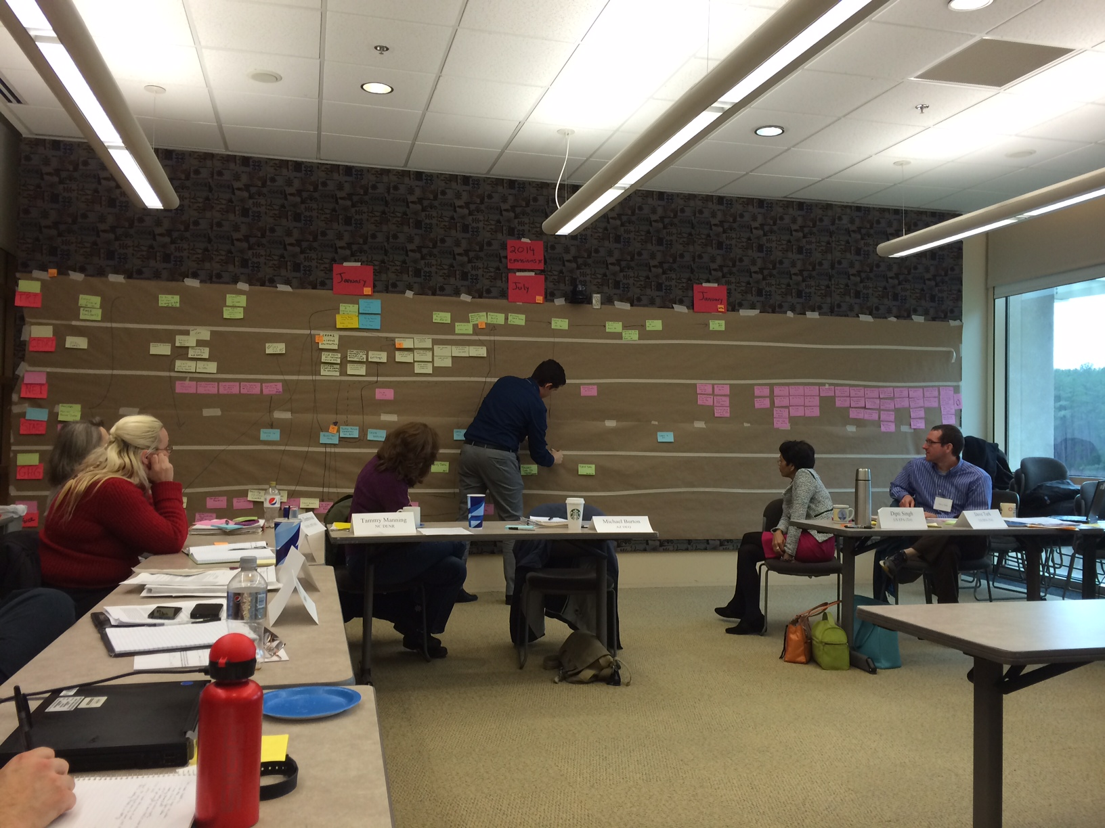
CAER Background
Current State
Notes:
The picture on the left shows the current state as maped out during the Lean Event. It is not important to be able to see each step in the process, rather, the photo is being depicted to show the universe of steps that industry, SLTs and EPA have to be involved in to meet air emissions reporting requirements mandated by law.
The future state shows an ideal state where electronic reporting allows for an approach that saves time and effort for everyone.
CAER is the program through which we are trying to move from the current, to the future state.

Slide 43
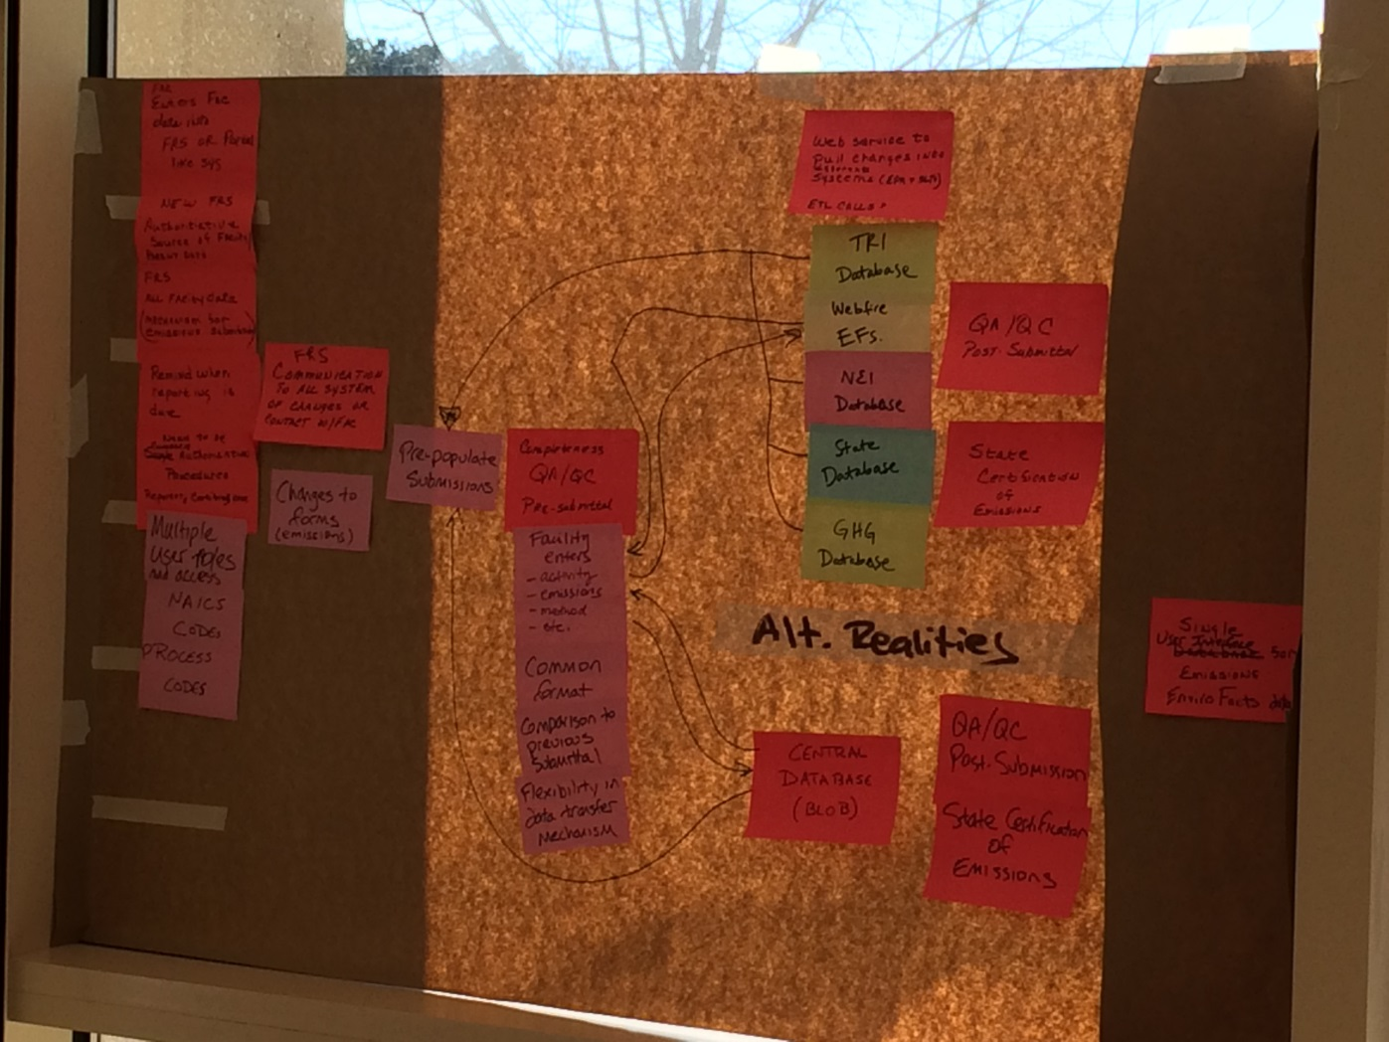
CAER Background
Future State

Slide 44
CAER Goals
CAER Lean event and subsequent events laid out goals:
  Reduce industry burden
  Improve timeliness and transparency
  Create consistent information across air emissions programs
  Improve data quality
  Improve accessibility and usability of data
  Support more timely decision-making
To do these things, both IT and business rules need to be changed
At subsequent CAER events, it was determined that a distributed, flexible, adaptable architecture is needed to meet diverse and shifting SLT and EPA program needs.

Slide 45
Four Major Federal Air Programs
Toxics Release Inventory (TRI) via TRI-MEWeb:
  21,000 facilities reporting annually
  80,000 XML files with over 250 reporting elements per file
National Emissions Inventory (NEI) via Emissions Inventory System (EIS) in 2014:
  Facilities report to their SLT first, then SLT reviews and submits to EPA
  75 SLT agencies reporting about 86,776 facilities
  1,477 point source emissions submissions & 196.27 KB is the average submission size
  1,600 facility data changes & 86.27 KB is average size per submission

Slide 46
Four Major Air Programs
Greenhouse Gas Reporting Program (GHGRP) via Electronic Greenhouse gas Reporting Tool (E-GGRT), annually:
  8,000 facilities and about
  1.5 GB for all reports per year (about 150-200 KB per report)
Risk & Technology Review (RTR) and other stack test results via Electronic Reporting Tool (ERT) to Compliance and Emissions Data Reporting Interface (CEDRI) for review:
  5,900 facilities and 31,000 submissions since 2014, and counting as rules change (10,000 reports this year alone, 8,000 in 2017).
  43,220 records (size: average 4,062 KB, minimum 1 KB, maximum 589,284 KB)
  CEDRI uses the most storage and bandwidth out of all the OAQPS systems.

Slide 47
Post Lean Event Short Term Wins
In 2016, five projects were aimed at improvements that could be made in a short time frame and would start rendering benefits immediately, without requiring the existence of the CF to become effective:
CAER Implementation plan – the formulation of a path forward to get from the current state to the future state.
WebFIRE search improvements and consolidated expert of industry test data – an initiative to enhance and streamline searches of test data from WebFIRE so that inventory developers can quickly and systematically update and QA data fields.
Identify and eliminate root causes of EPA augmentation for the NEI – an initiative to identify the reasons for the mismatch between inventory data submitted by state, local and tribal (SLT) authorities, and data required by EPA for the NEI. The goal was to reduce the need for EPA staff time (6-12 months) devoted to data augmentation after inventory data submissions.
Web-based Services for Source Classification Codes (SCC) - work that resulted in an SCC search tool and the availability of the “master” SCC table to be available to everyone via web-services. The goal was to provide access to the most updated list of SCCs in a central location, thus eliminating time and effort to find the correct list of SCCs. See: epa.gov/scc
Data dictionary and harmonization of codes tables – an effort to identify differences in similar types of codes needed by different programs and creating crosswalks. The goal was to harmonize codes tables across multiple programs where the same types of codes are needed.

Slide 48
Product Design Research and Development Teams
Were established as part of the E-Enterprise governance of CAER and include staff from EPA and SLTs:
Phase I (January-October 2017)
  QA & QC
  GHG Mapping Study
  NEI/TRI/SLT Sharing
  Emissions Data Model
  Emission Factors Scoping Study
Phase II (January-October 2018)
  GHG Mapping Study (continued)
  NEI/TRI/SLT Sharing (continued)
  Emissions Data Model (continued)
  Confidential Business Information
  State Emission Factors Compendium

Slide 49
TRI/NEI/SLT
Better defined overlap between TRI and NEI – in terms of numbers of facilities in both programs and quantity of emissions of overlapping pollutants for these facilities overlapping facilities
Quantified emissions differences for overlapping facilities and explored reasons through case studies
Looked at current QA procedures that involve using other program’s data for QA (TRI looks at NEI air emissions, NEI looks at TRI reported air waste streams)
Developed crosswalks for common data fields: chemicals (Phase 1), basis of estimate codes and waste treatment codes (Phase 2)
Made recommendations for common form interface and back end calculations that would be needed to support combined air emissions reporting for SLT, NEI and TRI programs

Slide 50
Quality Assurance/Quality Control
Compilation of QA/QC checks and procedures identified from review of states on the team (WY, VA, NC, SC, GA and AZ), EIS/NEI and TRI.
  Routine automated QA/QC checks from EIS, SLEIS and a few other SLT program systems. Members of the team focused on QA checks done on emissions data, but also some non-emissions data such as ranges for release point dimensions.
  Emissions data accuracy and reasonableness QA/QC checks: not broadly applied in automated/electronic manner, but rather as “engineering review” or “manual checks”.
National survey of SLTs: how checks are done by SLTs both automated (not EIS), and manual.

Slide 51
Emissions Data Model
Phase I: National survey to determine SLT required data elements, how they process emissions data, and possible interaction with the CEF
Phase II: Continues the documentation of the emissions-related data elements including the identification of state-specific data elements sufficient to allow for a broader usage by SLTs and EPA CAER programs.
  Research on data elements needed for the common form:
    Essential to pilot versus non-essential but necessary in future versions of the form for SLT and NEI
      Facility data that must be in FRS for the CF
  Emissions calculator needs that must be met by the CF

Slide 52
Emission Factors Compendium
Survey to states asking what emission factors they use and how they use them for NEI reporting which pointed to the need for a state-specific database of emission factors that could be shared.
Created business rules for compendium governance, researched venue for the compendium (Virtual Exchange Services in EPA) and recommendations of how the compendium should be used in the CEF.
Pulled together state-specific factors from MN, MI and SC to start the compendium.
Ongoing work (webservices and updates) and discussions so WebFIRE data can also be pulled into the CEF in a similar fashion.

Slide 53
Workflow Cases
Case 1: State interface and backend are retained (Common Form received data from state interface)
  (a) data goes to state first or (b) state and EPA at same time
Case 2: State interface and backend are retained (Common Form pushes data to state interface)
  (a) data goes to state first or (b) state and EPA at same time
Case 3: Common Form replaces state interface but state database is retained
  (a) data goes to state first or (b) state and EPA at same time
Case 4: State uses Common Form
  State reviews/revises data and signs off prior to use in EIS (new certification process in EIS would be needed)
Cases 1-3 assume the state uses its own system (custom) or SLEIS

Slide 54
Current CAER PDT State participants:
Names | State | Names | State
Anna Wood | AL | Tammy Manning | NC
Michael Burton | AZ | Elizabeth Elbel, Stephanie Summers | OR
Jing Wang, Deborah Basnight | GA | David McClard, Chad Wilbanks | SC
Mark Wert, Jordan Garfinkle | MA | Jill Dickey-Hull | TX
Dennis McGeen | MI | Sue Hines | VA
Chun Yi Wu, Azra Kovacevic | MN | Ben Way | WY
Elliot Bickerstaff, Deborah Boleware, Matt Carpenter | MS
As of July, 2018

Slide 55
MVP Criteria from the PDT
What is the MVP pilot? It is a “draft” Common Form reporting tool that has a minimum of functionality but works. However, it is not available for public use yet. It is in staging. We will be building this within the next year August 2019. We hope to enlist the help of one state that does not have their own electronic reporting system and a handful of facilities to create the pilot.
What is the MVP? The MVP is a minimum viable product, the first iteration of the CF that can address one workflow, per described in the table. It is in production mode. It can be used by a facility to report its emissions. We would like to aim to have the MVP done in June 2020. Its scope will still be limited to the one workflow and state, but multiple facilities may be able to use it, not just the four that were in the pilot.

Slide 59
Acronyms
CAER- Combined Air Emissions Reporting
CDX – Central Data Exchange
CEDRI – Compliance and Emissions Data Reporting Interface that supports stack test reporting
CFS – Common Form System
EF Compendium – State specific emission factors compendium that are not part of WebFIRE or AP-42
EGGR-T – Electronic Greenhouse Gas Reporting Tool that supports GHG emissions data reporting
EIS – Emissions Inventory System that supports data collection of NEI data
ERT – Electronic Reporting Tool that supports stack testing reporting
FRS – Facility Registry Service
GHGRP – Greenhouse Gas Reporting Program
MVP – Minimum Viable Product
NCC – National Computer Center at EPA
NEI – National Emissions Inventory
SLT – State, Local and Tribal authorities
TRI – Toxics Release Inventory
TRI-MEWeb – TRI emissions data collection system
WebFIRE – System that houses emission factors needed to estimate air emissions

