Slide 1
Permitting Assistance and Permitting Transformation Project Marcia Allocco – NC Department of Environmental Quality Section Chief – Environmental Assistance, DEACS

Slide 2
Environmental Assistance Coordinators
Non-regulatory liaison
Provide customized permit assistance and coordination
Tailored permit lists
Timeline development
Application tracking
Coordinate express, scoping and compliance assistance meetings
Identify opportunities to leverage NC tax certification program
Serve as DEQ Prosperity Zone Liaison

Slide 3
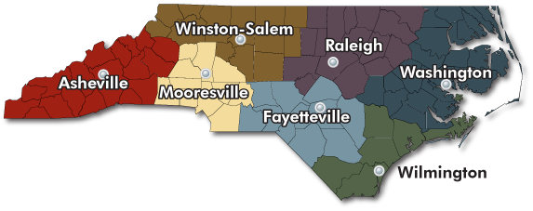
Permitting Assistance – Regional Coordinators
Asheville & Mooresville
Alison Davidson – (828) 296-4698
alison.davidson@ncdenr.gov
Raleigh, Fayetteville & Winston-Salem
David Lee – (919) 791-4204
david.lee@ncdenr.gov
Washington Region
Lyn Hardison – (252) 948-3842
lyn.hardison@ncdenr.gov
Wilmington Region
Cameron Weaver – (910) 796-7265
cameron.weaver@ncdenr.gov
Toll-free Hotline: 1-877-623-6748

Slide 4
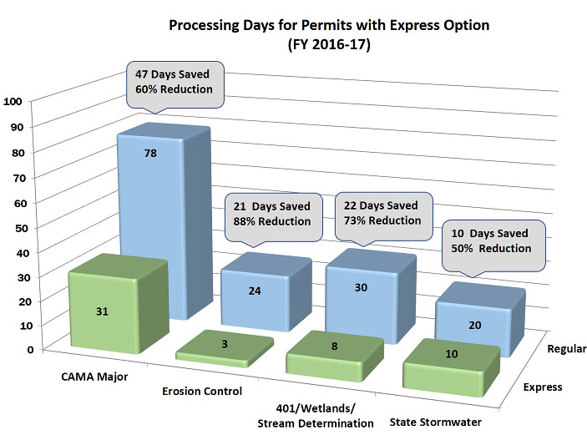
Express Permitting
More timely review of permit applications for development
Requires in-person pre-application meeting to identify necessary environmental requirements
Clients pay additional fee(s) for expedited permit review
Reduces issues with out-of-state consultants/engineers
Express program options:
Coastal Area Management Act-Major Permits (DCM)
Coastal State Stormwater Permits (DEMLR)
Erosion and Sedimentation Control Plans (DEMLR)
Wetland Certifications/Stream Determinations (DWR)

Slide 5
Multi-agency Scoping Meetings
All parties in the same room – saves clients time, money and resources
Learn how different agencies/permits interact
Agencies comment on best permit pathway – requirements vs. recommendations
Helps avoid costly missteps and surprises
Identify client next steps
Occurs in the planning phase when project proposal is defined enough to provide conceptual plans – but flexibility exists to incorporate recommendations

Slide 6
Scoping Meeting Partners
DEQ (DWR, DCM, DAQ, DWM, DMF, DMF-Shellfish Sanitation, DEMLR, Civil Rights Title VI, DMS, DWI, Energy)
NC Wildlife Resources Commission
US Army Corps of Engineers (regulatory and civil)
US Bureau of Energy Management (Offshore wind, dredging)
National Marine Fisheries (NOAA)
US Fish and Wildlife Service
US National Parks Services
US Military Affairs-Navy, US Marine Corp., Coast Guard, Air Force, Army (primary for wind facilities)
NC Dept. of Public Safety (EPCRA, Risk Mgt.)
NC Dept. Natural and Cultural Resources (Archives and History, Parks, Natural Heritage Program and Underwater Archeology)
Local Governments

Slide 7
Stakeholder Meetings
Sustainable Sandhill
Sound Rivers
Cape Fear River Watch
Blue Ridge Environmental Defense League
Appalachian Voices
Southern Environmental Law Center
Appalachian Mtn. Advocates
Clean Water for NC
NC Conservation Networks
DEQ - Environmental Justice
DEQ - SEPA Coordinator/DEACS Assistance Coordinators
DEQ - Regulatory Programs
NC DCNR - Archives and History
NC DCNR - Natural Heritage Program
NC Wildlife Resources Commission
NC Department of Public Safety - Risk Management
NCDOA - Commission of Indian Affairs (brings in other tribal groups)
For high profile projects with some controversy – this list for Atlantic Coast Pipeline

Slide 8
Getting Better Applications
DEACS – Permit Toolbox
Considerations for Development
Permit Application Pitfalls
Permit Tips and Timesavers
Scoping Meeting - What to Expect and How to Prepare?
Online form to request permitting assistance
Express Permitting
Developed Design Manuals and Submittal Checklists
Electronic submission of plans before in-person meeting
Require project owner to participate in submission meeting
Use of interactive flat-panel displays to view plans

Slide 9
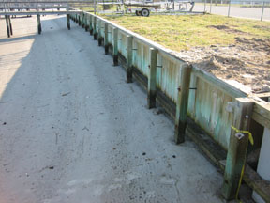
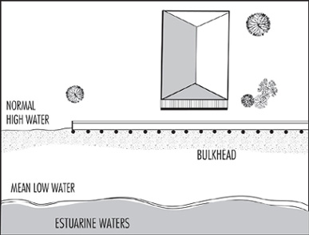
Getting Better Applications
Coastal Management – Major permit
Analysis showed ~5% of applications accepted on first try - DOT
Create glossary of terms (e.g. bulkhead vs. retaining wall)
Create dynamic e-application (permitting activity=required questions)
Make data portable for use in field (application verification)

Slide 10
Completed Permitting Improvements
Application Tracker
GIS-based tool to track application status
Search by 11 different categories
Identifies reviewer and their contact info
Information active for 30 days past decision
Some data not updated on a real-time basis
Wetland/Stream Impacts
Joint effort of state and federal 401/404 programs
Preconstruction Notification e-form (dynamically displayed fields)
Accepts applications, requests payment, notifies the applicant of reviewer/contact info and when the review is complete
Notifies other agencies (email) of new applications for comment and provides link to submit comments
Covers 137 different types of applications

Slide 11
Completed Permitting Improvements
Stormwater a leader in GIS map usage – NCDEQ 2018 ESRI SAG award winner
Stormwater – Laserfiche (LF)
Use LF to get supporting info for State Stormwater/NPDES applications
Process Name/Ownership and Owner Affiliation changes - cannot be submitted without supporting documentation (minor permit mod.)
E-renewal of industrial stormwater Certificates of Coverage (COCs)
Records the permittee request
Generates the COC
Files both records into LF Repository
Request cannot be submitted if the COC was not renewed (e.g., fees are still unpaid)
In process with e-application for Construction Stormwater permit

Slide 12
DEQ Permit Transformation Project Goals
Modernization
Permitting Interface
Permit Warehouse
Create web-based repository of permit details, compliance issues, and enforcement actions
Process Streamlining
Review processes to ensure consistent and efficient permitting process across all programs
Improve Communication & Transparency
Create web-based portal to apply, track and pay for permit applications
Develop outreach efforts to maintain an open dialogue between DEQ and its stakeholders
Permitting Backlog
Improve processes and identify efficiencies to reduce and prevent backlog in permit issuance

Slide 13
Permitting – Current Perspective
Digital/paper process
Applications for permits/renewals submitted in print and electronic format
Applications keyed into Custom IT applications
End products printed permits (mailed or electronically delivered)
Every application/application workflow is unique
Developed for the business unit’s unique needs
Unique Business Systems or Workflows
IBEAM
FIN
BIMS
Pros:
More efficient than paper only
Provides the opportunity to hold customer data, and reuse this information over time
Cons:
Requires multiple personnel to respond to each request
Manual unique workflows
Status can be monitored – only by business unit
Access DBs
Business Objects

Slide 14
Permitting – Future Vision
One system that supports data from application to issuance
Customer portal for tracking application status and permit details
Automatic notification of expirations or renewals
Integration with GIS and other applications
Automatic archiving of past permits
Create workflows for interdepartmental routing
Provide feedback to managers and executives
MS Dynamics
Customer Portal
Laserfiche
GIS
SharePoint
MS Office
Environmental Monitoring Network

Slide 15
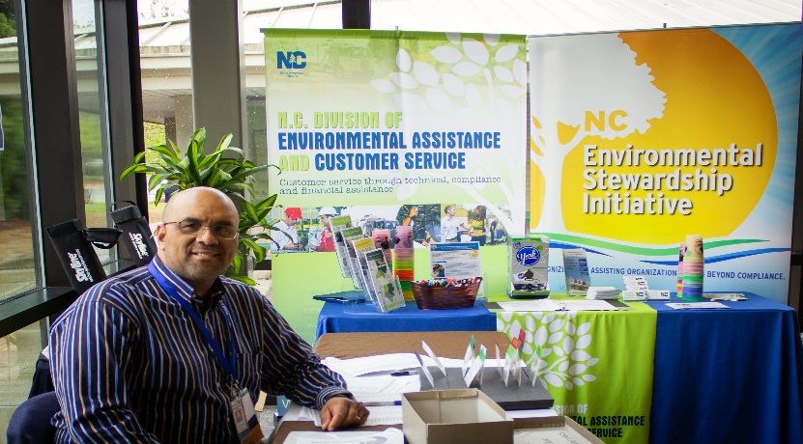
Questions?
Marcia Allocco – 919.707.8206
Marcia.allocco@ncdenr.gov
Jamie Ragan – 919.707.8141
Jamie.ragan@ncdenr.gov
Permitting Assistance & Guidance
https://deq.nc.gov/permits-rules/permit-assistance-and-guidance
Permit Directory
https://deq.nc.gov/permits-regulations/permit-directory

