Slide 1
Managing and Reviewing Draft and Proposed Clean Air Act Permits using the Electronic Permit System (EPS)
U.S. EPA Region 9, Air Division
2018 National e-Enterprise Conference October 22-24, 2018 | Addison, TX

Slide 2
WHY
Permit Submittal through Electronic Permit System:
Reduces Paper Usage
Eases Document Management
Reduces Cost
Region 9Air Permits Office/OAQPS/OEI/CGI Contractor:
Receive Documents from State/Local/Tribal Permitting Authorities through EPS
Easily Upload/Submit Permit Related Documents Electronically
Track Permit Status
Receives Permit Status Notifications
WHAT
HOW
Region 9Air Permits Office/OAQPS/OEI/CGI Contractor:
Register on CDX Websites
Access the System
Upload/Submit Documents
Receive Notifications/Status Updates
Notes:
We will discuss: the ‘Why’, including the Next Generation component of the project and the agency’s need to reduce paper usage, ease document management and reduce cost for both the Agency and the industry or source by including the requirement in a air permit.
We will discuss the ‘What’ of the project: the new tools that the Agency offers to facilitate e-reporting.
We will discuss the ‘Who’, mainly, which facility we chose to include e-reporting in their air permit.
And lastly, we will discuss the ‘How’, which includes a description of the specific tools we used, how we applied it to the permit requirements, and the expected results.

Slide 3
Outline
Background on Clean Air Act (CAA) Permits
Clean Air Act Requirements
Construction and Operating permits
Current Tools and Practices
Electronic Permit System
Background
Scope
Current Status and Future Enhancements

Slide 4
Electronic Permit System Team
Name | Affiliation
Nathan Wilkes | Office of Environmental Information
Dylan Mataway-Novak | Office of Air Quality Planning and Standards
Jessica Montanez | Office of Air Quality Planning and Standards
Eugene Chen | Region 9, Air Division
Bamikole Ogundele | Region 9, Air Division
Sheila Tsai | Region 9, Air Division
Jacob Kora | CGI Federal
Greg Slusher | CGI Federal
Tom Wible | CGI Federal

Slide 5
Clean Air Act Requirements
New Source Performance Standards (NSPS)
Maximum Achievable Control Technology (MACT) standards
New Source Review (NSR) Requirements
Reasonably Available Control Technology (RACT)
Acid Rain Program
Compliance Assurance Monitoring (CAM)…. and more
… How does someone (an owner/operator, regulator, public citizen) know what requirements apply to a facility?

Slide 6
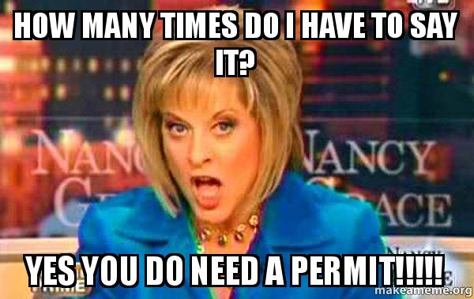
Clean Air Act Major Source Permitting
Under the CAA, states have primary authority for implementing regulations
Construction Permits (NSR/PSD, Nonattainment NSR)
Ensure proposed construction complies with regulations
Require public notice
Operating Permits (Title V)
Contain all applicable requirements for a facility in a single permit
Require public notice
Require 45-day period with opportunity for EPA to object to permit issuance

Slide 7
EPA Review of Title V Permits
Logistics of title V permit transmittal vary by Regional Office
Region 9 developed a Lotus Notes based system (1996) to allow electronic transmittal and storage of title V permits
EPS developed to replace and expand this capability
Web-based (as opposed to desktop-based)
Mosaic platform
Central Data Exchange (CDX) portal

Slide 8
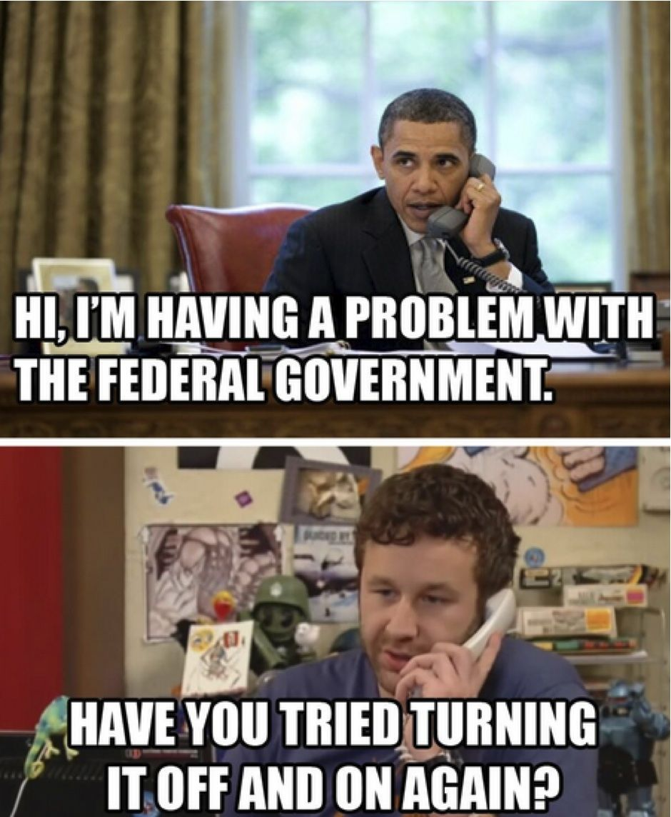
Why Mosaic?
Key needs for new system
Receive emails/documents external to the agency
Publish information to a public website
Document storage
Moderate workflow management
Available solutions
Sharepoint (Access web app)
Oracle
Salesforce
Mosaic (SPeCS for SIPs)

Slide 9
Mosaic Modules

Slide 10
EPS Overview
Public Dashboard
- Used by the Public, Permitting Authorities, and EPA
- To Be Developed
Clearinghouse
- Used by EPA
- Allows for review by all EPA Regions
- Tracks permit submissions and compliance with EPS requirements
- Stores documents submitted by permitting authorities and EPA review files electronically
Permit Collection Interface
- Used by Permitting Authorities
- Allows users to submit permits
- Provides list of all past and pending submissions through state landing page

Slide 11
Roles
Preparer
EPA Viewer
Regional Reviewer
HQ Reviewer
Regional Admin

Slide 12
Requirements To Access EPS
Computer
Internet Access
Registration through EPA Websites

Slide 13
Electronic Permit System (EPS)
Phase 1
Phase 1
Register through CDX Platform on EPA Website
Upload Document Electronically
Receive Email Status Notification
Track Status of Submission Online
Phase 1.5
Phase 1.5
Enhanced Phase 1 to include functionality update previously submitted files
Phase 2
Phase 2
Extend initial phase functionality to include operating as a national permits database

Slide 14
Dashboards
Qlik Sense - will be used for the public dashboard to display:
Permit status
EPA’s 45-day review period
60-day public petition period
Link to proposed permit

Slide 15
Current Status
Beta testing (February and August 2018)
Staff from all EPA regions
Multiple permitting authorities from Region 9
Initial production release October 26
Available for use in November
Additional collaboration with state, local, and tribal permitting programs through ECOS, NACAA, and AAPCA
Additional production updates expected in late November and December

Slide 16
Additional and Potential Enhancements
Public Website
Title V Petitions
EPA-Issued Permits
Facilitates Search for Permit Control Technology Information

Slide 17
Demo
https://test.epacdx.net/

