Slide 1
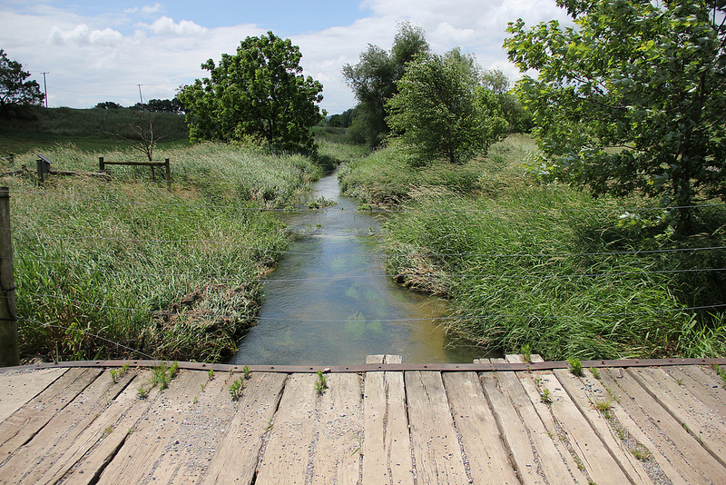
WQX Web REST API Dave Wilcox – Gold Systems Inc. DWilcox@GoldSystems.com Tim Paris – Chesapeake Bay Program (Contributor)
Notes:
Introduce myself as well as explain Gold System’s role as the developers behind WQX Web and the Rest API

Slide 2
Case Study -ChesApeake Bay PROGRAM
Program Overview
Geography
Contributing Partners
Collaborative Effort to develop Web Services
Notes:
A regional program to monitor and restore the Chesapeake Bay watershed. The watershed spans 6 states and the District of Columbia, covering 64,000 square miles
Approximately 50 water quality monitoring organizations submit data to the Program, which also is submitted to WQX

Slide 3
Chesapeake Bay Program Data Management
Data Provided by Contributors in MS Access
Data is imported into CBPO’s DUET data system
QA is performed in DUET
Data is loaded into the CEDR Data Repository and can be accessed via the DataHub interface
Notes:
Water quality data from contributing organizations is formatted in MS Access following a CBPO supplied format.
The formatted data is imported into CBPO’s data system, DUET, where QA is performed and the data is accepted for import.
Data is then loaded into the CEDR Data Repository and can be accessed via the DataHub interface.

Slide 4
Using WQX Web for Submissions
Prior to the Web Services, EPA staff loaded the CPBO data to WQX
Data was extracted from the CPBO DataHub in CSV format
WQX Web was used to load the files into WQX
Notes:
Prior to 2016 EPA Staff used the CBPO DataHub to download water quality data for the Chesapeake Bay Watershed and then manually formatted it and submitted it to WQX using WQX Web.
No Exchange Network Node was needed
CEDN did not need to be able to produce a WQX formatted XML file

Slide 5
Why Develop the WQX WEB SERVICES?
Eliminate the need for EPA to download and process the files from CEDR
Leverage the import configuration definitions and other meta data established in WQX Web
Streamline the submission of data to WQX and reduce the workload for staff and team members
Programs can fully automate submissions to run as a nightly process
Notes:
WQX Web Services eliminate the need for EPA to download and process the files from CEDR.
The Services leverage the import configuration definitions and other meta data established in WQX Web.
Organizations like Chesapeake Bay Program can streamline the submission of data to WQX and reduce the workload for both their staff and their team members.
Programs can fully automate the process to run as a nightly process.

Slide 6
Summary of CBPO data flow

Slide 7
What can you do with web services?
Upload
Upload Attachment
StartImport
StartXmlExport
SubmitDatasetToCdx
GetStatus
GetDocumentList
Notes:
Upload
Upload a data file to the web server
Upload Attachment
Upload an image or other file to the web server
StartImport
Start importing that file and get back a Dataset ID (for use with other web services)
StartXmlExport
Start building the WQX XML submission file for a dataset
SubmitDatasetToCdx
Submit a dataset to CDX
GetStatus
Get the status for a dataset
GetDocumentList
Get the list of available documents for a dataset

Slide 8
Some Technical Details
Each web service has a specific purpose and related parameters
You must be a registered WQX Web user
A WQX Web configuration definition is required
Data loaded through the web services is viewable via WQX Web
New services are being continually added
The latest web service documentation is available on the WQX Web help page
Notes:
Each Web Service has a specific purpose and requires a different set of parameters when utilized.
Only registered WQX Web users may utilized the Web Services
A WQX Web configuration definition must be present for files loaded with the Web Services
Data loaded through the Web Services is viewable via WQX Web
New services are being continually added
The latest Web Service documentation is always available on the WQX Web help page

Slide 9
WQX Web
Web interface used to manually load and submit WQX data
Provides import configuration templates
WQX Web Access
https://www.epa.gov/waterdata/wqx-web-account-registration
Notes:
Access WQX Web through the CDX Portal
WQX Web is the web interface used to manually load and submit WQX data. It also provides the configuration templates used when loading data via the web services, as well as other setup and configuration settings for an organization.

Slide 10
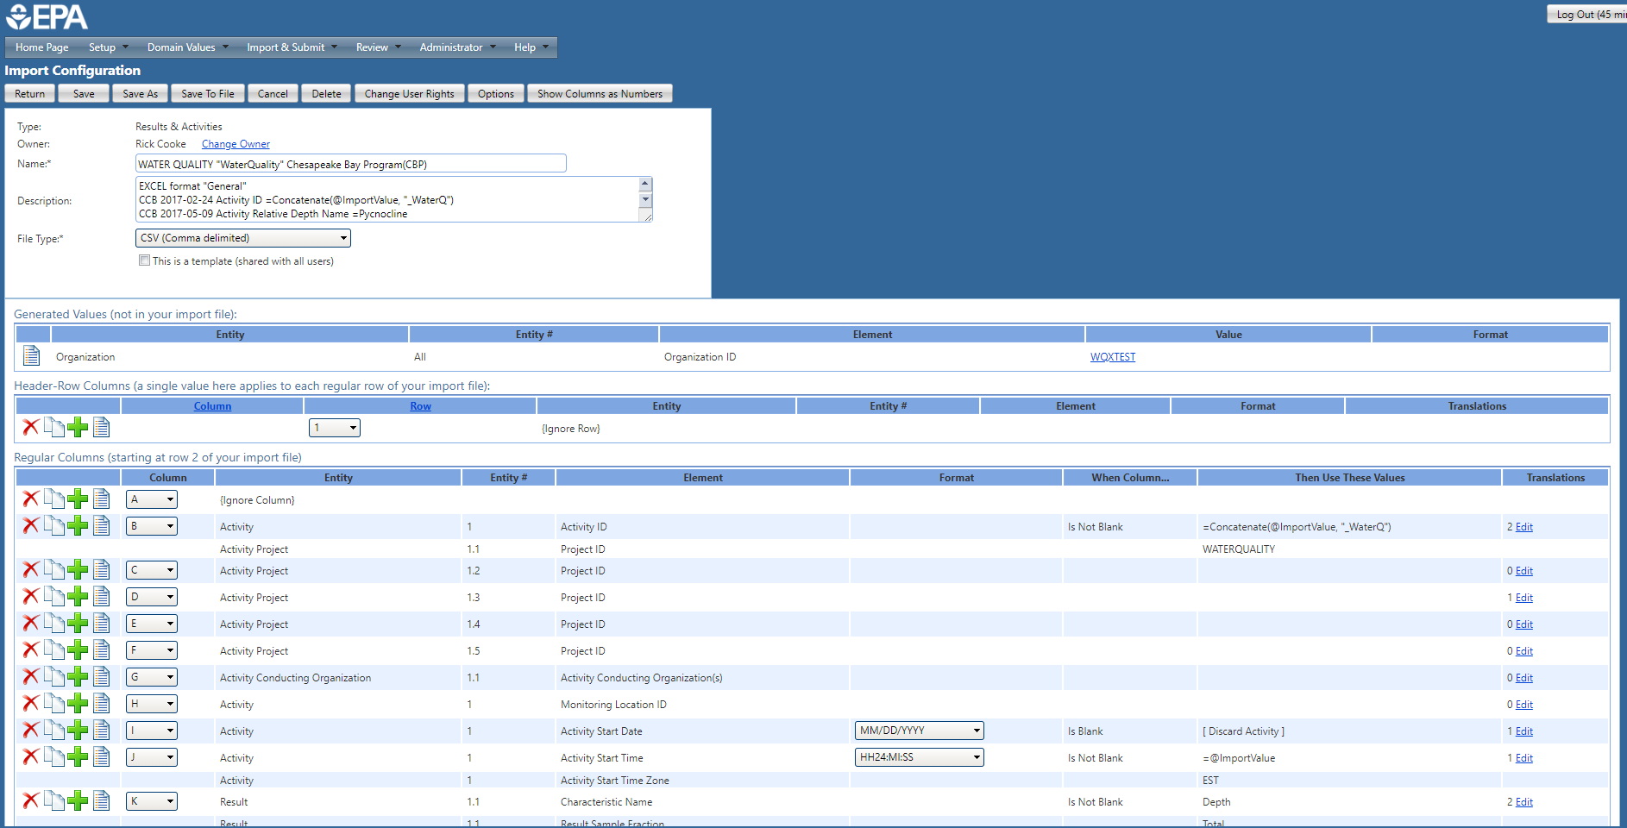
Configuration setup in WQX Web
WQX Web Import Configurations
Column Mappings
Translations
Default Values
Format Masks
Notes:
Mention Column Mappings, Translations, Defaults
WQX Web provides a way to specify the file layout and configuration for data files that will be submitted, either through WQX Web or the Web Services.

Slide 11
Upload Upload a file to the web server
Allowed file extensions:
txt
csv
xlsx
xls
xml
zip
Returns:
fileId

Slide 12
StartImport Start importing a file and get back a dataset ID (for use with other web services)
Parameters:
importConfigurationId
fileId
fileType (e.g. CSV, TAB, TILDE, PIPE, XLS, XLSX)
worksheetsToImport
(comma delimited list of values, e.g. "1,3“)
ignoreFirstRowOfFile:
true/false
(this parameter value will be ignored for Expert-Mode Import Configurations)

Slide 13
StartImport (continued)
newOrExistingData
0: file may contain new and/or existing data
1: file contains new data only
2: file contains existing data only (to be replaced)
uponCompletion
0: do nothing
1: start export
2: start export and submit to CDX
uponCompletionCondition
0: not applicable
1: start export only if no import errors
2: start export only if no import errors and no warnings
3: start export even when there are import errors
Returns:
datasetId

Slide 14
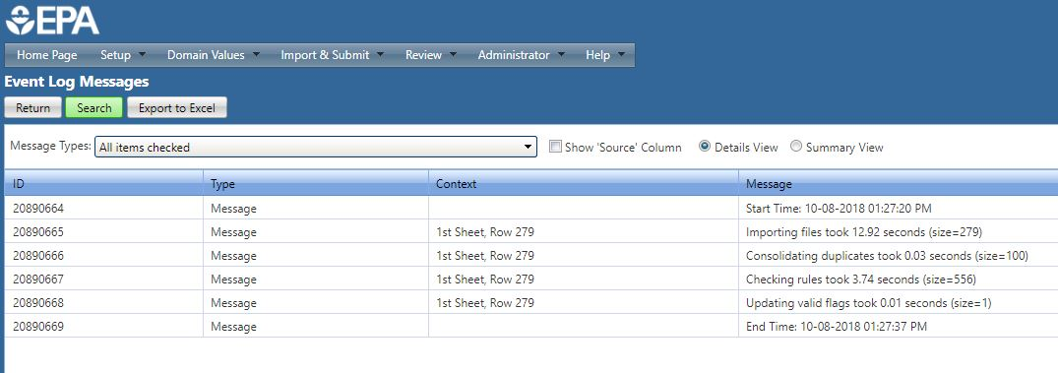
Checking the log in WQX WEB
Notes:
After data is submitted to WQX the status can be checked through the Web Services, or by reviewing the logs in WQX Web.
You can also make any needed data corrections prior to export if desired.

Slide 15
StartXmlExport Start building the WQX XML submission file for a dataset
Parameters:
datasetId
uponCompletion
0: do nothing
1: submit to CDX
Returns:
the initial status for the dataset

Slide 16
SubmitDatasetToCdx Submit a dataset to CDX
Parameters:
datasetId
Returns:
the initial status for the dataset

Slide 17
SubmitFileToCdx Submit an uploaded (WQX XML) file to CDX and get back a dataset ID (for use with other web services)
Parameters:
fileId
Returns:
datasetId

Slide 18
GetStatus Get the status for a dataset
Parameters:
datasetId
Returns:
StatusName
Waiting to Import, Importing, Imported, Import Failed
Waiting to Export, Exporting, Exported, Export Failed
Processing at CDX, Completed at CDX, Failed at CDX
Waiting to Delete, Deleting, Delete Failed
StatusUid
Numeric ID for the statuses above
PercentComplete
QueuePosition

Slide 19
GetDocumentList Get the list of available documents for a dataset
Parameters:
datasetId
Returns:
list of document URLs, which can be used to download the documents
For example:
the original import file
event logs (for the import and/or export in WQX Web)
validation report (for the XML submission file - from CDX)
processing report (for the XML submission file - from WQX)

Slide 20
Identity & Security
Each web service call must include a header with the following items:
X-UserID
The caller's "User ID" to determine rights to private data
X-Stamp
Timestamp when the call was made (in UTC)
Format is mm/dd/yyyy hh:mi:ss AM
X-Signature
The following pieces of information (concatenated together as a single string):
User ID
Timestamp
URI
Request Method (e.g. POST, GET, …)
Signature must be encrypted with the user’s private key, using the HMAC-SHA256 encryption algorithm, and placed in the header element

Slide 21
Summary
WQX Web Services provide a relatively simple way to automate the loading of data into WQX from an organization’s data management system
Organizations do not need an Exchange Network Node
Organizations do not need to produce WQX XML files
Leverages the powerful features of WQX Web without the human processing component

