Slide 1
Asbestos Notification Process
Observations on the AS-IS or Current State

Slide 2
What We Found - Common Themes
Every system is complex and tailored to each organization’s needs.
The Regulated Community must navigate many different requirements for local, state and federal for one location. Much duplication, confusing and changing requirements.
Paper is still a problem.
CROMERR certification/ digital signature is legally necessary but not always affordable for small entities.

Slide 3
Summary Table of Key Issues
Entity | ANFs Annually | Recurring Contractors/Universe | Acknowledgement of Receipt to Contractor | Fees (e.g. permit fees) | Signature (CROMERR/digital signature, "wet" copy, scanned signature)
West Virginia | 1,500 | ~30/100s | No | No-collected by WVDHHR | "wet" signature required
Delaware | 250 | 6/30 | Yes | No | electronic notification via portal accepted along with "wet" signature on hardcopy
District of Columbia | 400 | 30/30 | Yes | Yes | digital signature accepted with electronic account set up
Allegheny County | 1,200 | 25/70 + some GCs | Yes | Yes | "wet" signature requested, email accepted
Philadelphia County | 1,500 | 500 | Yes, can verify submission via electronic system | Yes | electronic notification via portal accepted along with "wet" signature on hardcopy
Pennsylvania | 7,000 | 2200 | No | No* | "wet" signature required
Maryland | 3,000 | 125 | No, Contractor notified of permit only by Local permitting agency (e.g. Balt city) | Yes- local entity can issue permit | "wet" signature required
Virginia | 1,300 | 30 |  | Yes | "wet" signature requested, email accepted
 |  |  |  | *fees probably in future

Slide 4
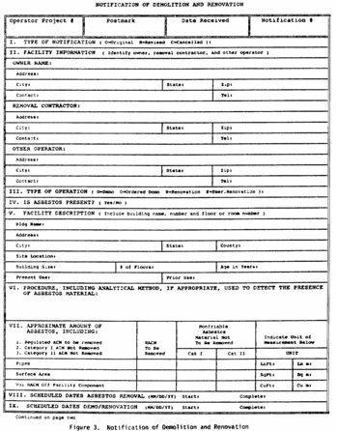
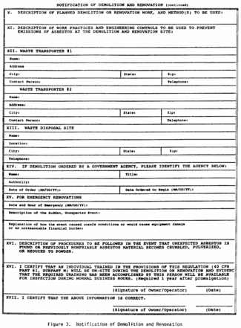
EPA 40 CFR 61.145, Part M – Standard for demolition and renovation. The information required in paragraph (b)(4) of this section must be reported using a form similar to that shown in Figure 3.

Slide 5
LEAN- Value Added Analysis
Value Added Analysis is a technique for improving a process by evaluating each process step to assess its importance to a customer.
Process steps are sorted into three categories:
  Value Added (VA)
  Non-Value Added (NVA)
  Non-Value Added Necessary (NVAN)
Value Added
Non-Value Added
Non-Value Added Necessary
Source: https://goleansixsigma.com/value-added-analysis
Notes:
 NOTES:
Given the resource constraints that many organizations face, we have to think about how we use our time. Let’s take a look at the concepts “value added versus non-value added” from a customer perspective. As a consumer of a good or service, what would you be willing to pay for?
“To provide any product or service, you have to use resources like money, materials, labor, time, and information. The goal is to provide the greatest amount of value to customers while utilizing the least amount of your resources. This idea of adding value to products and services is a key concept of Lean. It is defined as anything for which the customer would be willing to pay. If what you are providing is not something the customer would be willing to pay you for, then you are not providing value to the customer.
Any time you begin analyzing a process, you want to look at each step and determine if it is contributing to the value of the desired output. Each step can be classified into one of three categories:”

Slide 6
Value Added
Value Added (VA)
  Task or action a customer is willing to pay for (or cares about)
  Value added actions transform materials and information into products and services, towards completion (something changes, e.g. form, fit, function)
  The action is done right the first time (no rework required)
  Example
      Approve and issue a final permit to an
      applicant
      Fund a task order for an
      Emergency Response Spill Removal Activity
  Goal – Keep VA steps
Value Added
Notes:
 NOTES:
To be considered Value Adding (VA), the step must meet all of the three of the following criteria:
The step transforms the item toward completion (something changes)
The step is done right the first time (not a rework step)
The customer cares (or would pay) for the step to be done
“Value added steps in a process are those in which you add something to a product or service for which the customer would be willing to pay. These activities are where you gain the most from expending your resources when providing a product or service. ”

Slide 7
Non-Value Added Necessary
Non-Value Added Necessary (NVAN)
  These steps are necessary, although the step may not add value from the customer’s perspective
  They could be necessary because of laws, regulations or other requirements for a business to function effectively
  Example
      Research Federal Acquisition Regulations
      (FAR) clauses that need to be included in a
      contract
  Goal – Reduce NVAN steps
Non-Value Added Necessary
Notes:
 NOTES:
Non-valued added but necessary is another category to consider when evaluating steps in a process. A step may be viewed as necessary because of laws, regulations, or other requirements for a business to function effectively. However, a necessary step may be “non-value added” from a customer perspective.
“Non-Value Added But Necessary Steps
Just because a process step is not value-added does not mean it is a bad thing. Processes all include steps that do not add value, but are necessary to make the product or service happen. It has been my experience that the majority of activities in service processes fall into this category. They do use resources, so you want to reduce the amount of non-value added work whenever possible. Often, this type of activity fulfills some sort of administrative purpose such as enabling value added steps, maintaining organizational records, or meeting legal or regulatory requirements.”

Slide 8
Non-Value Added
Non-Value Added (NVA)
  Consumes resources without creating value
  Requires more time, effort, or resources than necessary
  Can be removed to focus on VA steps
  Example
    Conducting a quality assurance inspection of a final product
    Require a second approval on a travel voucher
  Goal – Eliminate NVA steps
Non-Value Added
Notes:
 NOTES:
Non-value added steps consume time but do not add value from the customer’s perspective. In short, non-value-added steps contribute to waste in a process.
Non-Value Adding Activities add to the cost of doing business. Typical Non-Value Adding activities include rework, inspection, movement and any of the 8 Wastes. We will examine common types of waste shortly.
“Non-Value Added Steps (Waste)
The third category that process steps can fall into is pure waste. In these steps resources are expended, delays occur, and no value is added to the product or service. Customers are absolutely not willing to pay for these activities. These steps should be eliminated from the process. The Sun Card process does not contain any pure waste steps.
Lean identifies seven or eight types of waste, depending on whom you talk to. I am one of those who identify eight types of waste. These are:”
Source: https://service.asu.edu/blog/value-added-and-non-value-added-process-steps

Slide 9
MICRO LEAN Exercise (5 min)
Use dots to apply to process boards posted around the room (5 min)
    Value Added
            Non-Value Added Necessary
    Non Value Added
Feel free to add your comments during the day

Slide 10
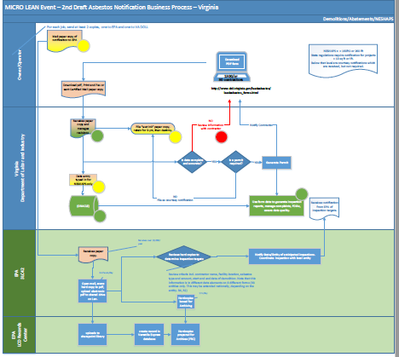
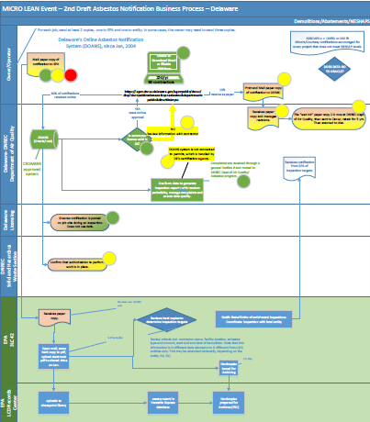
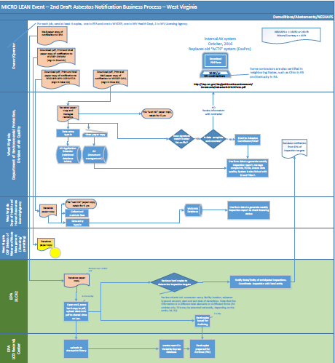
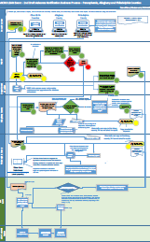
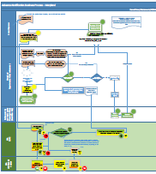
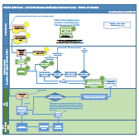

Slide 11
Towards Full Integration
Connect fillable pdf to database
Ensure Legal Signature requirements are met
Fully integrated online

Slide 12
Where We Are Now…
Planning
Maryland
Implementation
DC (January 30)
West Virginia (Jan-June)
Pennsylvania DEP (March)
Completion
Delaware
PA – Philadelphia
PA - Allegheny
Testing
Virginia

