Slide 1
Using a Shared Governance to
Streamline State and Tribal
Quality Assurance Project Plans
Prepared for EE2018
October 2018
Notes:
Rebecca

Slide 2
Background
Tribes and states submit Quality Assurance Project Plans (QAPPs) when using grant funds to support data collection.
QAPP requirements are specified in EPA’s regulations for extramural agreements.
EPA’s ten regional offices deploy different processes and procedures when working with tribes and states to develop a QAPP through the approval.
Tribes and states may experience delays, inconsistencies and variation in EPA’s reviews and approval of QAPPs.
Tribes and states spend extensive resources, including time and portions of the grant to facilitate the development of a QAPP.
Notes:
VINI – 5 minutes

Slide 3
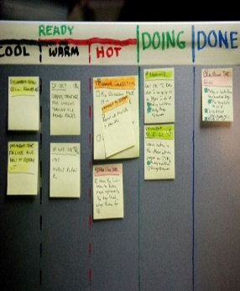
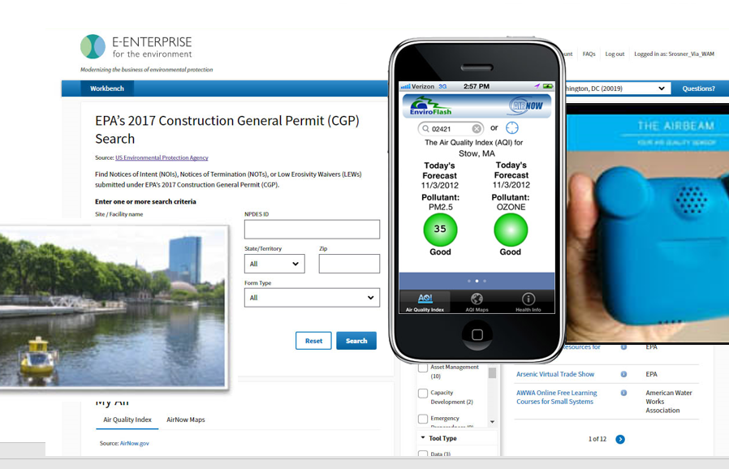
Using the E-Enterprise Framework
Shared Governance
Early & Meaningful Engagement
Working Collaboratively
Shared Priorities and Solutions
Streamlining Process
Optimizing Technology
Lean Culture
Simplicity, Certainty and Consistency
Burden Reduction
Automation and Online Services
Sensor Monitoring Technology
Shared Services
Notes:
JESSICA – 5 minutes
E-Enterprise Leadership Council (EELC) approved using the E-Enterprise framework to address issues related to processing Quality Assurance Project Plans prepared by tribes and states (Sept 2017).
A state, tribal, EPA workgroup has been developing and refining the project scope (Fall-Winter 2018).
Tribes and states shared input and anecdotal information with EPA, identifying challenges and suggestions for improvement. EPA collected process-related data from the regions. (Fall-Winter 2018).
Through this input, EPA, tribes and states developed a draft Action Plan, outlining a phased approach with the goal to improve the timely development, review, and approval of QAPPs to support state and tribal partners’ collection and use of quality environmental data (Mar 2018).
EELC recommended a Lean Kaizen event related to this effort before beginning Action Plan.

Slide 4
Key Take Aways
Engage process owners from inception to implementation.
Listen and act on customer’s input
Define current state to set future state
Use SIPOC to build consensus (charter goal posts/outcomes)
Acknowledge processes are inter-related (development of a document, impacts review/approval process)
Analyze needs and priorities of the end-users (EPA, states and tribes) before integrating technology into process
Identify and prioritize needed changes to move towards desired state
Notes:
Jessica and Vini (and others in room) - 5-10 minutes

