Slide 1
Harnessing the Power of New Information and Measurement Tools – A Water Perspective
Dwane Young, US EPA Office of Water

Slide 2
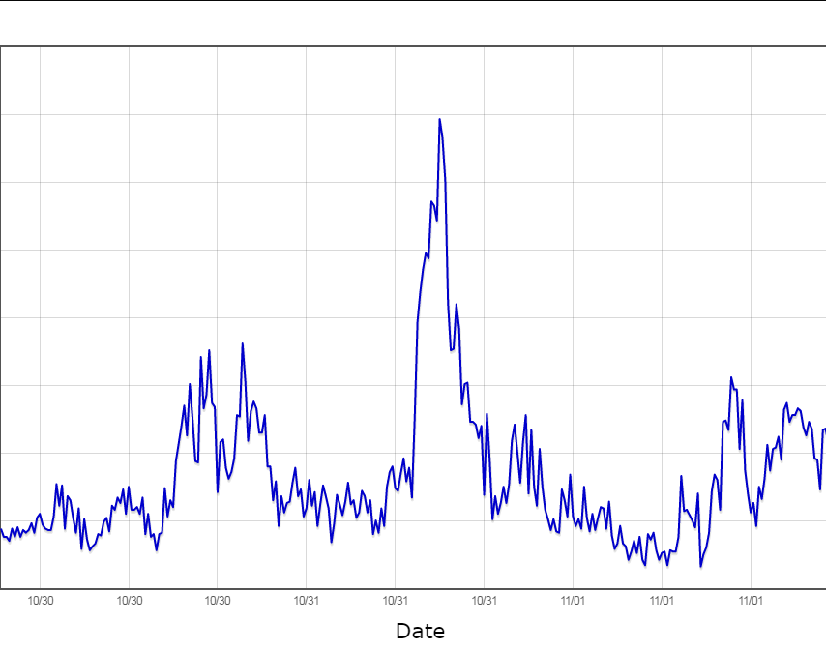
The Data Standards Problem
We needed a common way to represent and communicate the data
Standards for sensor data already exist, there was no need to create new standards
OGC Sensor Observation Service
OGC Water ML 2 and Sensor ML
The Open Geospatial Consortium is an open-source, international standards setting body
Notes:
This would be equivalent to the banking OFX standard in terms of what this accomplishes. These are also, by the way, the same standards that were used in the National Flood Interoperability Experiment

Slide 3
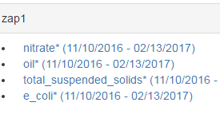
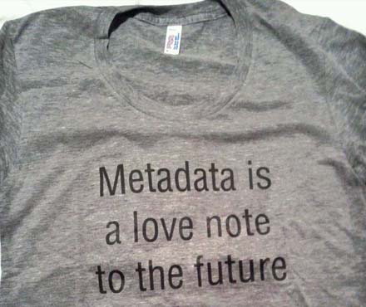
The Metadata Problem
Needed a standard way to answer the following questions:
What data are available and for what parameters?
What data can I use?
What’s the quality of the data?
We had to develop standard ways to do this (no existing standard existed)
Further work needs to be done in this area

Slide 4
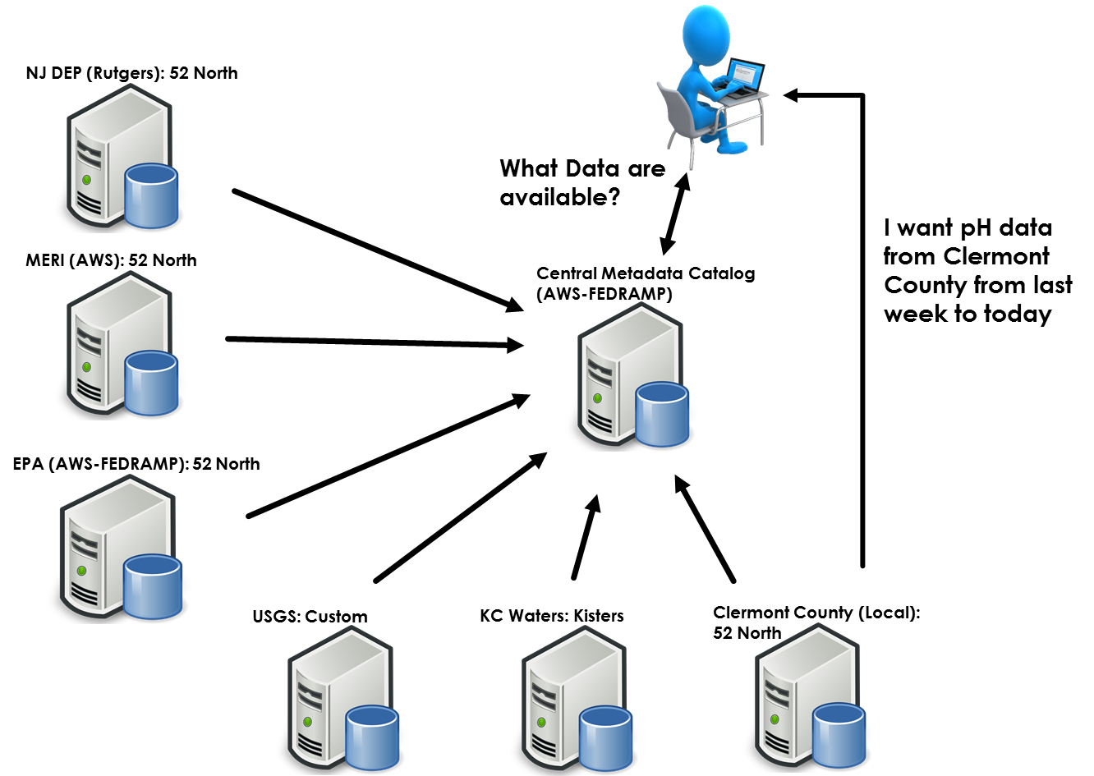
A New Approach for Sharing Data
How do you solve the problem of multiple data providers with large amounts of data that have the potential to change every 3-15 minutes?
Used a central catalog/index that references every data owner’s assets with the corresponding metadata for each sensor
Allowed for quick searching and discovery of available data
This approach is similar to how Google allows you to search the internet
Actual data comes from the partners systems in real-time

Slide 5
Improved Sensor Registration Process and QAQC implementation
Progress to date:
Three Sensors are currently flowing data to Currents:
Data Appliance complete:
Allows for optional QAQC implementation
Tests for values outside of range and removes values outside of range while also keeping the raw data
Future Tasks:
Deploy to OEI Amazon Cloud
Data ingestion software complete and ready for deployment
QAQC implementation:
-Nooksack at Ferndale; Nooksack at Lynden; and Fishtrap and Lynden

Slide 6
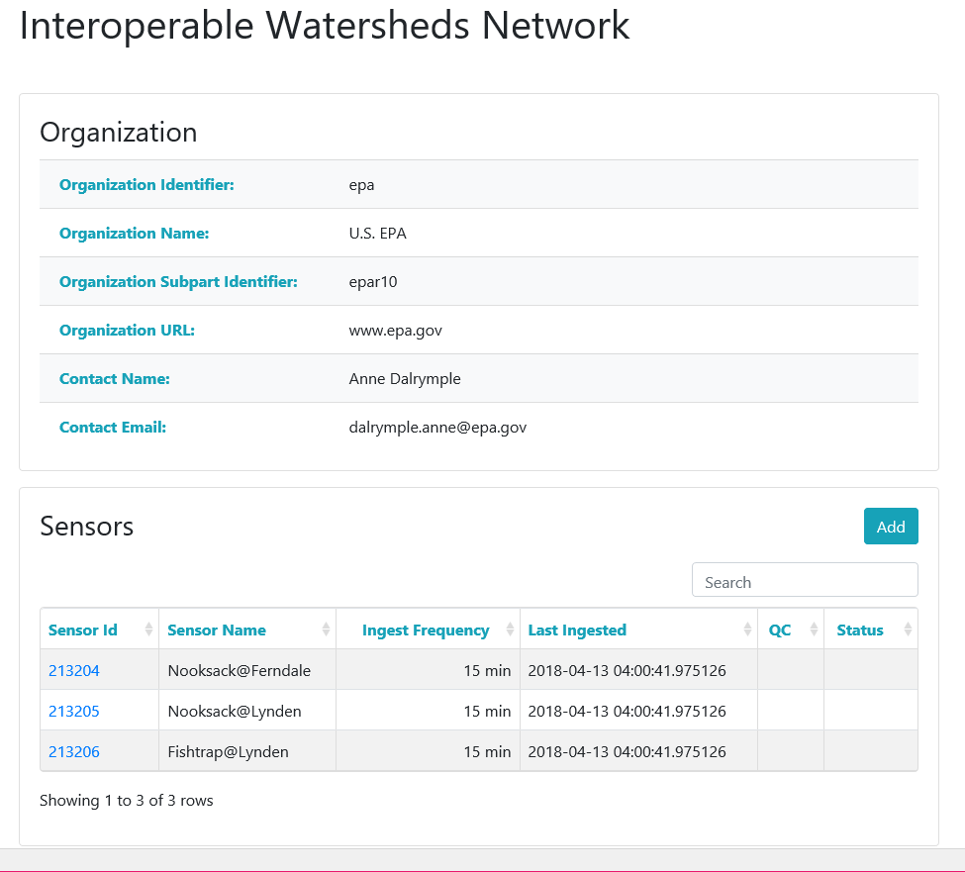

Slide 7
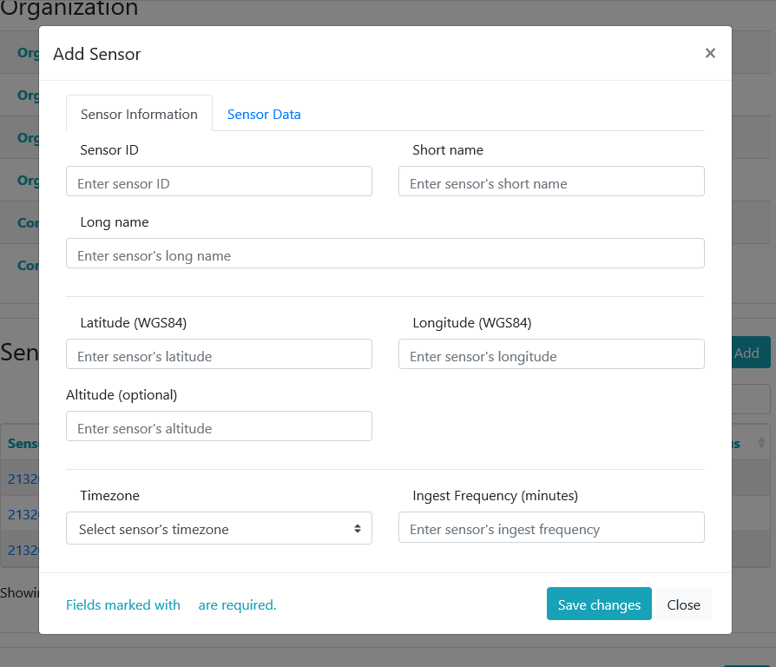

Slide 8
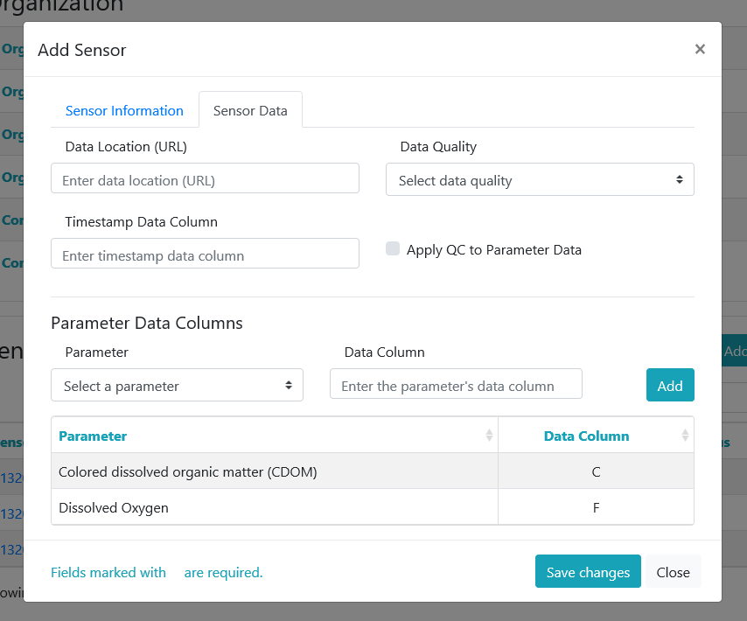

Slide 9
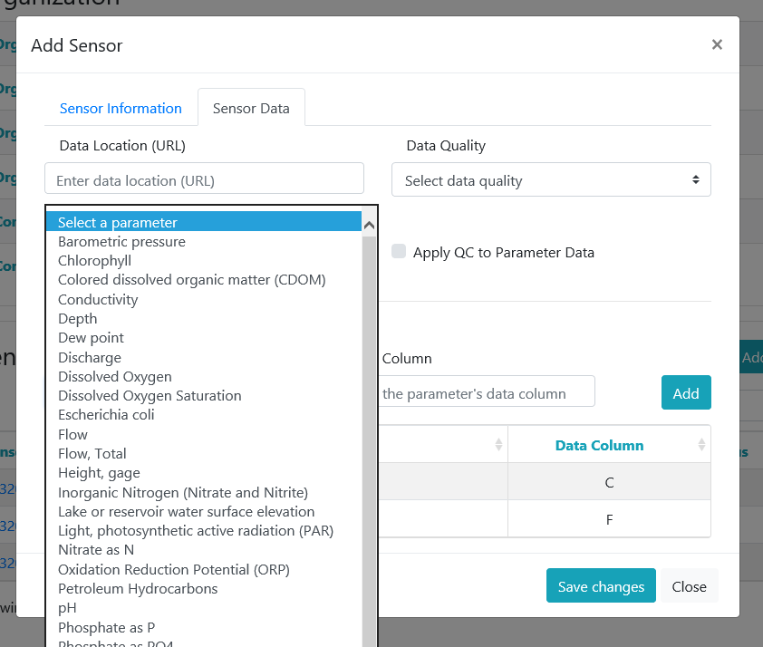

Slide 10
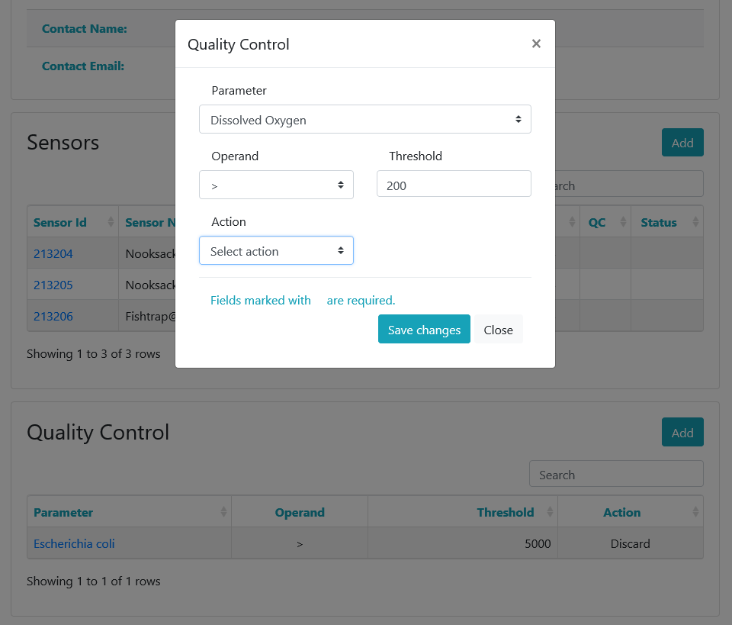

Slide 11
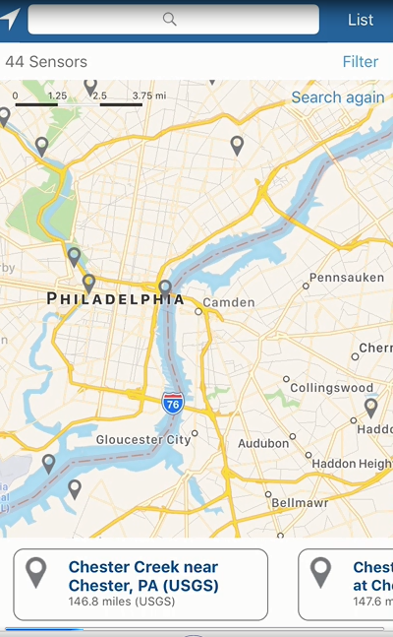
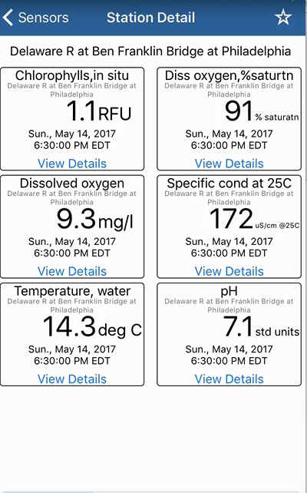
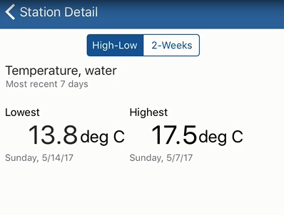
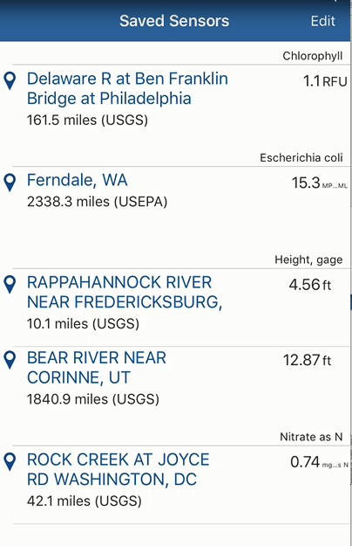
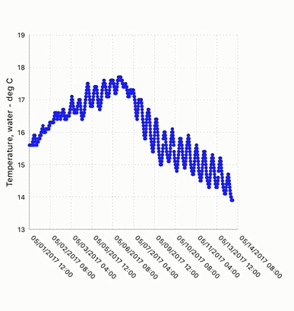
Real.m in Action
Discover Sensors
See Current Readings
Understand Trends
View Favorite Sites

