Slide 1
Harnessing the Power of New Information and Measurement Tools – An Open Discussion
October 24, 2018
Kristen Benedict
Office of Air Quality Planning & Standards
Disclaimer: Material presented is for informational purposes only. EPA does not recommend nor endorse any particular sensor product or data management platform.

Slide 2
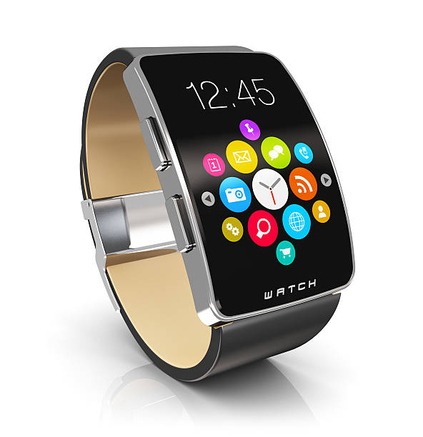

Emerging Technology

Slide 3
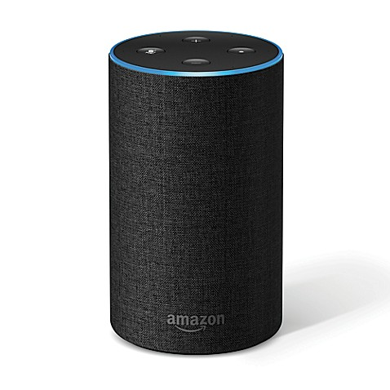
Disruptive Technology
Clayton Christensen coined the term in "The Innovator's Dilemma“^{1,2}
  Lacks refinement
  Often has performance problems because it is new
  Appeals to a limited audience and may not yet have a proven practical application
http://money.cnn.com/2018/05/10/news/companies/alexa-amazon-smart-speakers-voice-shopping/index.html

Slide 4
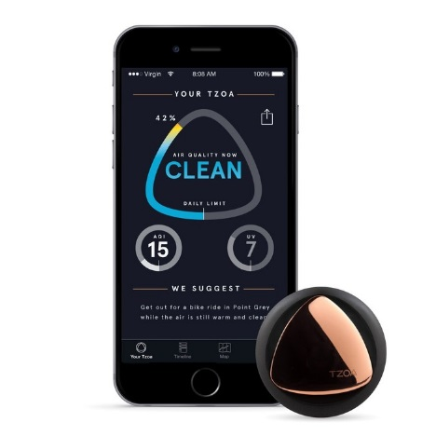
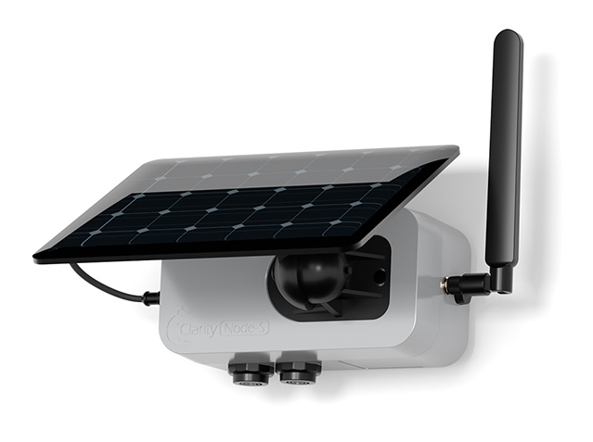
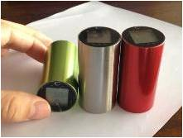

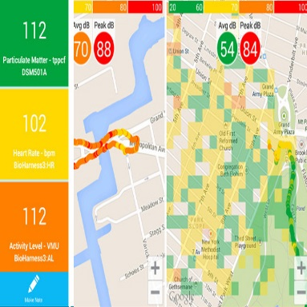
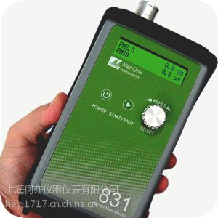
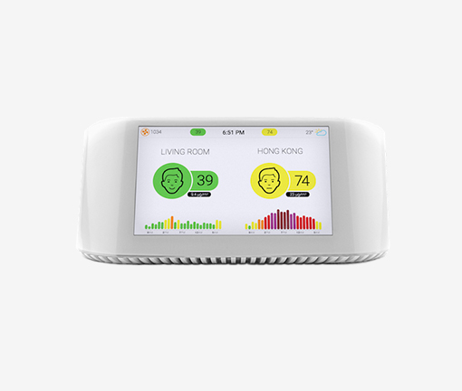
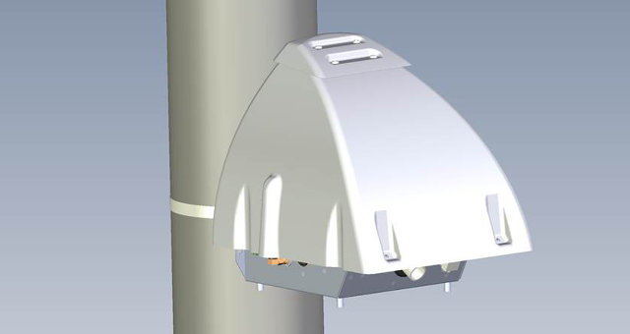

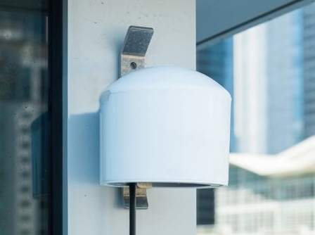

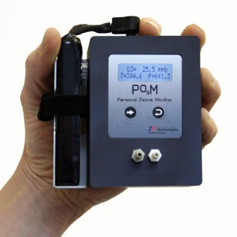
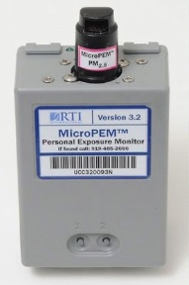
Low Cost Sensors & Real-time Data

Slide 5
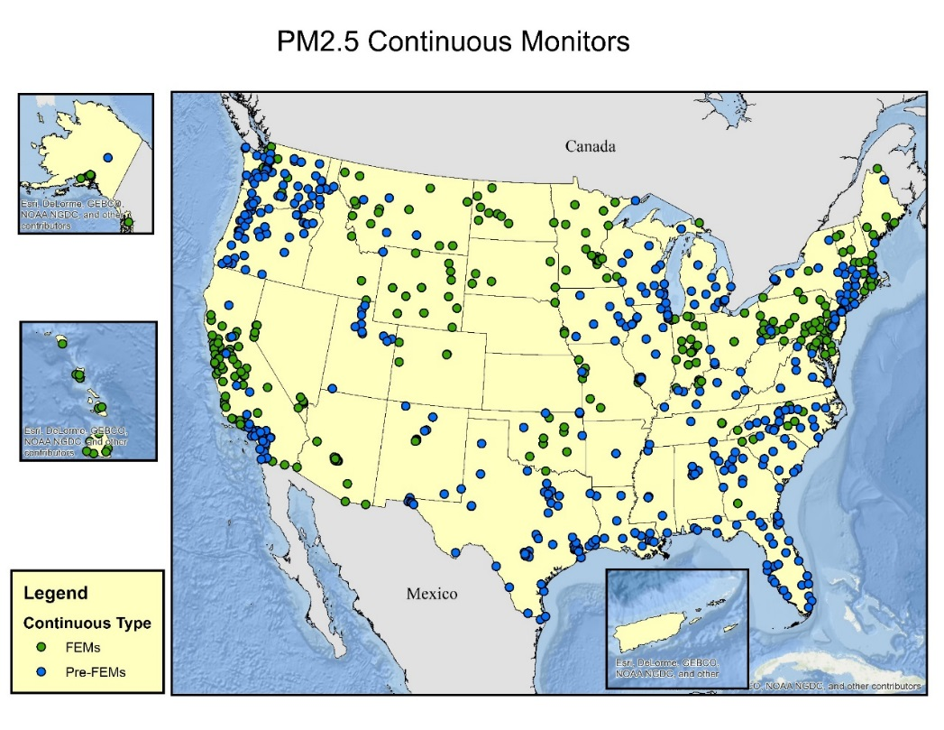
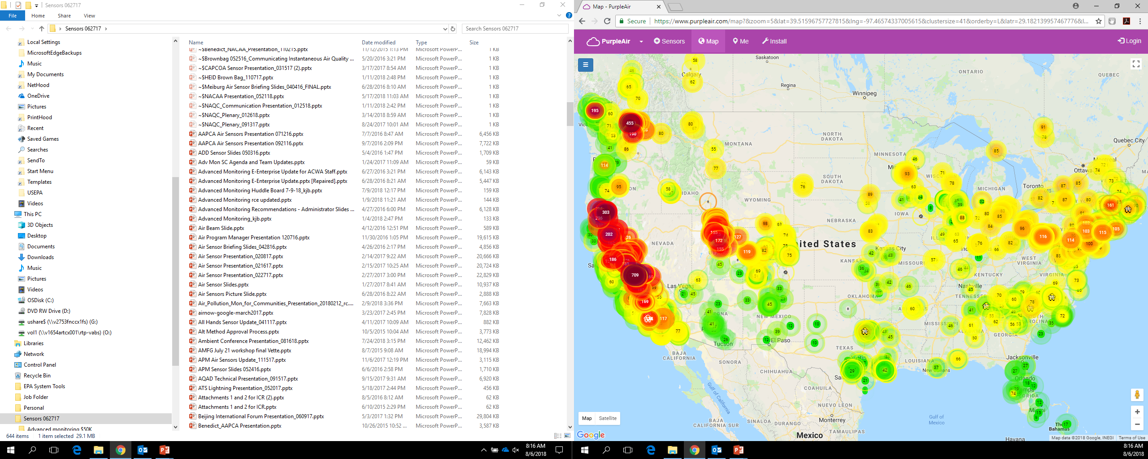
Ambient PM_{2.5} Monitoring
October 2016
Sensor Vendor PM_{2.5} Monitoring
August 2018

Slide 6

45 sensor network projects and counting…

Slide 7
Collection of Air Data
Air Quality – Complex Current State
Data Sets
Sensors
Satellites
Monitoring networks
Participants
Citizens/Communities
Researchers/Academics
Nonprofits
Businesses
Governments
Information Technology
Cloud storage
Data access
Advanced analytics
Visualizations
Consumer products
Notes:
A major shift in the traditional role of government agencies as the main resource for:
Collecting, storing, sharing, & communicating air data
Growing diversity of air monitoring participants and data sets
Participants: Citizens, communities, researchers, academics, nonprofits, businesses
Data sets: Sensor, satellite remote-sensing, traditional monitoring networks
Information Technology (IT) company capabilities
Providing data storage & access, promoting use of cloud and advanced analytics (e.g. machine learning), developing consumer products (e.g. smartphone applications)

Slide 8
2018 Air Sensors International Conference
Oakland, CA September 12-14th, 2018
Conference Numbers:
International Travelers From:
518 Attendees
237 Individual Presenters
149 Podium Presentations
106 Poster Display Presentations
49 Minute Madness Presentations
45 Exhibitors
Canada
China
France
Germany
Ghana
India
Israel
New Zealand
Norway
Philippines
Taiwan
The Netherlands
The UK
Senegal
U.S. Travelers From:
California
Colorado
Georgia
Iowa
Maryland
Massachusetts
Minnesota
New York
North Carolina
Ohio
Oklahoma
Oregon
Pennsylvania
Washington
Washington D. C.
Wisconsin
https://asic.aqrc.ucdavis.edu/

Slide 9
U.S. Air Sensor Trends
Resources & Evaluations (Past & Present)
Initial Performance Evaluations (in lab and field)
Short Term Studies/Applications
EPA Air Sensors Toolbox
https://www.epa.gov/air-sensor-toolbox
AQ Spec
http://www.aqmd.gov/aq-spec
Networks (Present)
Smart Cities
Local Networks
Community Engagement
Near Source Monitoring
Long Term Performance Characterization
Integration (Future)
Data Quality
Data Interpretation
Data Management
Personal Exposure
Data Fusion

Slide 10
Advancing Sensors: Focus Areas
Data Quality
Data Interpretation
Data Management

Slide 11
Sensor Performance – What We Heard
Mixed performance findings in the literature
Lack of systematic data quality characterization
Disparity in how well technologies perform under various meteorological conditions
Uncertainty in how long the devices perform over time
Questions in accuracy of measurements near sources
Deliberating Performance Targets for Air Quality Sensors (June 25-26, 2018)
Attendee | Approximate % of Various Groups | Note
International | 8% | ~700 registered participants representing dozens of countries
Private Sector/Manufacturers | 26%
Academics | 22%
State/Local/Tribal Agencies | 25%
Community Groups/Nonprofits | 5%
EPA & Other Federal Government Agencies | 14%
https://www.epa.gov/air-research/presentations-deliberating-performance-targets-air-quality-sensors-workshop

Slide 12
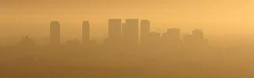
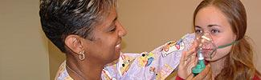
Application Categories in Literature
Air quality forecasting
Air quality index (AQI) reporting
Community near-source monitoring
Control strategy effectiveness
Data fusion
Emergency response
Epidemiological studies
Exposure reduction (personal)
Hot-spot detection
Model input
Model verification
Process study research
Public education
Public outreach
Source identification
Supplemental monitoring

Slide 13

Data Quality
  Next Steps (Ongoing)
    Non-regulatory PM_{2.5} & O₃ performance targets & testing protocols
        Journal publication of workshop findings – late 2018
        ORD EPA interim report with performance targets & testing protocols for sensors
    2019 Late Summer Workshop – additional pollutants (e.g. NO₂, SO₂, PM₁₀)
    Long term performance evaluations
  Intermediate Steps (1-2 years)
    Additional lab and field testing protocol development
    Coordinating public/private partnership initiative
    Possible VOC workshop
  Future Steps (2-3 years)
    Evolving, TBD in agile manner

Slide 14


“A Burning Question”
FRM/FEMs = 7
Temp Monitors = 10
Sensors = 30 (3 Vendors)
Decisions
  Use sensor data?
  How?
  Risk strategy?
Deadline – 10/25/18
https://www.sacbee.com/news/state/california/fires/article216227775.html

Slide 15
Data Interpretation Considerations
Context is needed for real-time data
  In general, health science doesn’t tell us what a minute of exposure to elevated levels of pollution means for an individual
  Analyses needed to understand relationship between continuous data and longer-term averaging times or discrete samples
  Interpretation varies by pollutant & should be scientifically grounded
  Sensor Scale Pilot: https://www.epa.gov/air-sensor-toolbox
Visualizations
  Display of sensor data alongside regulatory data in understandable way
  A complimentary - not contradictory – approach is needed
  Strategic partnerships (e.g. data management companies)

Slide 16
Beta Website Sandbox
https://sensormap-212220.appspot.com/

Slide 17



Data Management
vs
Primary Source for Storage and Dissemination
Photos provided by Powerpoint online pictures by Unknown Author(s) licensed under CC BY-SA-NC

Slide 18

Tracking Legislation
California Air Resources Board (ARB) Assembly Bill (AB) 617, AB 1647
South Coast Air Quality Management District (SCAQMD) Rule 1180
Bay Area Air Quality Management District (BAAQMD) Rule 12-15

Slide 19
Policy Memo
Purpose: To address recent questions from local and state agencies regarding the use of air sensor data (e.g. National Ambient Air Quality Standards (NAAQS) compliance)
In general, instruments - including sensors - should:
  Meet the applicable requirements in the Code of Federal Regulations (CFR) - Part(s) of Title 40, Protection of Environment
  Meet the requirements in other state environmental regulations
  Include detailed sampling, siting, and quality assurance conditions
  Sensors not meeting the above criteria may be useful in other applications (e.g. better understanding local air quality, siting regulatory monitors, and identifying hot spots) assuming known data quality and proper interpretation
  Fall/Winter 2018

Slide 20


