Slide 1
MOSAIC and SPeCS for SIPs Presentation
E-Enterprise Conference
October 24,2018
3:45 pm to 5:30 pm

Slide 2
Presentation Objectives
1. Overview of MOSAIC, Tom Wible, CGI Federal
  Description
  3 Solution Components
  3 Levels of Customization
  MOSAIC Modules
2. Overview of SPeCS for SIPS, Mia South, US EPA
  Overview of SPeCS
  Development Approach
  Major Components Plan
  Demo of SPeCS

Slide 3
Mosaic: A Collection, Collaboration and Review Service
Mosaic = Modular Submission Application Creator
EPA shared service IT platform
Delivers capability to review information received through CDX
(e.g., plans, permit applications, petitions, exceptional events)
Simplifies data and document sharing with stakeholders
Modular building blocks afford a range of implementation options
Collect
Review
Track
Store
Share
Distribute
CDX
Mosaic
Notes:
Application Service that can be used OOTB or customized to meet unique program needs.
CDX provides EPA Program Offices a platform for data collection from the regulated community and a data exchange platform with partners. CDX provides registration services, CROMERR services, and master data management services.
CDX makes the collection and distribution of data efficient …
…Mosaic completes the solution by providing a range of solutions for the review, tracking and reporting of collected data.

Slide 4
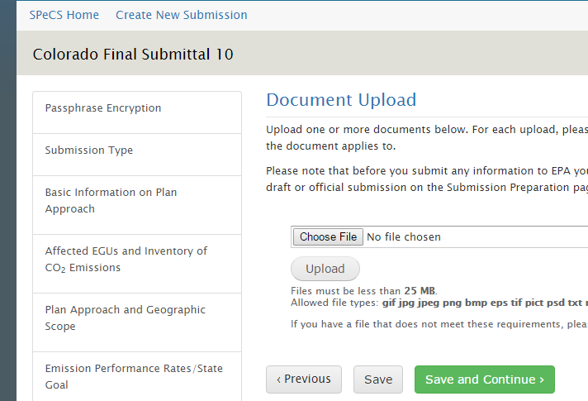
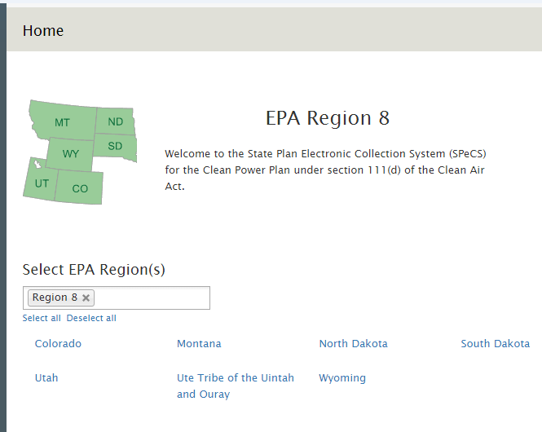
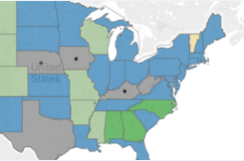
Three Solution Components
Collection Interface
Compilation & submission of plans through CDX using multiple choice questions, file upload, completeness checks
Optional Mosaic Modules
Clearinghouse
Plan review, issue tracking, comment development, and storage of review files
Core & Optional Mosaic Modules
Public Dashboard
Status updates, links to final approved plans, national and individual state summary information
Agency Visualization and Analytics Tools
Notes:
Collection Interface: Partner, Agency, or Regulated Community facing portion of the system. Web Forms module can be used if CDX data flow not already in place.
EPA Clearinghouse: EPA, Region, or SLT work area for review, collaboration, compliance determination, etc.
Public Dashboard: Public facing portion of the system for submission and processing status sharing. Qlik Sense is preferred data reporting & visualization solution.

Slide 5

Mosaic Modules
Mosaic Modules: FFeP
(Level 2 Solution)
Mosaic Modules: EPS
(Level 1+ Solution)
Mosaic Modules: SPeCS for SIPs
(Level 3 Solution)
EPA Central Data Exchange (CDX) Services
Registration, Cross –Media Electronic Reporting Rule, Substance Registry Service and Federal Registry Service.
Public/Stakeholder Dashboards
CDX Services
Registration, CROMERR, SRS, FRS, etc.
Public/Stakeholder Dashboards
Public/Stakeholder Dashboards
CDX Services
Registration, CROMERR, SRS, FRS, etc.
Public/Stakeholder Dashboards
CDX Services
Registration, CROMERR, SRS, FRS, etc.
Qlik Sense
EPA Program Office WebSite
Other EPA Systems
Collection Interfaces
Clearinghouse
Qlik Sense
Collection Interfaces
Clearinghouse
Qlik Sense
Collection Interfaces
Clearinghouse
Qlik Sense
Collection Interfaces
Clearinghouse
CDX SmartForms
CDX SubmitNow
Pages
CDX SmartForms
CDX SubmitNow
Pages
CDX SmartForms
CDX SubmitNow
Pages
CDX SmartForms
CDX SubmitNow
Pages
Submittal Search
EPA Program Office Websites
Submittal Search
Submittal Search
Submittal Search
EPA Program Office Websites
EPA Program Office Websites
Home Page
Comment Thread
Home Page
Comment Thread
Comment Thread
Home Page
Comment Thread
Home Page
Other EPA Systems
Other EPA Systems
State Landing Page
Other EPA Systems
State Landing Page
State Landing Page
Landing Page
Web Form
State Landing Page
Landing Page
Web Form
Landing Page
Web Form
Landing Page
Web Form
QuE / FAQ
QuE / FAQ
QuE / FAQ
QuE / FAQ
Pending Forms
Encryption
Pending Forms
Encryption
Pending Forms
Encryption
Pending Forms
Encryption
Pending Forms
Form Review Page
User Management
User Management
User Management
Form Review Page
User Management
Form Review Page
Form Review Page
Submission History
Tooltips
Submission History
Tooltips
Submission History
Tooltips
Submission History
Tooltips
Notifications
Submission History
Admin Page
Notifications
Notifications
Admin Page
Notifications
Admin Page
Admin Page
Question Validation
Question Validation
Question Validation
Question Validation
Form Review Status
Form Review Status
Form Review Status
EPA Contacts
Issue Tracker
Form Review Status
EPA Contacts
EPA Contacts
EPA Contacts
Issue Tracker
Issue Tracker
Issue Tracker
State Contacts
Form Preview
Milestones
State Contacts
Form Preview
State Contacts
Form Preview
State Contacts
Form Preview
Milestones
Milestones
Milestones
Full Text Search (SOLR)
Full Text Search (SOLR)
Full Text Search (SOLR)
Full Text Search (SOLR)
Key Dates / Milestones
File Resumable Upload
Quick Links
Key Dates / Milestones
Key Dates / Milestones
Key Dates / Milestones
File Resumable Upload
Quick Links
File Resumable Upload
Quick Links
File Resumable Upload
Quick Links
Facility Widget
Facility Widget
File Depot
Facility Widget
File Depot
Facility Widget
File Depot
Recent Activity
File Depot
Recent Activity
Recent Activity
Recent Activity
Quick Links
Quick Links
Quick Links
Quick Links
Focus of out-of-the-box solution
Notes:
Out-of-the-box Mosaic solution focuses on the Clearinghouse, functionality can be developed to support data collection and public/stakeholder dashboards
Mosaic includes a Web Form module to develop program-specific Collection Interfaces
Mosaic utilizes CDX Services and will be hosted in the CDX environment
CDX Services Utilized:
Authentication & Authorization Services: Collection Interface & Clearinghouse
Other Authentication providers can also be used: ex. WAM, E-Enterprise
CROMERR signing/archiving: Collection Interface
Facility widget (FRS): Collection Interface & Clearinghouse
SubmitNow, SmartForm: Collection Interface
Mosaic Collection interface & Clearinghouse can use other Authentication providers, for example E-Enterprise Federated Bridge.
Mosaic does into inherently include a public interface (Dashboard)
Datasets are generated for data publishing
Dataset sent to existing data visualization platforms: QlikSense, WebSites, GeoPlatform, etc.

Slide 6
Three Levels of Customization
1
Out-of-the-Box
  Development: No developer involvement, application is created in seconds
  Example: Moving simple paper review process to electronic
2
Moderate Customization
  Development: Some customization of out-of-the-box modules, additional modules as needed, including collection interfaces
  Example: Region 9 Electronic Permitting System (EPS) – NSR and Title V Permit application review
3
Highly Customized
  Development: Fully custom development using Mosaic modules as building blocks
  Example: SPeCS for SIPs replaces legacy systems FRED and AirTrax. Plans to replace other legacy systems in the future.
Notes:
Out-of-the-box solution is currently limited to the clearinghouse since several options already exist for plan collection interfaces (e.g., versiform). Custom collection forms are available as part of Levels 2 and 3.
Region 9 EPS: Custom Collection Interface using Web Forms module. OOTB Clearinghouse with custom review workflow and notifications.
Office of Land and Emergency Management (OLEM): Implementation of an ePortal solution to support OLEMS’s FFRRO assessments and investigations into Federal and Private facility site cleanup activities; and to provide an ePortal interface to the Site Evaluation Management System (SEMS).
SPeCS for Section 110 Plans: Collection Interface Web Forms module. Clearinghouse notifications, comments, worklists modules. Customized Web Forms module for review pages. Custom business rules and data model. EPA Qlik Sense used for internal and external reporting.

Slide 7
Cost Benefits for Development
Example Use Case | Java/.Net Application | Mosaic-based Application | Savings
Electronic Submission Review* Level 1: Out–of–the-Box | 4 months | 6 weeks | Weeks (60%)
Office of Land and Emergency Management Federal Facility e-Portal Level 2: Moderate Customization | 12 months | 3 months | 9 months (75%)
SPeCS for SIPs Level 3: Highly Customized | 12 – 24 months | 3 – 12 months | 9 – 12 months (50% – 75%)
* OAQPS Electronic Permitting System (EPS) Phase 1 development used a “Level 1” clearinghouse with a custom Collection Interface webform
Notes:
Note: L1, L2, L3 refer to the customization level.

Slide 8
SPeCS for SIPs
First Agency application of MOSAIC. Operational since January 2018.
E-Enterprise and OAR investment project that enables the Agency to track progress toward meeting Agency performance metrics related to State Implementation Plans (SIPs)
Listed in the Agency’s Strategic Plan for FY2018-22 and complements SIP Lean efforts
Replaces multiple legacy systems. Significantly enhances functionality to track state air agency SIP submissions, compliance with Clean Air Act requirements, and EPA review and actions on these submissions
SPECS is comprised of three main components: 1) the state Plan Collection Interface; 2) the EPA Clearinghouse; and 3) the Public Dashboard
Since January 2018, 49 states are using SPeCS and more than 220 plans have been submitted through SPECS

Slide 9
SPeCS Development Approach and State Input
EPA Core Team (HQ and Regions)
EPA National Workgroup
Multiple rounds of webinars and beta-testing with staff from state/local air agencies
Frequent input from state experts on e-Enterprise SPeCS Integrated Project Team
Regular check-ins with EPA Air Program Manager advisory group

Slide 10
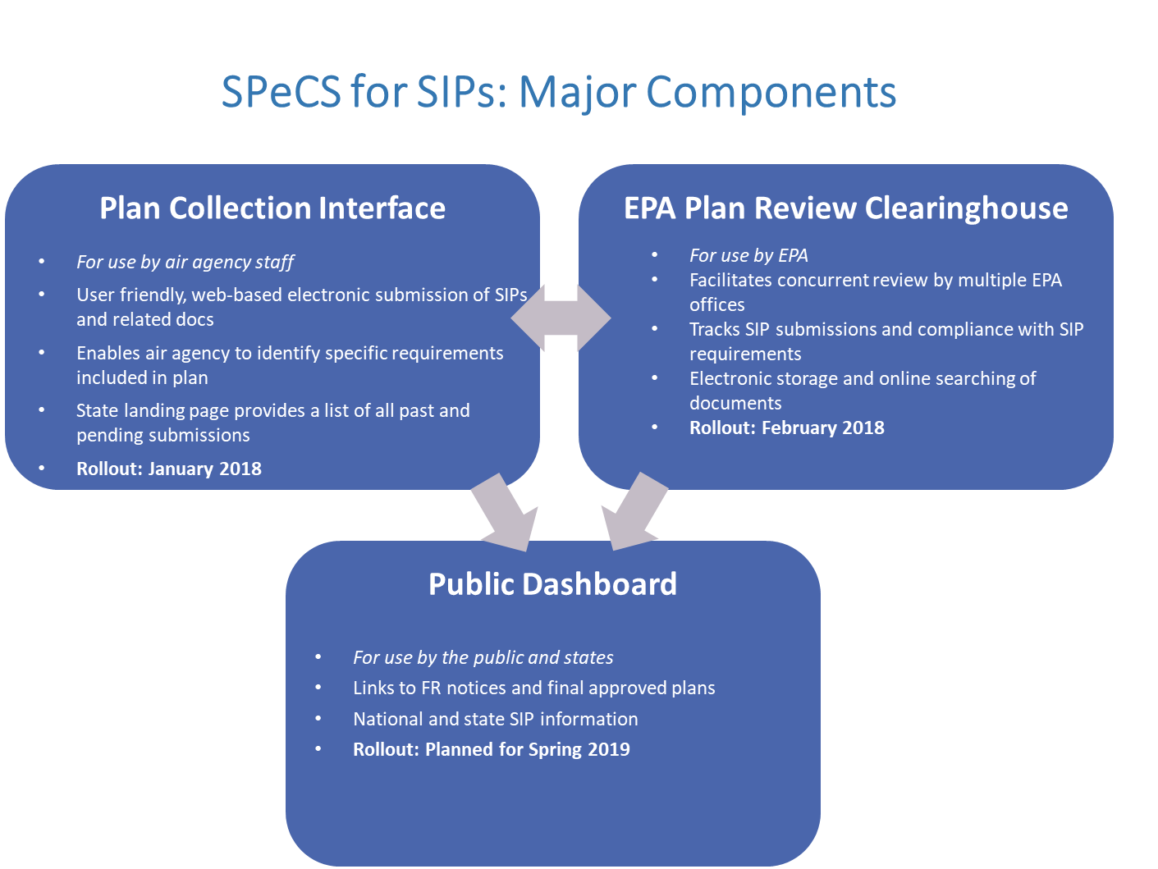

Slide 11

Questions
For further questions about MOSAIC, contact Tom.Wible@cgifederal.com
For further questions about SPeCS for SIPs, contact south.mia@epa.gov

Slide 12
Background

Slide 13
SPeCS for SIPs – Plan Collection Interface
The Plan Collection Interface (PCI) in SPeCS enables state “Preparers” to walk through a series of customized screens to enter information about the type of plan being submitted and the specific requirements addressed, and then upload relevant documents electronically.
The system includes completeness checks and will prompt the user if certain required questions are left blank. Plans must be submitted by a “Certifier” who has authority to make plan submissions for the state organization.
The system has security features such as Certifier identity authentication via text message code or secret question. It also provides a State Landing Page, a searchable listing of past and pending submissions and the status of such submissions in the steps leading to final EPA action. (The PCI is the next generation of the eSIP system, which has been in place since 2015 and has provided a basic capability for states to submit air quality plans to EPA electronically.) Launched January 26, 2018.

Slide 14
SPeCS for SIPs – EPA Clearinghouse
The EPA Clearinghouse, accessible only within EPA, provides Regional Office and headquarters office staff with access to state plan submissions and related data.
The Clearinghouse database tracks: milestones for plan submission and EPA review; compliance with nonattainment area and other Clean Air Act requirements; the backlog of SIPs requiring EPA action; and history of state and EPA actions regarding specific areas or program requirements.
SPeCS also provides email notifications to state and EPA staff regarding plan submissions and upcoming deadlines. Launched February 23, 2018.

Slide 15
SPeCS for SIPs – Public Dashboard
The Public Dashboard (still under development) will provide information on state plans that have been received to meet specific requirements and the status of EPA actions on such plans. It will be an enhancement of existing EPA websites that provide SIP status information, providing real-time data and greater transparency to the public. Planned launch in early 2019.
Future work includes enhancements to the three main components, as well as enhanced reporting capabilities, integration of additional plan types, integration of legacy SIP tracking systems, and an EPA administrator module.

