Slide 1
Artificial Intelligence and Machine Learning – An OW Perspective
October 24, 2018
Dwane Young
Office of Water
Disclaimer: Material presented is for informational purposes only. EPA does not recommend nor endorse any particular sensor product or data management platform.

Slide 2
1 – The Challenge for Water
Parameters that can be sensed in real-time right now don’t have a direct impact on human health
We need to be able to answer the question:
Is it safe to swim here?
Will my dog get sick if he goes in the water?
Will I get sick?

Slide 3
2 – What Data Do We Have?
We have two types of data to help answer these questions:
Sampling data – covers a broad range of parameters, but is not available in real time.
Sensor data – may be real time, but provides limited measurable parameters

Slide 4
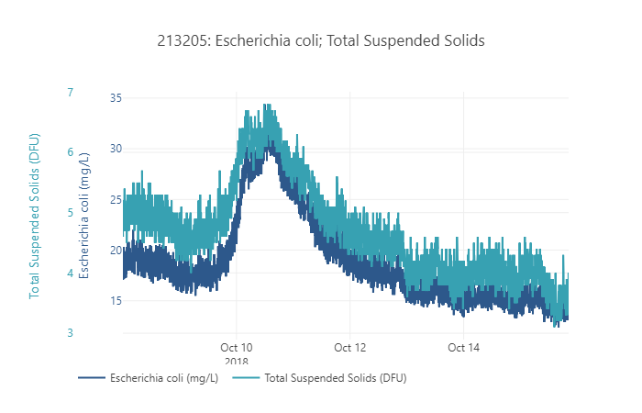
3 – Opportunity for AI
AI and Machine Learning could be used to develop relationships between what we can sense with automated processes to other parameters that we can’t directly sense
Example: Develop relationship between Total Suspended Solids and Bacteria concentration or use chlorophyll a, phycocyanin, and nitrate to predict algal blooms.

Slide 5
FOUR PILLARS OF OPEN WATER DATA
4 – What’s needed?
STANDARDS
METADATA
COMMON HYDROGRAPHY
DISCOVERABLE / SEARCHABLE
Notes:
These four concepts enable open water data:
Standards: Includes data standards, communication standards (how computers talk to each other), and common terminology
Metadata is often a piece of the data standard, but is important enough that it needs its own consideration. It provides the who, what, when, where, why, and how of data
Common Hydrography: Data should be linked to a common hydrography allow for data discovery using that hydrography (i.e. upstream/downstream searches or watershed searches)
Discoverable / Searchable: Data should be registered and summarized in data catalogs (or search indexes) to allow for easy discovery. Having huge data sets open and available is not enough. A user needs to be able to easily find the data that they’re interested in.
*** It is not enough to just post a file to a website. That does not make it ‘Open’, just ‘Available’.
***Open Water Data is about putting data together from multiple sources without requiring a lot of reformatting.

