Slide 1
Artificial Intelligence and Machine Learning: Opportunities & Challenges for Innovation in Environmental Protection
October 24, 2018
Kristen Benedict
Office of Air Quality Planning & Standards
Disclaimer: Material presented is for informational purposes only. EPA does not recommend nor endorse any particular sensor product or data management platform.

Slide 2
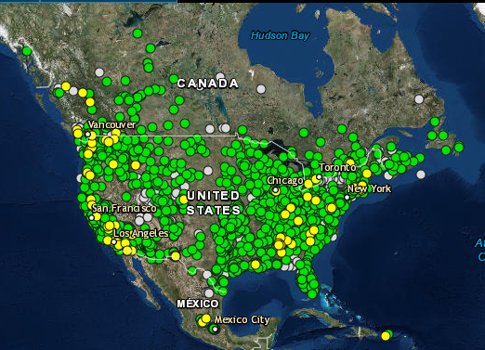
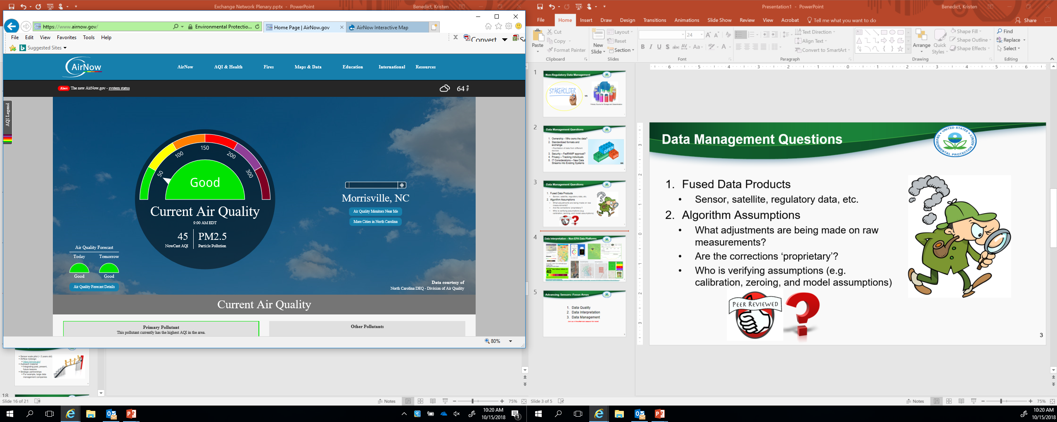
EPA’s AirNow Redesign
https://www.airnow.gov/

Slide 3
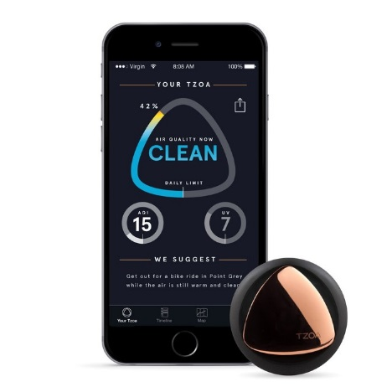
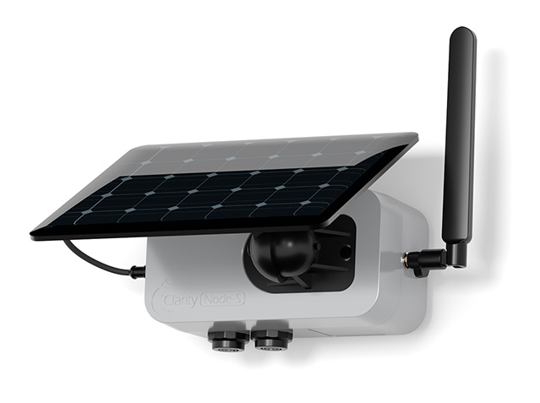
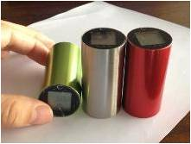

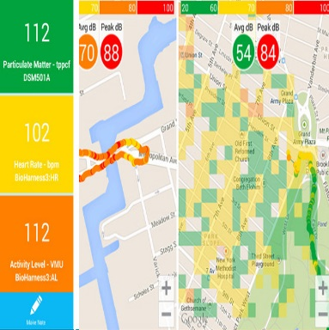
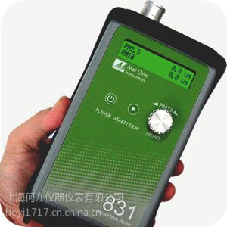
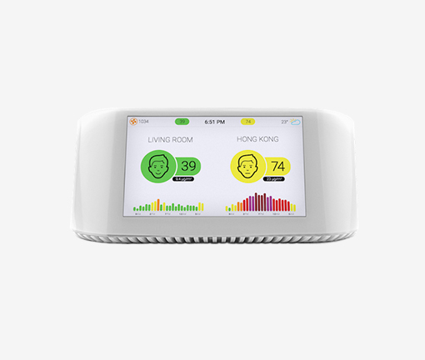
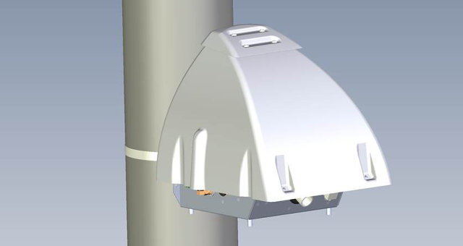



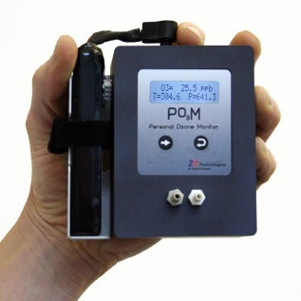
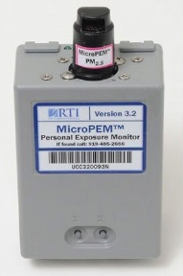
Low Cost Sensors & Real-time Data

Slide 4


Data Management Questions
Fused Data Products
  Sensor, satellite, regulatory data, etc.
Algorithm Assumptions
  What adjustments are being made on raw measurements?
  Are the corrections ‘proprietary’?
  Who is verifying assumptions (e.g. calibration, zeroing, and models)

Slide 5
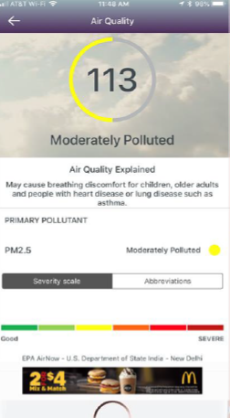
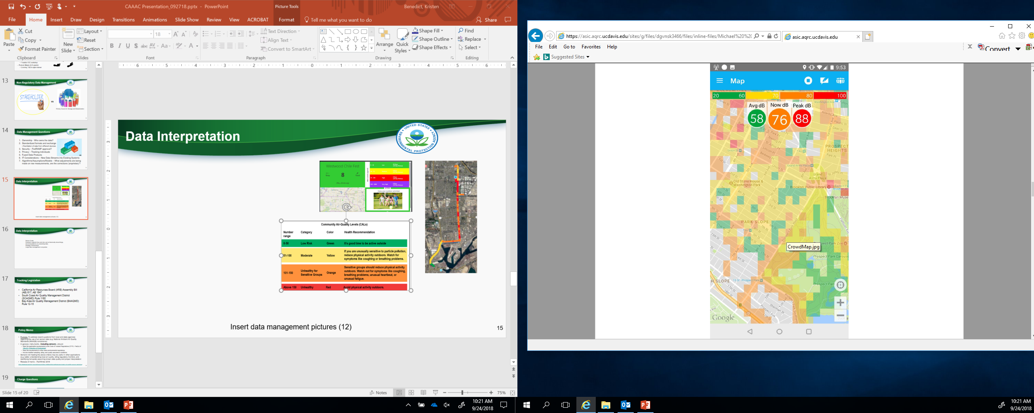
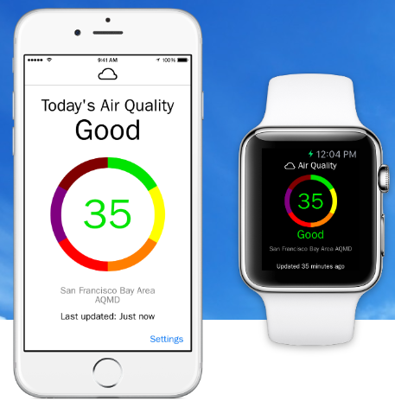
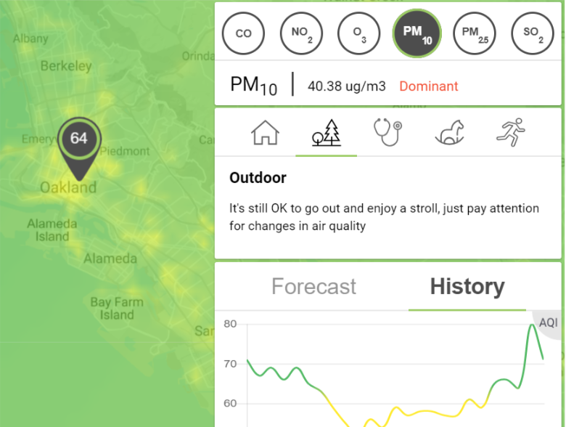
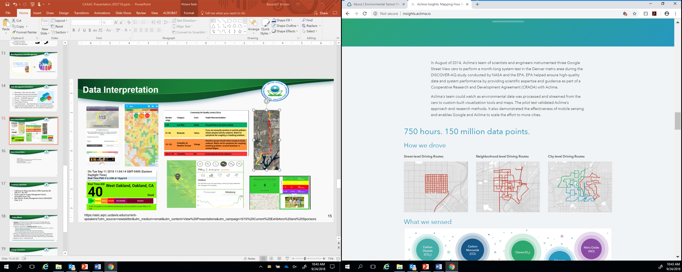
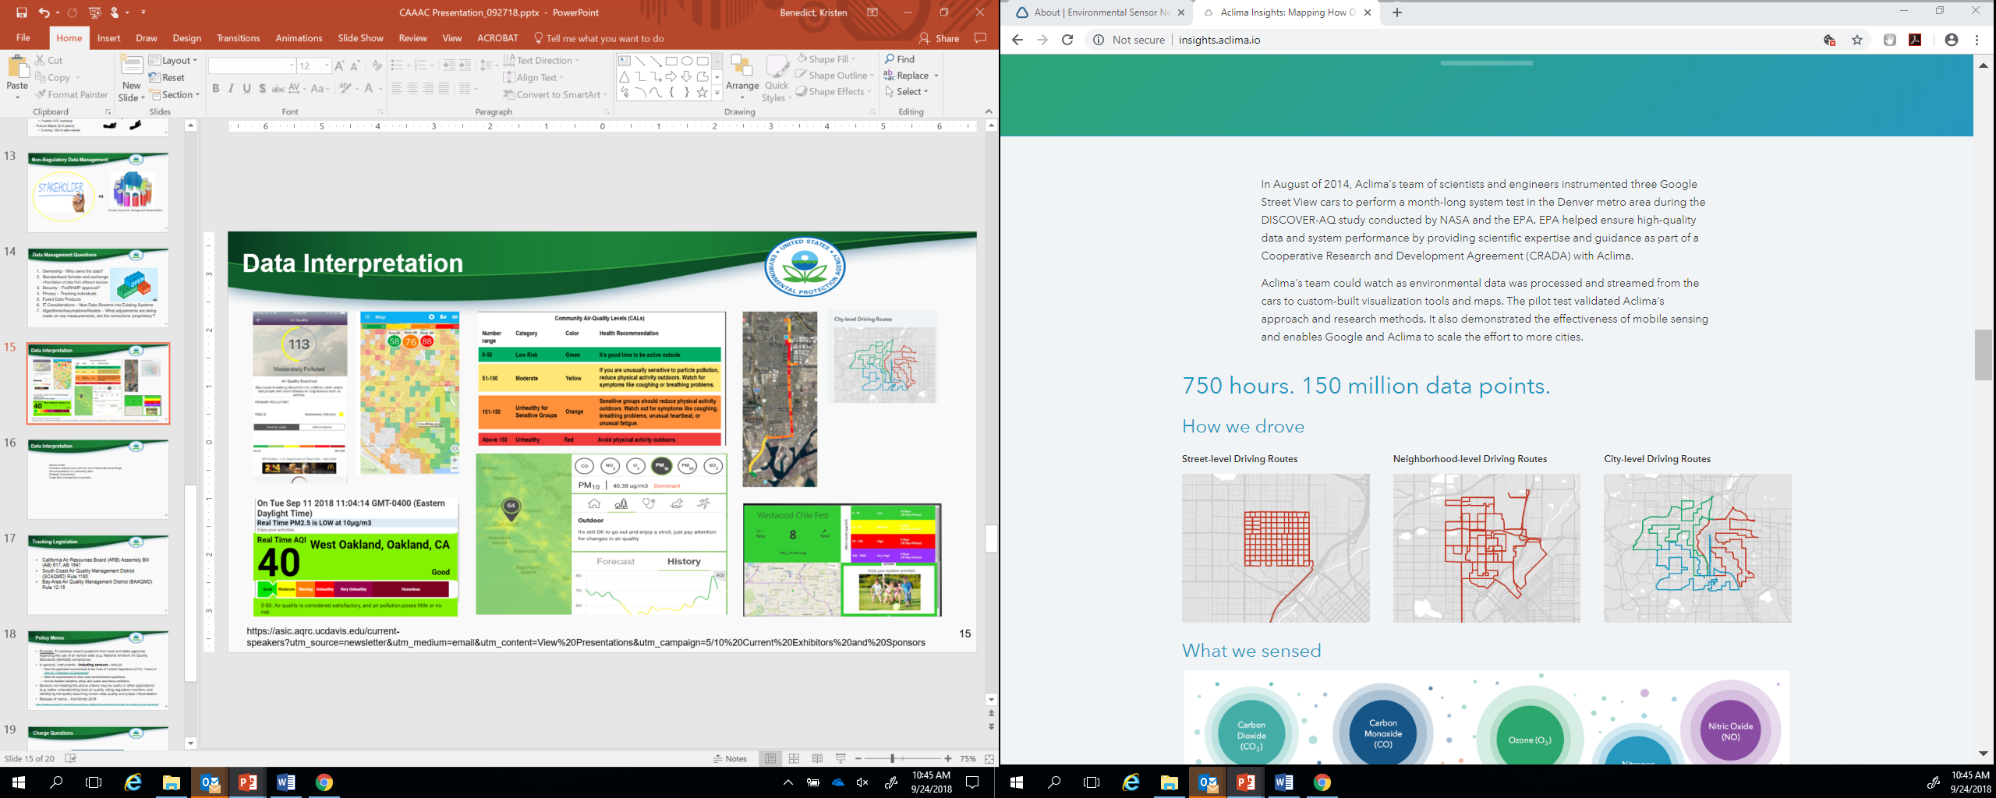
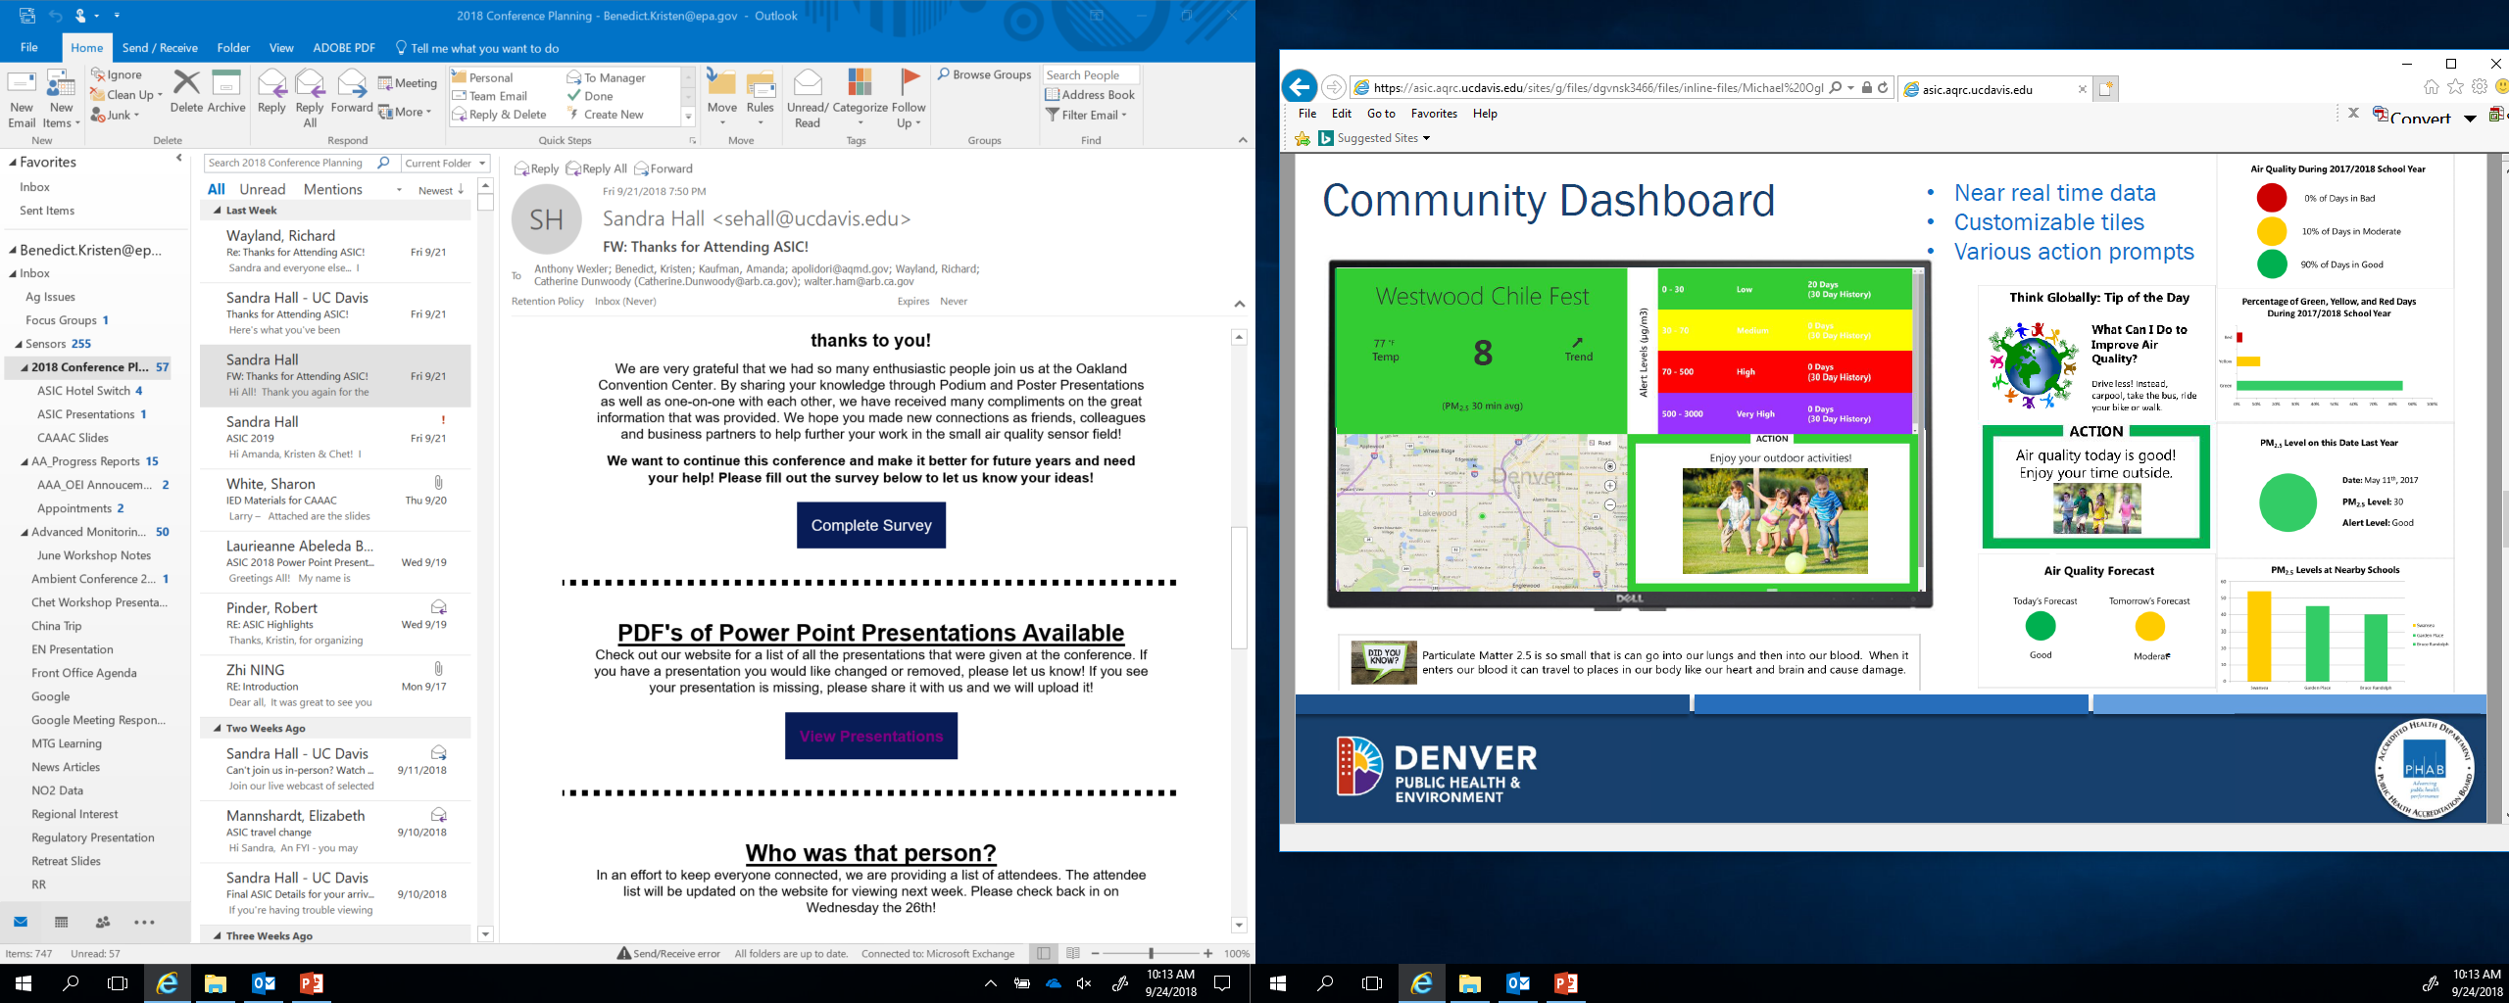
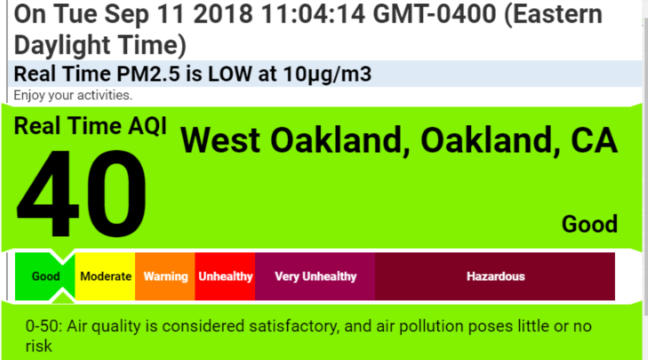
Data Interpretation – Non-EPA Data Platforms
https://asic.aqrc.ucdavis.edu/current-speakers?utm_source=newsletter&utm_medium=email&utm_content=View%20Presentations&utm_campaign=5/10%20Current%20Exhibitors%20and%20Sponsors

Slide 6


Non-Regulatory Data Management
vs
Primary Source for Storage and Dissemination

Slide 7

Data Management Questions (Cont.)
What is EPA’s role?
IT considerations – new data streams and existing systems
Ownership
Standardized formats and exchange
  Facilitation of data from different devices
Security – FedRAMP approval?
Privacy

Slide 8
Join us @ 3:45pm for much more!

