Slide 1

E-Enterprise for the Environment
EPA Data Analytics Platform
Dave Smith
Julie Kocher
US EPA, Office of Environmental Information
Fazal Mohammed, SAIC

Slide 2
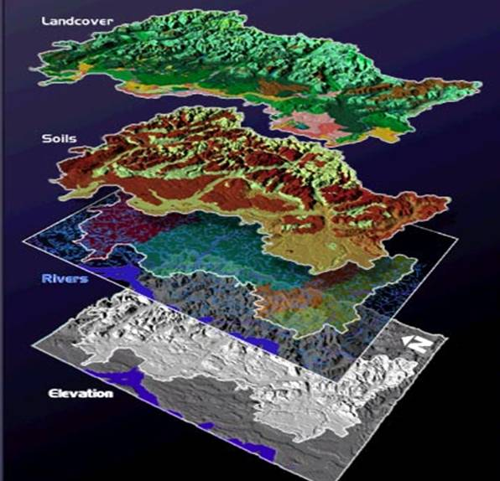
Data Platform
A solid foundation for analytics
Hosts shared core datasets (spatial & temporal)
  Multiresolution raster, vector, tabular datasets along with multidimensional data cubes
  Georeferenced and optimized for access and analysis
Supports data science and big data analytics
  Analytic Notebooks
  Amazon Athena
  Amazon Elastic MapReduce (EMR)
  AWS Lambda
Efficiencies of scale and ease of use through shared data framework and ecosystem of analytical tools
Notes:
The challenge: EPA has a fantastic community of scientists, engineers, researchers and developers scattered across many program offices tackling a wide variety of problems relating to how we can protect human health and the environment. A majority of them are doing their work on desktop and laptop machines, constrained by the limitations of their current architectures and hardware, whether data storage, RAM, CPU, network bandwidth or other issues. This has made it harder for them to share their data, models and outputs, harder to collaborate with colleagues. Additionally, it has led to many workarounds such as keeping data compressed until it needs to be used, which slows analysis down. The result is a thousand flowers blooming, all great work but often not able to benefit as much from reuse and collaboration.
A shared data platform can help improve how we support this work, by providing an efficient and optimized way to store and access spatial, temporal and other types of datasets.

Slide 3
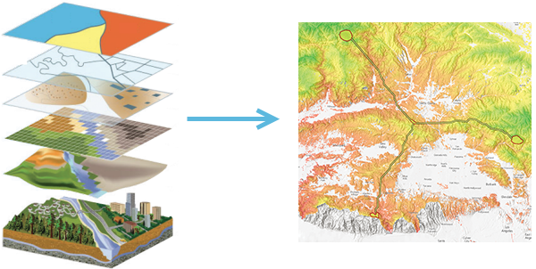
The Challenge: Data Access, Storage, & Reuse
Models require many different large datasets
Data management is often duplicative, stove-piped, and burdensome
A shared data platform can aid by housing large amounts of data optimized for analysis.
Notes:
Many of the models developed and used at EPA use multiple input datasets, these are often large datasets and due to lack of a robust environment for analysis and an inability to offload the work to larger, scalable compute environments, the model runs are often limited in scope geographically, et cetera – in many cases a national modeling effort is unattainable.
In many cases teams are independently wrangling and managing the datasets, having to download data from NOAA, USGS and other partners duplicatively, and teams spend an inordinate amount of time on the data and operations and maintenance side and not as much being able to do the development and analysis they’d like to be able to do.
The EPA data platform hopes to help with that burden by providing a more robust space for doing the data management and analysis.

Slide 4
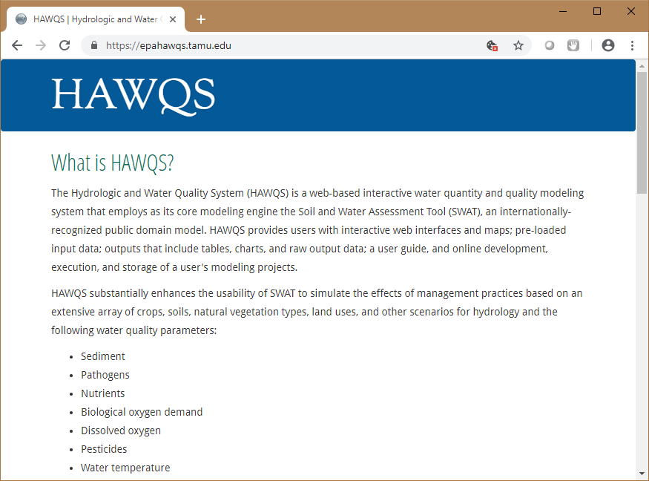
Example: Data Access & Reuse
2 Models - HAWQS and QED/SAM - require the same data:
  Topographic data
  Soils data
  Hydrology data
  Land use/land cover data
  Agricultural use pattern data
  Weather data
  With additional inputs and modeling these in turn generate
  Water quality and loadings
  Ecological pesticide risk assessments
  Human pesticide risk assessments
  …and other outputs
Notes:
Here is a good example of two teams with modeling applications that we are currently working with on a prototype basis. HAWQS is a hydrological and water quality modeling environment that uses SWAT models with a variety of datasets, it was jointly developed by Texas A&M and EPA’s Office of Water; the Quantitative Exposure Domain (QED) is a collection of models developed by EPA’s Office of Pesticides and Office of Research and Development, dealing with assessing risk and impact of toxic exposure. One of the QED models is the Spatial Aquatic Model which, shares some similarities to HAWQS in terms of the types of input datasets they both use for modeling surface conditions, meteorology, runoff and other effects.

Slide 5
Data
Platform: What’s Under the Hood?
The data platform lessens the need to copy/move/refresh data for individual applications as cloud-native models and applications can directly access the data in-place
This includes Hadoop and Apache Spark via AWS Elastic MapReduce, as well as distributed query via AWS Athena and other powerful tools for analysis.
The platform leverages large-scale AWS S3 data storage, which is integrated with many AWS capabilities, as well as being able to support more traditional RDBMS, NoSQL and other types of databases
Notes:
Under the hood of the data platform, its foundation is affordable, scalable cloud based storage technology on AWS. This is then layered with a variety of other tools and capabilities that gives us powerful querying capabilities and new ways to provide and consume the data in analytical applications. The data can be used to maintain traditional database systems, but we can also launch data analytics clusters on demand and leverage big data technologies and distributed query engines like Hadoop, Apache Spark and others.

Slide 6
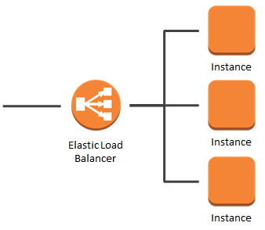
Data Platform:
Scaling & Load Balancing
Current models often have artificial constraints – limited file storage space, limits on hardware, leading to work-arounds
  For example, some tools work with large datasets; the modeling tools work around file storage constraints by extracting and uncompressing data on demand – this slows processing down. Instead, uncompressed data optimized for direct access can be made available via the data platform
  Some existing multi-user tools are not able to scale adequately to support users; through re-architecting the applications and instead of having a single instance accessing local storage, the storage is separated and pointed to the data platform, and then multiple instances can run using the same dataset using elastic scaling and load balancing based on demand
Notes:
One of the big opportunities of going to the cloud is that we will be able to take more advantage of scaling and elasticity. Models and analyses can be refactored to run in parallel, allowing workloads to be split up and spread out over a number of instances reducing the amount of time it takes to run, and allowing more data to be processed than otherwise might be possible via a single machine.

Slide 7






Analytical Tools
The data platform can support a rich ecosystem of tools and capabilities. Currently supporting:
Jupyter Notebooks – interactive code development in Python and other languages
Rstudio – powerful and popular interactive statistics-oriented environment
We are looking to be able to connect a variety of COTS and Open Source tools for data analysis and visualization, i.e. Qlik Sense, ArcGIS, Tableau, OPeNDAP and others
Notes:
We have currently been running initial pilots with a few analytical tools running in the cloud environment. What we did is develop a simple self-service console that allows users to select instance sizes and then spin up Docker containers running Rstudio and Jupyter notebooks. Our future hope is to be able to robustly support an even more wide array of analytics tools and services, such as GIS integration, Qlik integration and others. We are looking for EPA program office partners to help build this future ecosystem out.

Slide 8
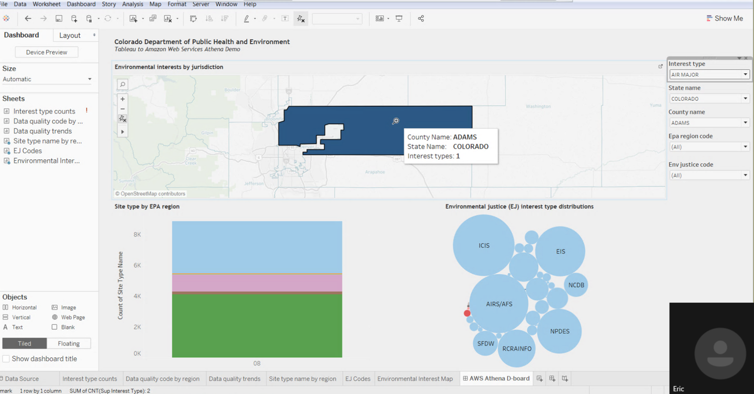
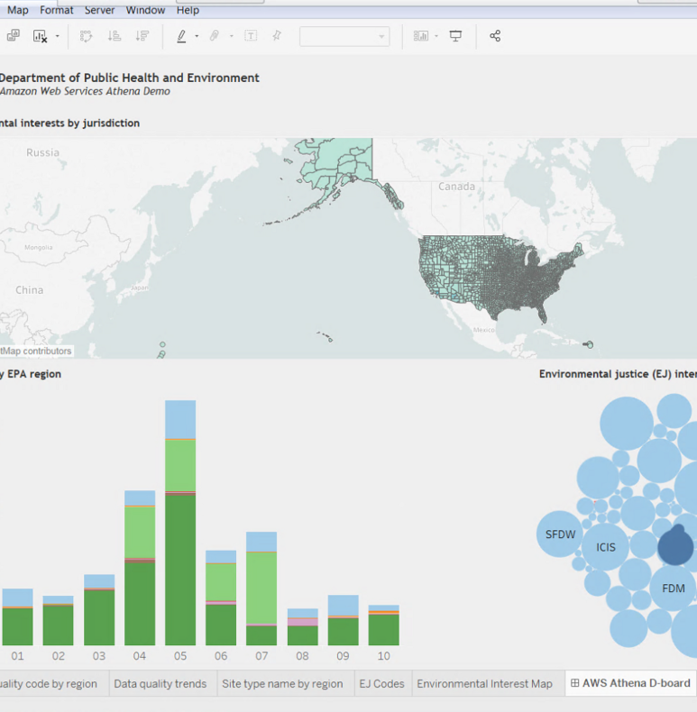
Proof of concept: Cloud-hosted EPA Envirofacts data provided with API and distributed query engine
Colorado DPHE and MassDEP were able to access the EPA Envirofacts data directly using their data visualization tools (Tableau and PowerBI)
Data Platform: Improved Data Sharing with EPA Partners
Notes:
Benefit - Another thing that the team has been exploring is the possibility of being able to share assets in the data platform with EPA partners. For example, as a quick proof of concept, the team uploaded EPA’s Envirofacts data into the data platform and set up a way to query it using Amazon Athena distributed query engine and expose the queries via the AWS API Gateway. We then had some of our friends in the states access the data and visualize it using their tools. What’s shown here are screenshots from a Tableau demo given by Eric Brown from Colorado’s Department of Public Health and Environment using the Envirofacts data exposed through this proof of concept API. EPA’s legacy APIs weren’t able to provide data in a similar way due to limitations imposed by the legacy backend databases.

Slide 9
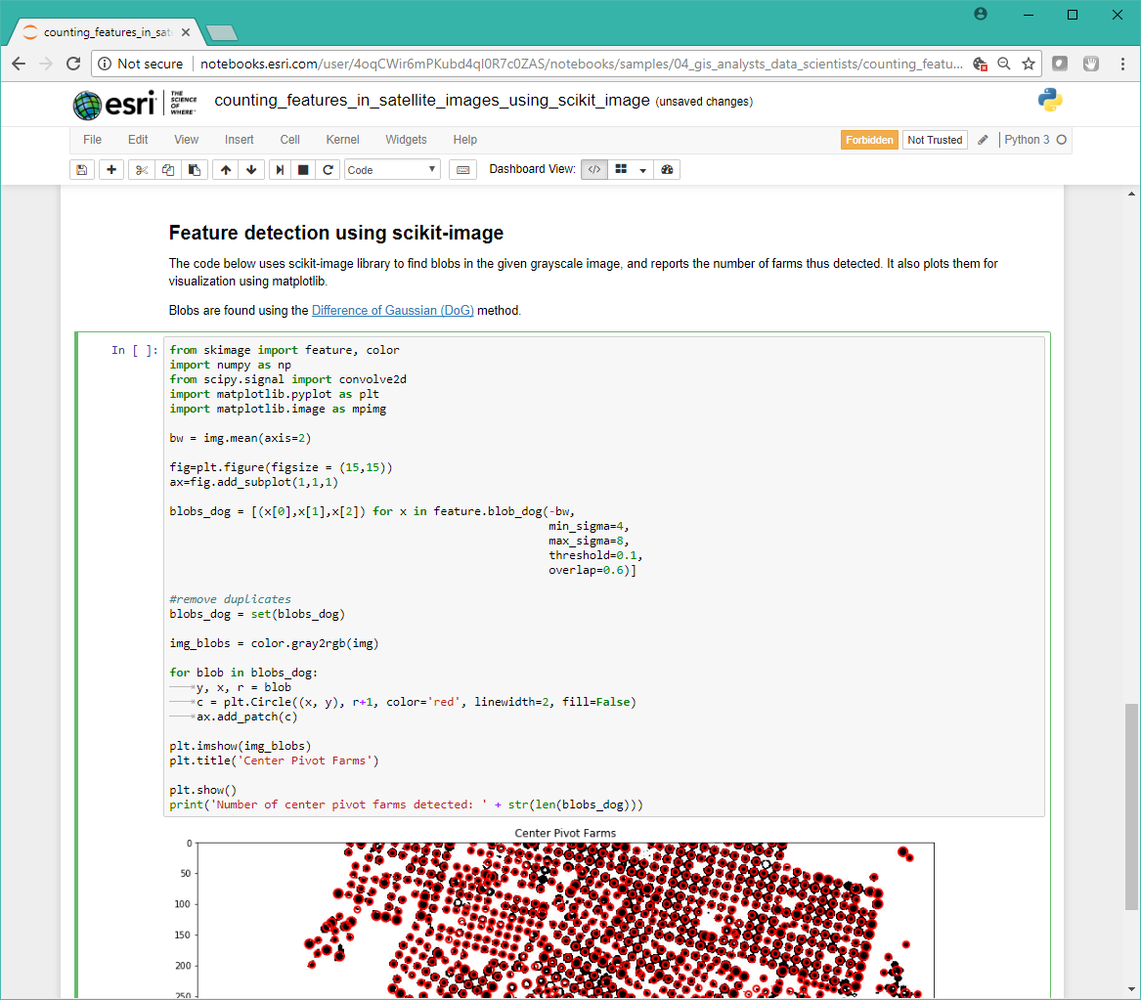
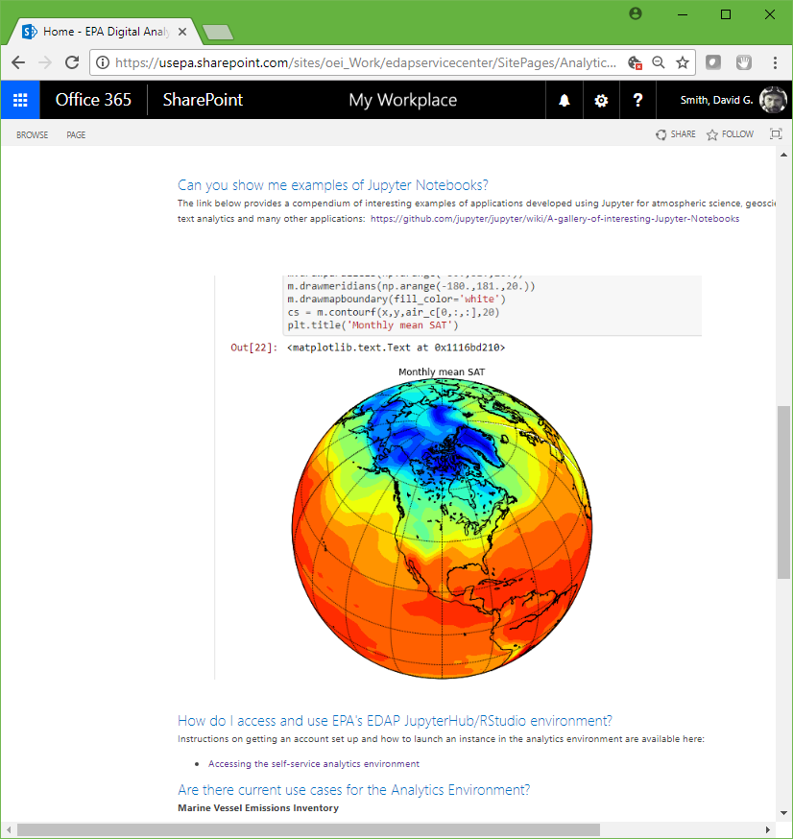
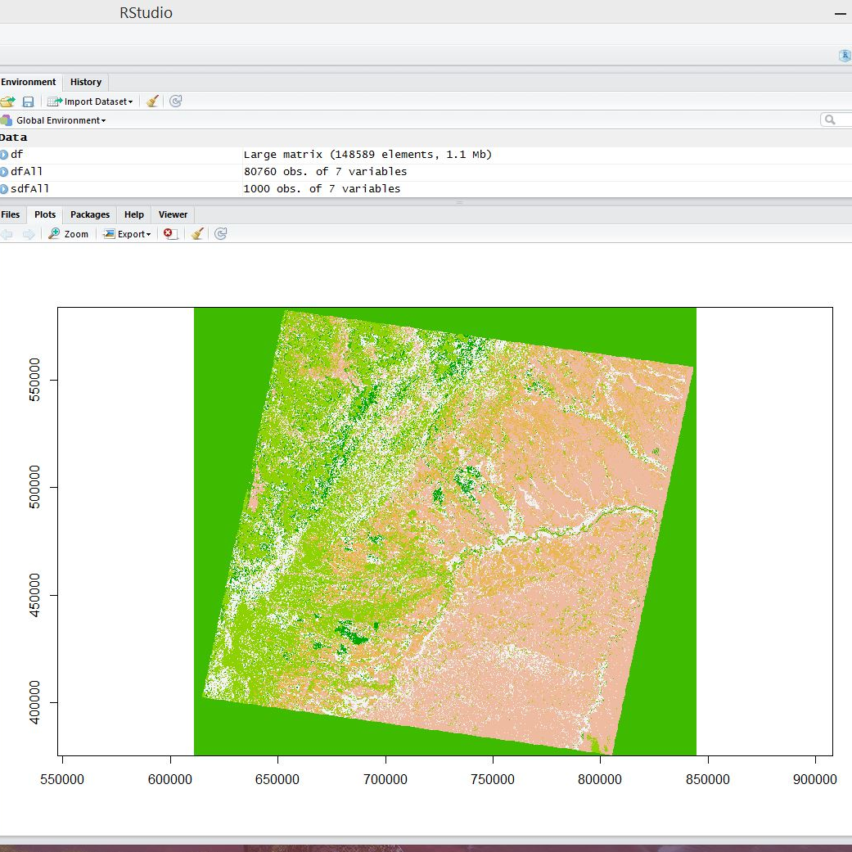
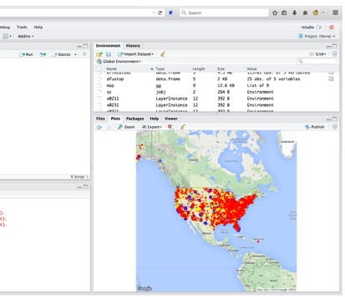
Data Platform:
Analytic Pilots
Current use cases
Remote Sensing
Machine Learning
GIS Analysis
Text Analytics
Computational Toxicology
Able to access and analyze cloud-hosted datasets
Example screen shots: Jupyter and Rstudio Analytics notebooks – currently running as on-demand instances in Docker containers in AWS environment.
Notes:
As mentioned, some of the internal proof-of-concept work at EPA has revolved around analysis using Rstudio and Jupyter running in Dockerized on-demand cloud-hosted instances. Currently 75 EPA users have been experimenting with data analysis, generally focusing in the areas of remote sensing, machine learning, GIS analysis, text analytics and computational toxicology. We are interested in seeing if we can support future genomics and other types of workloads using this cloud-based data platform and analytics capability.

Slide 10
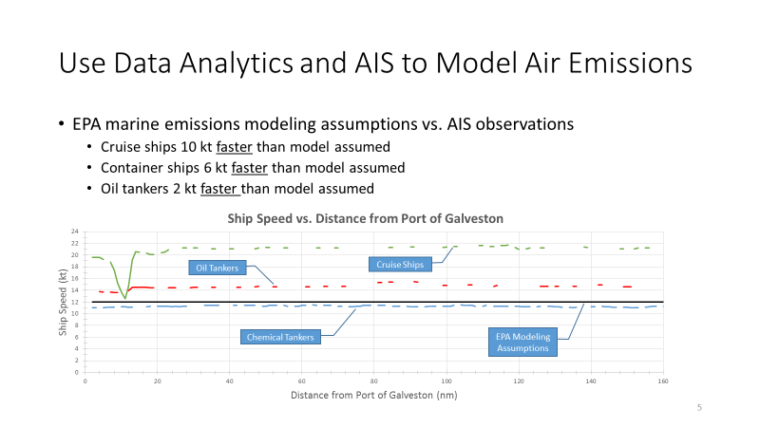



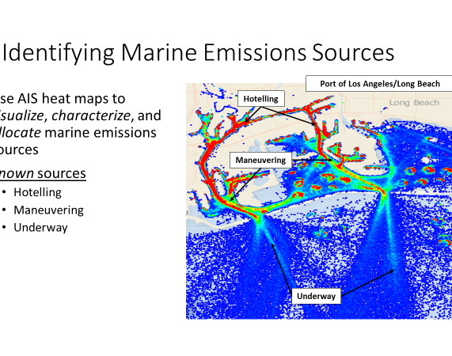
Data Platform:
Big Data Analytics
EPA’s Office of Air was able to leverage Amazon Elastic MapReduce (EMR) for analysis of a multi-terabyte dataset
  EMR is a managed, scalable distributed compute framework that runs Hadoop and can also run Apache Spark, Hbase, Presto, Flink and other tools
  Allows distributed interaction with data stored in Amazon S3 and DynamoDB NoSQL database
aws
EMR
Notes:
In the realm of big data analytics, we have been working with some of our program offices toward supporting mining and analysis of large, multi-terabyte datasets. We worked with Office of Air on air emissions modeling for marine vessels using AIS tracklog data. The OEI team has worked with Office of Air on a number of iterations and technology evaluations and Office of Air has been an excellent partner toward helping us mature and learn.

Slide 11
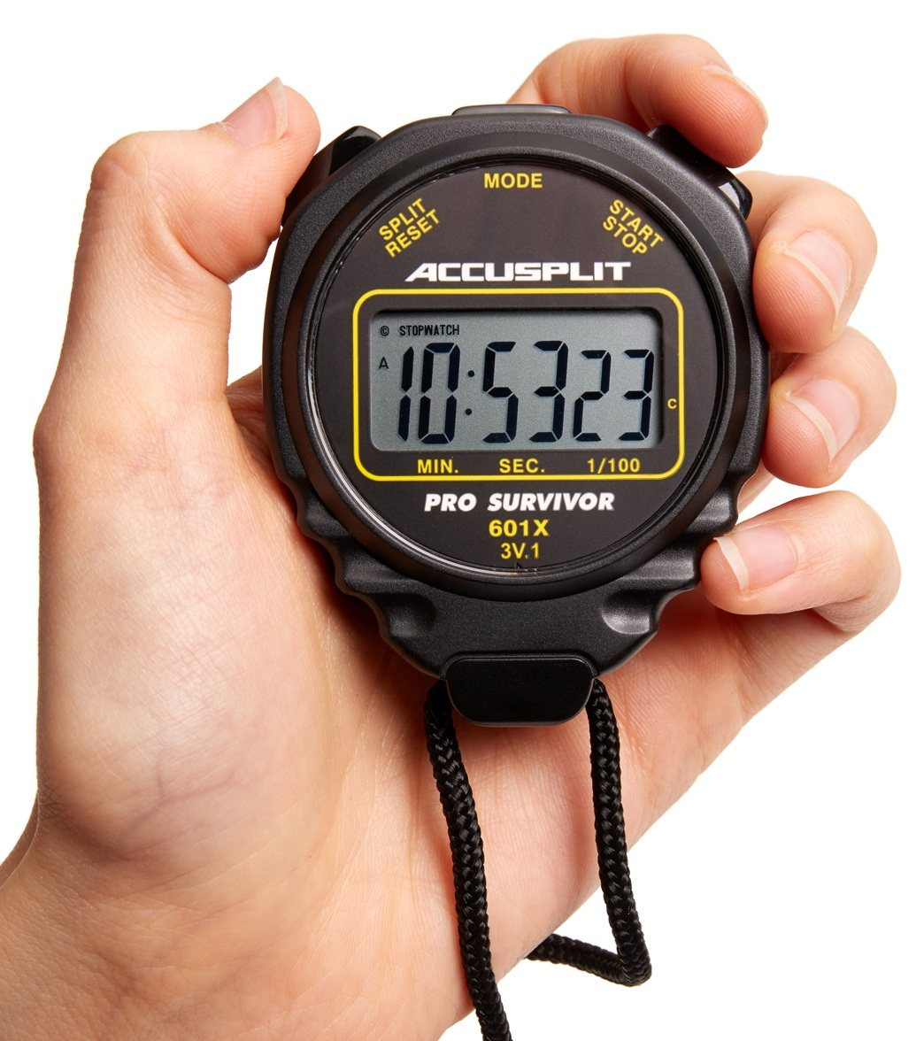
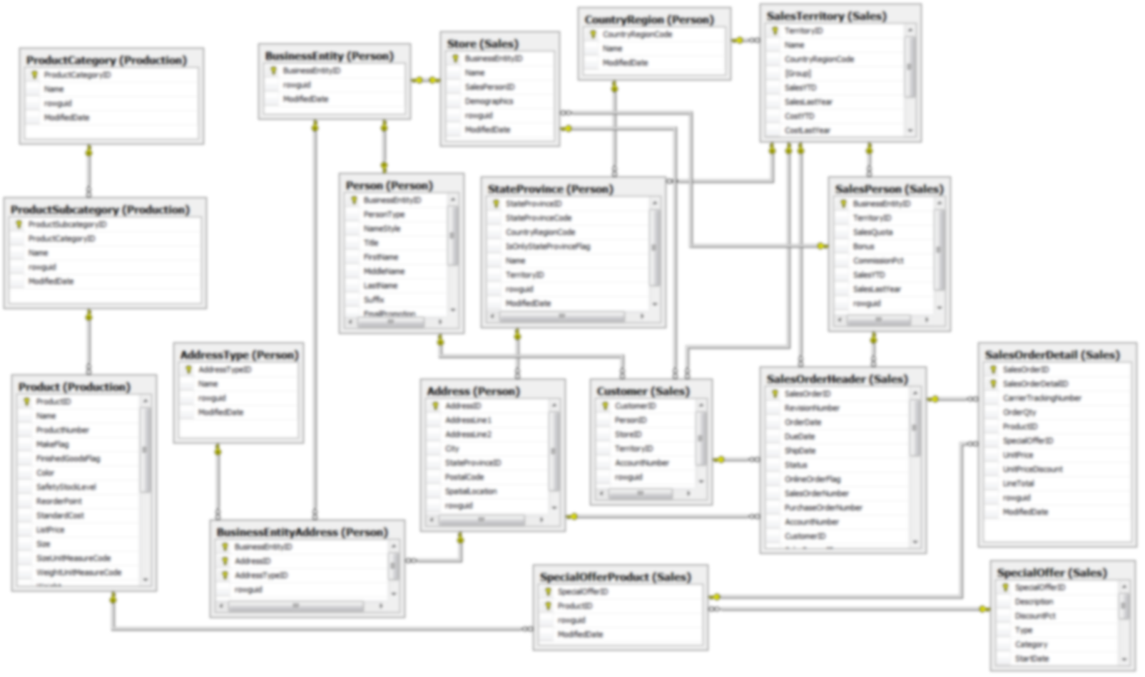
Data Platform:
Big Data Analytics
A complex Oracle query with a table join across 19 tables on our biggest server took over 20 hours. The data was exported out as .csv files, loaded into S3 and queried using AWS Athena (built on Apache Presto) and the same SQL ran in 20 minutes – without even any optimization
Notes:
Another example in the big data analytics realm was with our Office of Enforcement and Compliance Assistance, for some complex analyses they periodically run. This involved running a table join across 19 different database tables, some of which contain many millions of rows. On EPA’s biggest Oracle server, this query took over 20 hours to run. The data was exported as .csv files and loaded into the data platform, and the same SQL query was run using Amazon Athena and the query time was reduced to 20 minutes. Further optimizations can yield even faster queries.

Slide 12

Next Steps/Conclusions
Next Steps
  Finalizing steps toward agency authorization and approval for production
  Developing more robust and sustainable business model
Conclusions
  EPA’s cloud-based data platform offers excellent opportunities to improve how data science and analysis can be supported in the future
  Excellent opportunity to break new ground and improve how we can protect human health and the environment with new tools and capabilities
Notes:
OEI is in a great position. There has been a lot of interest from EPA program offices and regions in the analytics environment and great anticipation of our being able to transition from testing and proof of concept to production environment. Much of that hinges upon satisfying security requirements and receiving an Authorization to Operate (ATO) and then working collaboratively across the agency to more sustainably and robustly fund and continue building out the environment.
Our future horizons look great.

Slide 13

Thanks and stay tuned, exciting times are ahead…
Dave Smith smith.davidg@epa.gov
202-566-0797
Julie Kocher kocher.julie@epa.gov
202-566-0710

