Slide 1
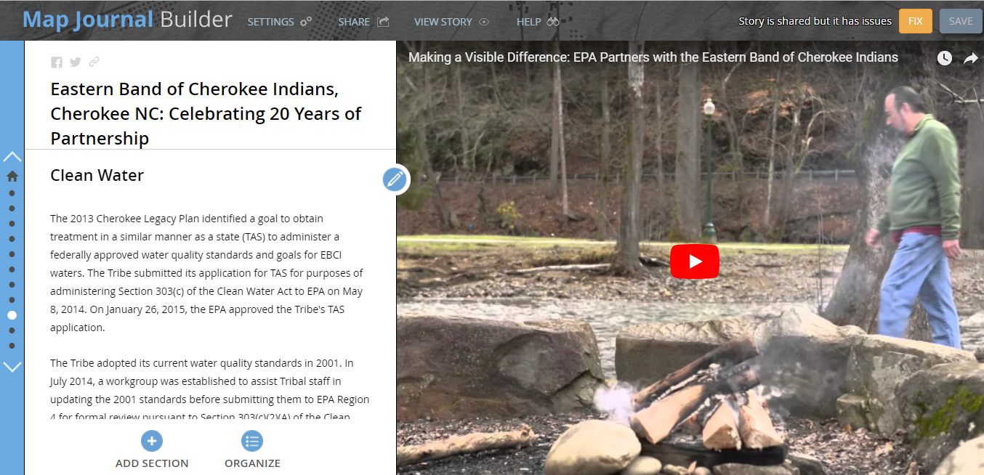
Story Maps for communication and coordination
Lee Pera -- EPA Office of Environmental Information -- Pera.lee@epa.gov -- 202-566-2332

Slide 2
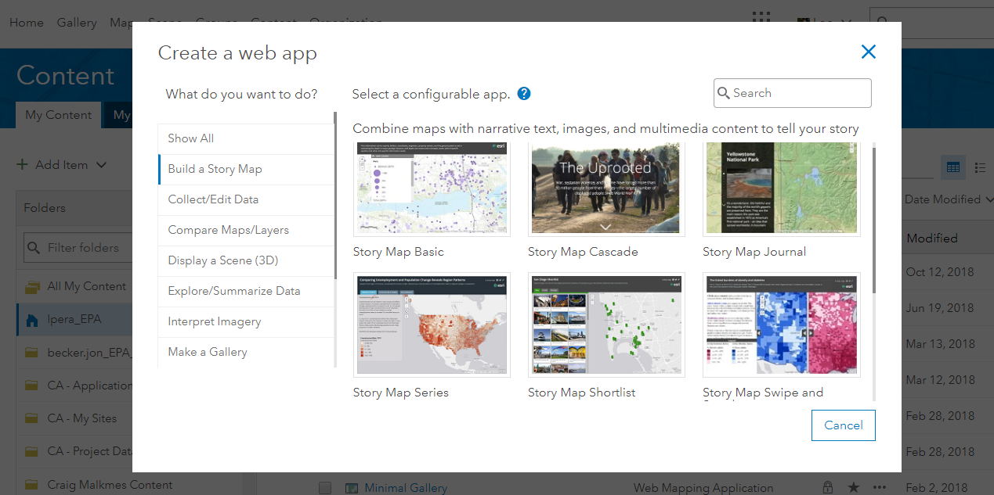
Story Maps
Esri Story Maps let you combine authoritative maps with narrative text, images, and multimedia content.

Slide 3
STEPS IN THE PROCESS
1: Get Inspired - Look at Examples 2: Identify your audience 3: Decide which template to use 4: Assemble or create the components - maps and media 5: Write text for story pieces
6: Build an initial draft story using Esri story map template 7: Get feedback and revise the draft story
8. Test on different devices 9: Share and socialize the story

Slide 4
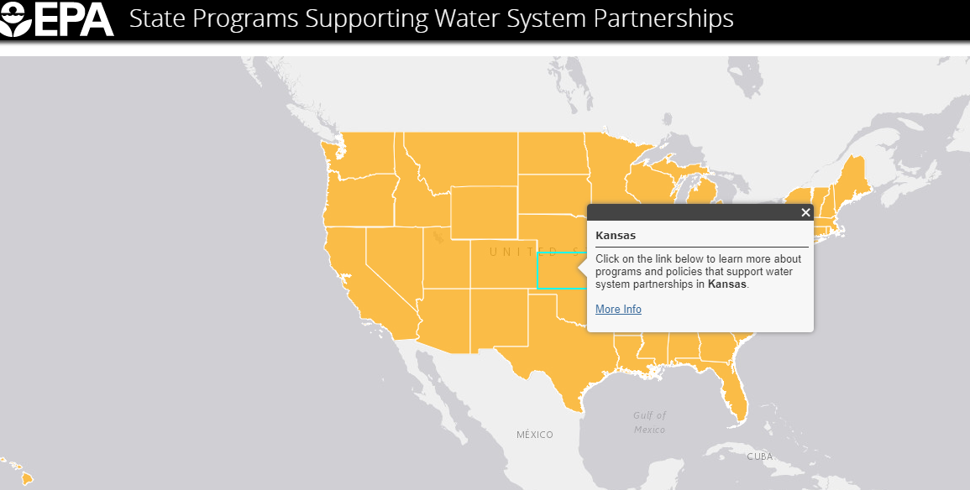
EXAMPLES
Cascade Template: From Eyesores to Assets, EPA Brownfields Example
Map Journal Template: Eastern Band of Cherokee Partnership
Map Series: Water System Partnerships
Storymap as Training Guide: Using CFRST, EPA
Region 6 Grants to
States, Tribes and Communities
Water Utilities Case Studies
Emergency Response Storymaps:
Florence and Maria

Slide 5
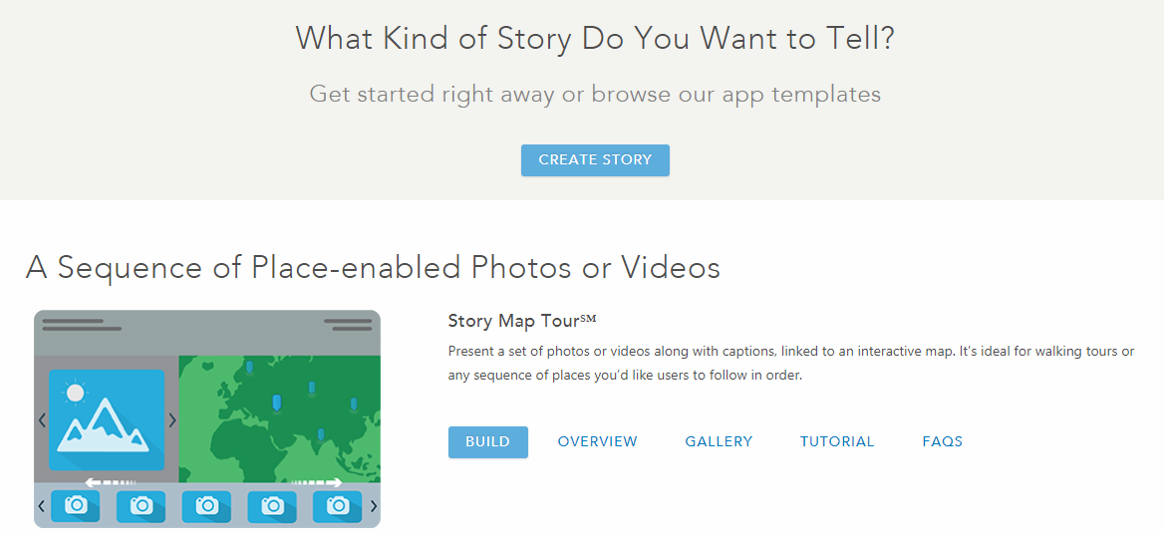
TEMPLATES
How to Choose: https://storymaps.arcgis.com/en/app-list/

Slide 6
STORYBOARD
A useful practice before creating and assembling the Story Map is to story board out the process. A good first step is to summarize the story concept in a sentence or two. A second step might be to sketch out a storyboard that diagrams the basic elements of the story and the means by which users will access it (see Table 1).
Home Section Title | Side Panel | Main Stage
Section Title | Side Panel | Main Stage

Slide 7
STANDARDS
Most organizations will be able to identify several story patterns that represent their most frequent storytelling needs. Common story patterns are annual reports, scientific publications, event promotions, project summaries, and weekly briefings. It’s beneficial to have standards for each type of story pattern to establish common look and feel.
Be sure to consider standardizing story elements like the logo, tagline, and click-through links that appear in story headers for each type of story pattern. Your may also want to establish a standard or suggested format for story titles, subtitles, or even the tab/section names in a Map Series or Map Journal. Think about what makes each story pattern unique and establish standards that make sense for your work.

Slide 8
MAKE A STORY MAP!
https://storymaps.arcgis.com/en/

Slide 9
ESRI EXAMPLES
Instructional Storymaps: “How-to stories” for all aspects of storymaps
Esri Team’s Favorite Storymaps 2017
Storymap Galleries – a template to display all your storymaps

Slide 10
RESOURCES
Storymap Resources
Getting Started with Storymaps
Storymaps 101
Developer’s Resources
Instructional Story maps showing you how to build great maps
Ten essential steps for storymap success –
ArcGIS Blog – 15 things you can do with storymaps
EPA Guide to Storymaps – email Lee – pera.lee@epa.gov

Slide 11
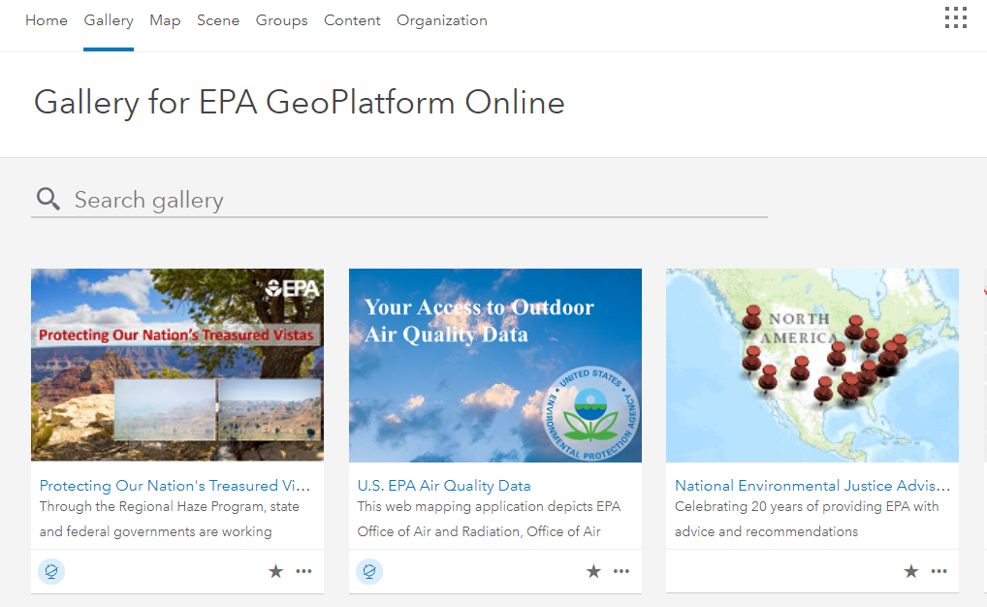
THANK YOU
Lee Pera -- EPA Office of Environmental Information -- Pera.lee@epa.gov -- 202-566-2332

Slide 13
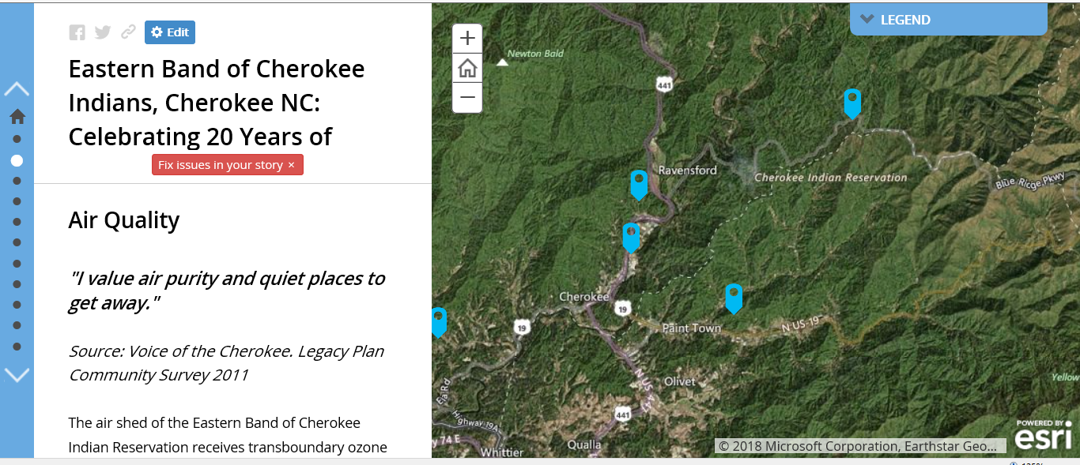

Slide 15
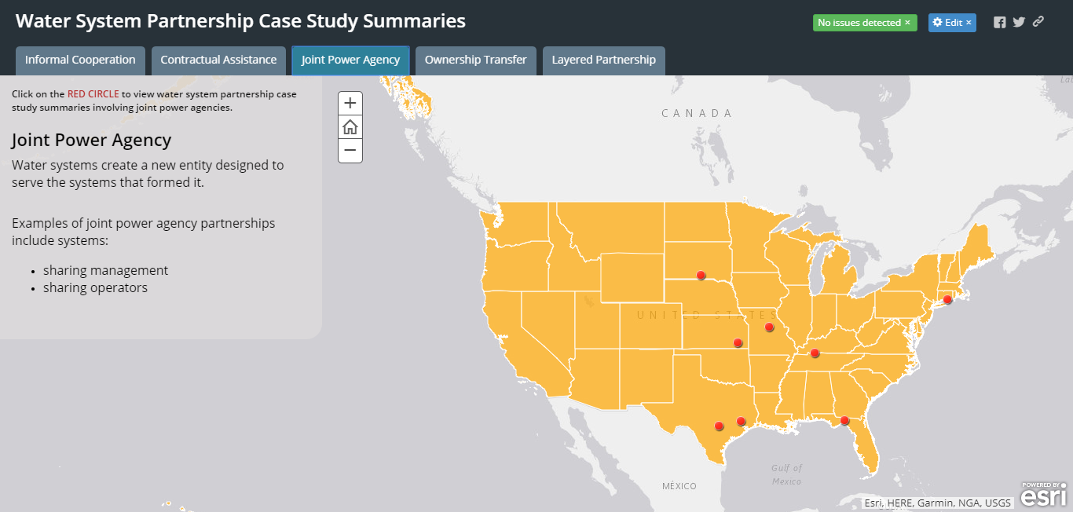

Slide 16
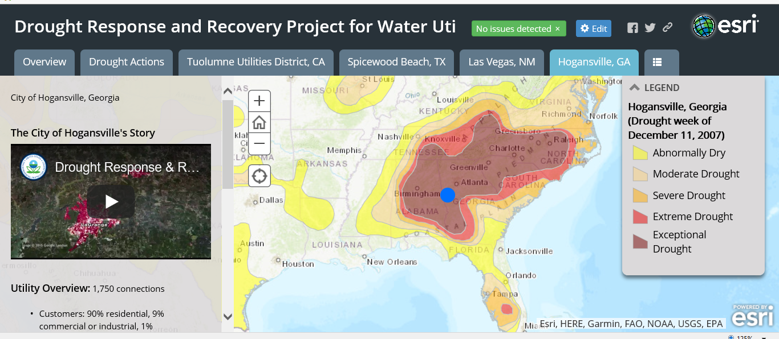

Slide 17
