Slide 1
Streamlining Field to Desk: Port Gamble S’Klallam Tribe’s Strong Water Mobile Application
Abigail Welch
Finfish Management Biologist
Maki Dalzell
Environmental Scientist, HDR
E-Enterprise for the Environment 2018

Slide 2
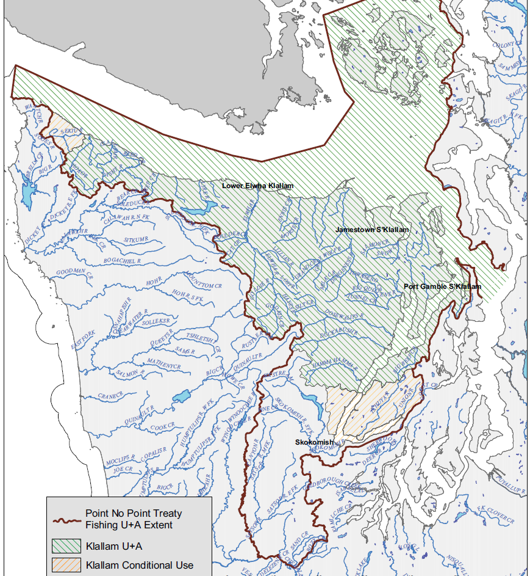
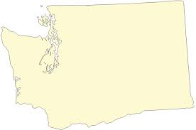
About Us
Located in the northwest corner of Washington state. One of 29 federally recognized tribes in WA state.
Reservation consists of 1,700 acres
1,300 enrolled members
Treaty rights to harvest fish, wildlife, and other natural resources under a co-management process
Usual and Accustomed areas includes 1250 river miles and 2250 square miles of marine areas.

Slide 3
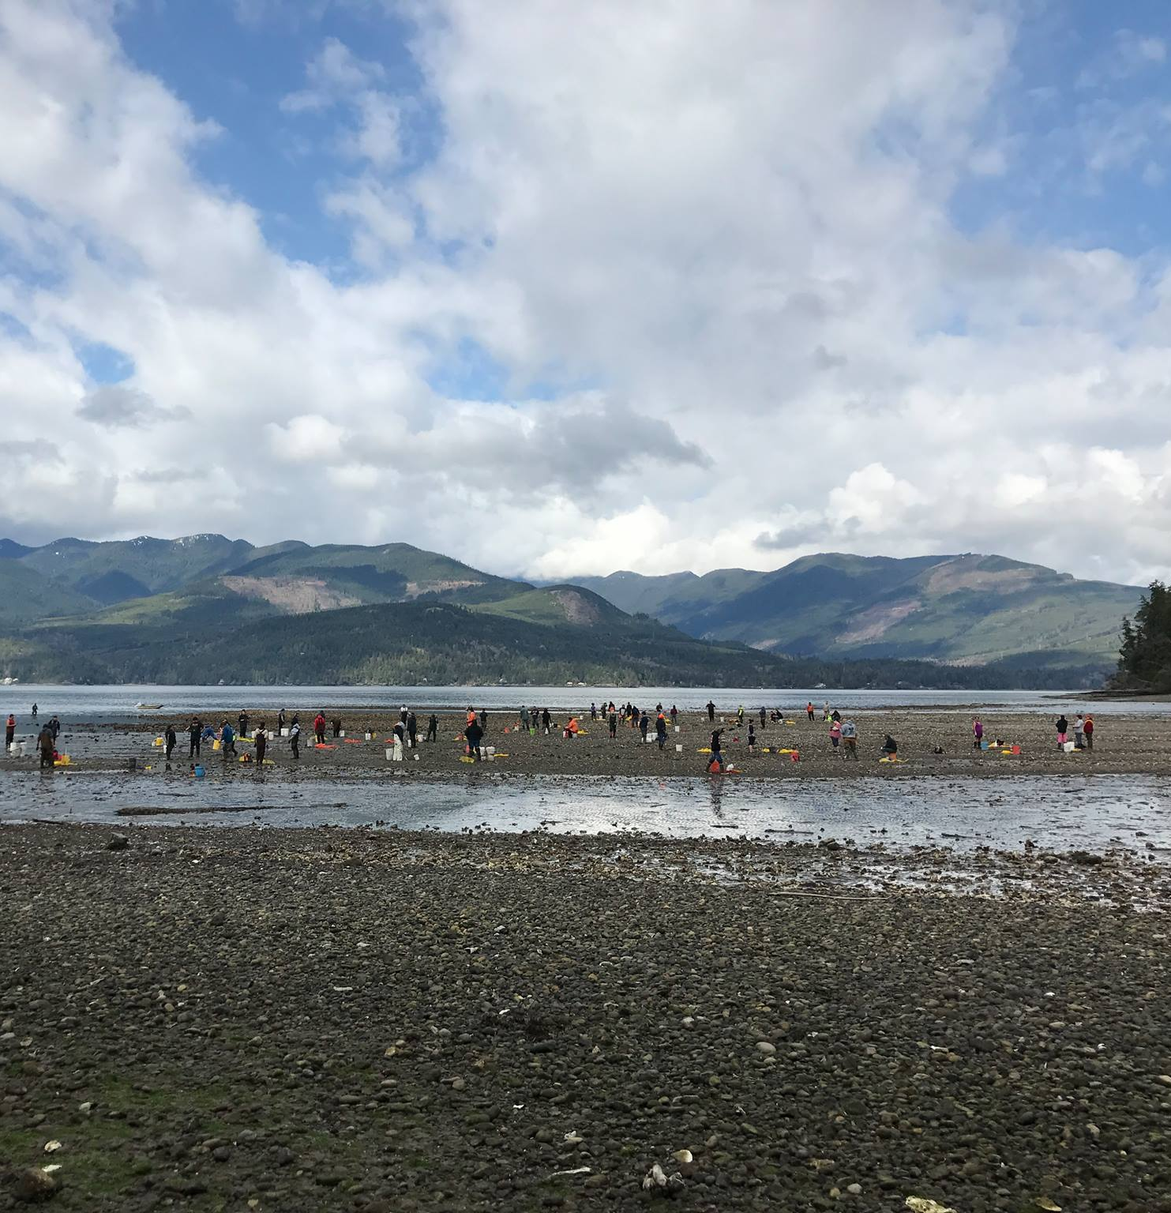
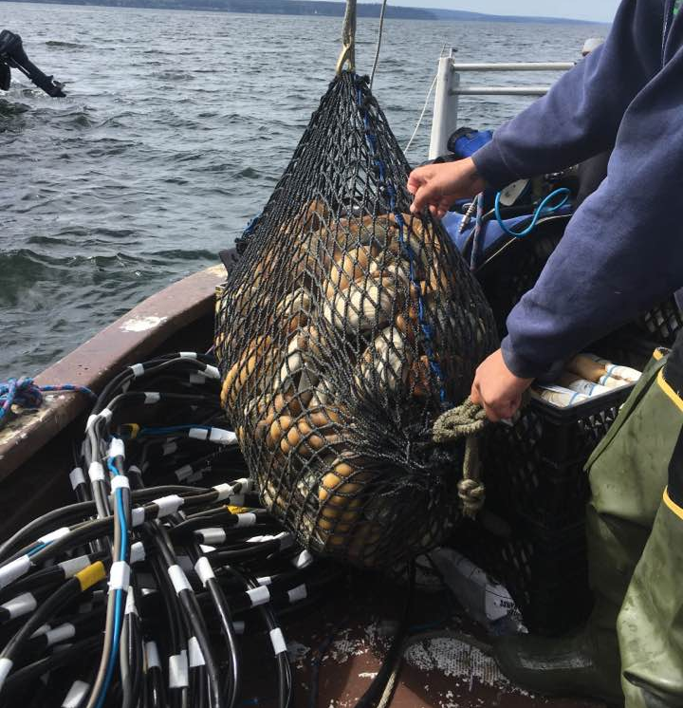
Natural Resources

Slide 4
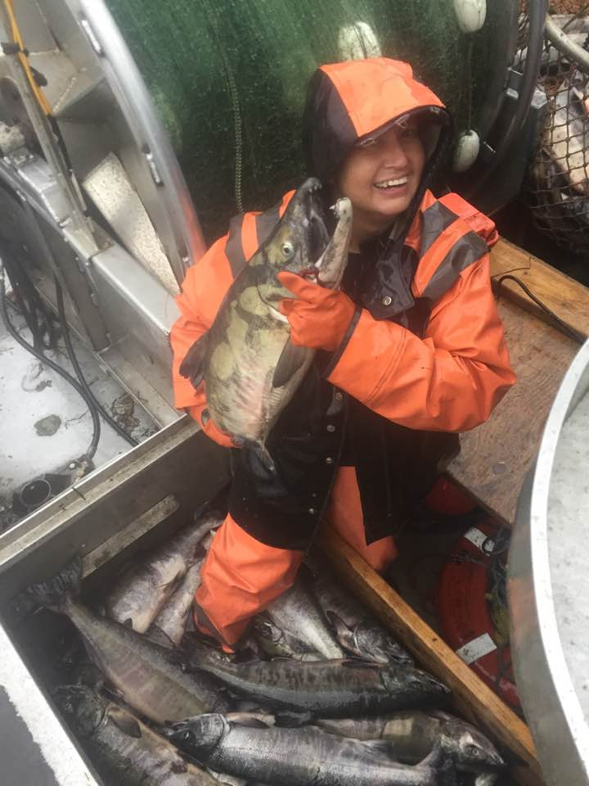
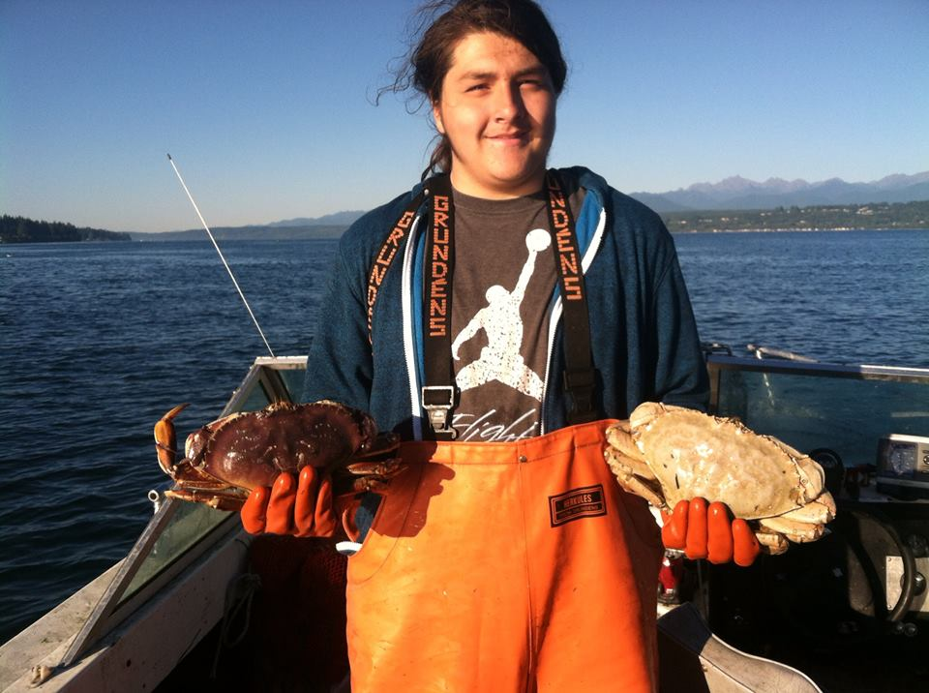
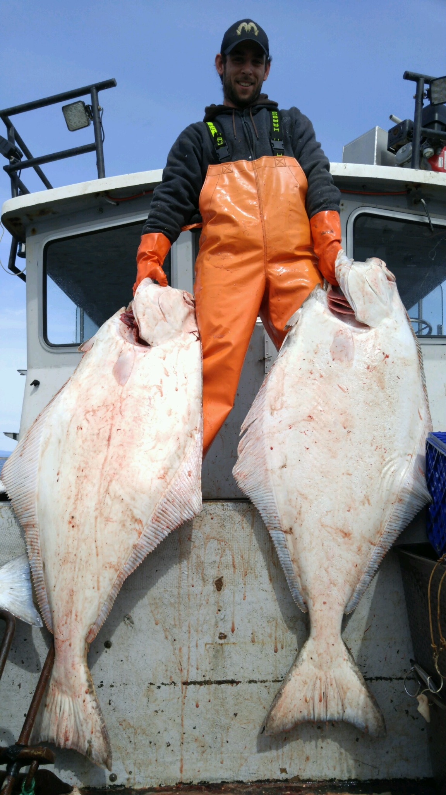
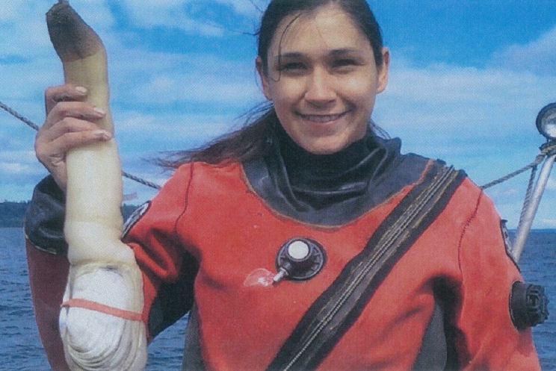
Fisheries Management
• Finfish
Hatchery & Net Pen program
Harvest
Commercial sampling
• Shellfish
Harvest
Beach Surveys
Flupsy-Floating Upweller System

Slide 5
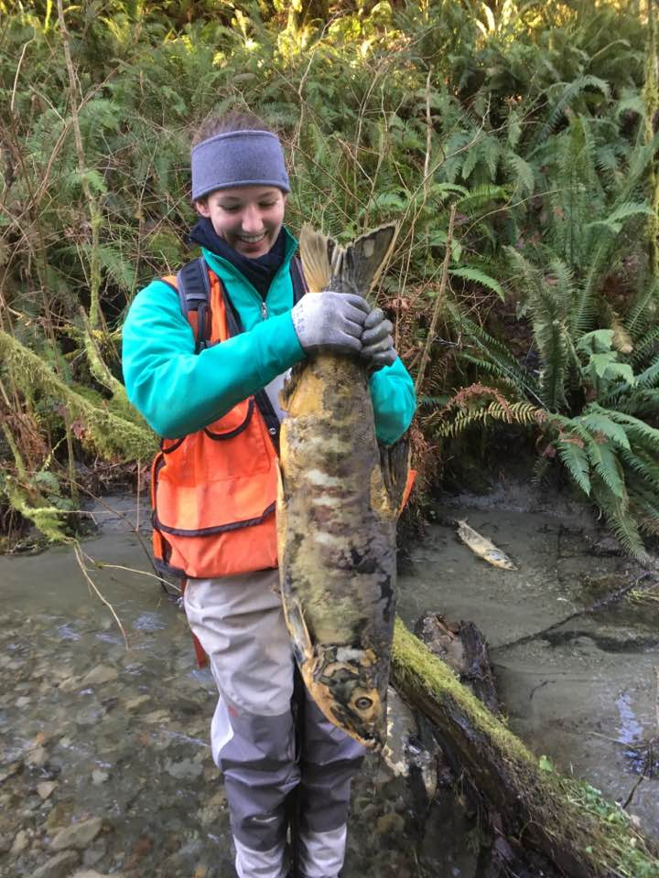
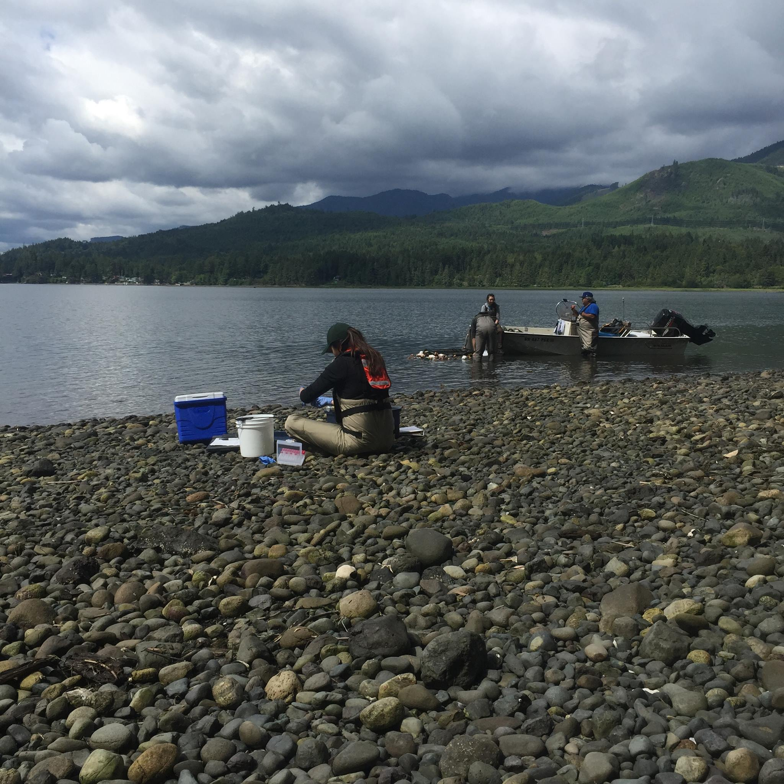
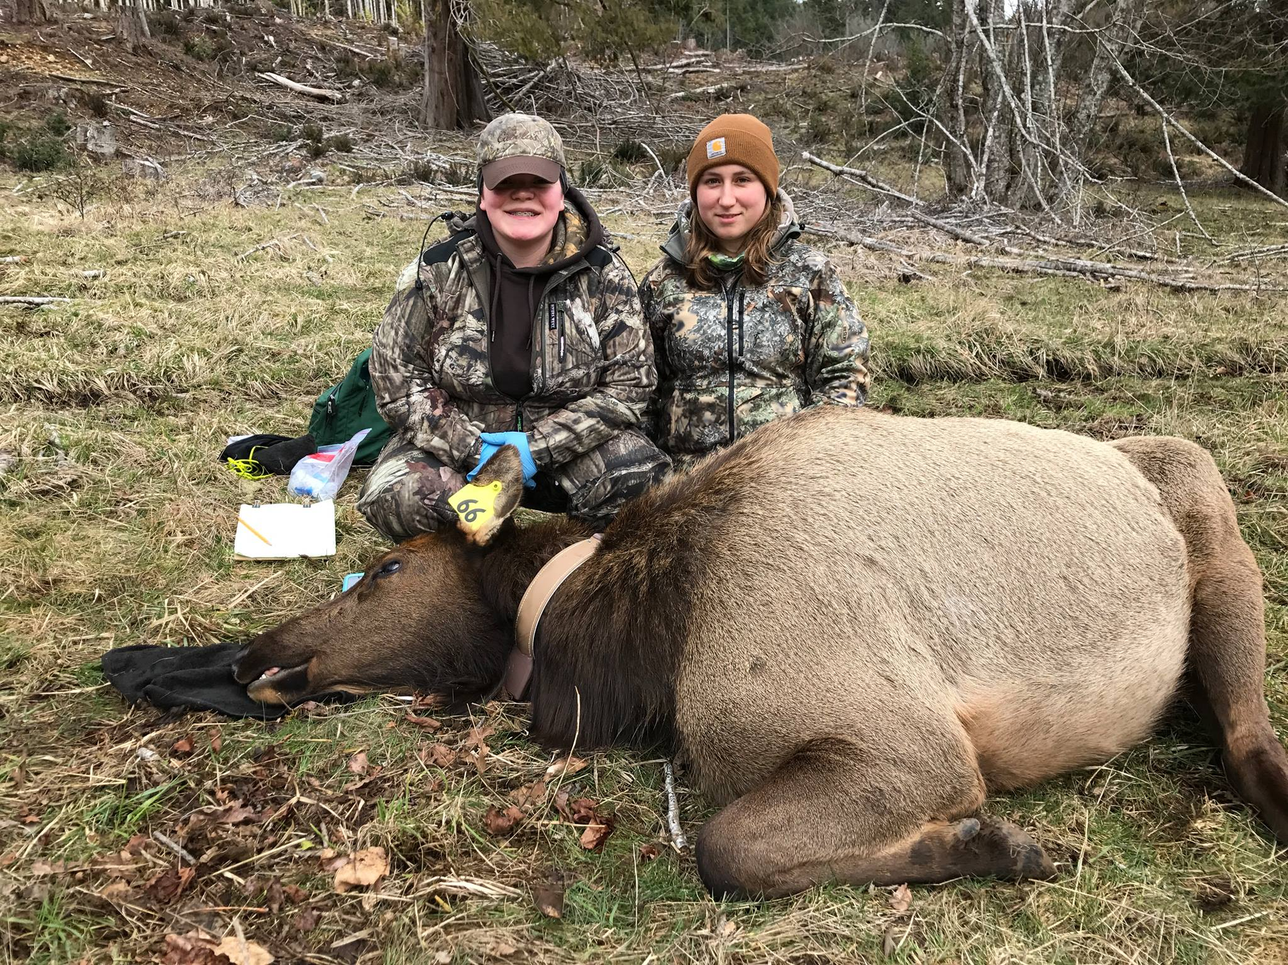
Habitat Research & Monitoring
Salmon Recovery
Forestry
Wildlife/Hunting
Elk surveys

Slide 6
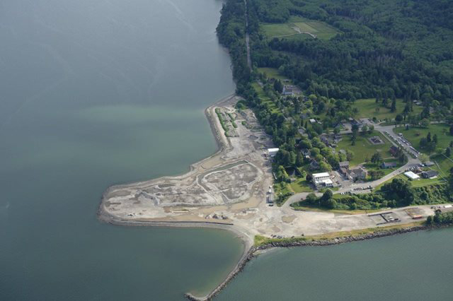
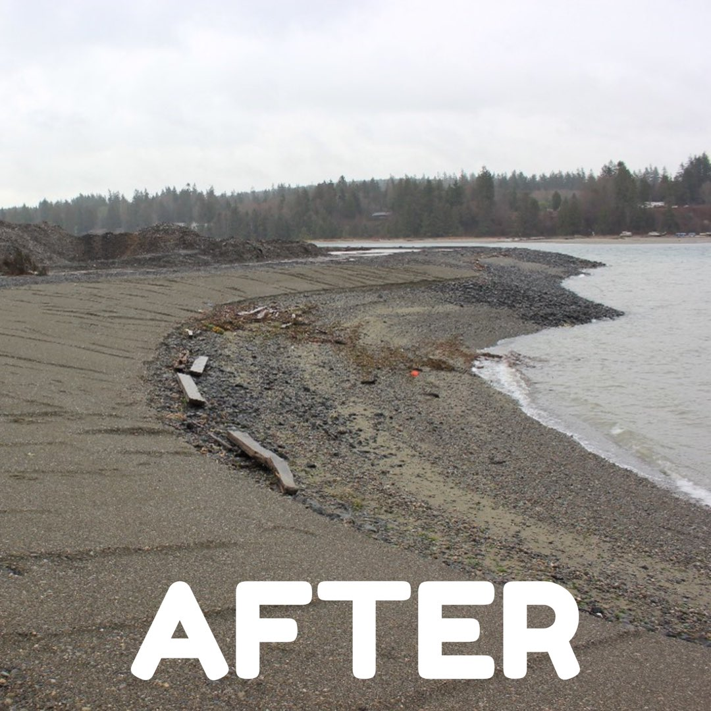
Environmental Programs
Brownfields
Climate Change
Protection/Restoration
Shoreline Management
Water Resources

Slide 7
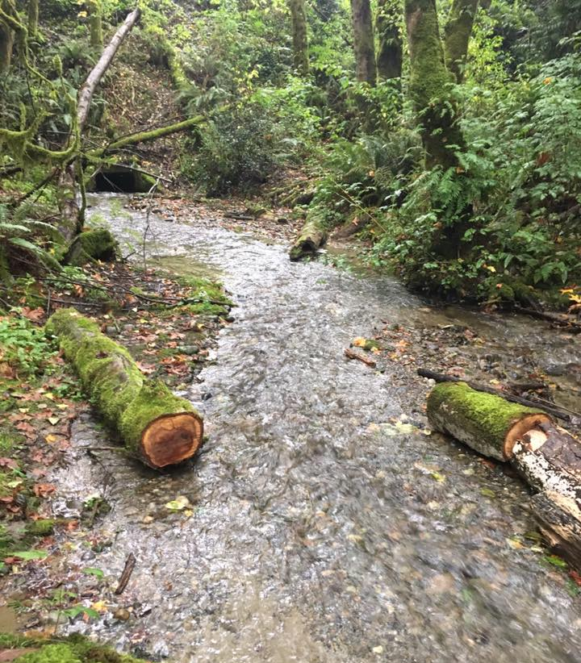
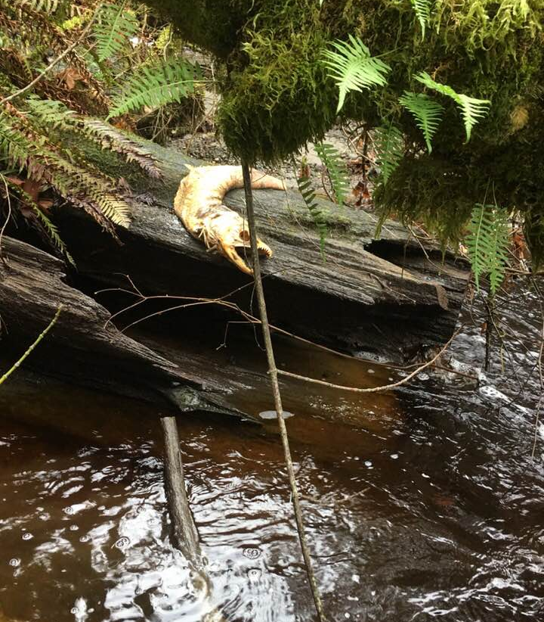
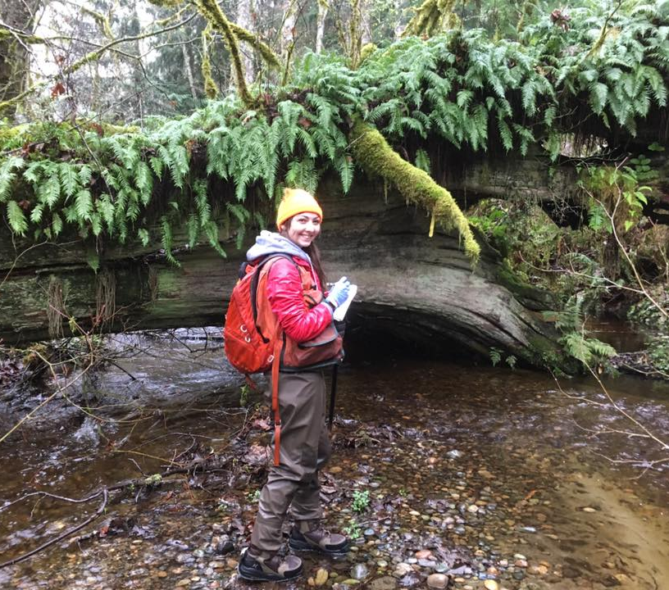
WQX Data Flow
First successful data flow to EPA
Monthly sampling on 13 different creeks and streams throughout the reservation.
Quarterly submittals to EPA-106 grant requirements.
Needed to streamline data entry into STORET
Utilizes the NWIFC front end but uses PGST’s own network node (2009 Readiness grant).
Paper to database data entry time consuming
Mobile App that can sync to our database
Notes:
Help streamline ability to get data into EPA’s database-elaborate on this, describe the “front end”, challenges of STORET database

Slide 8
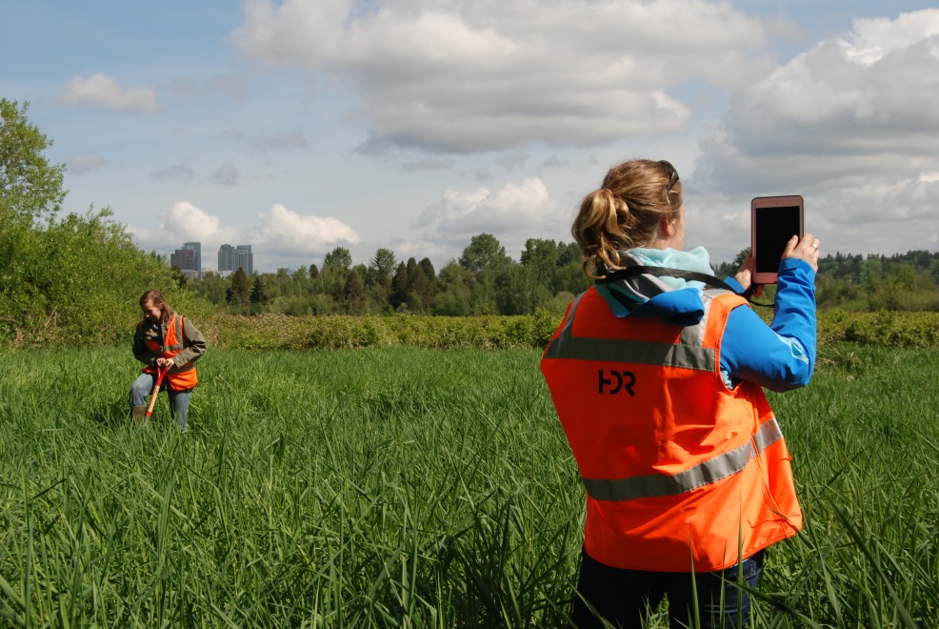
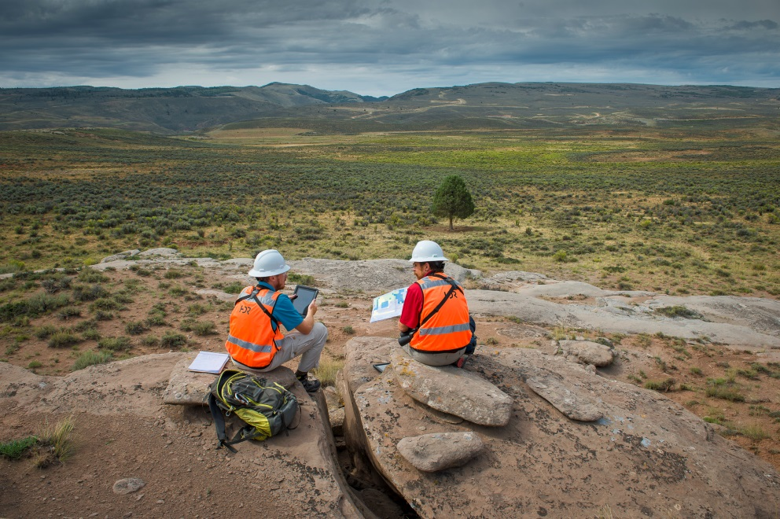
WQX Mobile Application
2017 Grant awarded
Goals
Paperless in the field
Ability to function offline, data transfers can resume when connection is restored.
Rapid Collection
Increased availability of timely, high quality data to improve decision making
Affordable maintenance fees
Notes:
Elaborate how much time we are saving, compare to NWIFC front end and how many clicks/time for entering it in.

Slide 9
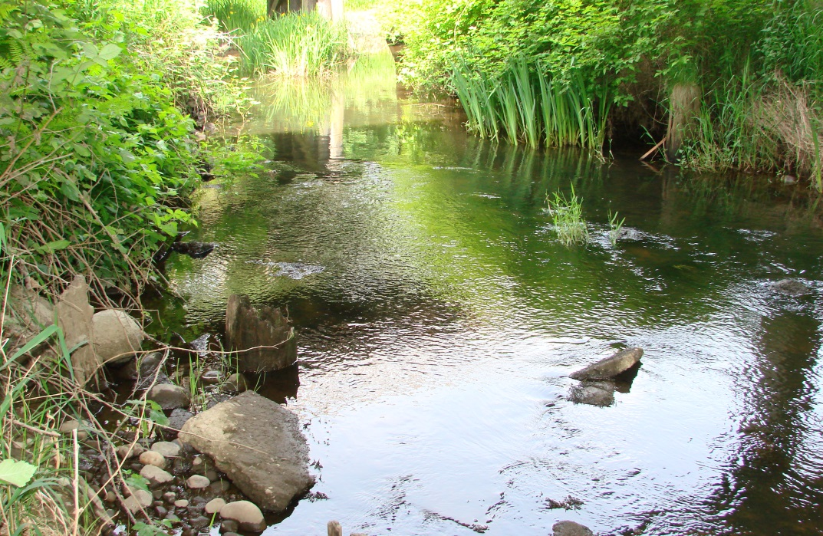
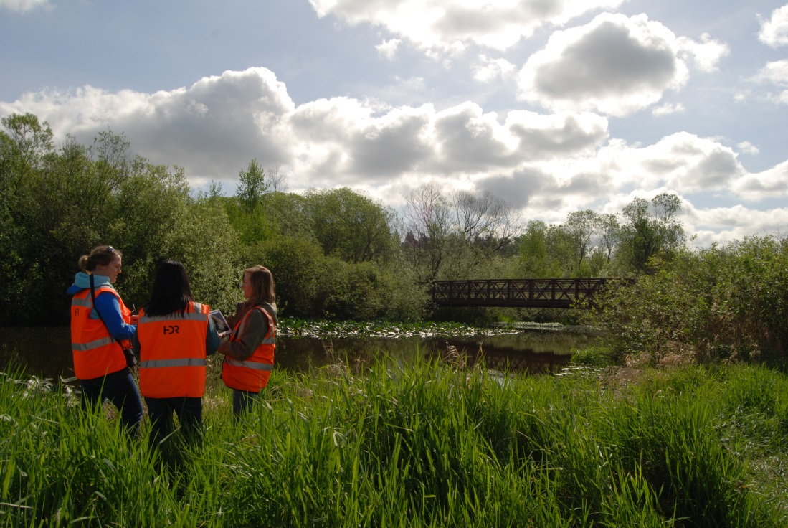
WQX Mobile Application
Platform: iOS
Mobile Framework: Xamarin
Data Connection: ASP.NET core, web API
Works offline
One-way sync
Installs and updates are distributed via custom app store or iTunes
Notes:
Xamarin is a cross platform mobile framework owned by Microsoft.
Xamarin can support iOS, android, or window apps. So we can reuse the same code if we want to extend into another platform
The app works offline by storing data on a device using SQLite, which is a database that lives on the device. SQLite connects to the SQL database via ASP.NET core, web API.
All of these programs are open source and don’t require fees.

Slide 10
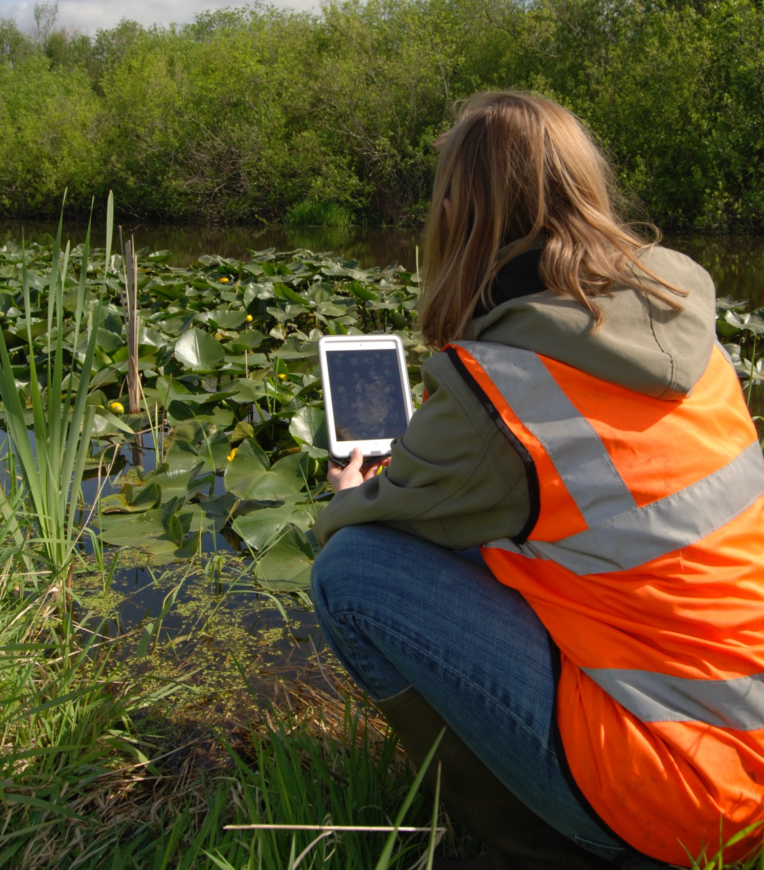
WQX Mobile Application
Challenges
Complex database to understand
Validation of tables

Slide 11
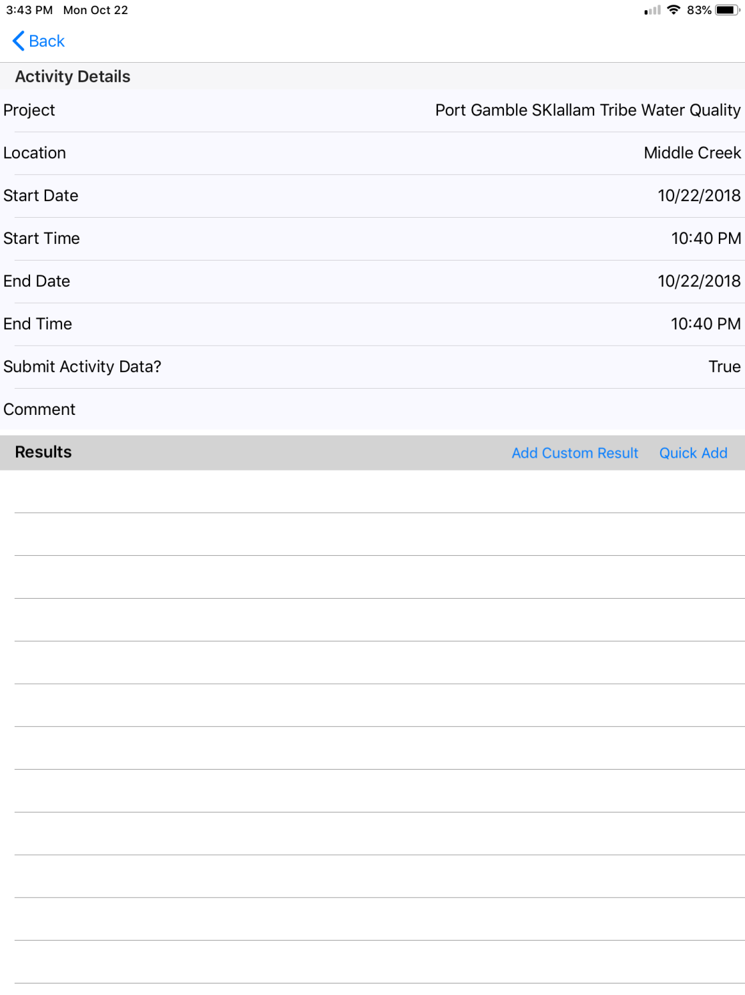
Benefits
Simplified flow having to select 10 of 3,028 characteristics
Search function added for characteristics and units
Minimize errors in the field having uniform data entry requirement and acceptable ranges for units

Slide 12
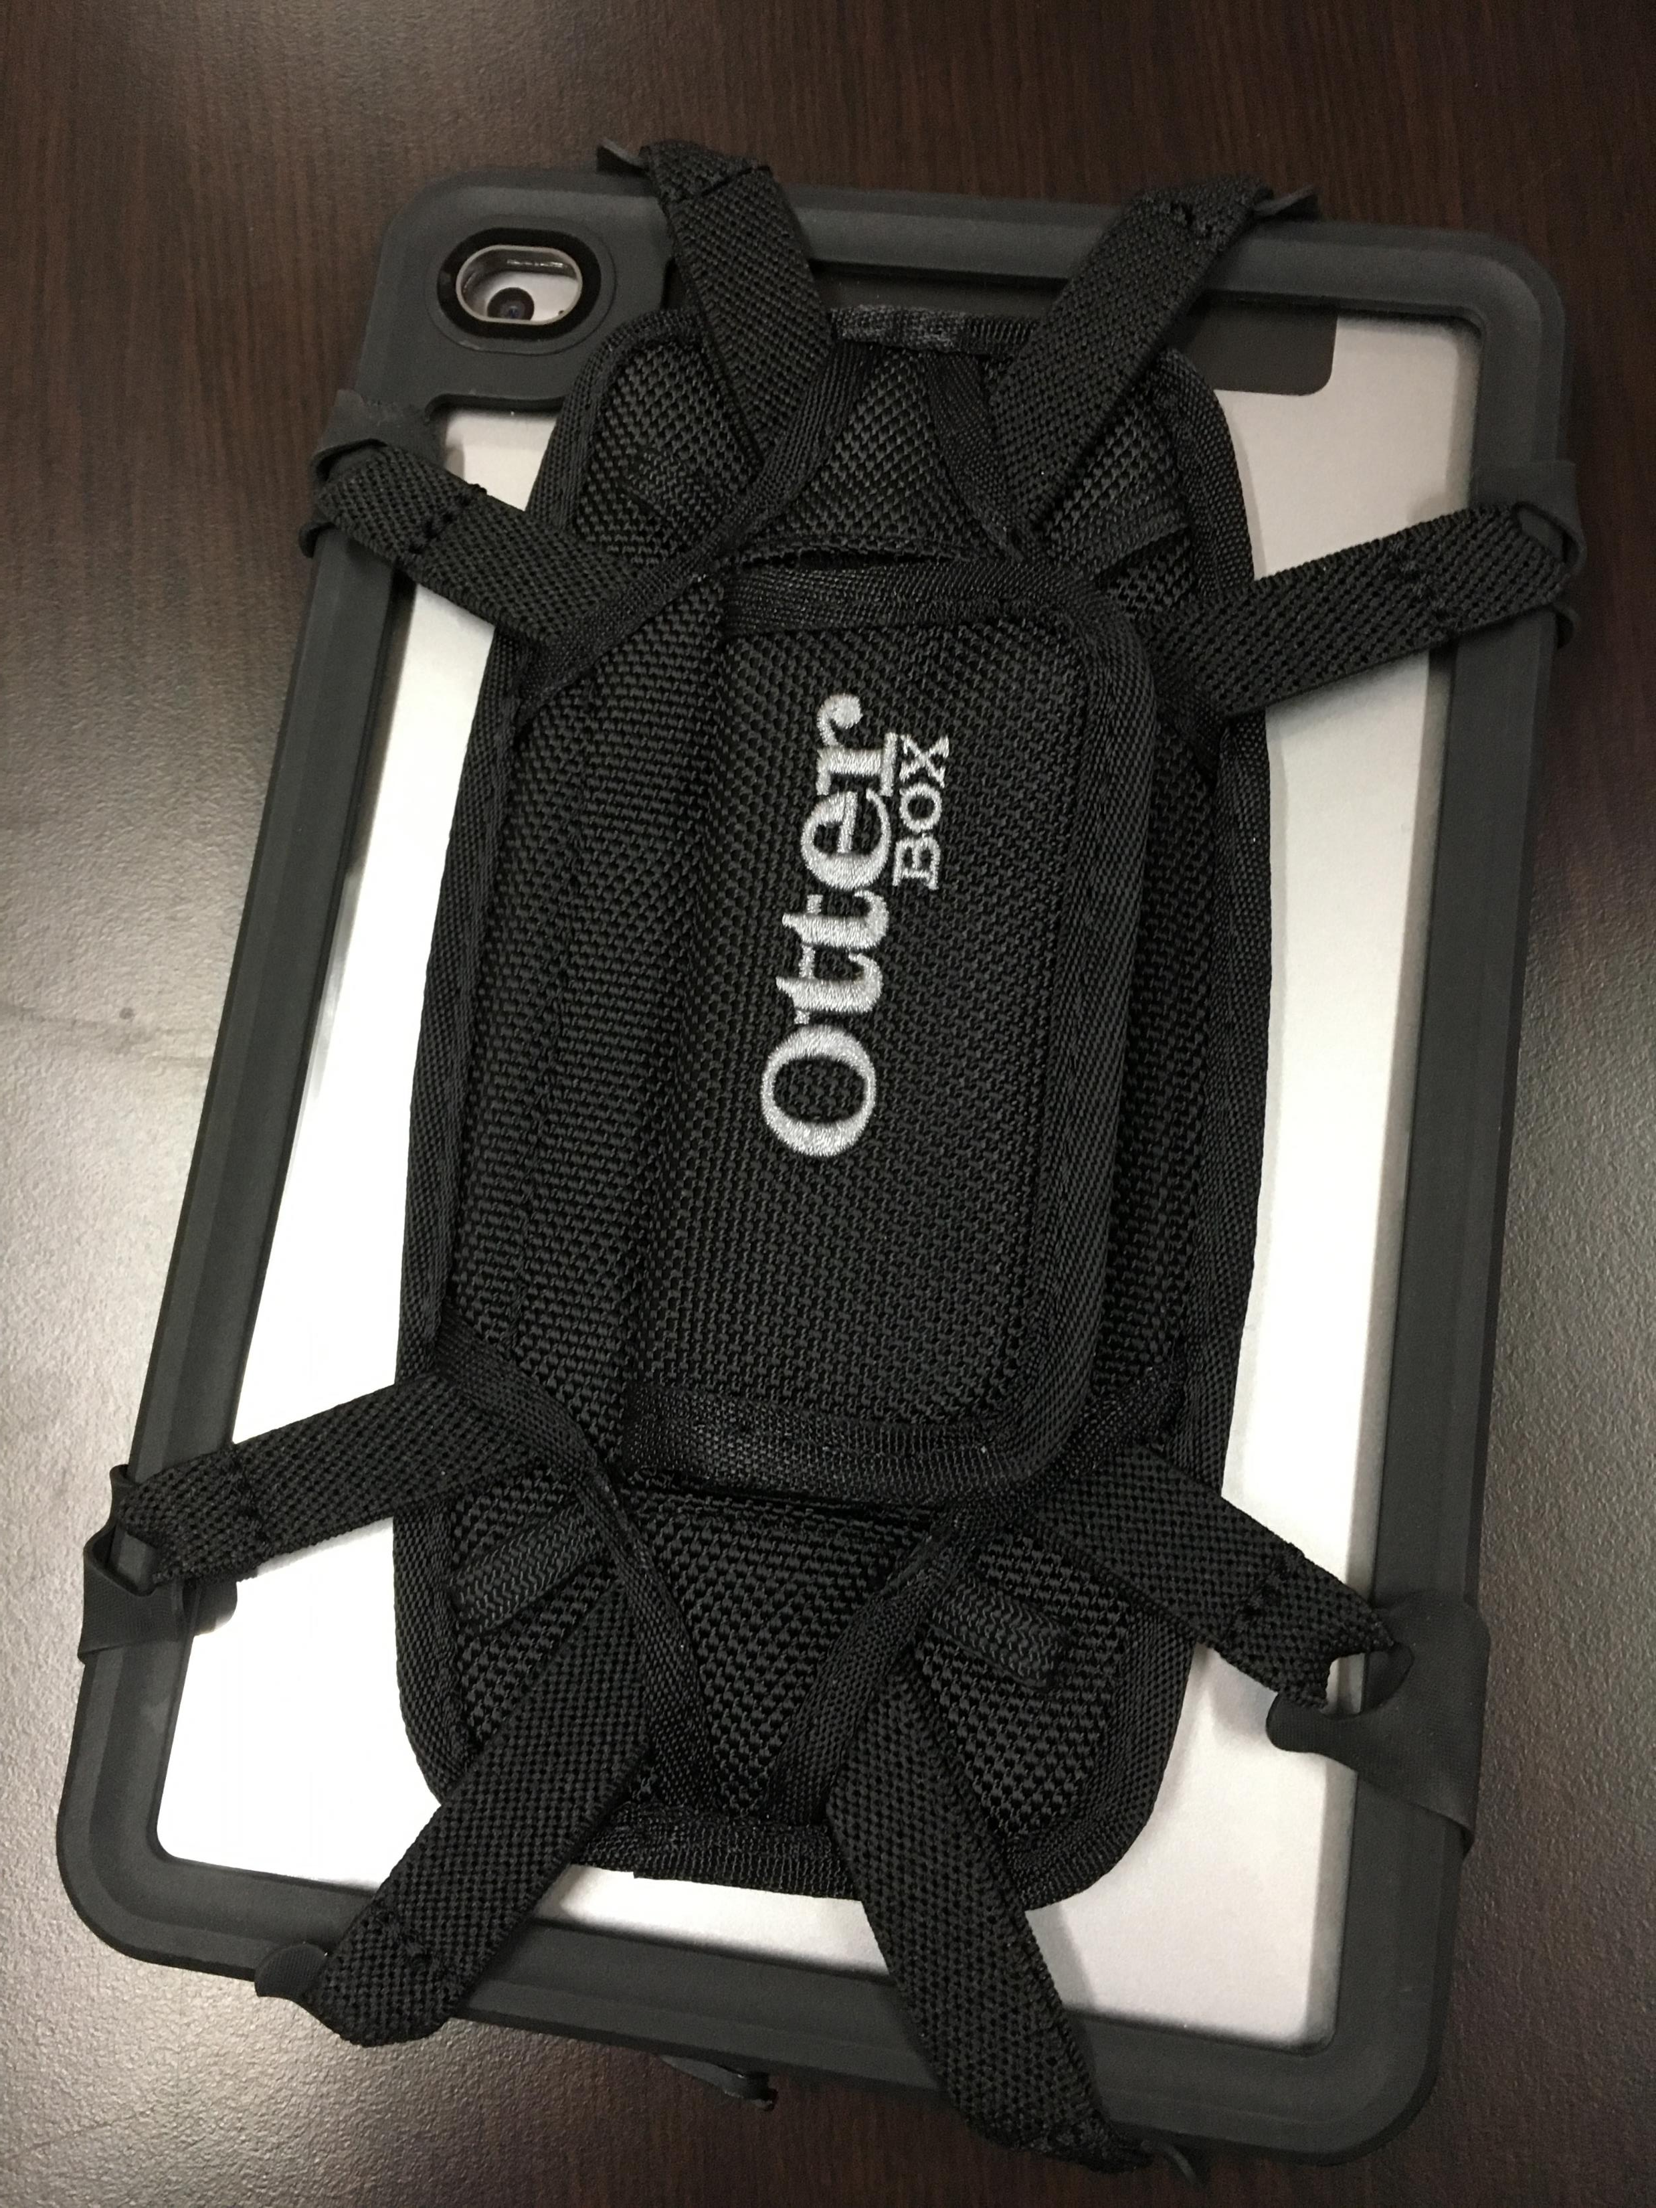
Ipad Mini with waterproof case and holder

Slide 13
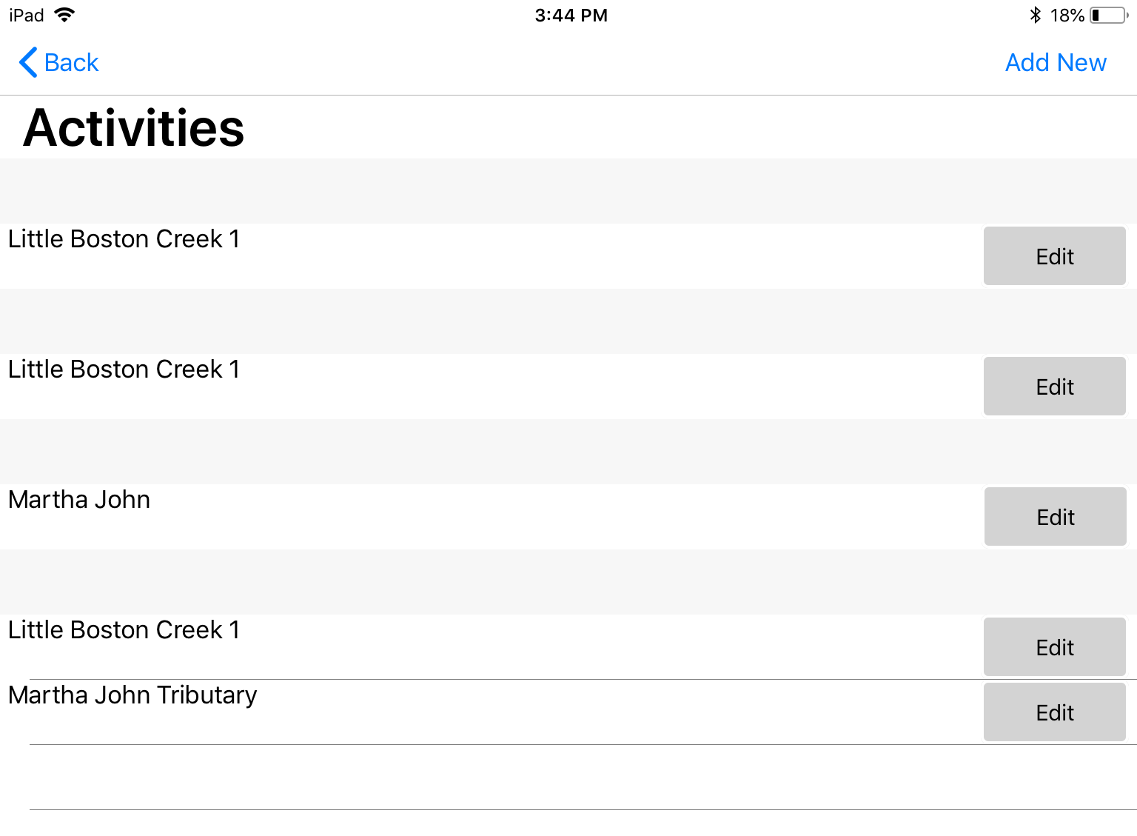
Notes:
Crop, make larger or do a video clip of data collection.

Slide 15
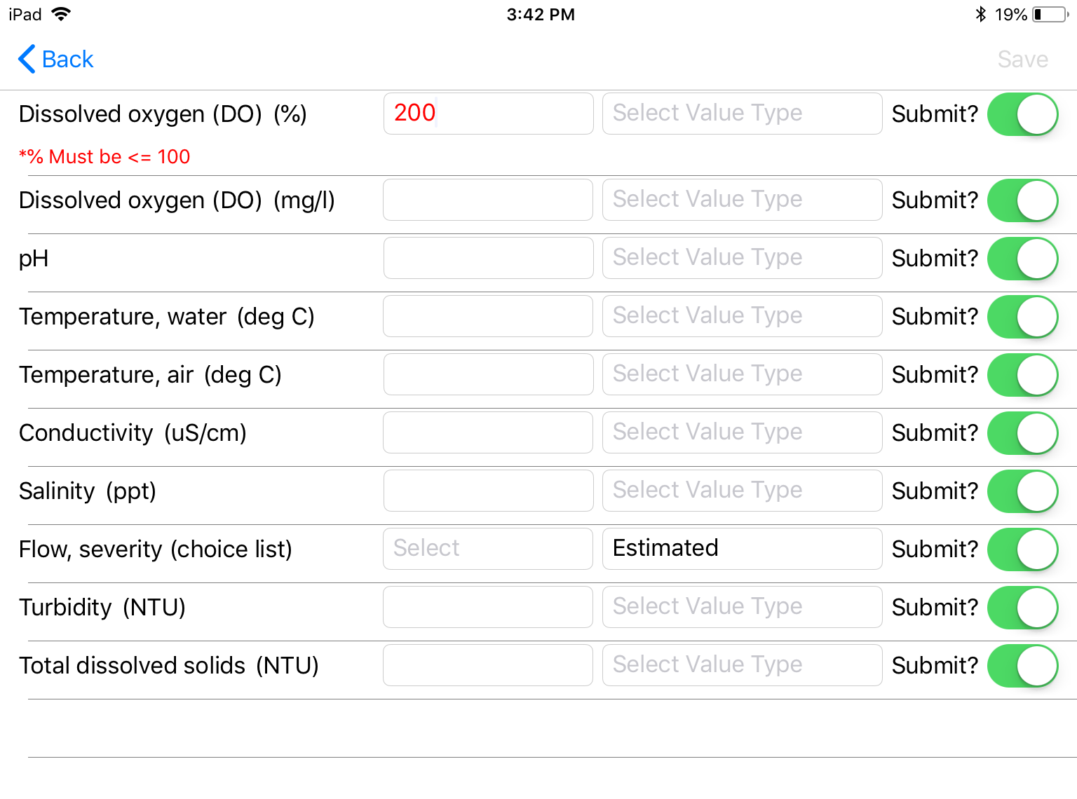
Notes:
Talk about QA/QC

Slide 16
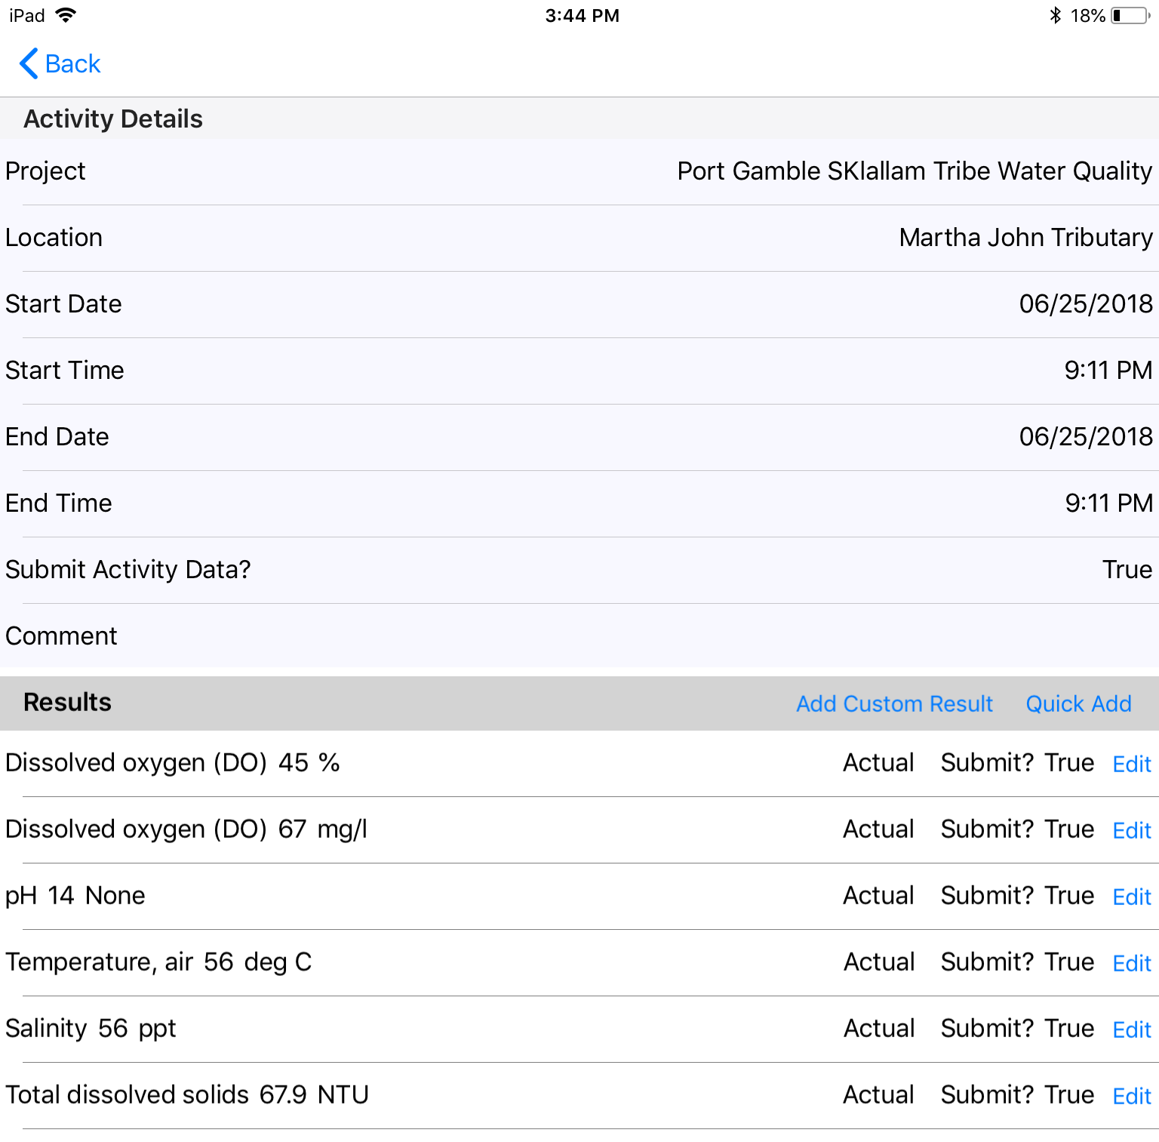

Slide 17
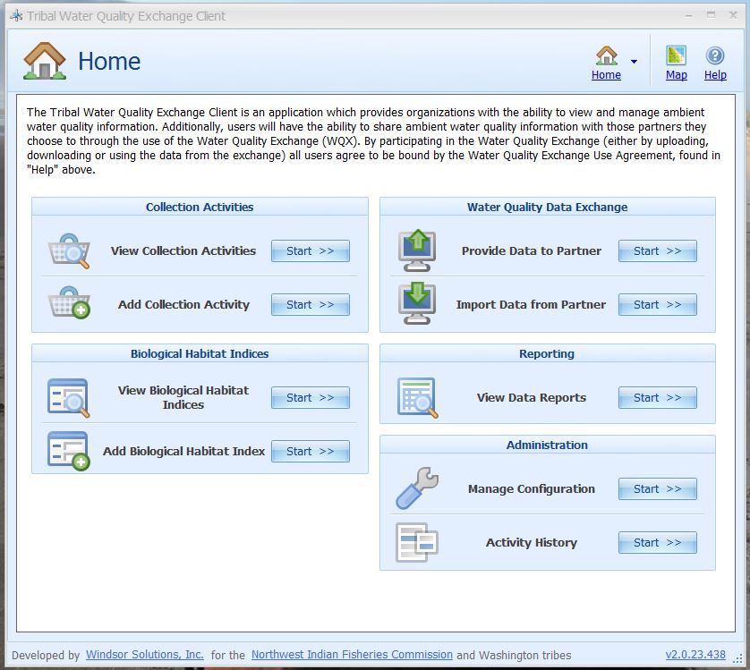
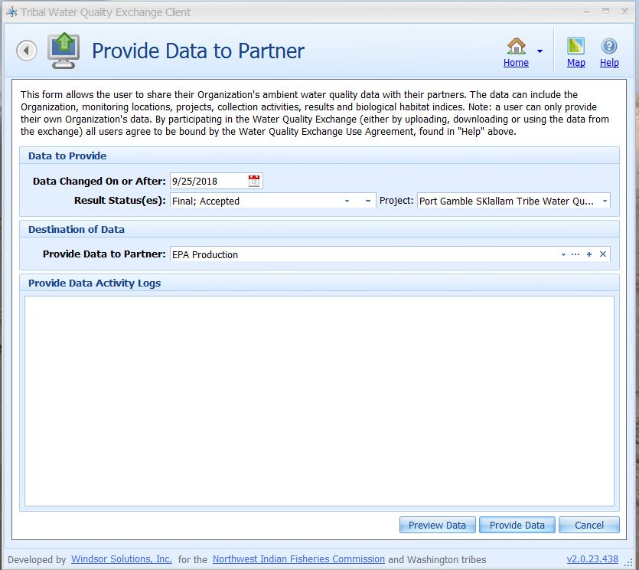
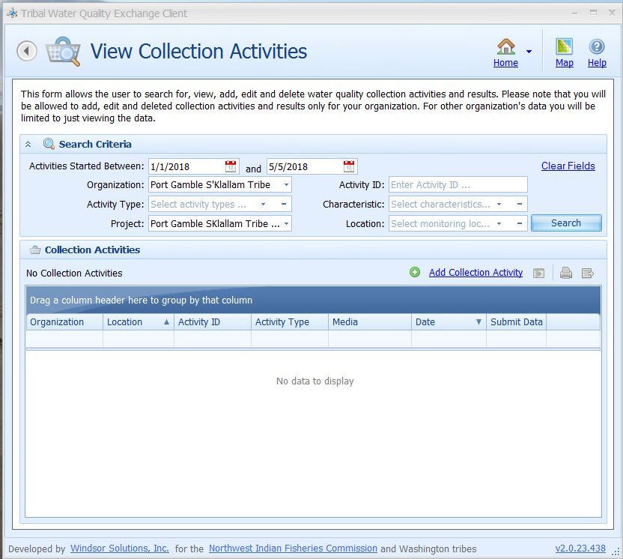
From the Field to EPA
TWQD
PGST network
Sync data

Slide 18
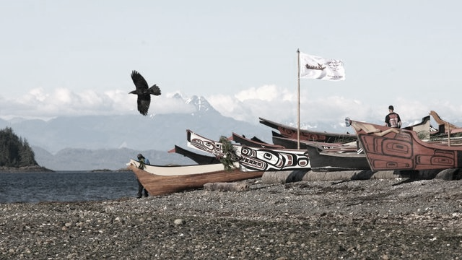
Questions?
PGST Resources:
Northwest Indian Fisheries Commission/ SSHIAP https://nwifc.org
HDR Inc: www.hdrinc.com
Windsor Solutions: www.windsorsolutions.com

