Slide 1
Implementing an ePermitting Solution in South Carolina
Michael Sheehan, SC DHEC
John Kostakos, Windsor Solutions

Slide 2
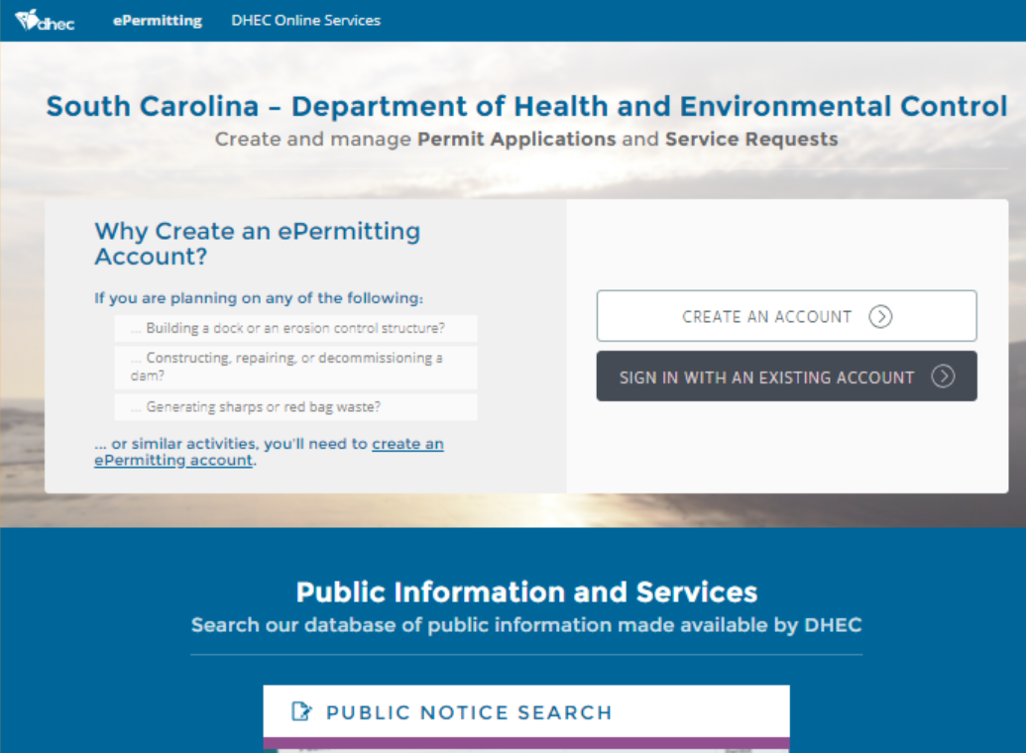
Project
Overview
DHEC Online Services

Slide 3

Project Definition & Scope
ePermitting is the agency’s official solution for permitting and compliance
Complete lifecycle
  Inspections, enforcement, complaints, and finance
Air, Land, Water, & Environmental Health
Integrations with existing applications
  Contractor search, many GIS applications
  Emergency response
FUN FACT - The state dance of South Carolina is the Shag!

Slide 4


Project Drivers
Reduce risk
  Aging legacy system
Empower customers
  Self-service for internal and external users
Business transformation
  Standardization & Streamlining
  Customer Service
FUN FACT – The salamander is the official SC state amphibian!

Slide 5

Programs & Timeline
Pilot programs
  Dams and Infectious Waste
OCRM (CA & CZC), Stormwater, Agriculture
Focus on enterprise capabilities
Very close to finishing the implementation of wastewater
FUN FACT – Sumter SC has the largest Gingko farm in the world.

Slide 6
System Overview

Slide 7
nVIRO
COTS Solution
  Currently in production at DHEC + 4 other States
Why did DHEC select nVIRO?
  Supports Core Regulatory Life-Cycle
  User Configurability
  Online access - Internal Users, Registered Users, and Public
  Ongoing enhancement releases
Notes:
Windsor’s Enterprise Solution for Permitting Compliance and Enforcement
Key benefit for DHEC, are regular enhancement releases
- First, Windsor has continued to invest in the product making enhancements and developing new features
- Windsor collaborates with DHEC and other states to implement enhancements or new features that they desire
- Each state benefits from the enhancements contributed by Windsor and the other states

Slide 8
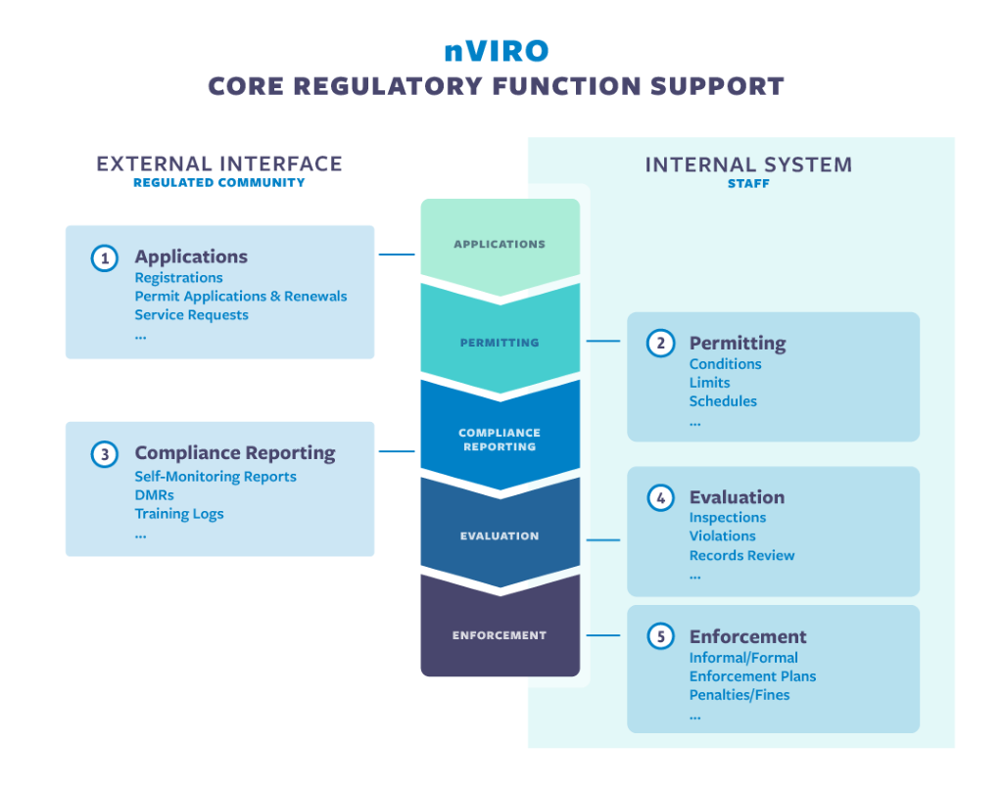
nVIRO
Supports Core Regulatory Life-Cycle
  Applications
  Permitting
  Compliance Reporting
  Evaluations
  Enforcement
CROMERR
Notes:
nVIRO supports the core regulatory lifecycle:
Applications – Account registration, online submittal of applications, other service requests
Permitting – New permits and permit revisions, specification of permit conditions, reporting schedules, generation of permit docs
Compliance Reporting – Online submittal of required or as-needed reports, Discharge Monitoring Reports
Evaluations – Records review or Inspections, tablet based inspection forms (nSPECT), Violation identification
Enforcement - Informal or Formal actions, specification of compliance reporting schedules, penalties / fines

Slide 9
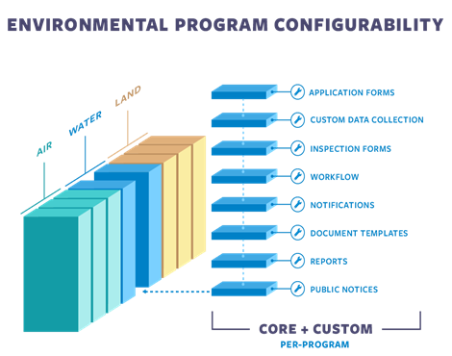
nVIRO
Core Functions + User Configurability
Promotes agency-wide standardization and sharing
Allows programs to maintain their own configuration
More rapid response to change
Notes:
nVIRO core the fundamental functions of an Environmental Regulatory Agency
AND augments these with dynamic user-configurable capabilities.
This promotes agency wide standardization and sharing where most valuable
While also supporting program-specific configuration of
Applications Inspection and data maintenance forms, workflows, notifications, document templates and reports where necessary.
Program staff can make the majority of required modifications to the system resulting from regulatory or policy change themselves, with no need for vendor or IT support.
This provides two additional significant, and sometimes undervalued, benefits: agility and sustainability.
By shifting the responsibility for making system changes ( such as adding or editing forms, changing workflow processes, creating new fees etc.) shifts from IT/consultants to the end users, agency staff can respond to change more easily and more rapidly.

Slide 10
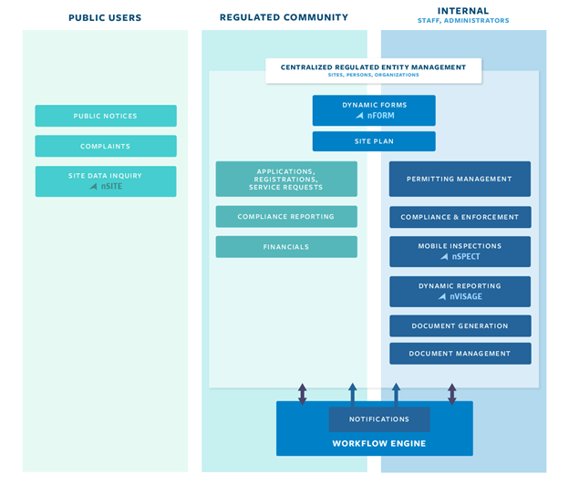
nVIRO
Online Access
Public Users
Regulated Community
Internal Staff
Notes:
nVIRO was built to support the spectrum of key stakeholders including
- external agency “customers” (licensees, regulatees, reservations)
- internal agency staff
- and the general public (GIS based inquiry, complaint submission, responding to public notices).
Wherever appropriate, nVIRO uses the same user interface for these different stakeholders, which reduces redundancy and improves communication between parties.

Slide 11
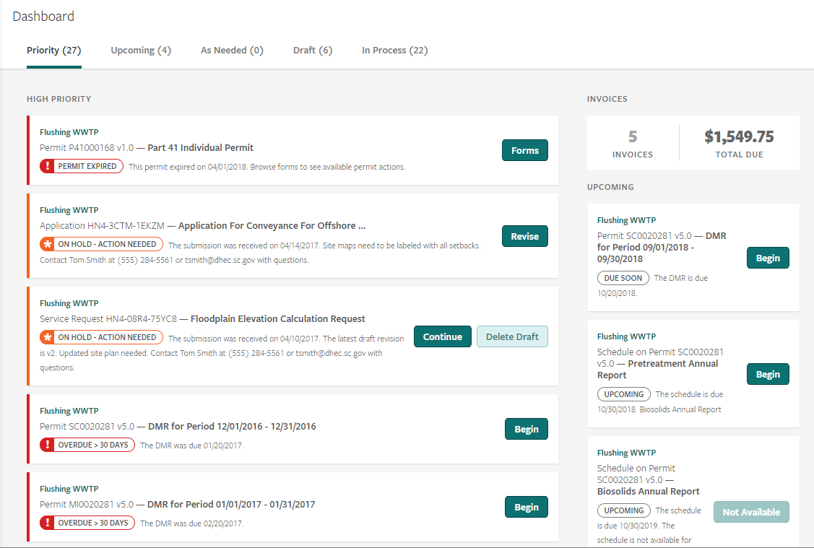
External User Dashboard
Actions Needed
Due / Past Due
  Renewals, Reports
Outstanding Financials
Submission Status
One-Click access to related item
Notes:
Allows the regulated community to see at a glance what is important
Priority Actions to be taken
Invoices to needing to be paid etc.
By clicking on an item the system takes them to the screens needed to complete the action

Slide 12
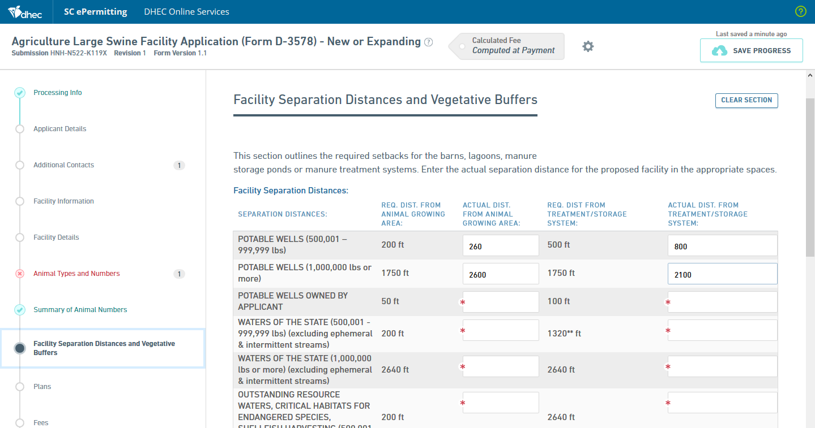
Dynamic Forms (nFORM)
User Customizable
Navigable Sections
Advanced controls
Conditional Controls / Sections
Calculations
Online Fee Payments
Notes:
Dynamic Forms are a key component
- User configurable
- Fully featured
Used to create custom Application Forms, Service Requests, Permittee Reporting/Reporting Schedules
Also leveraged by nVIIRO to extend the system – What we call “Program Component Forms”.
Allows programs to extend the system for data they wish to maintain.
Regulatory change comes along requiring a program to collect another data point? It’s no problem. They just add a field to the component form

Slide 13
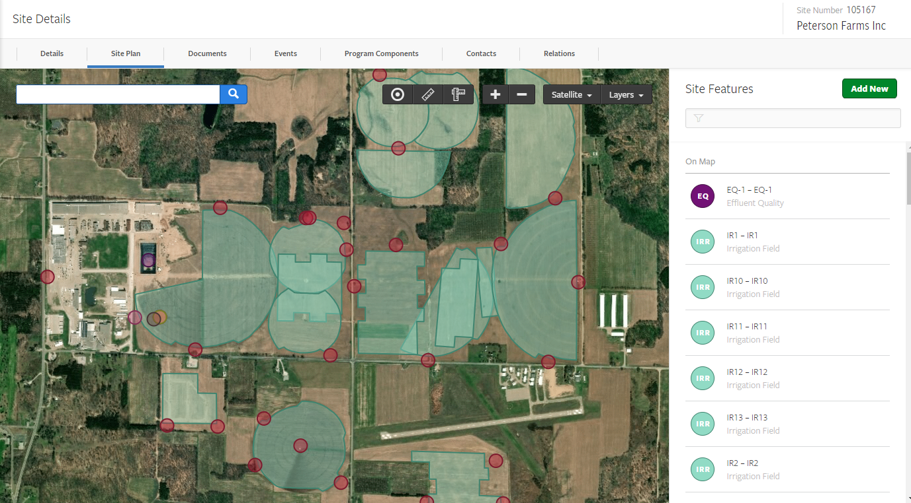
Site Plan
Site Features
Points, Lines Polygons
GIS Layers
Layer Intersections
Measurements
Reference in Permits (e.g. Limits)
Notes:
May be used by both Internal and External staff
Provide spatial information for Sites and Site Features
Also provides the basis for GIS Inquiry for both internal and external users

Slide 14
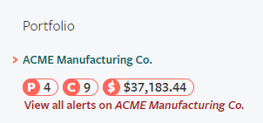
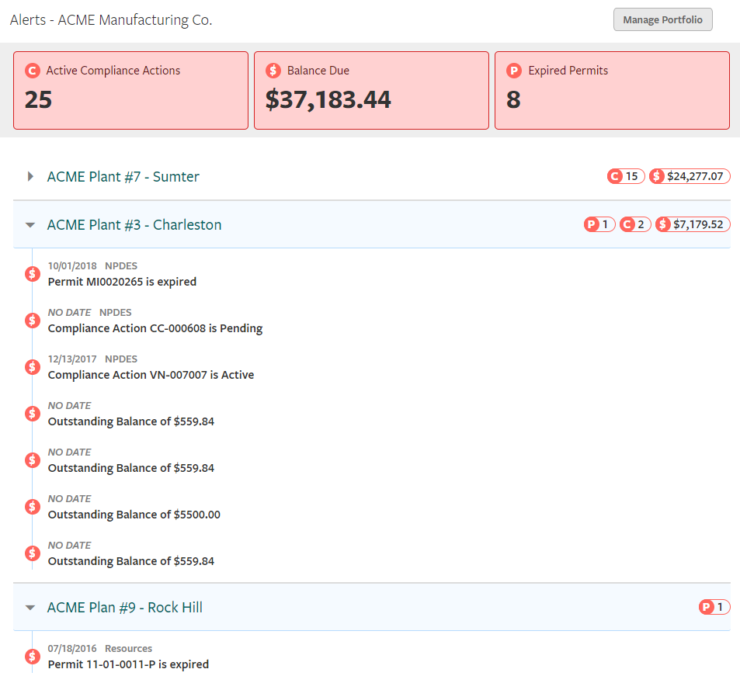
Portfolios
Ability to group related Sites into “Portfolios”
Alerts displayed on each related site
Notes:
Example of an enhancement driven by DHEC
Within DHEC programs to be aware of what was happening on other sites
The portfolio allows related sites to be grouped together providing the ability to show alerts on one site on all related sites
For example – Active compliance actions or outstanding balances owed on related sites may prevent DHEC from issuing a permit.

Slide 15
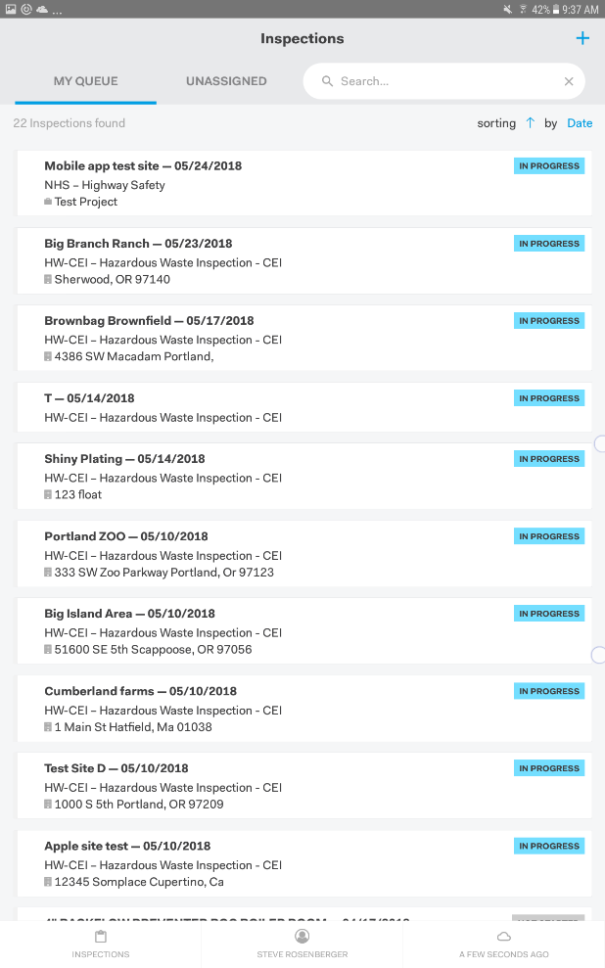
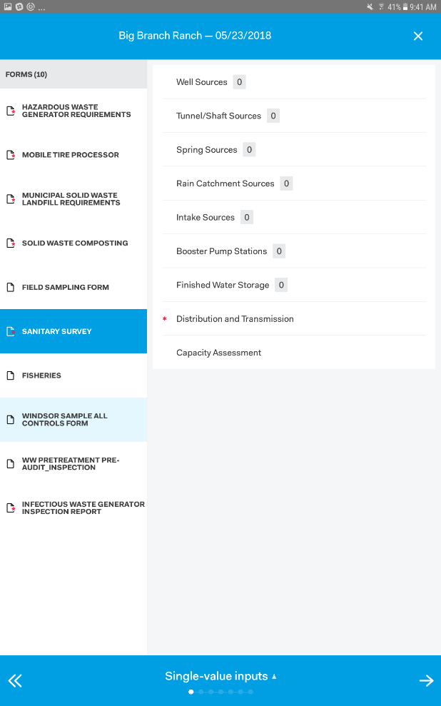
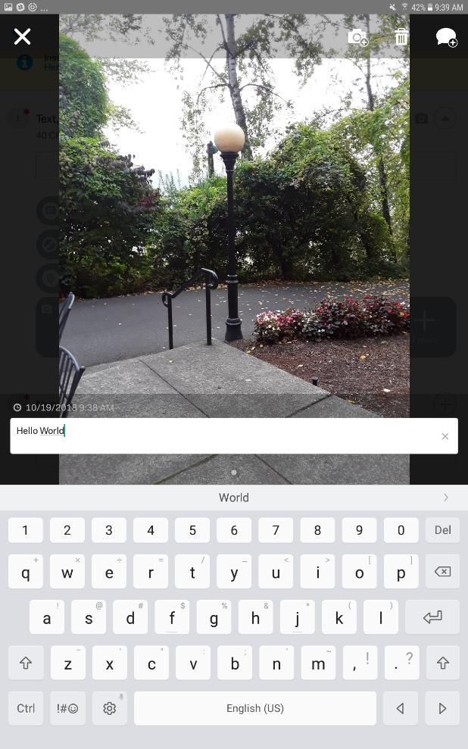
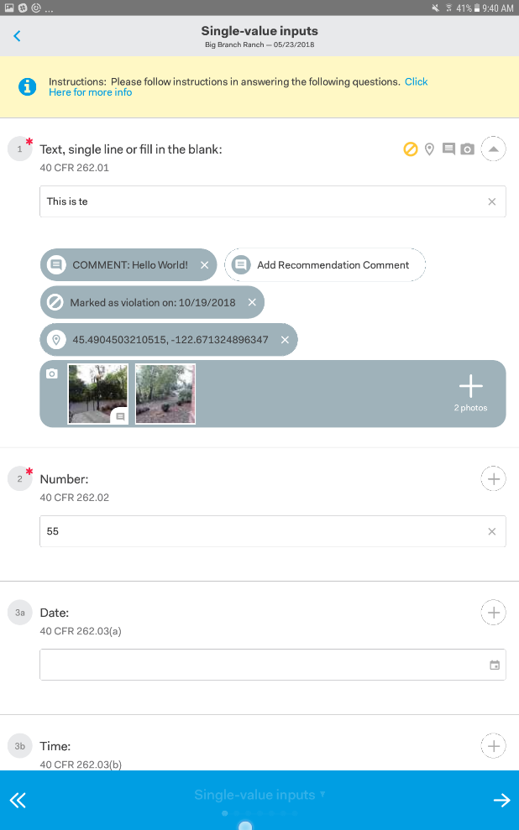
Mobile Inspections
Tablet based
User configurable inspection forms
Connected or disconnected mode
Notes:
nVIRO has a Mobile Inspection component called nSPECT
Tablet based
Supports user configurable inspection forms
Can operate in a connected or disconnected mode.
We just completed development of a new downloadable App for Android and IOS (screen shots)

Slide 16
Integration with EPA Systems
EPA Reporting
  ICIS/NPDES
  ICIS/Air
  RCRAInfo (planned)
No manual data entry
Automatic Flow to EPA via OpenNode2 and standard plug-ins
Notes:
The last very important thing
Integration with EPA systems
Automated flows to EPA vi OpenNode2 for ICIS/NPDES, ICIS/Air, RCRAInfo

Slide 17
Challenges and Lessons Learned

Slide 18

Program, & Process
Change Resistors
  Program & IT Staff Roles
    Address fear and uncertainty of change
Communication
  Consistent and frequent
Focus on process, not forms
Interaction with Public
FUN FACT - Before being known as the Palmetto State, South Carolina was known as the Iodine State.

Slide 19

Project
Dependent projects
  Migration to state DTO
  Data
Scheduling Considerations
  Financials, reporting
Identify Program "Super Users“
  Implementation and ongoing support
FUN FACT - Duncan Park Baseball Stadium in Spartanburg is the oldest minor league stadium in the nation.

Slide 20
Significant Results

Slide 21
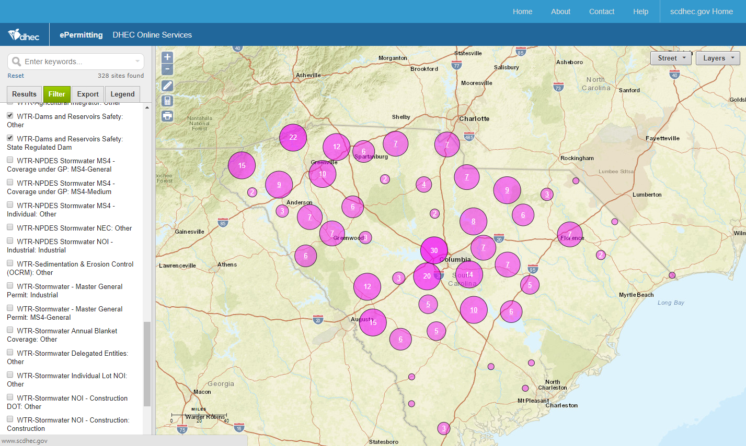
Notes:
Biz transformation in action – data validation, we saw sites in the middle of the ocean, Africa
Self service – live view of data, critical to emergency response
Peak into lesson learned on planning
Plan how to use features – site types as example, IW went crazy, need to scale back and understand better.
Shows the EFIS legacy mentality carrying over where programs had too much individual control

Slide 22

Significant Results
Dams
  Statewide Inspections completed 2 months ahead of schedule
ORCM – Critical Areas & CZC
  Online Permit Application Submissions by regulated community
  Integrated workflow with other programs (e.g., Stormwater)
Stormwater
  External Rollout starting 2019
Data availability
FUN FACT – SC entered the Union on May 23, 1788 as the 8th state.

Slide 23

Noteworthy stats
Over 10,000 form submissions received
1,529 verified external user accounts
3,381 external user logins
Over $1.5m in charges created
Significant reduction in SW document templates (from 157 to under 33)

Slide 24
Stats
Program Area | Application Forms | Inspection Forms | Custom Data Entry (Component) Forms | Document Templates
OCRM - Critical Area | 16 | 2 | 1 | 35
LWM - Infectious Waste | 10 | 4 | 1 | 13
Water - Agriculture | 19 | 6 | 4 | 29
Water - Wastewater | 57 | 24 | 8 | 206
Water - Dams | 3 | 3 | 1 | 41
Water - Stormwater | 20 | 31 | 9 | 33

Slide 25
Questions?

