Slide 1


Proposed Mitigation Rule
Amendment Rulemaking
Pre-Proposal State and Local Government Outreach
June 20, 2019

Slide 2
Meeting Logistics
Call in for folks joining via telephone
General facility information
Agenda
How participants can ask questions in the end
Introductions

Slide 3
Why Are We Here?
The Corps and EPA (the Agencies) are beginning consultation and coordination with state and local governments on the Agencies’ proposed rulemaking to revise the compensatory mitigation regulations.
This presentation will provide you with information regarding the Agencies’ questions for considerations for revising the compensatory mitigation regulations.
The Agencies are seeking your feedback about how this rulemaking might affect state and local governments and any recommendations regarding content of a rulemaking that you may have.

Slide 4
Background
Section 404 of the Clean Water Act authorizes the Corps or a State or Tribe that has assumed the 404 Program to issue permits for discharges of dredged or fill material in waters of the United States.
During the review of applications for Department of the Army permits, the Corps is required to consider mitigation.
When there is a proposed discharge, all appropriate and practicable steps must first be taken to avoid and minimize impacts to aquatic resources.
For unavoidable impacts, compensatory mitigation may be required to replace the loss of wetland, stream, and/or other aquatic resource functions.

Slide 5
What is Compensatory Mitigation?
Compensatory mitigation refers to the restoration, establishment, enhancement, and/or preservation of wetlands, streams, or other aquatic resources conducted for the purpose of offsetting impacts to these resources authorized by permits issued under Section 404 of the Clean Water Act and/or Section 10 of the Rivers and Harbors Act of 1899.
The Corps (or other approved state/tribal authority) is responsible for determining the appropriate type and amount of compensatory mitigation for Section 404 permit actions.

Slide 6
Why was this rule developed?
The 2004 National Defense Authorization Act, Section 314 required the Corps to promulgate a regulation to:
  Maximize available credits and opportunities for wetland mitigation,
  Provide flexibility for regional variation in wetland condition, functions, and values, and
  Establish equivalent standards for mitigation banks, in-lieu fee programs (ILF programs), and permittee-responsible mitigation.
  During the rulemaking process, this became a joint rule with the EPA.

Slide 7
Mitigation Rule - Background
In 2008, the Agencies issued joint regulations clarifying compensation requirements for losses of aquatic resources at 33 CFR Part 332/40 CFR Part 230, Subpart J.
The Mitigation Rule incorporates recommendations from the National Research Council for improving the planning, development, implementation, and performance of wetland compensatory mitigation projects.
The regulation recognizes three mechanisms for providing compensatory mitigation: mitigation banks, in-lieu fee (ILF) programs, and permittee-responsible mitigation.
Notes:
To provide compensatory mitigation for Department of the Army permits, mitigation banks and ILF programs must be approved by the Corps. The Corps approves a mitigation banking instrument or ILF program instrument, which is the legal document for the establishment, operation, and use of that mitigation bank or ILF program. The current regulations require the Corps to solicit public comment on each proposed mitigation bank or ILF program and consult with an interagency review team (IRT) prior to deciding whether to approve the mitigation banking or ILF program instrument.

Slide 8
Mitigation Rule - Background
The Mitigation Rule establishes equivalent standards for aquatic resource compensatory mitigation projects regardless of whether they are conducted by mitigation banks, ILF programs, or permit applicants.
In order to provide compensatory mitigation for Department of the Army permits, mitigation banks and ILF programs must be approved by the Corps.
The Corps approves a mitigation bank or ILF program instrument, which is the legal document for the establishment, operation, and use of that mitigation bank or ILF program.

Slide 9
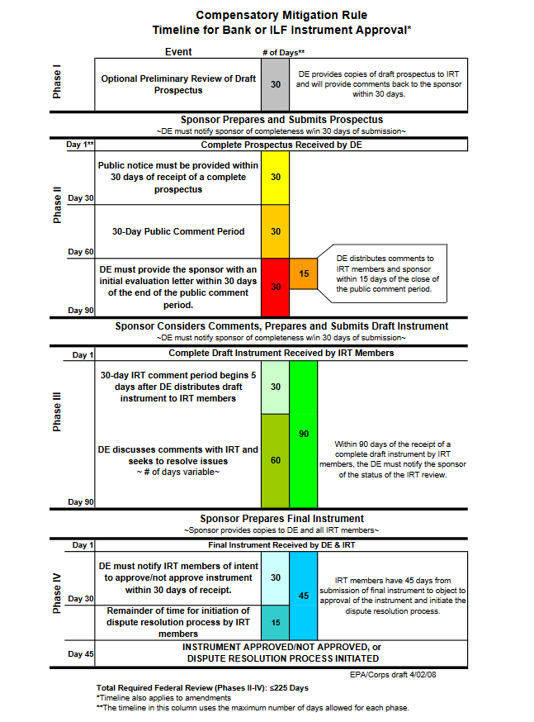
Mitigation Rule – Background
Under the 2008 Rule, there are three required phases of bank/ILF proposal review with a cumulative total of 225 days of Corps-led review (non-consecutive days).
  Prospectus: 90-day review period for Corps/IRT.
  Includes 30-day public comment period.
  Draft Instrument: 90-day review period for Corps/IRT.
  Final Instrument: 45-day review period for Corps/IRT.

Slide 10
Mitigation Rule - Background
The Mitigation Rule requires the Corps to solicit public comment on each proposed mitigation bank or ILF program and consult with an interagency review team (IRT) prior to deciding whether to approve the mitigation banking or ILF program instrument.
  During review of mitigation banks and ILF programs, the Corps may be required to conduct Section 7 consultation under the Endangered Species Act, Section 106 consultation under the National Historical Preservation Act, and/or government-to-government consultation with tribes, depending on the potential impacts of the proposal.

Slide 11
Interagency Review Team (IRT)
The IRT, as described in the Rule:
  Is chaired by the Corps.
  May include representatives from EPA, U.S. Fish and Wildlife Service, NOAA Fisheries, the Natural Resources Conservation Service, and other federal agencies, as appropriate.
  May also include appropriate federal, tribal, state, and local regulatory and resource agencies, as appropriate.
  Is responsible for facilitating the establishment of mitigation banks and ILF program instruments.

Slide 12
Legislative Outline for Rebuilding Infrastructure in America (February 2018)
The Administration’s Legislative Principle B(10): Remove duplication in the Review Process for Mitigation Banking by Eliminating the Interagency Review Team states:
  IRT approval timelines often are extended beyond those specified in the Mitigation Rule.
  The final approval of a mitigation bank often is delayed because time required to resolve disagreements among the IRT.
  Removing the second review would enhance the efficiency of the mitigation bank approval timeframes.
  The members of the IRT would still have an opportunity to review and comment through the public participation process required in the Mitigation Rule.

Slide 13
Potential Changes for Consideration
Removal of the IRT Process
Alternatives to add efficiencies in mitigation bank and ILF program evaluation
Compliance with Miscellaneous Receipts Statute
ILF program accounting
Multipurpose compensation projects
Changes to the mitigation regulations to address Tribal/State assumption of the Section 404 program
Clarity for principal unit of credits for stream mitigation projects

Slide 14
Removal of the IRT Process
  The Agencies seek suggestions for rule changes that continue to provide opportunities for federal, tribal, state, and local input, while making the review process more efficient.
  For example, whether to remove the IRT process and include this review during the 30-day public comment period.

Slide 15
Mitigation Bank and ILF Program Proposal Review
The Agencies also seek comment on:
  Alternatives to removing the IRT process to improve the efficiency of bank and ILF proposal evaluation, such as:
    Revising the existing IRT process; and/or
    Implementing other administrative changes to improve mitigation bank and in-lieu fee program review process.

Slide 16
Compliance with the Miscellaneous Receipts Statute
Financial assurances are funds set aside to provide a high level of confidence that the compensatory mitigation will be successfully completed.
To better address compliance with the Miscellaneous Receipts Statute (31 U.S.C. 3302(b)), the Agencies are considering proposing modifications to better reflect how the Corps can implement financial assurances to ensure that the Corps would not be in actual or constructive receipt of financial assurance funds.

Slide 17
ILF Program Accounts
Once an ILF program is approved, an ILF program account must be established at a financial institution to ensure funds are used within a reasonable period of time to provide compensatory mitigation.
The Agencies are taking comments on whether revisions to Mitigation Rule text are needed to:
  Improve tracking program account funds
  Allow for periodic third-party audits of the ILF program; and
  Add clarity to when program account funds may be used to provide alternative compensatory mitigation as determined necessary by the Corps.

Slide 18
Multipurpose Compensation Projects
A multipurpose compensatory mitigation project provides compensation to satisfy regulatory or statutory requirements in addition to compensation under the Section 404 program:
  Endangered Species Act
  Magnuson-Stevens Fishery and Conservation Management Act
  Natural Resource Damage Assessments
  Natural resources of traditional religious or cultural importance to tribes
  Other tribal, state, or local programs, such as water quality programs
  The Agencies are taking comments on whether modifications to the Mitigation Rule are needed to provide clarification on aspects of multipurpose compensation projects including credit generation and accounting to ensure authorized impacts are appropriately offset.

Slide 19
Tribal/State Assumption of the 404 Program
Under CWA Section 404(g), states or tribes may assume administration of the Section 404 permitting program.
The Agencies are seeking comment on any revisions to the rule text that would accommodate state and/or tribal assumption of the Section 404 program.
The Agencies are interested in whether to clarify any aspects of the 2008 Rule that may be considered challenging for state and tribal assumption of the Section 404 program;
  For example, some revisions could include:
    Adding the definition of “permitting authority” included at 40 CFR 230.3 to the definitions section of the 2008 Mitigation Rule (33 CFR 332.2/40 CFR 230.92).
    Providing additional clarification regarding bank/ILF review and use in the context of state/tribal assumed programs.

Slide 20
Quantification of Stream Mitigation
The Mitigation Rule defines the principal units of credits and debits as acres, linear feet, functional assessment units, or other suitable metrics of particular resource types.
The Agencies are seeking input on approaches to quantify stream mitigation credits that better reflect the total amount of stream ecosystem restored, enhanced, or preserved in rivers and larger streams, and stream-wetland complexes, while maximizing available credits and opportunities for larger compensatory mitigation projects within a given watershed.
  For example, whether linear feet, square feet, or some other metric that considers stream length, width, order, and/or flow regime should be the preferred credit metric.

Slide 21
In Summary Agencies Seeking Input Regarding:
Whether the IRT process should be eliminated or modified;
Whether other administrative changes are needed to improve mitigation bank and in-lieu fee program review process;
Whether the Agencies should make changes to address the Miscellaneous Receipts Statute;
Whether changes need to be made to the requirements associated with ILF program accounts;
Whether clarity is needed to facilitate multipurpose compensation projects;
Whether changes are needed to accommodate State/Tribal assumption of the Section 404 program; and
Approaches to quantify stream mitigation credits that better reflect the total amount of stream ecosystem restored, enhanced, or preserved in rivers and larger streams, and stream-wetland complexes, while maximizing available credits and opportunities for larger compensatory mitigation projects within a given watershed.

Slide 22
Next Steps
August 9, 2019 – The Pre-Proposal Comment Period Concludes
  Comments can be submitted to MitigationRuleAmendment@usace.army.mil and copied to MitigationRuleStates@epa.gov
July 23, 2019 - Webinar for state and local governments on Tuesday, July 23, 2019 from 1:00-3:00 p.m.
  To register, visit https://mitigationrulestates2019.eventbrite.com

Slide 23
Contact Information
Contacts
  Krystel Bell, HQUSACE Regulatory Program
    202-761-4614, MitigationRuleAmendment@usace.army.mil
  Stacey Jensen ASA(CW), Assistant for Tribal and Regulatory Affairs
    703-695-6791, Stacey.M.Jensen.civ@mail.mil
  Charles Kovatch, EPA HQ Office of Water
    202-566-0399, MitigationRuleTribes@epa.gov
  Andrew Hanson, EPA HQ Office of Intergovernmental Relations
    202-564-3664, Hanson.Andrew@epa.gov

