Slide 1


Vessel Incidental Discharge Act (VIDA)
The U.S. Regulatory Framework for Discharges from Commercial Vessels
2019

Slide 2
Disclaimer
The following EPA presentation is intended to provide information to the public on the recently enacted Vessel Incidental Discharge Act (VIDA) and currently in-force statutes, permits, and regulations. Neither the slide presentation nor the corresponding remarks represent final agency decisions regarding the implementation of VIDA.

Slide 3
Federalism Consultation
Objective: Provide state and local government officials and representatives an opportunity to consult and provide early and meaningful input into EPA actions and decisions.
Consultation Period: July 9, 2019 – September 9, 2019
Key State Interests:
  Vessels covered under VIDA regularly operate in state waters
  Upon completion of USCG implementing regulations, VIDA requirements will preempt state and local law

Slide 4
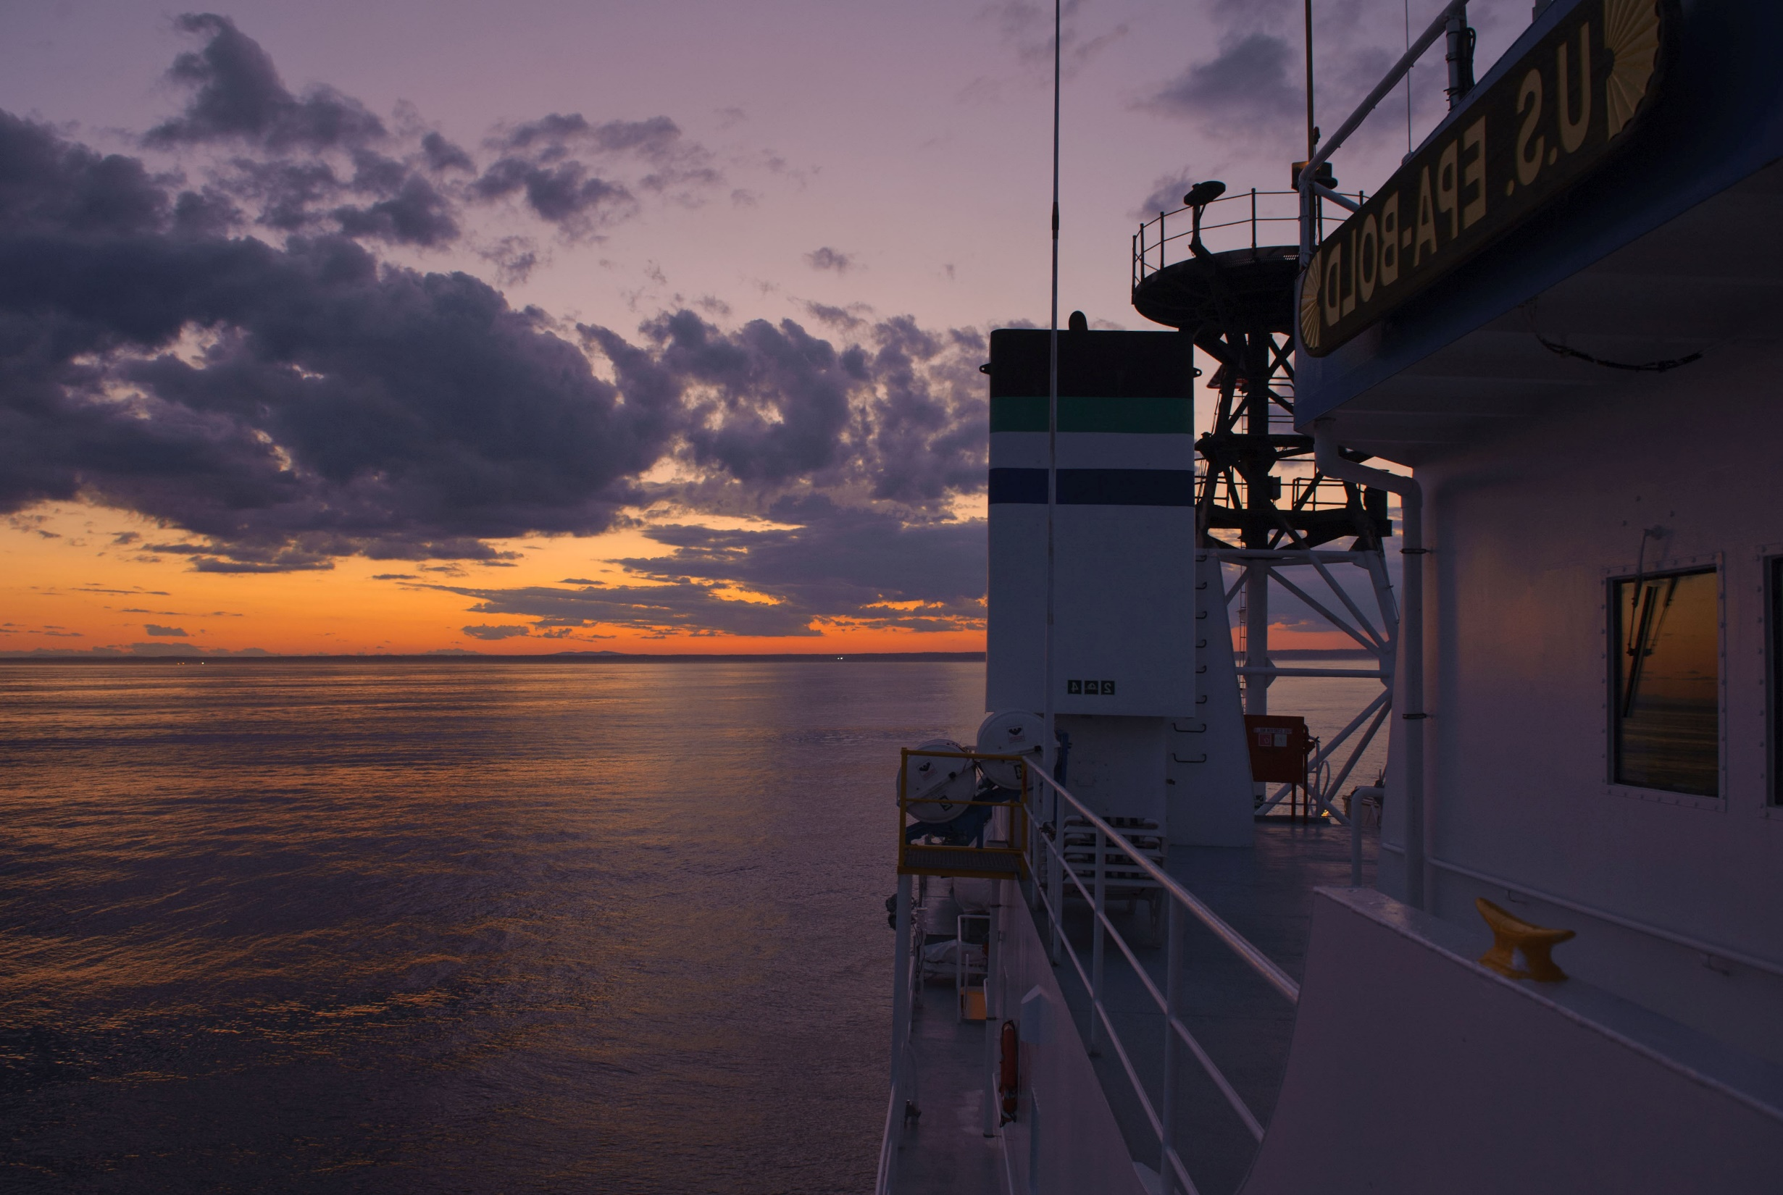

Overview
Vessel Regulatory History
Vessel Incidental Discharge Act (VIDA)
Interim Requirements (~2019 to 2022)
Future Requirements and Programs
Key State Provisions
Questions

Slide 5
Vessel Regulatory History
Numerous federal, state and local requirements regulate discharges from vessels.
EPA’s Vessel General Permit (vessels > 79 ft) and the small Vessel General Permit (vessels < 79 ft) (under Clean Water Act section 402)
The U.S. Coast Guard’s (USCG) Ballast Water Discharge Standard and a type approval program for Ballast Water Management Systems (BWMS)(National Invasive Species Act)
Notes:
Incidental discharges – VGP and sVGP covered discharges originating from a vessel as a result of its normal operation as a means of transportation
Commercial vessels – Non-military, non-recreational vessels

Slide 6
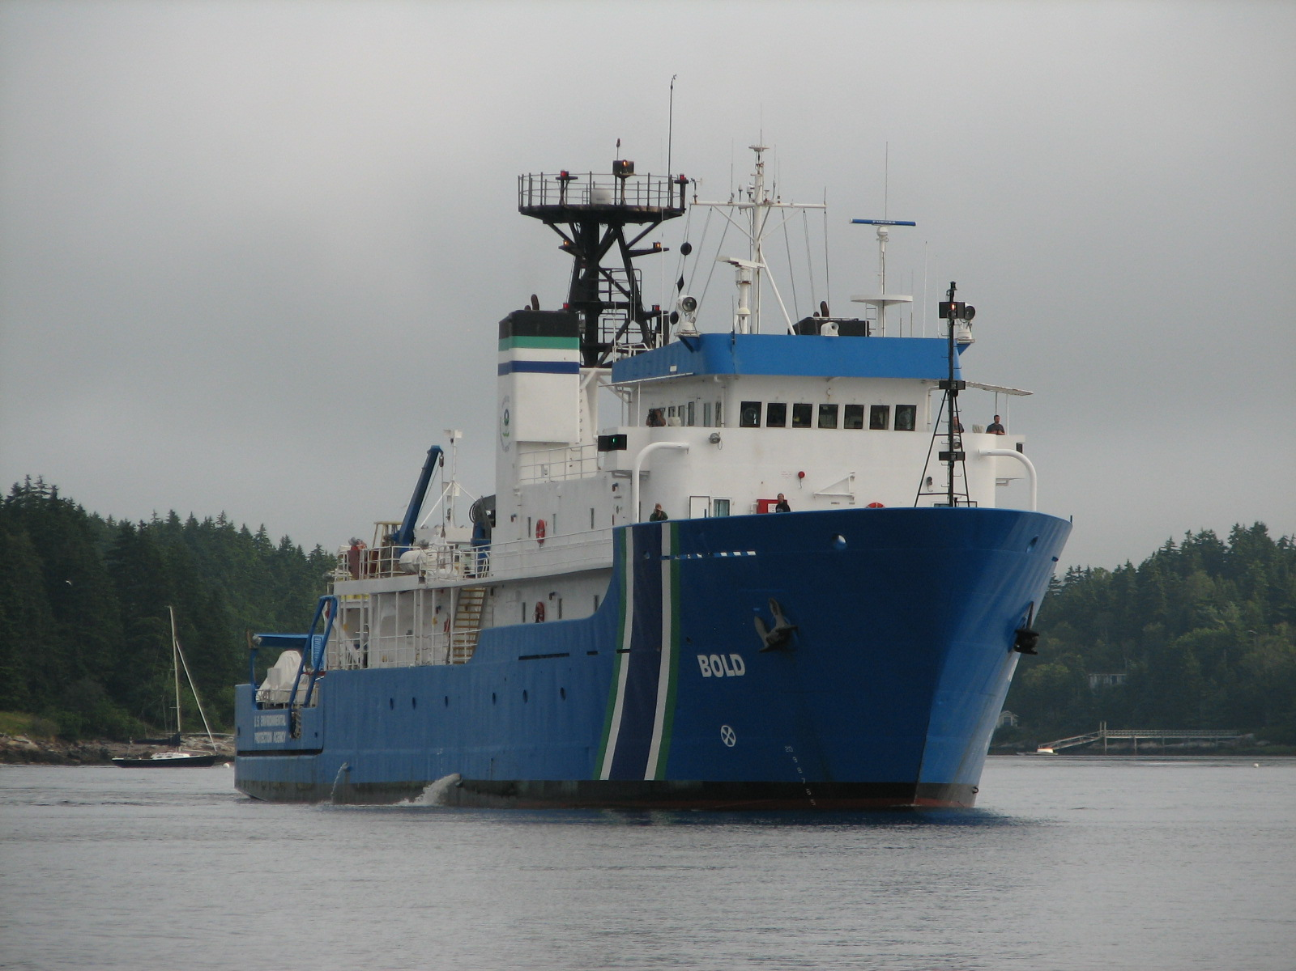
The Vessel Incidental Discharge Act (VIDA)

Slide 7
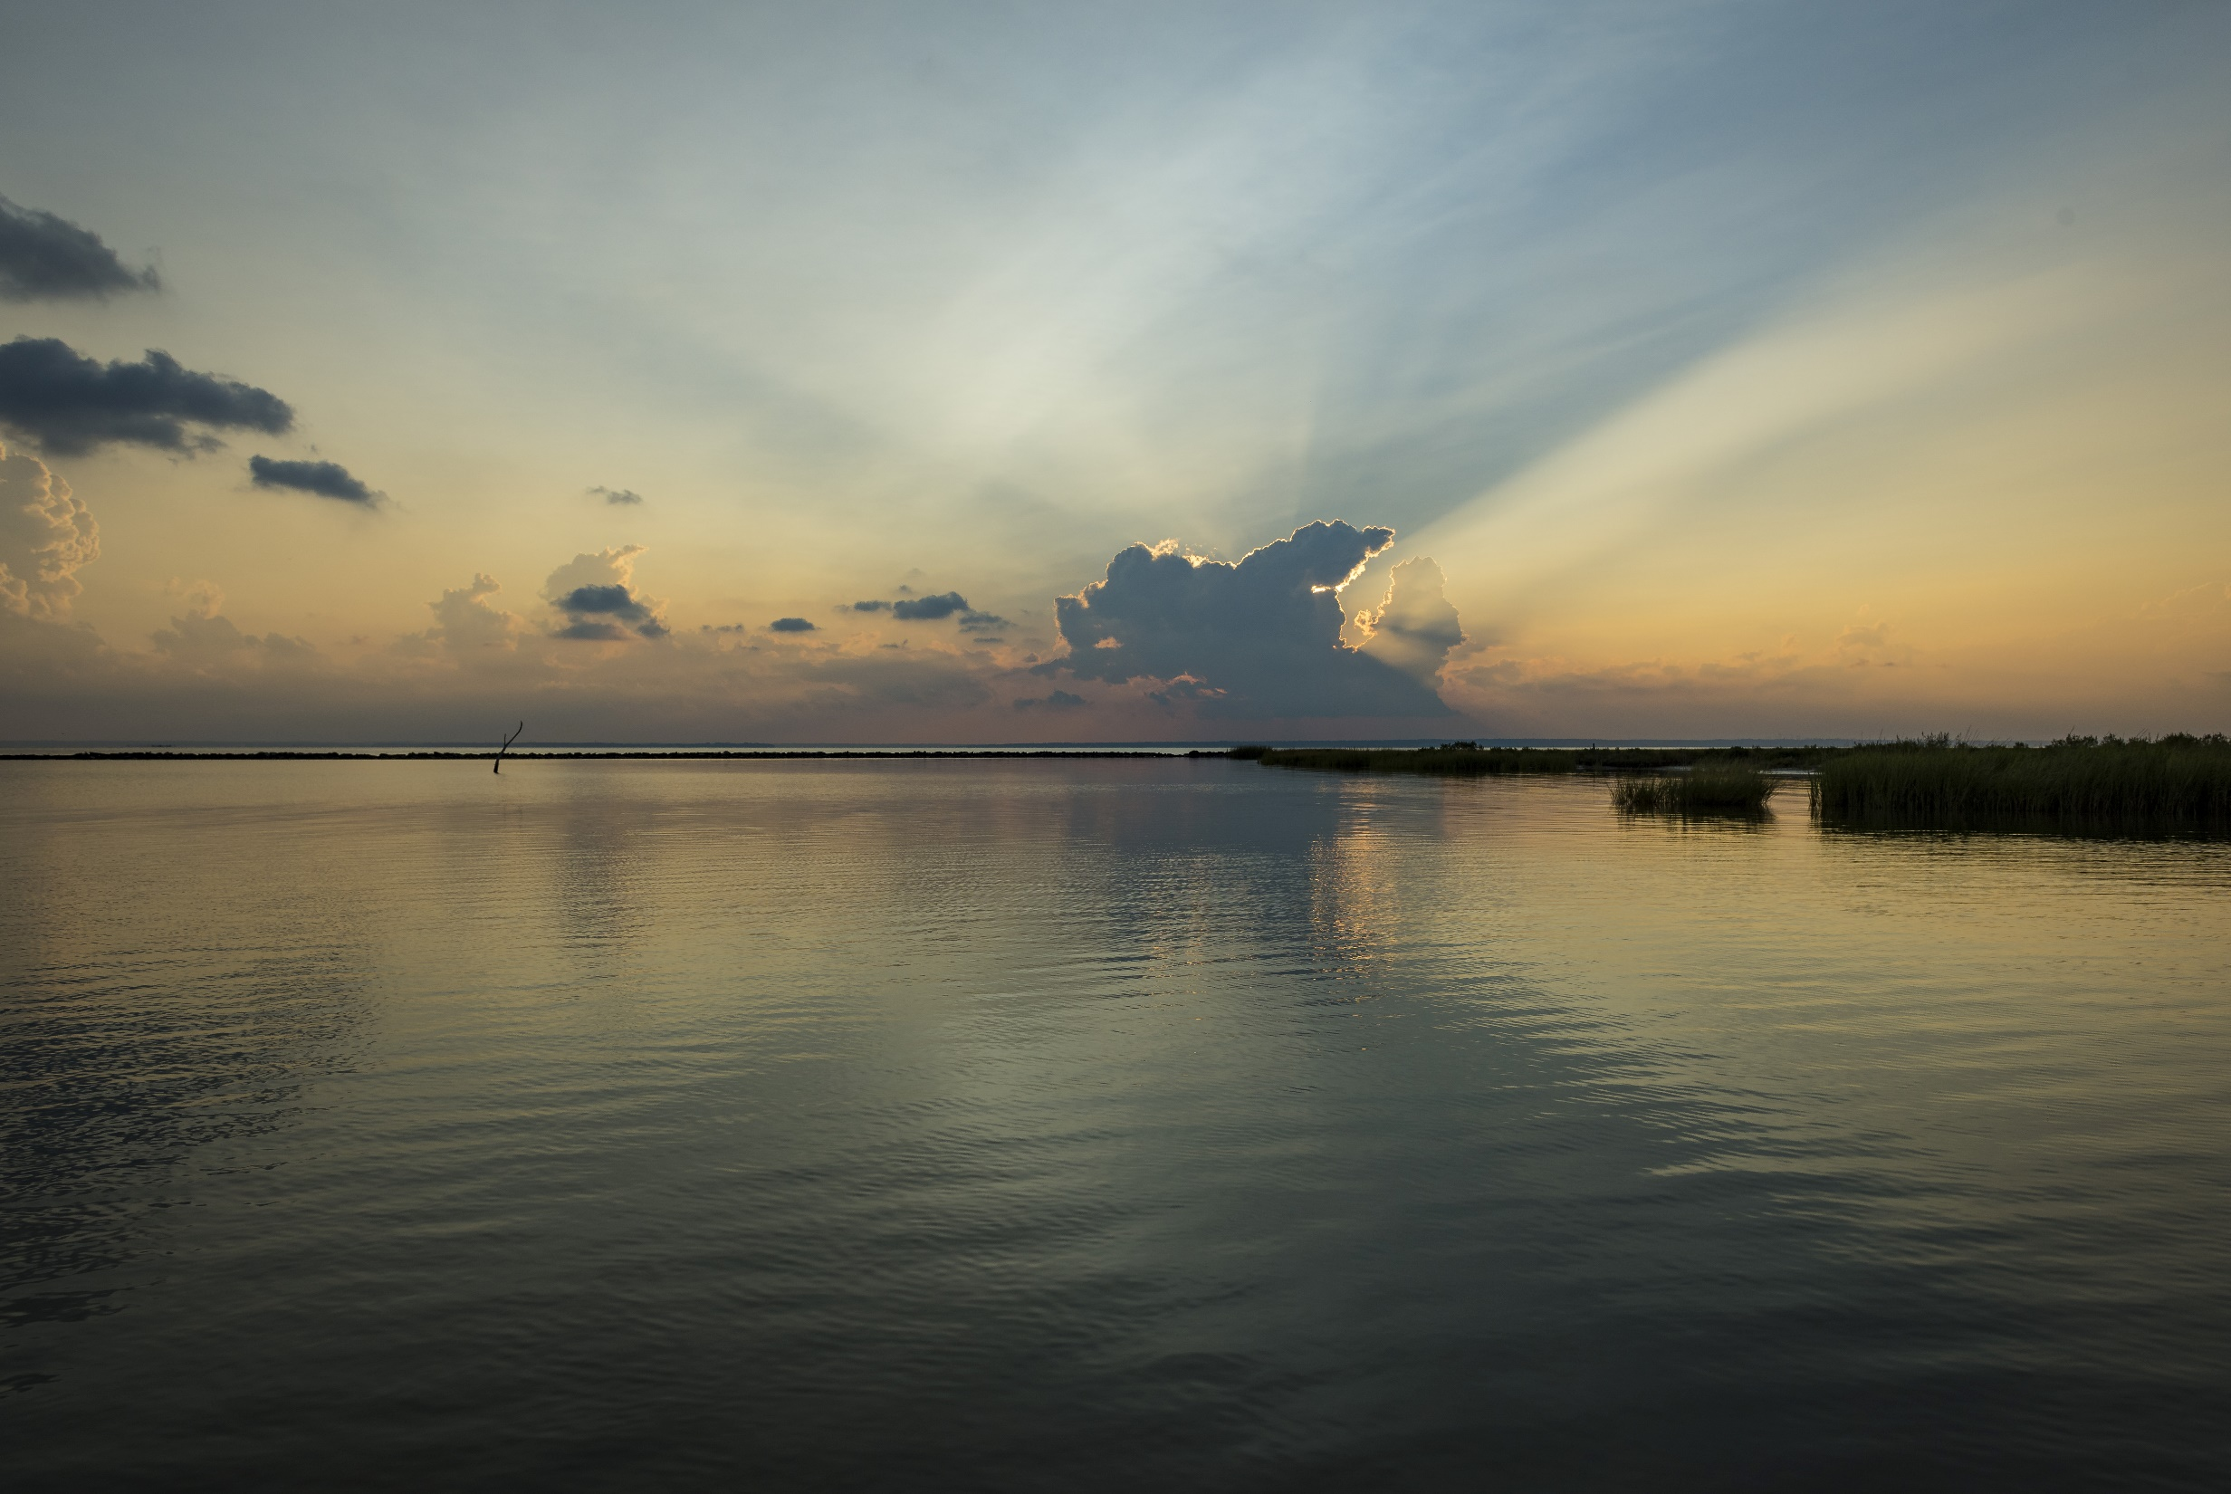
Introduction
December 4, 2018: The Vessel Incidental Discharge Act (VIDA) is enacted and changes the U.S. framework for regulating incidental discharges from commercial vessels.
VIDA passed to streamline the patchwork of federal, state, and local requirements for the commercial vessel community.

Slide 8

Highlights
Applies to waters of the U.S. and waters of the contiguous zone; specific requirements in certain waters (e.g., Great Lakes)
Maintains existing vessel discharge requirements for most vessels (EPA 2013 VGP and the USCG ballast water regulations)
Authorizes EPA and the USCG to develop new vessel discharge regulations
Establishes enhanced and regional ballast water requirements to address invasive species
Requires the USCG to consider ballast water test methods based on organism viability

Slide 9
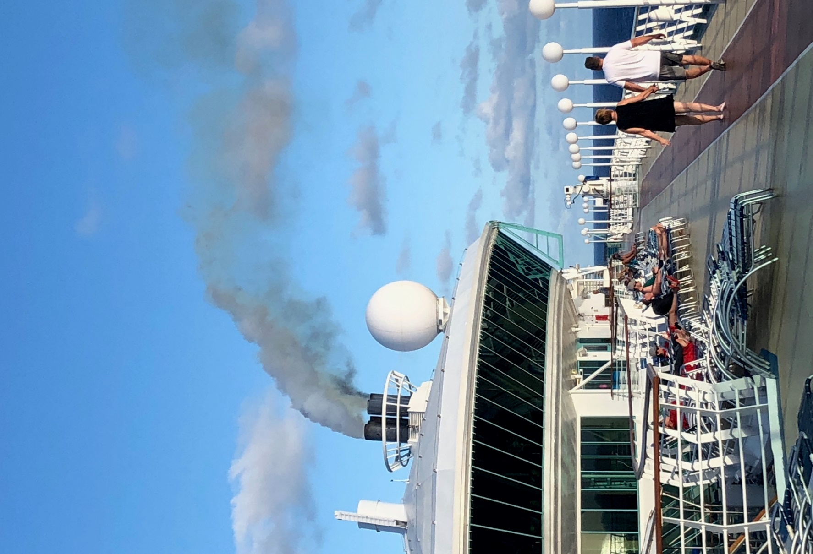
Types of Incidental Discharges
Anti-Fouling Hull Coatings and Leachate
Aqueous Film Forming Foam
Ballast Water
Bilgewater/Oily Water Separator Effluent
Boat Engine Wet Exhaust
Boiler/Economizer Blowdown
Cathodic Protection
Chain Locker Effluent
Deck Washdown and Runoff
Distillation and Reverse Osmosis Brine
Elevator Pit Effluent
Exhaust Gas Cleaning System Washwater
Firemain Systems
Fish Hold Effluent
Freshwater Layup
Gas Turbine Washwater
Graywater
Hull Fouling and Cleaning
Inert Gas Scrubber Washwater
Motor Gasoline Compensating Discharge
Non-Oily Machinery Wastewater
Oil-to-Sea Interfaces
Pool or Spa Water
Refrigeration and A/C Condensate
Seawater Cooling Overboard Discharge
Seawater Piping Biofouling Prevention
Sonar Dome Discharge
Well Deck Discharges

Slide 10
Vessel Universe
Source: VGP eNOI System (2018)
Notes:
ROROs -

Slide 11
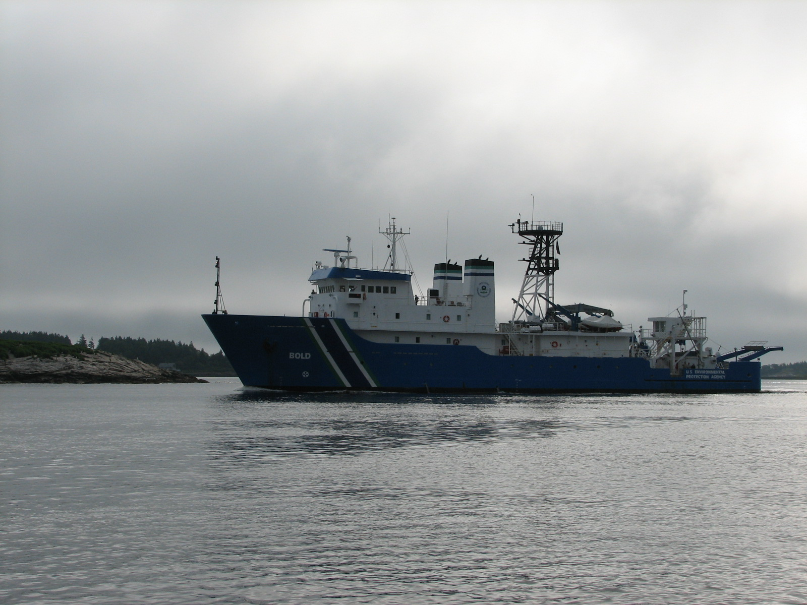
Interim Requirements
(4 Dec 2018 to ~2022)
For large commercial vessels, except for fishing vessels:
The provisions of the EPA 2013 VGP, the USCG ballast water regulations, and state and local government requirements
remain in force and effect, until the
future regulations are
enforceable.
For small commercial vessels
and fishing vessels of any size: Only the ballast water provisions of the EPA 2013 VGP, the USCG regulations, and state and local government requirements remain in force and effect until the future regulations are enforceable.

Slide 12
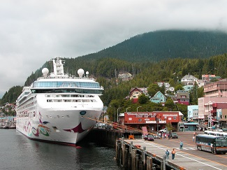
Future Requirements and Programs

Slide 13

Federal Regulations
VIDA requires EPA and the USCG to develop two federal rules to address commercial vessel discharges:
  EPA to develop regulations establishing national discharge standards of performance within two years of enactment of VIDA; and
  The USCG to develop corresponding implementing, monitoring, and enforcement regulations two years thereafter.

Slide 14
EPA Discharge Standards
Generally at least as stringent as the existing 2013 EPA VGP requirements
Technology-based
Numeric, best management
practices, or a combination of both
May distinguish between class,
type, size, and age of vessels
Developed in concurrence with the USCG
and in consultation with interested governors

Slide 15
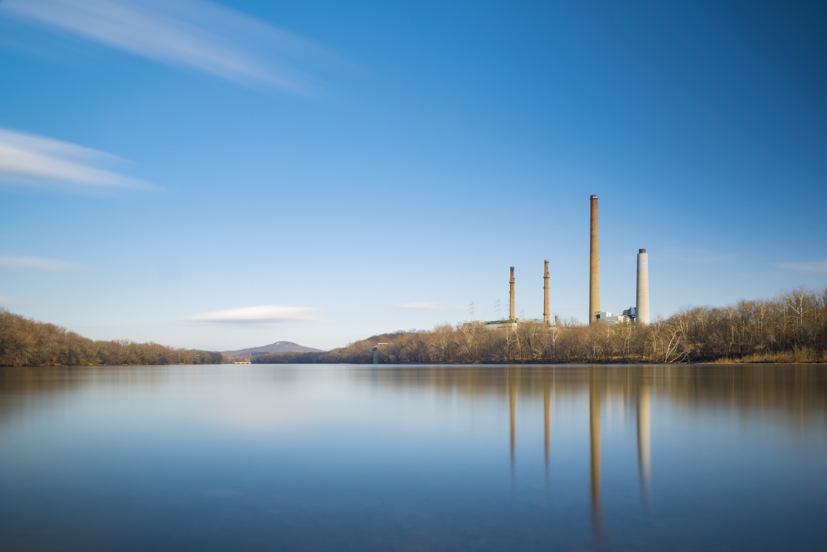
USCG Implementing Regulations
Generally, at least as stringent as EPA’s 2013 VGP and USCG ballast water requirements
Address inspections, monitoring, reporting, sampling, and recordkeeping
May address the design, construction, testing, approval, installation, and use of devices to achieve the EPA standards
Developed in consultation with interested governors
Generally preempt adoption or enforcement of other state or local regulations for incidental discharges from vessels covered under VIDA

Slide 16
Enforcement
  EPA, the USCG, and U.S. states will have enforcement authority (under CWA Section 309).
  USCG will have primary responsibility for enforcing regulations consistent with the discharge standards established by EPA.
  Enforcement is to be consistent with new USCG inspection, monitoring, data management, and enforcement procedures.
  VIDA authorizes citizen suits under certain circumstances.

Slide 17
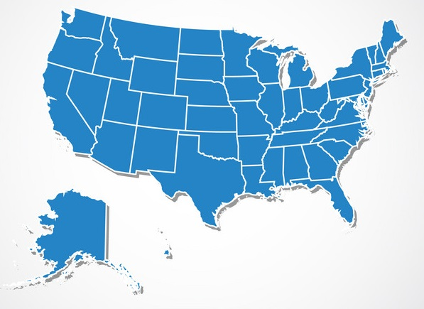
Key State Provisions
Notes:
KEEP – IF CLARIFICATION NEEDED

Slide 18
Petitions for Modifications
Allows governors of states (or a designee) to submit to the Administrator or the Secretary a petition to review any standard of performance, regulation, or policy if there exists new information that could reasonably result in a change to:
  the standard of performance, regulation, or policy; or
  a determination on which the standards of performance, regulation or policy was based
The Administrator or Secretary, as applicable, shall grant or deny the petition within 1 year.

Slide 19
Petitions for Orders
Allows governors of states (or a designee) to submit to the Administrator or the Secretary a petition to issue an order to use an emergency best management practice for any region or category of vessels:
  to reduce the risk of introduction or establishment of an aquatic nuisance species
  to mitigate the adverse effects of a discharge that contributes to a violation of water quality requirements under CWA section 303
The Administrator, in concurrence with the Secretary, shall grant or deny the petition within 180 days.

Slide 20
Applications for No-Discharge Zones
Allows states to apply to EPA to prohibit one or more types of discharge, whether treated or not treated, into certain waters
The Administrator, in concurrence with the Secretary, shall by regulation prohibit the discharge from a vessel of one or more discharges upon determination that:
  the prohibition would protect and enhance the quality of the specified waters;
  adequate facilities for the safe and sanitary removal and treatment of the discharge are reasonably available for the affected water and vessels; and
  the discharge can be safely collected and stored.
  Additional limitations are included for ballast water.
The Administrator shall approve or disapprove an application within 90 days.

Slide 21
Petitions for Great Lakes
The governor of a Great Lakes State (or a State designee) may submit a petition to propose that the other governors of Great Lakes States endorse an enhanced standard of performance or other requirement with respect to any of the incidental discharges subject to regulation under VIDA that occur within the Great Lakes System.
  Petitions shall be submitted to the Great Lakes Commission, the governor of each Great Lakes State, and the Director of the Great Lakes National Program Office for review and endorsement.
  Governors endorsing proposed requirements and standards of performance may jointly submit to the Administrator and the Secretary for approval each proposed standard or requirement.
The Administrator and the Secretary shall approve or disapprove within 180 days of receipt.

Slide 22
Coastal Aquatic Invasive Species (AIS) Mitigation Grant Program
Purpose: Award grants to improve understanding and support the prevention, mitigation, and restoration of areas affected by aquatic invasive species
Eligibility: States, local governments, tribes, non-governmental organizations, and institutions of higher education
Funding: Up to $5 million/ fiscal year + penalties for CWA 312(p) violations
Matching requirement: Matching funds of no less than 25% to carry out the activities funded
Notes:
Eligibility:
a State;
a unit of local government;
an Indian Tribe;
a nongovernmental organization; and
an institution of higher education.
The purposes of the Program are—
to improve the understanding, prevention, and mitigation of, and response to, aquatic invasive species in—
the coastal zone; and
the Exclusive Economic Zone;
to support the prevention and mitigation of impacts from aquatic invasive species in the coastal zone; and
to support the restoration of Pacific Island habitats, marine, estuarine, and Great Lakes environments in the coastal zone and the Exclusive Economic Zone that are impacted by aquatic invasive species.

Slide 23
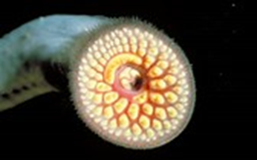
Great Lakes and Lake Champlain
Invasive Species Program
Purpose: Monitoring and responding to AIS; type approval of ballast water management systems for vessels operating solely within the region
Requirement: Collaboration with Federal, state, local and tribal agencies
Appropriations: Up to $50 million/fiscal year from 2019 - 2023

Slide 24
Comment Submission
At any point during the Federalism Consultation Process (July 9 – September 9, 2019), states or local governments may submit comments or questions to:
Email:
Katherine Weiler at Weiler.Katherine@epa.gov
Andrew Hanson at Hanson.Andrew@epa.gov

Slide 25
Questions?

