Slide 1
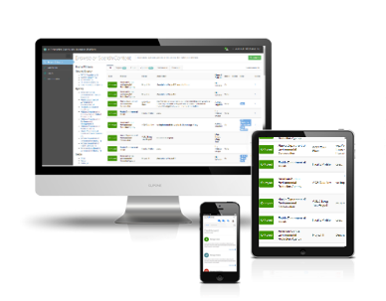
E-Enterprise Community Inventory Platform
The E-Enterprise Community Inventory Platform is an online community and living project inventory for State, Local, Tribal, and Federal environmental agencies and their employees across the US.

Slide 2
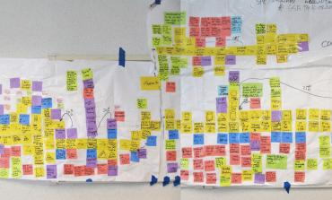
The E-Enterprise Model
Transforming environmental protection to deliver better customer services and improved environmental and public health results.
Streamline Processes
Optimize Technology
Stakeholder input
Simplicity and consistency
Measures and metrics
States
EPA
Tribes
Automation and online services
Advanced Monitoring Technologies
Shared services
Shared Governance and Collaboration

Slide 3
Examples of E-Enterprise in Action
Disaster Debris Recovery Tool (DDRT) | In the wake of a disaster, government and the public face unique challenges that complicate even the simplest of tasks, including cleaning up and disposing of debris. Embracing the opportunity for a technology solution, EPA and its state and tribal partners created a unique mapping tool for these situations. The Disaster Debris Recovery Tool (DDRT) is an interactive forum that can be used by disaster response, recovery, and planning experts to advance the safe recovery, recycling, and disposal of disaster debris. The DDRT is available now and includes data for all 50 states, Puerto Rico, and the U.S. Virgin Islands.
Smart Mobile Tools for Field Inspectors (Smart Tools) | Environmental inspections are largely paper-based processes requiring hours of preparation and post-inspection work. Smart Mobile Tools for Field Inspectors bring environmental inspections into the 21st century by streamlining operations and improving quality of information. Smart Mobile Tools for Field Inspectors supports inspection planning and management, field data collection, and evidence management, all within an integrated suite of digital tools to improve the quality and consistency of environmental inspections.

Slide 4
E-Enterprise for the Environment and the Exchange Network
ENABLES
Supporting the Business of Environmental Protection
through Shared Governance
Improved Business Processes and Environmental Management Approaches
Shared Technology Innovation and Solutions
Information sharing for environmental protection since 1998
Modernizing the business of environmental protection
since 2013
DRIVES
Notes:
In 2015, the Exchange Network and E-Enterprise became jointly governed under the E-Enterprise Leadership Council (EELC).
E-Enterprise was the next step in the evolution of the Exchange Network and focuses on the places where process and technology modernization will improve existing data management. E-Enterprise is only made possible by the long history of the Exchange Network and the process it put in place for collaboration and joint governance.

Slide 5
EECIP Implementation Timeline

Slide 6
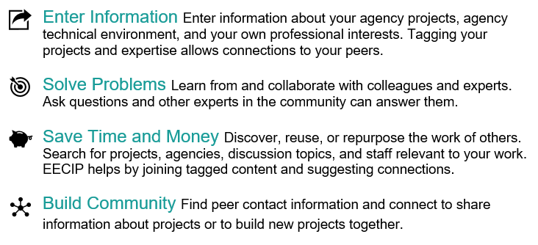

Slide 7
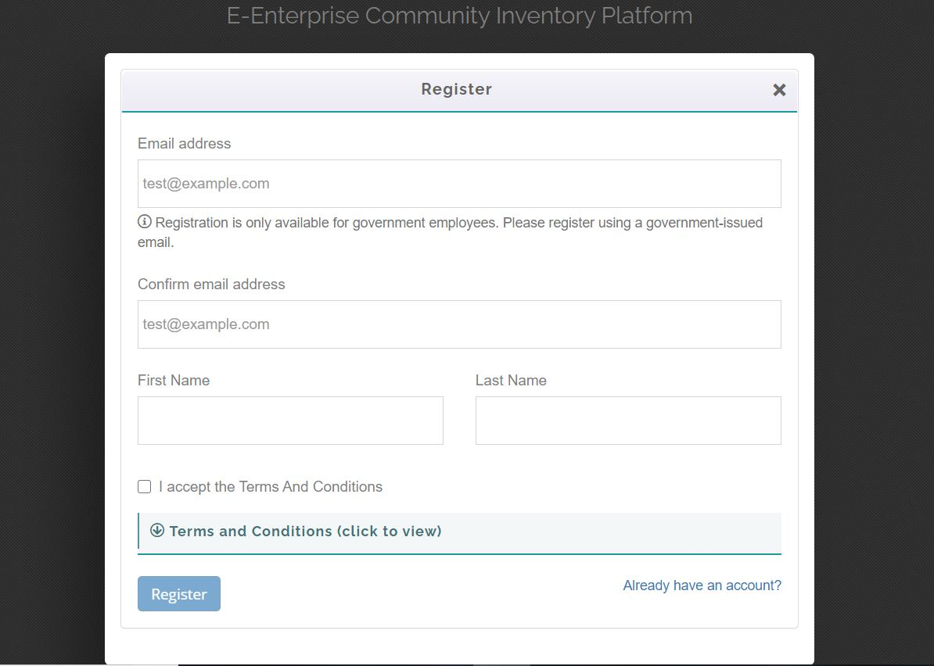
Create an Account & Log-In
To create an account, visit www.eecip.net.
Click Register and input all contact information.
Please note - automated registration is only available for government employees. If you have an email address ending in “.com”, or encounter any registration issues, please email support@eecip.net.
Once you’ve registered, you will receive a confirmation email, and can then revisit www.eecip.net to log into your account.
Notes:
We try to keep the EECIP site secure so that government officials can speak and share freely. Some approved contractors are allowed in as read-only users who can’t add content.
So, as a new user you would first need to sign up, which takes just a few clicks. If you have a government-associated domain type for your email address, such as a .gov or .us, your account will be approved immediately. Once you have verified your email account and registered your agency if you’re its first user, you can build your profile and tag yourself with your interests.
It’s important to note that tribal users are more likely to require manual registration if they’re the first user from their agency. However, once your agency has been registered in the EECIP by a site admin, your colleagues will have access to automated registration.

Slide 8
Setting Up Your Profile
On the left hand toolbar: Edit Profile>User Profile
On the left-hand panel, edit your basic contact information including:
Name, email address, phone number, & feel free to opt in to upload a profile picture
Click Save.
Notes:
Having lots of information on your user profile is a great way for other users and the EECIP team to keep you in the loop on new content, feature your projects, and get in touch to collaborate.

Slide 9
How to Earn Points and Badges
Points are awarded for most site activity
Badges are awarded for specific milestones
Updating your profile information and picture, adding and liking projects, making a post, voting up discussions, etc.
Click the Badge image (top right of homepage) to view your progress.
Users with the most points make it on the leaderboard (bottom of homepage)
Notes:
EECIP Users earn virtual “points” for most types of activity on the site. Searching and viewing site content typically does not generate points, but adding content is the best way to earn points!
Badges are awarded for specific goals or milestones. These include updating your profile information and picture, adding and liking projects (badges are awarded for different increments of likes or projects), making a post, voting up discussions, and others. You can check your badge progress in the top-right of the homepage.
Users who earn the most points make it onto the site’s leaderboard (at the bottom of the homepage). There are two leaderboards: one for all-time points and another for the past week’s leaders. We will also be setting up and sharing a link to a leaderboard for the specific time-range of the Tribal Virtual Data Conference, so you can see how you did relative to your co-attendees and other EECIP users.
This feature injects some fun competition, and we find that people enjoy competing against their E-Enterprise partners or colleagues within their agency.

Slide 10
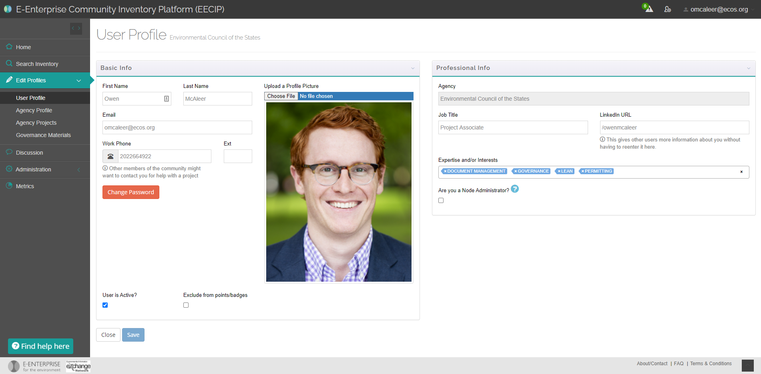
Adding / Updating Subscriptions
On the left-hand toolbar: Edit Profiles>User Profile
On the right-hand panel, edit professional info and interests
You can select professional interests from a list of existing tags OR type in your own
This step is important for customizing your feed and e-newsletter!
Notes:
There are dozens of subjects in the list of EECIP tags, including topics like GIS, Advanced Monitoring, Cloud and AI, Lean, and others.
[More info on curation / personalization on next slide]

Slide 11
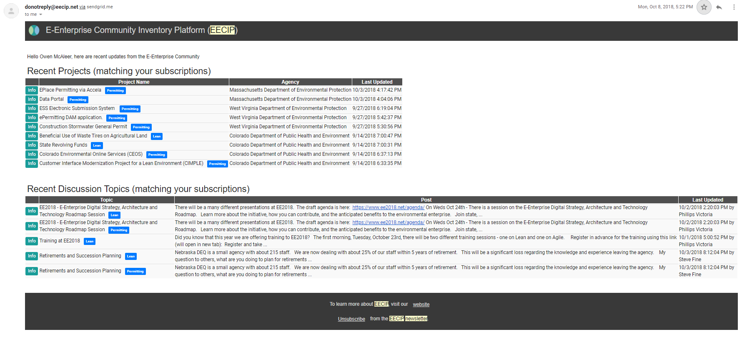
Personalization and EECIP Newsletter
Notes:
The tags and topics you select in your user profile as “Expertise / Professional Interests” will determine the content that displays in the monthly EECIP Newsletter mailing, and on your homepage feeds which we’re going to check out right now…
There are a few key elements here: the announcements section up top where you can view information on upcoming meetings as well as featured projects from states and tribes. Next we’ll look at these sections showing recent projects and discussion topics; these feeds are personalized based on the interests you’ve selected for your profile, and you can filter for a specific interest through this drop-down.
For all of these personalized content areas, you’ll still see recent content even if you don’t subscribe to anything, but if you have subscriptions they will be highlighted and will appear higher in the list.

Slide 12
Communities of Interest
Click “edit subscriptions” above homepage feeds
Communities of interest appear as tags; hover over them to see more details
You can also edit your notification settings in the top right.
Notes:
Certain Tags are “promoted” and relate to communities of interest. You can access the menu of COI’s by clicking “edit subscriptions” on the homepage above your feeds. The promoted tags / COI’s are the only ones that get tiles on this screen.
Once you’re on this screen, you can hover over one of the tiles for a description and click on the corresponding button to see tagged projects (left) and discusisons (right).
On this screen, you can also update your subscription and notification preferences in the top-right panel.

Slide 13
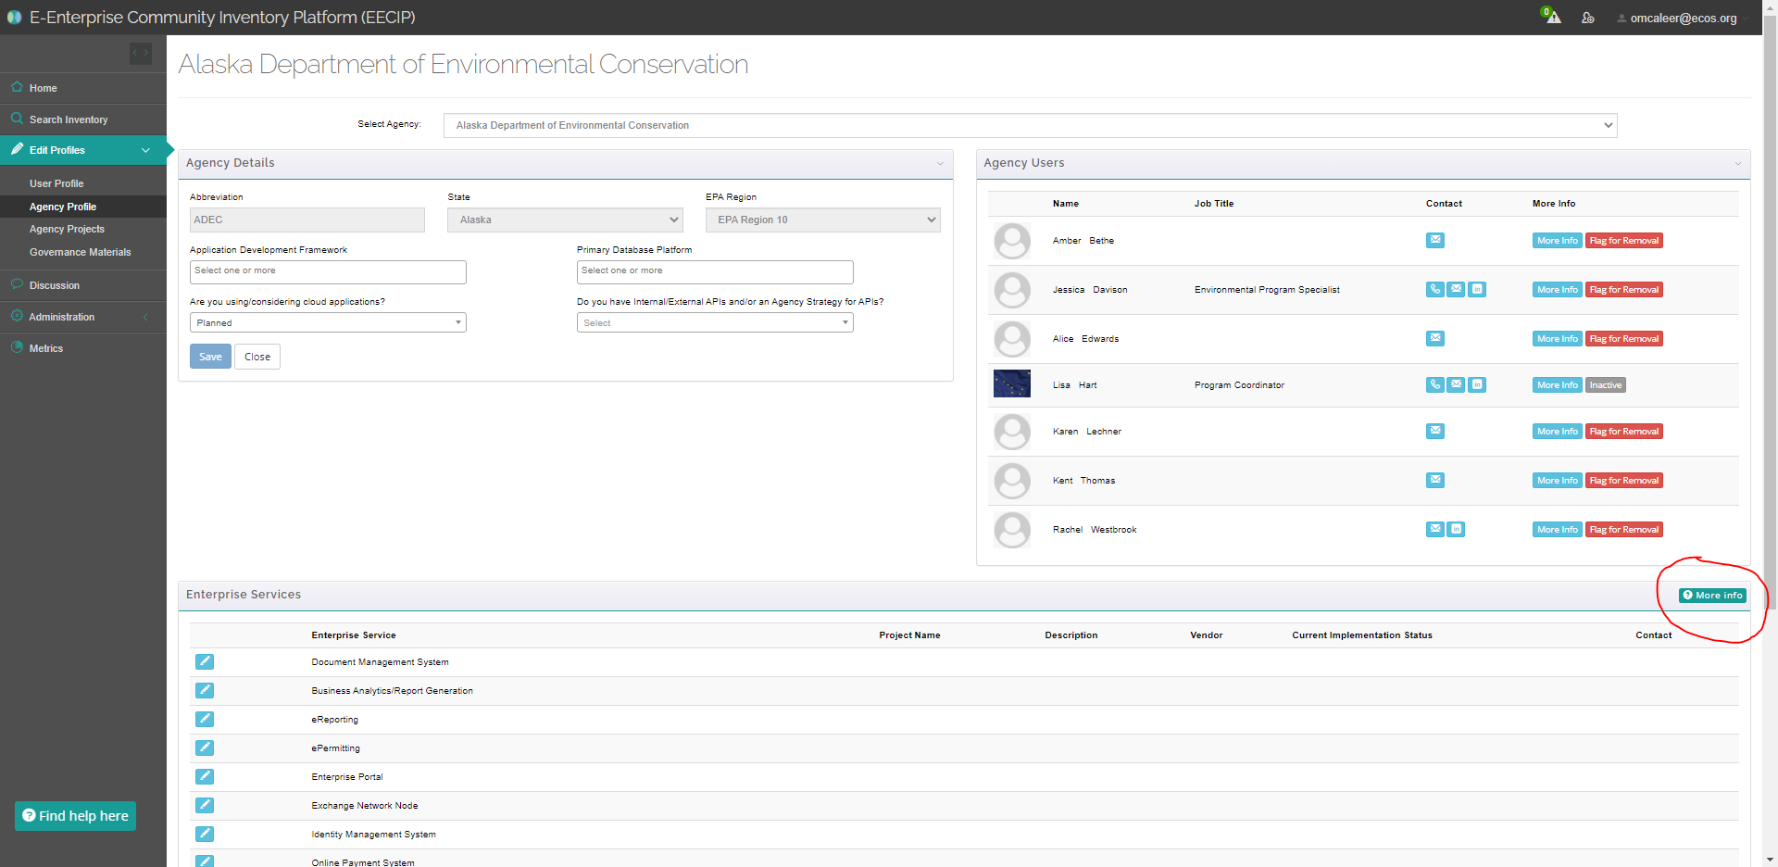
Agency Profile
Select your agency from the drop-down at top of screen
Edit eligible fields under “Agency Details”
View colleagues and flag staff departures under “Agency Users.”
Update your agency’s Enterprise Services by clicking the corresponding blue button on the bottom left (more info on next slide).
Notes:
In addition to updating your User profile, you can also update the profile of your agency. Some agency details in the top left are off-limits to change, but you can update information like your agency’s App Development Framework, and very importantly, your enterprise services.
We define enterprise services as agency-wide platforms or processes; they are typically apps or other technology but not necessarily. For example, one of the enterprise services is related to GIS, so you could enter there that you use ESRI products. You can find a list of all the enterprise services in the bottom pane here, and you can find explanations and other information about them by clicking this turquoise button on the right-hand side. That will take you to a screen with panels for the various services, which you can hover over to see their definitions, or click on to see details of what other agencies have entered (screenshot next slide).

Slide 14
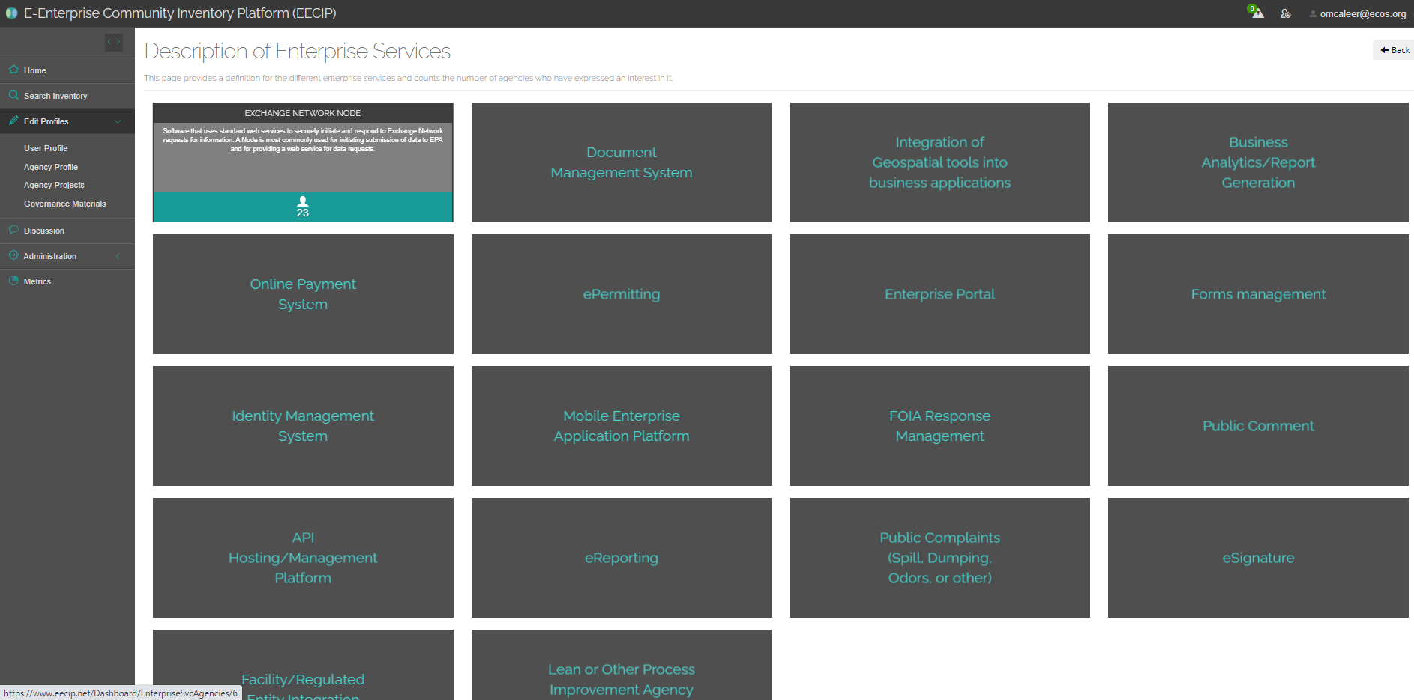
Enterprise Services
Enterprise services are agency-wide platforms or processes; they are typically apps or other technology but not necessarily.
Hover over an enterprise service tile to see the description on the back
Click on a tile to see more information from agencies that have that enterprise service
Notes:
People sometimes get a little confused about the difference between enterprise services and projects. In general, enterprise services are more like an established platform or system for recurring work, whereas a project is typicaly more time-limited like an improvement or piloting of an existing system.
But these definitions aren’t meant to be hard-and-fast rules, and there isn’t a bright line separating projects and services. It can definitely get a little squishy at times, so the EECIP team is always on hand to tackle any questions, OR your suggestions of new enterprise service categories.

Slide 15
Search the EECIP Inventory
Click the magnifying glass in top-left, or the “Search Database” button on home screen
The inventory contains projects, enterprise services, people, agencies, discussions and E-Enterprise governance info. Use tabs below search bar to toggle between content types.
Enter search terms, or use filters on the left to select regions, agency type, media, tags, etc.
Click the corresponding green button for detailed view of a specific project
Sort by source, status, date added, etc.
Notes:
The inventory is the heart of the EECIP site – it’s where we hope that users will go when you’re considering a new project or product to improve some part of your work and you want to see what other folks have done.
We offer a bunch of different options to narrow your search and find the most applicable projects out of the 2,000+ that are currently in the database.
We feature new or interesting projects from the inventory every month (we usually pick at least one from both states and tribes). Since there aren’t a ton of tribal projects in there you’ve got a good chance of scoring the featured spot!

Slide 16
View Project Details
Access project URL or attached file(s)
“Like” button in the top right
Use project details URL in outreach to colleagues / agency contacts.
Notes:
If you’re planning to ask questions or offer suggestions to the project or agency contact person for this project, you’ll want to include the link to this page for their reference.

Slide 17
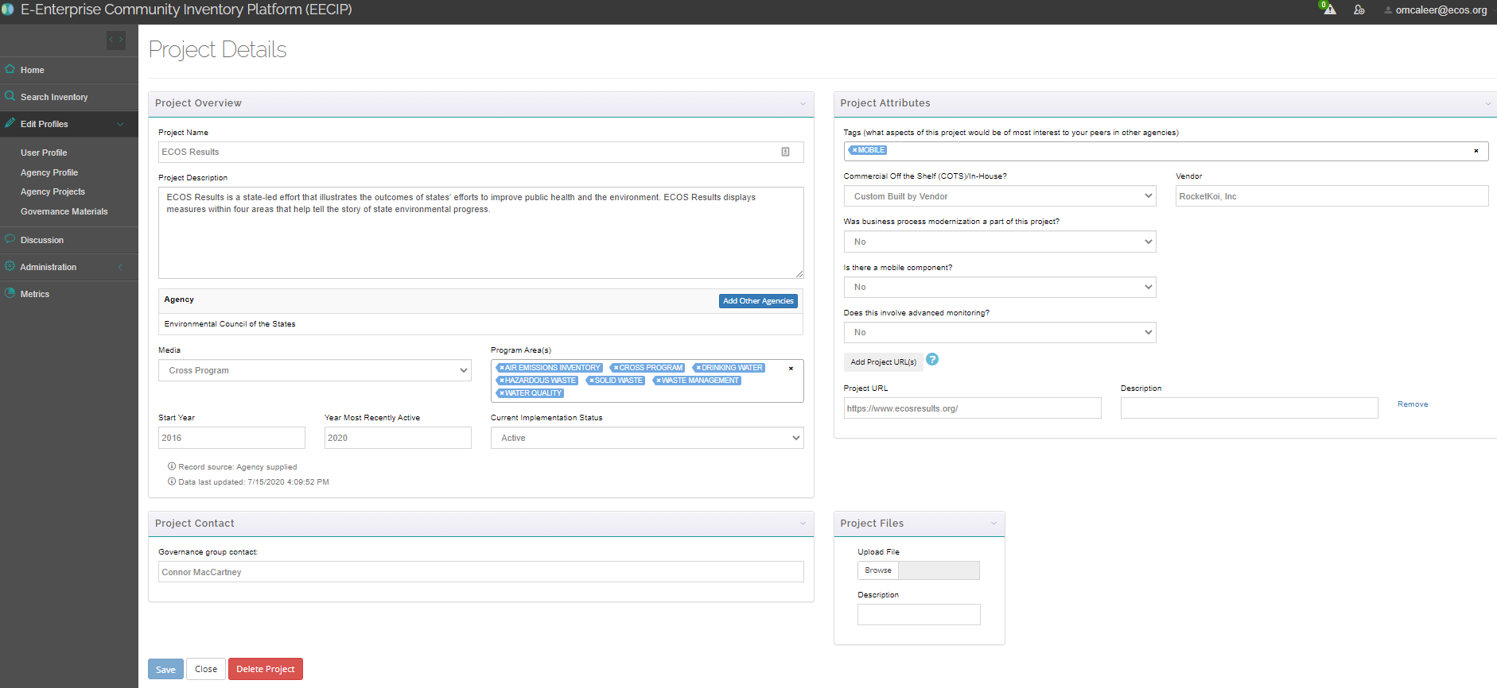
Add or Edit a Project
All content welcome – NOT JUST TECH!
Click “add project” button on homepage, or go to Edit Profiles > Agency Projects
All projects must have an agency and a name; other fields optional
Important fields for data quality: description, project URL, attachments, contact person, and TAGS
The site will prompt you to update projects older than 6 months (you can do it in one click)
You can add projects in bulk by emailing support@eecip.net
Notes:
~~~~ SAVE ‘TIL END!!~~~~~~
If you’re wondering whether something you’re working on is appropriate to include in the EECIP, IT IS! E-Enterprise as an initiative is not only concerned with tech, or data, or IT. E-Enterprise has to do with all aspects of environmental programs and agency management, and the content on the site reflects that. Projects can also be entered into the database at any stage of development, even if it’s something you’re just thinking about doing someday.
So similarly, if you’re wondering whether EECIP will have information on questions related to a given environmental program or facility type, etc, it’s always worth a shot and we hope you won’t think of it as an IT resource.
General add a project:
You can also add projects to the database. Here’s how:
On the left-hand toolbar, select the “edit profiles” option with a pen icon next to it
Under “Edit Profiles” select “Agency Projects”
Make sure your agency is selected in the drop-down field at the top of the screen
Click “add new” in the top left, or click the blue pens to edit any project that you’d like to claim or update. We’ll do this one.
If the project is unclaimed, the “Project Contact” field in the bottom left will be highlighted in red. To claim the project or assign it to a colleague, select them from the first drop-down menu or enter their contact information in the text field below that.
To edit the project description or other information, make any appropriate changes to the other fields on the Project Details screen.
Any new information helps; even if the results from that project haven’t been formally tracked, you can give your perspective on any lasting effects the project may have had. Or if there are no lasting effects, you can say that!
Add projects in bulk by emailing support@ eecip.net!
Fond du Lac Chippewa description:
The Region 5 Tribal Water Quality Monitoring and Assessment Consortium used EN grant funds to implement the Ambient Water Quality Monitoring System (AWQMS), and steadily expanded the consortium to include now nearly 30 tribal water quality programs in Region 5. We now have a new EN grant to continue building upon our existing system to adopt and adapt new system features (e.g. new groundwater and well tracking and reporting capabilities). We’ll also add new needed capabilities for streamlining fish consumption advisory generation and publication, and improve the system capabilities for supporting and streamlining our water quality assessment decision-making and reporting process, in a format that can submitted to ATTAINS or used as the basis for a Tribal Water Quality Assessment Report.

Slide 18
How to Start a Discussion
In the left-hand toolbar, click the text bubble labeled “Discussion.”
Then click the green “New Discussion” button on the right-hand side of the next page.
Fill out the discussion form – you will need to pick a topic and various related “tags.”
If applicable, add a polling question.
Post the discussion!
Notes:
Along with the project inventory, the discussion forum is the other main component of the site and it sees a lot of user activity and new posts. So it’s always worth checking! The interface is meant to work similarly to other internet discussion boards like Reddit, StackExchange, or WikiHow.
Some interesting features I’d like to highlight here: Users can attach links, polls, or files to a discussion, and they can click a box to receive email notifications when other people post responses.
If the original poster receives a particularly good answer that hits it on the nose, they can mark their question “solved.” This isn’t required as a lot of questions are open-ended, and people can still continue to comment and propose alternate ideas on discussion threads that have been “solved.”

Slide 19
How to Join a Discussion
If you don’t see a recent discussion that interests you on the home page – click “Discussion” on the left.
Click the title of the discussion that interests you or type in search words to look for a specific topic.
Add your content and click “Add Post!”
Notes:
Joining a discussion is similar to starting one and is a great way to connect with colleagues and leverage similar work.
Users can respond to a post and include links to external websites and documents; however, you cannot attach links, files or add polls to a discussion you are responding to instead of starting.
This feature offers a way for users to share their knowledge – not just with each other – but with the entire tribal, state, local, and federal community. Any discussion and discussion responses will also show up in keyword searches by future users. This means your answer may provide benefits to you colleagues that tackle similar issues in the future.

Slide 20
Engage with your colleagues!
Visiting projects and discussions, and/or giving a project or discussion a “thumbs up” draws attention to helpful information.
If you see something you like or learn something from a colleague’s post, respond and let them know!
Notes:
This last feature is more of a soft feature, but I think an important one. When you see a cool project or maybe one of your colleagues asks a great questions – you can give the discussion question or the project a “thumbs up.” For example, on this slide you see a link to a story map titled “An Introductory Guide to Wild Rice” that talks about the history of wild rice, the impact of poor water quality on wild rice, and goes through the process of harvesting and processing it.
It is a very cool story map and only has one like so far. While giving a project or discussion – for example, the discussion on exceptional events – a thumbs up seems simple and maybe inconsequential – it helps to elevate that particular post. It also is a touch point for interaction between colleagues which I – personally – think is important right now in this time of social distancing.
So definitely get on EECIP, take a look at what’s there, and join the conversation.

Slide 21
ECOS EECIP Team
Kurt Rakouskas, Executive Project Manager, krakaouskas@ecos.org, 202-266-4935
Beth Graves, Executive Project Manager, bgraves@ecos.org, 202-266-4923
Owen McAleer, Project Associate, omcaleer@ecos.org, 202-266-4922
Kelly Poole, Senior Project Manager, kpoole@ecos.org, 202-266-4939
Connor MacCartney, Project Associate, cmaccartney@ecos.org, 202-849-4981
Paulina Lopez-Santos, Project Associate, plopezsantos@ecos.org, 202-266-4920
Notes:
Here we have ECOS staff contact information. Owen’s contact info is underlined because he is the ECOS EECIP lead; however, feel free to reach out to anyone listed here with thoughts or questions at any time. We really believe in the benefits that the E-Enterprise Community Inventory Platform has to offer, and we are always happy to help users navigate this tool.
Thank you for you time – we hope to see you on EECIP!

Slide 22
Visit: https://www.eecip.net
Registration approval is automatic for anyone with a .gov or .us email address

