Slide 1
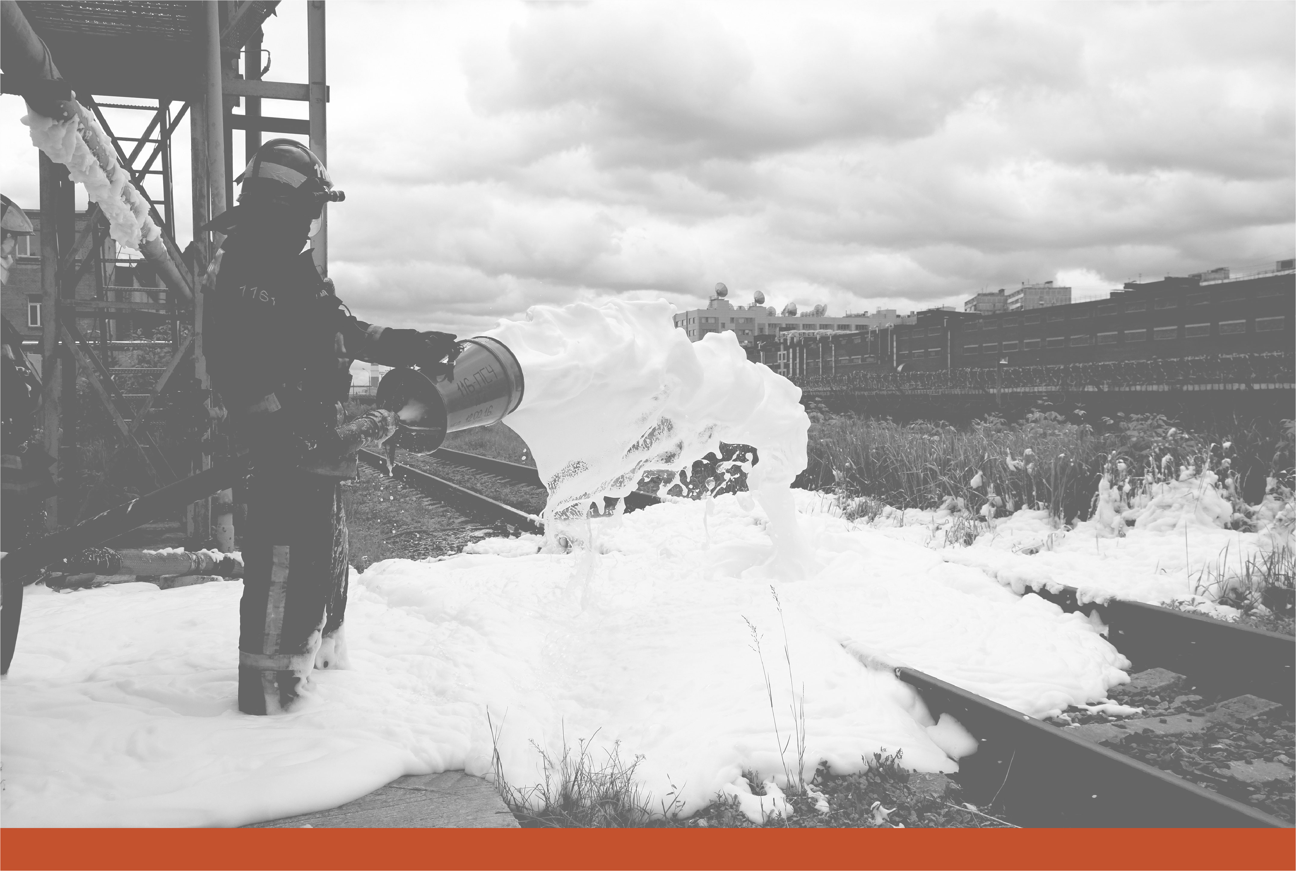

ENVIRONMENTAL COUNCIL OF STATES (ECOS)
2021 ECOS Spring Meeting
March 16, 2021
Management Considerations for PFAS and 1,4-Dioxane
Mitch Olson, PE, PhD
Subject Matter Expert, Emerging Contaminants

Slide 2
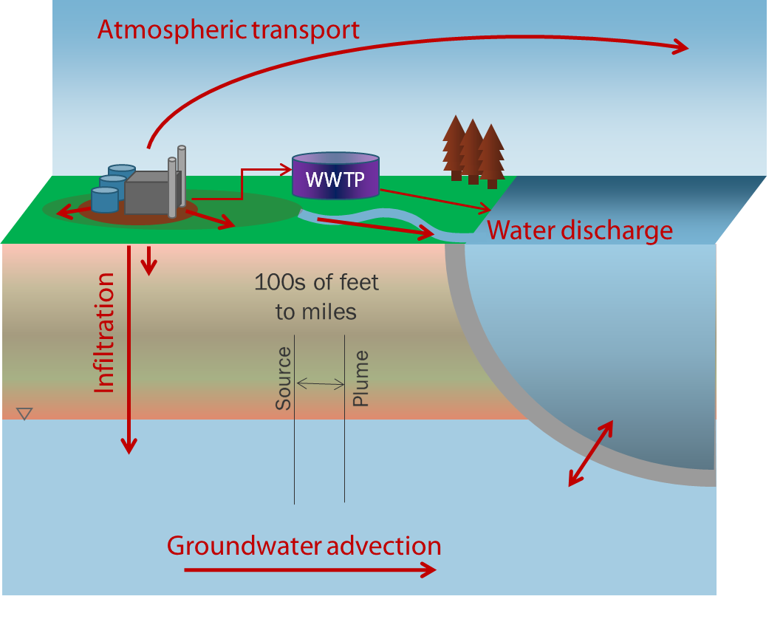
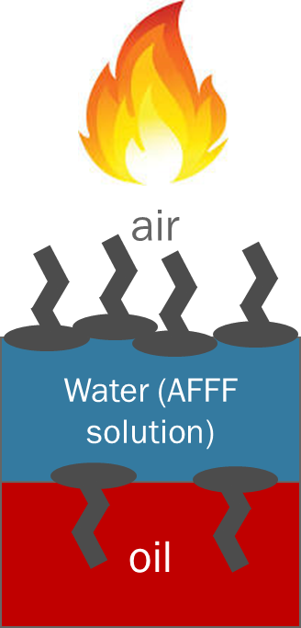
WHAT HAPPENS TO PFAS/1,4-DIOXANE WHEN RELEASED?

Slide 3
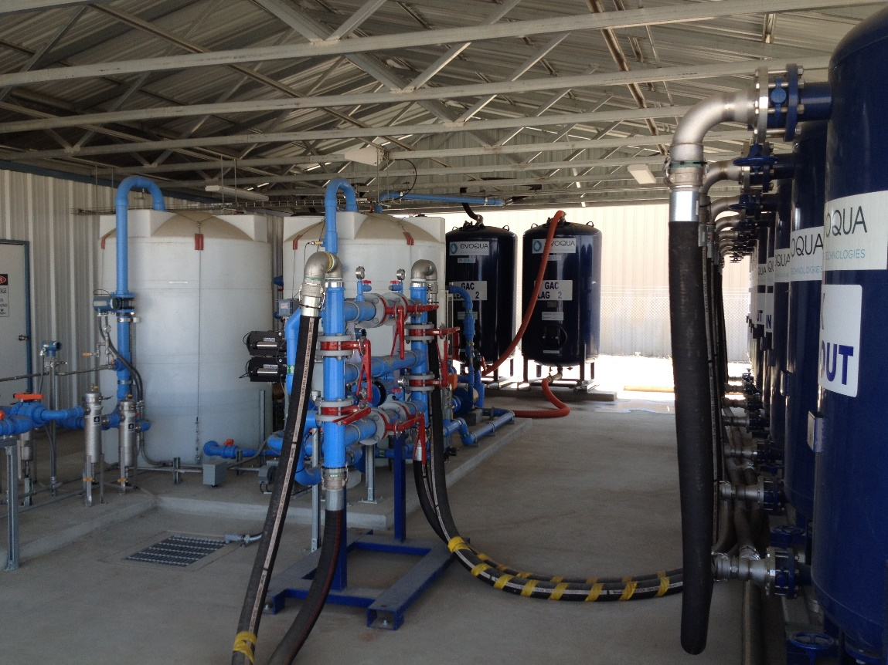
TREATMENT OF PFAS IN WATER
Things that don’t work for PFAS
  Conventional wastewater treatment
  Standard chemical oxidants or reductants*
  Air stripping
  Biodegradation
  In situ degradation
What does work?
  Groundwater extraction/point of use treatment is typical
  Activated carbon/ion exchange (GAC/IX)
  Reverse osmosis, nanofiltration
What is the fate of PFAS?
GAC/IX system treating 80 gallons per minute (for 123-trichloropropane in this case)
*research in progress

Slide 4
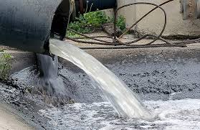
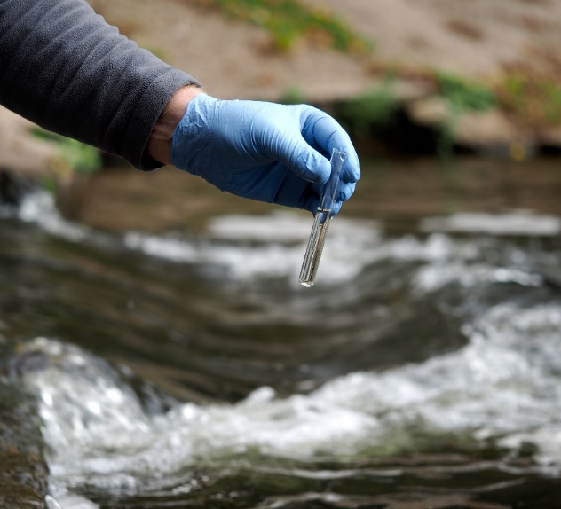
TREATMENT OF 1,4-DIOXANE IN WATER
Things that don’t work for 1,4-Dioxane
  Air stripping
  GAC
What does work?
  Advanced oxidation processes (AOP)
  Select resins
  Biodegradation (conditionally…)
What is the fate of 1,4-dioxane?
  Unlike PFAS, it’s destructible

Slide 5
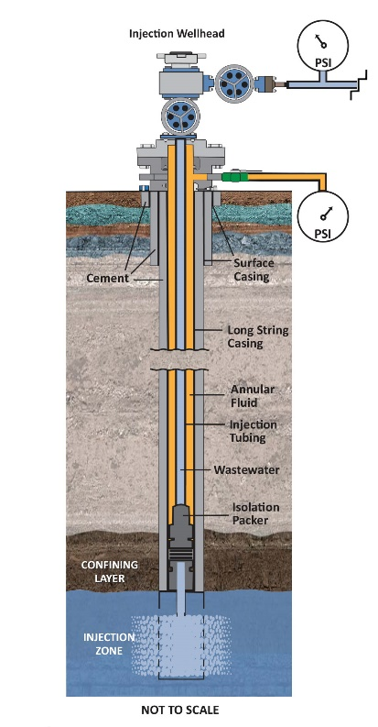
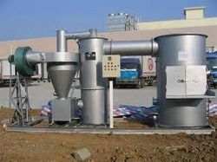
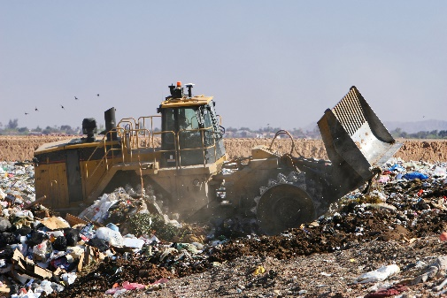
FINAL PFAS DISPOSAL OPTIONS
Incineration
(+) Commercially available/destructive
(+) Works for all types of media
(-) Temperatures 900 - 1400˚C
(-) Emissions issues/lawsuits – need for improved monitoring
Landfills
(+) All types of media
(+) Well established/understood
(-) Not destructive
(-) Perpetual need for leachate control
Deep Well Injection
(+) Permitted wells >6,000 ft
(+) Relatively simple to employ
(-) Few locations, long-distance trucking
(-) Not destructive
Storage (?)
(-) Not “disposal” but may be appropriate under certain circumstances
Image provided by Buckeye Brine
All PFAS disposal methods have limitations – solutions are site-specific. Resources being dedicated to solving these problems.

Slide 6
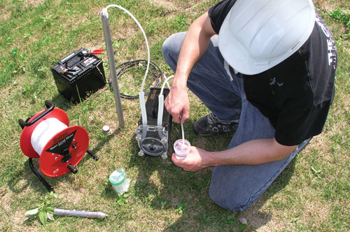
SITE CHARACTERIZATION & SAMPLING
PFAS and 1,4-Dioxane
PFAS
  Cross contamination – need to understand restricted equipment list
  Note Rodowa et at. 2020: maybe not as bad as was thought?
  Disposable/dedicated equipment is preferred
  Plan ahead, follow protocols
  Simplify, remove clutter, minimize
  Change gloves often
  Quality control – field & equipment blanks
  Analytical methods…
1,4-Dioxane
  Comparable to VOCs
  Analytical methods…
https://www.solinst.com/products/groundwater-samplers/peristaltic-pump.php

Slide 7
Trichloroethene
Petroleum
PFAS
10,000 ppm
10 ppt
10 ppb
10 ppm
10 ppb
10 ppm
10 ppt
10 ppb
10 ppm
Residual mass…
Residual mass…
Biotransformation
Precursor sorption (electrostatic & hydrophobic)
Interface accumulation
Leaching to GW
NSZD/MNA
Back diffusion
Sorption
Biotransformation
Back diffusion/MNA
TCE
Total Cl. ethenes
Total/free-phase
Dissolved phase
Precursors
Long chain PFAAs
Short chain PFAAs

