Slide 1
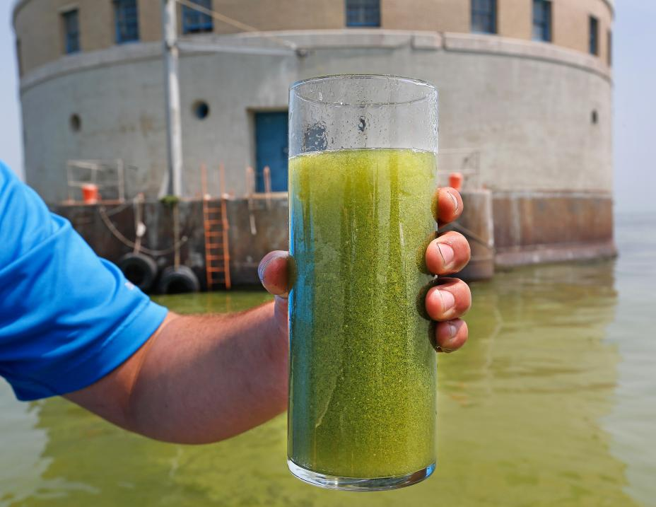
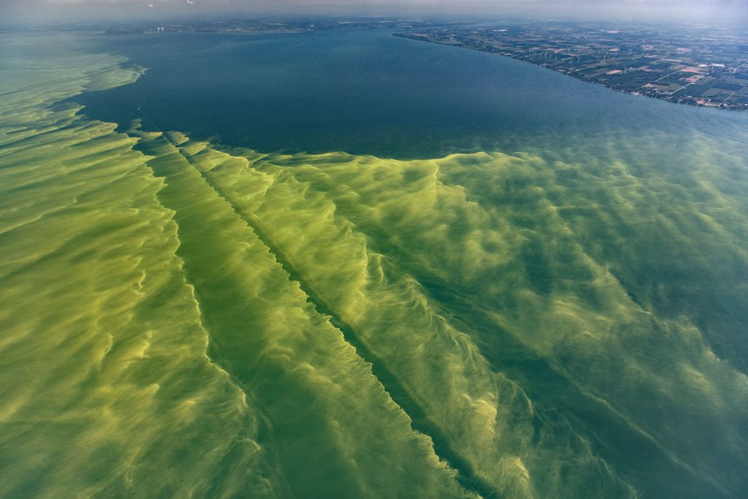
Harmful Algal Blooms
Lake Erie bloom
Toledo Water Sample

Slide 2
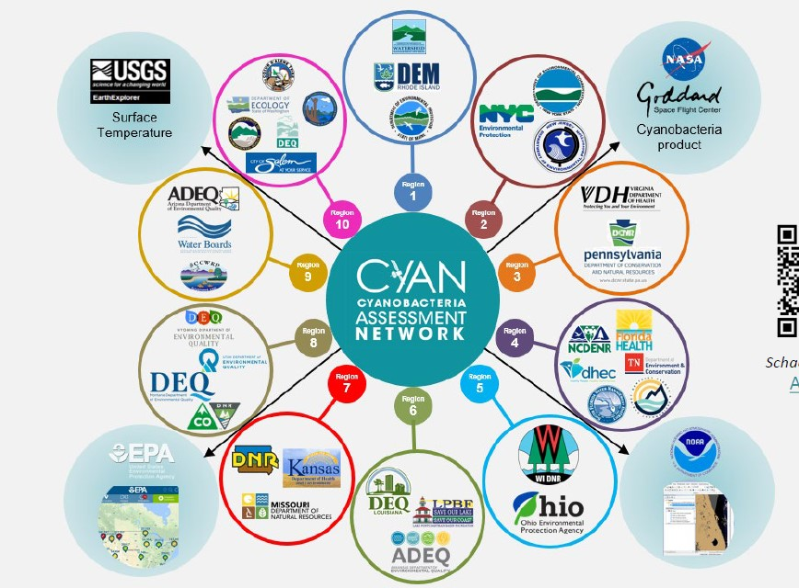
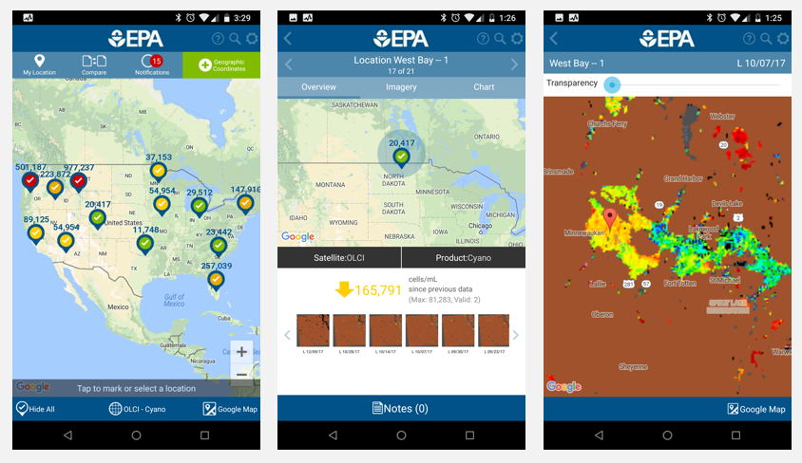
CyAN Mobile App
Download the CyAN app today:
epa.gov/water-research/CyANapp
Contact us about the CyAN app:
CyAN@epa.gov

Slide 3
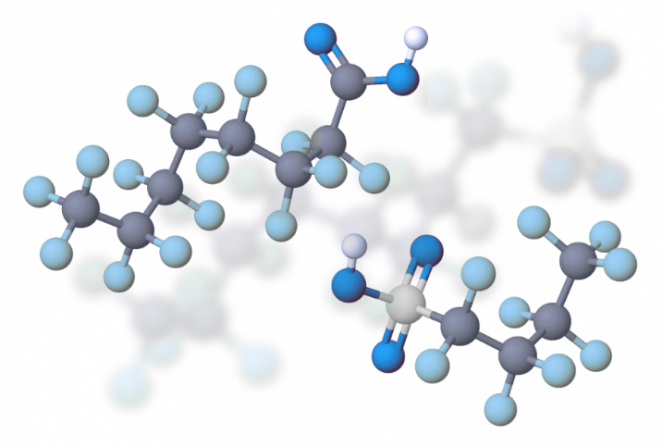
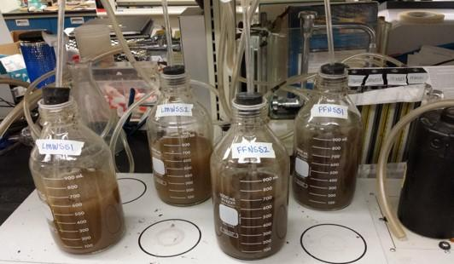
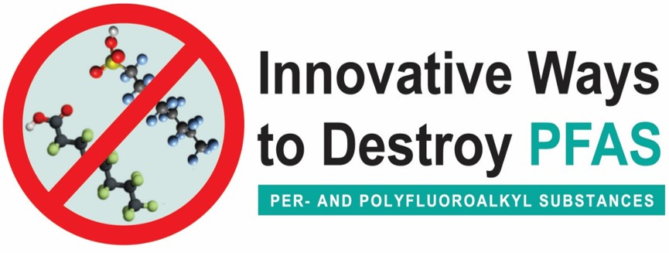
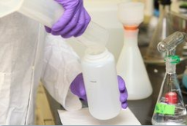
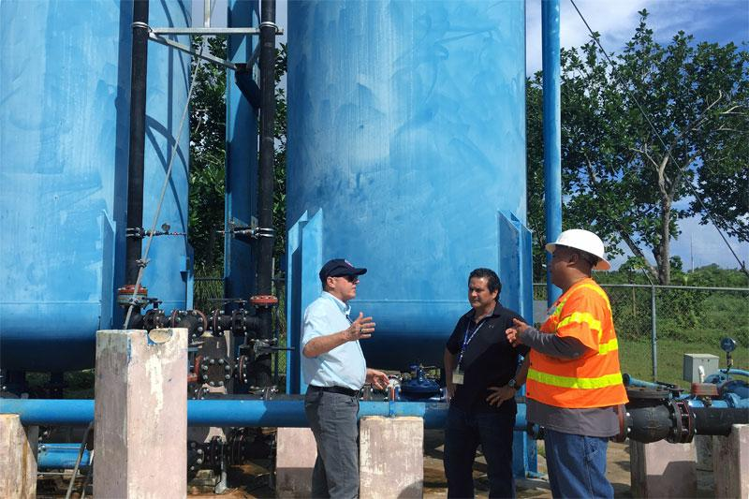
PFAS
Resources
Status of EPA Research and Development on PFAS
PFAS Innovative Treatment Team (PITT)
EPA PFAS Data and Tools
PFAS Science Webinars for EPA Region 1 and State & Tribal Partners

Slide 4
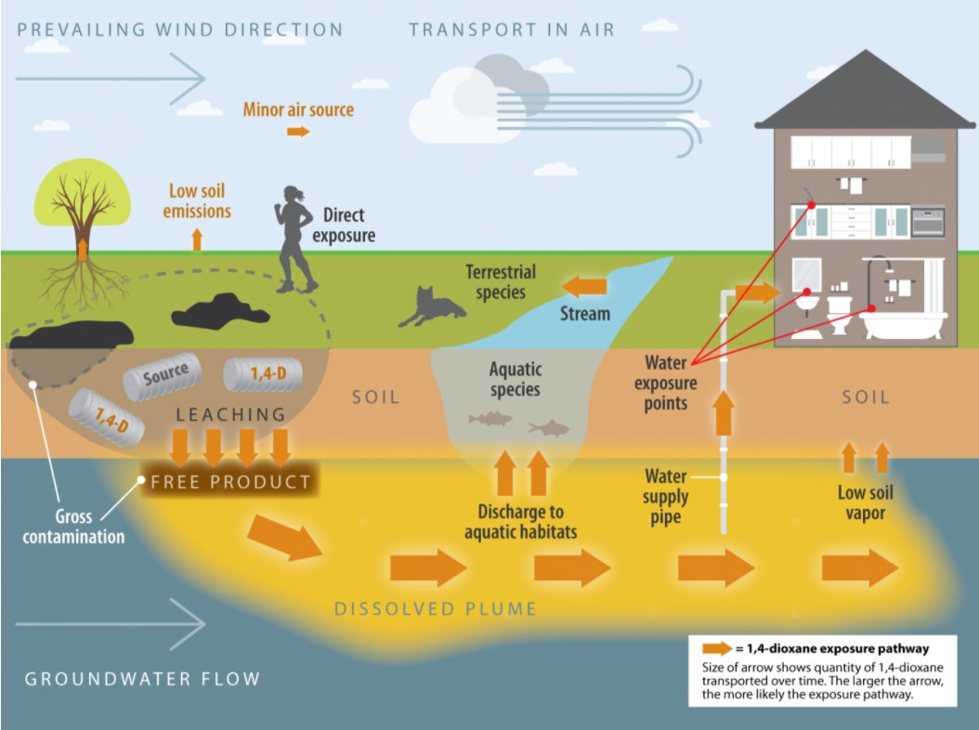
1,4-Dioxane
1,4-Dioxane Exposure Pathways
Source: Interstate Technology and Regulatory Council (ITRC)
1

