Slide 1
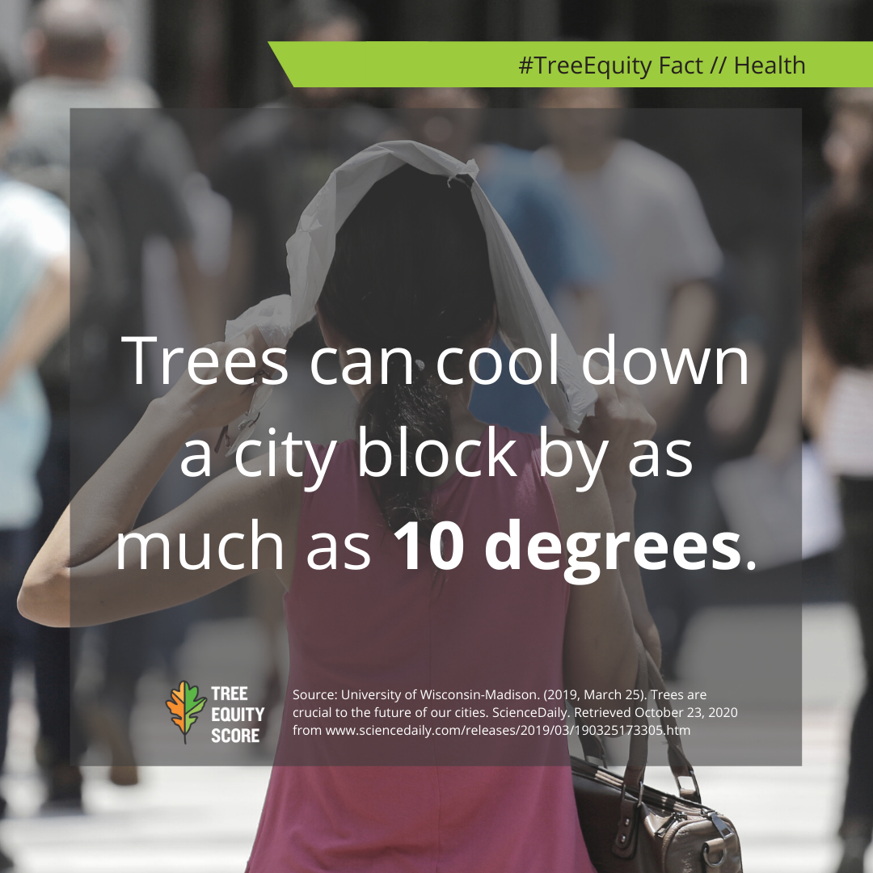
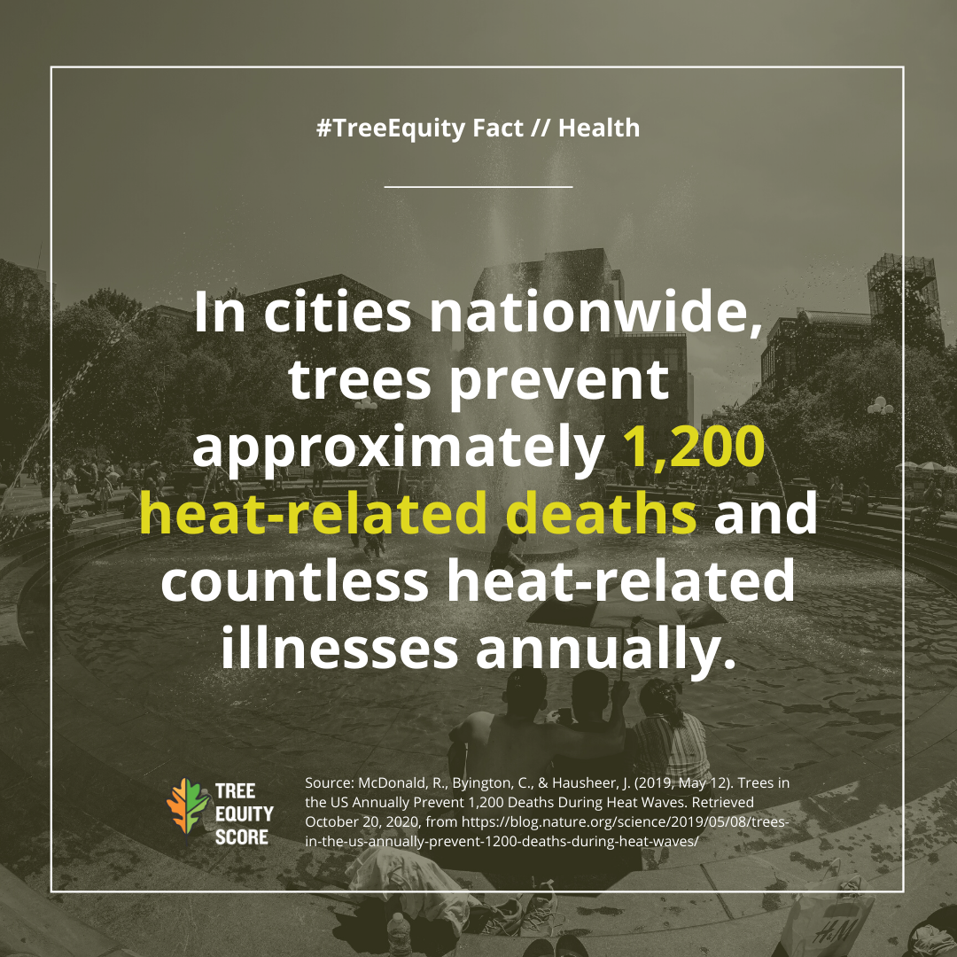
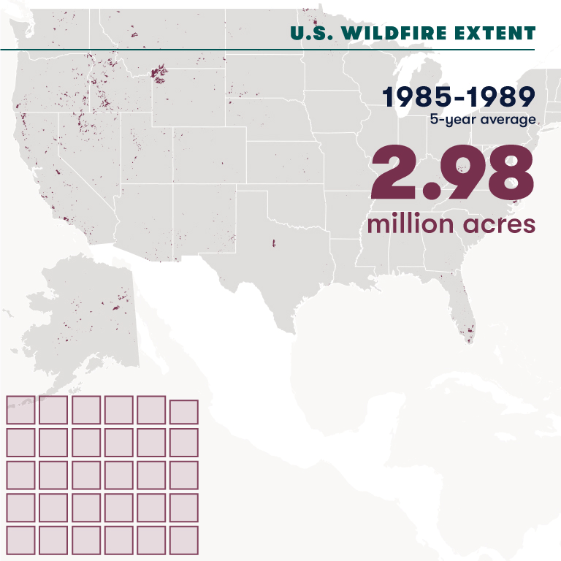
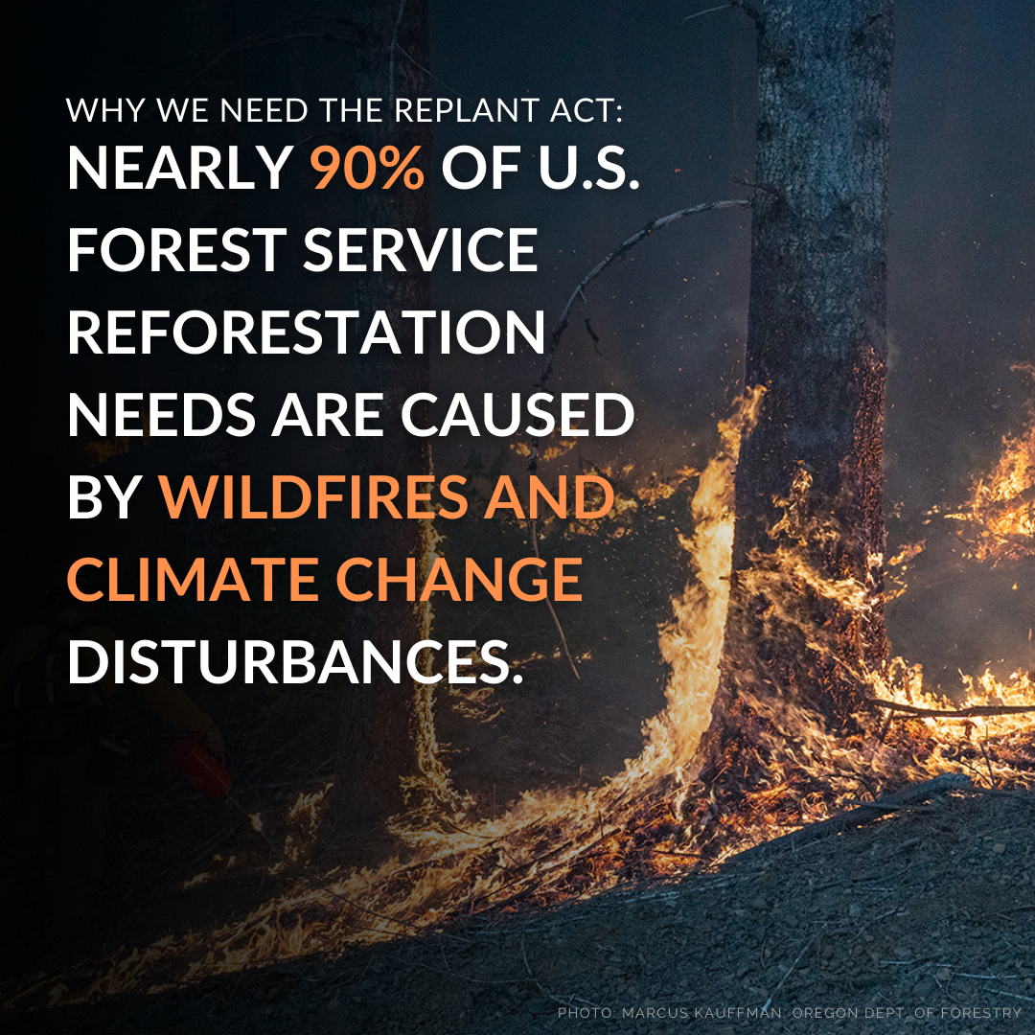
Trees are essential to our health and well-being,
so we strive to create Tree Equity—trees in every part of every city.
Forests are our best nature-based solution to climate change,
so we work to create healthy and resilient forests in every landscape.
Notes:
GIF version

Slide 2
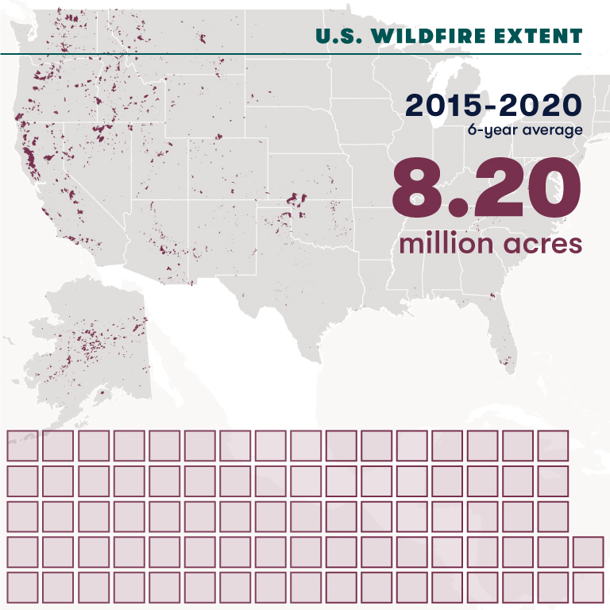
Trees are essential to our health and well-being,
so we strive to create Tree Equity—trees in every part of every city.
Forests are our best nature-based solution to climate change,
so we work to create healthy and resilient forests in every landscape.
Notes:
Static version

