Slide 1
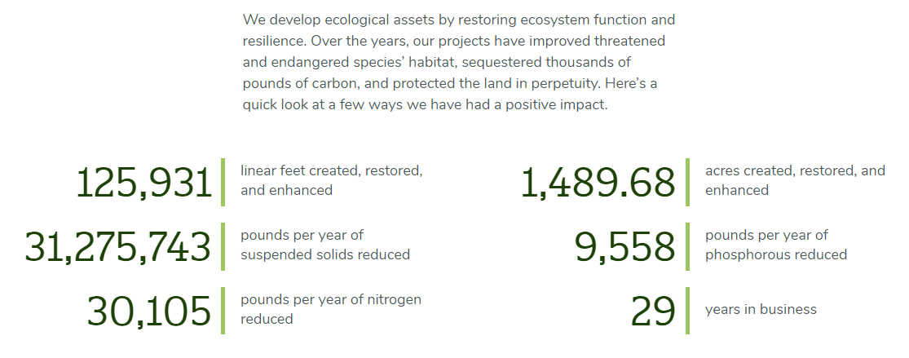
GreenVest, LLC
Report Card
We develop ecological assets by restoring ecosystem functions and resilience. Over the years, our projects have improved water quality, improved threatened and endangered species’ habitat, sequestered thousands of pounds of carbon, and protected the land in perpetuity. Here’s a quick look at a few ways we have had a positive impact.
Linear feet (23.85 miles) of streams created, restored, and enhanced
Acres of wetlands created, restored, and enhanced
Pounds per year of suspended solids reduced
Pounds per year of phosphorous reduced
Pounds per year of nitrogen reduced
Years in business
1

