Slide 1
Policies that will dramatically speed progress in environmental and equity outcomes.

Slide 2
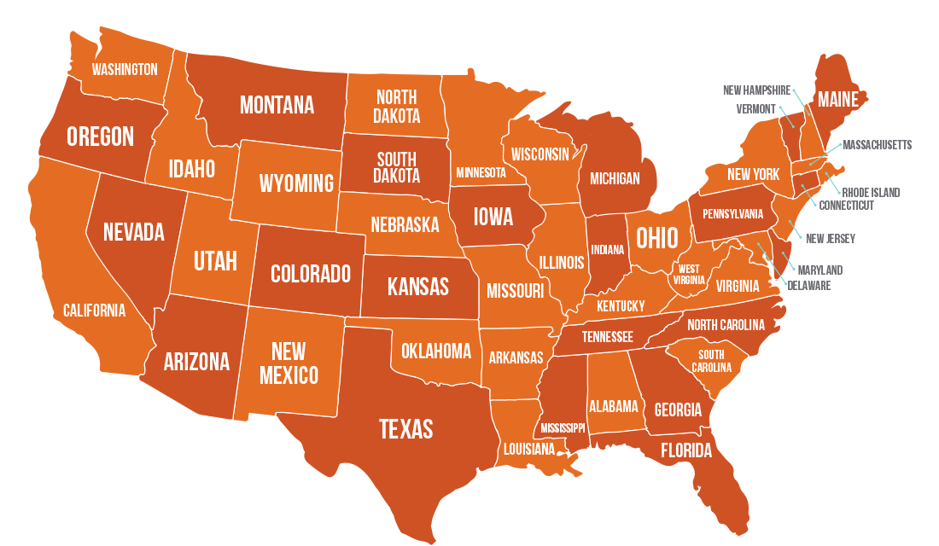
Notes:
Define innovation: give a specific example → the Chesapeake model that quantifies outcomes.

Slide 4
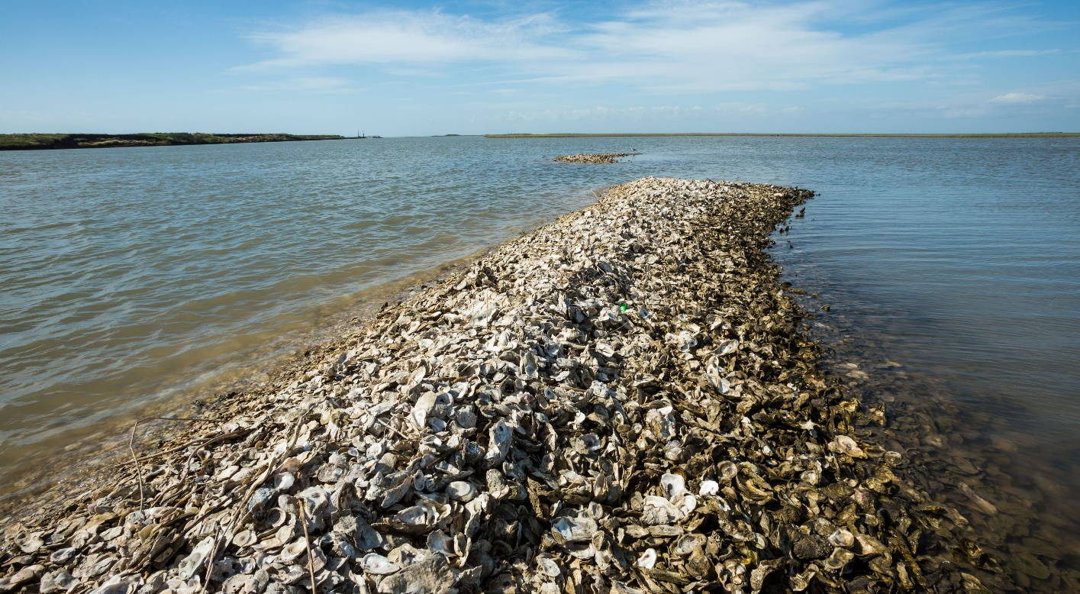
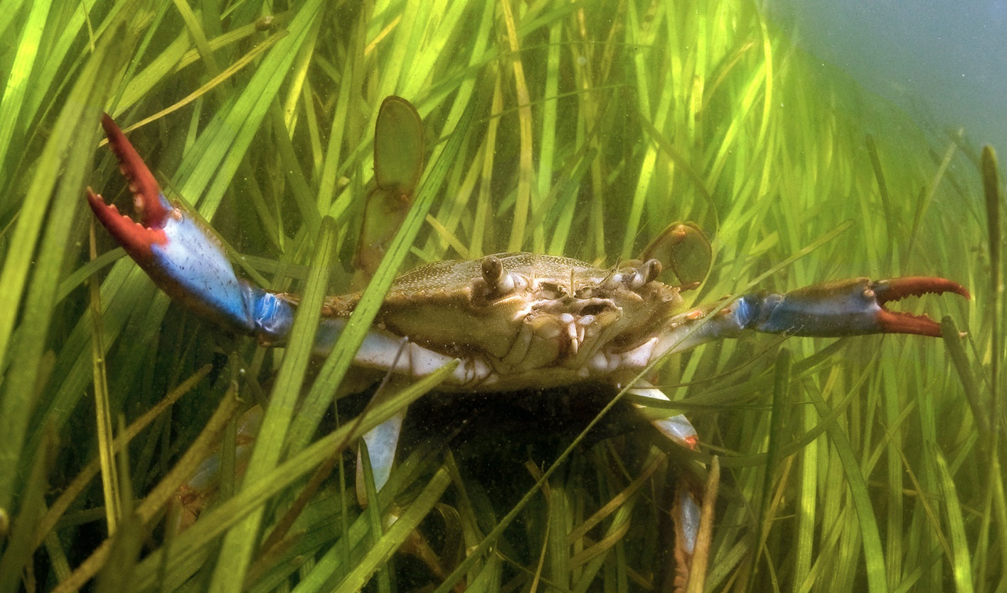
Conservation Finance Act
“Pay for Success” contracting added to state procurement code for all environment, transportation and agriculture agencies.
Authorizes the state (and counties) to buy ‘environmental outcomes’ as a commodity, including soil carbon, carbon sequestration, and water quality outcomes.
Green infrastructure defined, given a problem-solving commission, and allowed to be the focus of public-private partnerships.
A dozen changes to State Revolving Loan funds to better focus them on equity, lead pipe removal, and nature-based infrastructure.

